Slide 1
Impressions
First

Slide 3
Write your name on the paper

Slide 4
Throw it to someone else

Slide 5
What did you think when
you first met them?

Slide 6
First Impressions

Slide 7
First Impression
First 7 to 17 seconds
55% wear, walk, act
38% quality of voice (tone, grammar)
7% the words you use
https://theundercoverrecruiter.com/power-first-impressions/#:~:text=Takeaways%3A,you%20walk%20through%20the%20door.

Slide 8
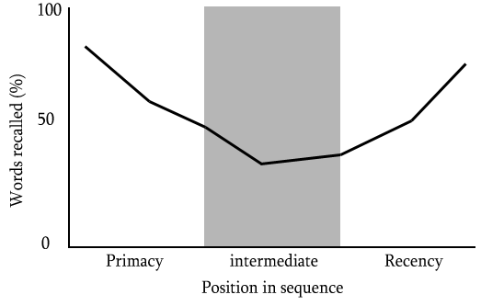
First Impression
Persistent
primacy effect

Slide 9
First Impression
Subconscious
feelings

Slide 10
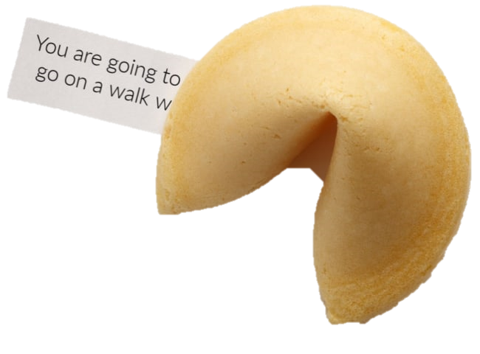
First Impression
Predictive power
future relationship

Slide 11
Qualities

Slide 12
What are the first things you
notice about someone?

Slide 13
Make a list

Slide 14
Rank your list

Slide 15
Loyal
Trustworthy
Loving
Compassionate
Supportive
Funny
Intelligent
Fun
Moral
Hard-working
Ranker
https://www.ranker.com/list/best-qualities-in-a-person/samantha-dillinger

Slide 16
Hard-working
Witty
Confident
Passionate
Modest
Honest
Loving
Responsible
Reliable
Empathetic
thetoptens
https://www.thetoptens.com/admirable-qualities-person/

Slide 17
Humility
Ability to learn
Integrity
Responsibility
Resilience
Compassion
Respect
Big vision (think big)
Inspiring
Reinvent ourselves
Forbes
https://www.forbes.com/sites/palomacanterogomez/2019/06/18/the-top-10-characteristics-of-highly-admired-people/#6642581055d9

Slide 18
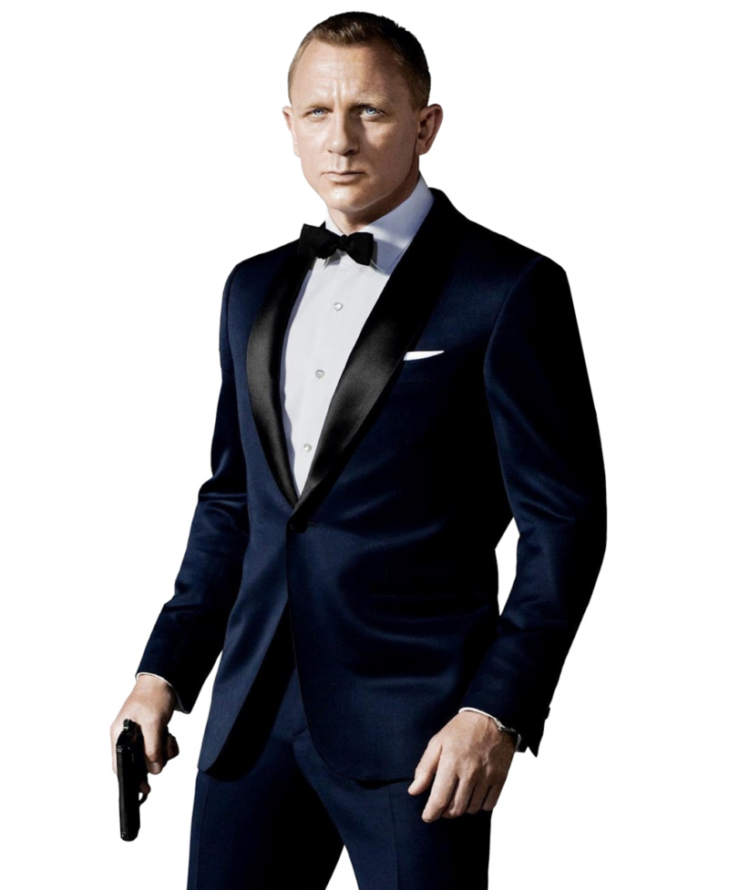
Qualities
What is important in:
a business relationship
a personal relationship
a romantic relationship

Slide 19
Predicted Outcome
Value theory

Slide 20
Predicted Outcome Value Theory
Outcome value
what will you get out of this relationship?
more important for long term

Slide 21
Predicted Outcome Value Theory
Predicted outcome value is
more important than:
relationship type
liking someone
similarity

Slide 22
Predicted Outcome Value Theory
Predicted value
we make judgments
when we get to know someone

Slide 23
Experiment

Slide 24
Predicted Outcome Value Theory
Experiment
random partner
get-to-know conversation (3-10 minutes)
fill out a questionnaire

Slide 25
Predicted Outcome Value Theory
Experiment
9 weeks later
follow up questionnaire

Slide 26
Results

Slide 27
Predicted Outcome Value Theory
Similar results between partners
first impression is shared

Slide 28
Predicted Outcome Value Theory
First impression influences future
sit closer
communication
attraction
type of relationship

Slide 29
What do you want
people to ask you?

Slide 30
Talk to each other

Slide 31
Ask the Question
Ask follow up questions

Slide 32
First Impressions and Predicted Friendship Value | Making Friends though Good Impressions
https://www.realmenrealstyle.com/first-impressions-friendship-value/
The Top 10 Characteristics of Highly Admired People
https://www.forbes.com/sites/palomacanterogomez/2019/06/18/the-top-10-characteristics-of-highly-admired-people/#6642581055d9
The Ten Most Admirable Qualities in a Person
https://www.thetoptens.com/admirable-qualities-person/
The Best Qualities in a Person
https://www.ranker.com/list/best-qualities-in-a-person/samantha-dillinger
At first sight: Persistent rational effects of get-acquainted conversations
http://library.allanschore.com/docs/AtFirstSight-PersistentRelationalEffects.pdf
Sunnafrank, M., & Ramirez, A. (2004). At first sight: Persistent relational effects of get-acquainted conversations. Journal of Social and Personal Relationships, 21(3), 361-379. Link: http://library.allanschore.com/docs/AtFirstSight-PersistentRelationalEffects.pdf

