Slide 1
Musicality of English

Slide 2
Verbal Components
Individual sounds
vs
English rhythm

Slide 3
Verbal Components
Intonation
Stress
Juncture
Pitch
Words

Slide 4
Intonation

Slide 5
Intonation
Rising
Falling
Rising-falling
Falling-rising
High
Low
Flat
https://www.youtube.com/watch?v=A6aE4nceJt8

Slide 6
Rising
Mostly used at the end of questions.

Slide 7
Rising
Where are you going?
How much?
Are you serious?

Slide 8
Rising
… or to show you are not finished the sentence.

Slide 9
Rising
She’s a teacher, although she is currently on maternity leave.
We might be a bit late, because I need to go to the store first.

Slide 10
Rising
Finishing a sentence with rising intonation is confusing for the listener.

Slide 12
Falling
Mostly used at the end of sentences.

Slide 13
Falling
Touch your thigh at the end of the sentence.

Slide 14
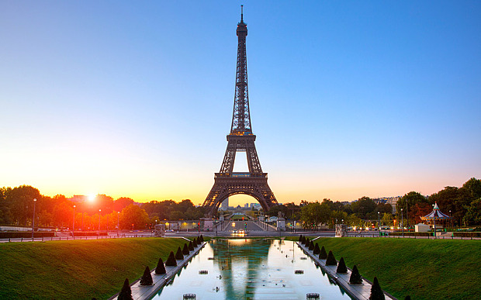
Practice
Have you ever been to France?

Slide 15
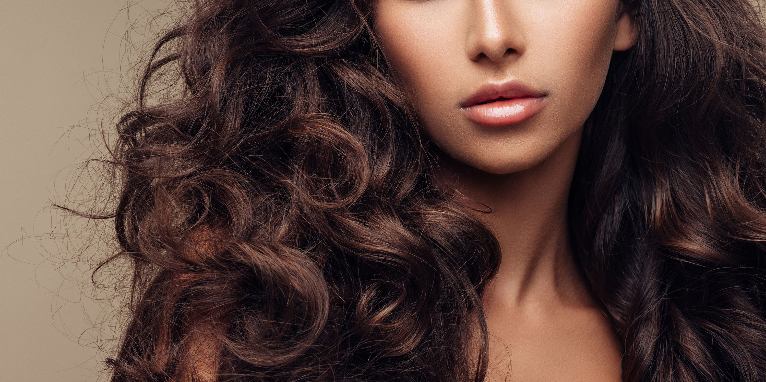
Practice
I like what you did with your hair.

Slide 16
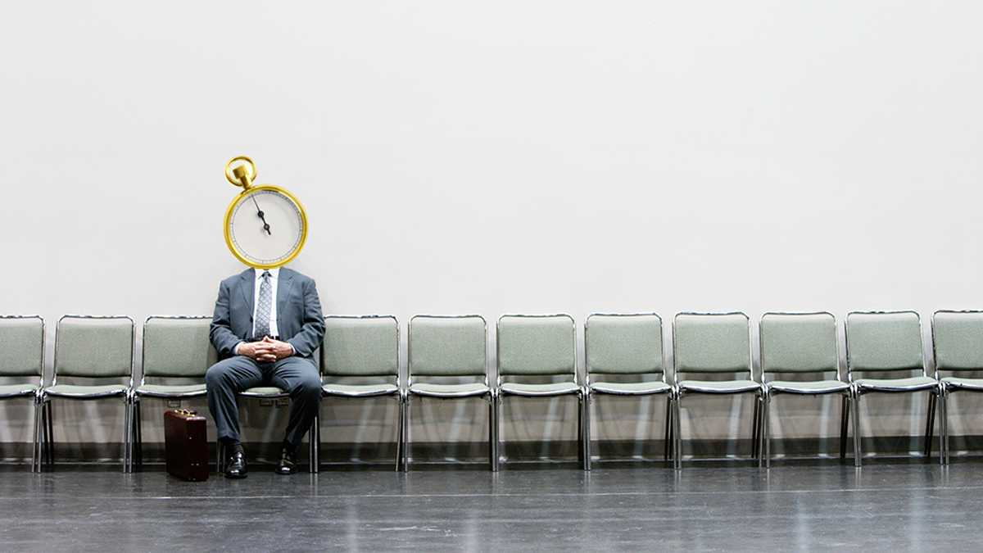
Practice
If you wait a minute, I can help you.

Slide 17
Practice
How often do you come here?

Slide 18
Practice
I can’t come tonight because I have to do homework.

Slide 19
Stress

Slide 20
Syllables
First, we need to know about syllables.
https://youtu.be/Vu6UVwkUgzc

Slide 21
Syllables
How many syllables?

Slide 22
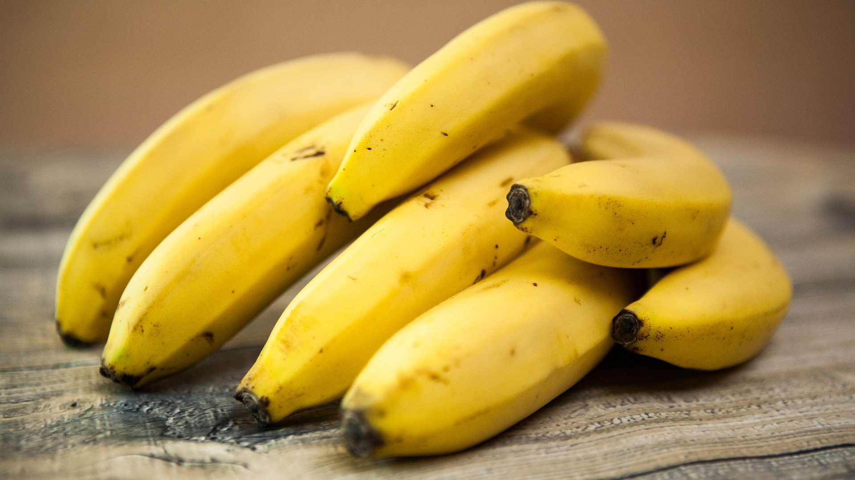
How many syllables?
BANANA

Slide 23
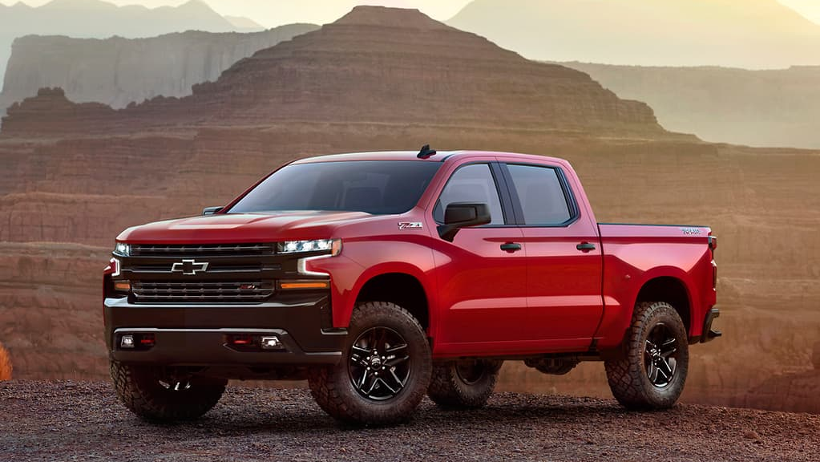
How many syllables?
TRUCK

Slide 24
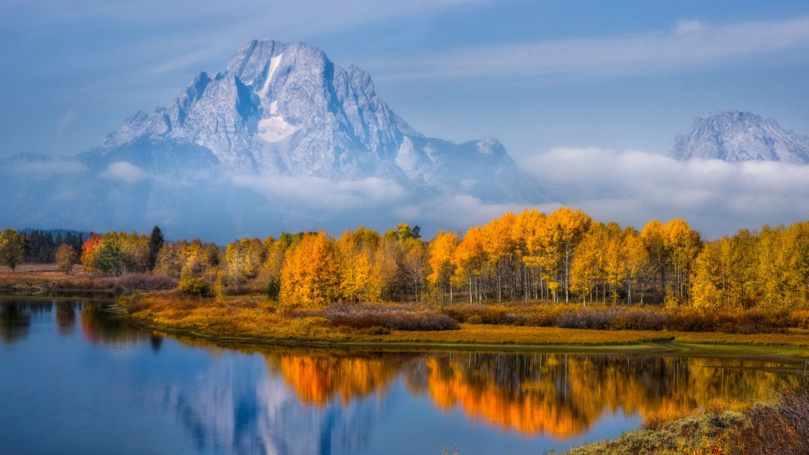
How many syllables?
BEAUTIFUL

Slide 25
How many syllables?
TIME

Slide 26
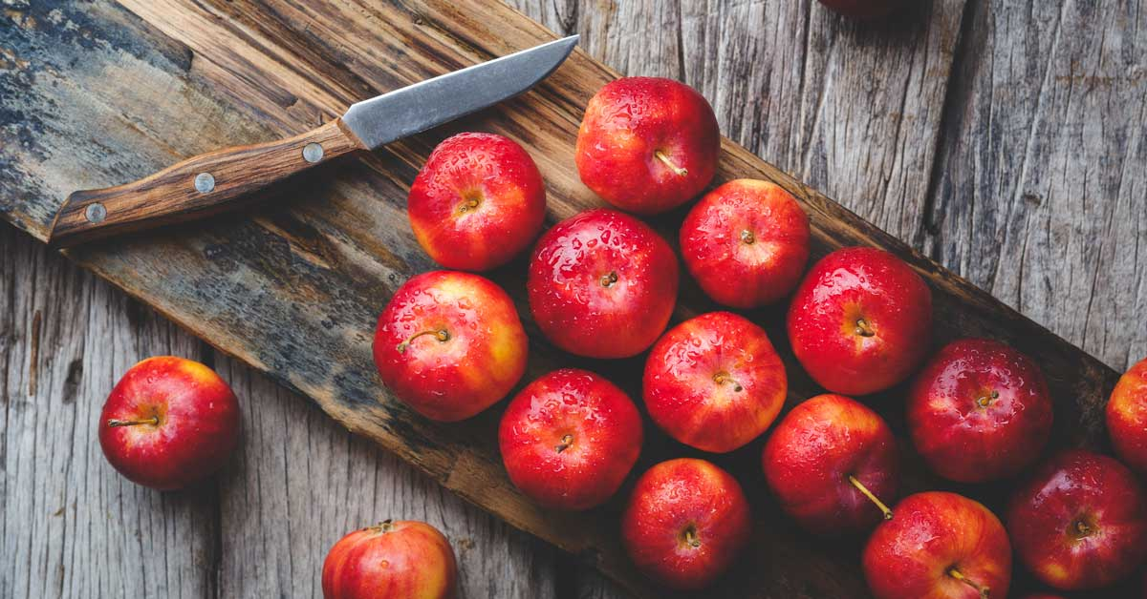
How many syllables?
APPLE

Slide 27
How many syllables?
STUDY

Slide 28
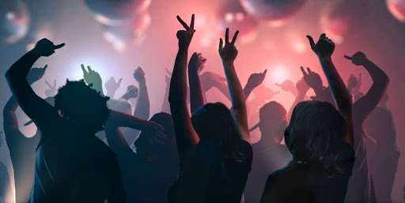
How many syllables?
SPECIAL

Slide 29
How many syllables?
UNIVERSITY

Slide 30
How many syllables?
HONORABLE

Slide 31
How many syllables?
CONTAGIOUS

Slide 32
Stress
One syllable in each word has strong, clear pronunciation

Slide 33
Stress
Louder
Higher
Longer

Slide 34
Stress
In the dictionary, look for ‘ the next syllable is stressed.

Slide 35
Stress “rules”
Nouns (and adjectives) with two syllables, usually have stress on the first syllable.
Picture
Minute
Money
Doctor

Slide 36
Stress “rules”
Verbs with two syllables, usually have stress on the last syllable.
Decide
Forget
Explain
Repeat

Slide 37
Stress “rules”
Three syllable words can have stress anywhere, but usually first or middle.
Anyone
Computer
Korean
Employee

Slide 38
Stress “rules”
Four syllable words are usually stressed in the middle.
Information
Communicate
Photographer

Slide 39
Stress “rules”
If a word ends in –tion, -sion, or –cian; The stress is usually on the second to last syllable.
Concentration
Confusion
Politician

Slide 40
Stress
Think of three more words that end in:
-tion
-sion
-cian

Slide 41
Contrast
Stressed syllables are higher, louder, and longer.
So, unstressed syllables are…

Slide 42
Contrast
So, unstressed syllables are lower, softer, shorter (especially vowels)

Slide 43
Stress
In the dictionary, look for ‘ the next syllable is stressed.

Slide 44
Game
Use the dictionary to find the correct stress.

Slide 45
Stress
Content words
vs
Grammar words
stressed
unstressed
The ‘rules’ are flexible.

Slide 46
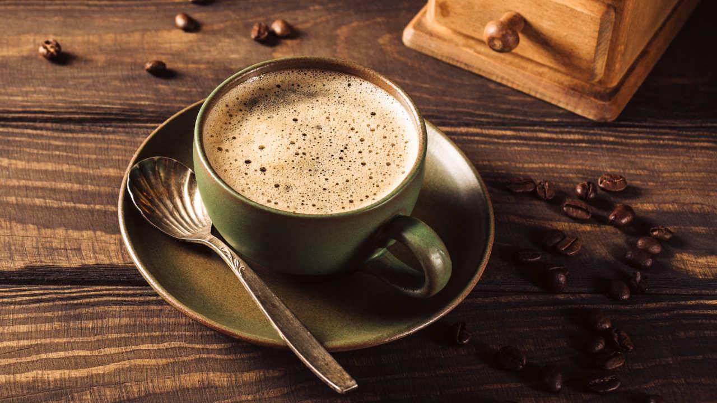
How about we GO for a COFFEE this AFTERNOON?

Slide 47
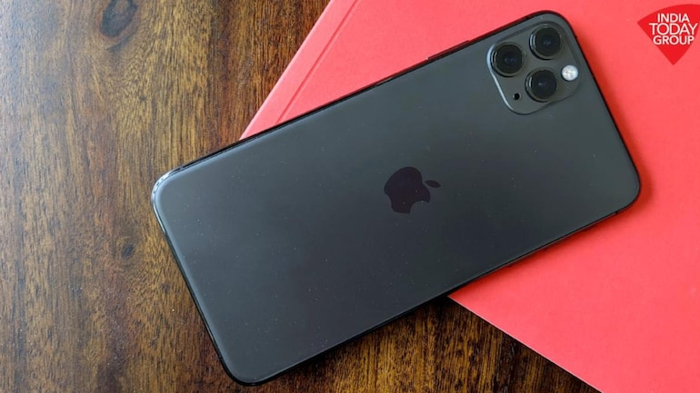
My phone is broken, so I am going to buy a new one.
My phone is broken, so I am going to buy a new one.

Slide 48
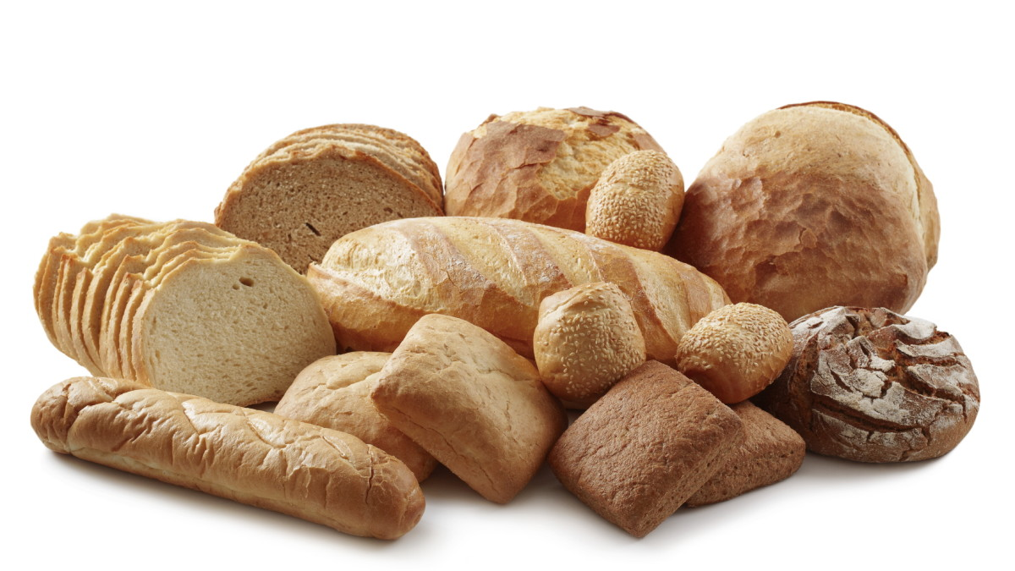
Could you get some bread from the bakery on the way here?
Could you get some bread from the bakery on the way here?

Slide 49
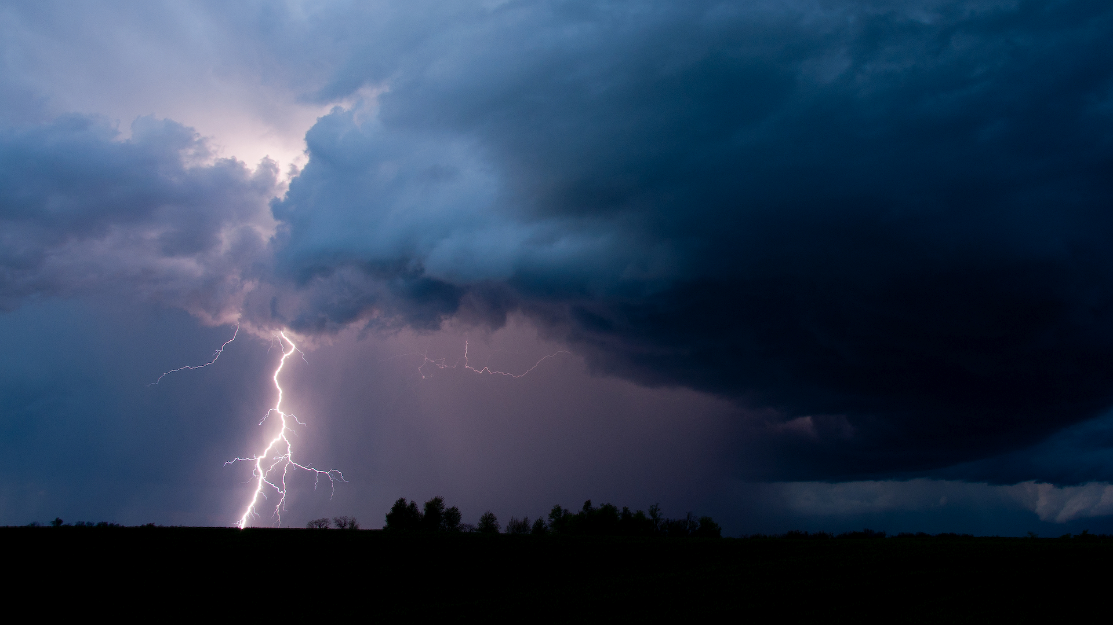
I heard the weather will be bad tomorrow.
I heard the weather will be bad tomorrow.

Slide 50
He has no idea what he wants to do after he graduates.
He has no idea what he wants to do after he graduates.

Slide 51
Cave Man Game
Say a sentence with only the stressed words. Can your group understand you?

Slide 52
Stress
Use exaggerated stress for corrections.

Slide 53
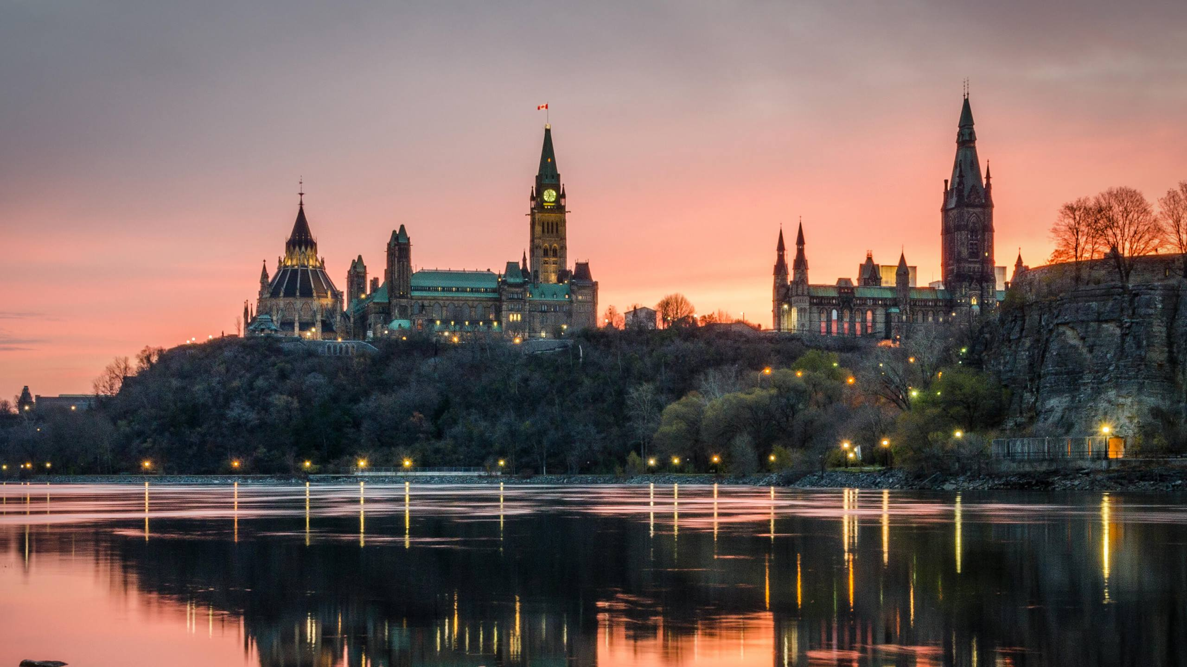
TORONTO is the CAPITAL of CANADA.
No, OTTAWA is the CAPITAL of CANADA

Slide 54
Juncture

Slide 55
Juncture
Juncture is how sounds are mixed or how they transition.

Slide 56
Juncture
How’s it going?
How-sit goin’

Slide 57
Open Juncture (pauses)
Pauses show the boundaries of words and phrases.
He lies / Heal eyes
My turn / Might earn
Play nice / Plain ice

Slide 58
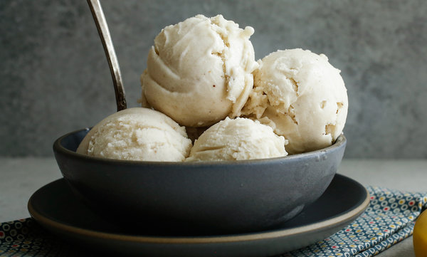
I scream, you scream, we all scream for ice cream.

Slide 59
Close Juncture (connection)
Syllables are connected to show a shared meaning.
Night trait / Nitrate
A corn/ Acorn

Slide 60
Where is the Juncture?
Super
Dinner
Hello
Paper
Supper
Diner
Happy
Open

Slide 61
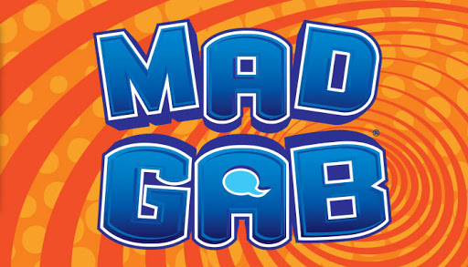
Mad Gab
Move the junctions and change the pronunciation.

Slide 63
TEAM OATH
HE
Name
TIMOTHY

Slide 64
MAY PULL
SIR UP
Canadian Food
MAPLE SYRUP

Slide 65
BEYOND SAY
Singer
BEYONCE

Slide 66
ACHE UP PUCK OFF HE
Morning happiness
A CUP OF COFFEE

Slide 67
ACORN REHAND REST
Chuseok
A KOREAN DRESS

Slide 68
TREE COURT WREATH
Holiday phrase
TRICK OR TREAT

Slide 69
PILL EAST OPERA NING
Say to children
PLEASE STOP RUNNING

Slide 70
DEPOT STALL FIZZ
Place
THE POST OFFICE

Slide 71
AIM US KEY TUB HEIGHT
Camping problem
A MOSQUITO BITE

Slide 72
DUNE HOT FEED THAN HYMN HULLS
Zoo rule
DO NOT FEED THE ANIMALS

Slide 73
CREASED MY SIEVE
Aniticpation
CHRISTMAS EVE

Slide 74
ACE HECK HUNCH ANTS
Again?
A SECOND CHANCE

Slide 75
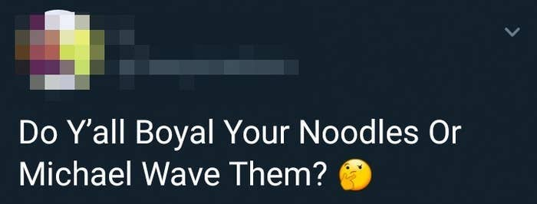
boil
microwave

Slide 76
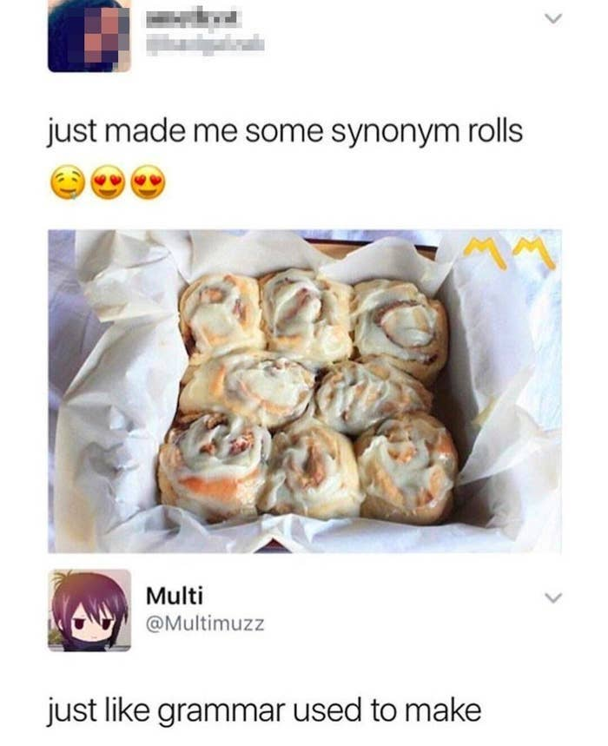
cinnamon rolls
gramma

Slide 77
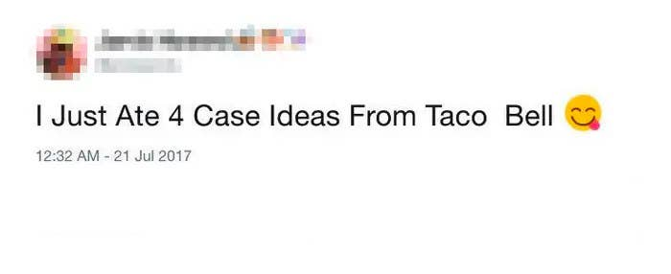
quesadillas

Slide 78
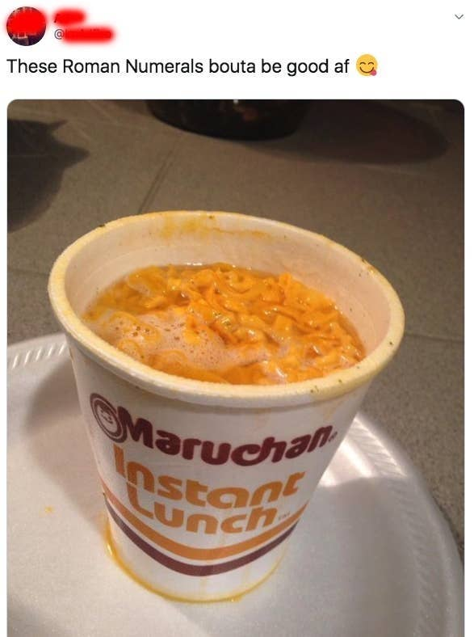
ramen noodles

Slide 79
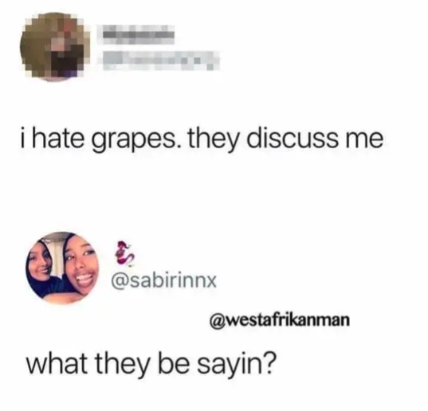
disgust

Slide 80
Pitch

Slide 81
Pitch
The high and low sounds help in communication.

Slide 82
Speed

Slide 83
Speed (pace)
The speed of language adds emotion to what you are saying.

Slide 84
Speed
Contrast is more important than overall speed.

Slide 85
Slow
Slow sentences are dramatic or serious.

Slide 86
Slow
Slow down at key moments.

Slide 87
Fast
Fast sentences are used to show excitement or nervousness.

Slide 89
Communication
Try to communicate without words. Use intonation, stress, juncture, pitch, and speed.

Slide 90
Syllables and Word Stress – English Pronunciation Lesson
https://youtu.be/Vu6UVwkUgzc
Sentence Stress in English Pronunciation
https://www.youtube.com/watch?v=rnJCKda4oWU
Intonation in English – English Pronunciation Lesson
https://www.youtube.com/watch?v=A6aE4nceJt8
Effective Speaking
https://www.skillsyouneed.com/ips/effective-speaking.html

