Slide 1
Compliments

Slide 3
What makes a compliment good?

Slide 4
Genuine

Slide 5
GENUINE
From the heart
True

Slide 6
I really appreciate your friendship.
I am so happy for you.

Slide 7
Specific

Slide 8
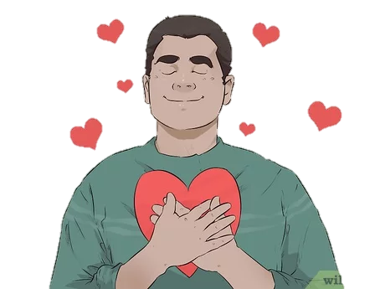
SPECIFIC
Meaningful
Shows you are interested and paying attention
Avoid hyperbole (sounds fake)

Slide 9
I like how your earrings compliment your eyes today.
This restaurant was a great choice. Well done.
You are the smartest person I have ever met. You make Einstein look like a moron. You should run for president.

Slide 10
Accomplishment

Slide 11
ACCOMPLISHMENT
Praise effort not results
Something they are proud of
Not born with

Slide 12
You got 100%? That’s awesome. Congratulations.
I appreciate your insight; you have spent a lot of time thinking about this.

Slide 13
Reason

Slide 14
REASON
Why do you appreciate that quality?
Adds meaning

Slide 15
You have a great taste in music. I can always count on you for good song suggestions.
I loved the animations in your ppt. They really made the lesson come to life.

Slide 17
Better Compliment

Slide 18
You are so smart.
OR
Your essay was well-written.

Slide 19
You are so smart.
OR
Your essay was well-written.

Slide 20
I love how you styled your hair today.
OR
You have a pretty smile.

Slide 21
I love how you styled your hair today.
OR
You have a pretty smile.

Slide 22
You are my favorite teacher of all time!
OR
I appreciate you explaining the question to us.

Slide 23
You are my favorite teacher of all time!
OR
I appreciate you explaining the question to us.

Slide 24
Congratulations on winning the writing contest. You must have worked really hard.
OR
Congratulations on turning 30 years old. Happy birthday!

Slide 25
Congratulations on winning the writing contest. You must have worked really hard.
OR
Congratulations on turning 30 years old. Happy birthday!

Slide 26
You are amazing.
OR
I like that you helped him carry his bags. It shows that you are kind.

Slide 27
You are amazing.
OR
I like that you helped him carry his bags. It shows that you are kind.

Slide 28
I appreciate that you are all attentive listeners. I like that.
OR
I appreciate you listening to me.

Slide 29
I appreciate that you are all attentive listeners. I like that.
OR
I appreciate you listening to me.

Slide 30
Giving
Compliments

Slide 31
SNOWBALL COMPLIMENTS
Write your name at the top of the paper
Throw the paper to a new person
Let’s all use the same color (anonymous)

Slide 32
GIVING COMPLIMENTS
You have a list of other trainees
Think about a genuine compliment for each of them.
Give each person a compliment.
If someone gives you a compliment, give one in return.

Slide 34
Backhanded Compliments + Qualifiers
A compliment that includes criticism
The use of qualifiers

Slide 35
You are really good at baseball, for a girl.
You’re a great singer, but I don’t listen to music much.
I don’t care what everyone else says, I think you’re smart.
That was a good presentation. I never expected that from you.

Slide 36
Complimenting
Students

Slide 37
Why and When?

Slide 38
Praise for
Accomplishments
Working hard

Slide 39
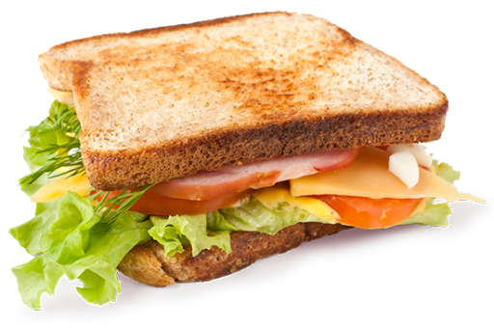
Compliment Sandwich
Positive feedback
Negative feedback
Positive feedback

Slide 40
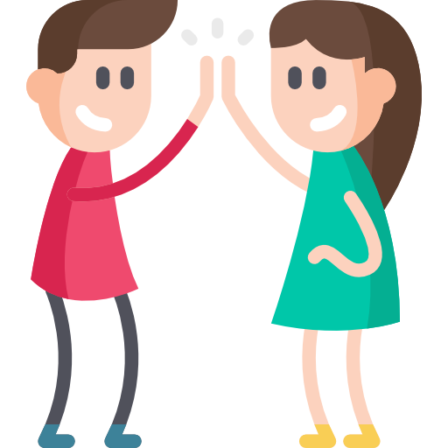
Most Common Sentences
“I like…”
“That’s great!”
*high Five*

Slide 42
Amy’s Advice
1. Thing
2. Like
3. Change
https://www.instagram.com/amychapman/
http://www.voicelabla.com/

Slide 44
How to Give Sincere Compliments
https://www.oprahmag.com/life/relationships-love/a28221845/how-to-give-compliments/
How to Give a Compliment
https://www.wikihow.com/Give-a-Compliment

