Slide 1
Talk
Small

Slide 2
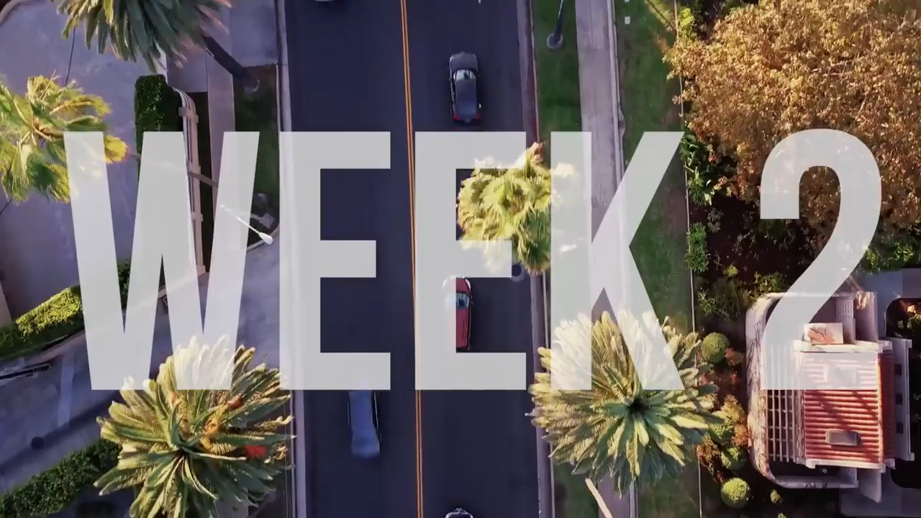

Slide 3
Make a list of safe
small talk topics

Slide 4
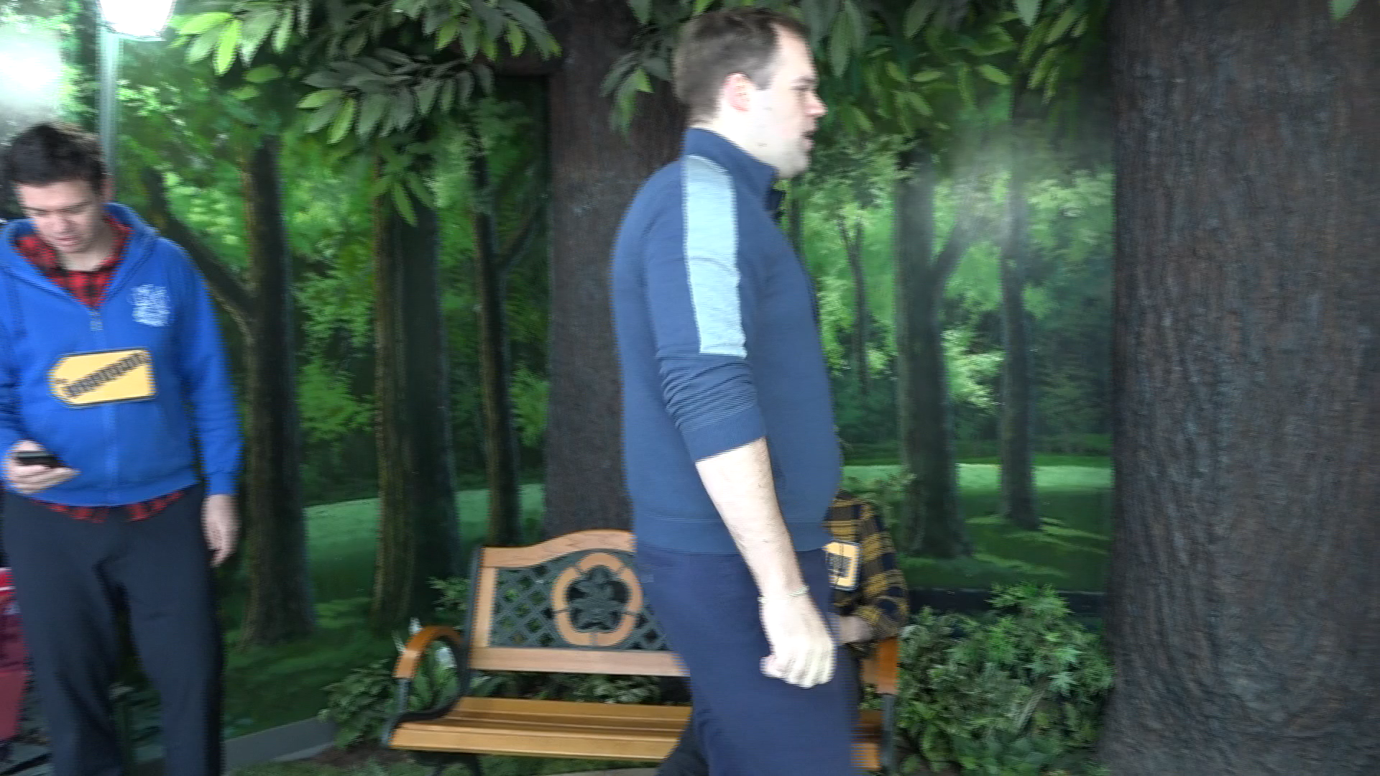
Do you have
a boyfriend?

Slide 5
Personal

Slide 6
What are some more personal questions?

Slide 7
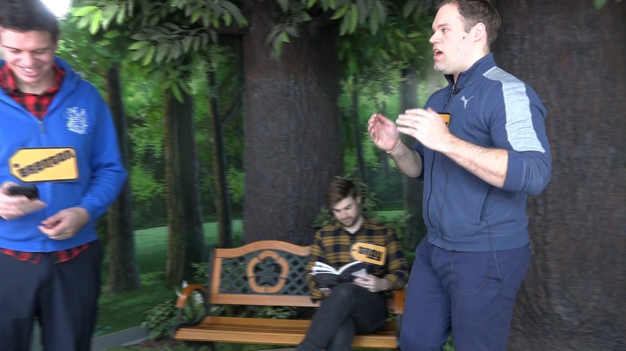
How old are you?
Where are you from?
What is your blood type?

Slide 8
Personal Questions
How tall are you?
How old are you?
Where do you live?
What is your blood type?
What is your credit card number?

Slide 9
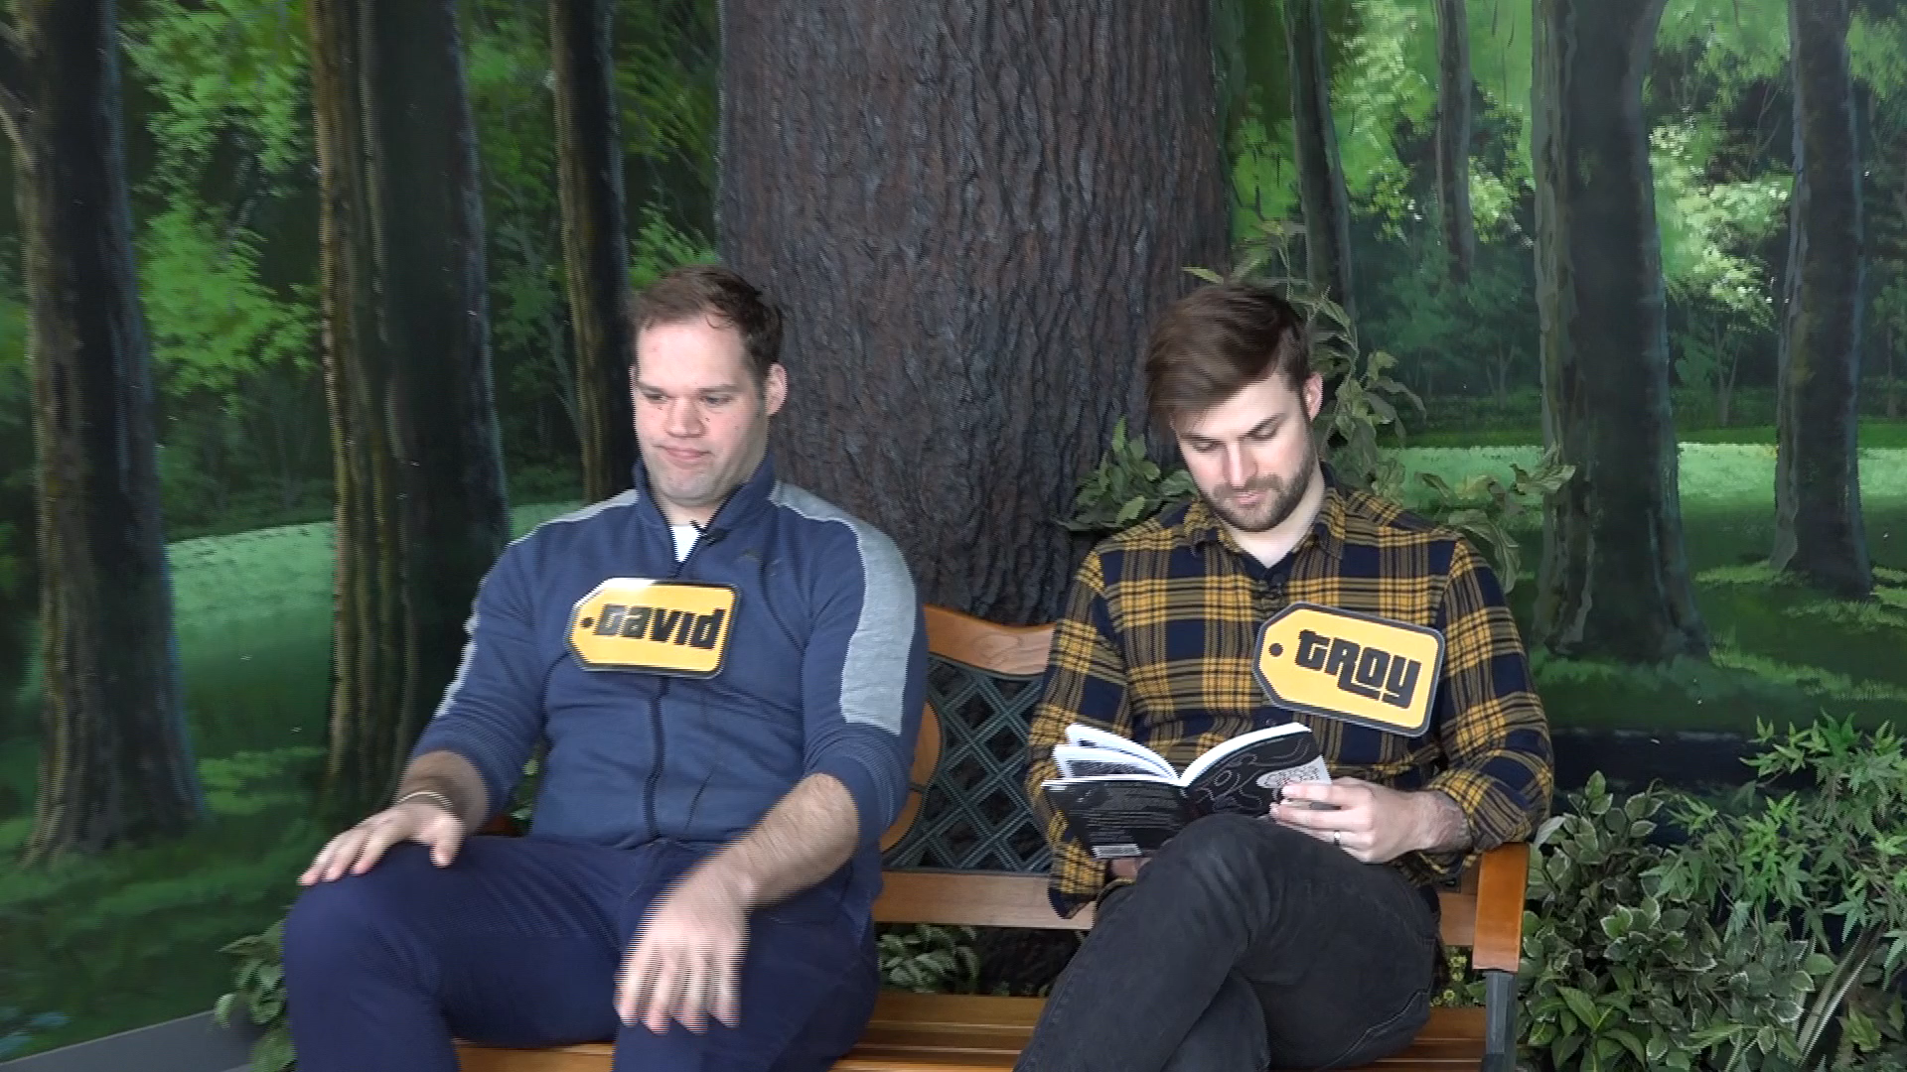
I see you’re reading a book.
That looks interesting.

Slide 10
Avoid
These Topics

Slide 11
Politics

Slide 12
Religion

Slide 13
Observation

Slide 14
I see you are…

Slide 15
That looks / sounds…

Slide 16
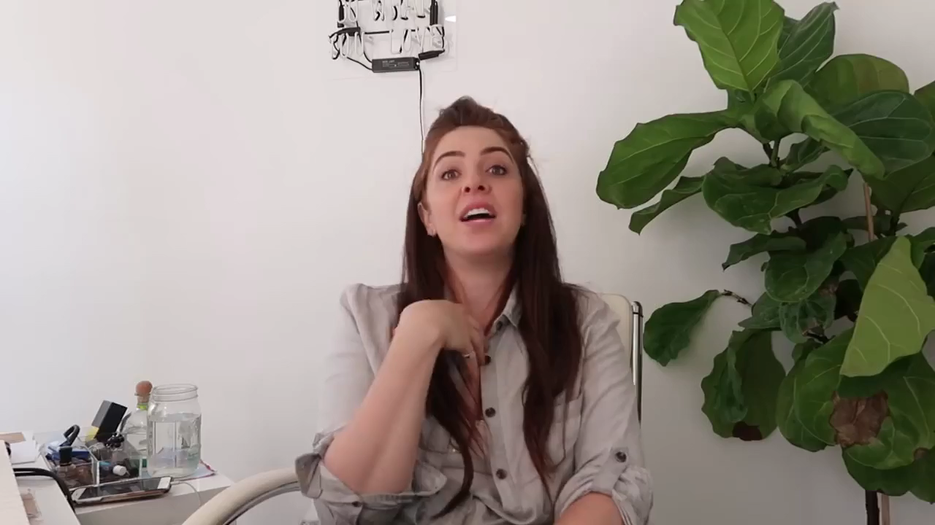

Slide 17
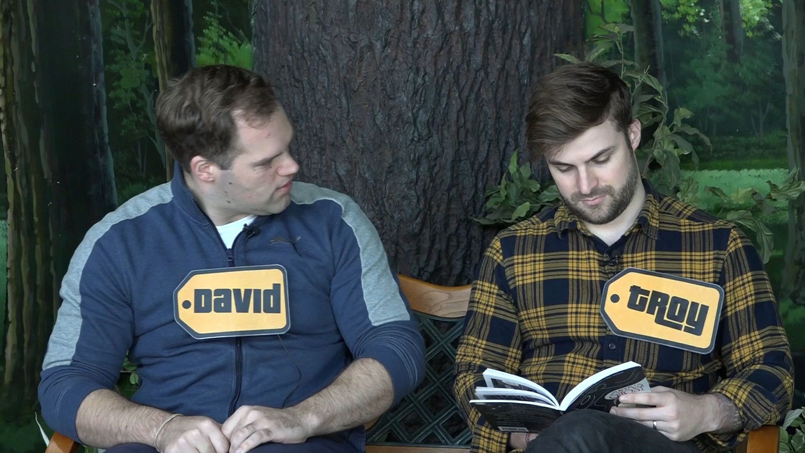

Slide 18
Opinion

Slide 19
What do you think
about…?

Slide 21
Response

Slide 22
add details

Slide 23
Add Details
Full sentences > one word
Story
It reminds me of…

Slide 24
Turn-around
questions

Slide 25
Turn-Around Questions
What about you?
How about you?
And you?

Slide 26
Turn-Around Questions
Stress on “you”
  Rising pitch
  Volume louder
  Elongate

Slide 27
Turn-Around Questions
How are you doing?
I’m good. How are you doing?

Slide 28
Small Talk
Practice

Slide 29

Turn the Question Around by Asking What About You? | Repeat Questions Back with Stress & Intonation
https://englishwithkim.com/turn-questions-around-what-about-you/
Lesson 3: Small Talk
https://youtu.be/uUJpDRHkZfc

