Slide 1
OPENING UP

Slide 2
Who are you open with?
family, friends, strangers, teacher?

Slide 3
Why are you open with them?

Slide 4
What do you talk about with them?

Slide 6
“Coming Out”
Coming out of the closet

Slide 7
OPEN-ENDED QUESTIONS

Slide 8
Tell me about it
Tell me about your childhood.

Slide 9
How does it feel?
How does that make you feel?

Slide 10
What do you think?
What do you think you need to do to improve?

Slide 11
LET THEM TALK

Slide 12
WRITE
Open-Ended Questions

Slide 13
Questions
Tell me about your childhood.

Slide 14
Questions
How is your dating life?

Slide 15
Questions
How has life been lately.

Slide 16
ASSUMPTION QUESTIONS

Slide 18
Visual / Verbal Cues
Assumption
NO
YES
Correction
Open Up

Slide 19
LABELING
You must feel…
You must be….
It sounds like you are…
You’re feeling ______ about that.

Slide 20
OPEN BODY LANGUAGE

Slide 21
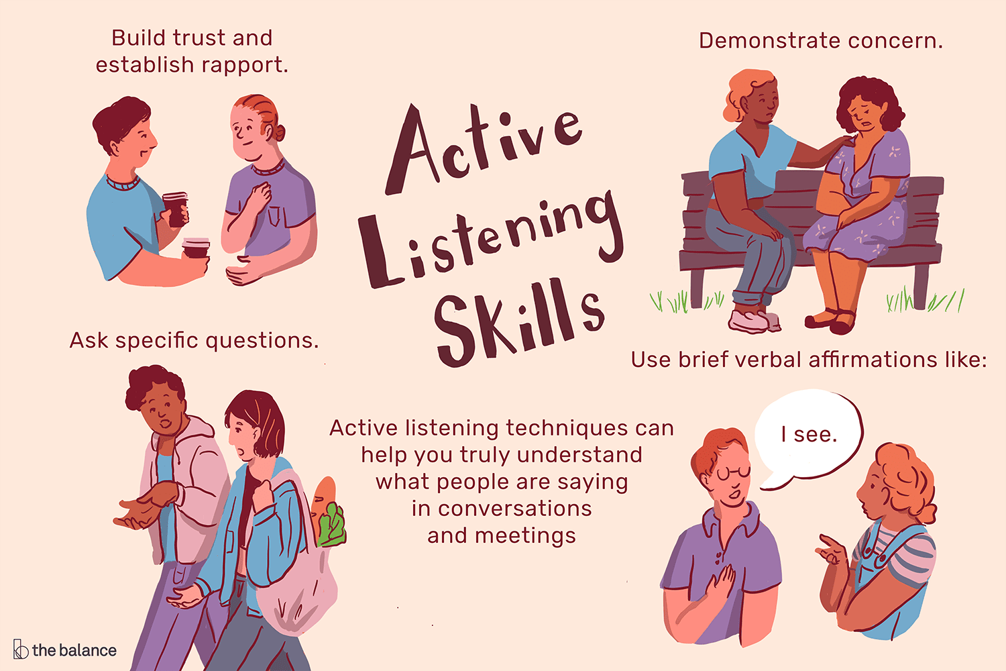

Slide 23
CLARIFICATION QUESTIONS

Slide 24
Questions
What do you mean?

Slide 25
Questions
Tell me more about…

Slide 26
Questions
Can you explain that?

Slide 27
HELPING THE SPEAKER

Slide 28
Affirmation Responses (minimal encouragers, background cues)
“I agree”
Oh…
Ok.
Sure.
Yes.
Yeah?
I see.
Interesting
Right
Uh huh.
Go on.
응…
Oh, really?

Slide 29
Continuation Questions
[encourages more speaking, no judgment]
And then?
Really?
Oh ya?
Go on
Tell me more?

Slide 30
PRACTICE OPENING UP

Slide 31
RULES
It’s not about you.
Try not to judge.
Reflect their emotions.
Be open.

Slide 33
What will his speech be about?

Slide 34
How can you show that you are open as well?

Slide 35
Sharing something weird
shows you are open.

Slide 36
Self-deprecation
No one is perfect.

Slide 38
How to Get People to Open Up
https://www.youtube.com/watch?v=uKO6MidWggs
Body Language
https://www.mindtools.com/pages/article/Body_Language.htm
How to Practice Active Listening
https://www.verywellmind.com/what-is-active-listening-3024343#:~:text=Active%20listening%20refers%20to%20a,and%20withholding%20judgment%20and%20advice.

