Slide 1
Travel in Korea

Slide 2
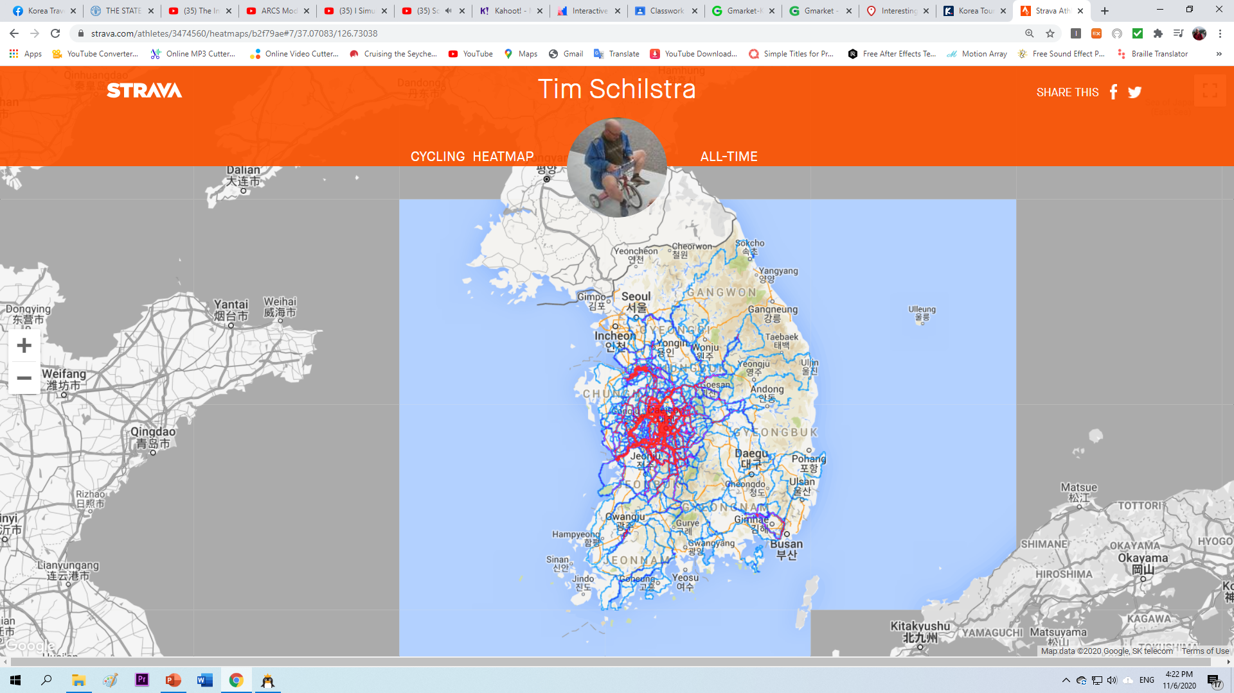

Slide 3
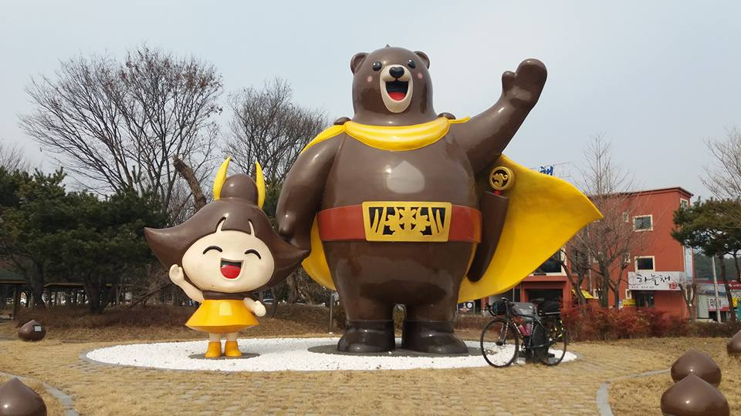
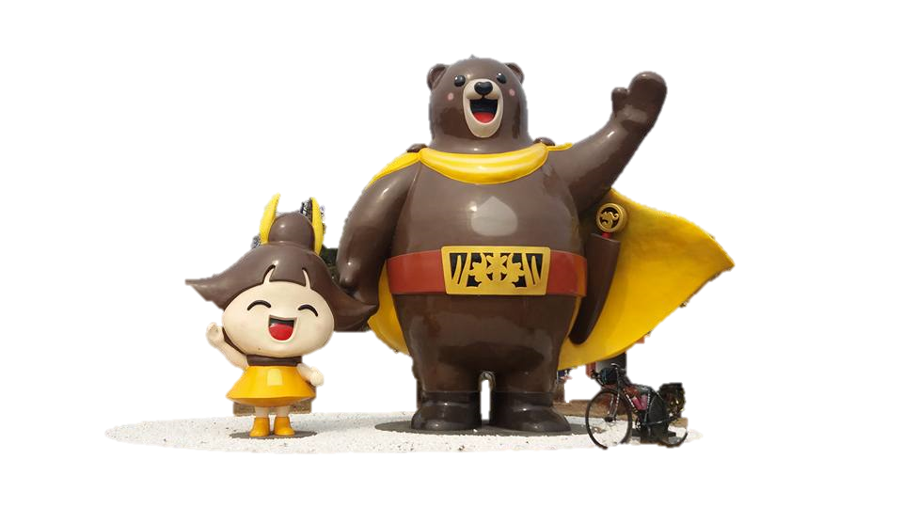
http://naver.me/GXhPg1fv

Slide 4
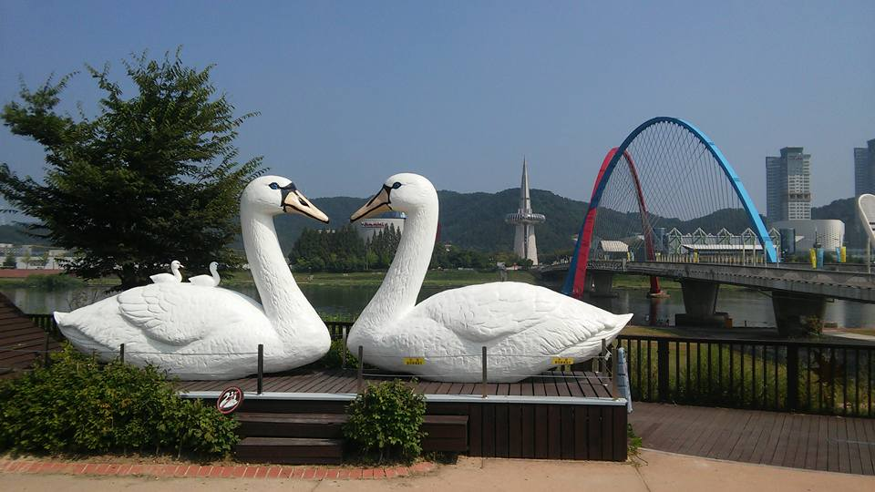
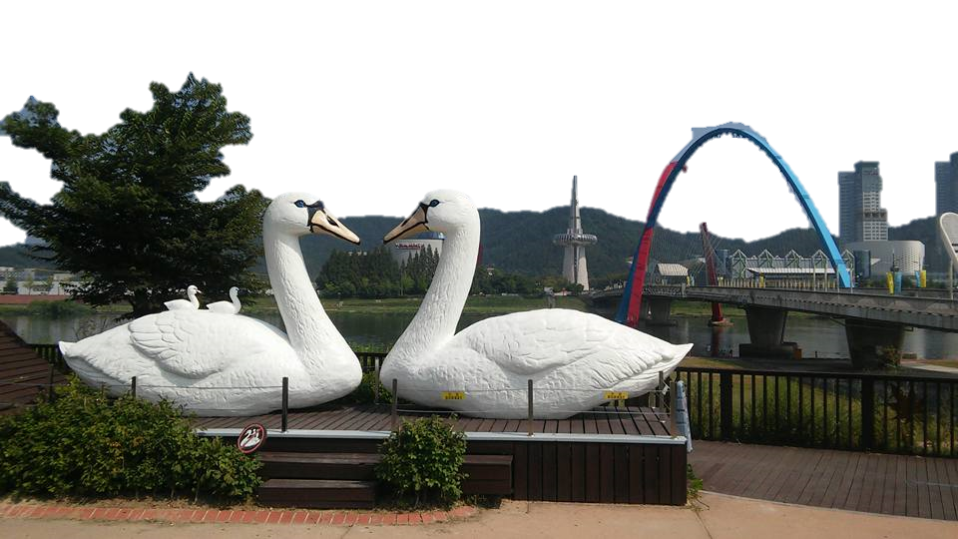
http://naver.me/FJBhIh2g

Slide 5
http://naver.me/IxvfKSKO

Slide 6
http://naver.me/58hVjchR

Slide 7
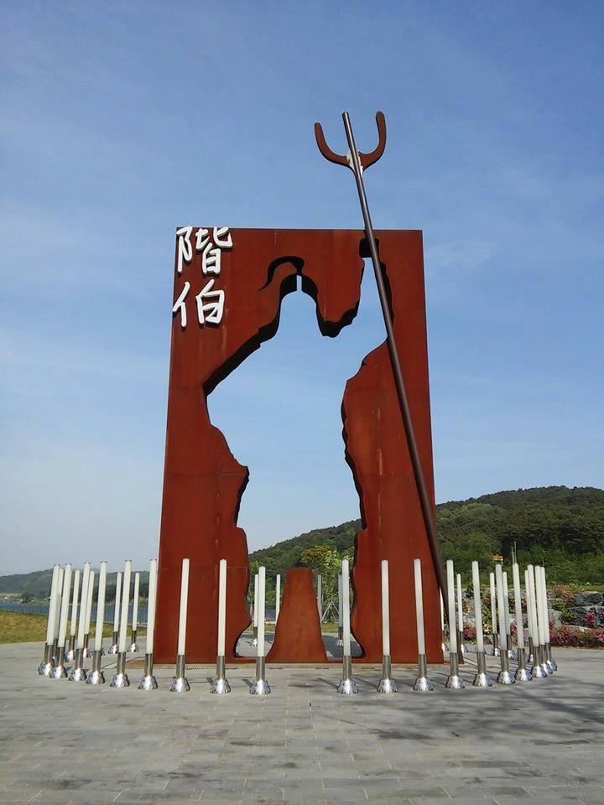
http://naver.me/x015XTaF

Slide 8
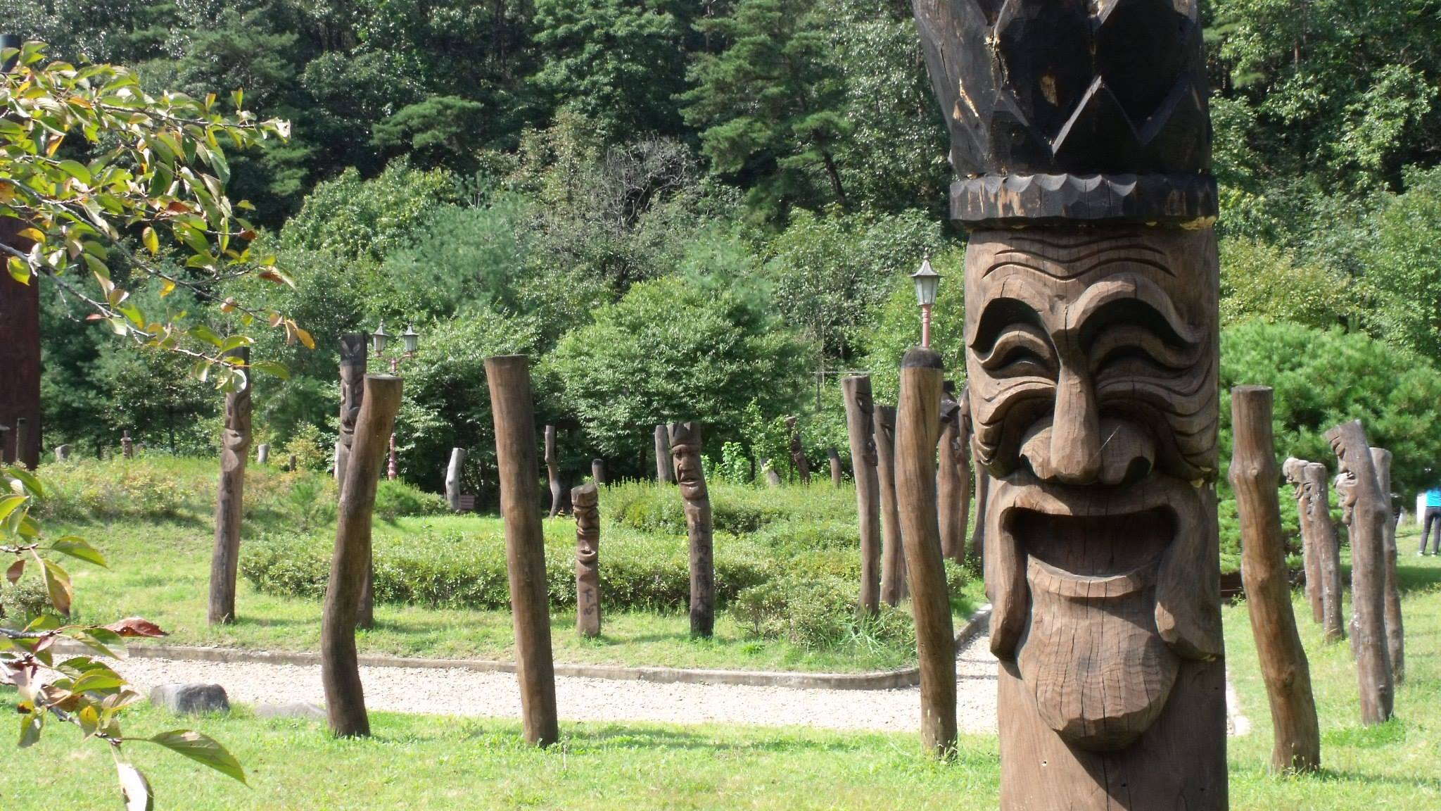
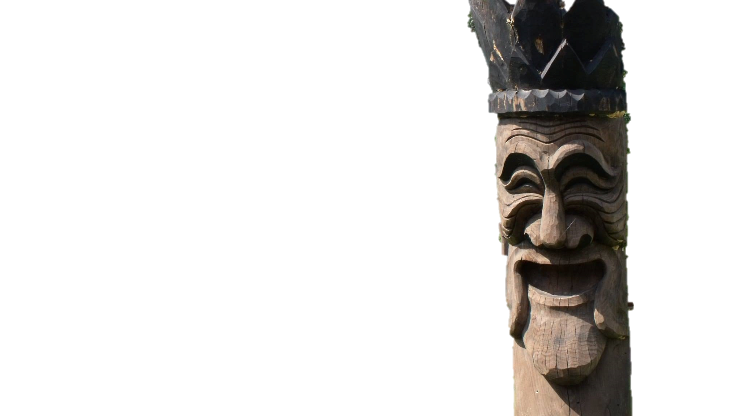
http://naver.me/5AeIg03X

Slide 9
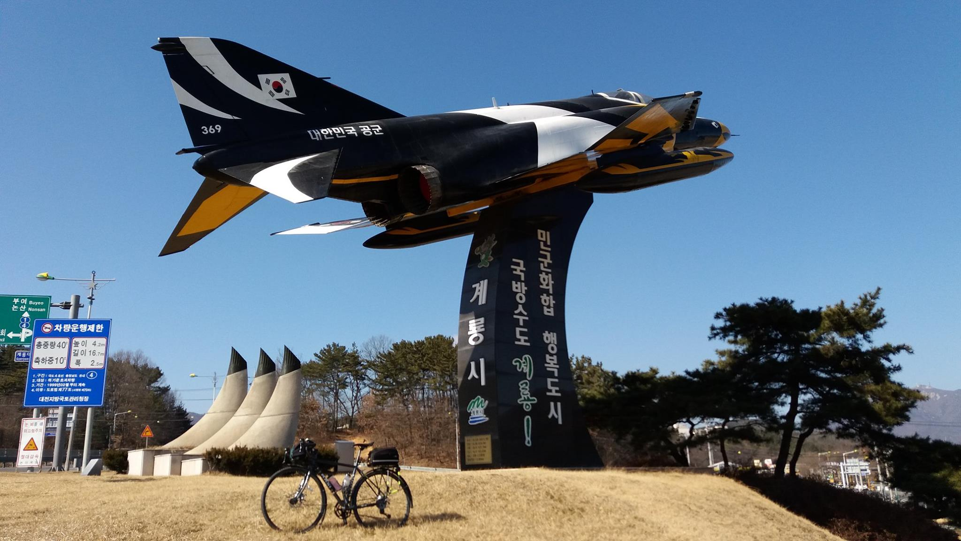
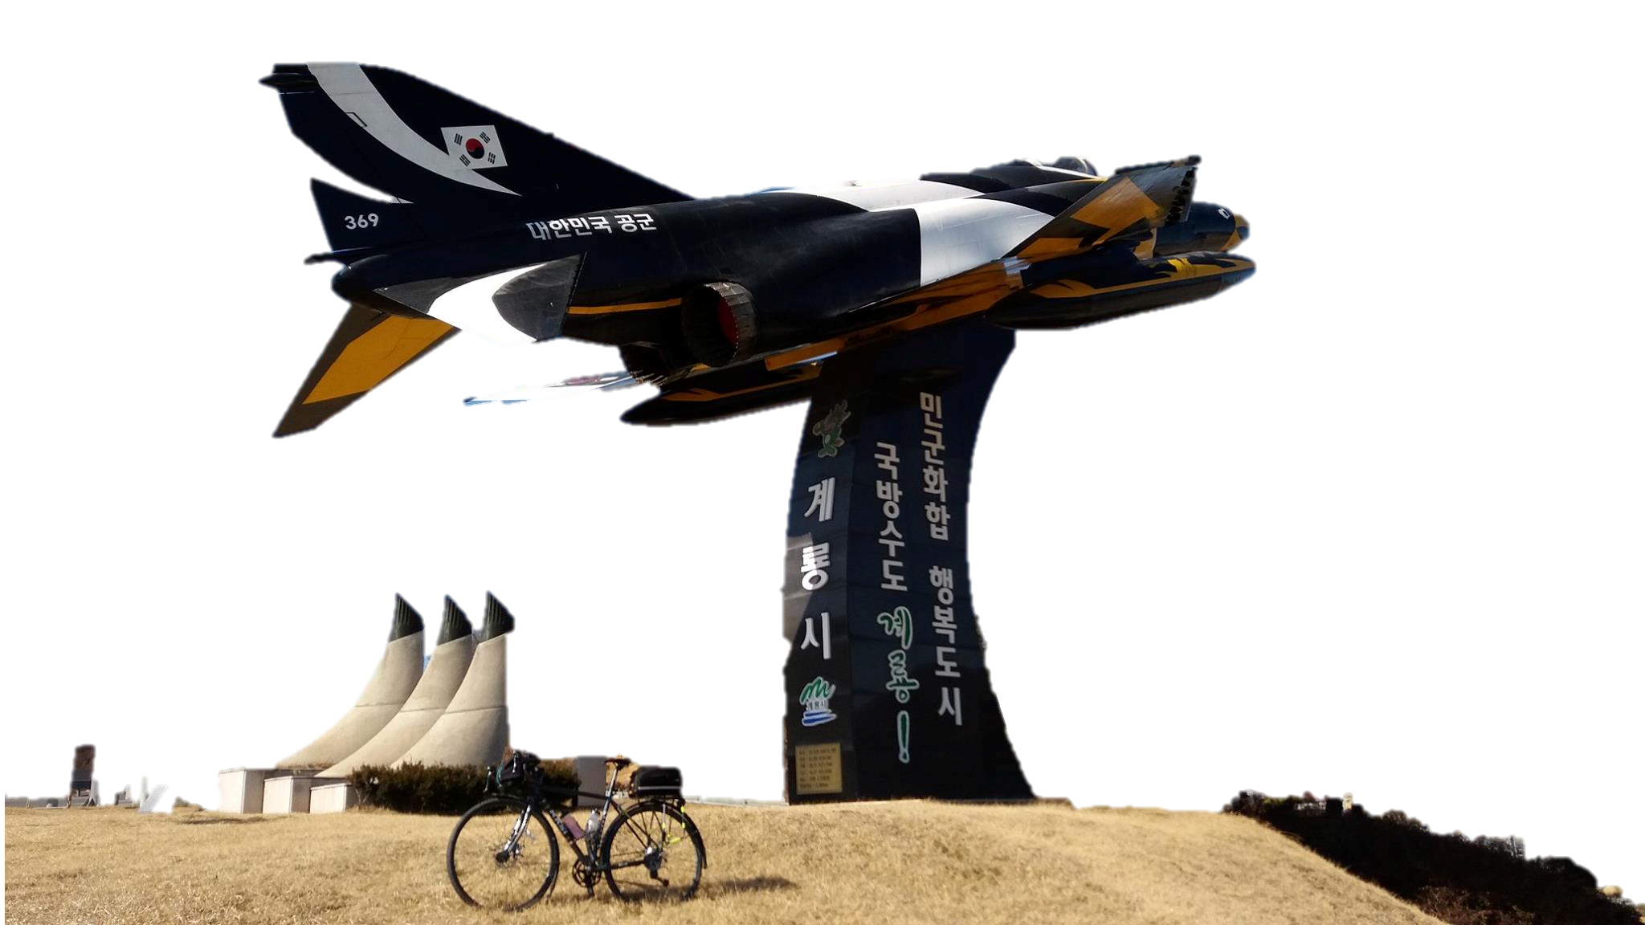
http://naver.me/5vBLJPNn

Slide 10
http://naver.me/GT7u4YrT

Slide 11
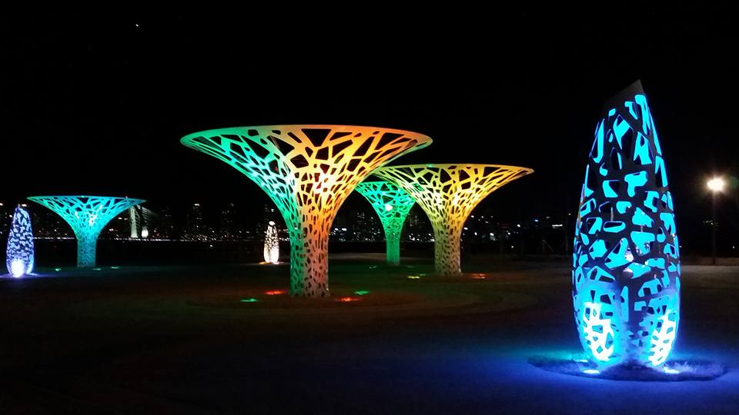
http://naver.me/xJnocnQu

Slide 12
http://naver.me/G85Ki98w

Slide 13
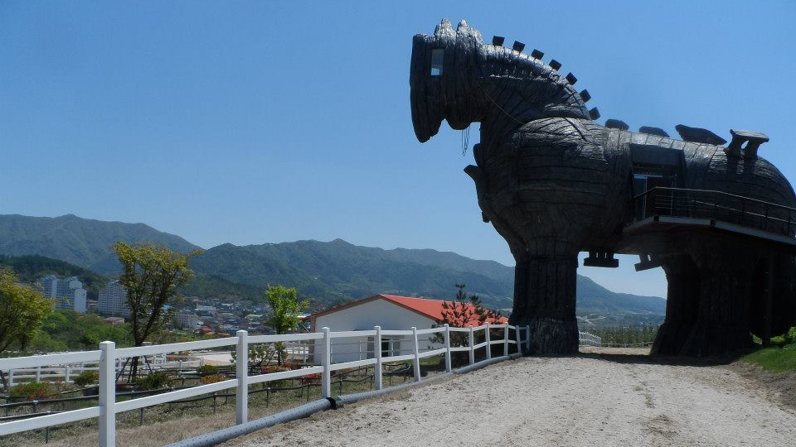
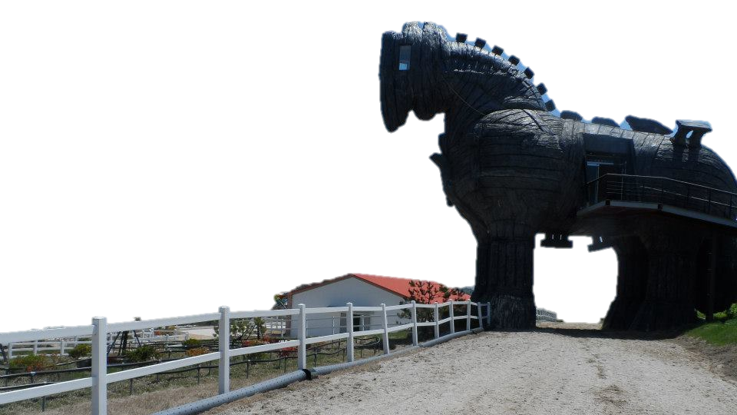
http://naver.me/FUwTirez

Slide 14
http://naver.me/GkEd4hfV

Slide 15
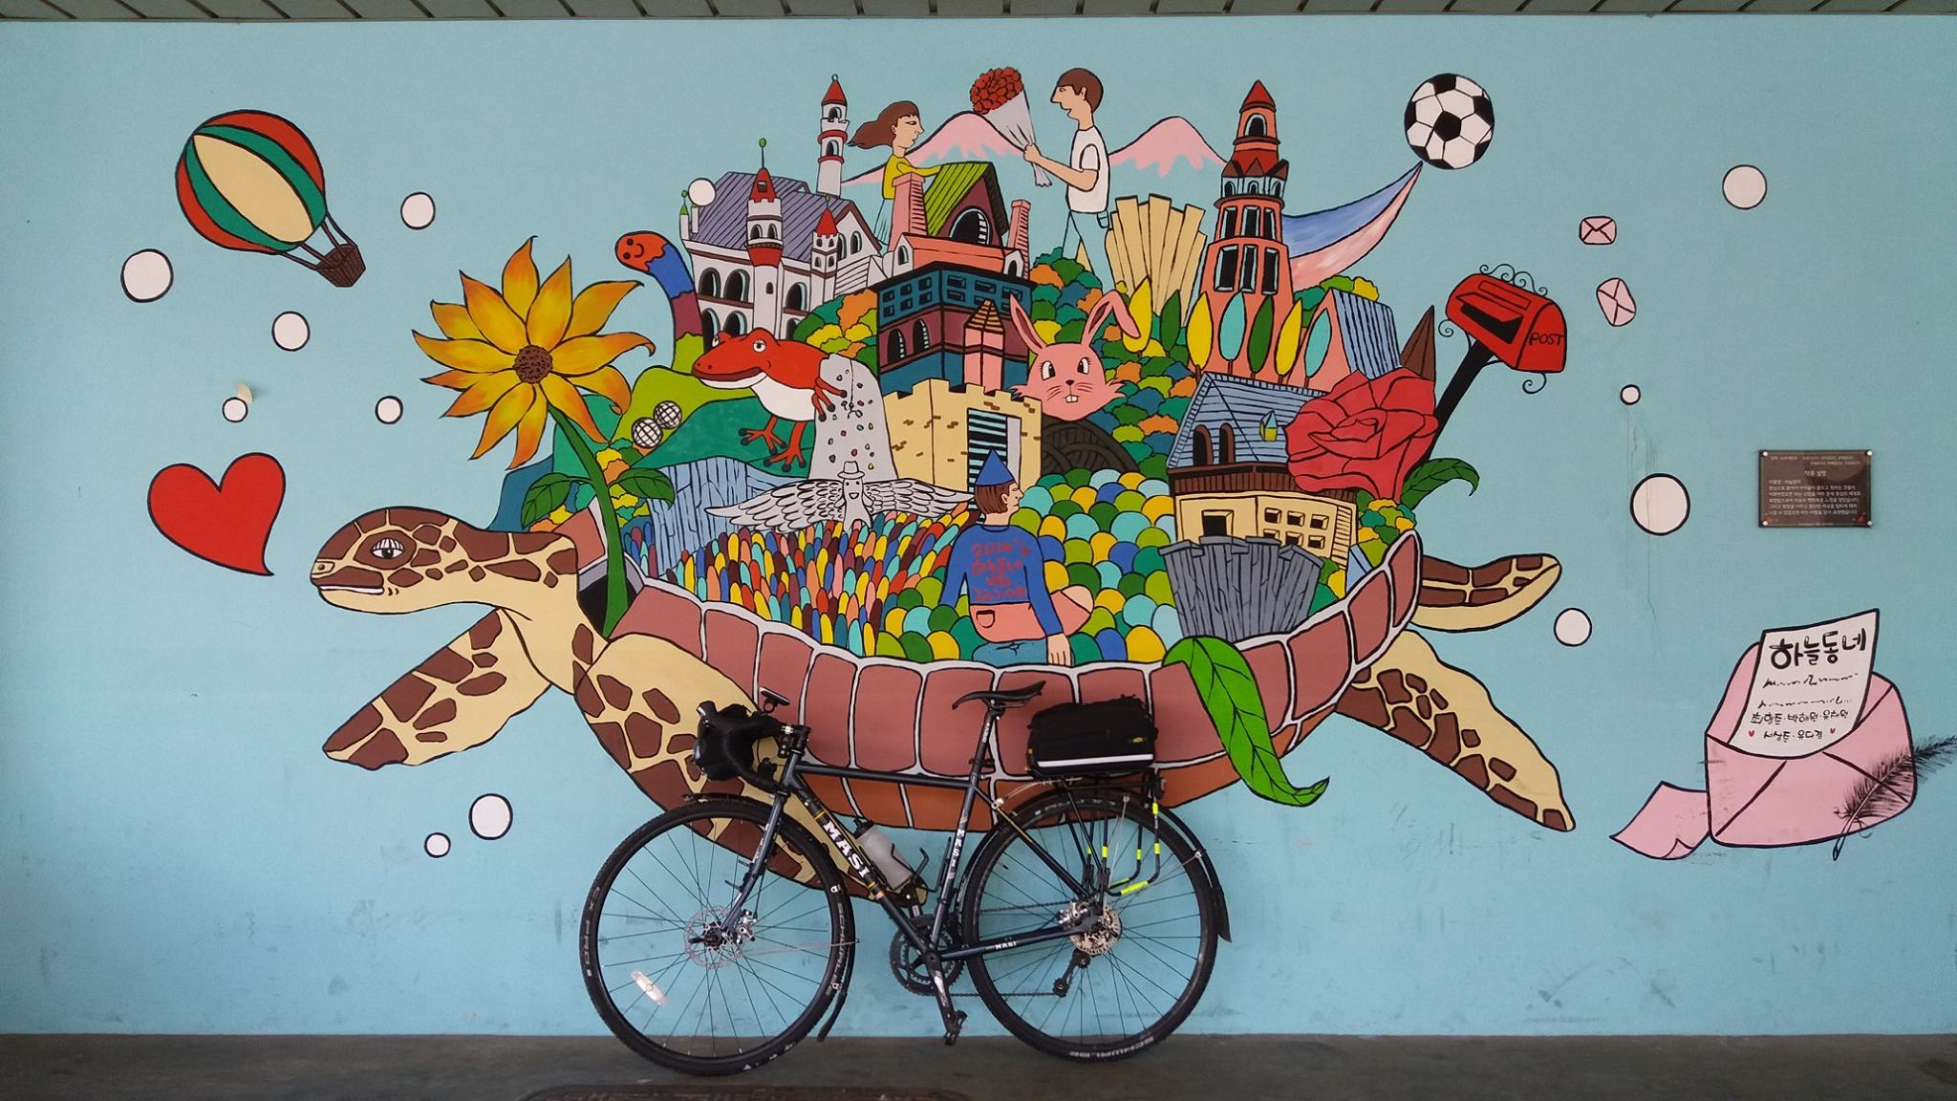
http://naver.me/GvFmbtyw

Slide 16
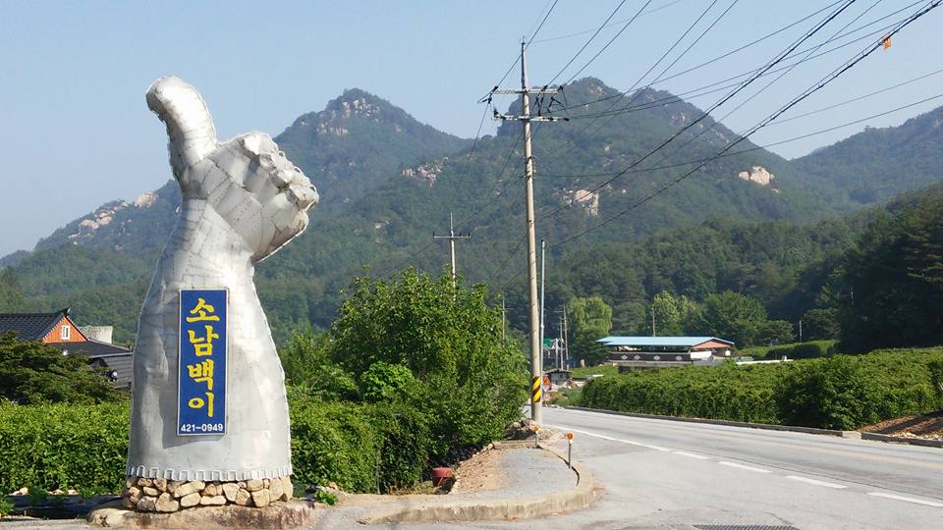
소남백이
http://naver.me/xOfgJciQ

Slide 17
https://www.geoguessr.com/maps/5fa4ee74408bc100015d24f0

Slide 18
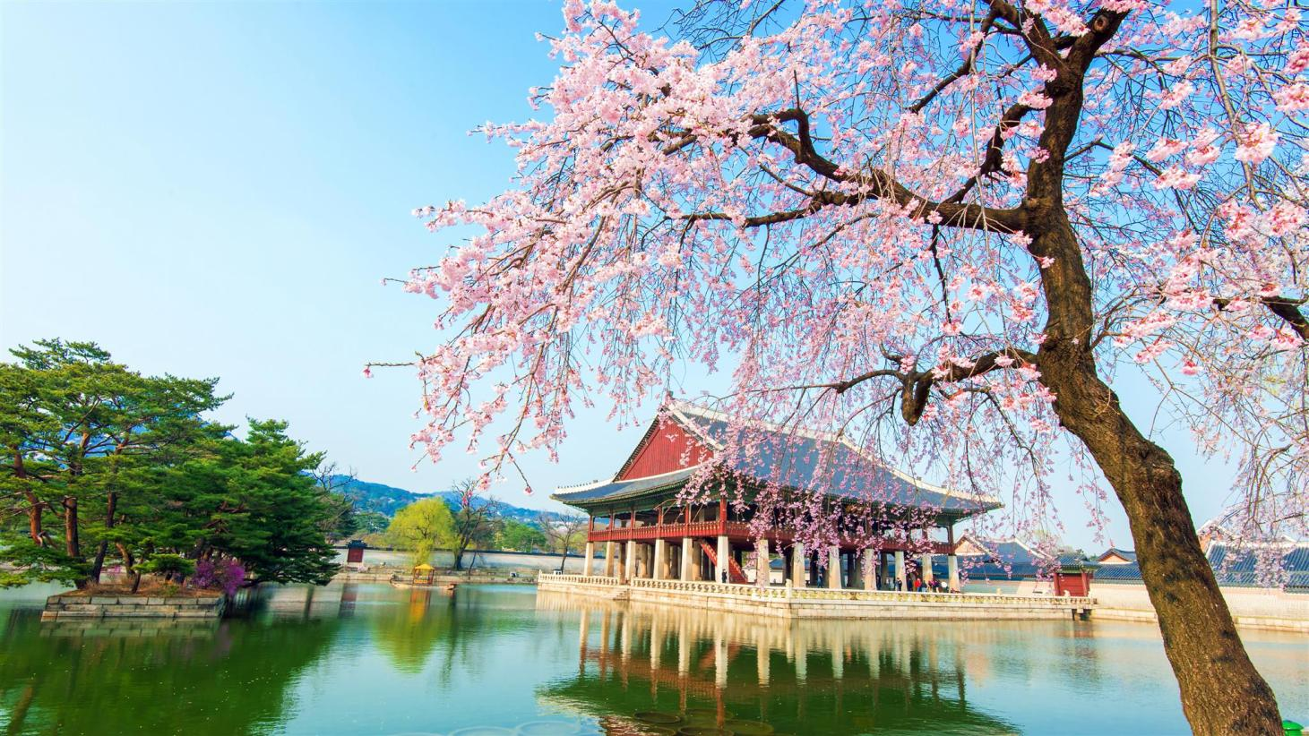
Hot
Spots

Slide 19
Top 10
mountains

Slide 20
Jirisan
Seoraksan
Gyeryongsan
Hallasan
Bukhansan
Odaesan
Deogyusan
Chiaksan
Naejangsan
Songnisan
1
2
Joel’s Travel
Tips
3
4
5
6
7
8
9
10

Slide 21
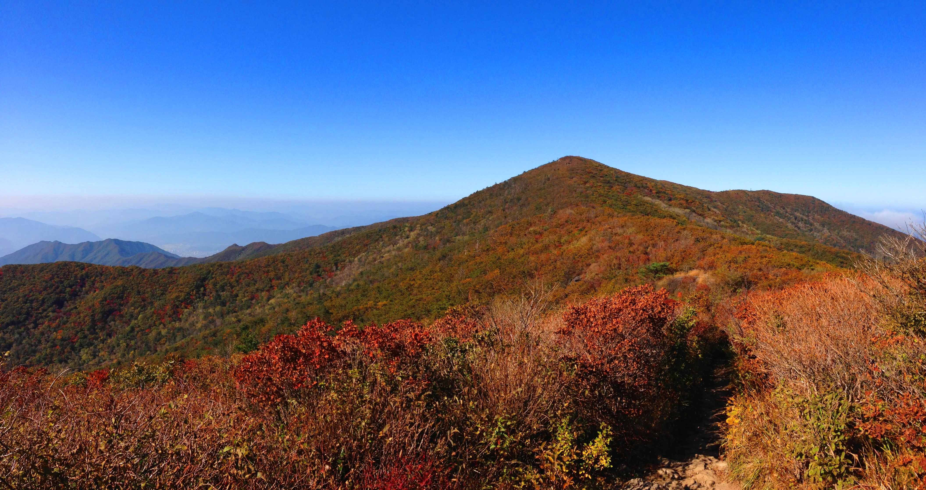
1
Jirisan

Slide 22
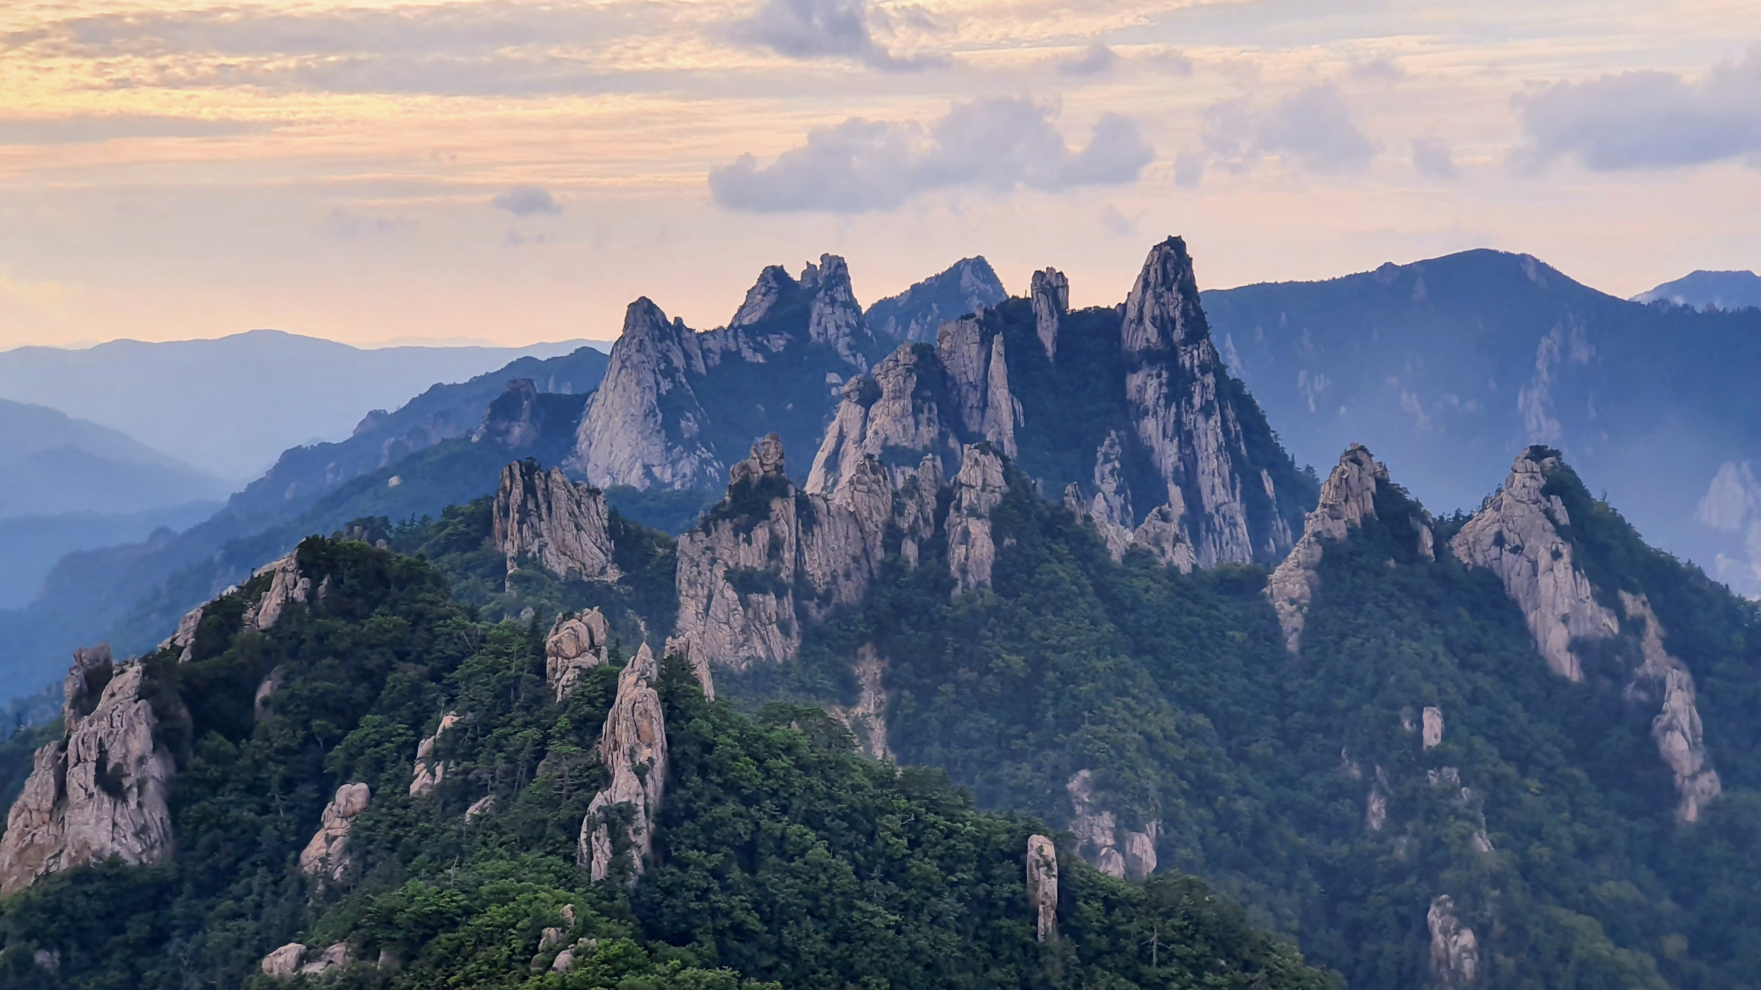
2
Seoraksan

Slide 23
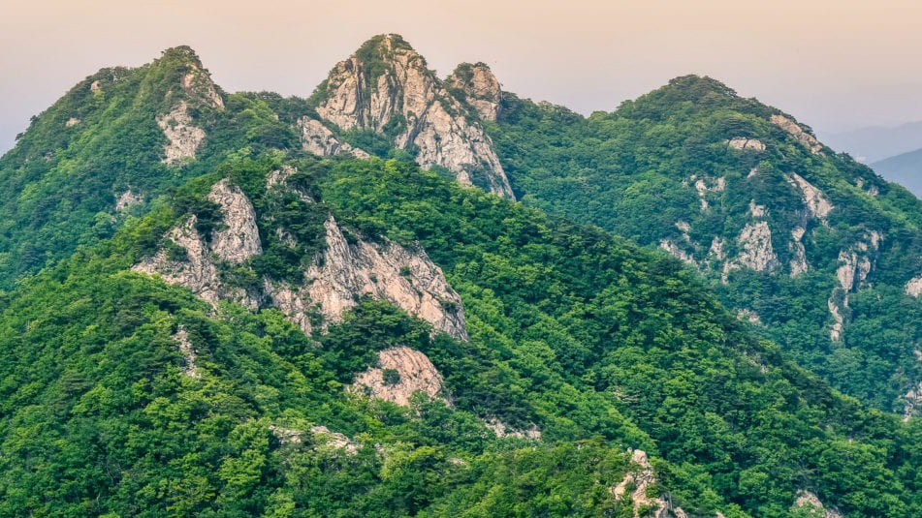
3
Gyeryongsan

Slide 24
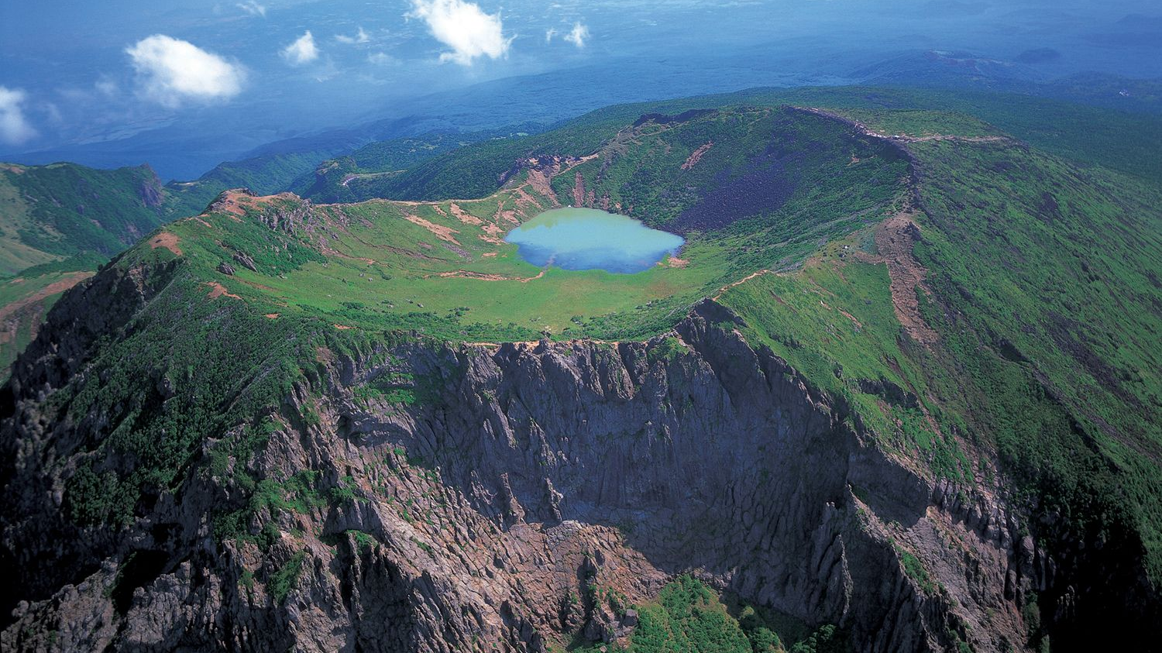
4
Hallasan

Slide 25
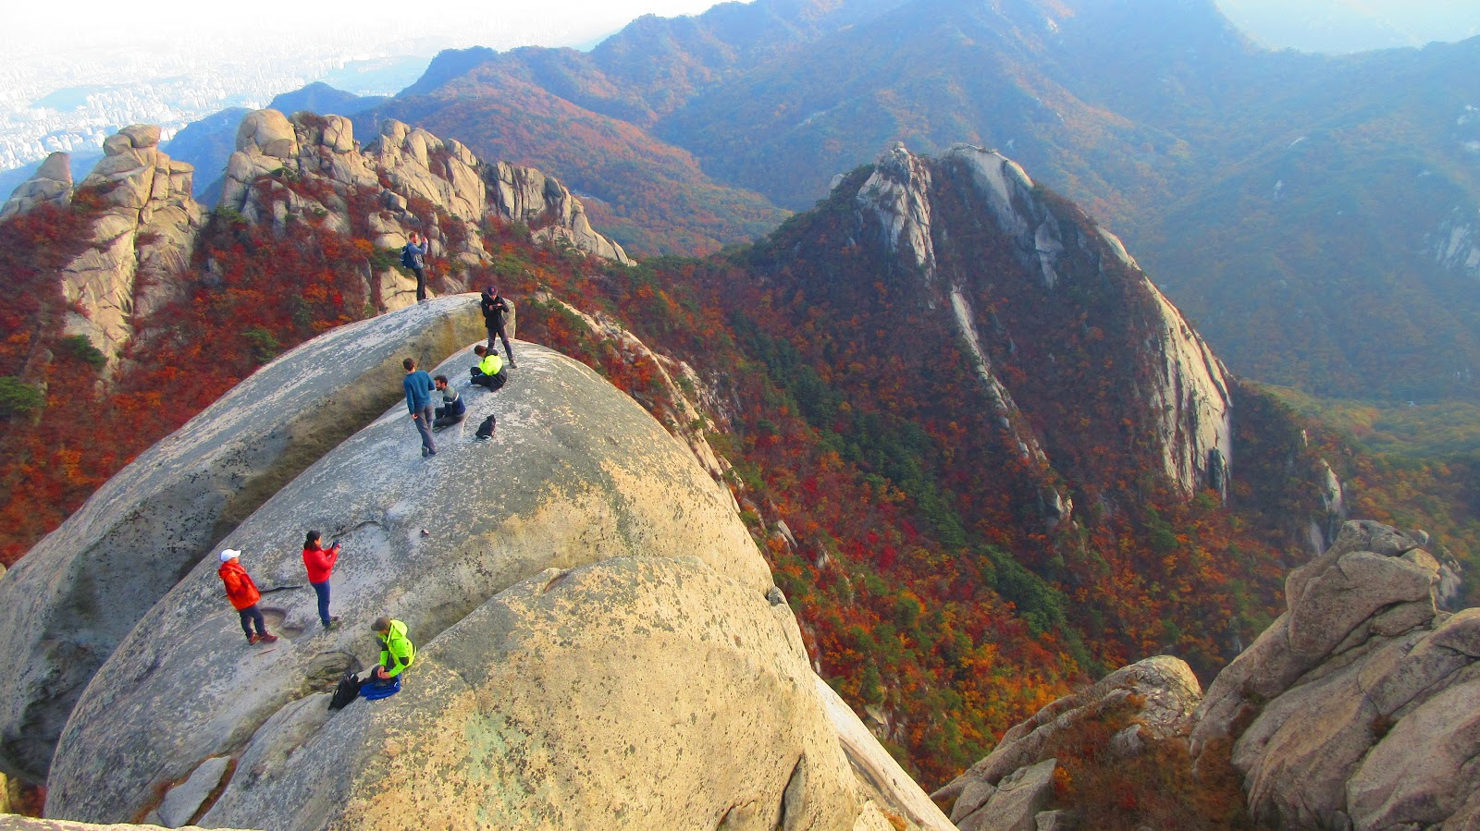
5
Bukhansan

Slide 26
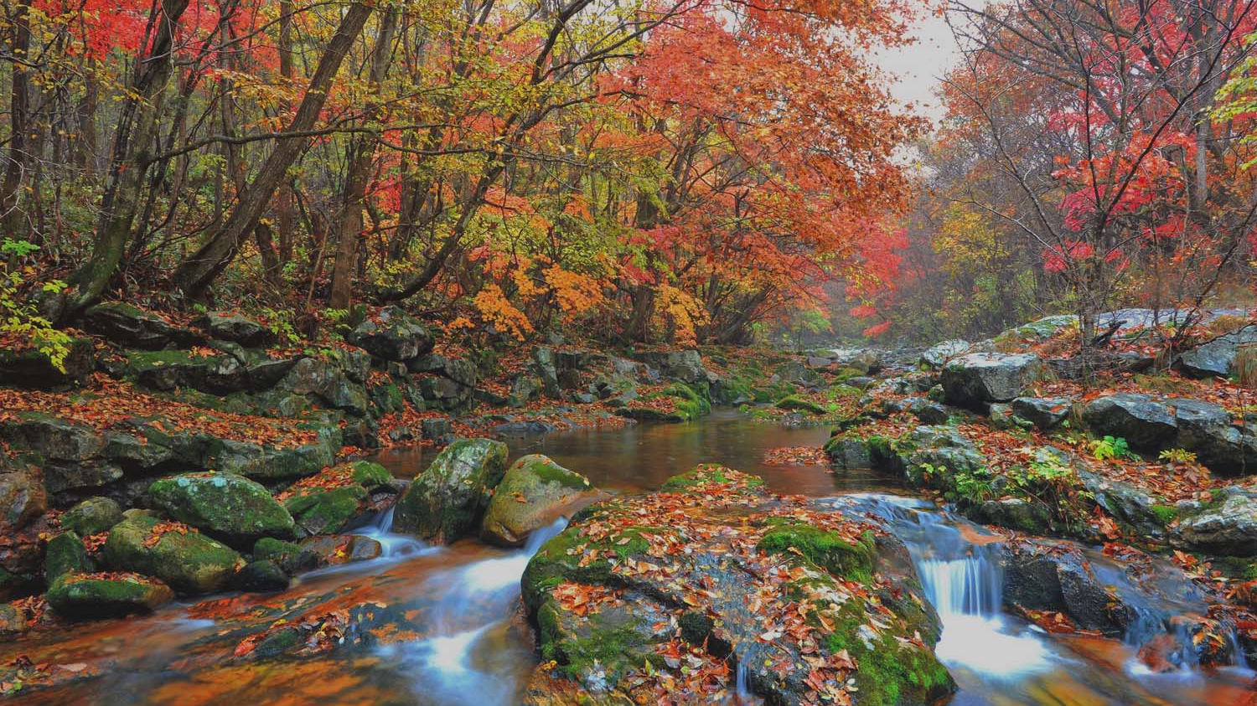
6
Odaesan

Slide 27
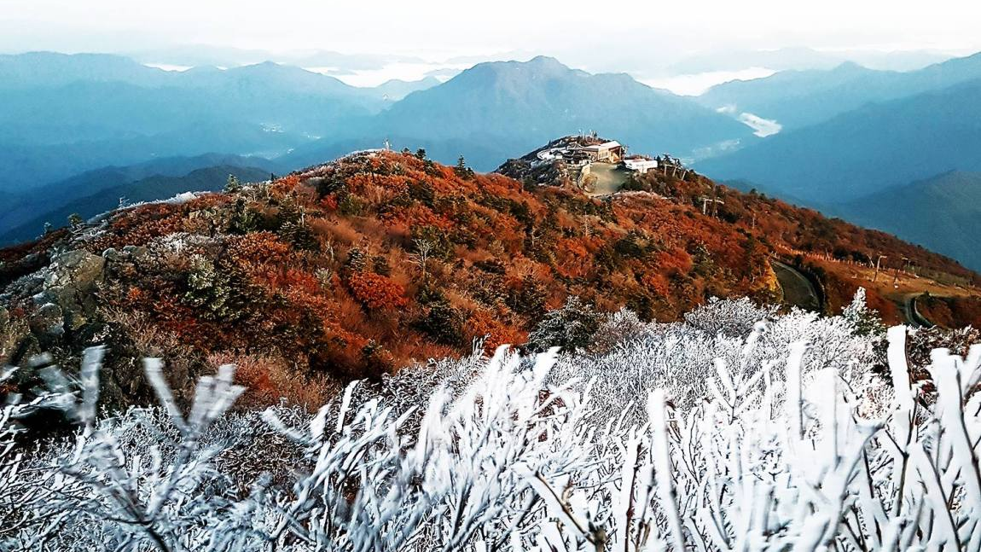
7
Deogyusan

Slide 28
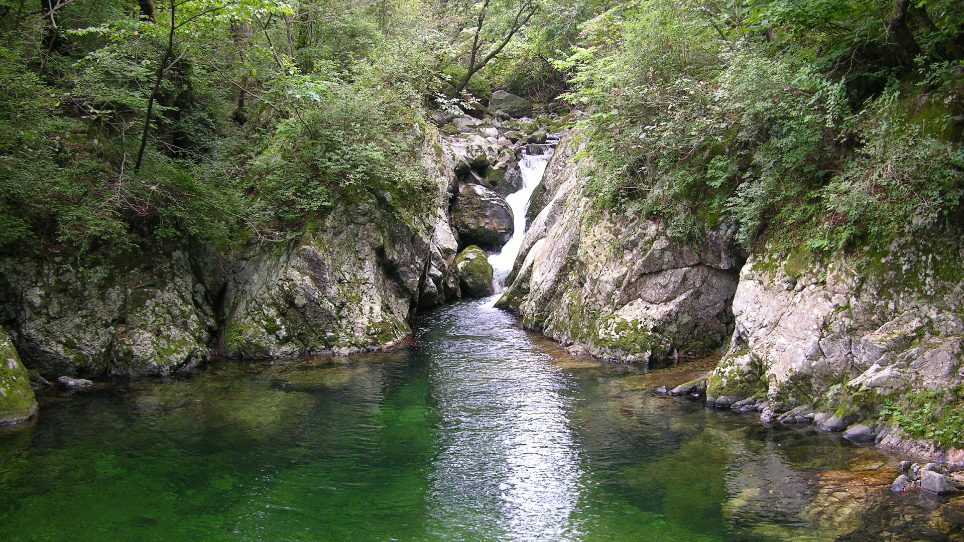
8
Chiaksan

Slide 29
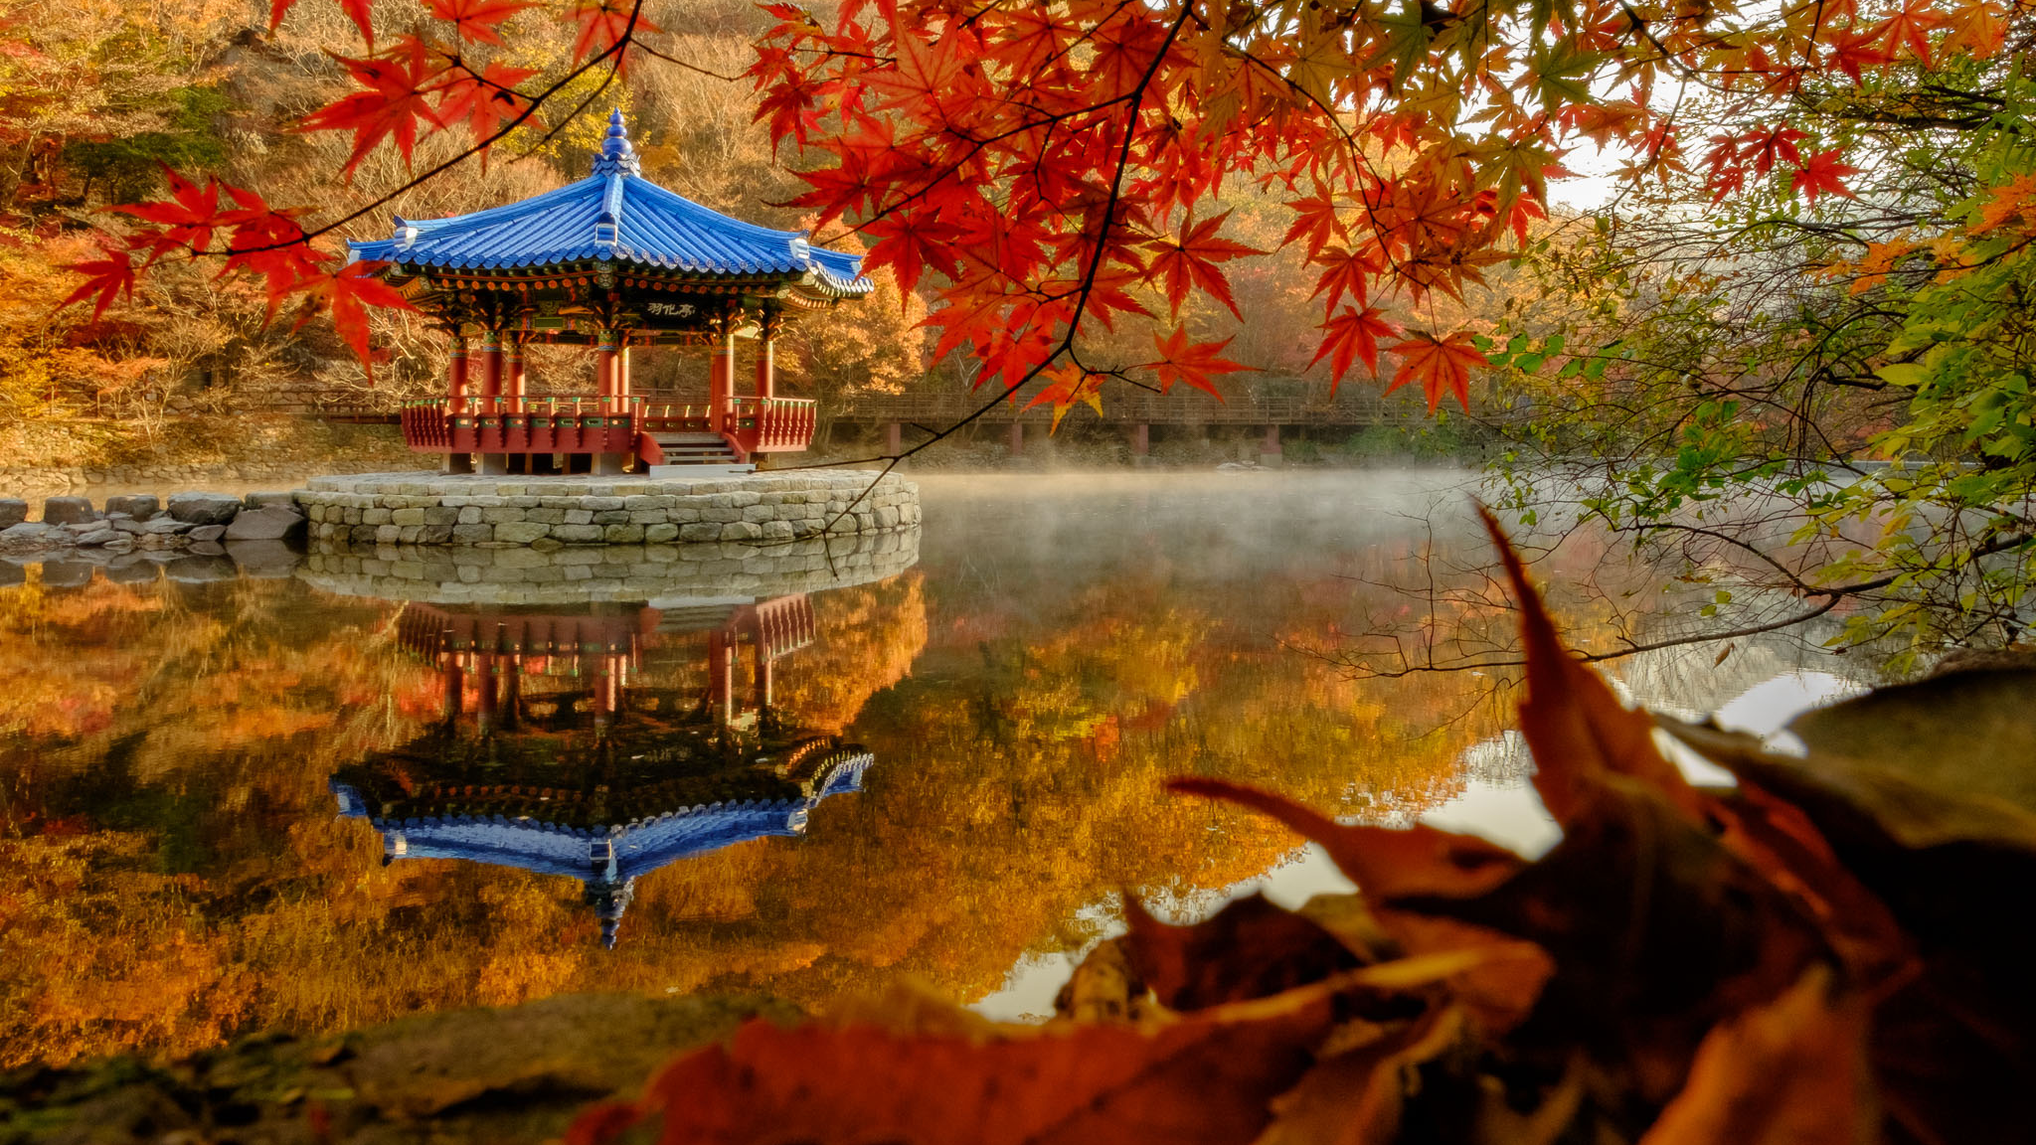
9
Naejangsan

Slide 30
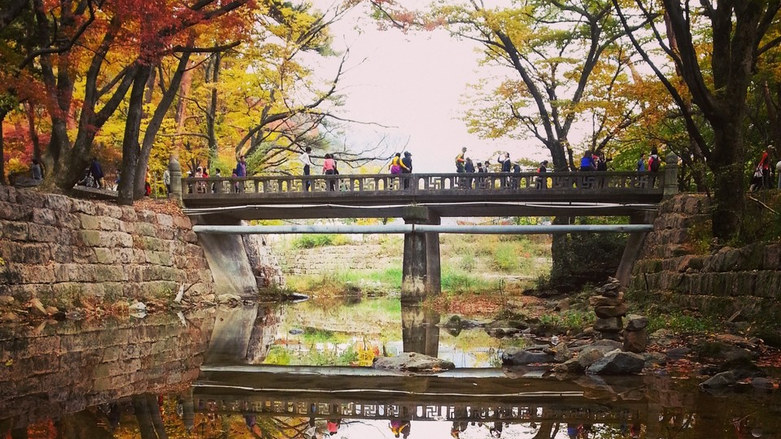
10
Songnisan

Slide 31
Assignment
Destination Korea

Slide 32
Choose a place
Tell us about it
2 Minute Speech

Slide 33
https://joelstraveltips.com/best-mountains-to-hike-in-korea/
https://www.geoguessr.com/
https://www.geoguessr.com/maps/5aec9bb130e010ac3087c237

