Slide 1
Would I Lie to You?

Slide 2
As a child, I was afraid of the sun.
https://www.youtube.com/watch?v=mKc32jQIY0w

Slide 3
I accidently bought a horse.
https://www.youtube.com/watch?v=B94q7gUu75k

Slide 4
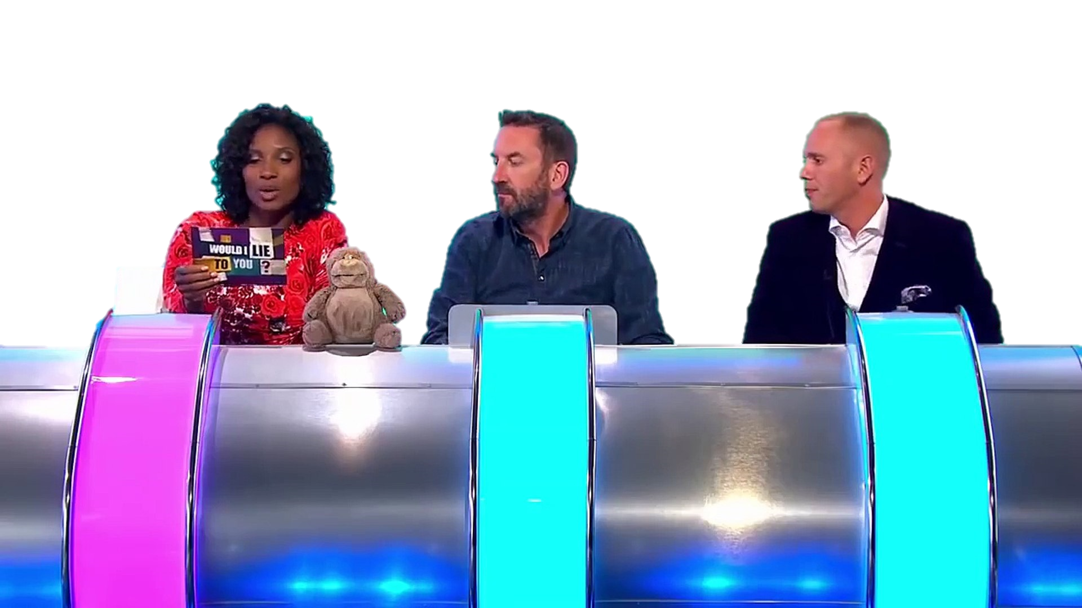
One person says a statement.

Slide 5
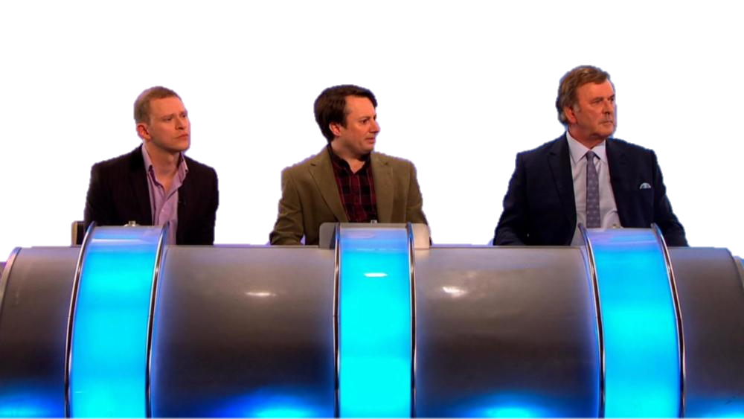
The other team can ask questions.

Slide 6
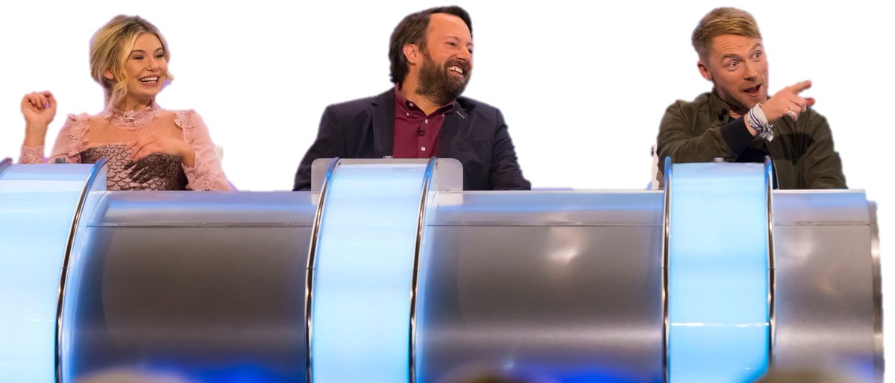
Guess if it is a lie or the truth.

Slide 7
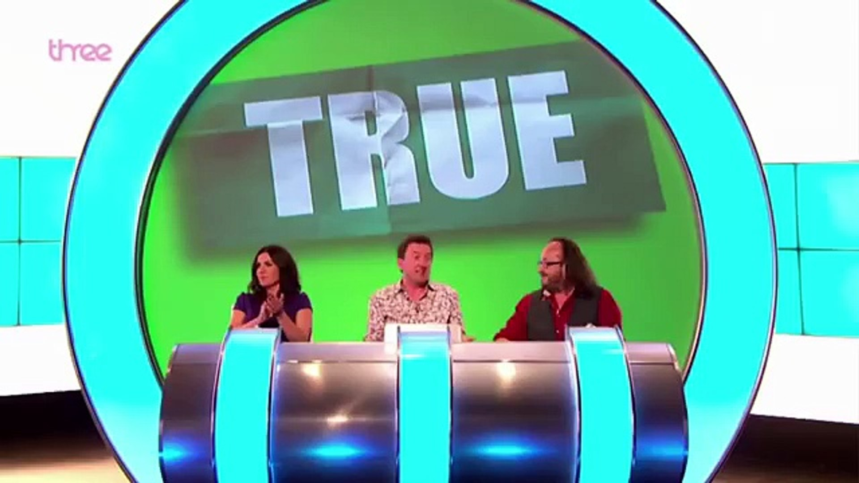
Reveal the answer.

Slide 8
One team:
Make a statement – truth or lie
The other players can ask questions
If it is a truth, you may not lie, but you can be misleading
If it is a lie, you can say anything to convince the others
Guess if it is a truth or lie -> reveal the answer

Slide 9
Would I Lie to You?

Slide 11
Round 1

Slide 12
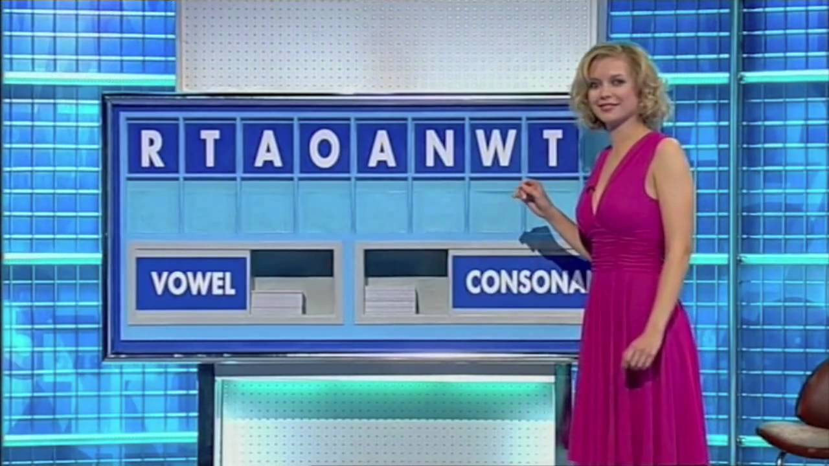

Slide 13
LETTERS
Choose the 9 letters randomly
At least 3 vowels and 3 consonants

Slide 14
LETTERS
Create the longest word
2 minutes

Slide 15
Round 2

Slide 16
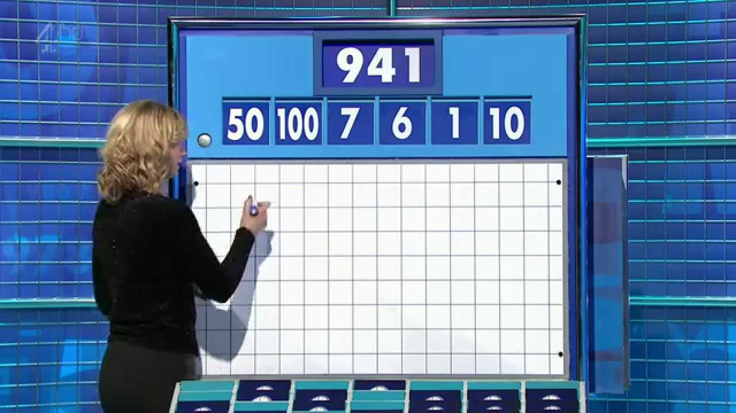

Slide 17
NUMBERS
Choose the 6 numbers randomly
Small numbers (1-10)
Large numbers (25, 50, 75, 100)

Slide 18
NUMBERS
Make a math equation
Only use a number once
add, subtract, multiply, divide

Slide 19
NUMBERS
How close was your final answer?
Closest is the winner

Slide 20
Round 3

Slide 21
H
Y
M
N
B
O
O
K

Slide 22
CONUNDRUM
First to rearrange the letters
Anagram
First correct

Slide 23
T
H
E
Y
S
E
E
T
H
E
E
Y
E
S

Slide 24
T
E
A
C
H
E
R
S
C
H
E
A
T
E
R
S

Slide 25
O
T
A
K
E
D
O
W
N
T
A
E
K
W
O
N
D
O

