Slide 1
2021
STT

Slide 2
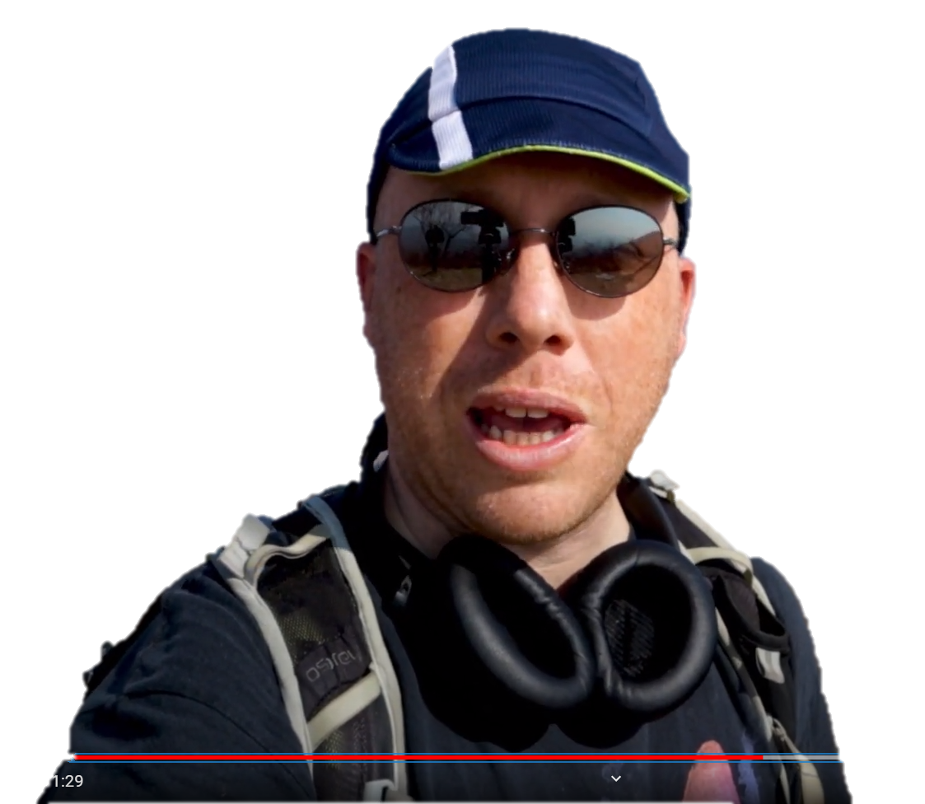
Tim

Slide 3
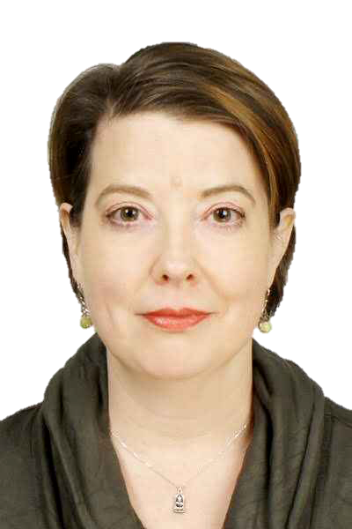
jessamine

Slide 4
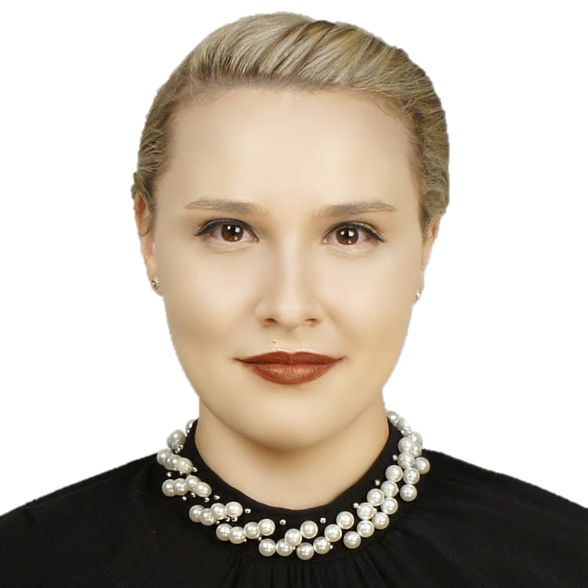
suri

Slide 5
picture
Hidden

Slide 7
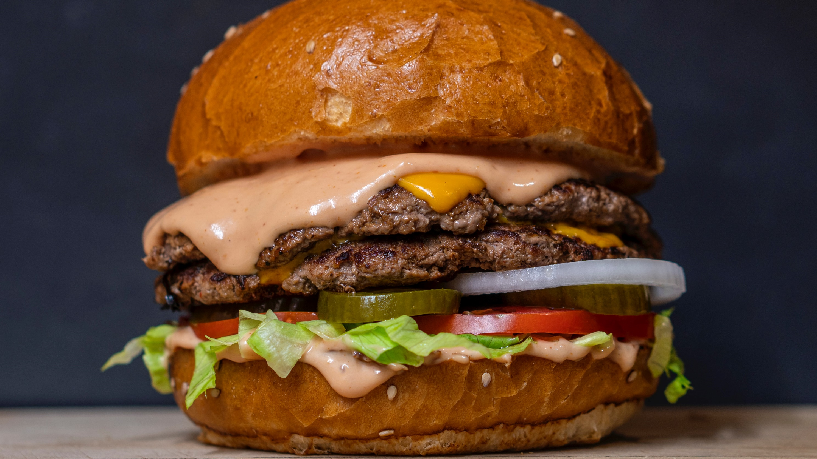

Slide 9
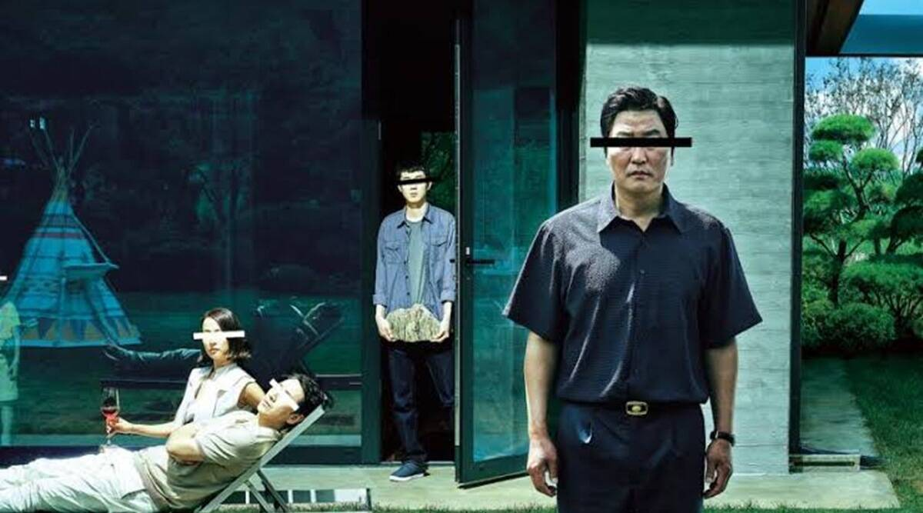

Slide 10
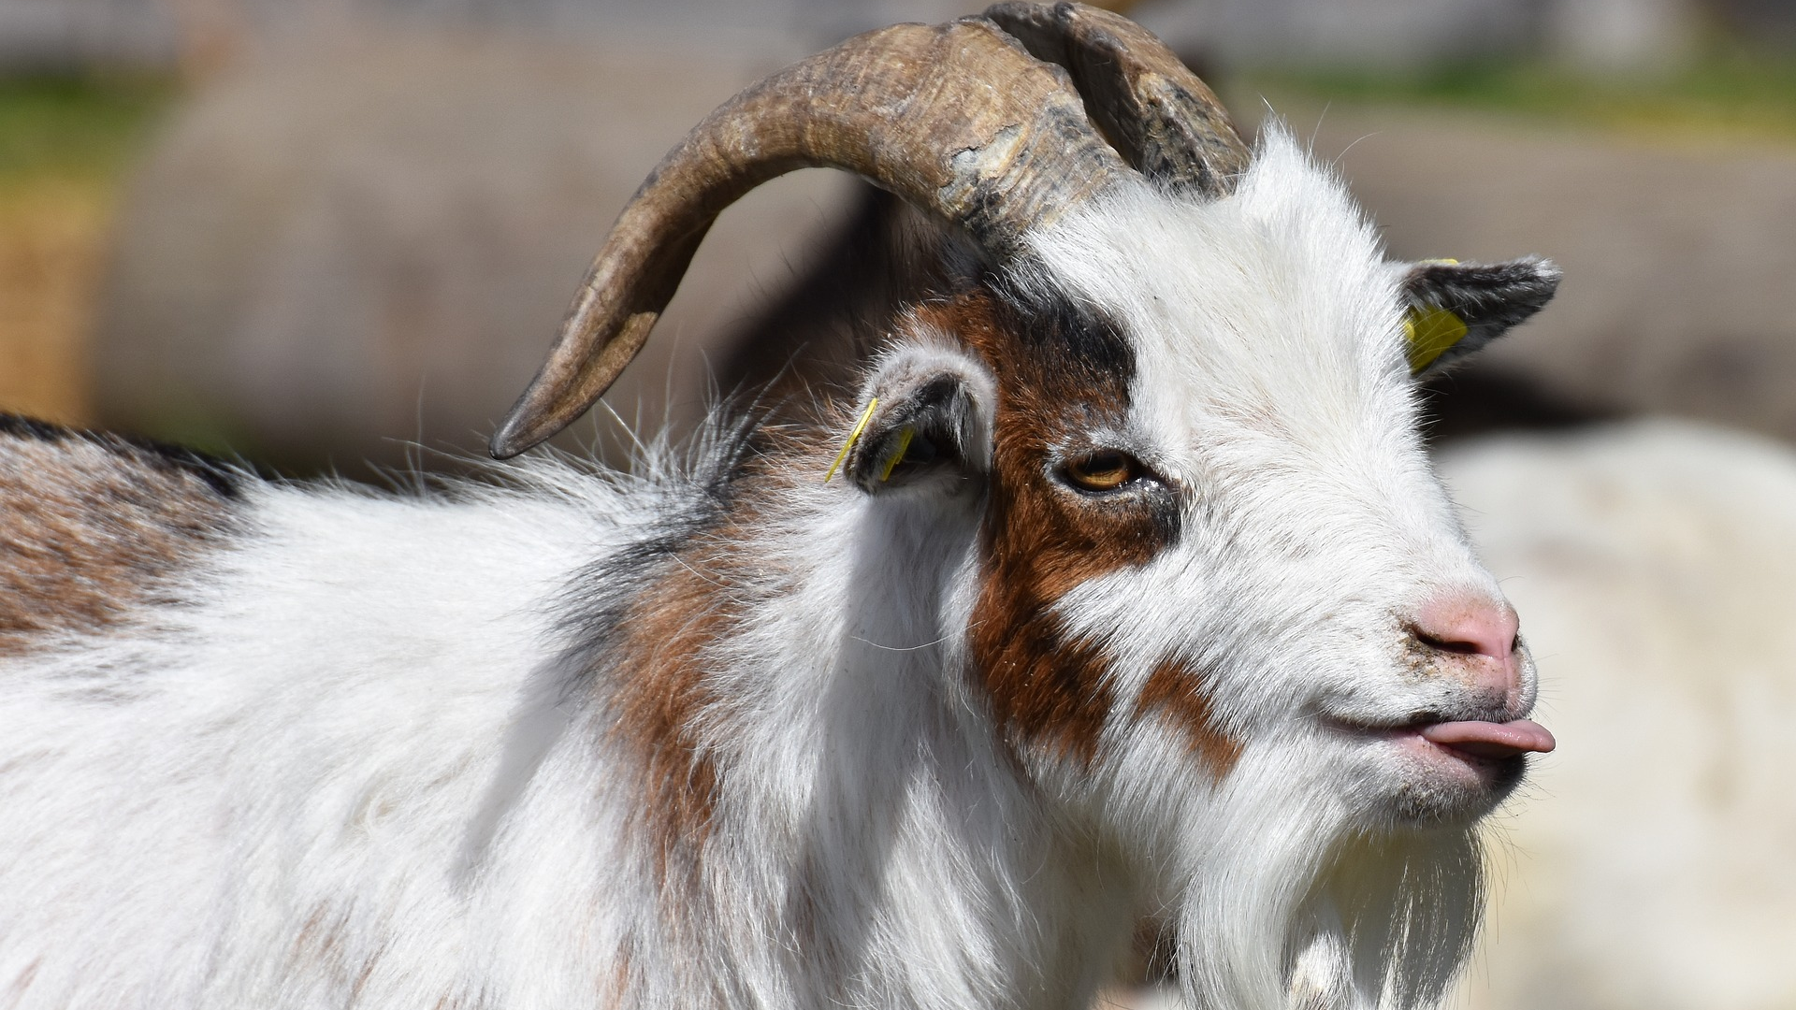

Slide 11
google
classroom

Slide 12
ESSENTIAL

Slide 13
Etiquette
Turn on your camera.
Mute the microphone (unless speaking)
Find a quiet place.
Tell others you’re on camera.

Slide 14
Extensions
Nod – raise hand
Grid View – shows all participants

Slide 15
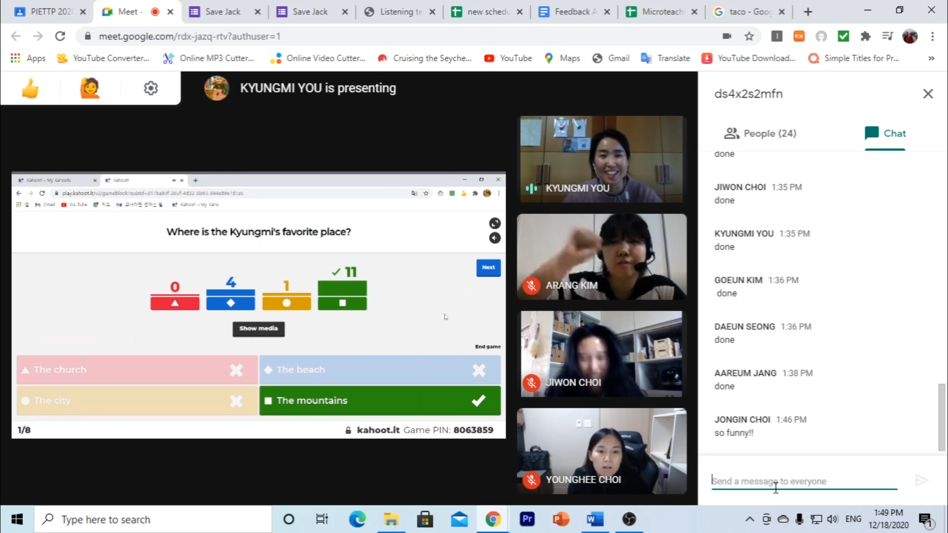
TRAINEE
TRAINEE
TRAINEE
TRAINEE
TRAINEE
TRAINEE

Slide 16
Submitting documents

Slide 17
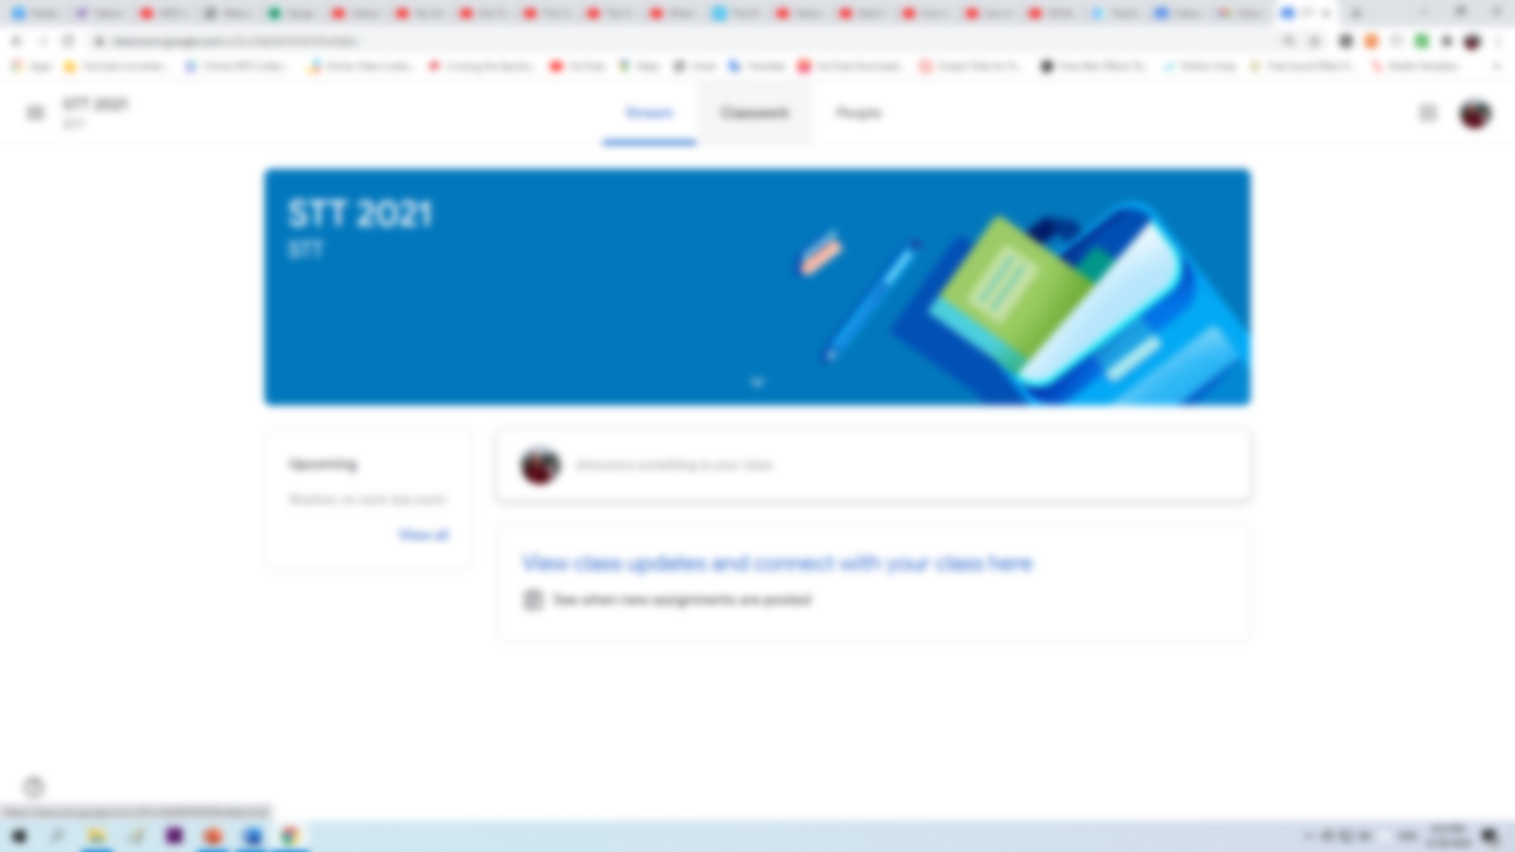
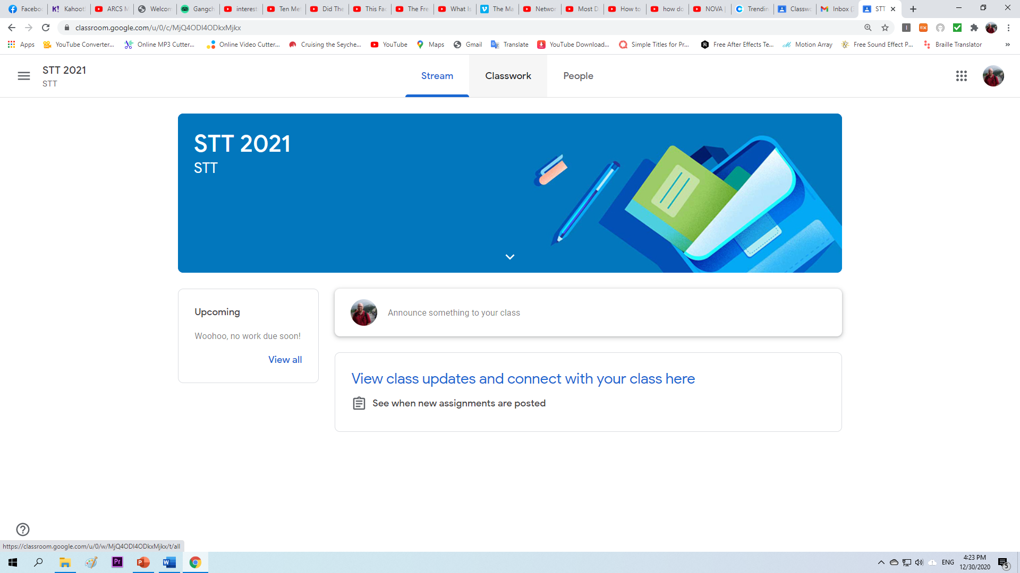

Slide 18
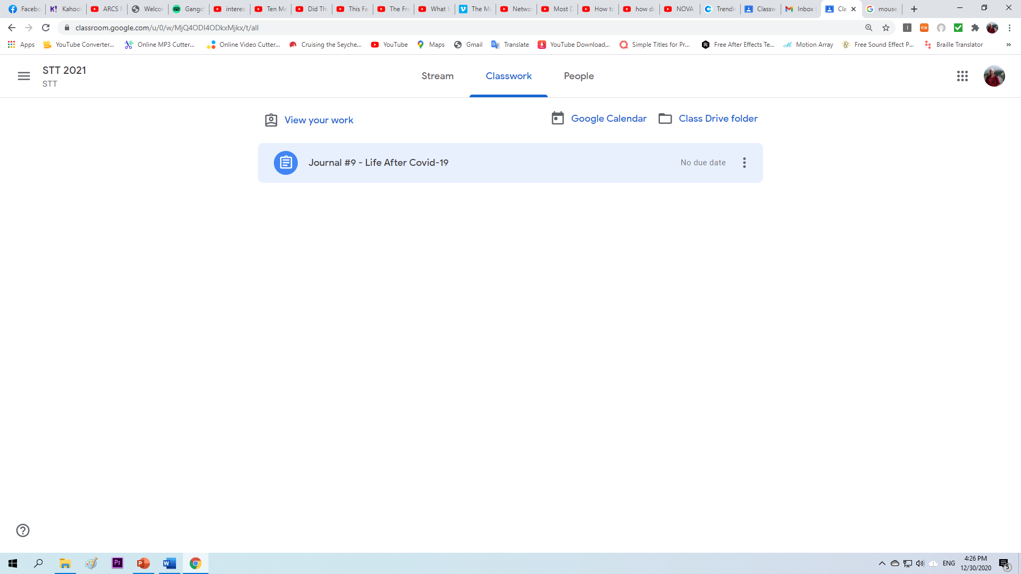

Slide 19
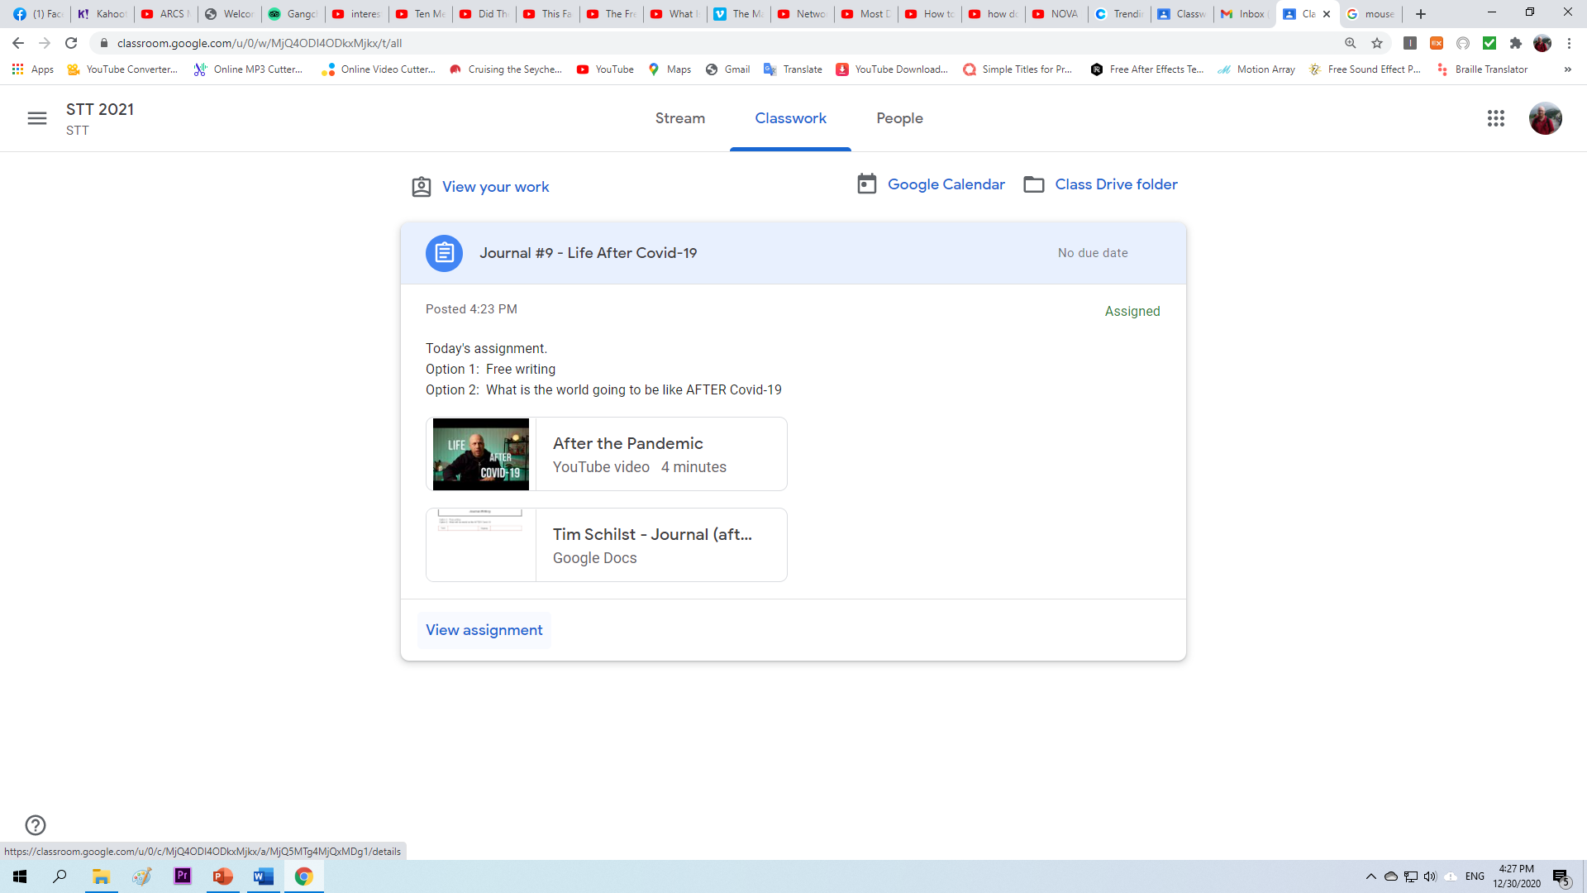

Slide 20
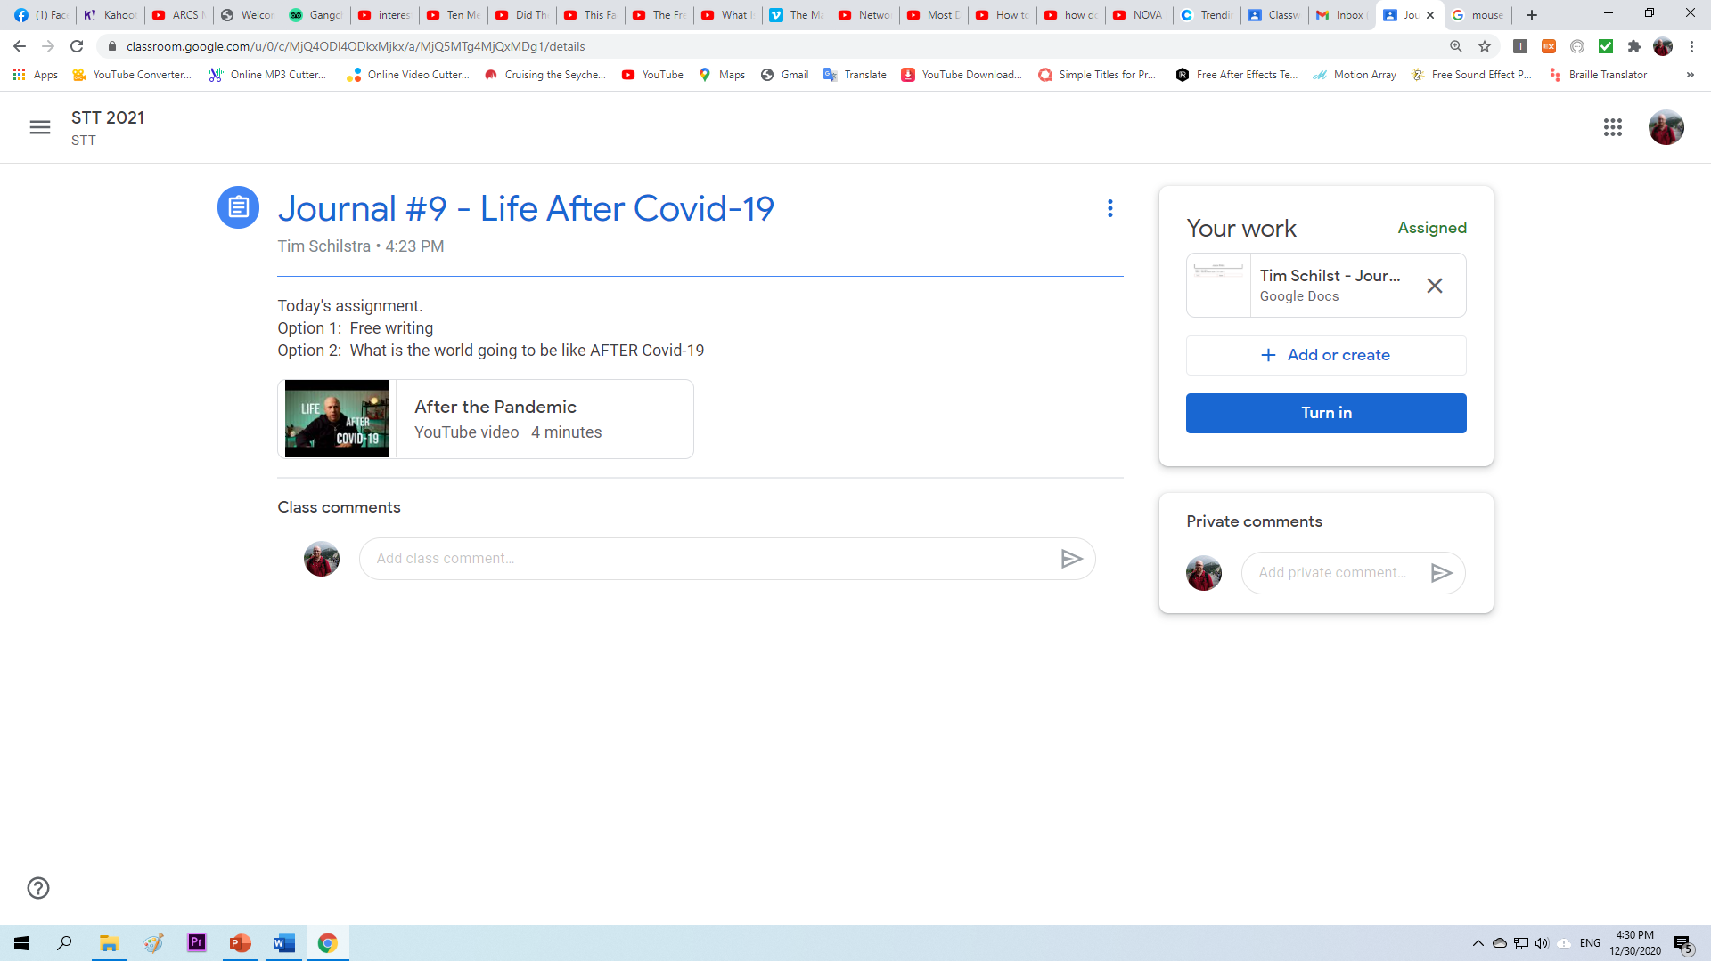

Slide 21
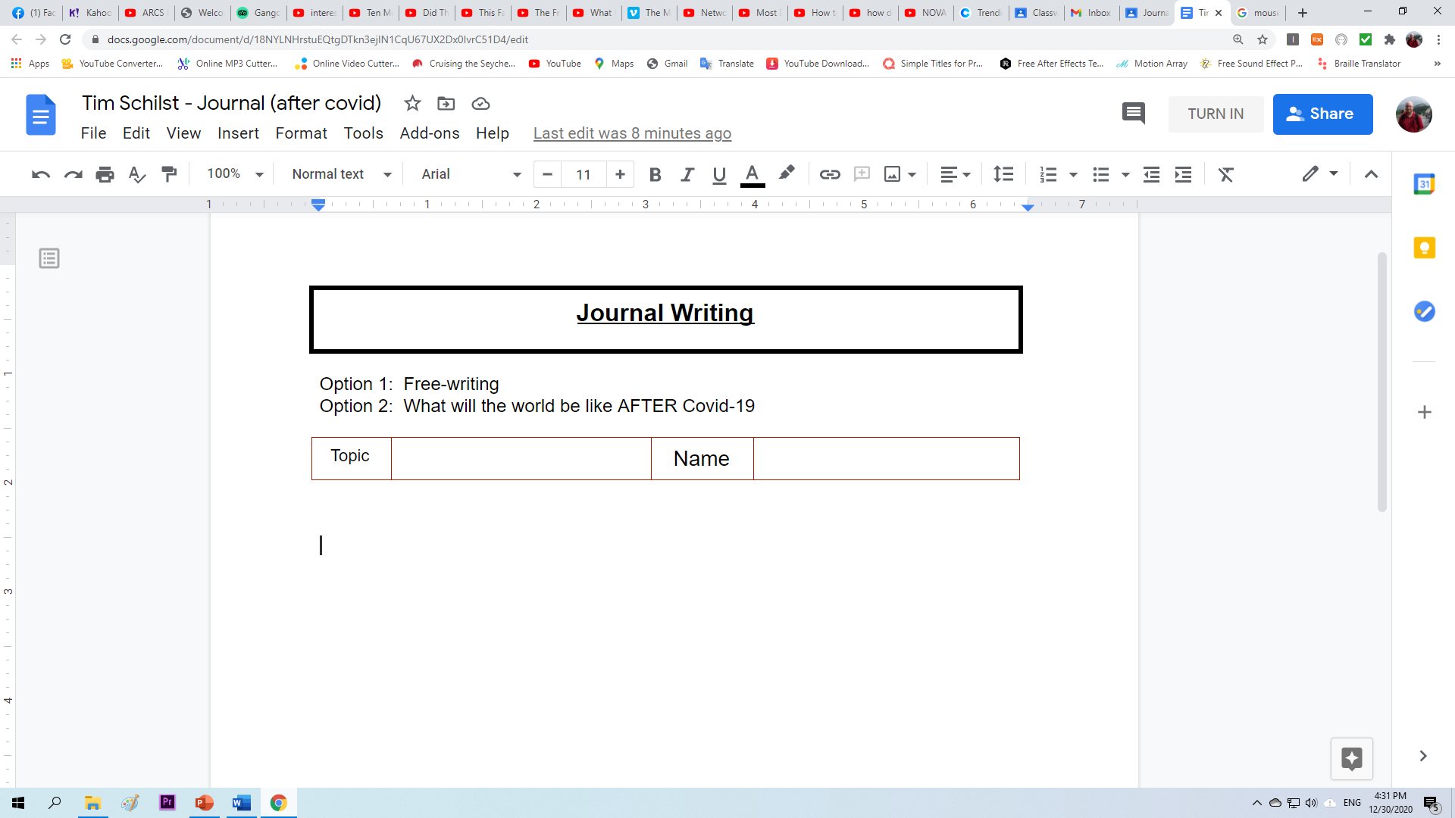
After Covid-19
Tim
I believe we will all live happily ever after.

Slide 22
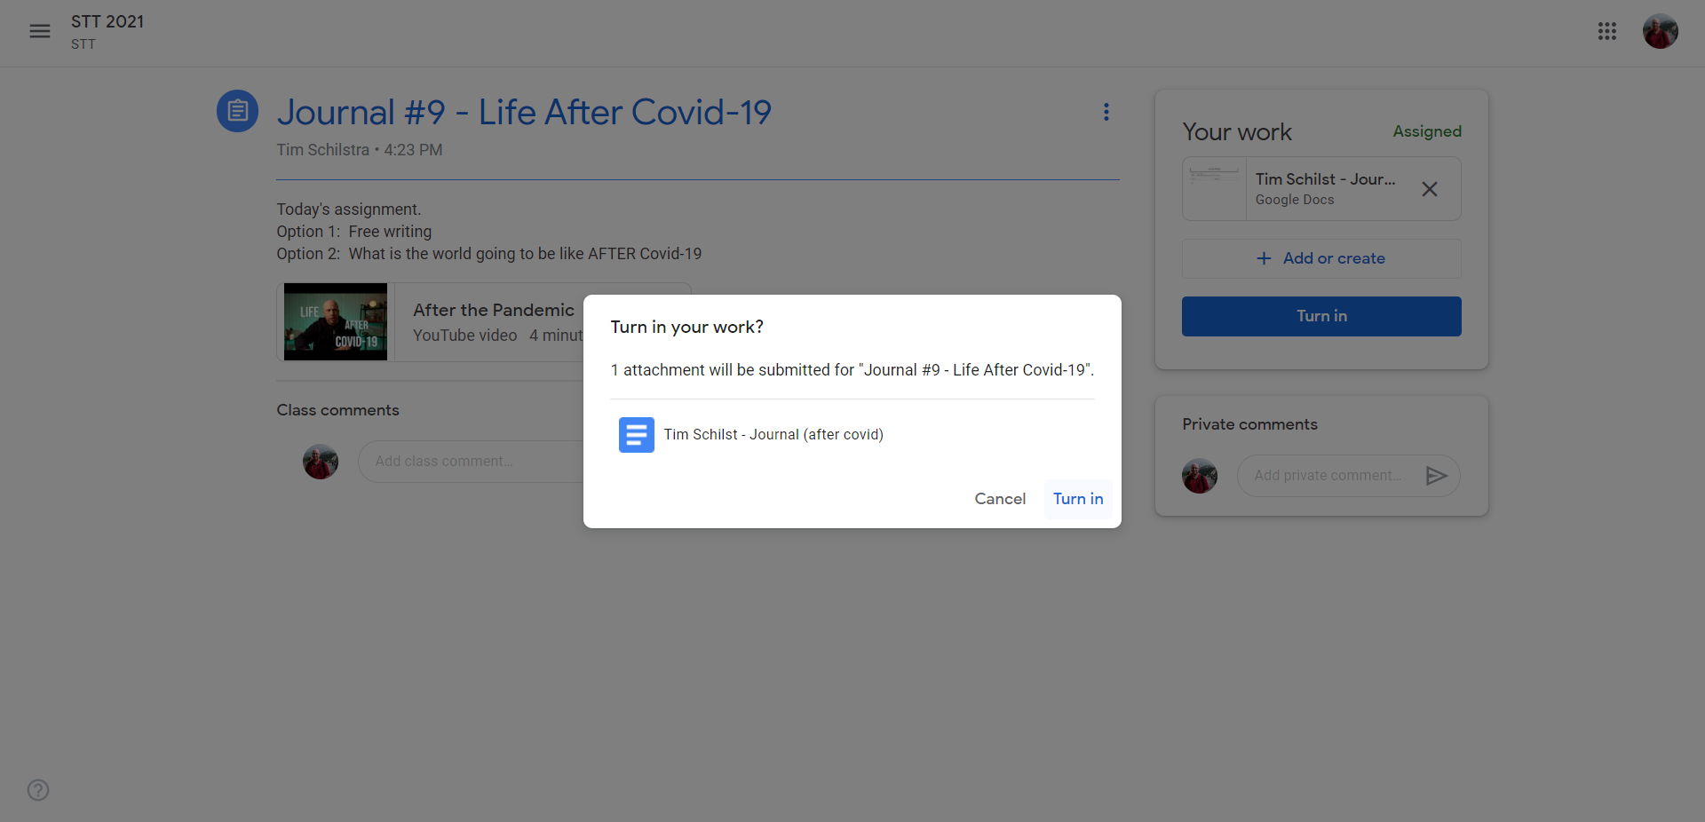

Slide 23
Alternatively

Slide 24
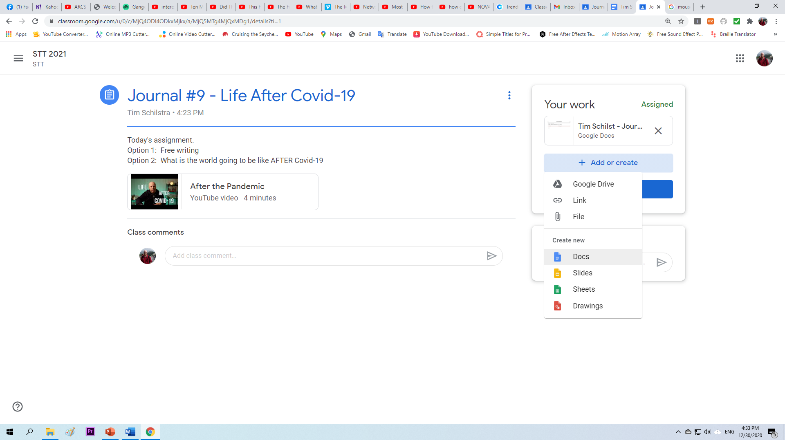

Slide 25
Breakout Groups

Slide 26
Breakout Groups
Links provided.
Find your name
Click the link
The teacher can hear EVERYONE, so please type your question

