Slide 1
Life Lessons from 100 year olds
https://www.youtube.com/watch?v=9AThycGCakk&list=PL9i6nLIBlfKvunIYrc60Hsw0vNQsANk5n&index=13&t=0s

Slide 2
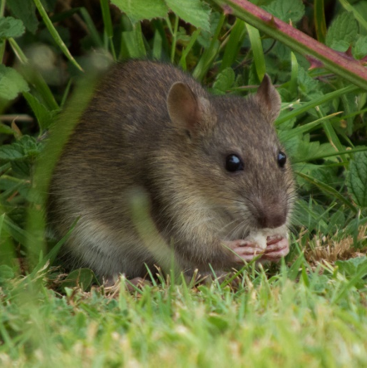
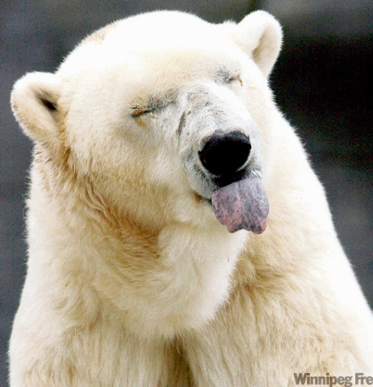
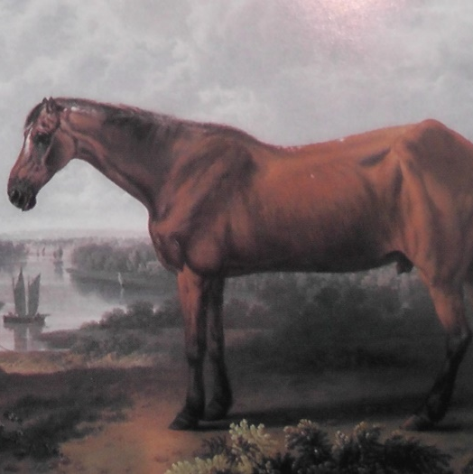
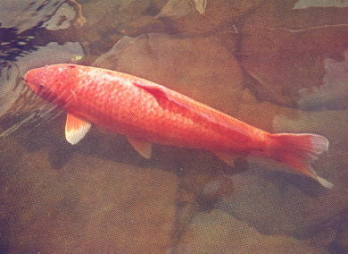
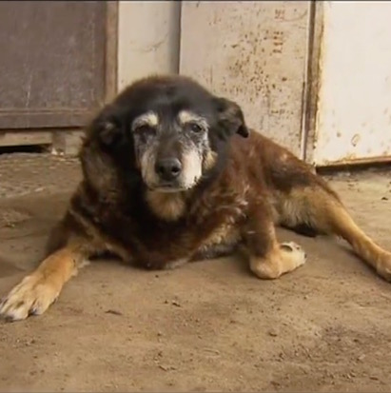
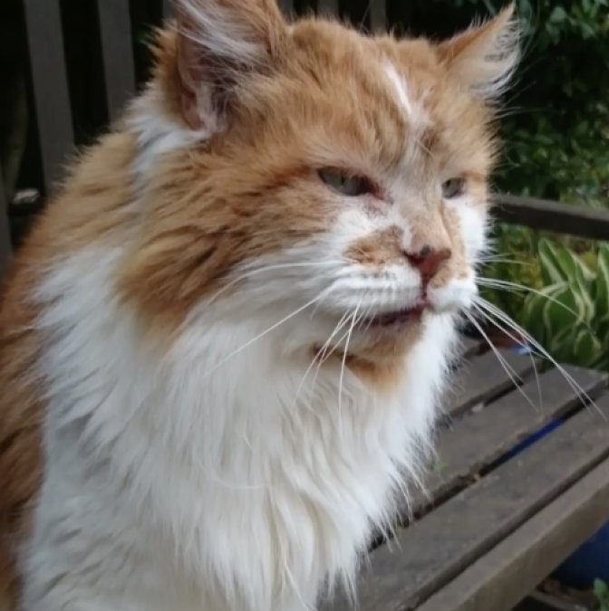
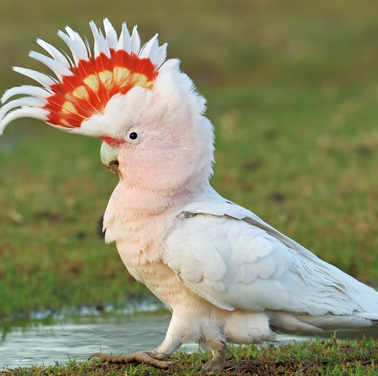
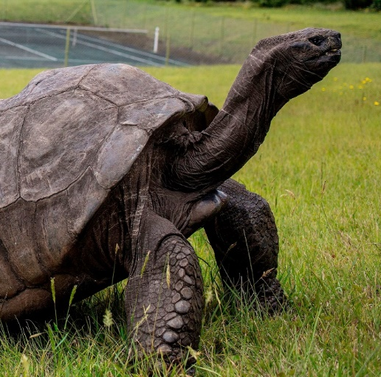

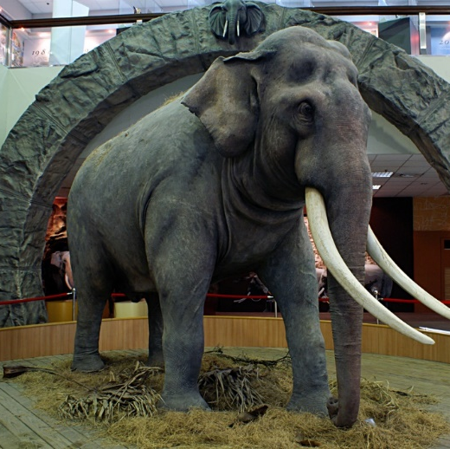
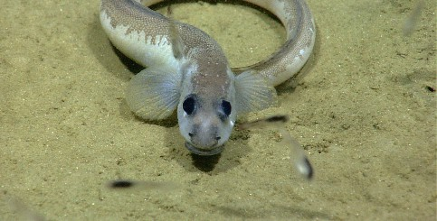
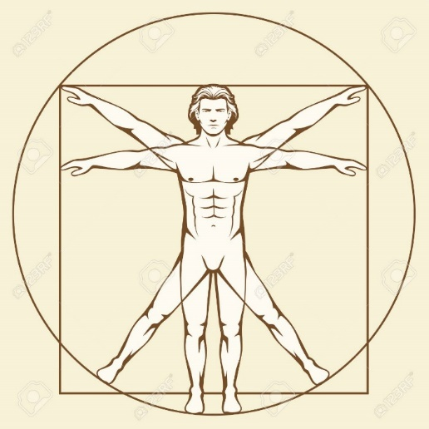
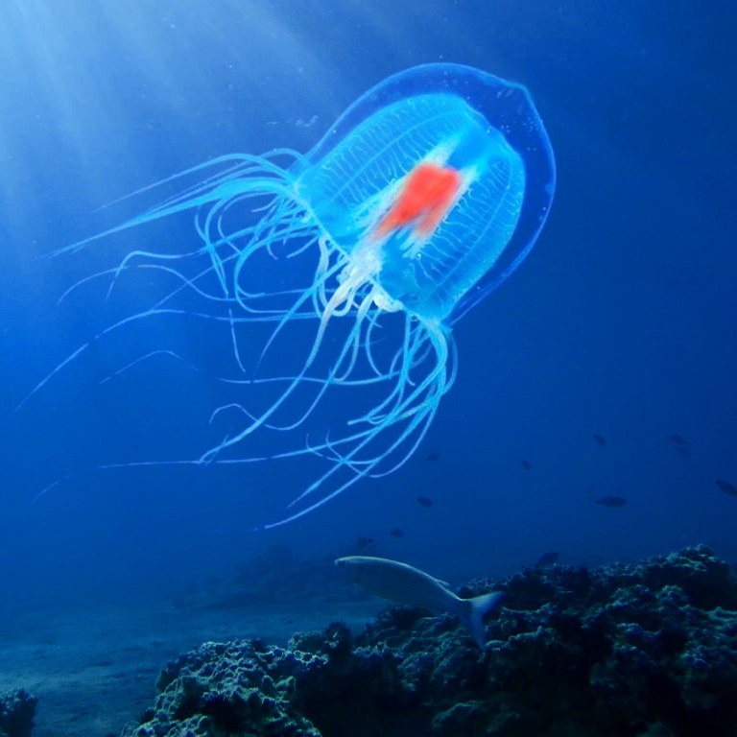
4 years
42 years
62 years
226 years
29 years
38 years
82 years
187+
years
86 years
150 years
122 years
∞

Slide 3
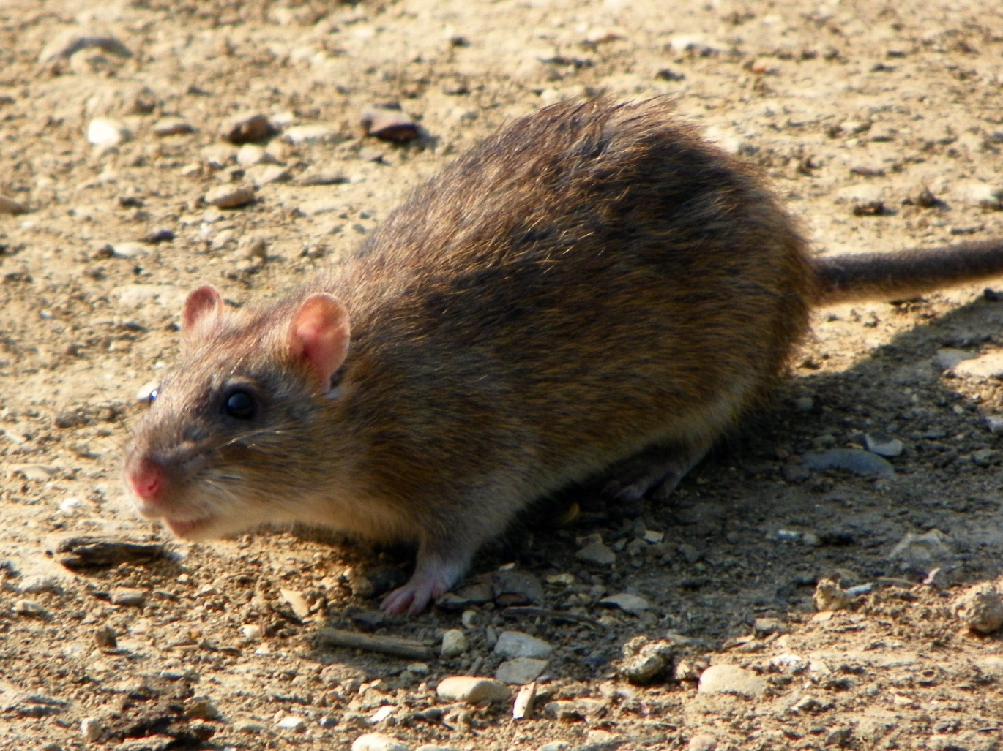
Brown Rat
In the wild <1 year
Used for experiments

Slide 4
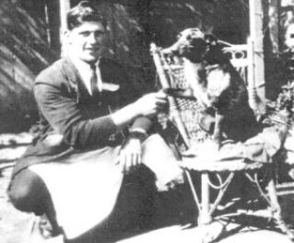
Bluey
1910 - 1939
Australian Cattle Dog

Slide 5
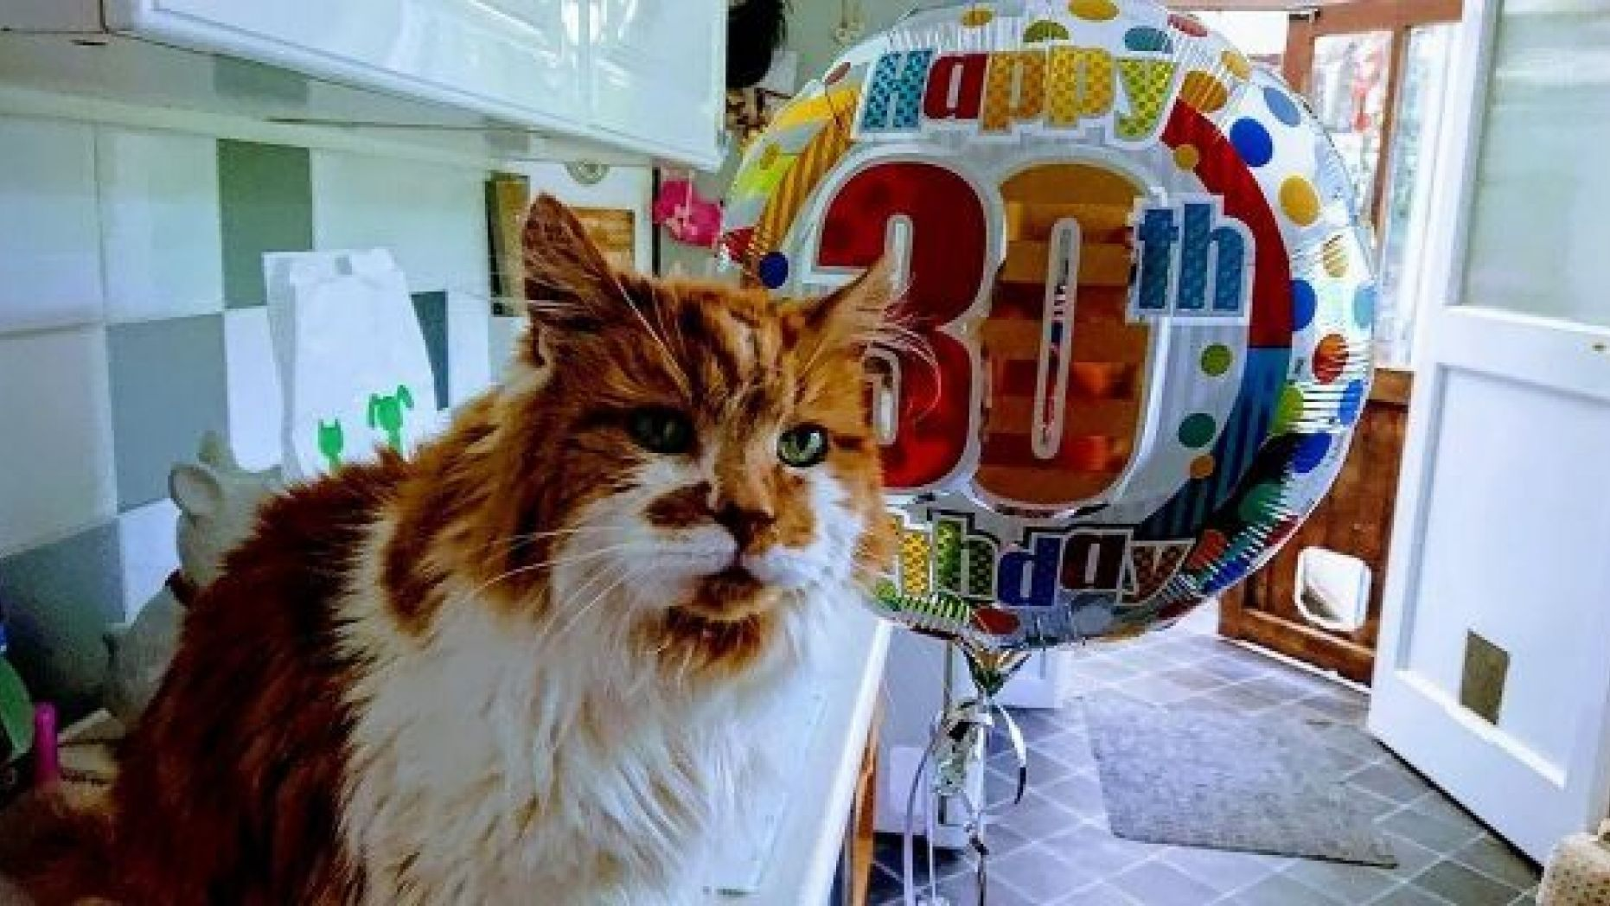
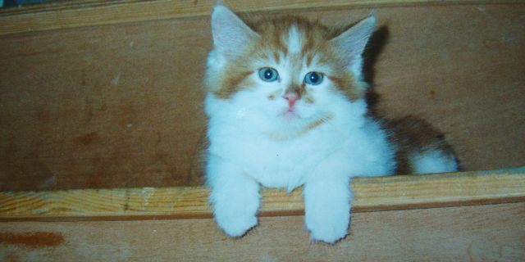
Creme Puff
1967 – 2005
“167 human years”

Slide 6
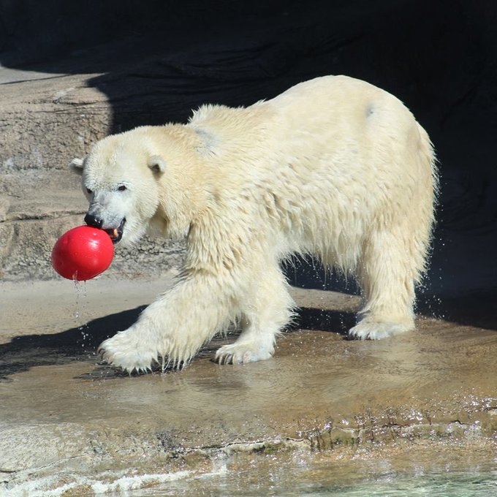
Coldilocks
1980 - 2018
Philadelphia Zoo

Slide 7
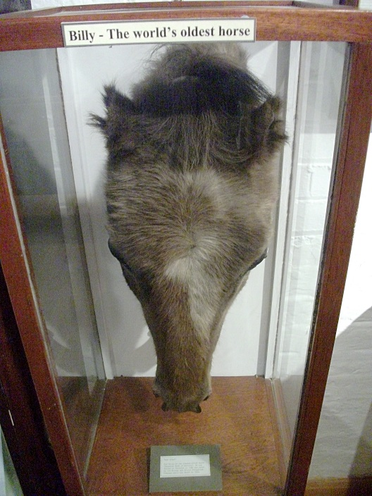
Old Billy
1760 – 1822
England
Barge horse

Slide 8
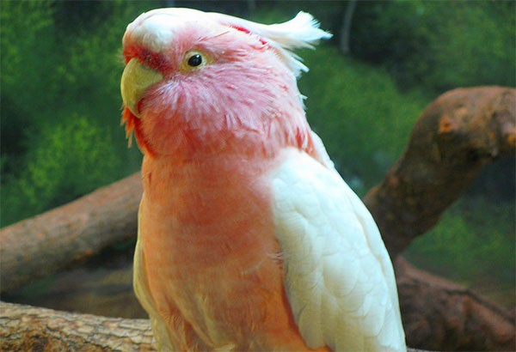
Cookie
At least 82 years and 88 days old
Brookfield Zoo (1934)
Died 2016

Slide 9
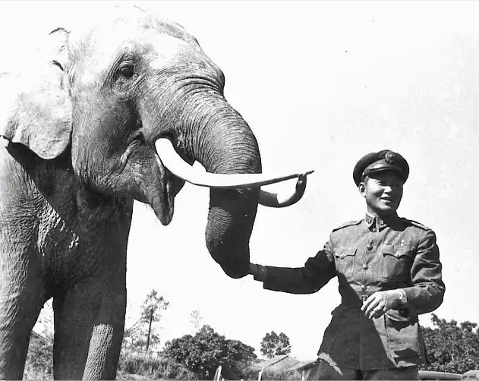
Lin Wang
1917-2003
Asian elephant
Taiwan

Slide 10
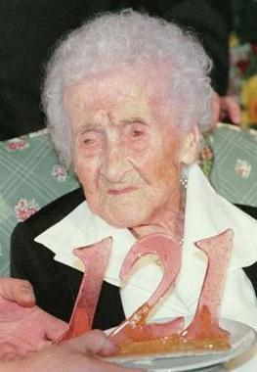
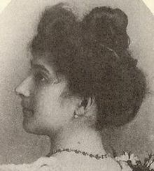
Jeanne Calment
1875 - 1994
France

Slide 11
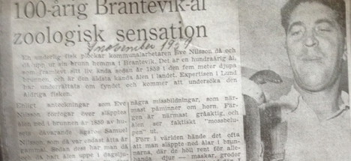
European Eel
Sweden
Lived in a well
Eels were used to eat flies and creatures that fall into the well… it was for sanitation.

Slide 12
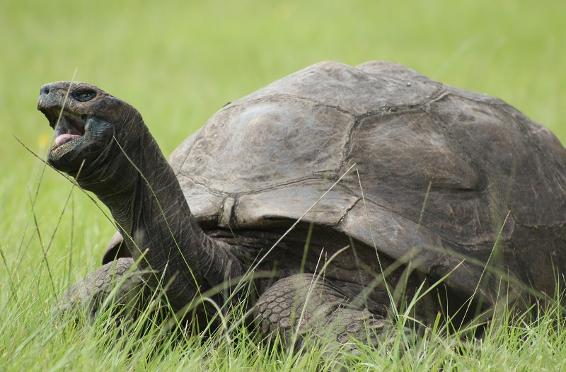
Jonathan
1832 - (still alive)
Seychelles Giant Tortoise
Lives in Saint Helena

Slide 13
Hanako
1751 – 1977
Scarlett koi
“flower girl”

Slide 14
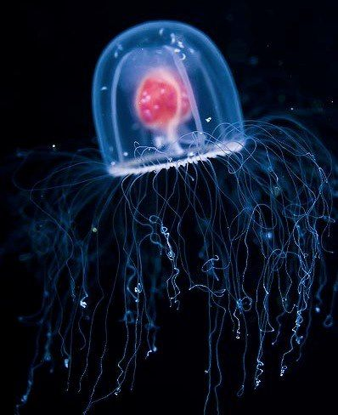
Immortal Jellyfish
Turritopsis dohrnii medusa
Biologically immortal
After reproduction it returns to it’s polyp state.

Slide 15
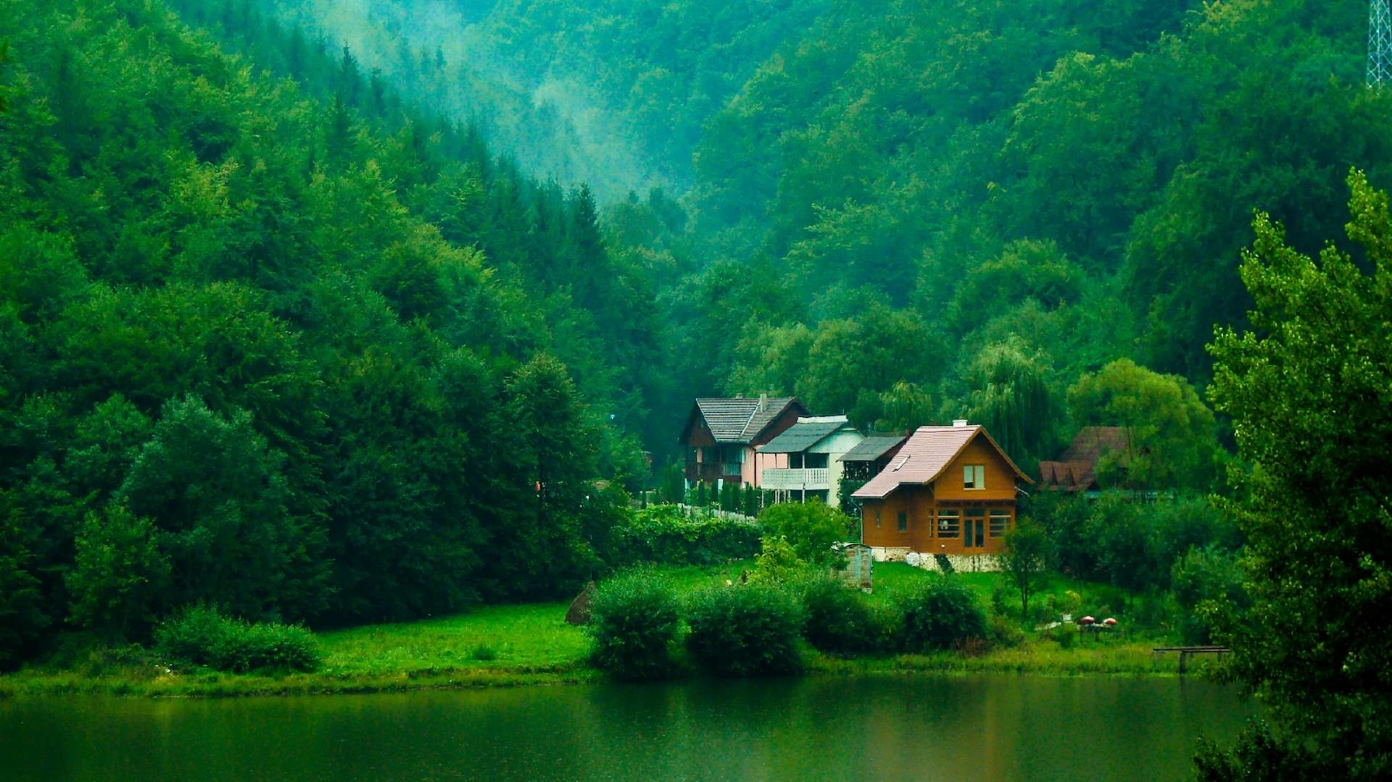
Centenarian
A person over 100 years old.

Slide 16
Supercentenarian
A person over 110 years old.

Slide 17
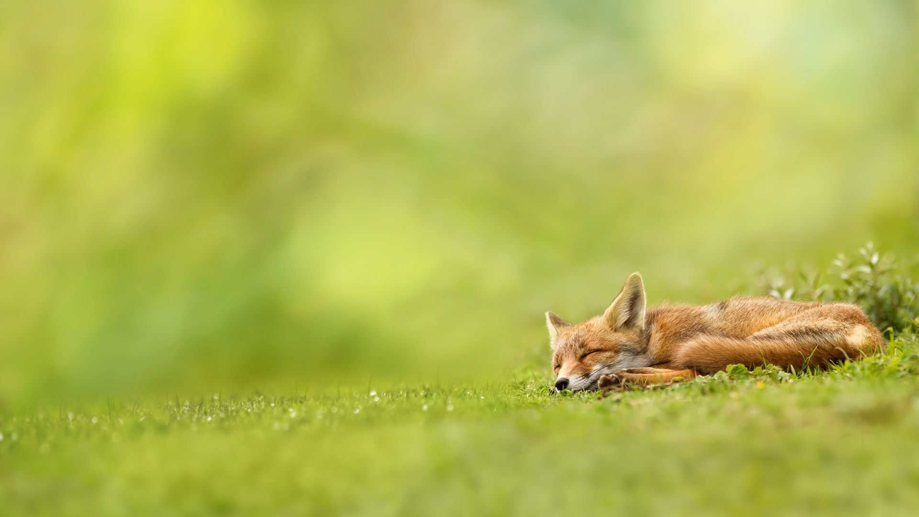
What is the key to a long and happy life?

Slide 18
Clifford Crozier

Slide 19


Slide 20

How old is Cliff?
101 years old

Slide 21
Where is he from?
Cheshire, England

Slide 22
How long has he been retired?
38 years

Slide 23
How is he robbing the government?
Old age pension.

Slide 24
What is his secret to living?
Live for the day.
(a spot of whiskey)

Slide 25
Emilia Tereza Harper

Slide 26
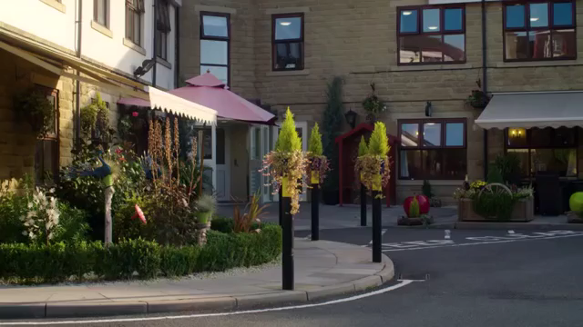

Slide 27
How old is she?
103 years old.

Slide 28
Why is her name “Tereza”
She’s Czechoslovakian.

Slide 29
What does Emilia like to do?
Mix the people she met.
Play matchmaker.

Slide 30
Why was she living with her
Grandparents?
He was a prisoner of war.

Slide 31
What makes her happy?
Talking to people
Doing things
Going out shopping

Slide 32
Why can she live happily forever?
Lovely memories

Slide 33
“I’ve never been unlucky.
Touch wood.”
To avoid bad luck.

Slide 34
John Millington Denerley

Slide 35


Slide 36
How old is John?
102.5 years old

Slide 37
Where was he born?
Manchester, UK

Slide 38
What was John’s job?
Pharmacist

Slide 39
Where did John climb a tower?
Sri Lanka (Sigirya)

Slide 40
“I’ve always been fond of the
water.” Why?
Yachting

Slide 41
What is the RAF?
Royal Air Force

Slide 42
What is his feeling about
fighting in the war?
It was an adventure.

Slide 43
Sometimes he would stay
awake all night, why?
Listening to jazz music.

Slide 44
How old do you feel?
https://www.youtube.com/watch?v=9AThycGCakk&list=PL9i6nLIBlfKvunIYrc60Hsw0vNQsANk5n&index=13&t=0s

Slide 45
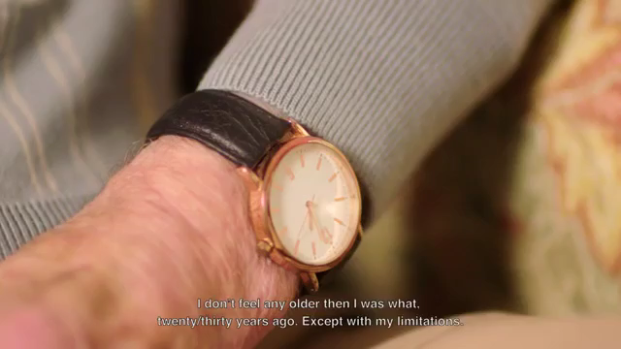

Slide 46
Relationships
https://www.youtube.com/watch?v=9AThycGCakk&list=PL9i6nLIBlfKvunIYrc60Hsw0vNQsANk5n&index=13&t=0s

Slide 47
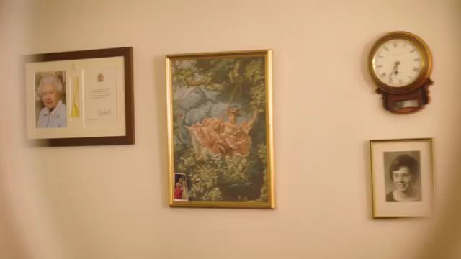

Slide 48
Did they have perfect
relationships?
No

Slide 49
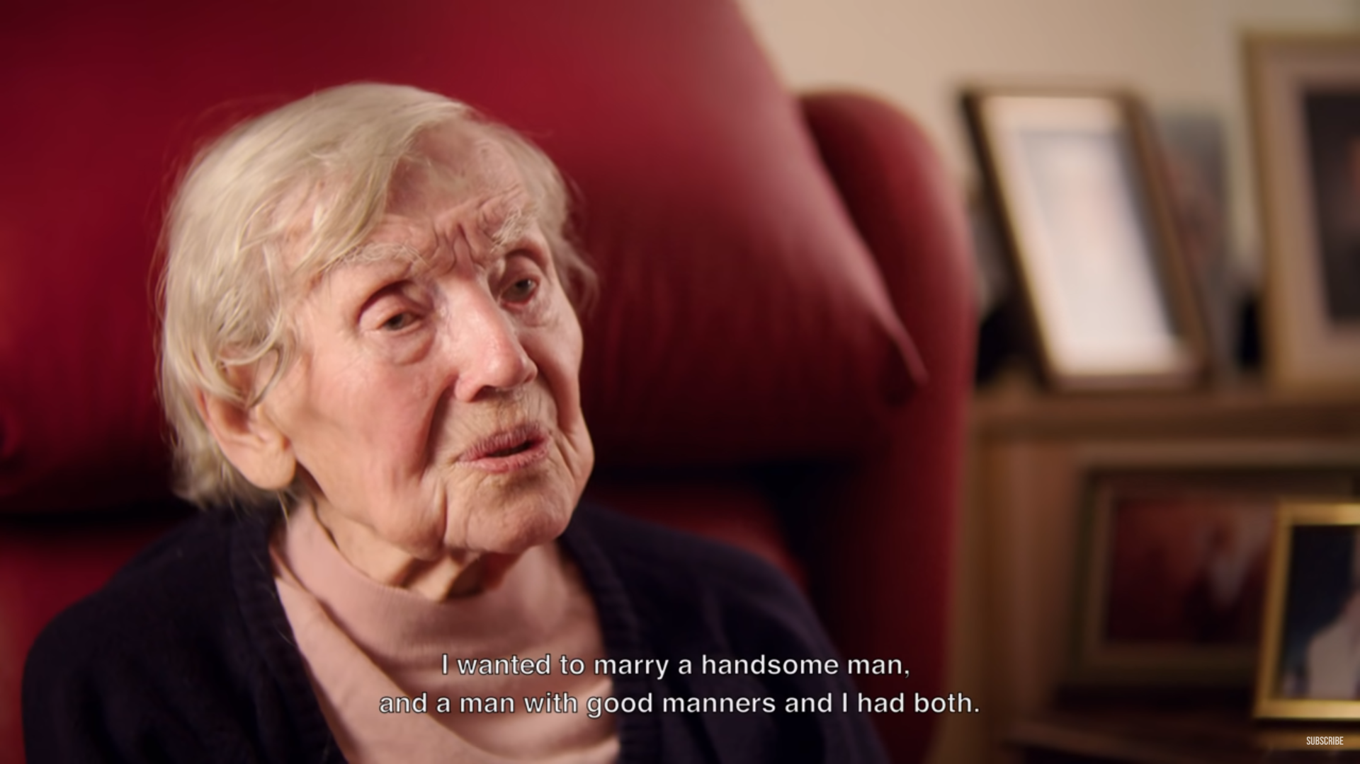

Slide 50
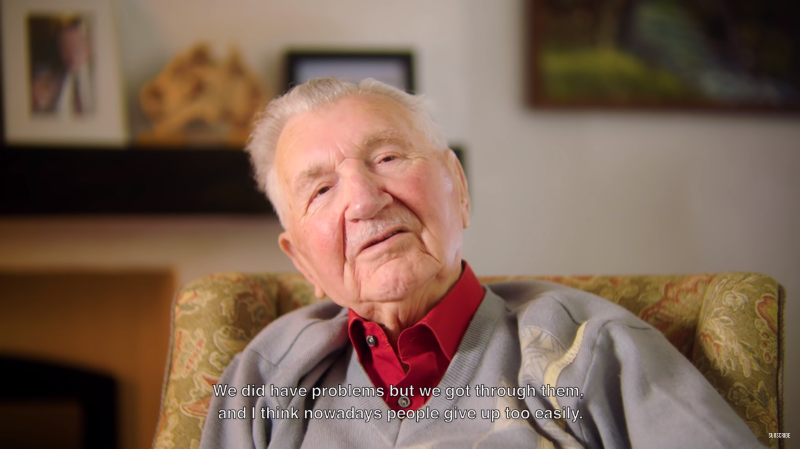

Slide 51
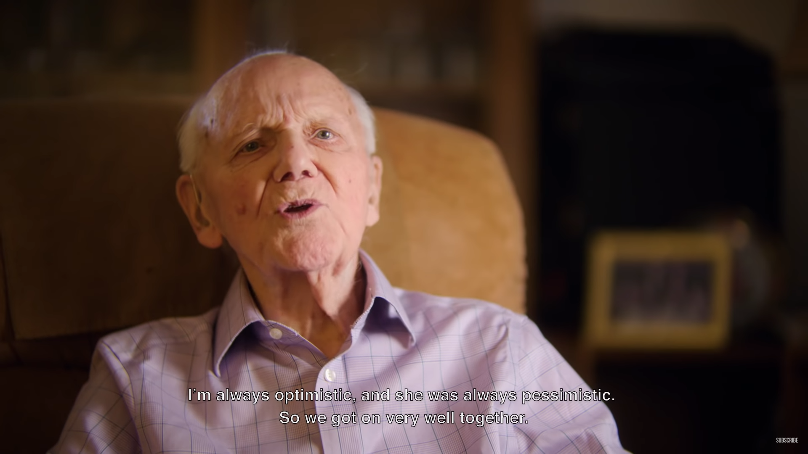

Slide 52
What relationship advice does
Emilia give?
Make the most of it.

Slide 53
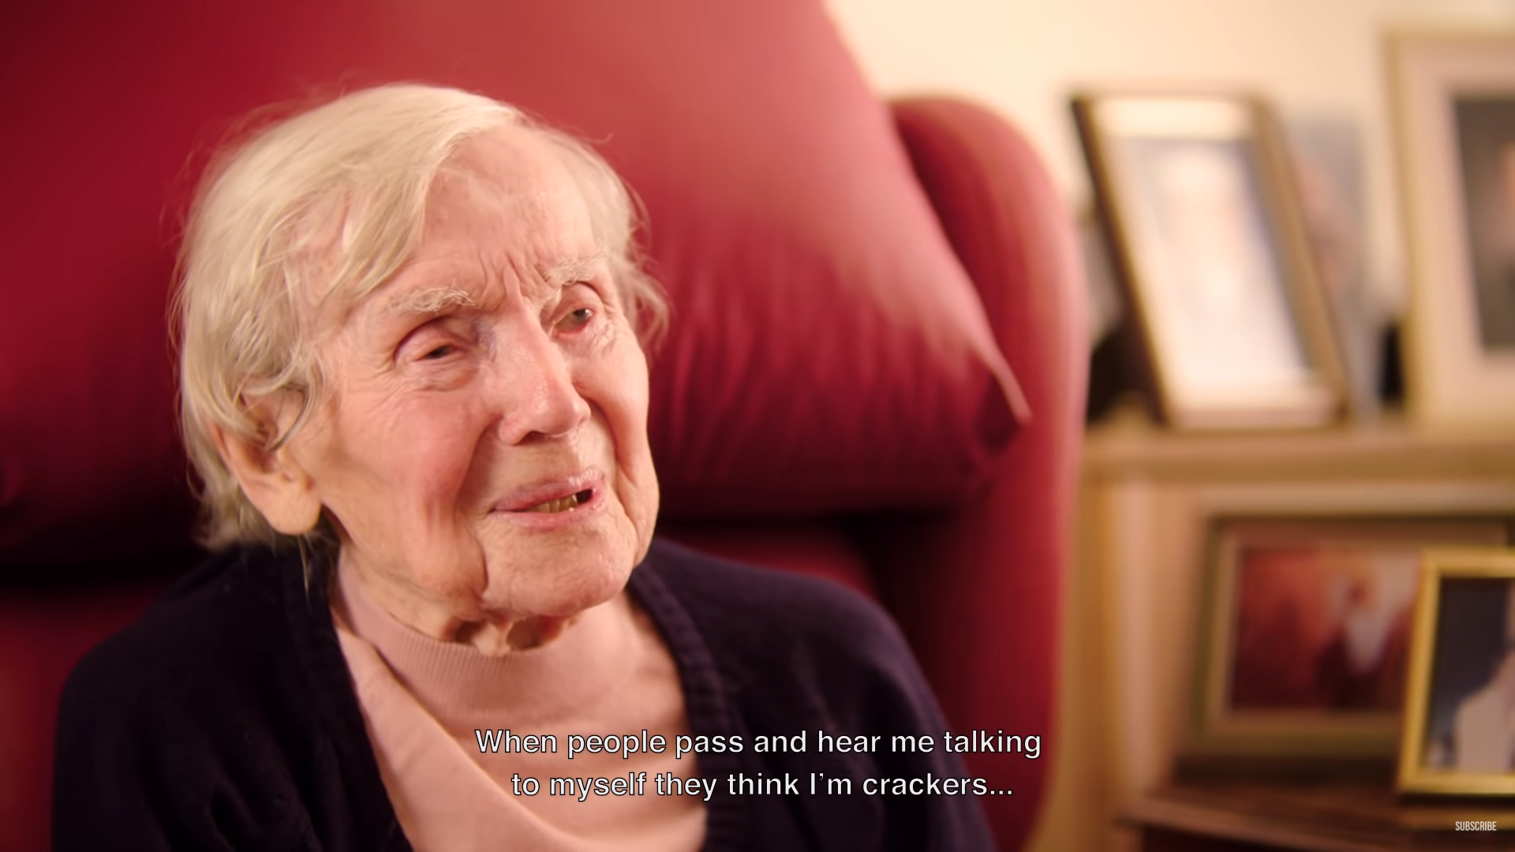

Slide 54
Regrets
https://www.youtube.com/watch?v=9AThycGCakk&list=PL9i6nLIBlfKvunIYrc60Hsw0vNQsANk5n&index=13&t=0s

Slide 55
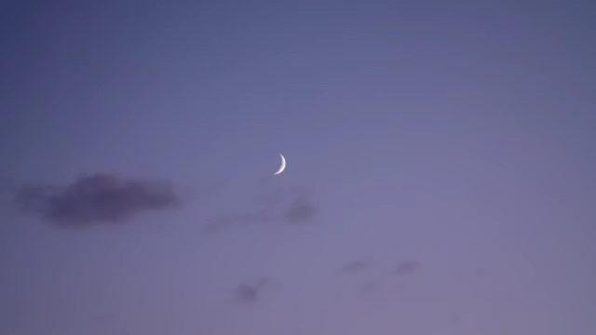

Slide 56
What are their regrets?
No regrets
Study harder
Didn’t go with his father

Slide 57
Advice
https://www.youtube.com/watch?v=9AThycGCakk&list=PL9i6nLIBlfKvunIYrc60Hsw0vNQsANk5n&index=13&t=0s

Slide 58
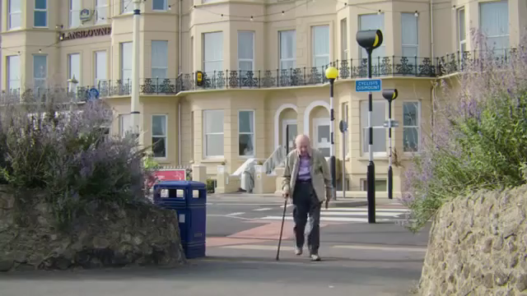

Slide 59
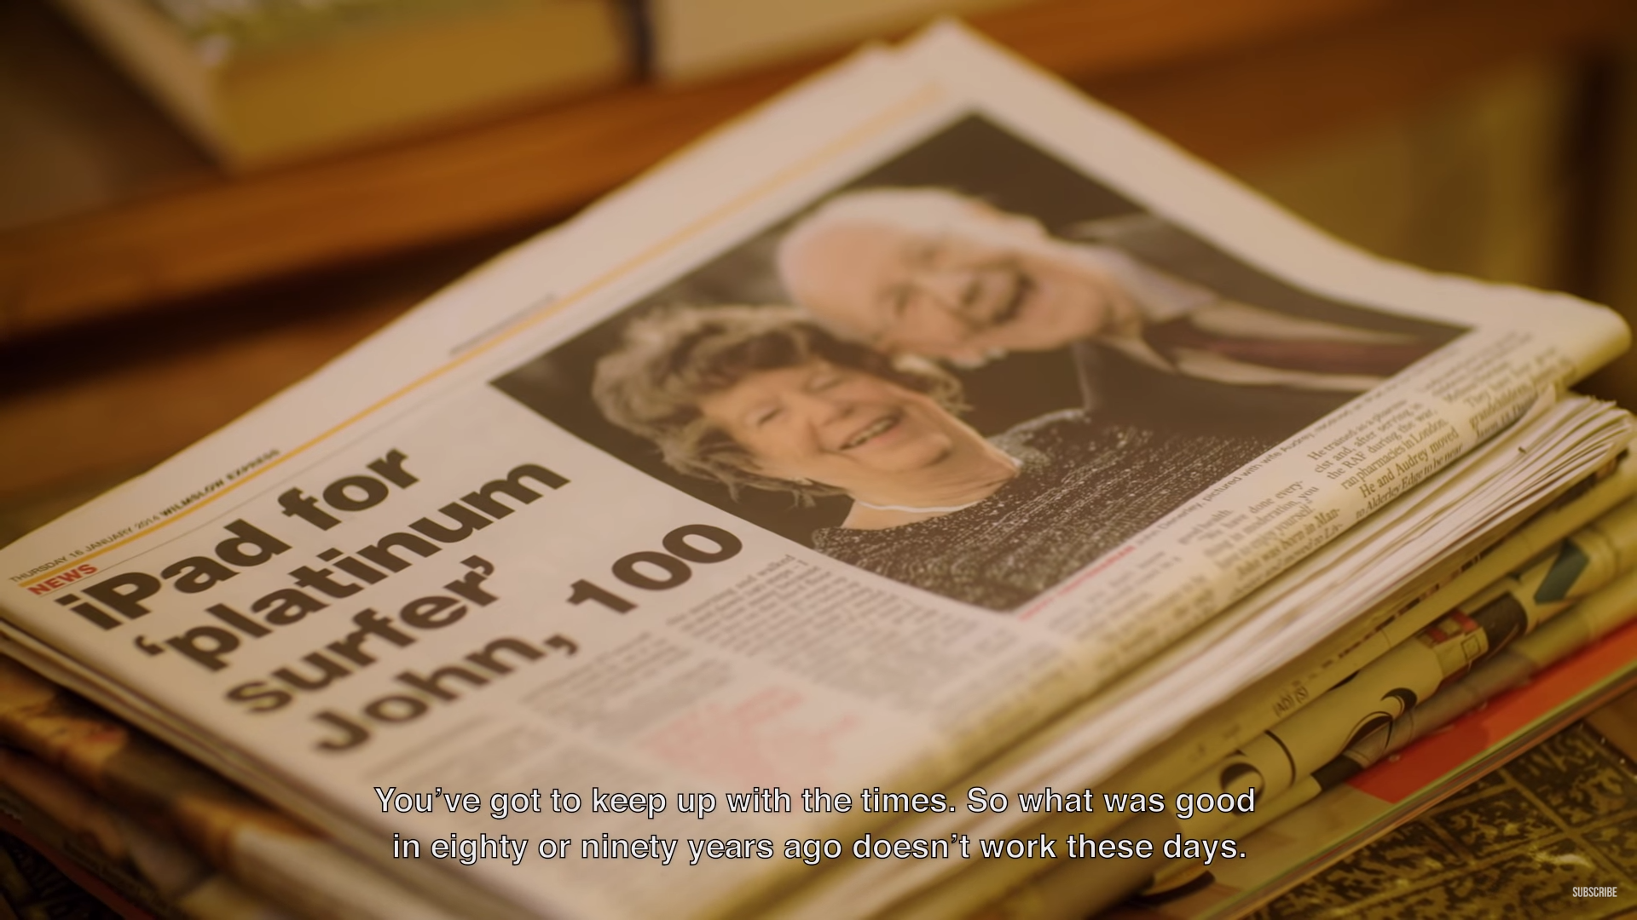

Slide 60
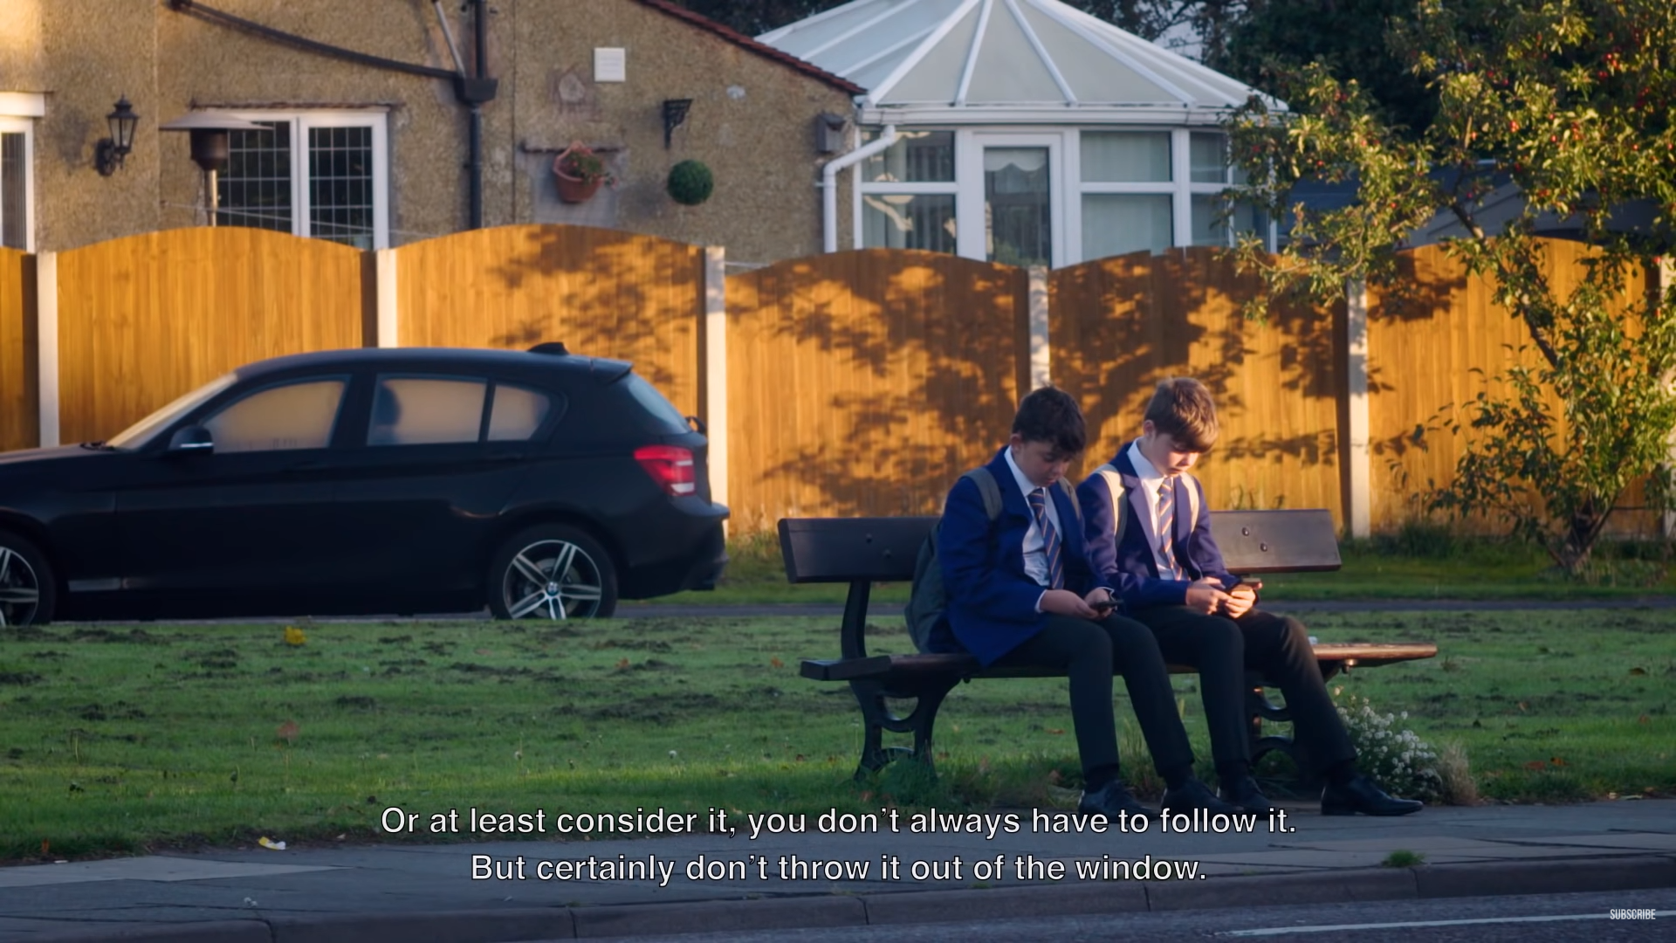

Slide 61
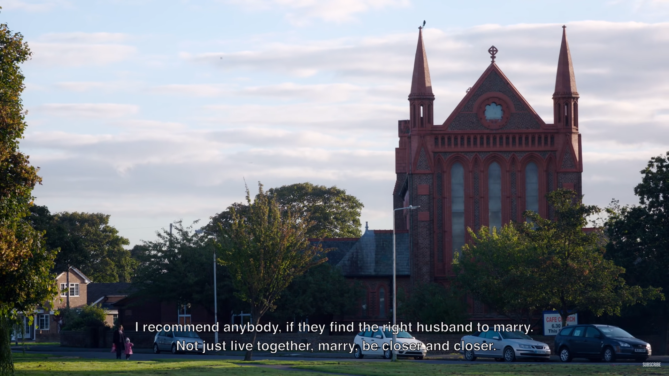

Slide 62
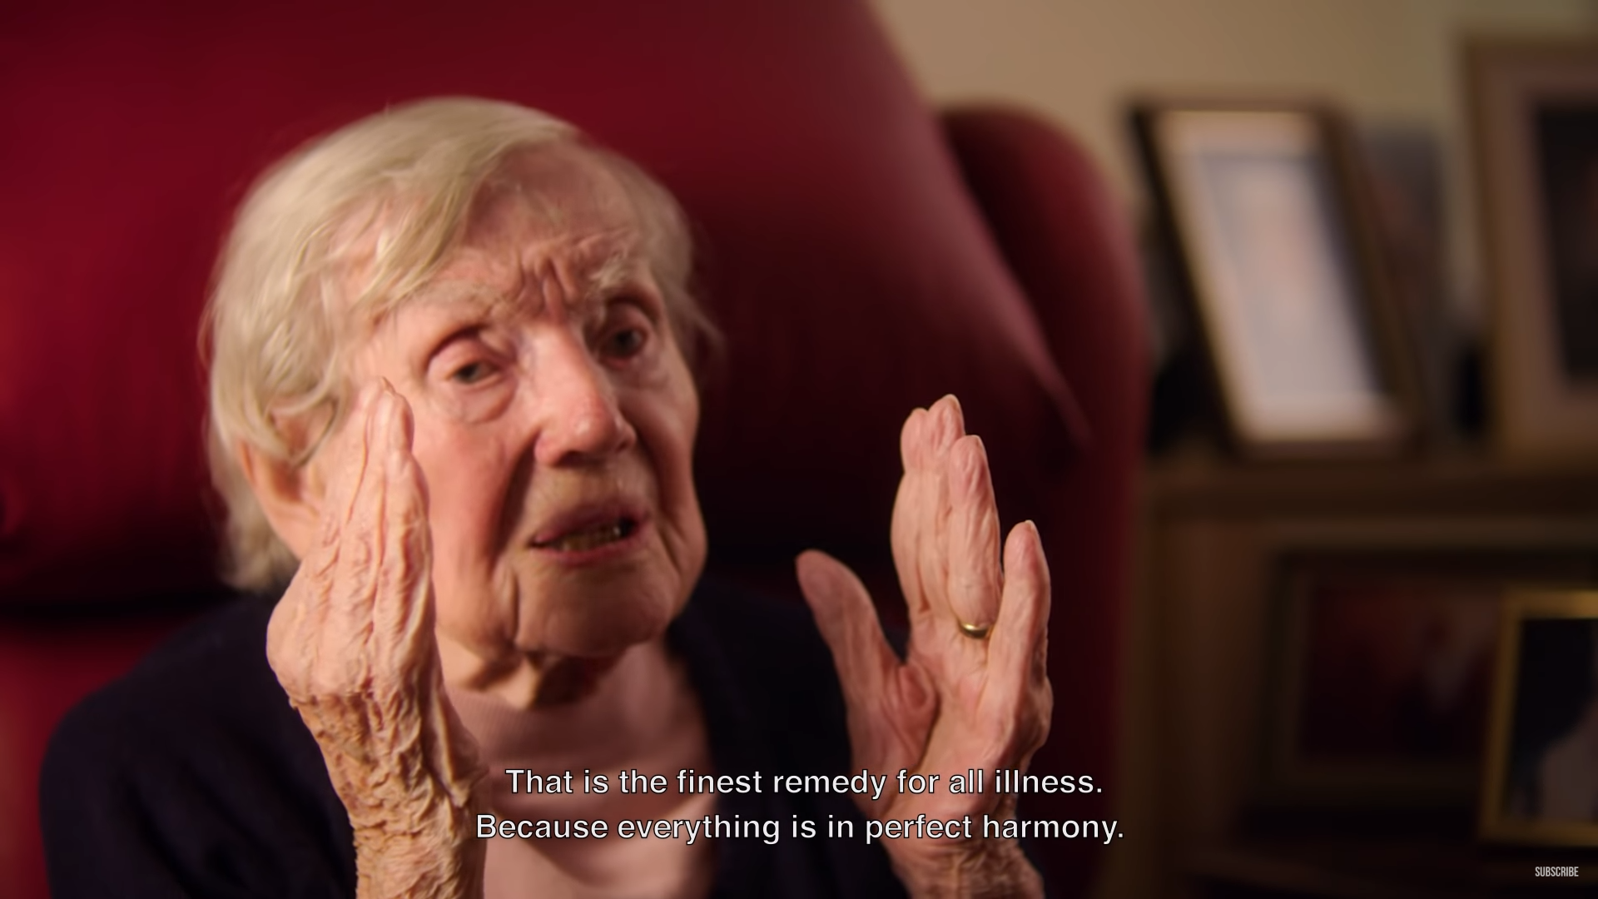

Slide 63
Time spent on reconnaissance is seldom wasted.
Be as independent as you can but don’t be reluctant to ask for help when you think you need it.

Slide 64
A good idea is to behave well to other people, show them respect. And help them as much as you possibly can, and it will be repaid hundredfolds.

Slide 65
My motto for life, there’s an old Scottish comedian. Harry Lauder, sir Harry Lauder. He used to sing: “keep right on to the end of the road.”…
… and that’s my motto.

Slide 66
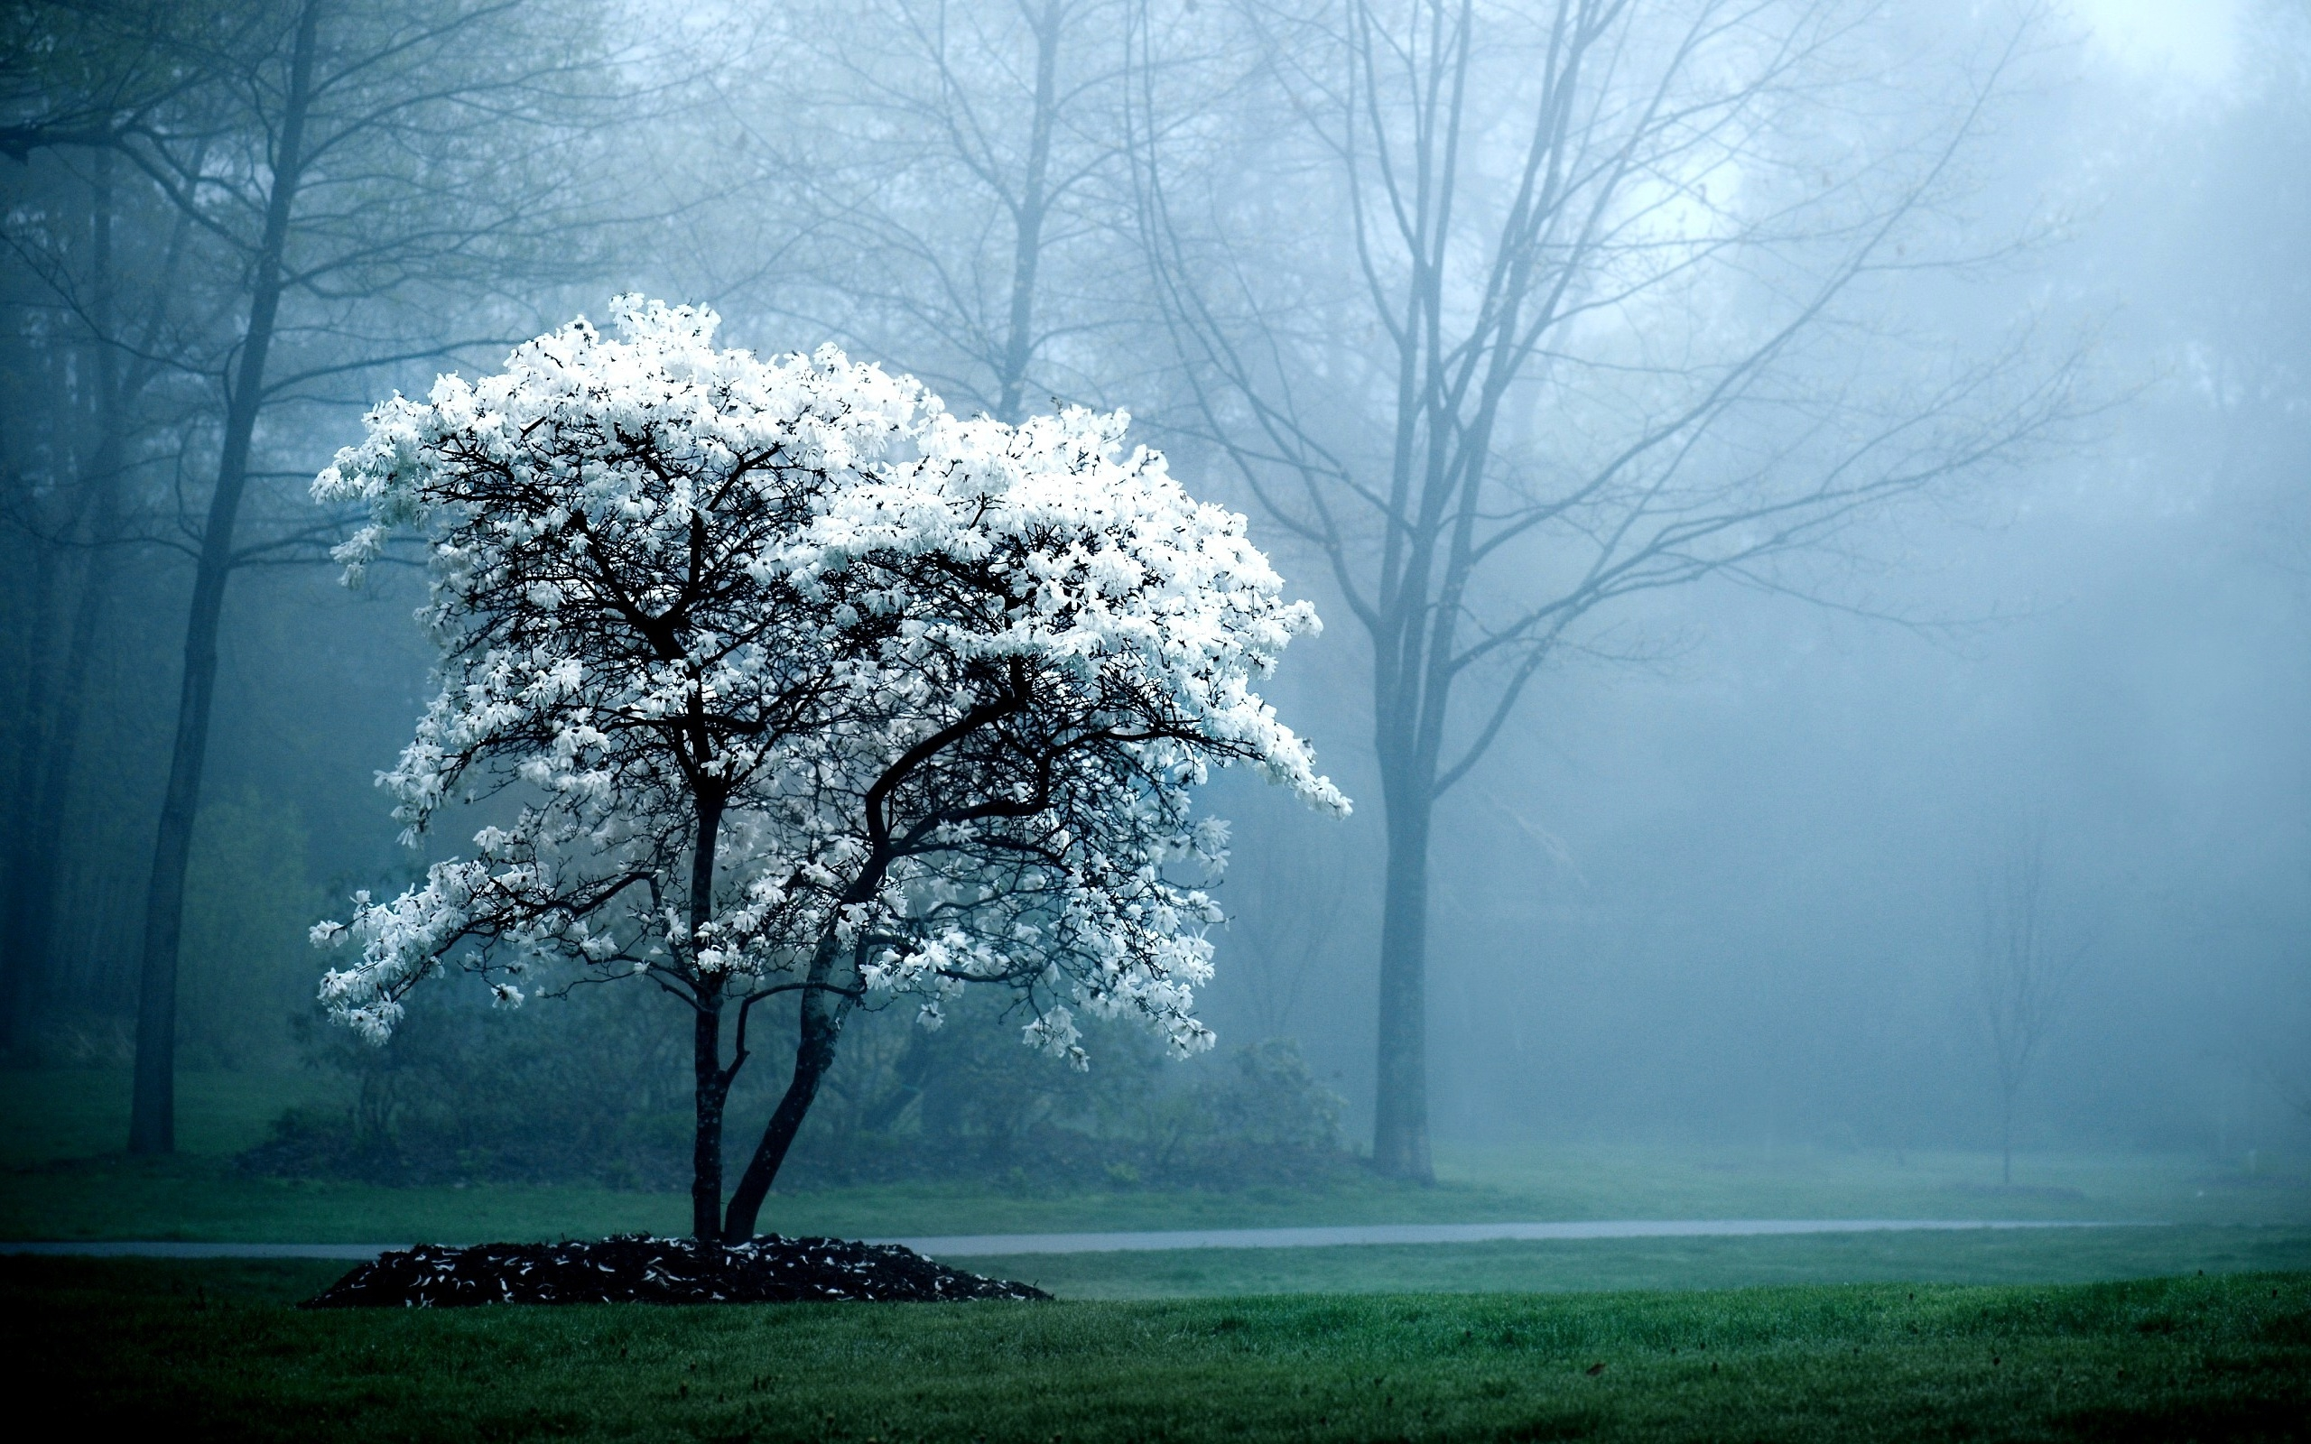
Living Longer

Slide 67

Genetics?
Centenarian siblings are 4 times more likely to live to 100.
Hyperactive telomerase

Slide 68
Diet?
Vitamin A, E + D

Slide 69

More Medicine
Require less medicine (especially early in life)
Recover quickly

Slide 70
No Smoking
Many centenarians smoked as much as 60 cigarettes per day for 50 years.

Slide 71
No Alcohol
1/3 of Japanese centenarians drank alcohol regularly.

Slide 72
No obesity
Albert Einstein College of Medicine found that centenarians were more obese, sedentary and exercised less.

Slide 73
Independence
Functionally independent until 92 (average).
40% of supercentenarians needed little or no assistance

Slide 74
Sex / Gender
80% of centenarians are women.

Slide 75
Low Calorie?
Causes a longer life in some animals.
Unknown for humans.

Slide 76
Where you are born?
Access to high quality healthcare, water, nutrition.
Some genetic links
Denmark, France, Japan, Switzerland, Sweden
Notes:
https://www.ncbi.nlm.nih.gov/pmc/articles/PMC3143446/

Slide 77
When you are born?
September to November are more likely to become centenarians.

Slide 78
Personality
Personal tenacity
Optimism
Coping Mechanisms
Self-Control

Slide 79
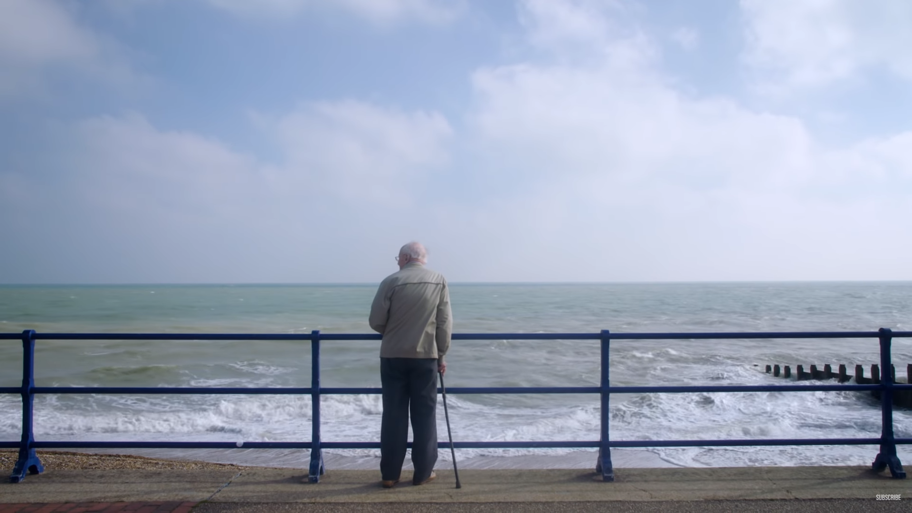
The End

