Slide 1
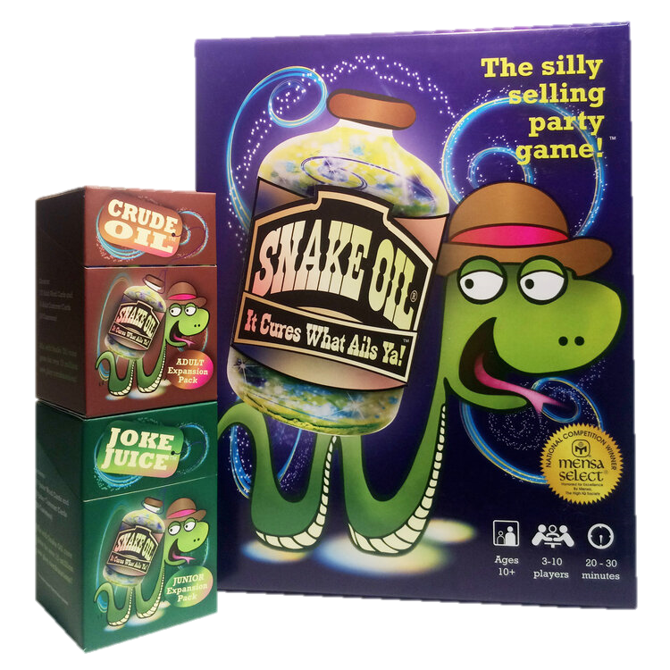
Snake Oil

Slide 2
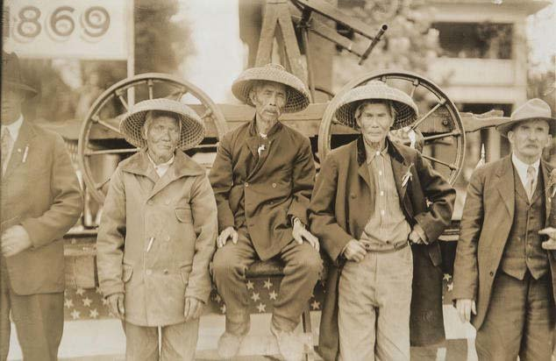
1800s – Chinese workers

Slide 3
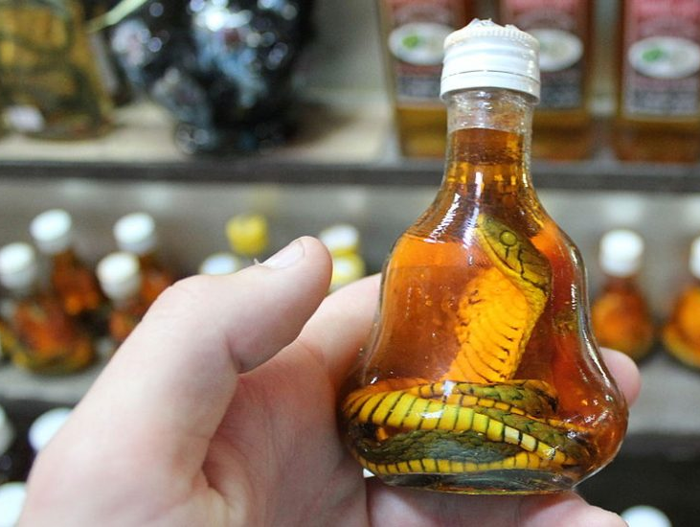
Traditional Chinese
Medicine
Chinese water snake

Slide 4
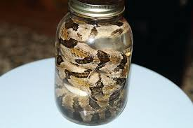
FAKE Chinese Medicine

Slide 5
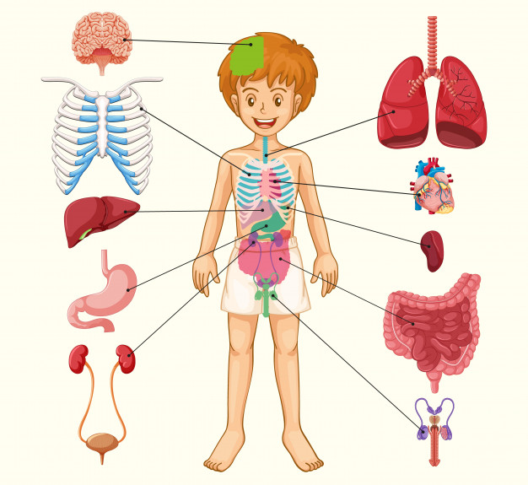
Promised it can cure
ANYTHING!

Slide 6
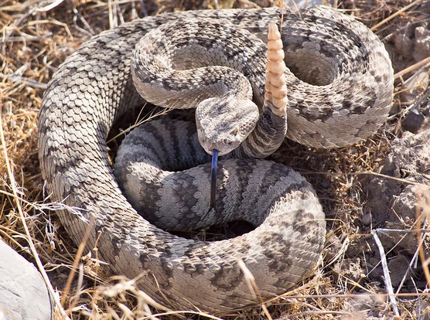
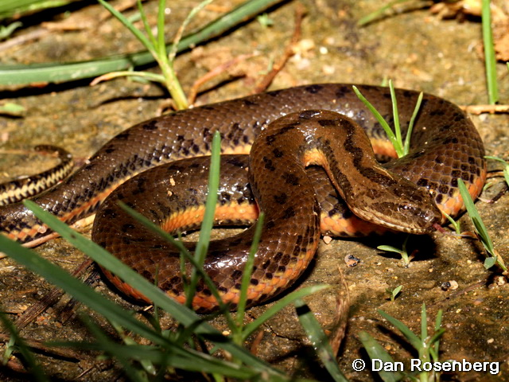
Rattlesnakes MUCH less effective
rattlesnake
water snake

Slide 7
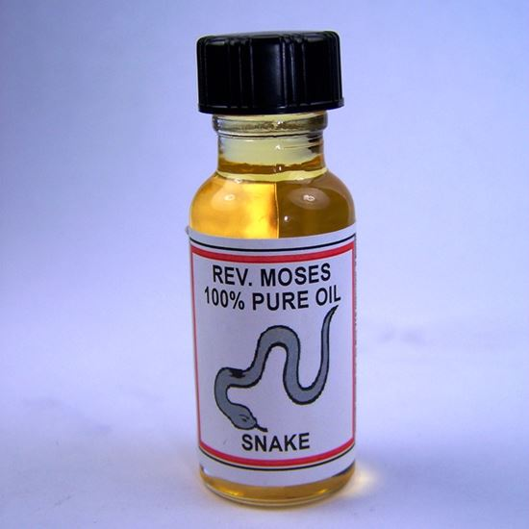

Usually DID NOT
include snake oil

Slide 8
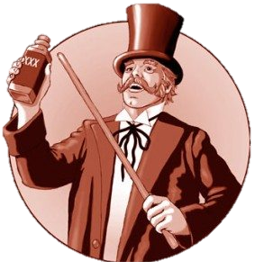
Convicted of fraud

Slide 9

Today - Wild Claims / Fraud

Slide 10
Snake Oil

Slide 11
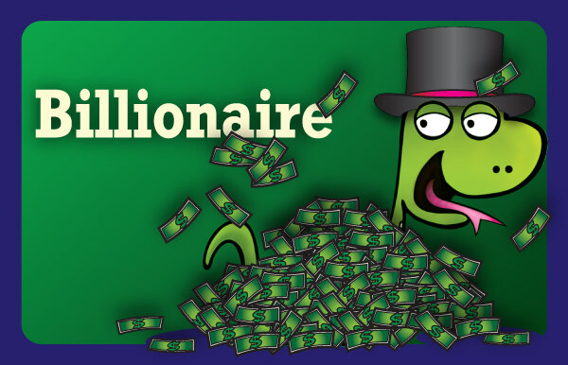
First player draws a card to select a customer ...

Slide 12
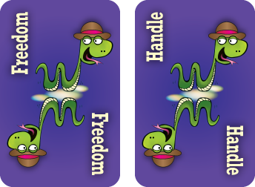

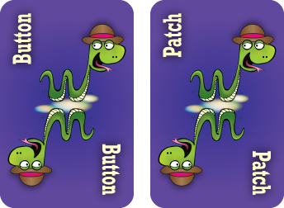
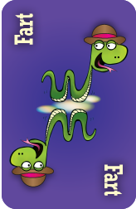
The other players create a 2-word product for that customer from their 7-card hands ...

Slide 13
Try selling the product.
It’s so hard for a billionaire to get away.
Everybody wants your money.
Don’t you wish you could press a button and get away?
Now with the AMAZING Freedom Button, you have that power.
OMG! This is what you NEED!

Slide 14

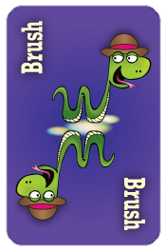
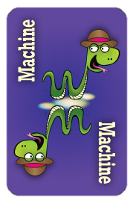

The customer chooses their favorite product.

