Slide 1
The 13 Most Powerful
WORDS in Advertising
https://www.media-marketing.com/en/opinion/the-thirteen-most-powerful-words-in-advertising/

Slide 2
NOW

Slide 3
EASY

Slide 4
FREE

Slide 5
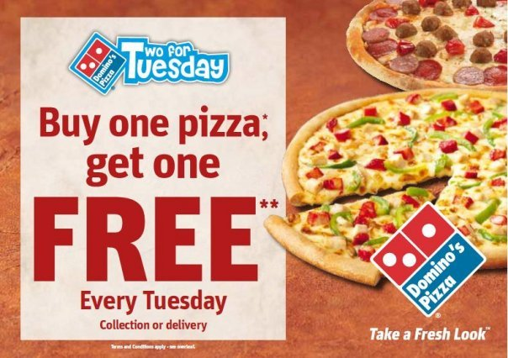
Buy one, get one free

Slide 6
NEW

Slide 7
SAVING

Slide 8
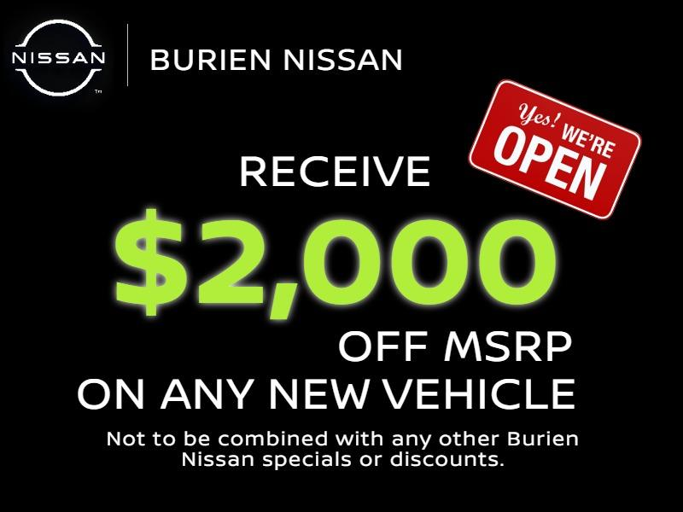
Retail Price (MSRP)

Slide 9
SAFE

Slide 10
Proven

Slide 11
LOVE

Slide 12
DISCOVER

Slide 13
GUARANTEE

Slide 14

Guaranteed or your money back.

Slide 15
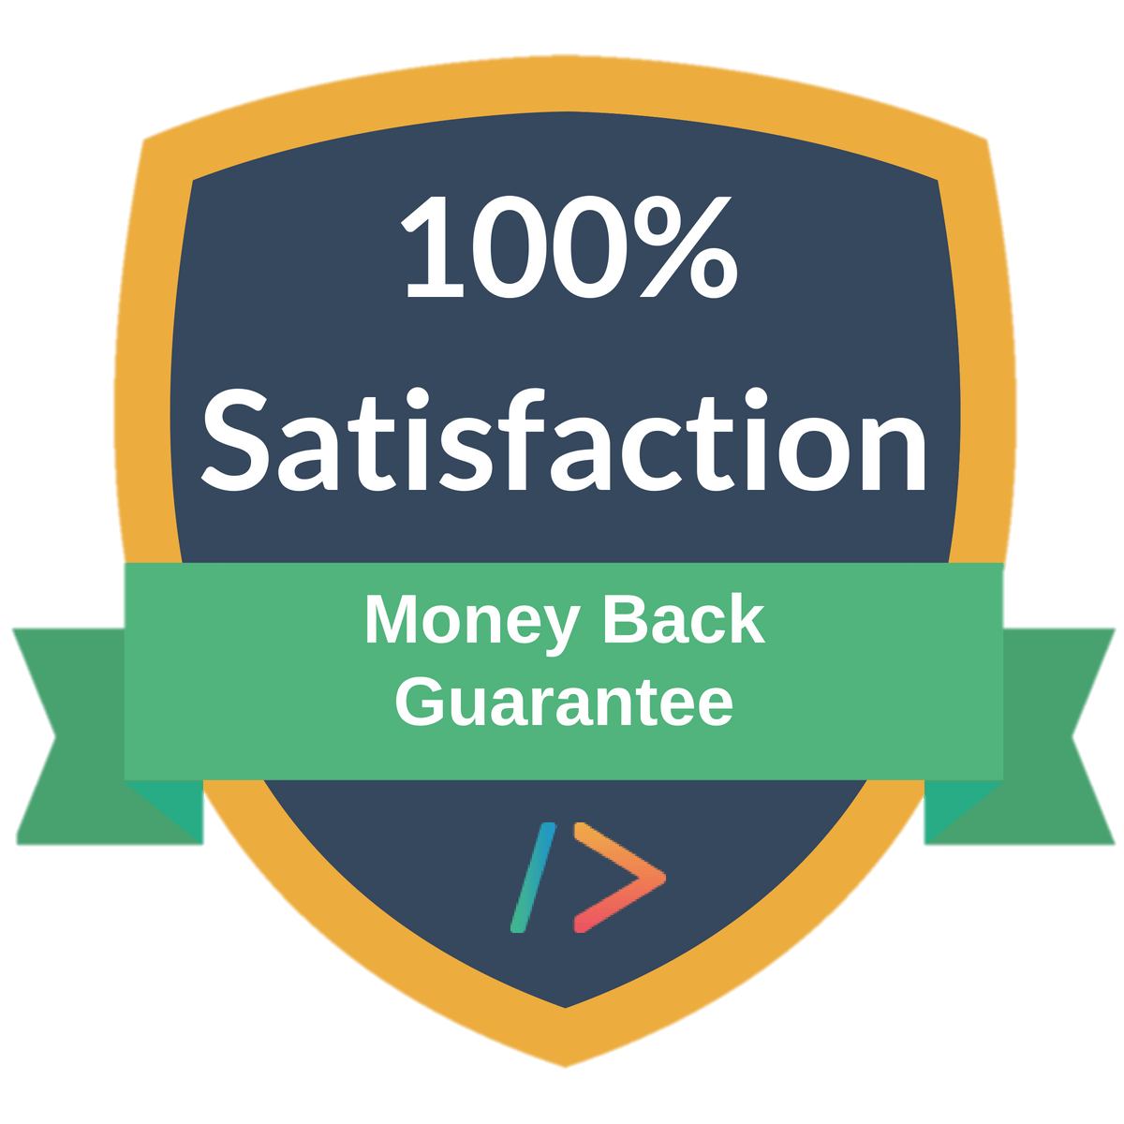

Slide 16
HEALTH

Slide 17
RESULTS

Slide 18
You

Slide 19
Some Pricing
VOCABULARY

Slide 20
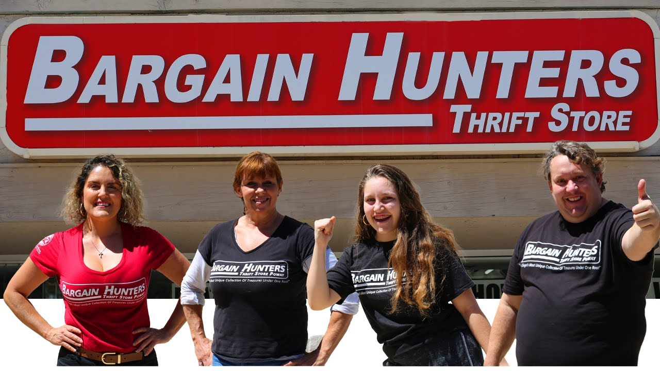
Bargain

Slide 21
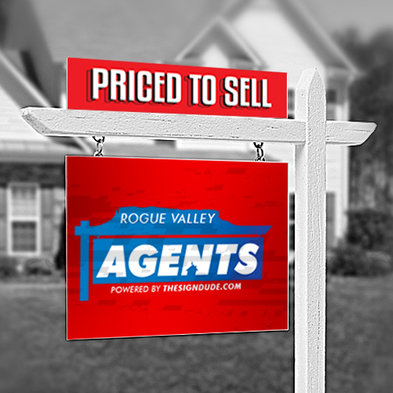
Priced to sell

Slide 22
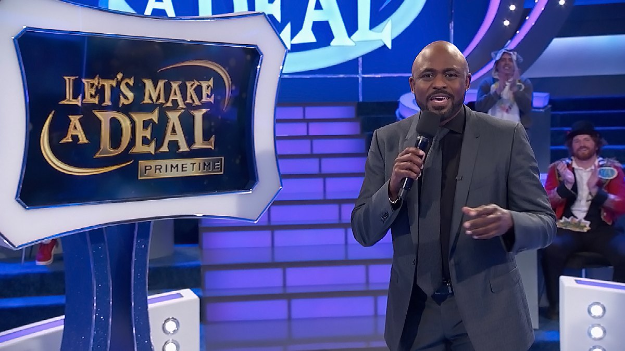
Deal of a lifetime

Slide 23
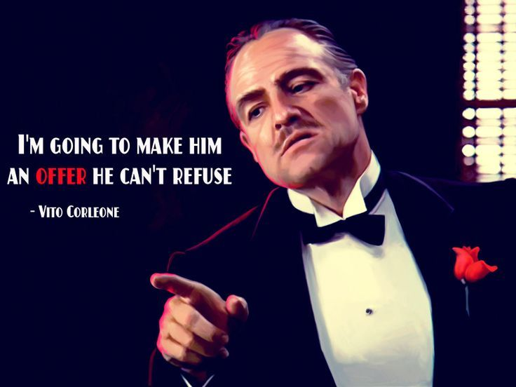
An offer he can’t refuse

Slide 24
Some Quality
VOCABULARY

Slide 25


Slide 26


Slide 27


Slide 28
https://www.ultraboardgames.com/snake-oil/game-rules.php
https://www.media-marketing.com/en/opinion/the-thirteen-most-powerful-words-in-advertising/

