Slide 1
Perspective
Put yourself in someone
else’s shoes.

Slide 2
Before you judge someone,
WALK A MILE in their shoes.

Slide 3
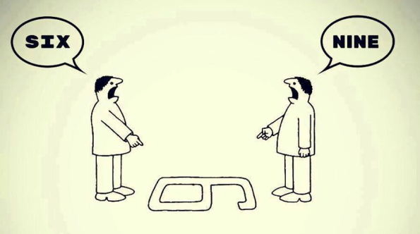
Perspective
How you view the world

Slide 4
Perspective
From my perspective, health care costs are low in Korea.

Slide 5
Point of view
How you view the world

Slide 6
Point of view
From my point of view, making mistakes in English is ok if people understand you.

Slide 7
In my eyes
How you view the world

Slide 8
In my eyes
In my eyes, the most beautiful place on earth is Antarctica.

Slide 9
It seems to me
How you view the world

Slide 10
It seems to me
It seems to me that quality of life is improving.

Slide 11
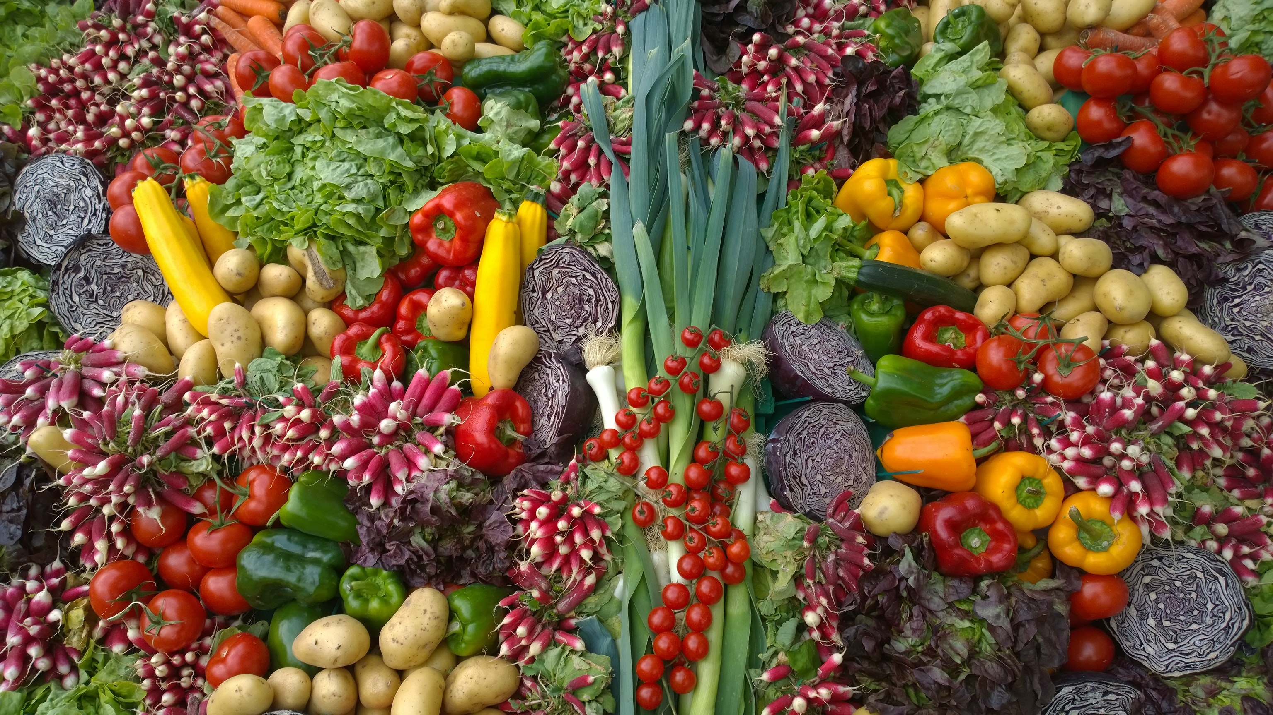
According to me
How you view the world

Slide 12
According to me
According to me we should all become vegetarians.

Slide 13
Opinion

Slide 14
Personally speaking
This is what I believe

Slide 15
Personally speaking
Personally speaking, I think celebrities get paid too much money.

Slide 16
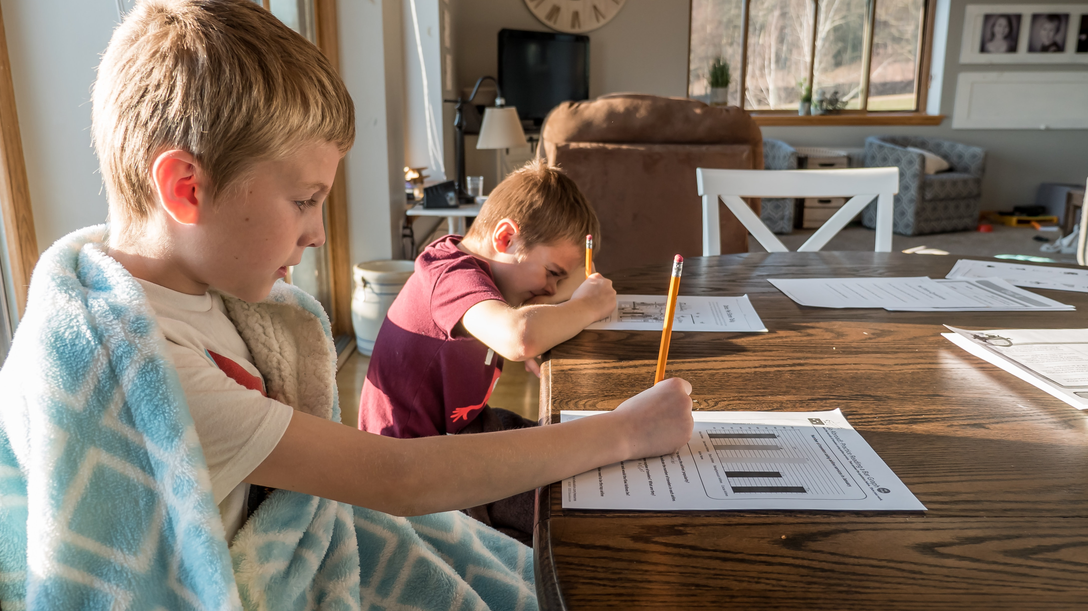
In my opinion
This is what I believe

Slide 17
In my opinion
In my opinion, homework is bad.

Slide 18
In my opinion
I think
I believe
I feel
I guess
I’m sure

Slide 19
School
perspectives

Slide 20
Situation
Hypothetical
situations

Slide 21
roles
Principal
Teacher
Student
Parent

Slide 22
Special rule:
“Put yourself in my shoes”
exchange roles

Slide 23
goal
Find a solution that
everyone agrees with.
10 minutes per situation.

Slide 24
http://myenglishonline.ca/wp-content/uploads/2014/08/100-Phrases.pdf

