Slide 1
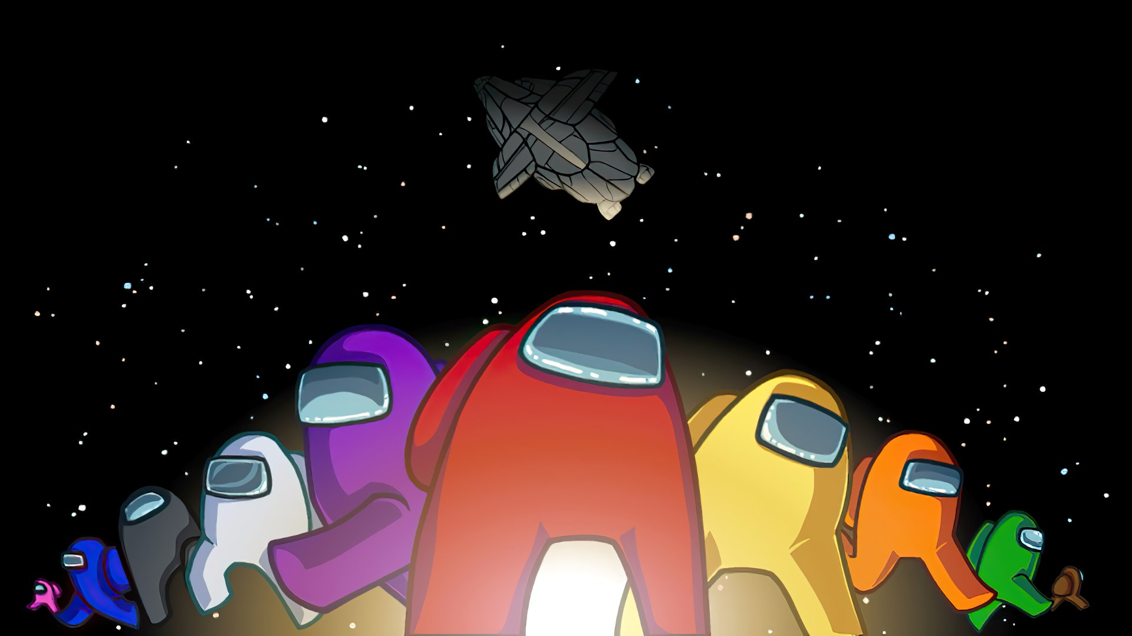

Slide 2
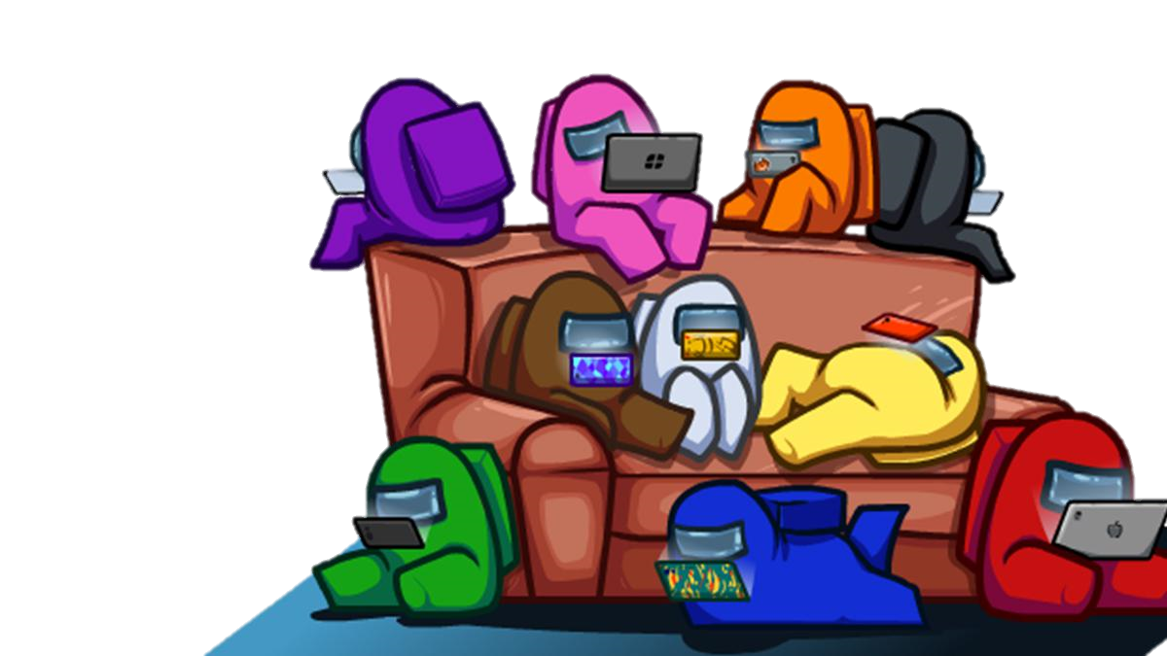
Online Multiplayer

Slide 3
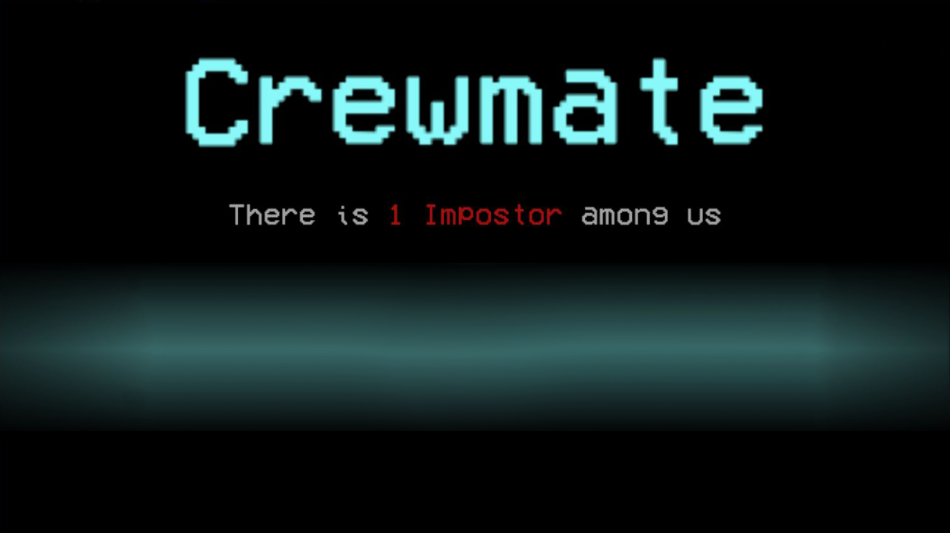
Finish tasks
Each crewmate has a question.
Ask as many people as possible.
Each task is 1 point (self-tracking)
Don’t get murdered by the imposter.

Slide 4
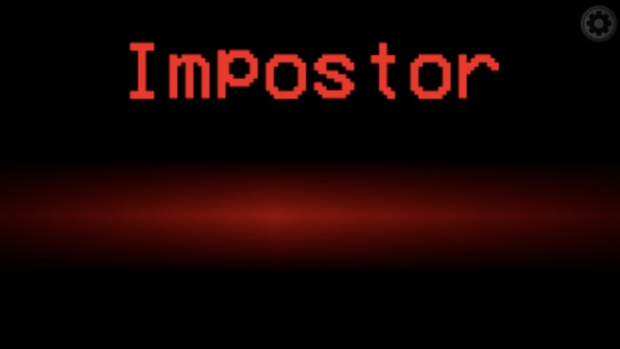
Murder crewmates:
Each crewmate has a question.
If you ask them their question, they die
Each murder is 1 point
Total kills include other imposters.
Don’t get caught by the crewmates.

Slide 6
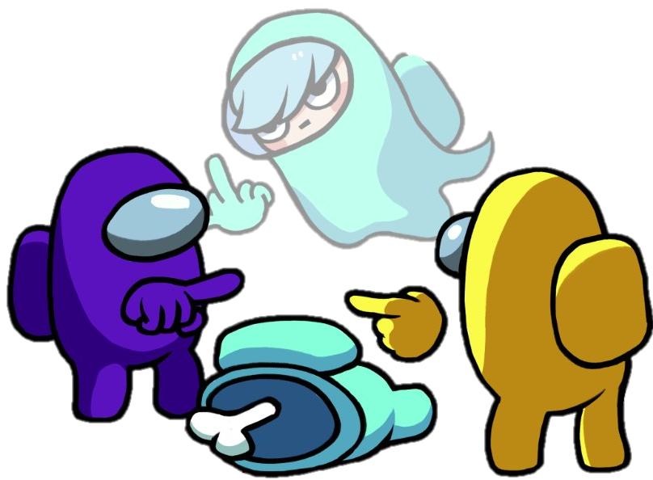
If you die:
Someone asked you YOUR question
Or reasonably close
Quietly sit down
Don’t speak or give hints

Slide 7
Vote:
You can kick out a member
4 votes
“Kicked out” follow rules for dying.

Slide 8
HINTS
Ask many questions:
Mix in the real question so imposters can’t guess
“How are you? Did you have a good night last night? How old are you? Where did you go last night?”

Slide 9
HINTS
Don’t get exposed
Don’t repeat each question.
Do it secretly.

Slide 10
HINTS
Play along
Listen
Make up your own questions

Slide 11
1
ROUND
STARTING QUESTIONS

Slide 12
How many crewmates died?
Notes:
Each imposter gets that many points. This should also include the number of members that were “kicked out”

Slide 13
Living people: Guess the Imposters
Notes:
Let the students guess who the imposters are before revealing the answer. Have the imposters identify themselves.

Slide 14
Notes:
When each character is revealed, have that student read their question. You can also ask if there were any interesting answers.

Slide 15
2
ROUND
SMALL TALK

Slide 16
How many crewmates died?
Notes:
Each imposter gets that many points. This should also include the number of members that were “kicked out”

Slide 17
Living people: Guess the Imposters
Notes:
Let the students guess who the imposters are before revealing the answer. Have the imposters identify themselves.

Slide 18
Notes:
When each character is revealed, have that student read their question. You can also ask if there were any interesting answers.

Slide 19
3
ROUND
WEIRD DEBATES

Slide 20
How many crewmates died?
Notes:
Each imposter gets that many points. This should also include the number of members that were “kicked out”

Slide 21
Living people: Guess the Imposters
Notes:
Let the students guess who the imposters are before revealing the answer. Have the imposters identify themselves.

Slide 22
Notes:
When each character is revealed, have that student read their question. You can also ask if there were any interesting answers.

