Slide 1
Family
Welcome
to
Talk
Talk

Slide 2
Today

Slide 3
True or False
Introduction
Rock Paper Scissors
Recap and goodbye

Slide 4
Introduction

Slide 5
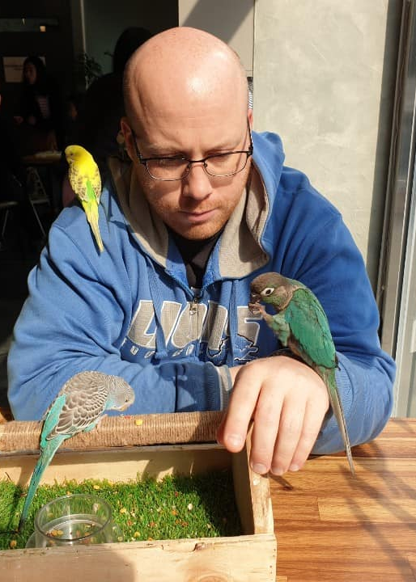
Hello, My name is Tim.

Slide 6
What is your name?
My name is _________

Slide 7
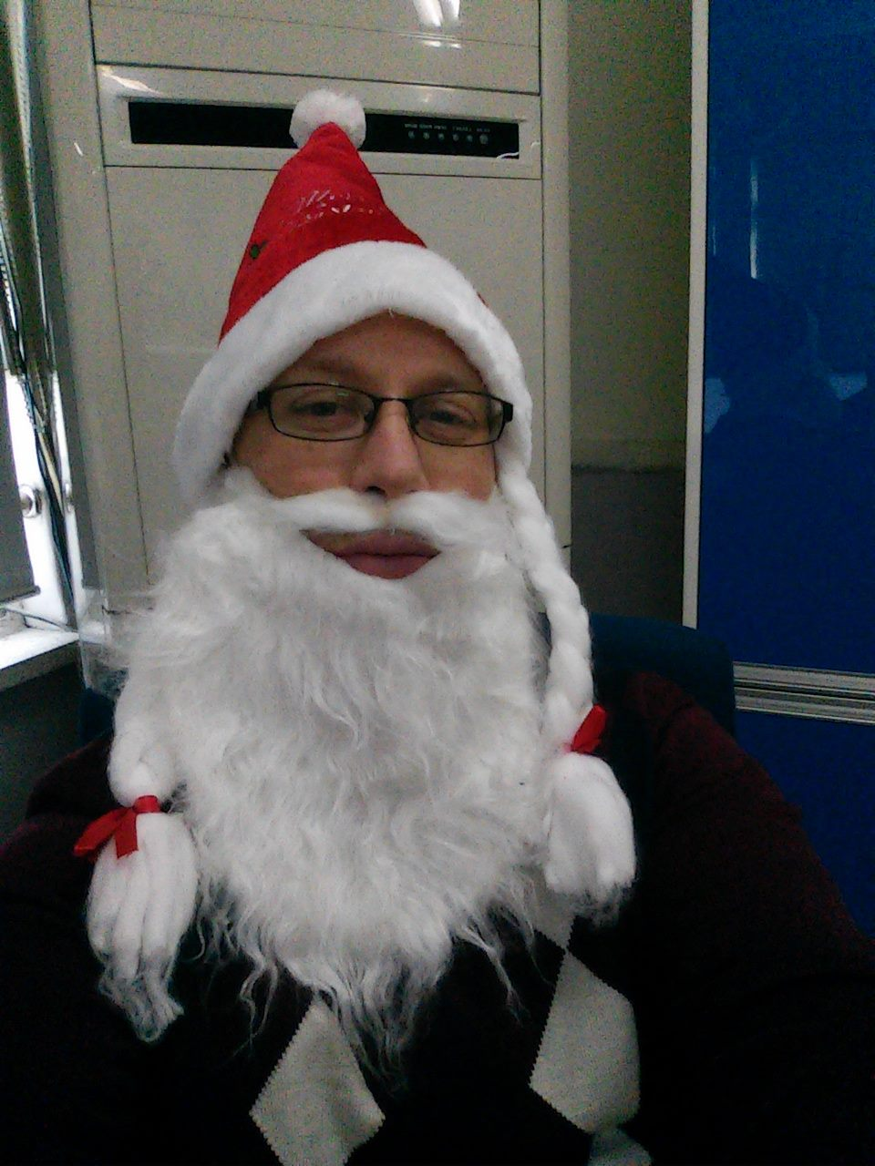
I am 37 years old.

Slide 8
How old are you?
I am ______ years old.

Slide 9
I live in Gongju.

Slide 10
Where do you live?
I live in ________.

Slide 11
I work at COEILI.

Slide 12
What grade are you in?
I am in _____ grade.

Slide 13
My favorite subject is science.

Slide 14
What is your favorite subject?
My favorite subject is ______.

Slide 15
True and
False

Slide 17
I am from America.

Slide 19
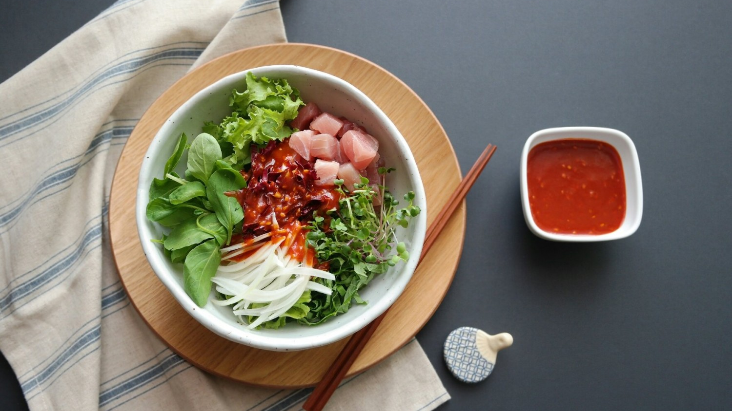
My favorite food is 회덮밥.

Slide 20
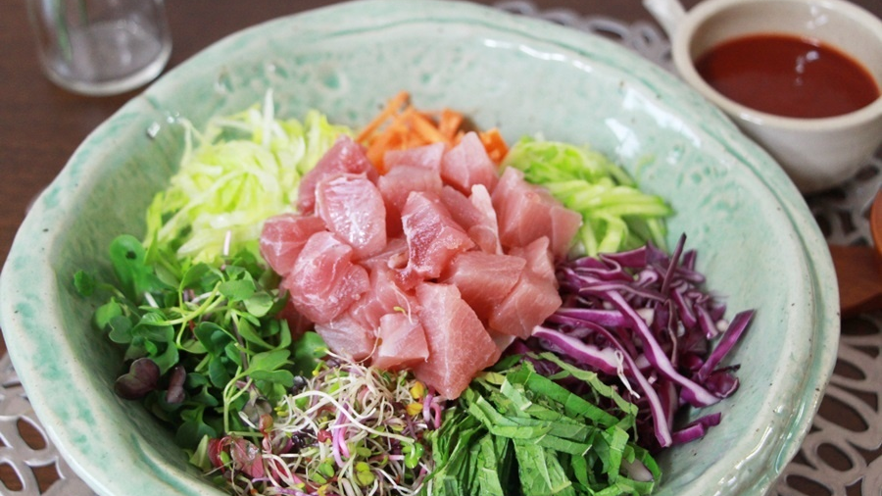

Slide 21
My favorite sport is soccer.

Slide 22
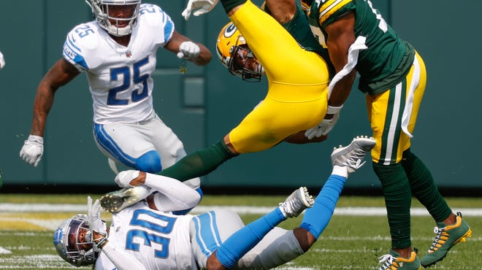

Slide 23
I have three sisters.

Slide 24
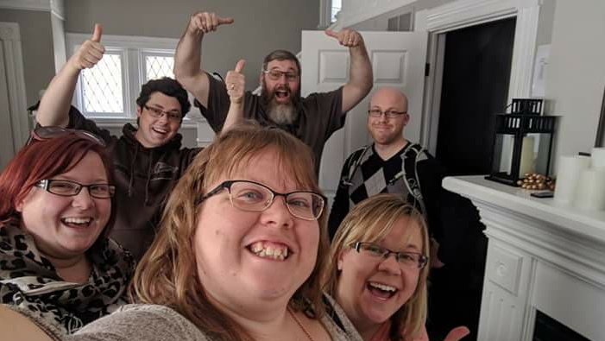

Slide 25
I have lived in Korea for 11 years

Slide 27
Rock
Paper
Scissors

Slide 28
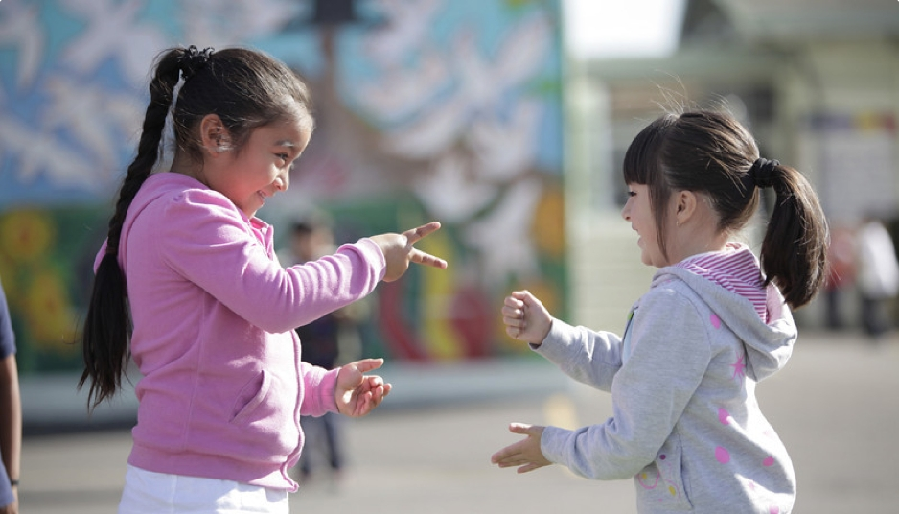
Notes:
Play a game of rock/scissor/paper
-Winner will ask questions and loser will answer the question.
Best out of 5

Slide 29
The winner asks a question
Notes:
Play a game of rock/scissor/paper
-Winner will ask questions and loser will answer the question.
Best out of 5

Slide 30
Recap
and
Goodbye

Slide 31
5 things I like
___________________________________
___________________________________
___________________________________
___________________________________
___________________________________

Slide 32
5 things I don’t like
___________________________________
___________________________________
___________________________________
___________________________________
___________________________________

Slide 33
See You
Tomorrow!

