Slide 1
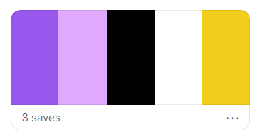
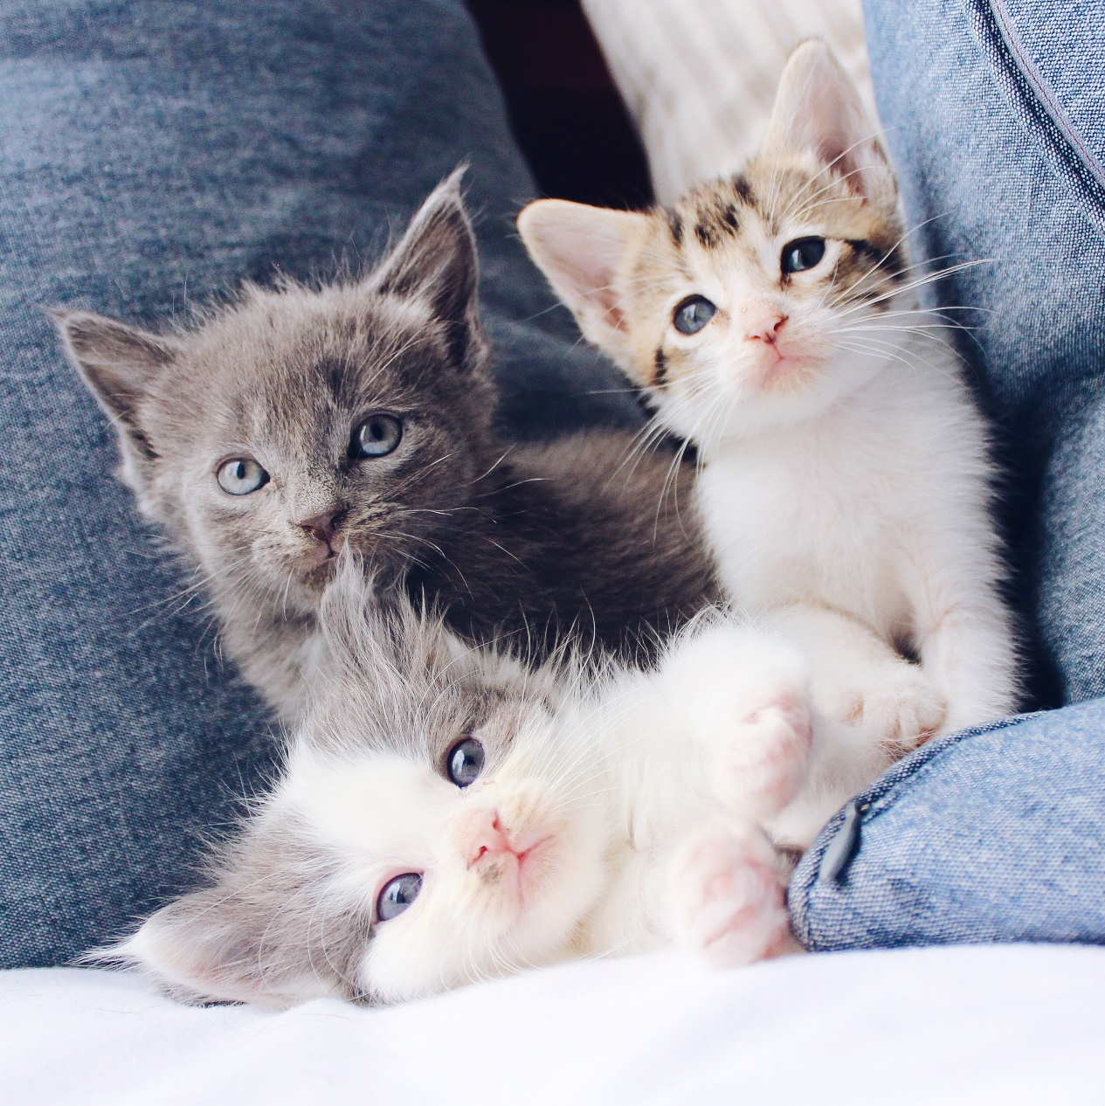
What do you see?

Slide 2
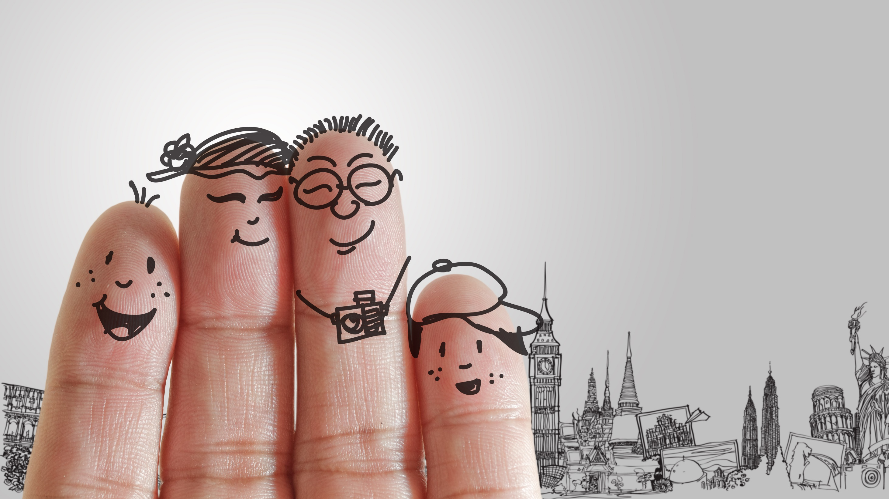
Friends
Welcome
to
Talk
Talk

Slide 3
Today

Slide 4
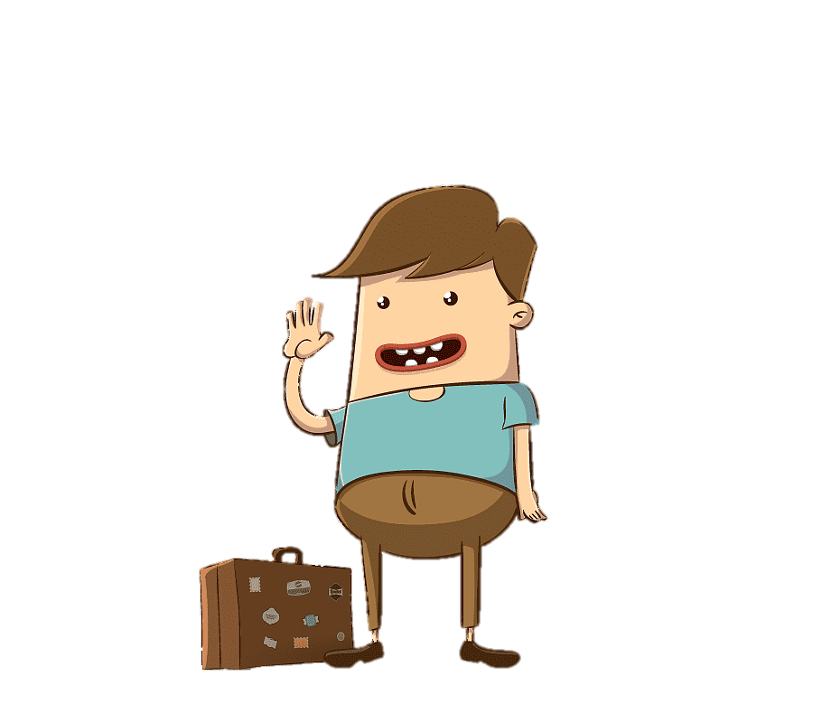



2 truths and 1 lie
Introduction
Bingo
Recap and goodbye

Slide 5
2 truths and
1 lie

Slide 6


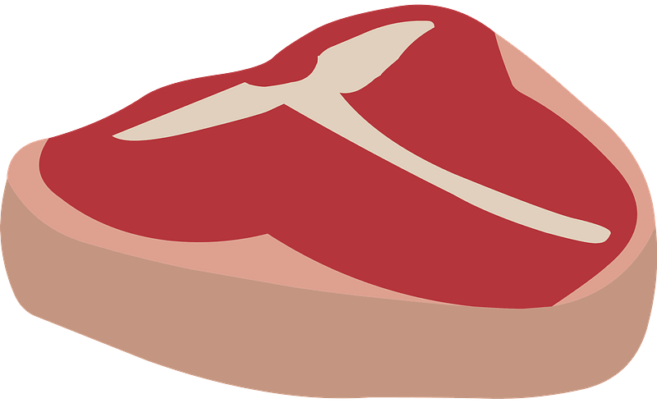
Which is a lie?
1
I have cycled more than 75,000kms in Korea.
2
I traveled to North Korea.
3
I ate tiger meat.

Slide 7



Which is a lie?
1
I like to travel.
2
I have been to London.
3
I am an elementary school teacher.

Slide 8
Introduction

Slide 9
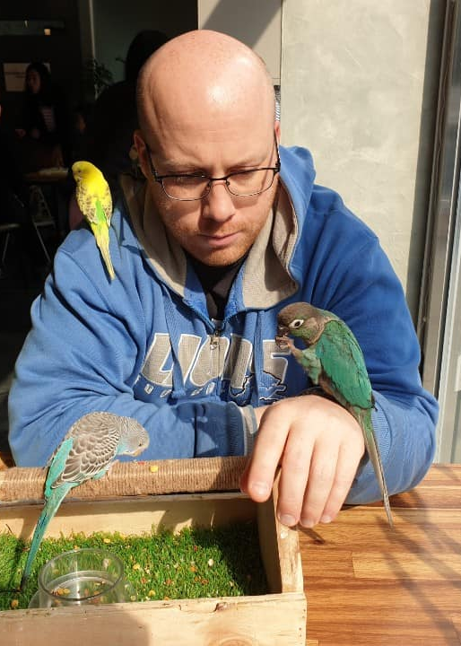
Hello, My name is Tim.

Slide 10
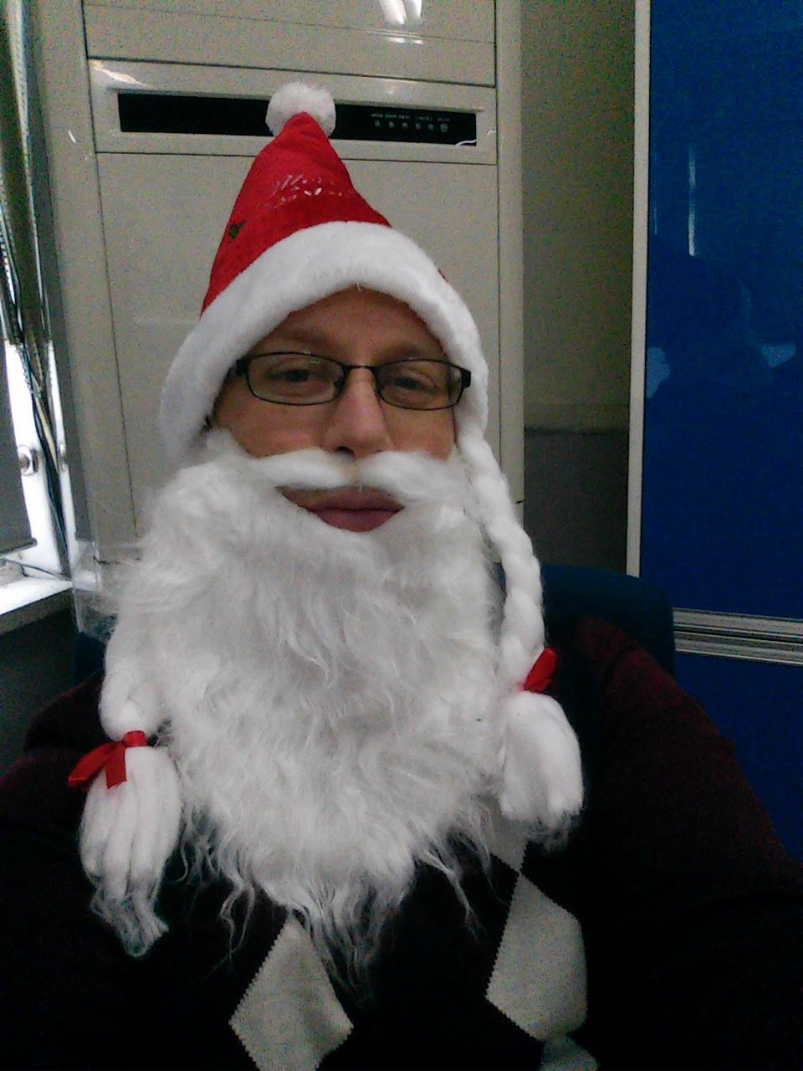
I am 37 years old.

Slide 11
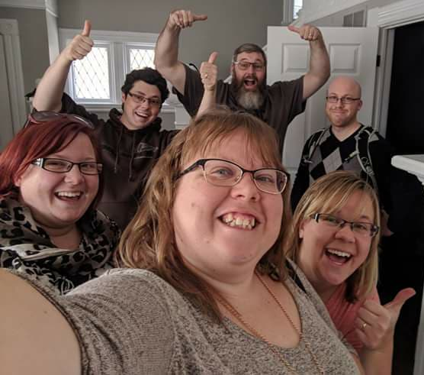
I have 3 sisters.

Slide 12

I live in Gongju.

Slide 13
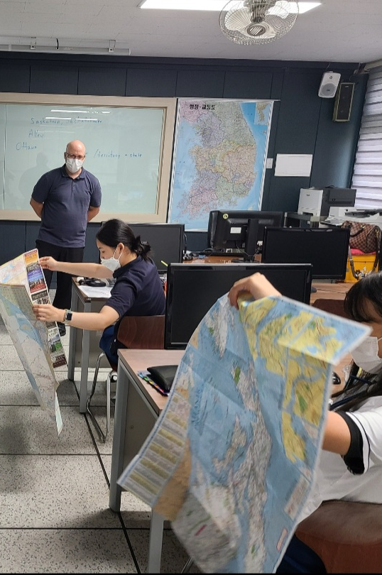
I work at COEILI.

Slide 14
How about You?

Slide 15
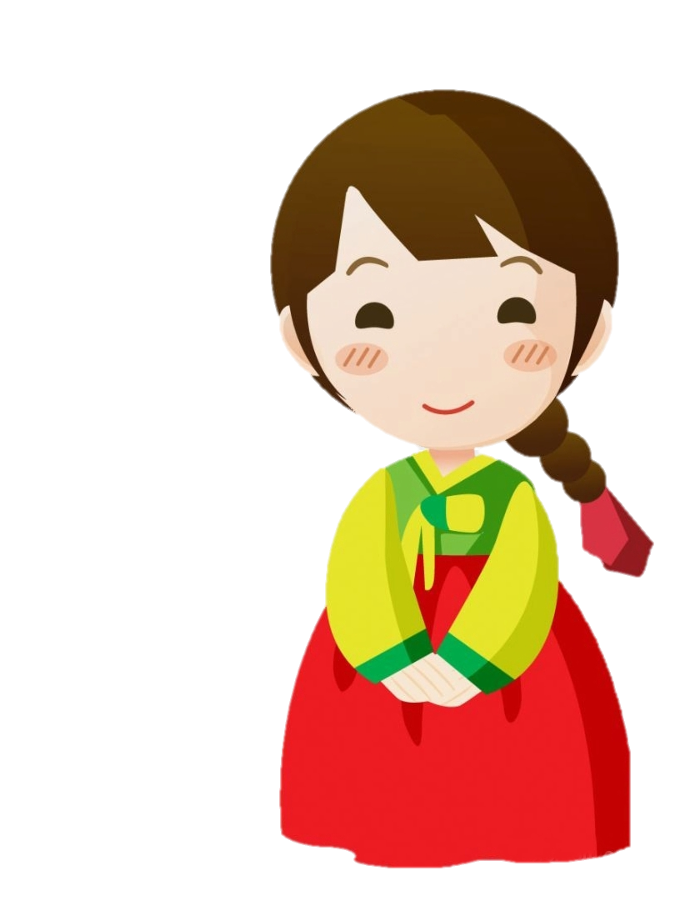
Hi, my name is ________________.
I am _______________ years old.
I have _____________.
(brother and sister/I am the only child).
I live in ________________. (City name)
I go to ____________ school.

Slide 16
Hi, my name is Lee So Yeon.
I am 10 years old.
I have 1 brother and 1 sister.
I live in Gongju.
I go to Gongju Middle School.

Slide 17
Bingo

Slide 21
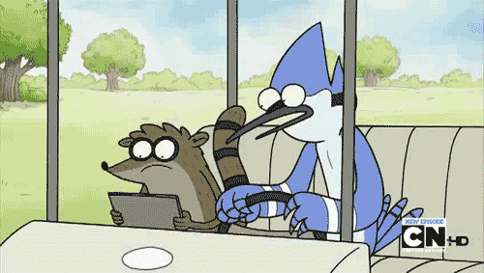
Notes:
Play a game of rock/scissor/paper
-Winner will ask questions and loser will answer the question.
Best out of 5

Slide 22
Recap
and
Goodbye

Slide 23

2 Truths and 1 lie
___________________________________
___________________________________
___________________________________

Slide 24
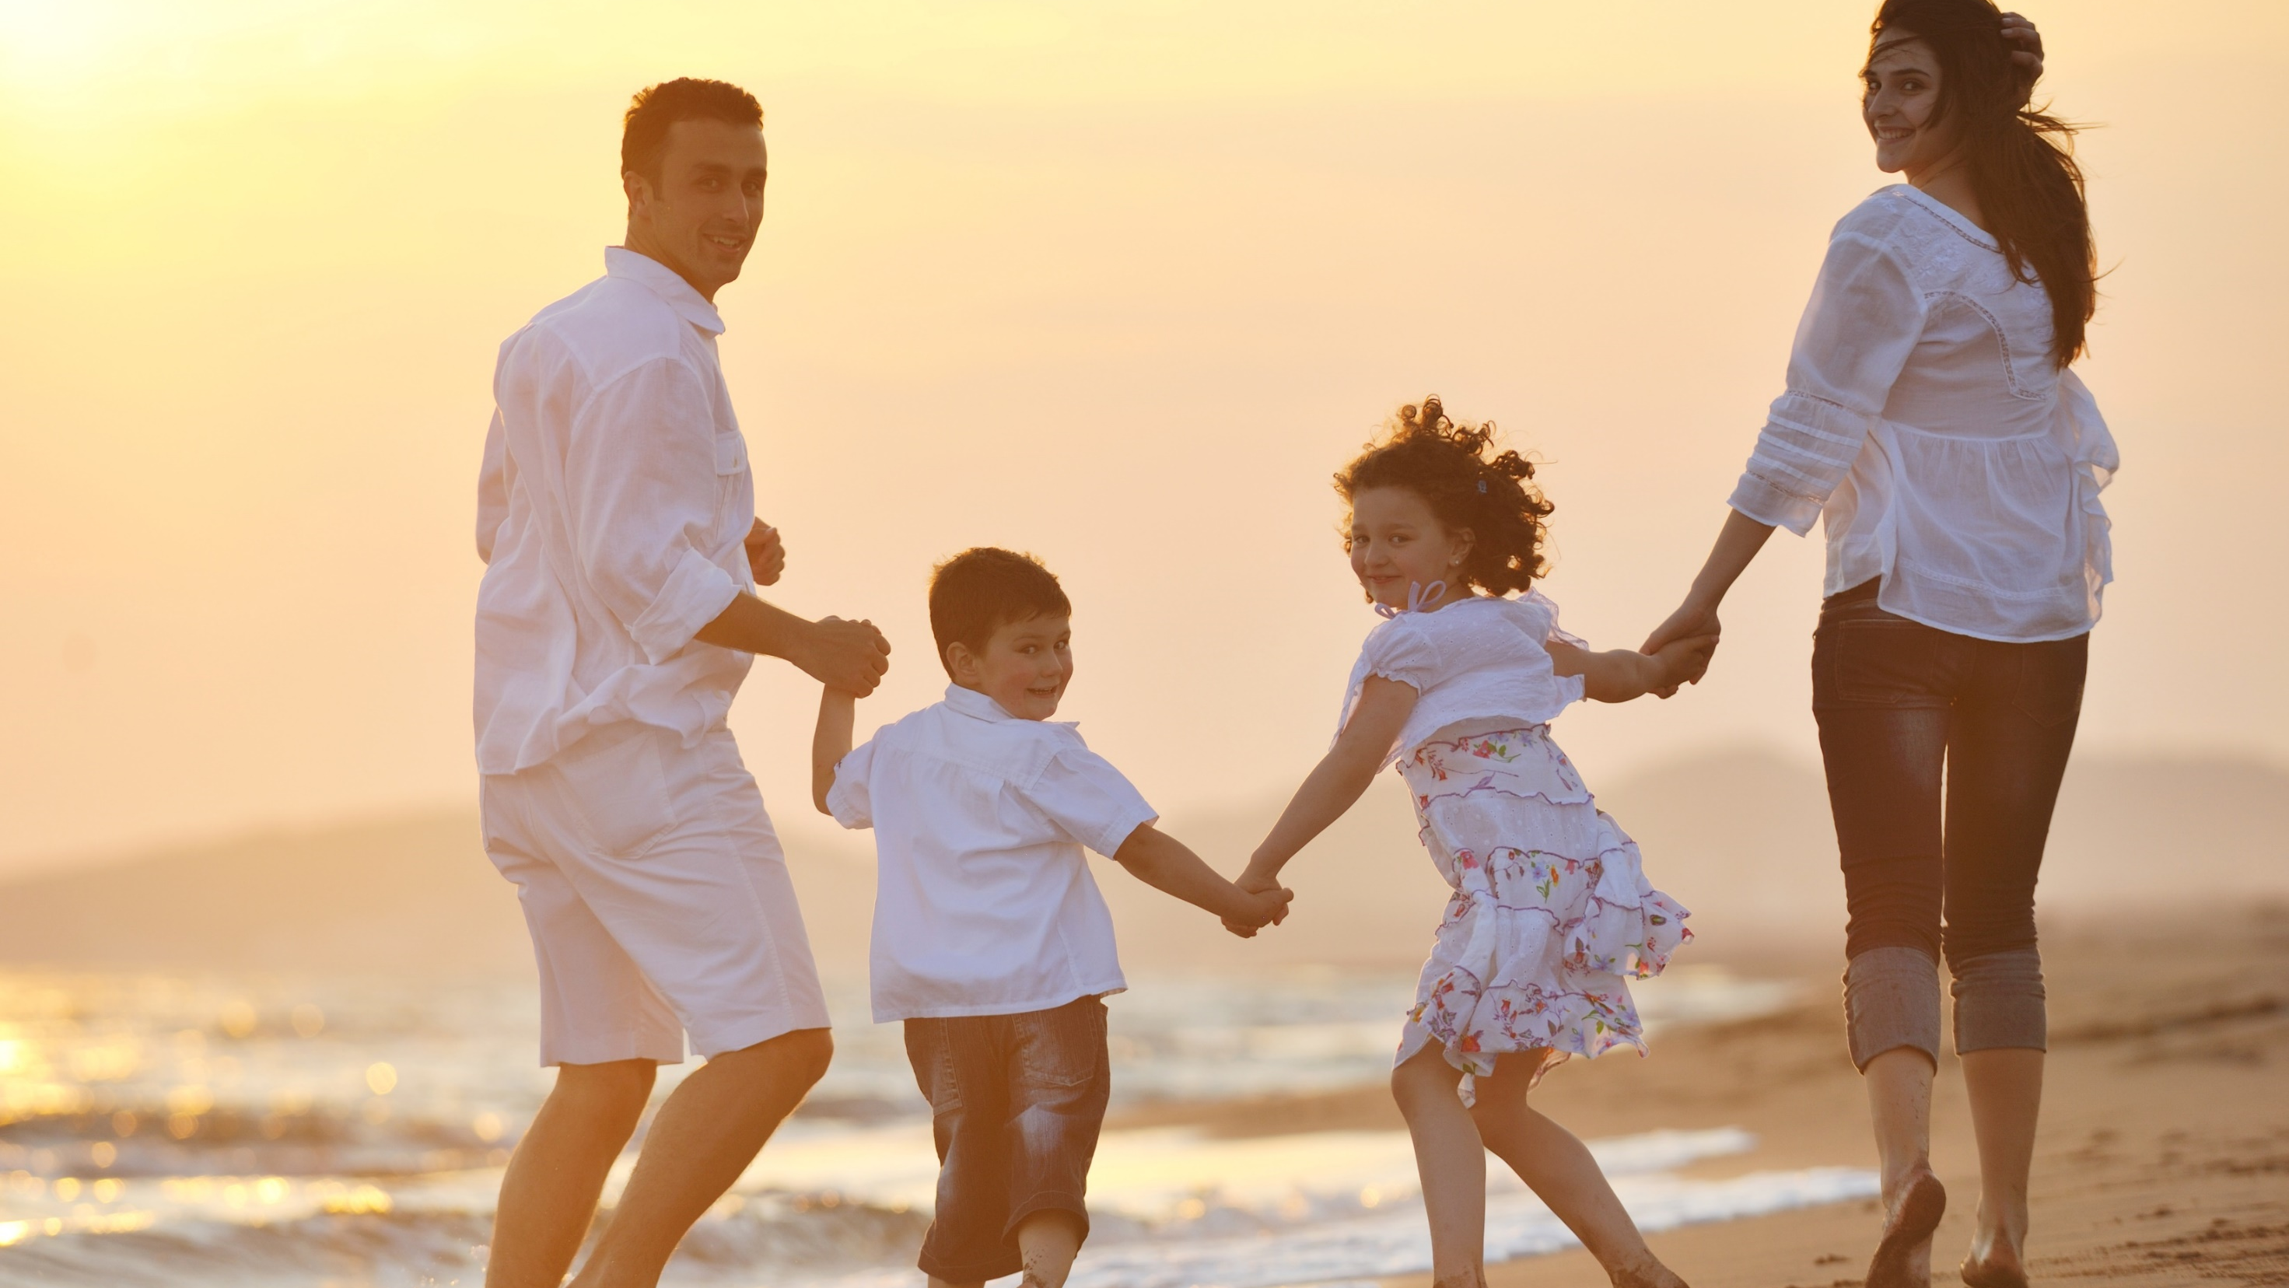

See You
Tomorrow!

