Slide 1
Introduction
and
Favorites

Slide 2
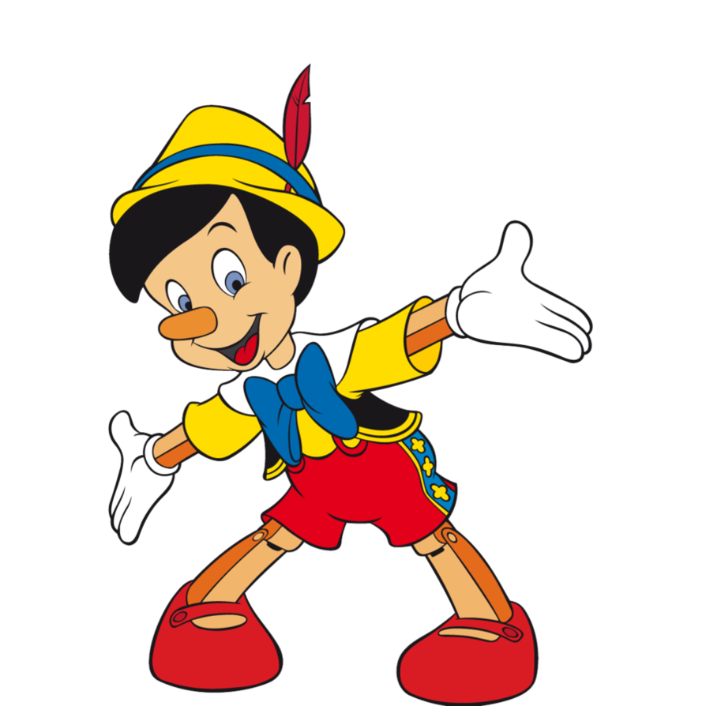
2 true
1 lie

Slide 3
Which is the lie?
I am 50 years old.
I have a car.
I like cycling.

Slide 4
Which is the lie?
I was on TV.
I worked at a school in Hawaii.
I can speak Spanish.
ELLEN

Slide 5
Which is the lie?
I like to read webtoons.
My favorite sport is baseball.
I have two sons.
Jenny

Slide 6
Introduction

Slide 7
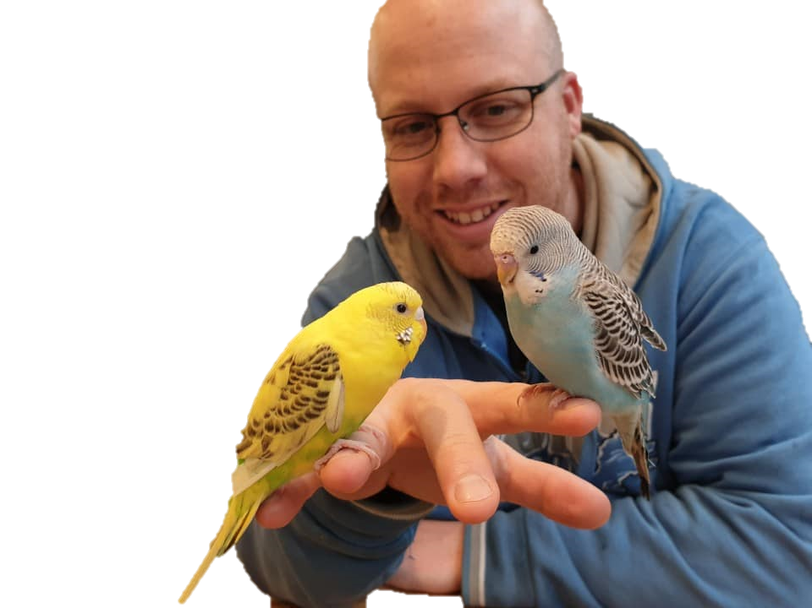
About me:
My name is Tim.
I’m 38 years old.
I live in Gongju.
I go to COEILI.
I’m in grade ∞.

Slide 8
About me:
My name is ________.
I’m ____ years old.
I live in _________.
I go to _________ Elementary School.
I’m in grade ____.

Slide 9
Favorites
BINGO

Slide 10
Phrases:
What is your favorite _______?
What is your favorite _______?
My favorite _______ is ________.
My favorite _______ is ________.

Slide 11
Practice:
What is your favorite color?
My favorite color is ________.

Slide 12
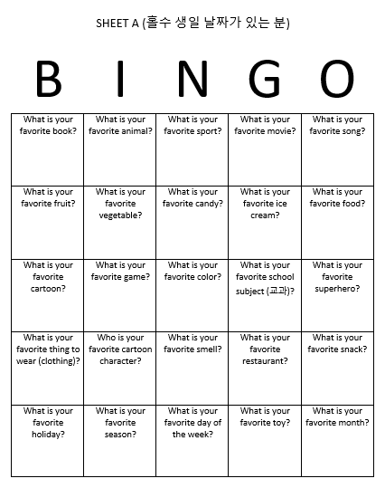
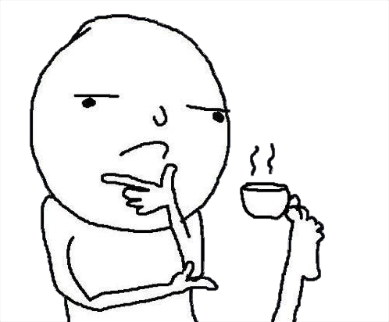
Play:
Choose a question.
Choose a person.
Ask the question.

Slide 13
Play:
If you ask or answer the question, mark your paper.

