Slide 1
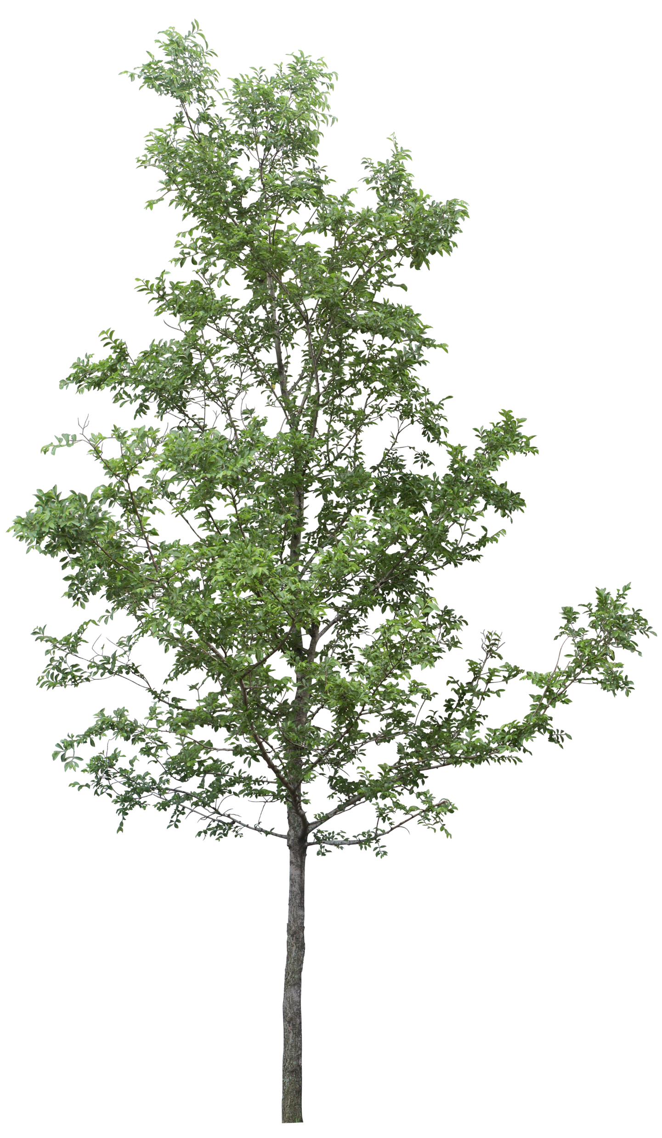
FAMILY
TREES

Slide 2
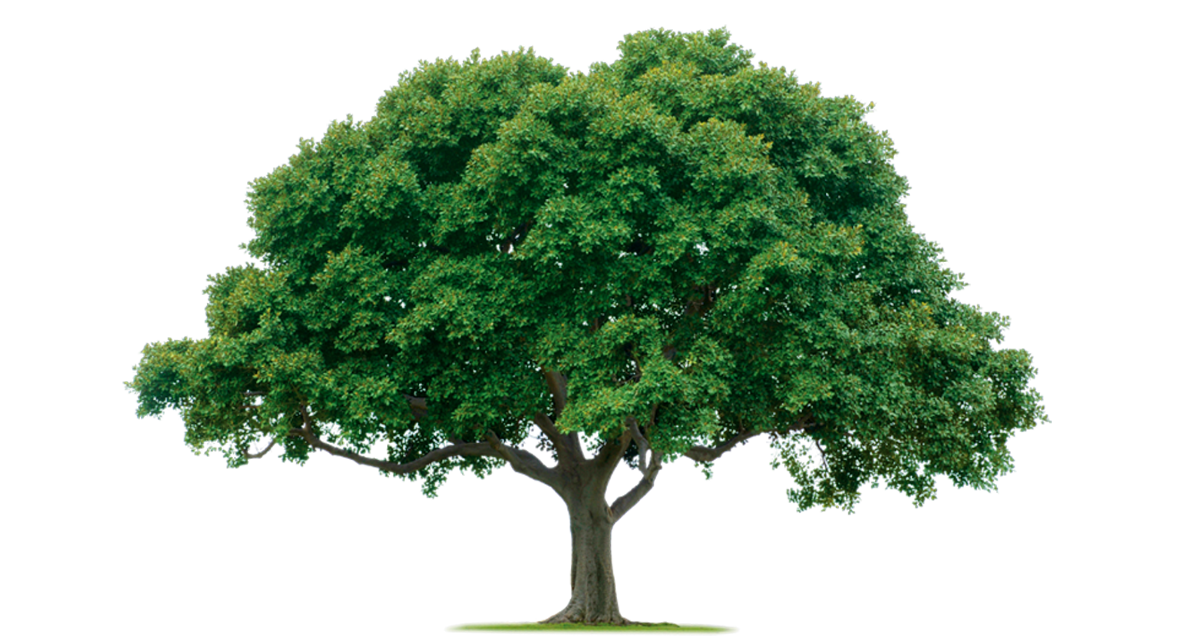
v

Slide 3
Grandmother
(grandma)
Grandfather
(grandpa)
Mother
(mom)
Father
(dad)
Cousin
Cousin
Uncle
Aunt
ME

Slide 4
grandmother
grandfather
grandmother
grandfather
Father
Mother
Uncle
Aunt
Uncle
Aunt
Uncle
Aunt
ME
Cousin
Cousin
brother
Sister

Slide 5
www.familyecho.com

Slide 6
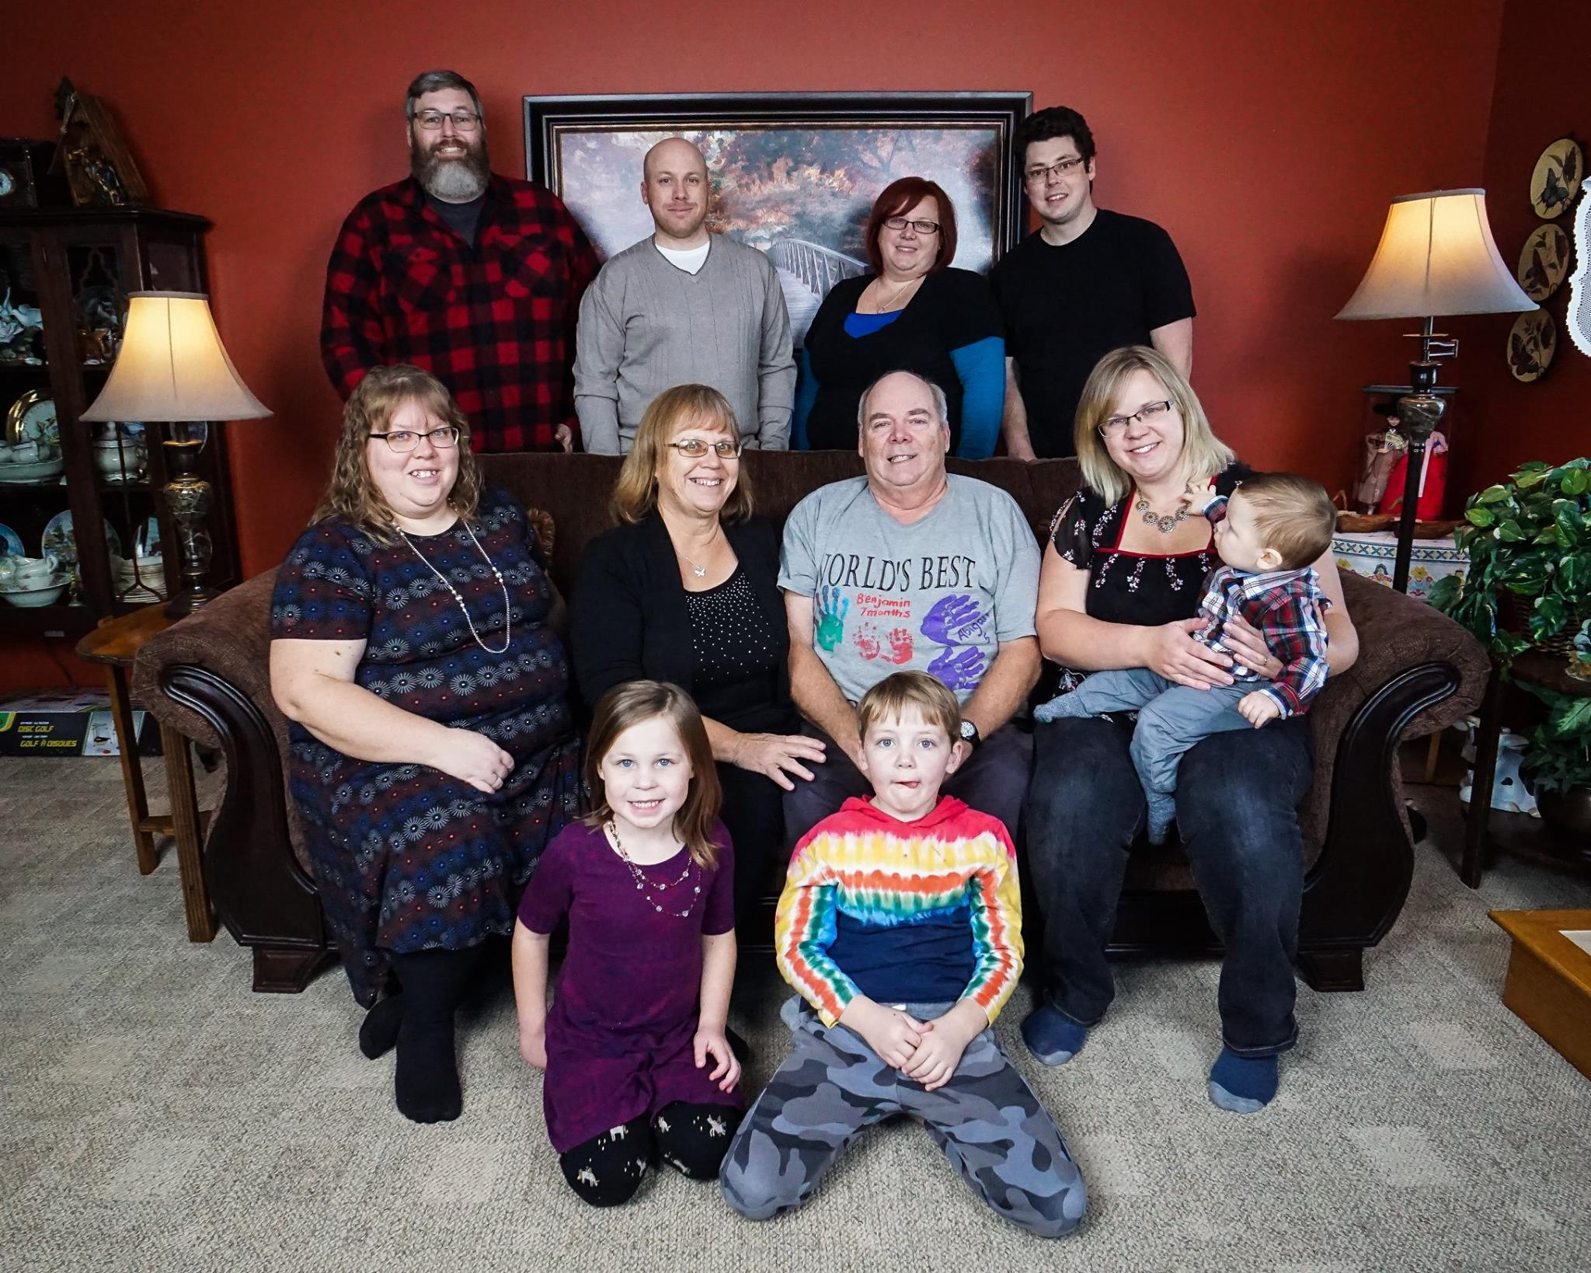
My Family

Slide 7
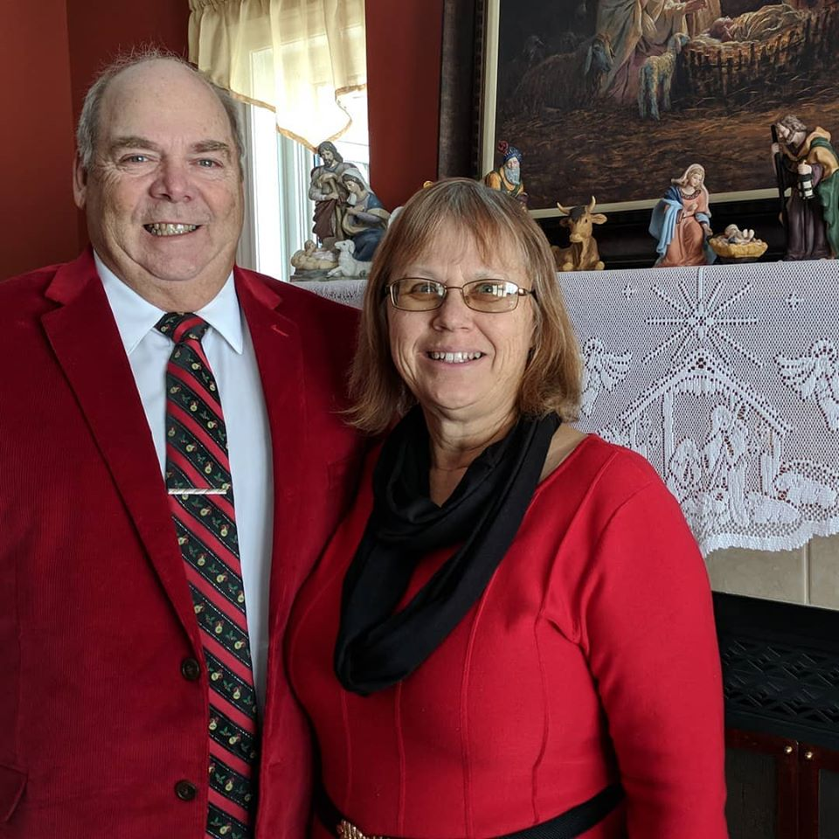
Mother and Father

Slide 8
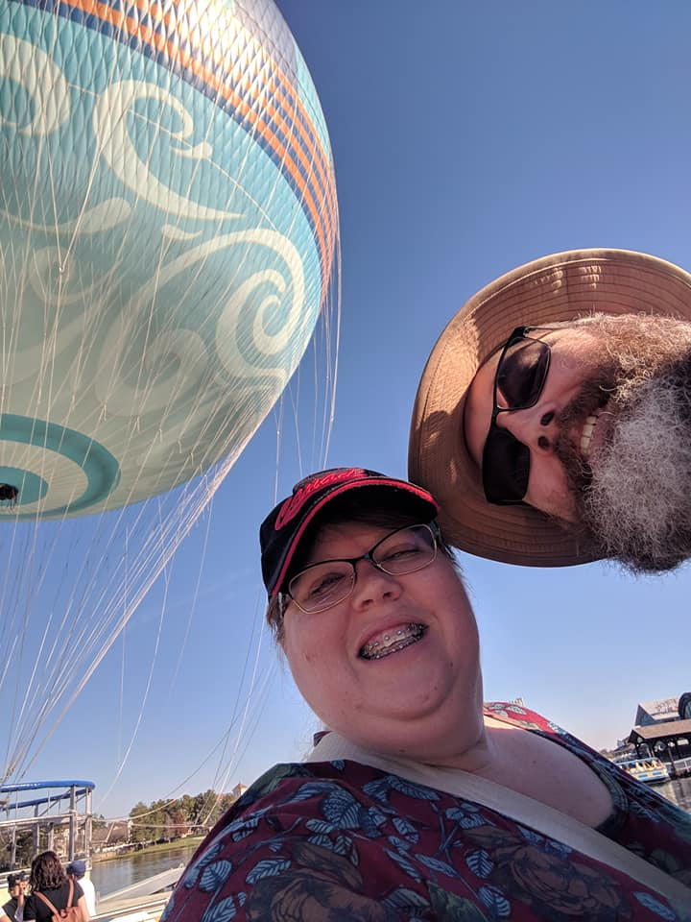
Debbie and Dave

Slide 9
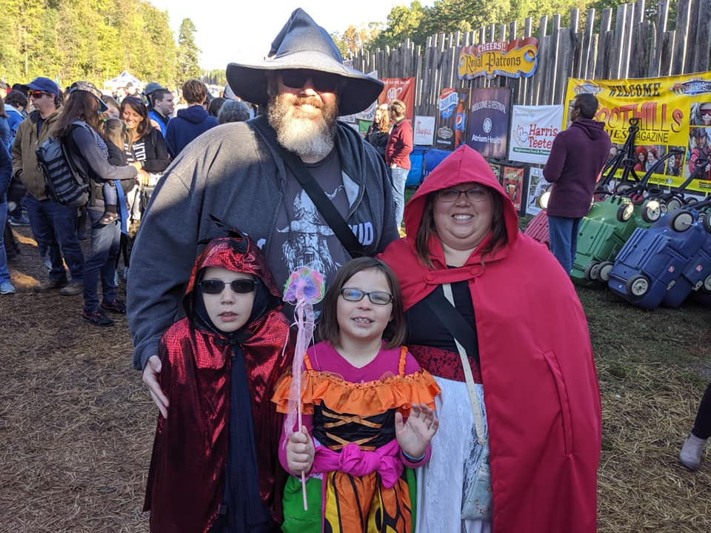
Zeke and Abigail

Slide 10
Amanda

Slide 11
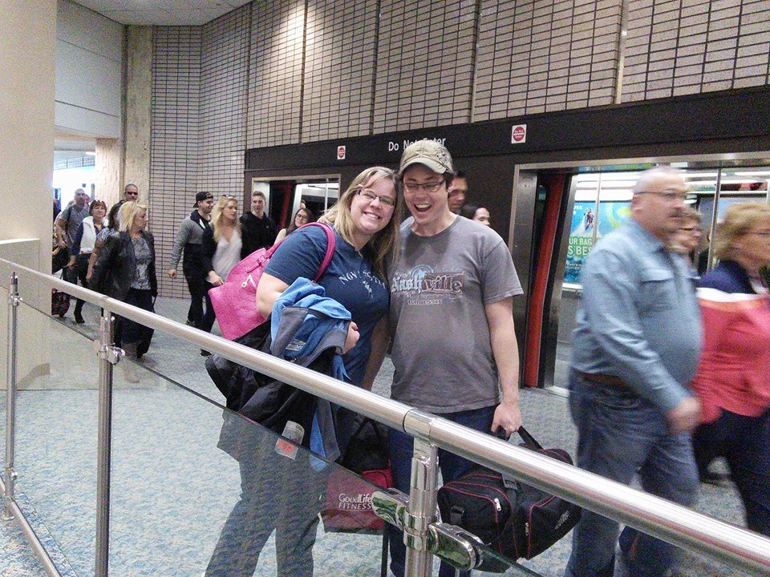
Melissa and Bob

Slide 12
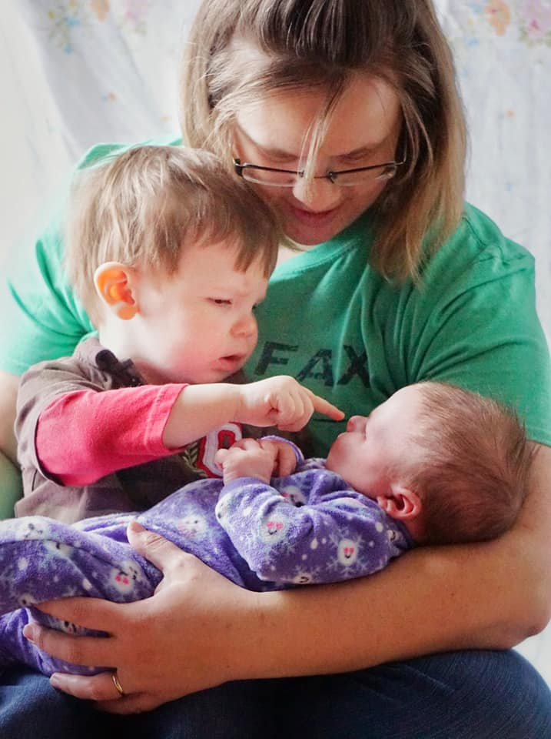
Benjamin Lydia

Slide 13
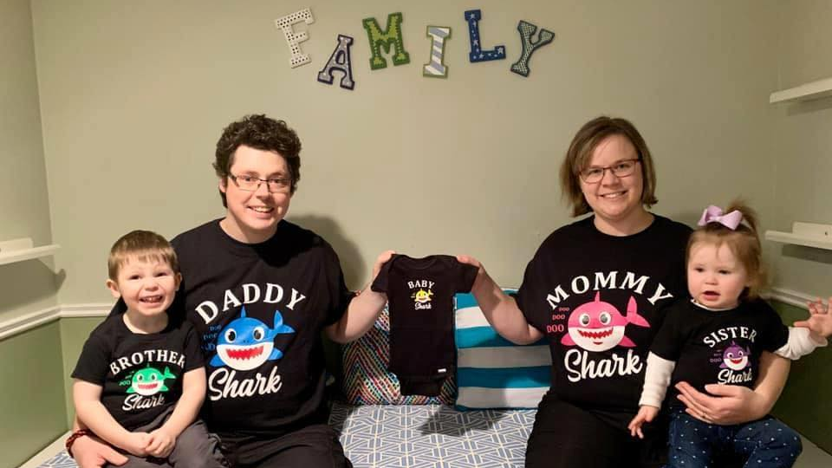

Slide 14
