Slide 1
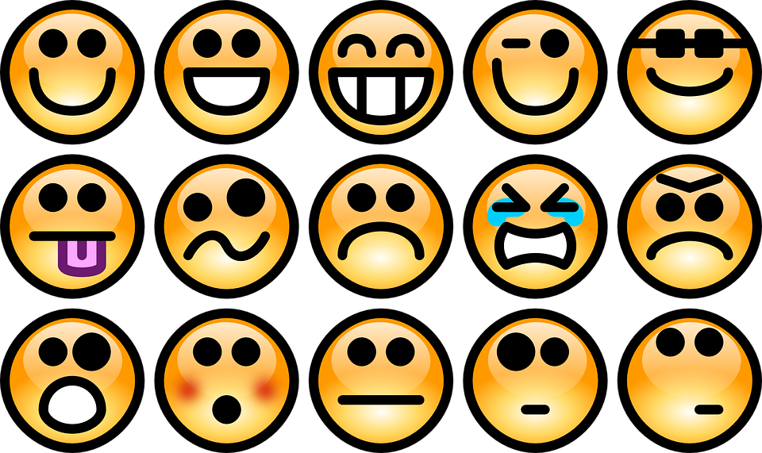
FEELINGS

Slide 2
Matching
1
2
3
4
5
6
scared
angry
sad
sick
tired
happy

Slide 3
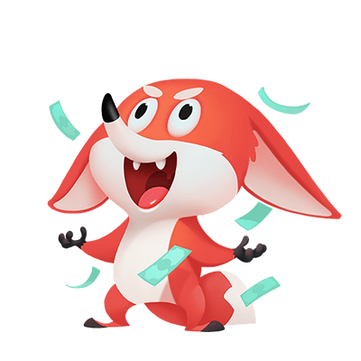
FEELINGS
Excited
She is excited.
Are you excited?

Slide 4
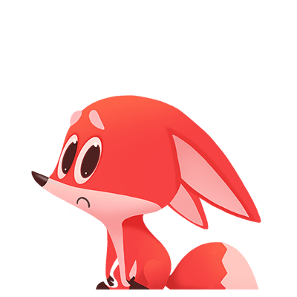
FEELINGS
Jealous
She is jealous.
When do you feel jealous?

Slide 5
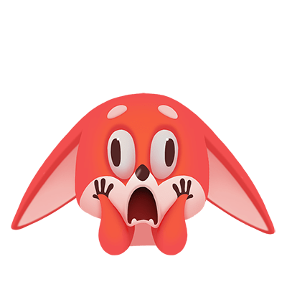
FEELINGS
Surprised
He is surprised.
When are you surprised?

Slide 6
FEELINGS
Bored
She is bored.
Are you bored?

Slide 7
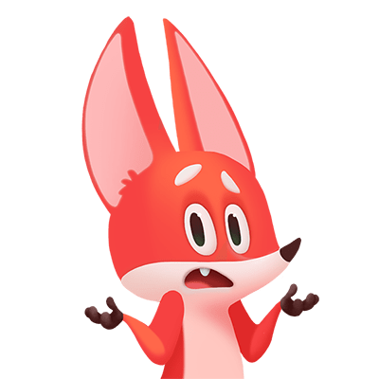
FEELINGS
Confused
He is confused.
Are you confused?

Slide 8
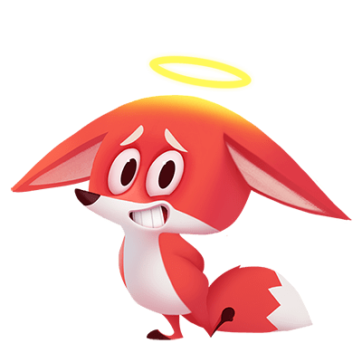
FEELINGS
Worried
He is worried.
Are you worried ?

Slide 9
Matching
1
2
3
4
5
6
excited
confused
surprised
worried
jealous
bored
?

Slide 10
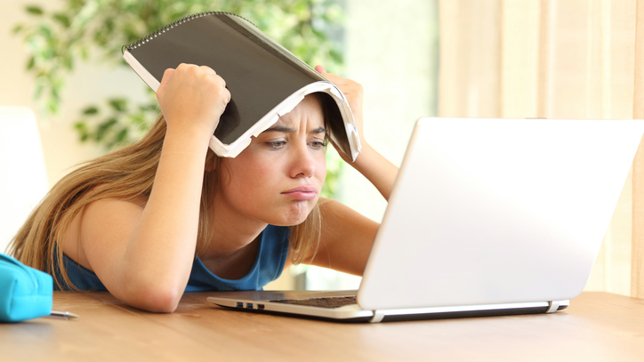
How does she feel?
Excited
Jealous
Surprised
Bored
Confused
Worried
bored
She is _______.

Slide 11
Excited
Jealous
Surprised
Bored
Confused
Worried
How does he feel?
confused
He is ___________.

Slide 12
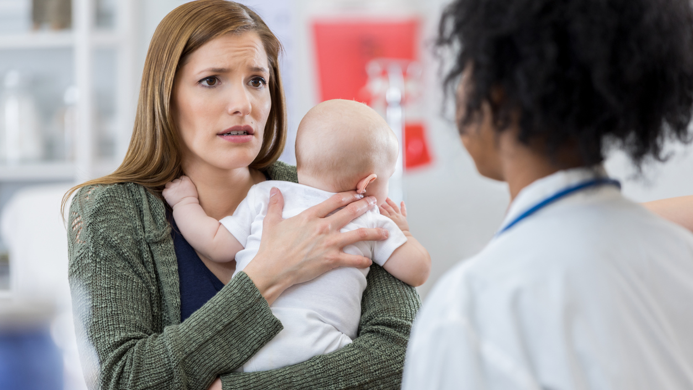
Excited
Jealous
Surprised
Bored
Confused
Worried
How does she feel?
worried
She is _________.

Slide 13
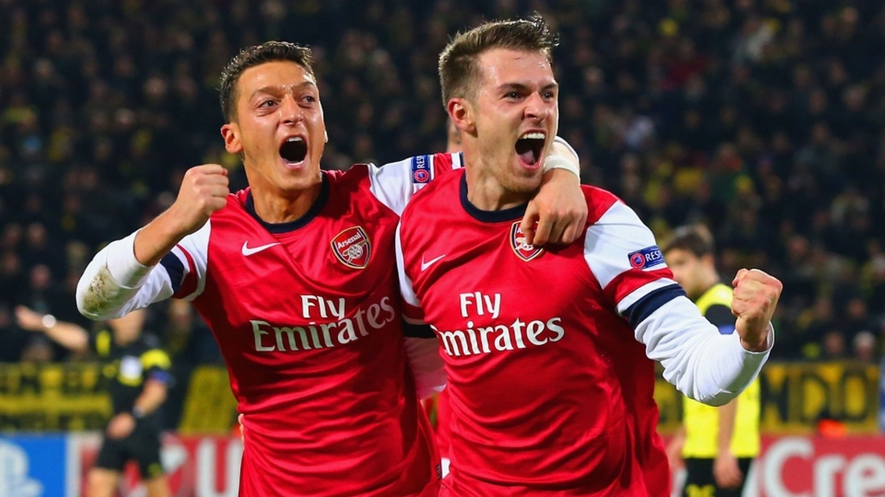
How do they feel?
excited
They are ________.
Excited
Jealous
Surprised
Bored
Confused
Worried

Slide 14
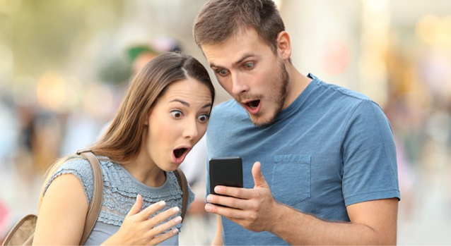
How do they feel?
Excited
Jealous
Surprised
Bored
Confused
Worried
surprised
They are ___________.

Slide 15
How does she feel?
jealous
She is ________.
Excited
Jealous
Surprised
Bored
Confused
Worried

Slide 16
Questions

Slide 17
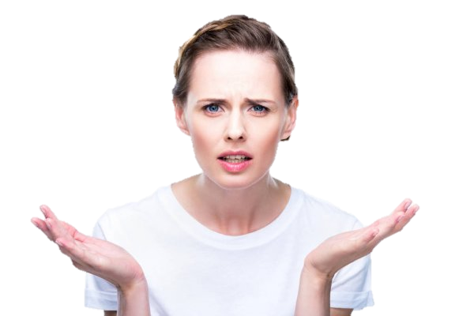
What subject makes you confused?
I am confused
by...

Slide 18
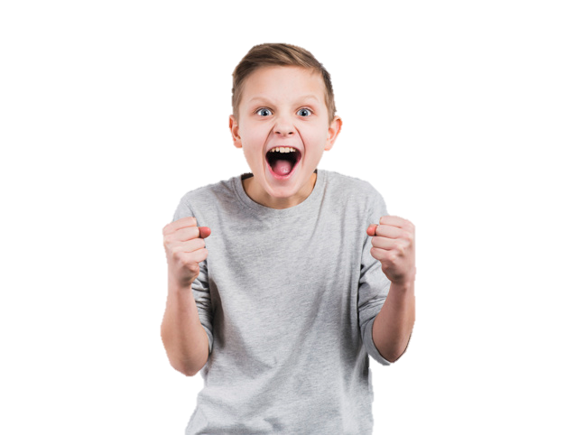
What makes you excited?
I feel excited
when...

Slide 19
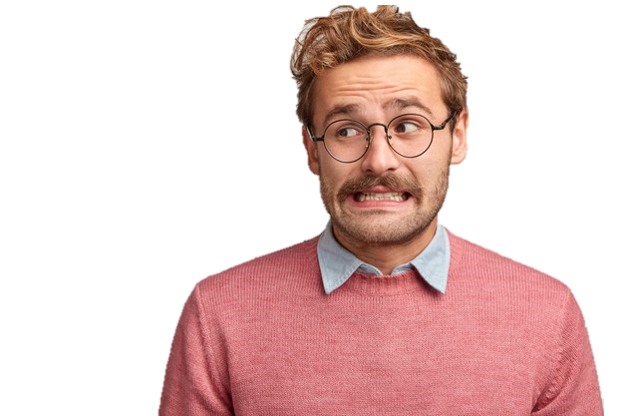
Are you worried about anything?
I am worried
about...

Slide 20
When do you feel bored?
I feel bored
when...

Slide 21
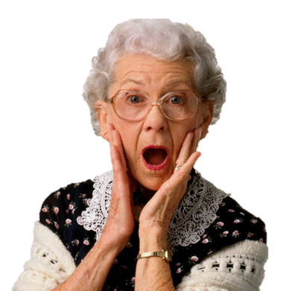
Do you like feeling surprised?
I like / don’t like being surprised
because...

Slide 22
Are you jealous of anyone?
I am jealous
of...

