Slide 1
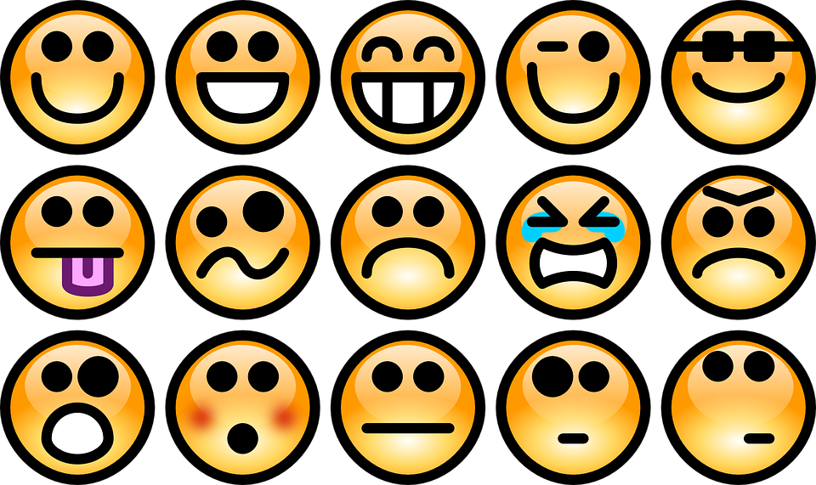
FEELINGS

Slide 2
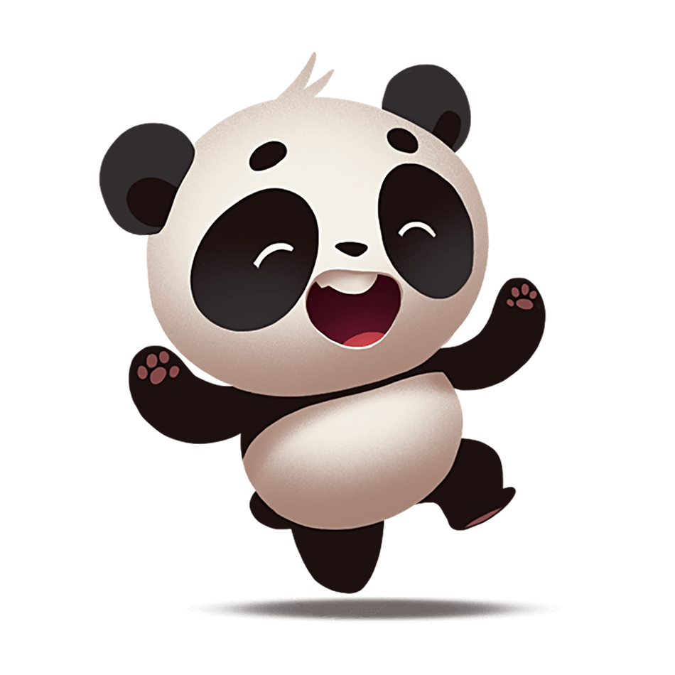
FEELINGS
happy
She is happy.
Are you happy ?

Slide 3
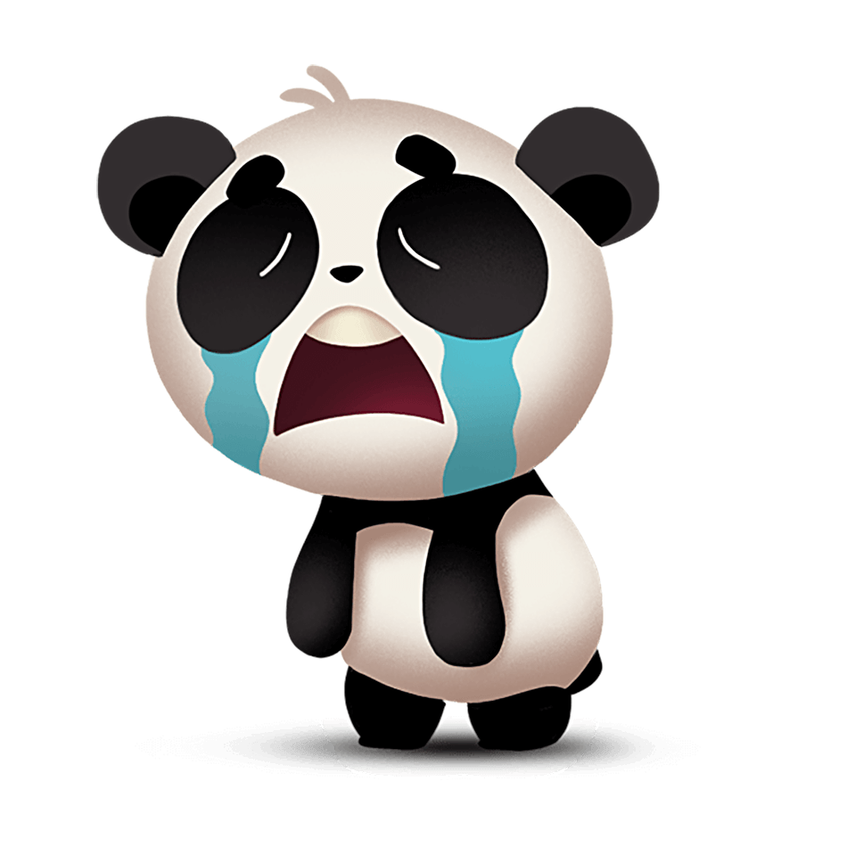
FEELINGS
Sad
She is sad.
When do you feel sad ?

Slide 4
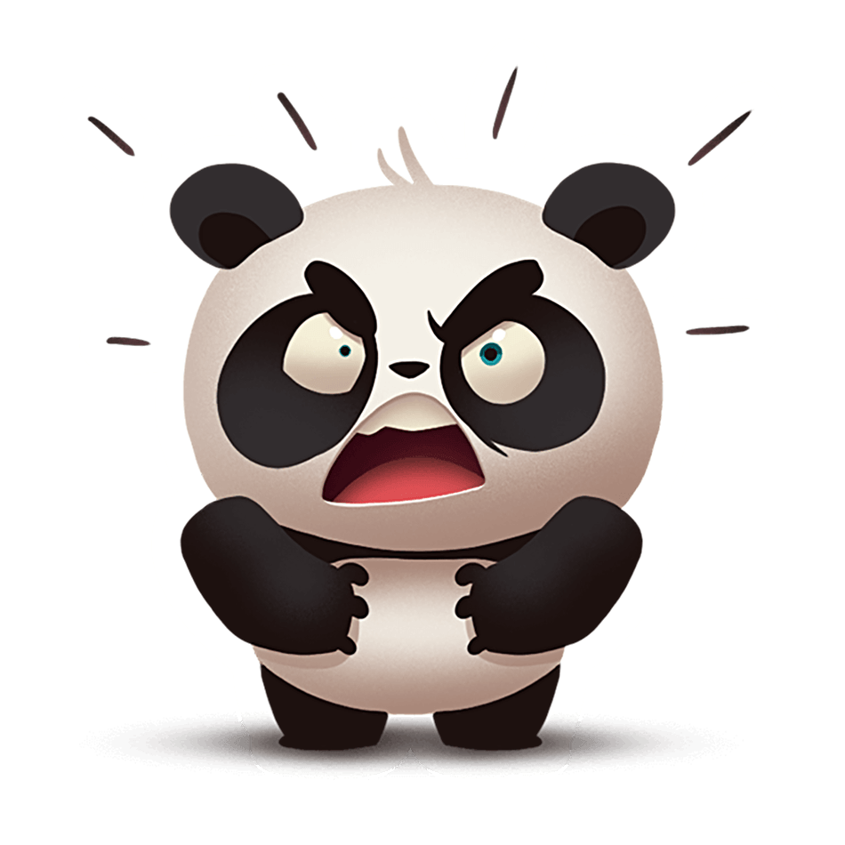
FEELINGS
angry
He is angry.
Are you angry ?

Slide 5
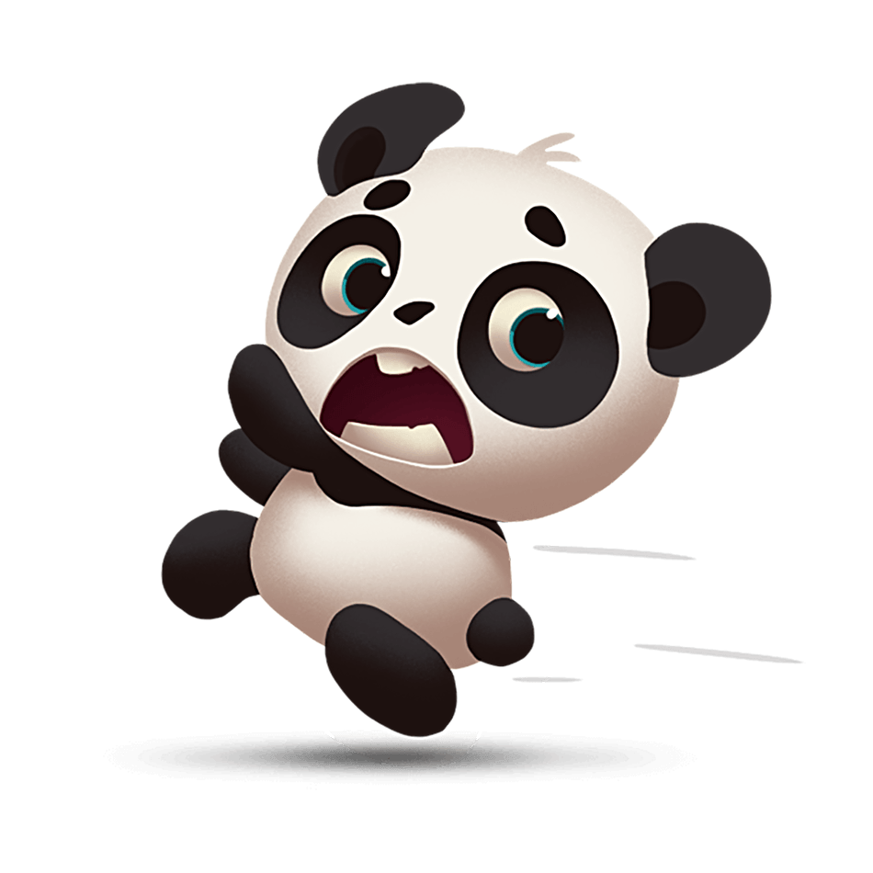
FEELINGS
scared
She is scared.
Are you scared ?

Slide 6
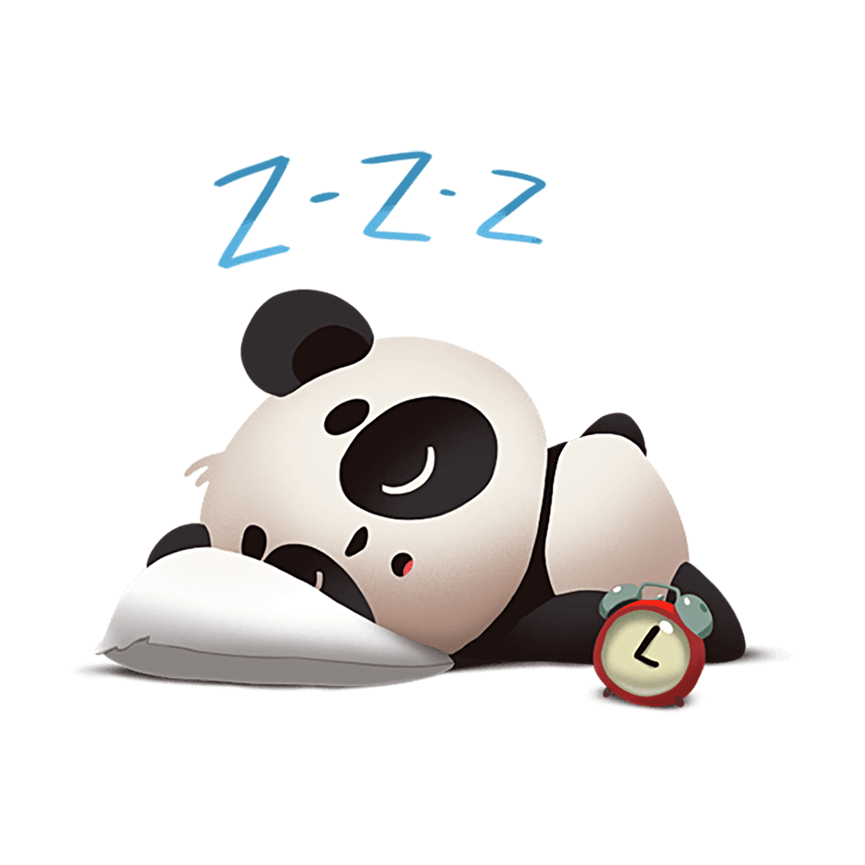
FEELINGS
tired
He is tired.
Are you tired ?

Slide 7
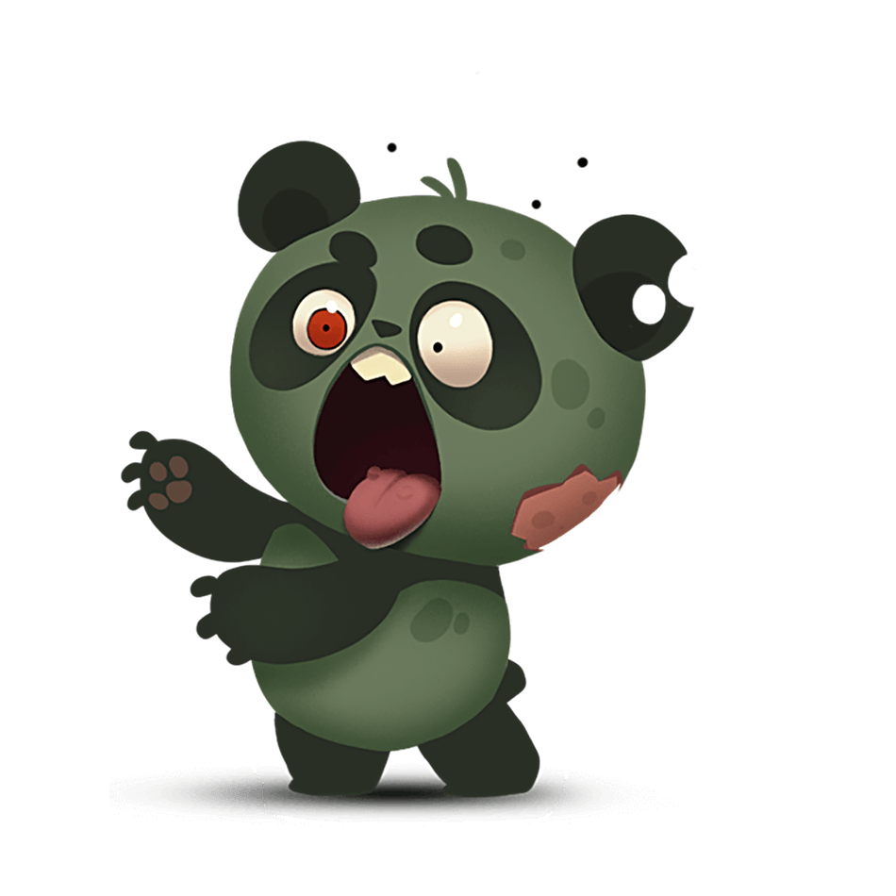
FEELINGS
sick
He is sick.
Are you sick ?

Slide 8
Matching
1
2
3
4
5
6
scared
angry
sad
sick
tired
happy

Slide 9
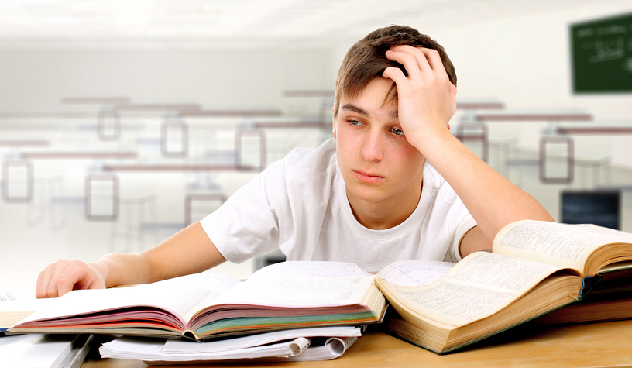
happy
sad
angry
tired
scared
sick
How does he feel?
tired
He is ______.

Slide 10
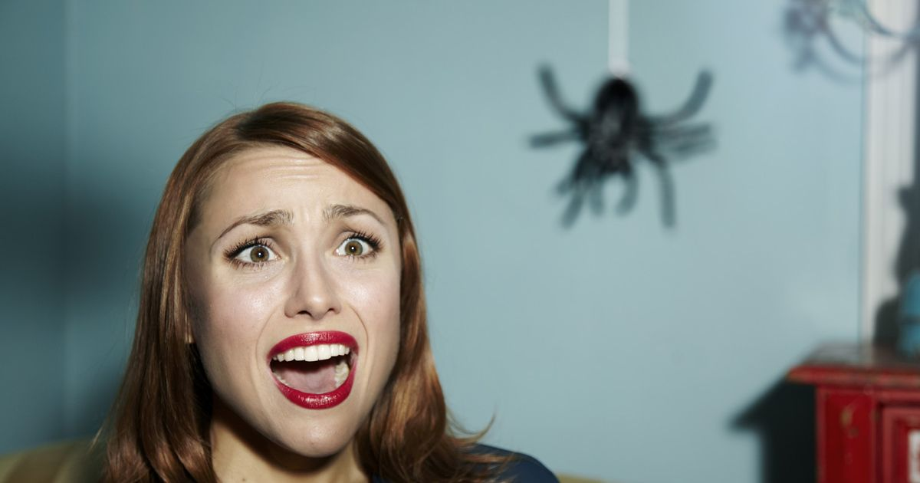
happy
sad
angry
tired
scared
sick
How does she feel?
scared
She is _________.

Slide 11
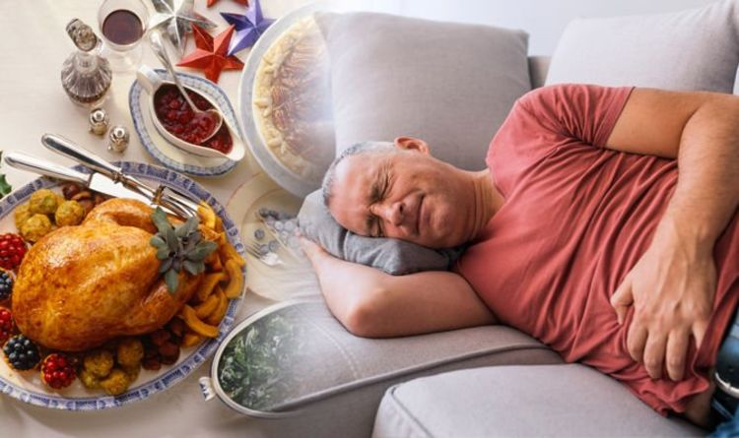
tired
scared
sick
happy
sad
angry
How does he feel?
sick
He is ________.

Slide 12
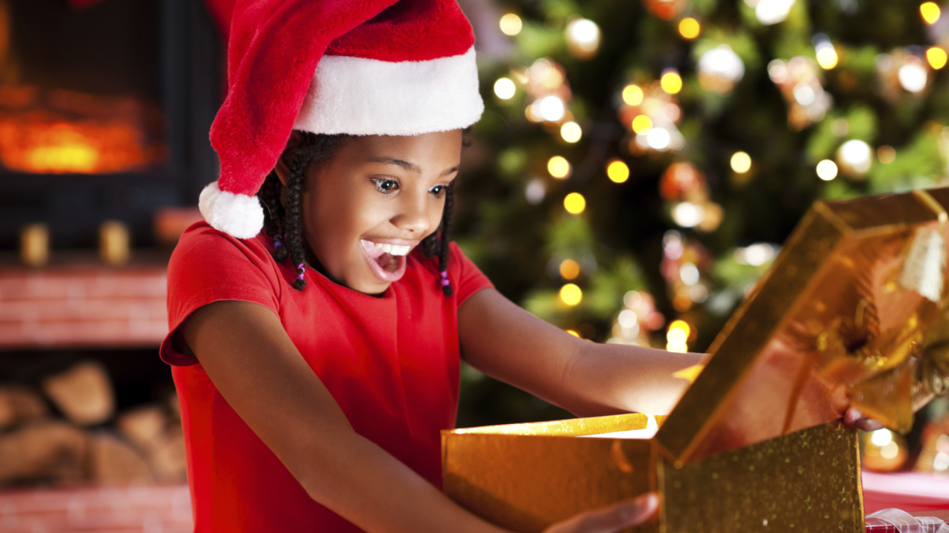
happy
She is ________.
How does she feel?
happy
sad
angry
tired
scared
sick

Slide 13
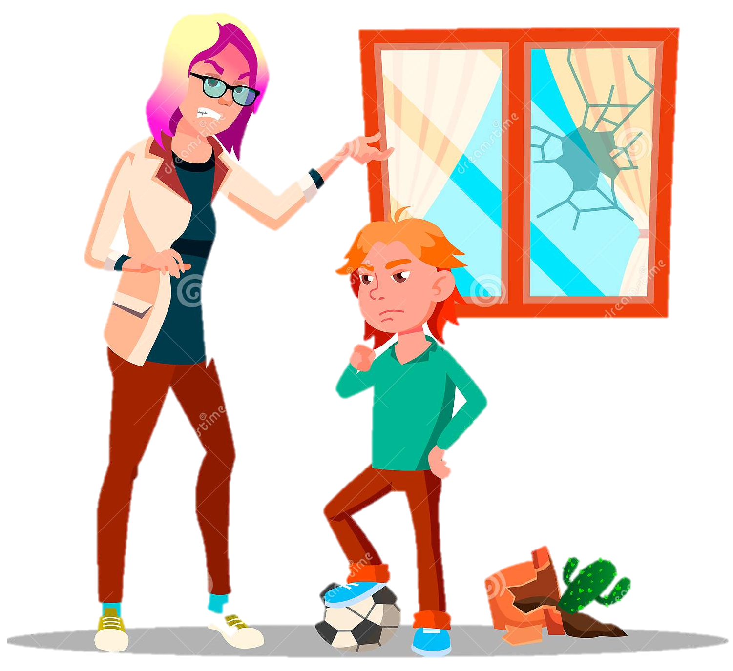
happy
sad
angry
tired
scared
sick
How does she feel?
angry
She is ________.

Slide 14
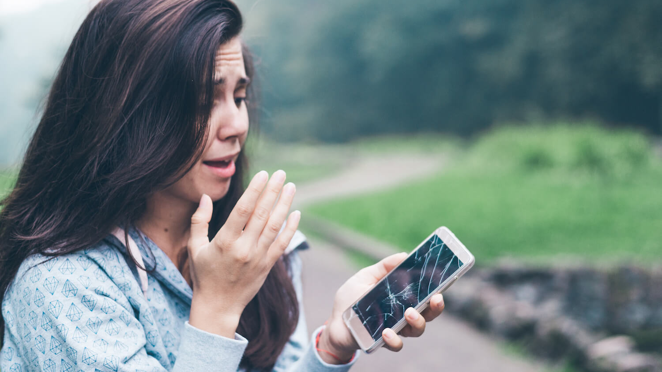
sad
She is ________.
How does she feel?
happy
sad
angry
tired
scared
sick

Slide 15
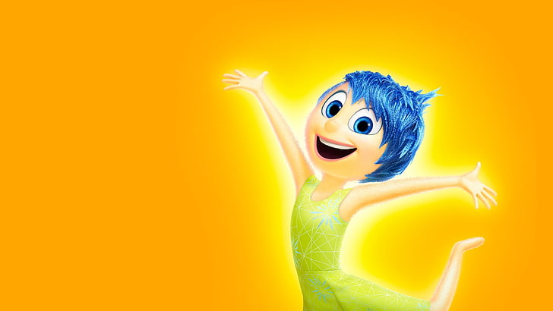
Questions
When do you feel happy?
I feel happy
when...

Slide 16
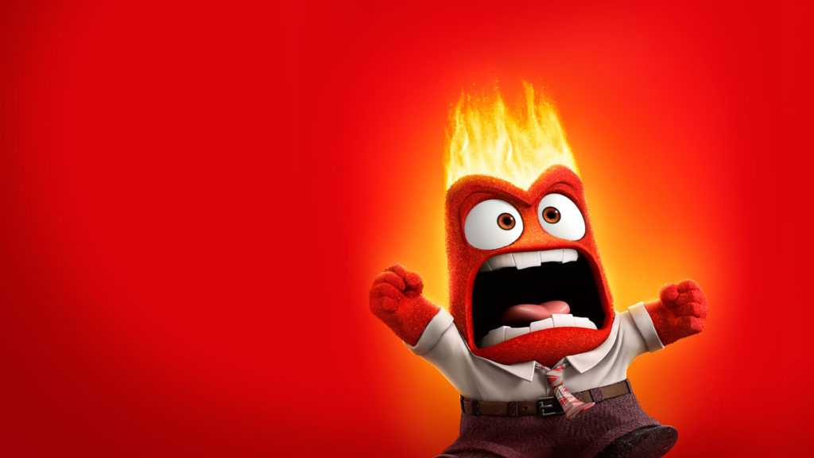
Questions
When do you feel angry?
I feel angry
when...

Slide 17
Questions
When do you feel scared?
I feel scared
when...

Slide 18
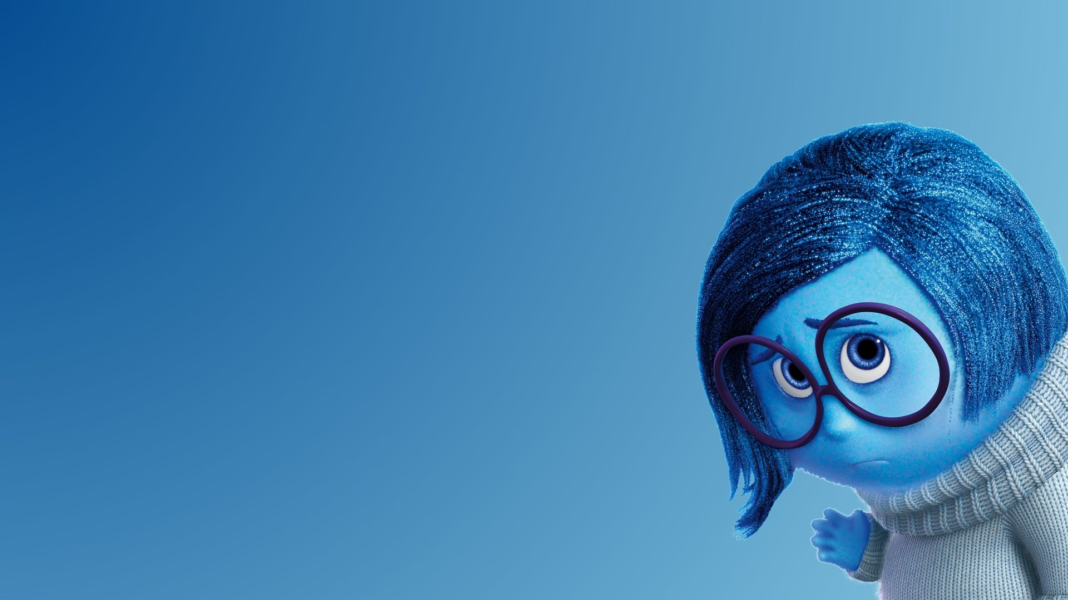
Questions
When do you feel sad?
I feel sad
when...

Slide 19
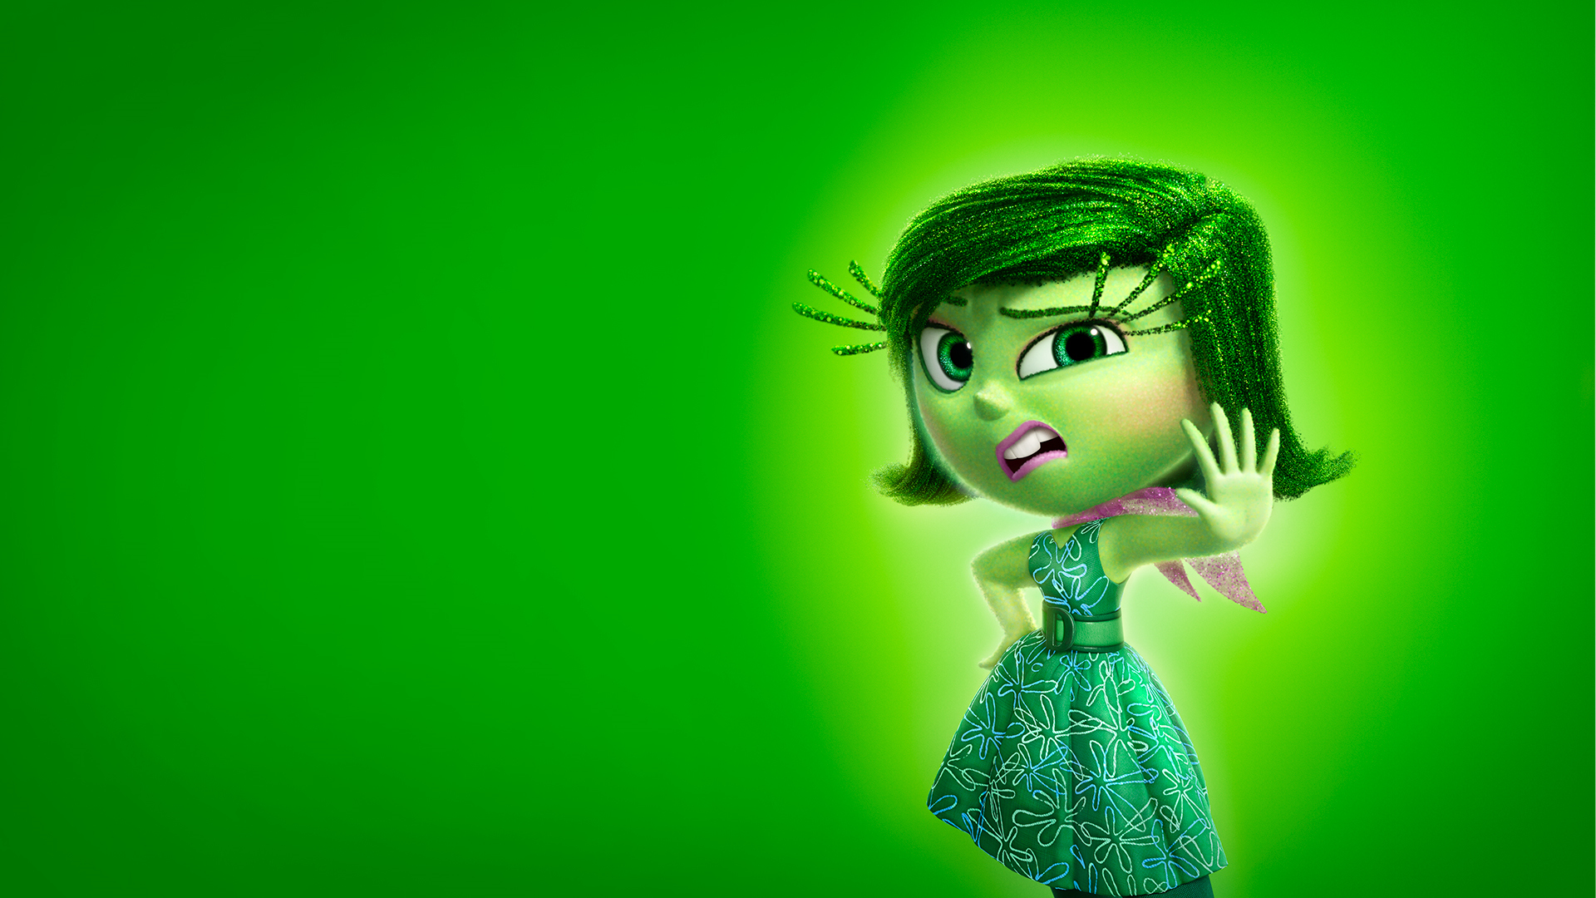
Questions
When do you feel sick?
I feel sick
when...

Slide 20
Questions
When do you feel tired?
I feel tired
when...

