Slide 1
FOOD
FOOD
FOOD
FOOD
FOOD
FOOD
FOOD
FOOD
FOOD
FOOD
FOOD
FOOD
FOOD
FOOD
FOOD
FOOD
FOOD
FOOD
FOOD
FOOD

Slide 2
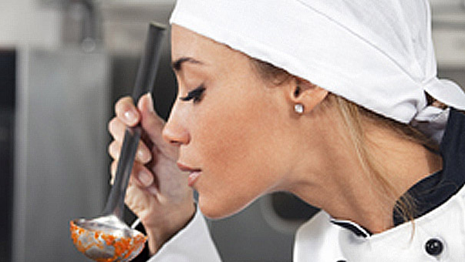
FOOD
Flavor
맛
- the taste of the food

Slide 3
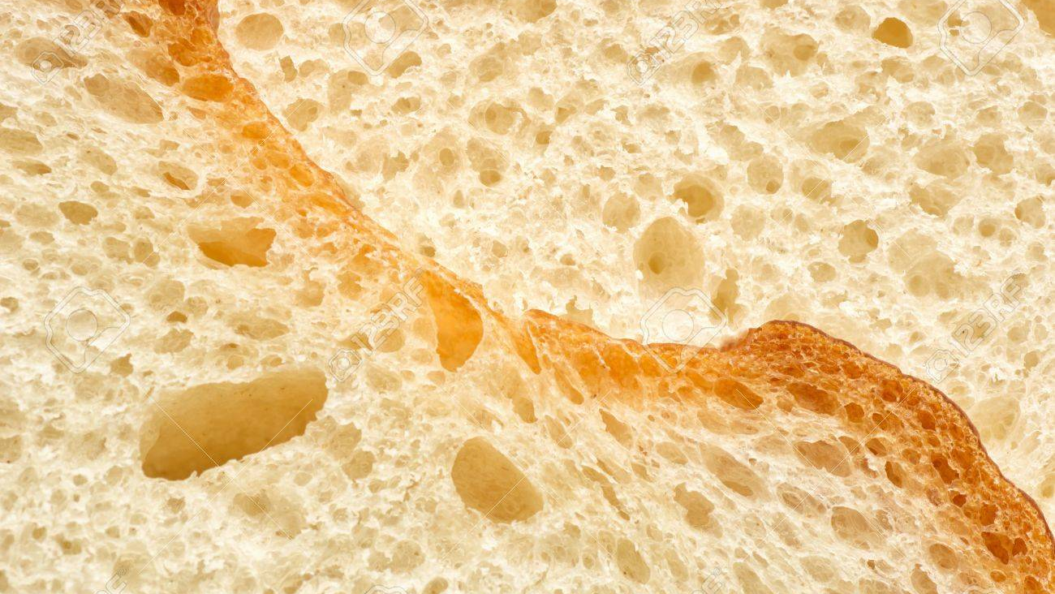
FOOD
Texture
질감
- how does the food feel?

Slide 4
GUESS

Slide 5
TEXTURE
Chewy
TASTE

Slide 6
TEXTURE
Moist
TASTE

Slide 7
TEXTURE
Spicy
TASTE

Slide 8
TEXTURE
Greasy
TASTE

Slide 9
TEXTURE
Sweet
TASTE

Slide 10
TEXTURE
Salty
TASTE

Slide 11
TEXTURE
Sour
TASTE

Slide 12
TEXTURE
Crunchy
TASTE

Slide 13
TEXTURE
Bitter
TASTE

Slide 14
MATCH

Slide 15
Greasy
Chewy
Moist
Crunchy

Slide 16
Salty
Spicy
Sour
Sweet
Bitter

Slide 17
EXPLAIN

Slide 18
TASTE
TEXTURE
Food
taste
texture
_______________ is / are _________________ and __________________.

Slide 19
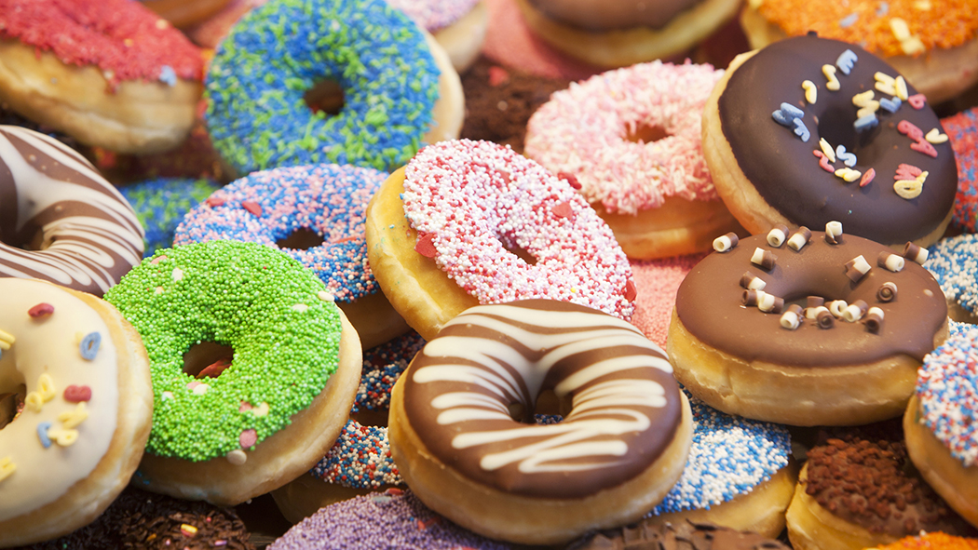
DONUTS
Donuts
sweet
moist
_______________ is / are _________________ and __________________.

Slide 20
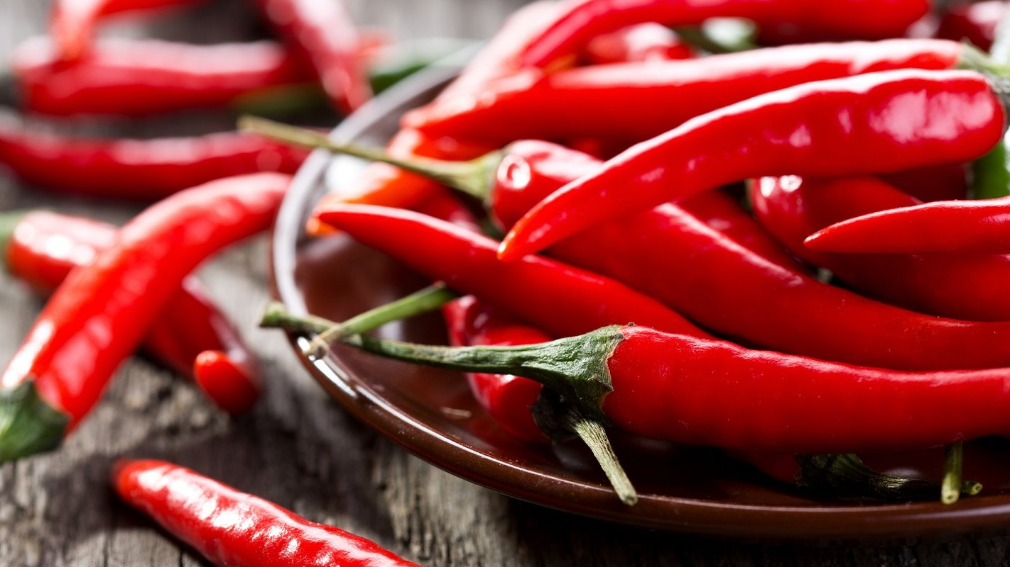
PEPPERS
Peppers
spicy
crunchy
_______________ is / are _________________ and __________________.

Slide 21
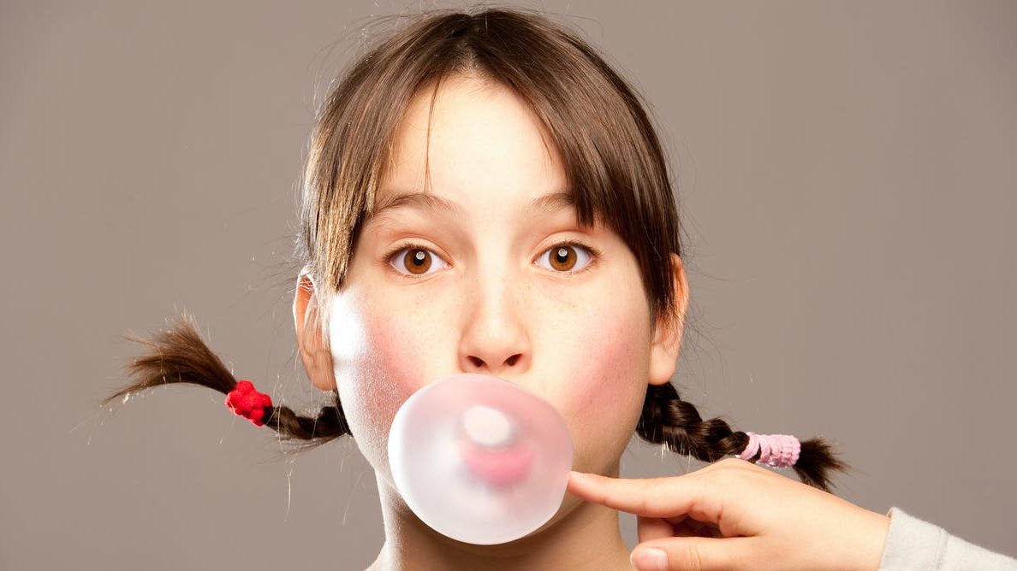
GUM
Gum
sweet
chewy
_______________ is / are _________________ and __________________.

Slide 22
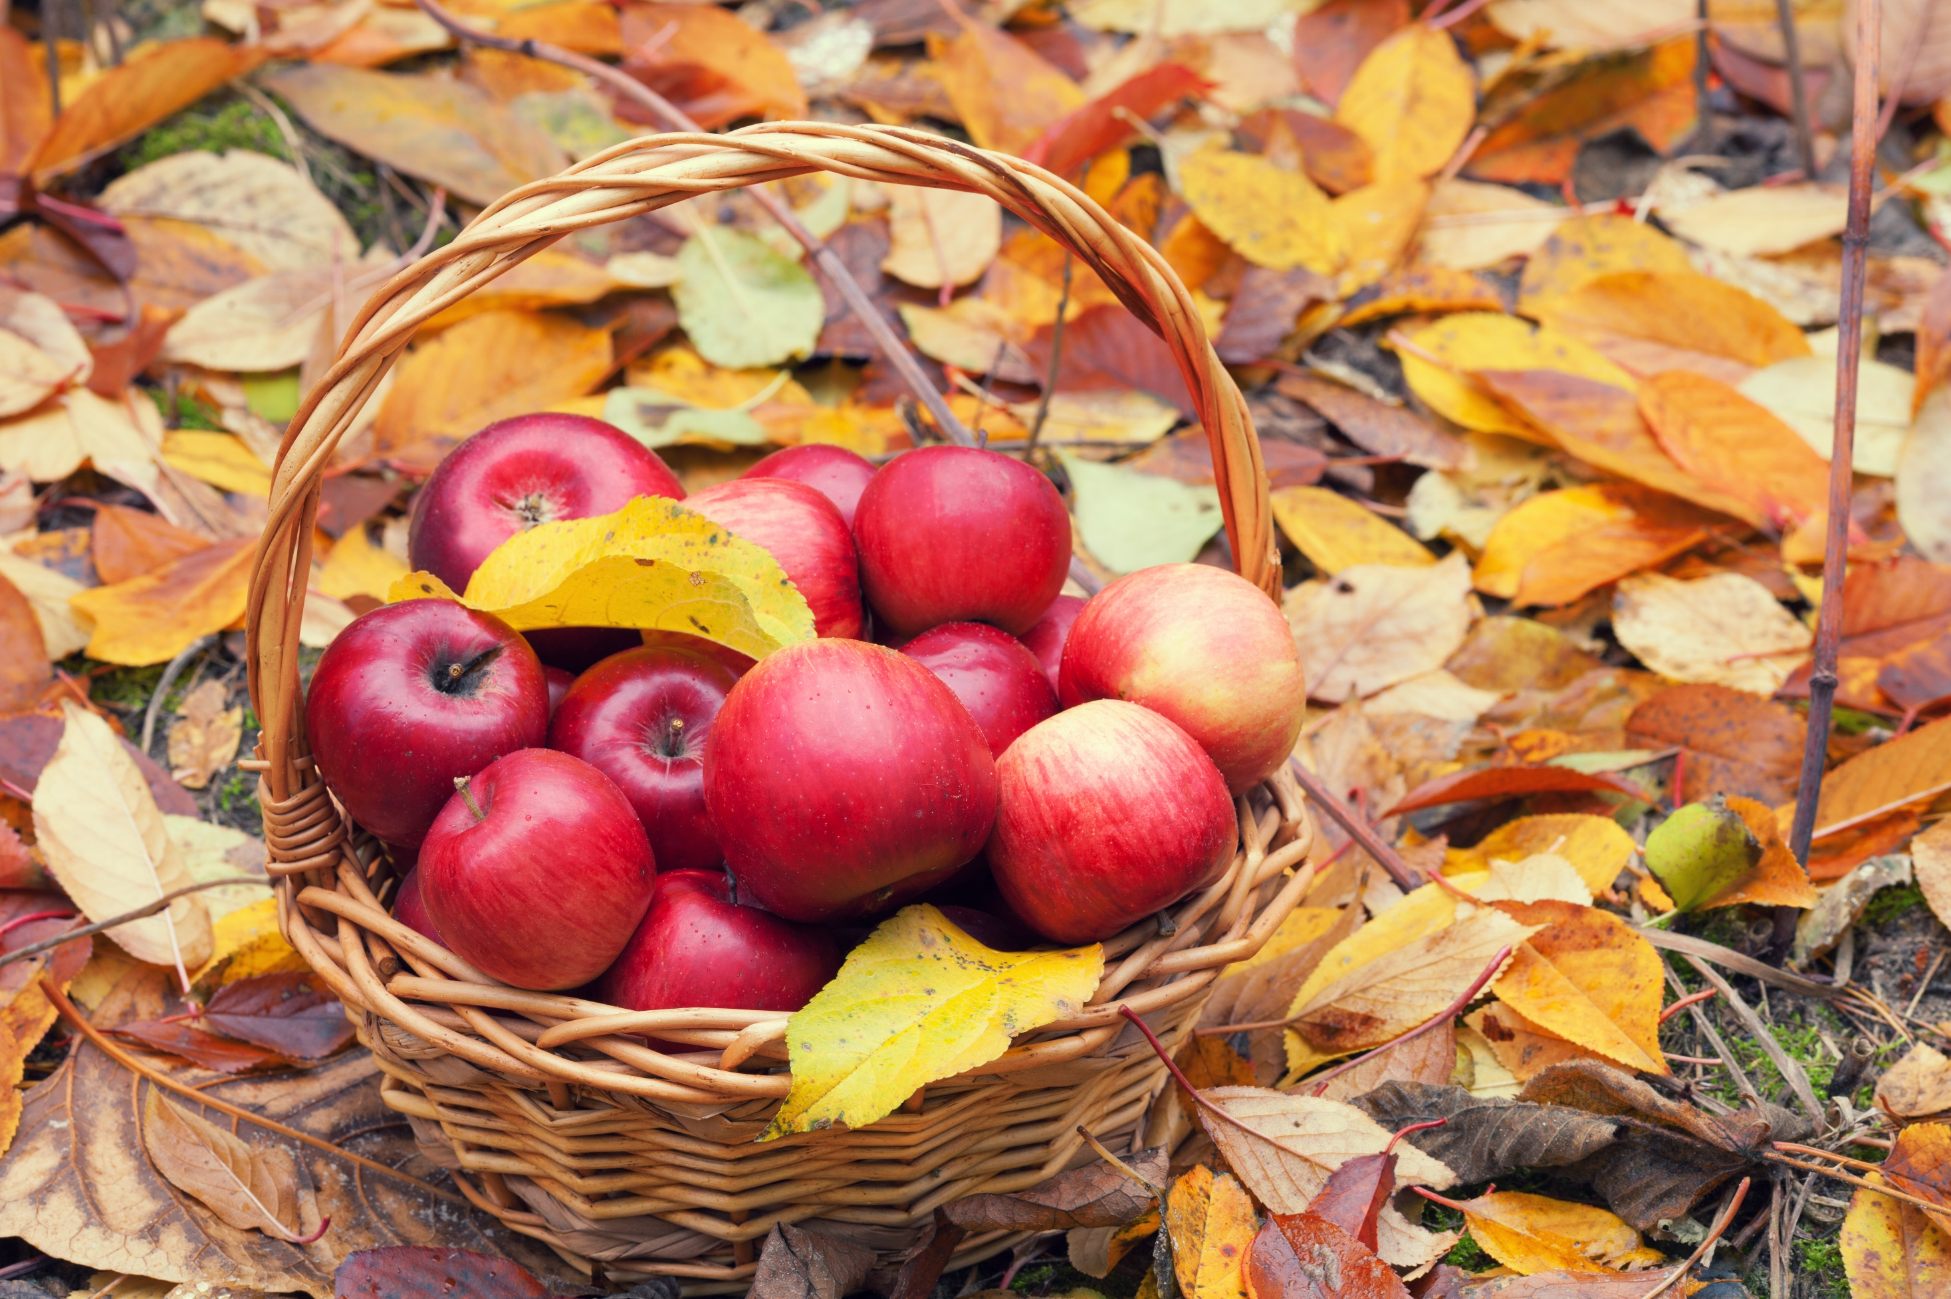
APPLES
Apples
sweet
crunchy
_______________ is / are _________________ and __________________.

Slide 23
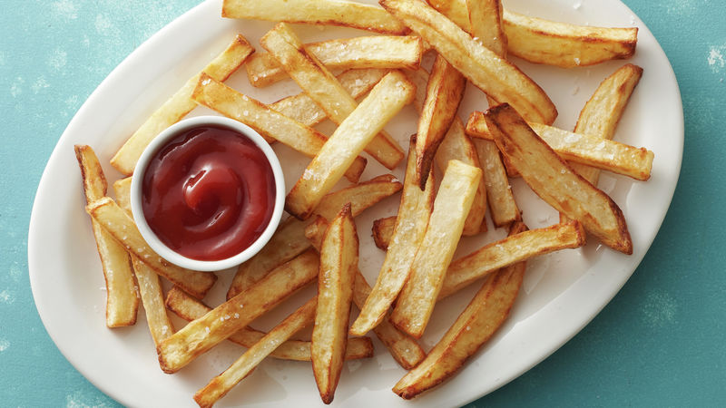
FRENCH FRIES
French Fries
salty
crunchy
_______________ is / are _________________ and __________________.

Slide 24
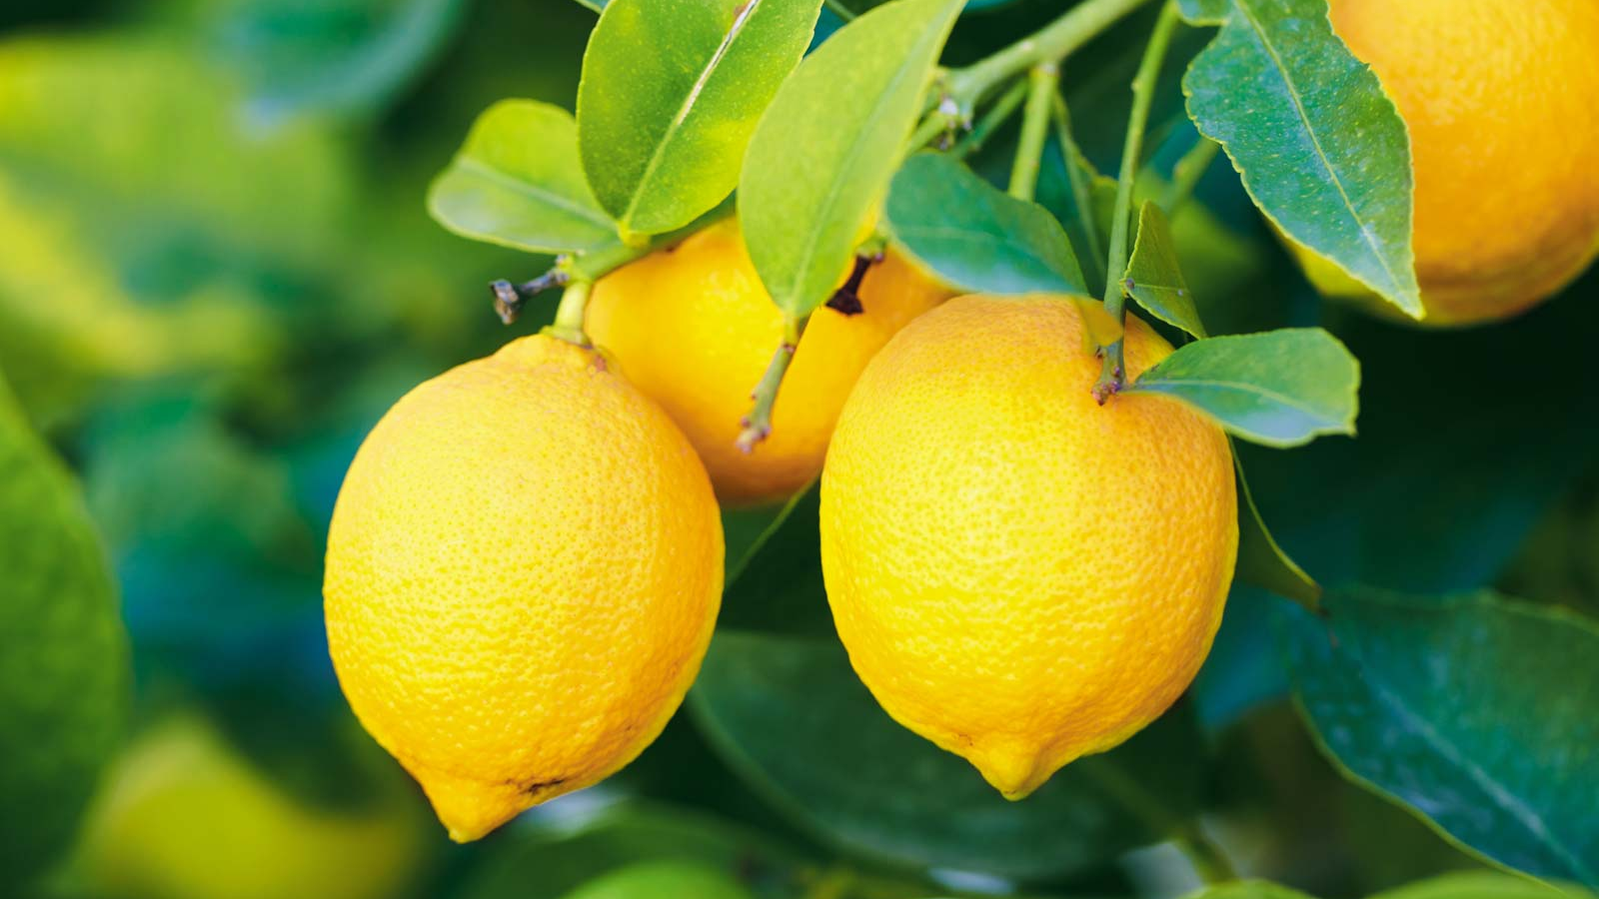
LEMONS
Lemons
sour
moist
_______________ is / are _________________ and __________________.

Slide 25
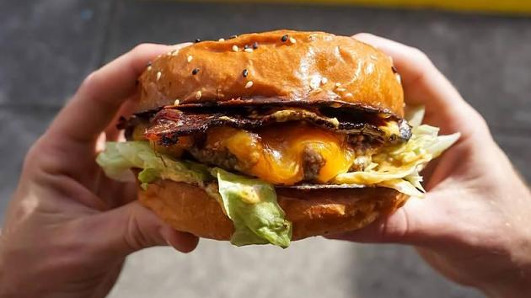
HAMBURGERS
Hamburgers
salty
greasy
_______________ is / are _________________ and __________________.

Slide 26
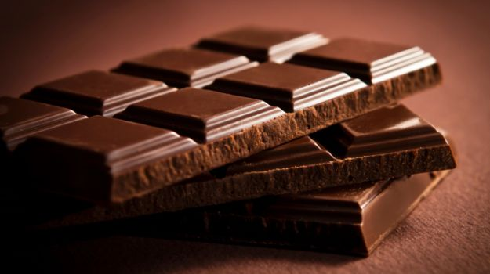
CHOCOLATE
Chocolate
sweet
crunchy
_______________ is / are _________________ and __________________.

Slide 27
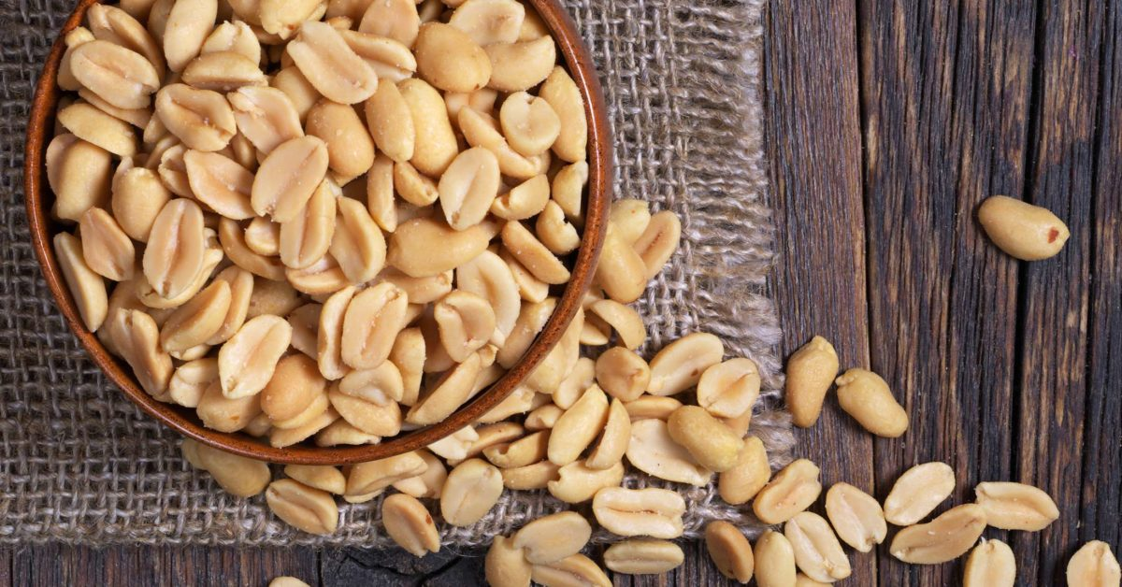
PEANUTS
Peanuts
salty
crunchy
_______________ is / are _________________ and __________________.

Slide 28
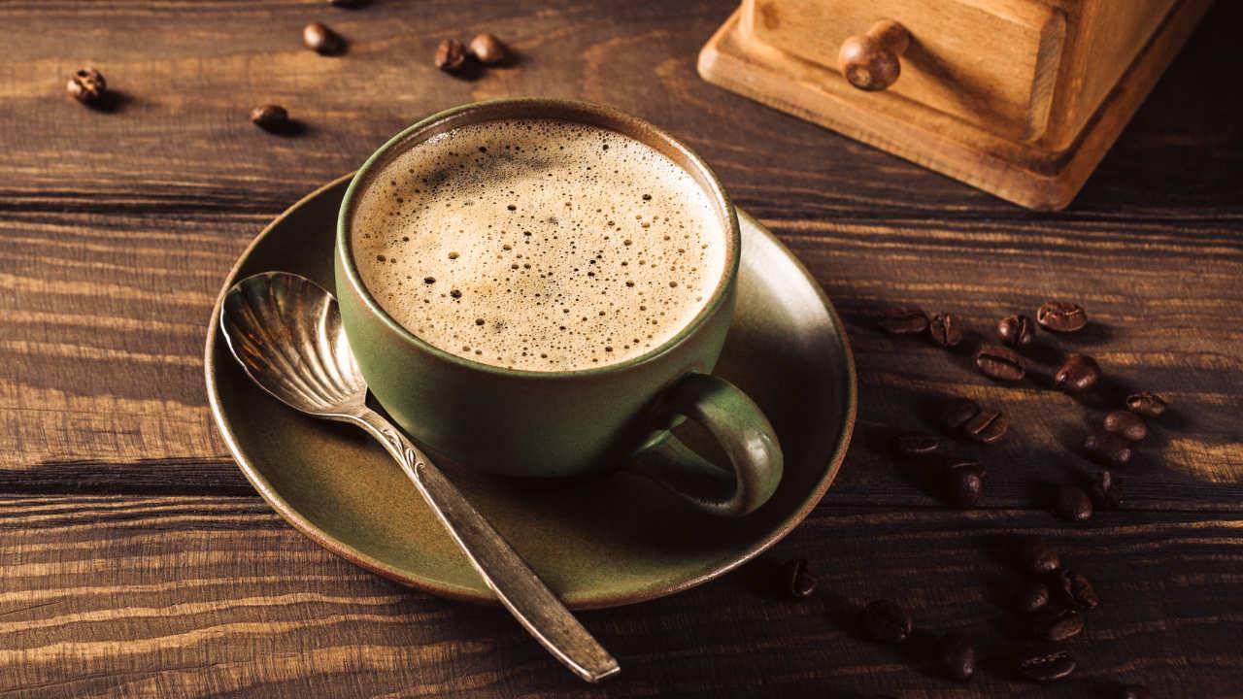
COFFEE
Coffee
bitter
moist
_______________ is / are _________________ and __________________.

Slide 29
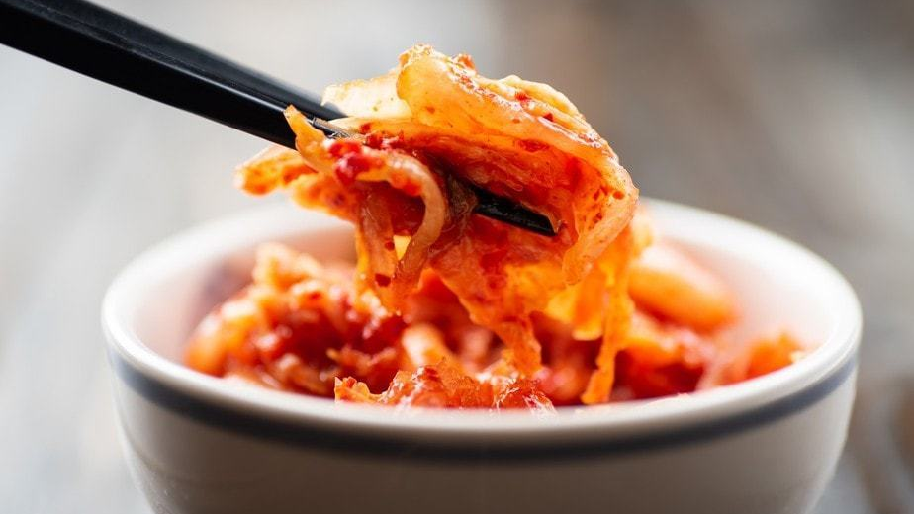
KIMCHI
Kimchi
spicy
crunchy
_______________ is / are _________________ and __________________.

Slide 30
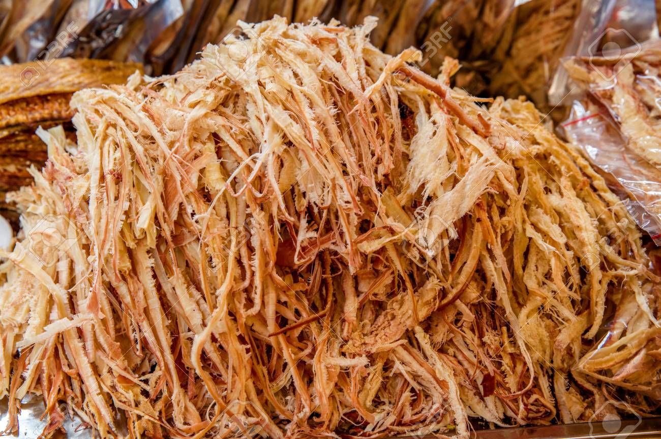
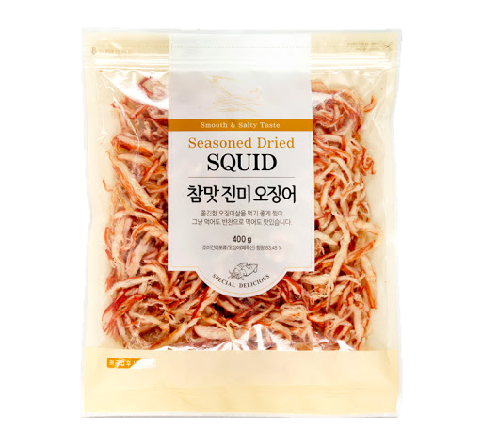
DRIED SQUID
Dried squid
salty
chewy
_______________ is / are _________________ and __________________.

Slide 31
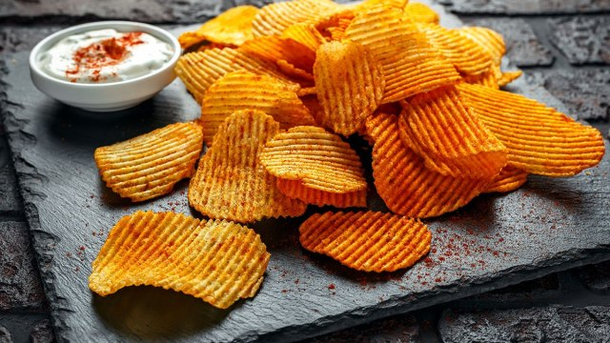
CHIPS
Chips
salty
crunchy
_______________ is / are _________________ and __________________.

Slide 32
FAVORITE
Food
taste
texture
_______________ is / are _________________ and __________________.

