Slide 1
Chia Pets

Slide 2
Cat

Slide 3
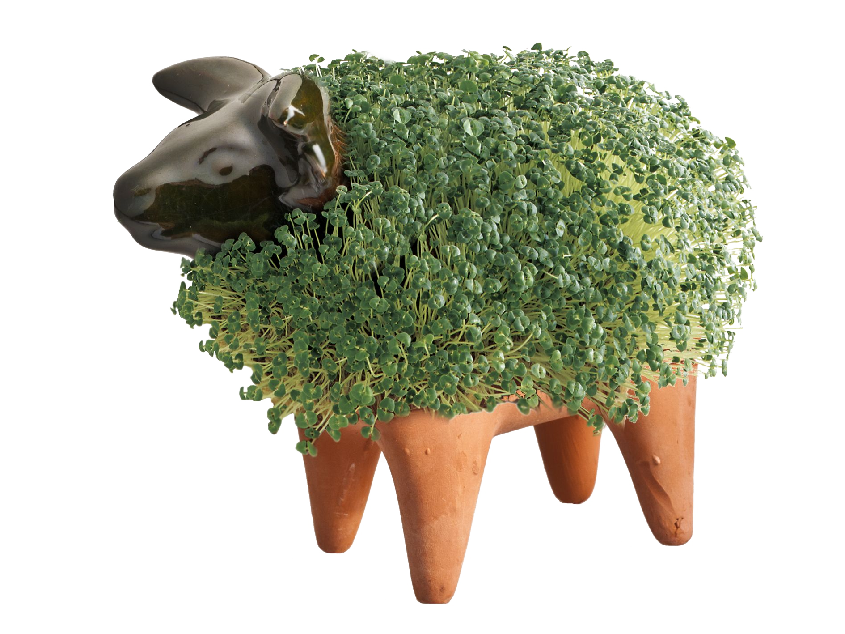
Sheep

Slide 4
turtle

Slide 5
Alligator

Slide 6
Elephant

Slide 7
Hedgehog

Slide 8
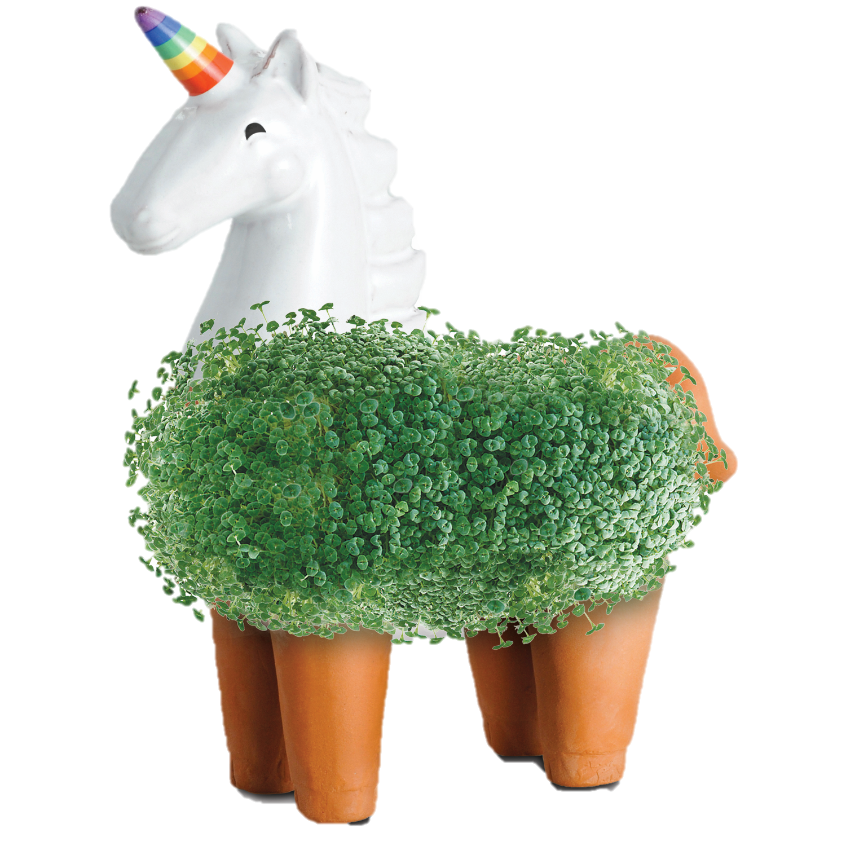
Unicorn

Slide 9
Groot

Slide 10
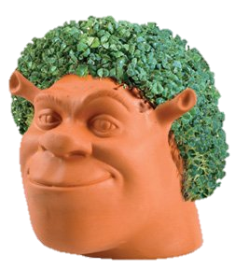
Shrek

Slide 11
Deadpool

Slide 12
Spongebob

Slide 13
Hello Kitty

Slide 14
Trump

Slide 15
Yoda

Slide 16
Lama

Slide 17
ET

Slide 18
end

