Slide 1
D
escribing
A
nimals

Slide 2
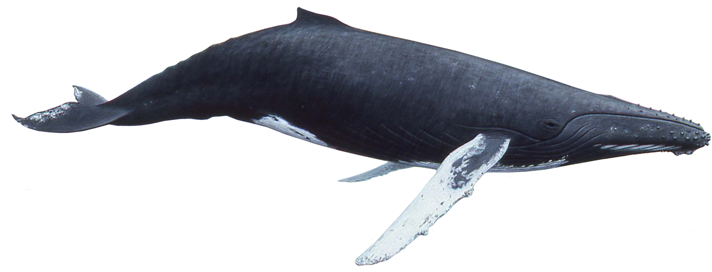
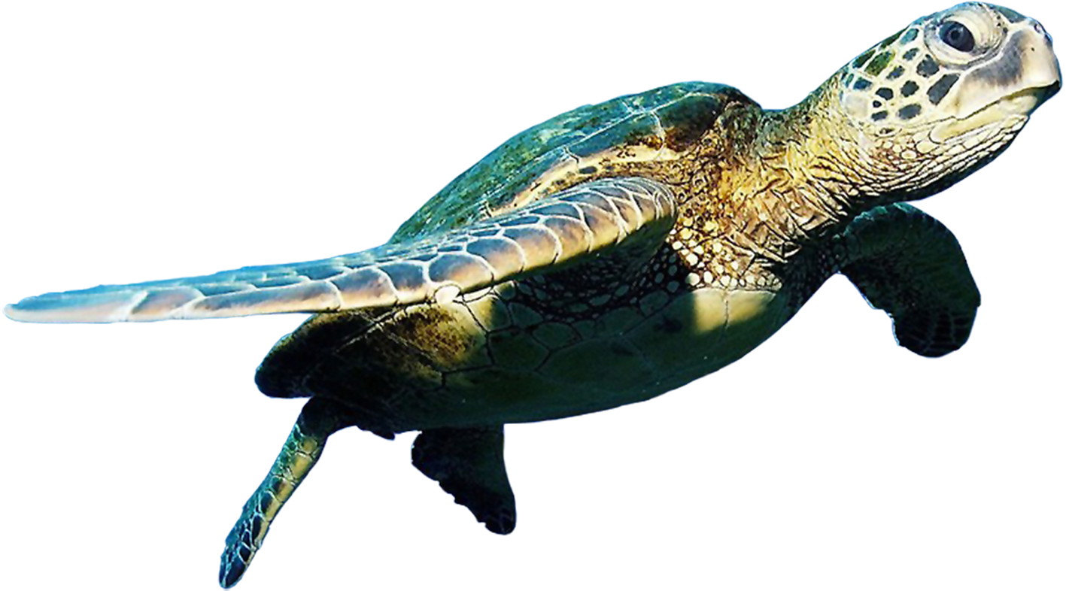
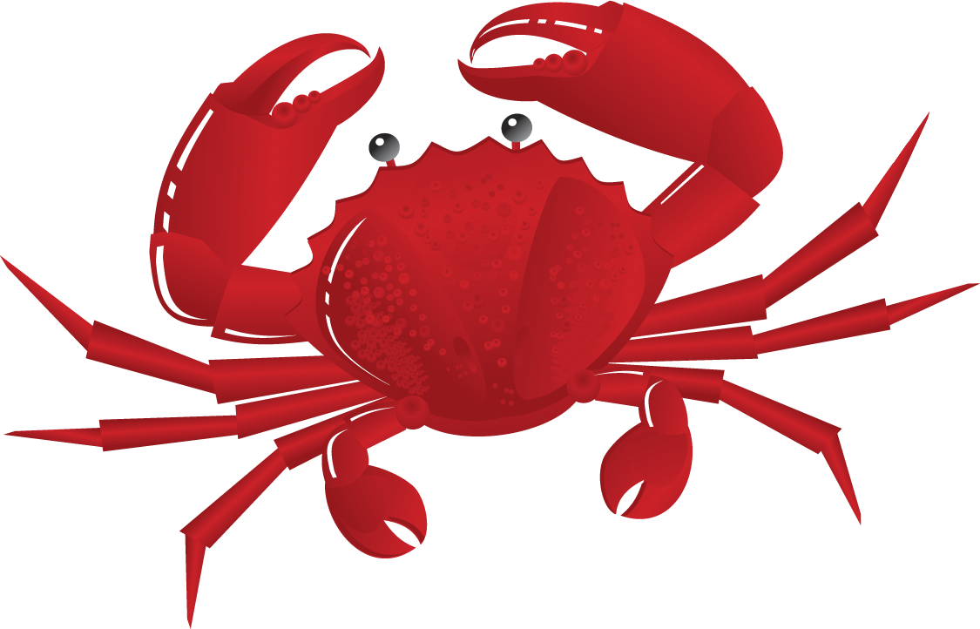
Water
What animals live in
Water?

Slide 3
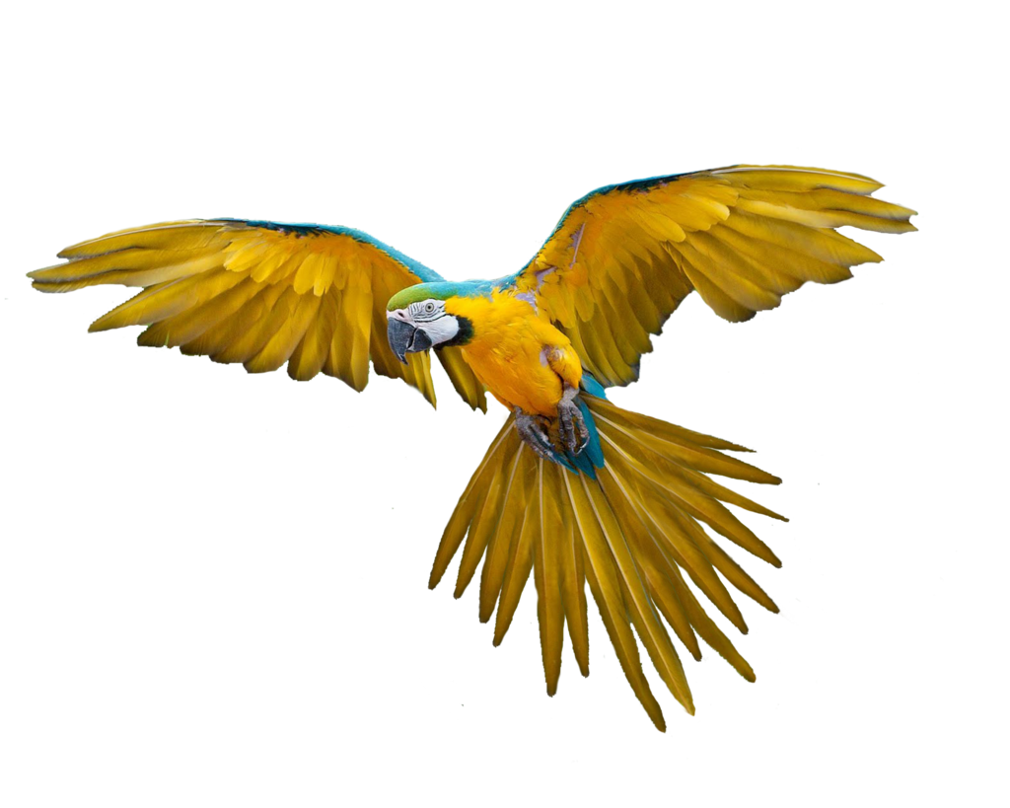
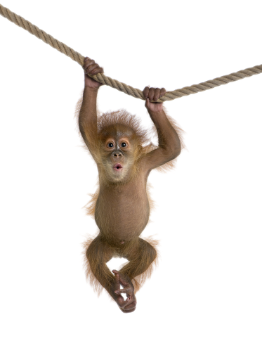
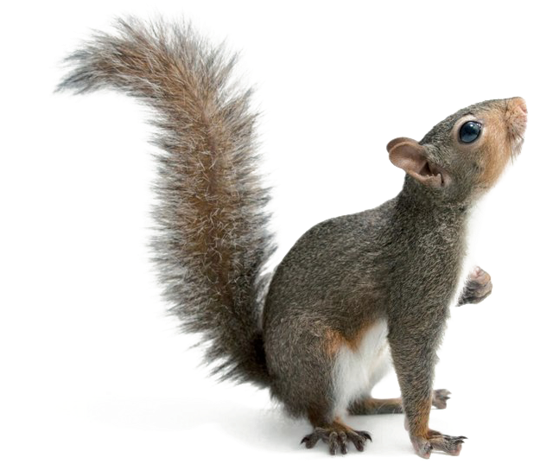
Trees
What animals live in
trees?

Slide 4
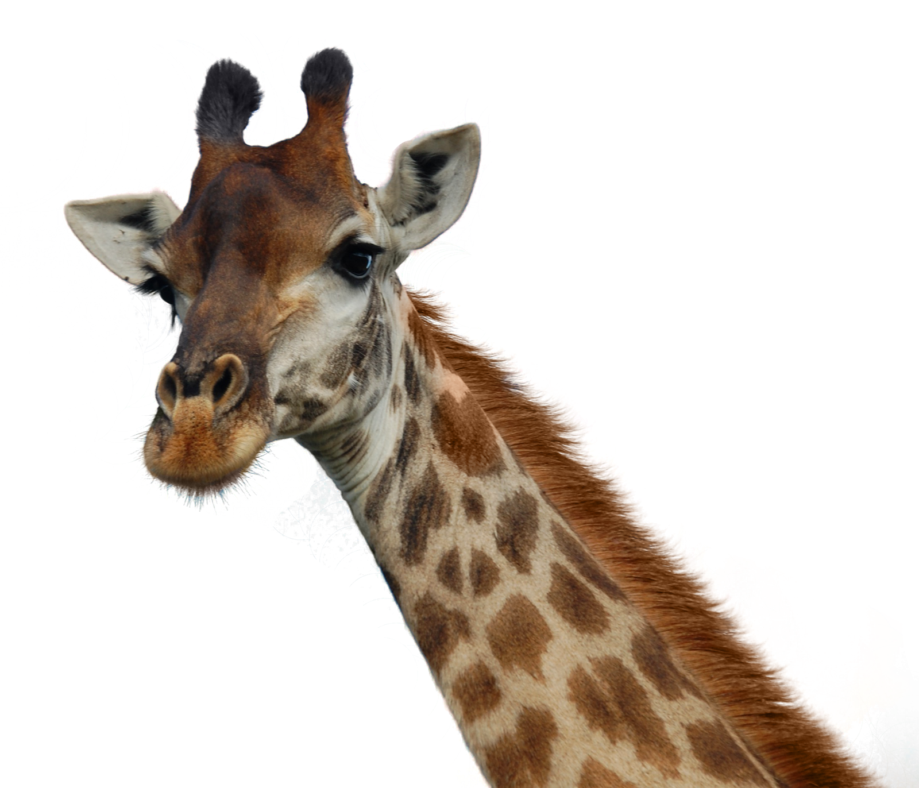
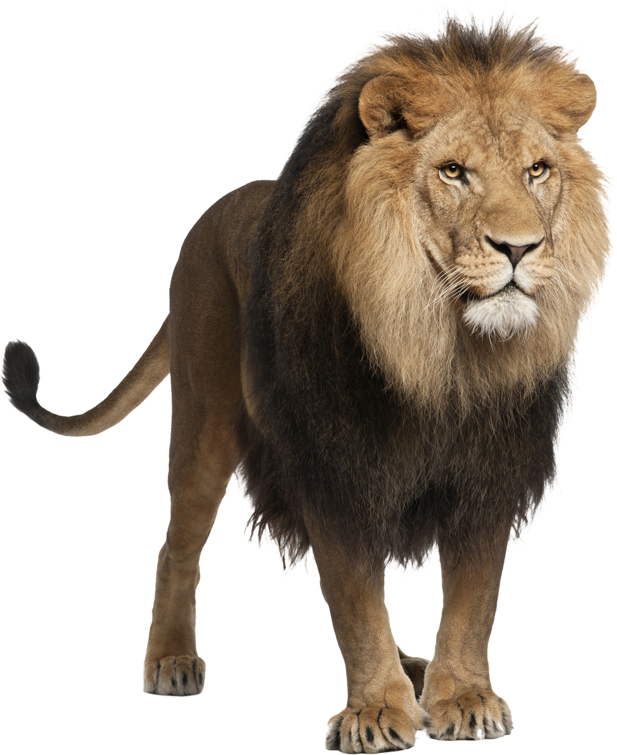
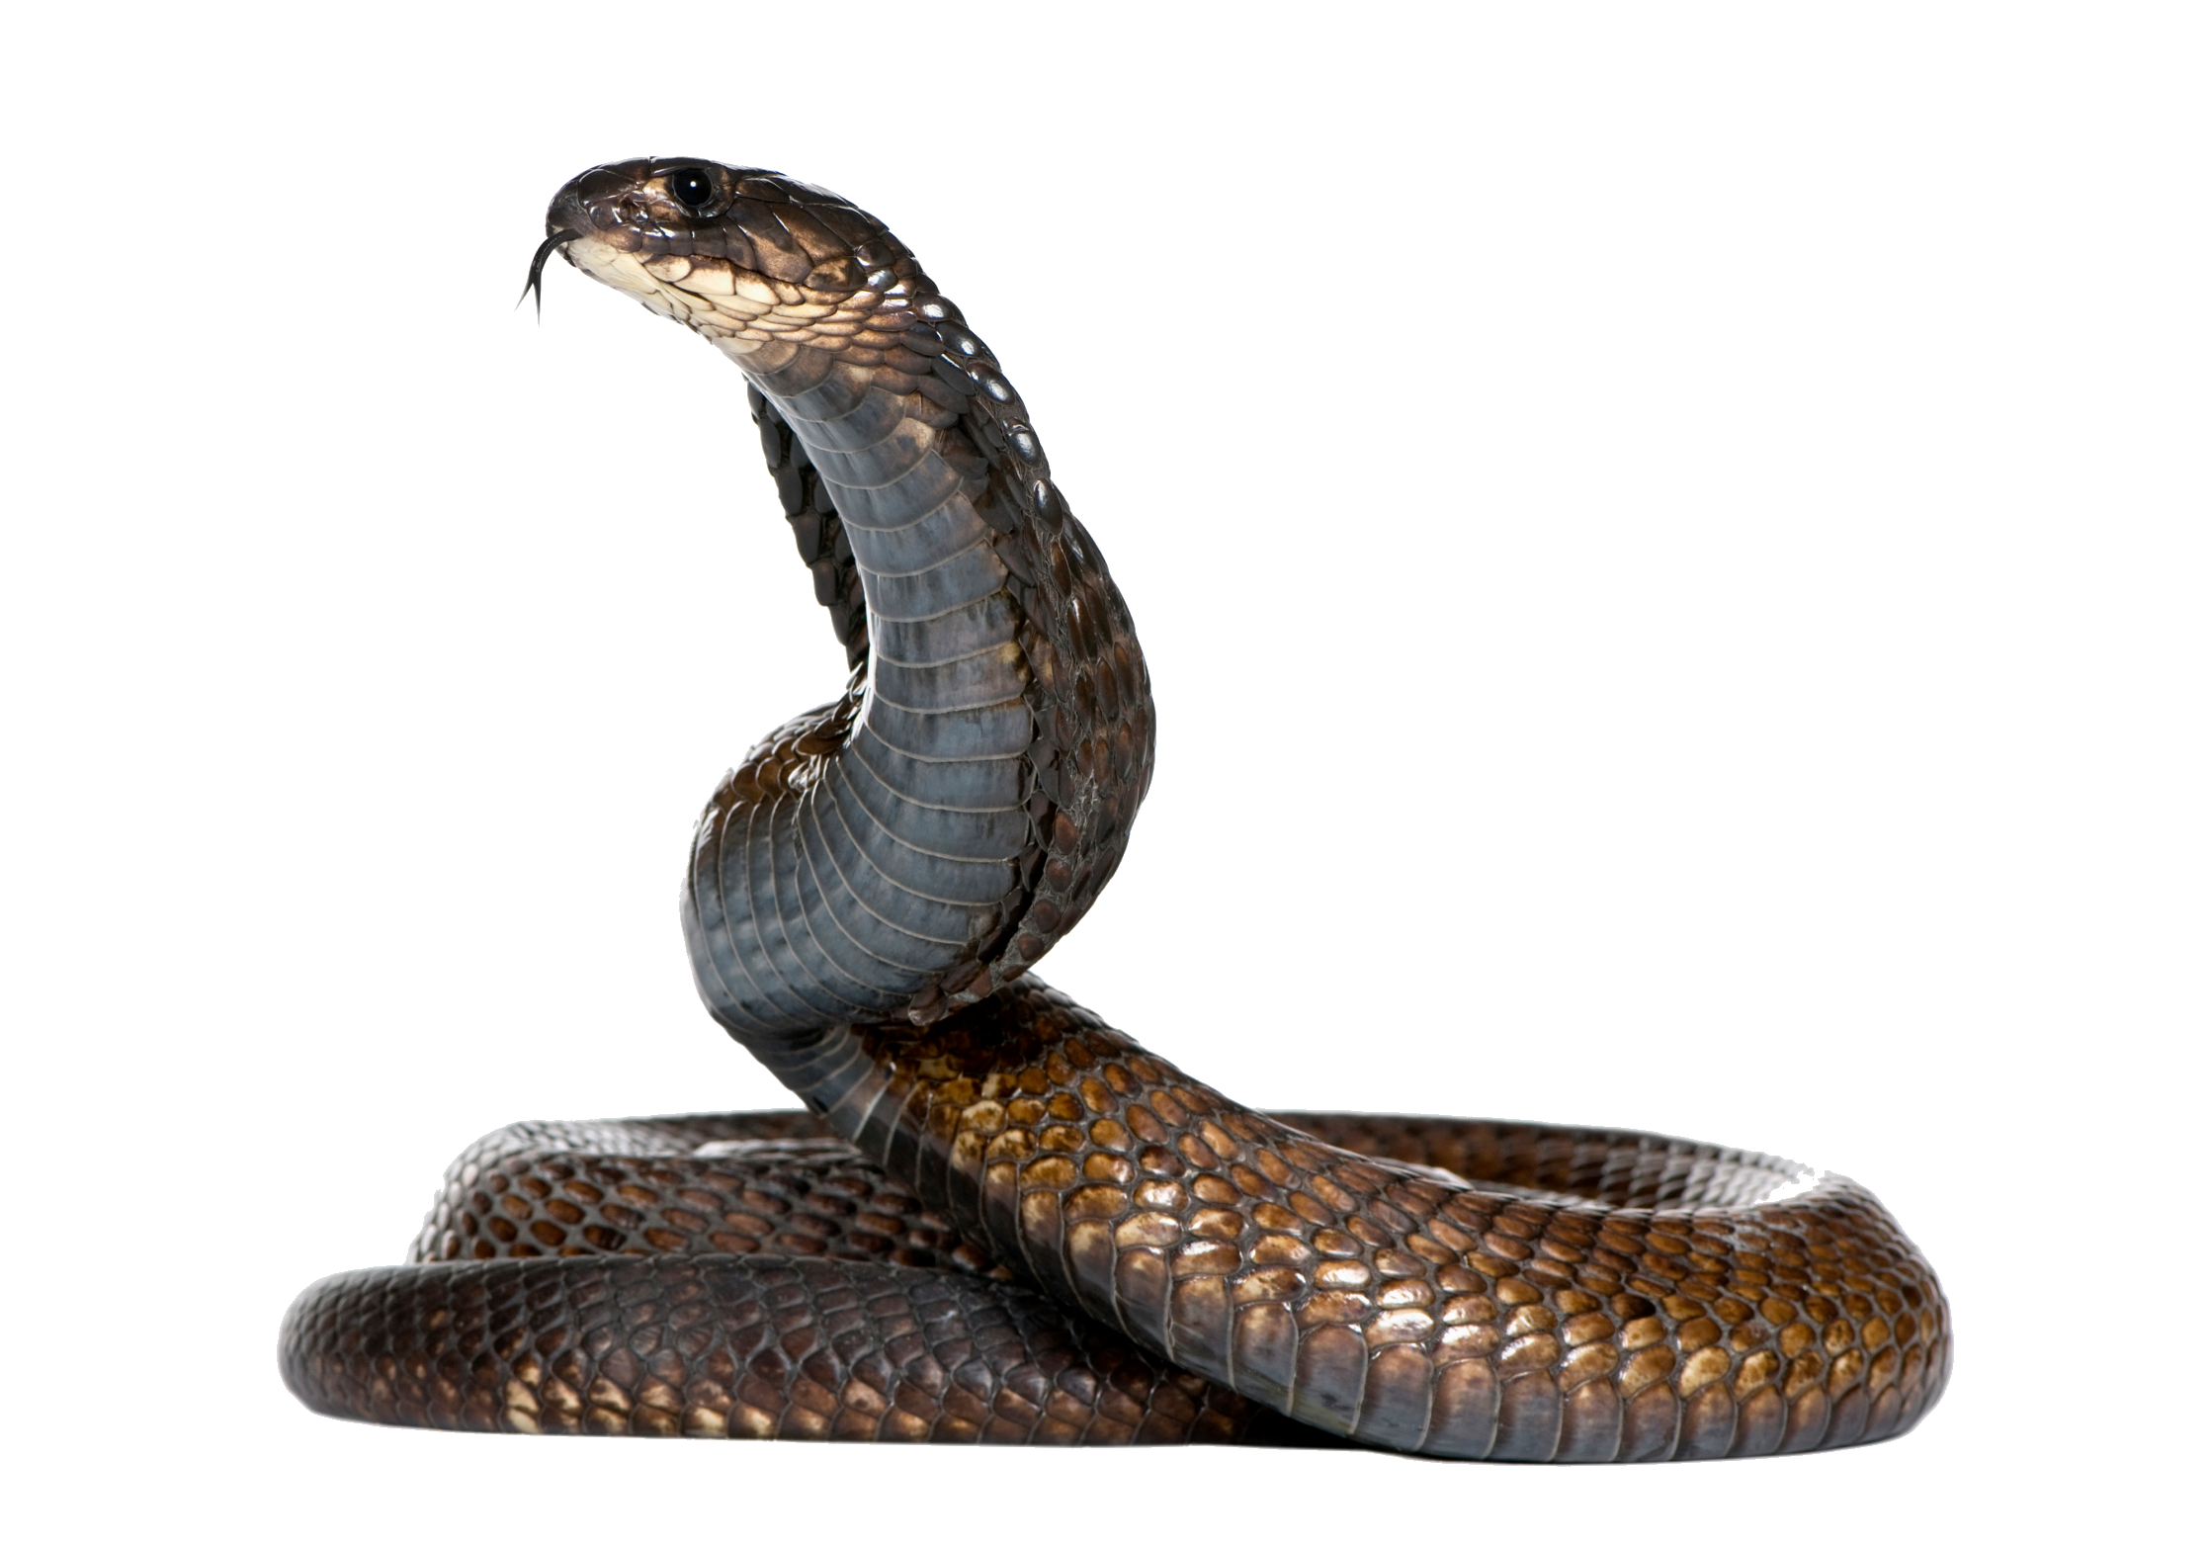
Grass
What animals live in
Grass?

Slide 5
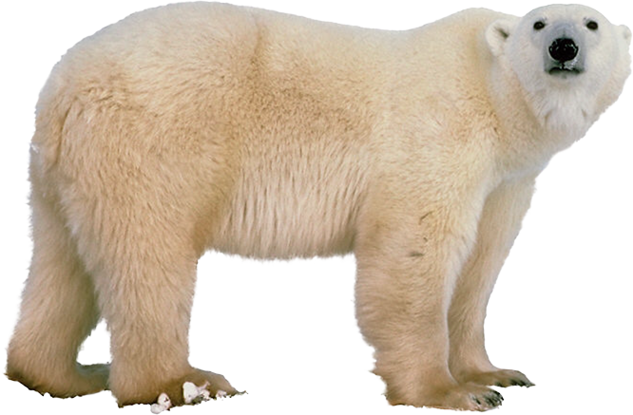
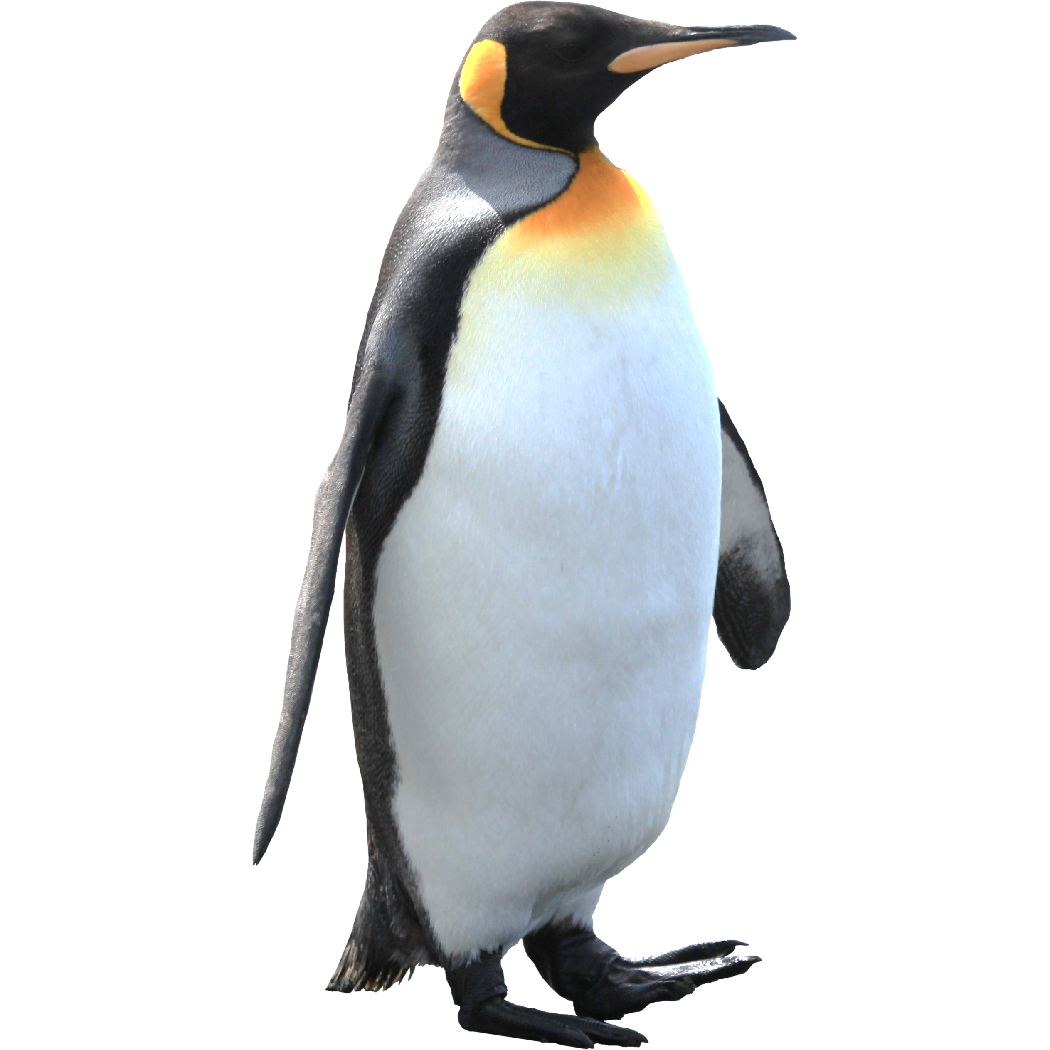
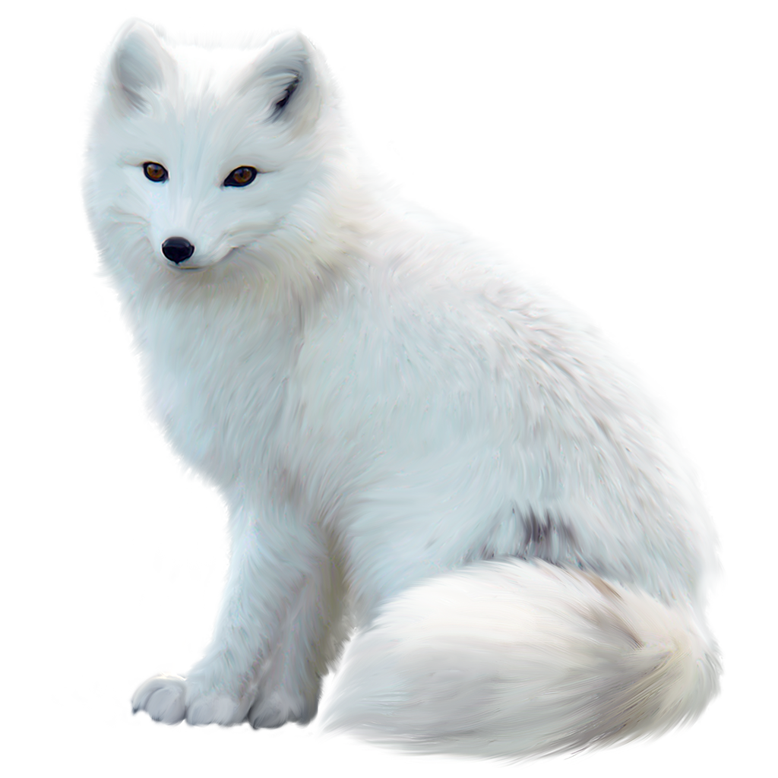
Snow
What animals live in
snow?

Slide 6
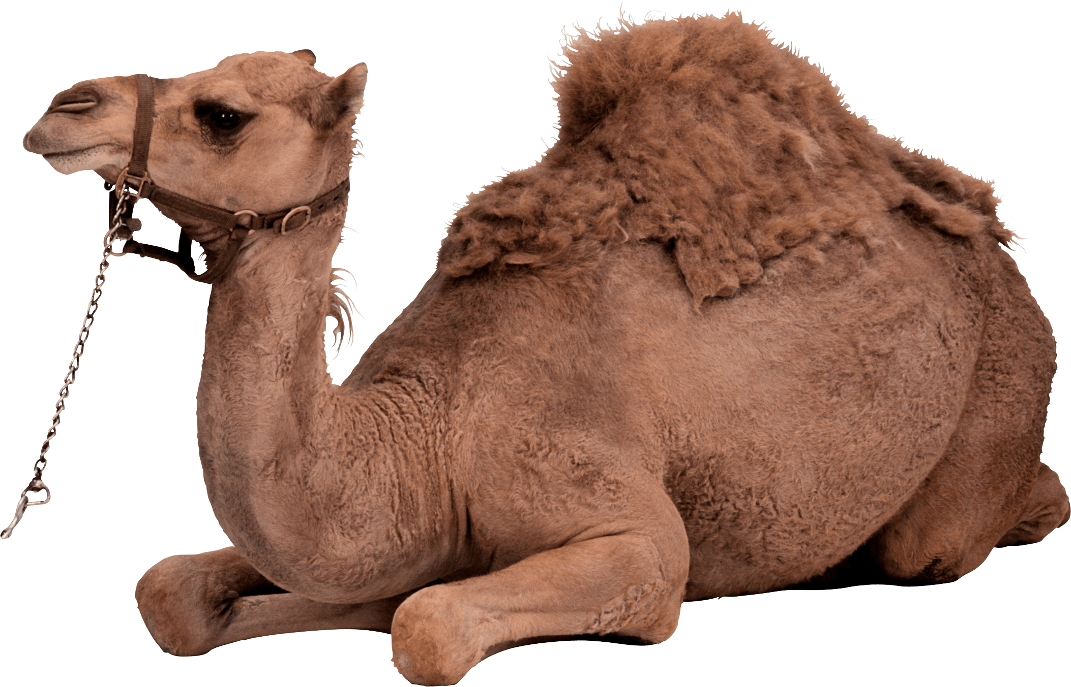
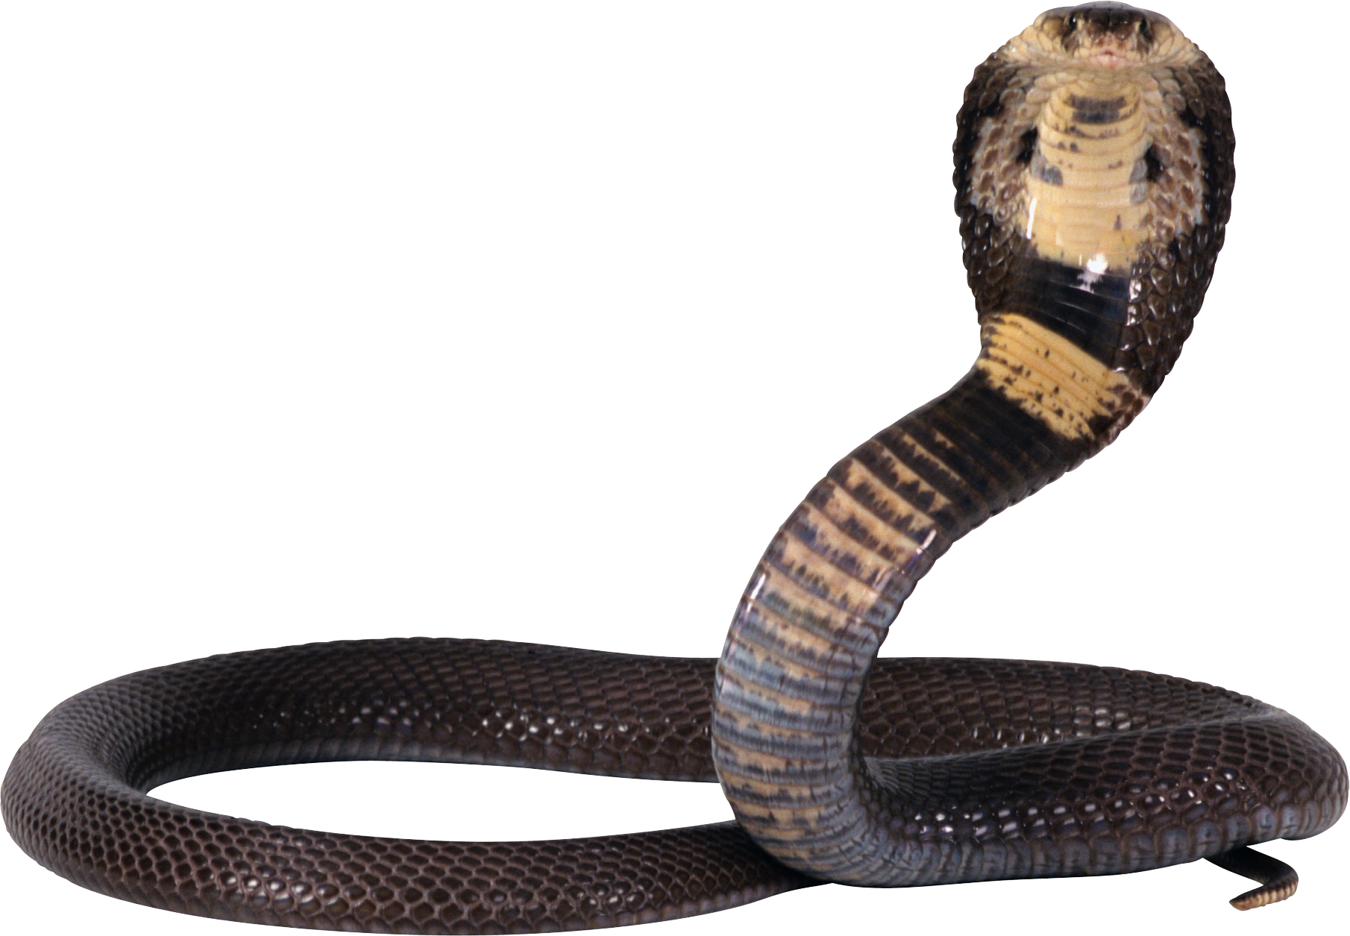
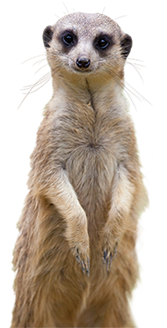
Desert
What animals live in the
desert?

Slide 7
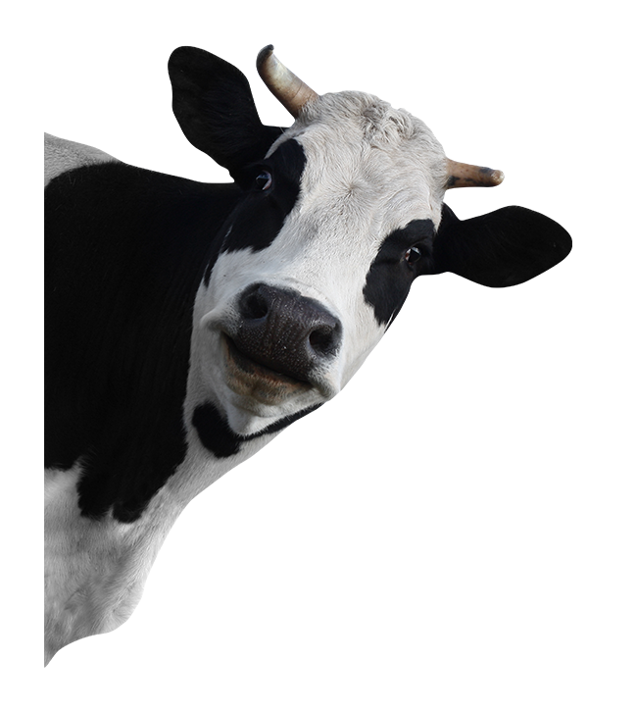
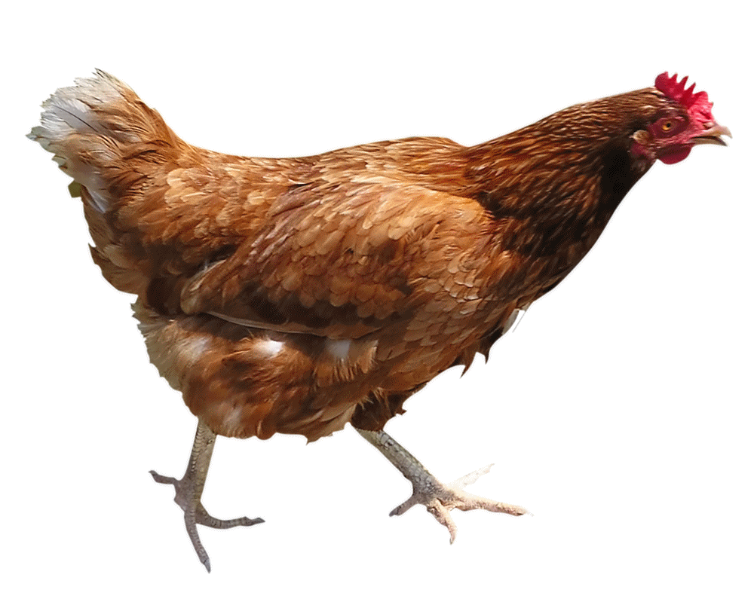
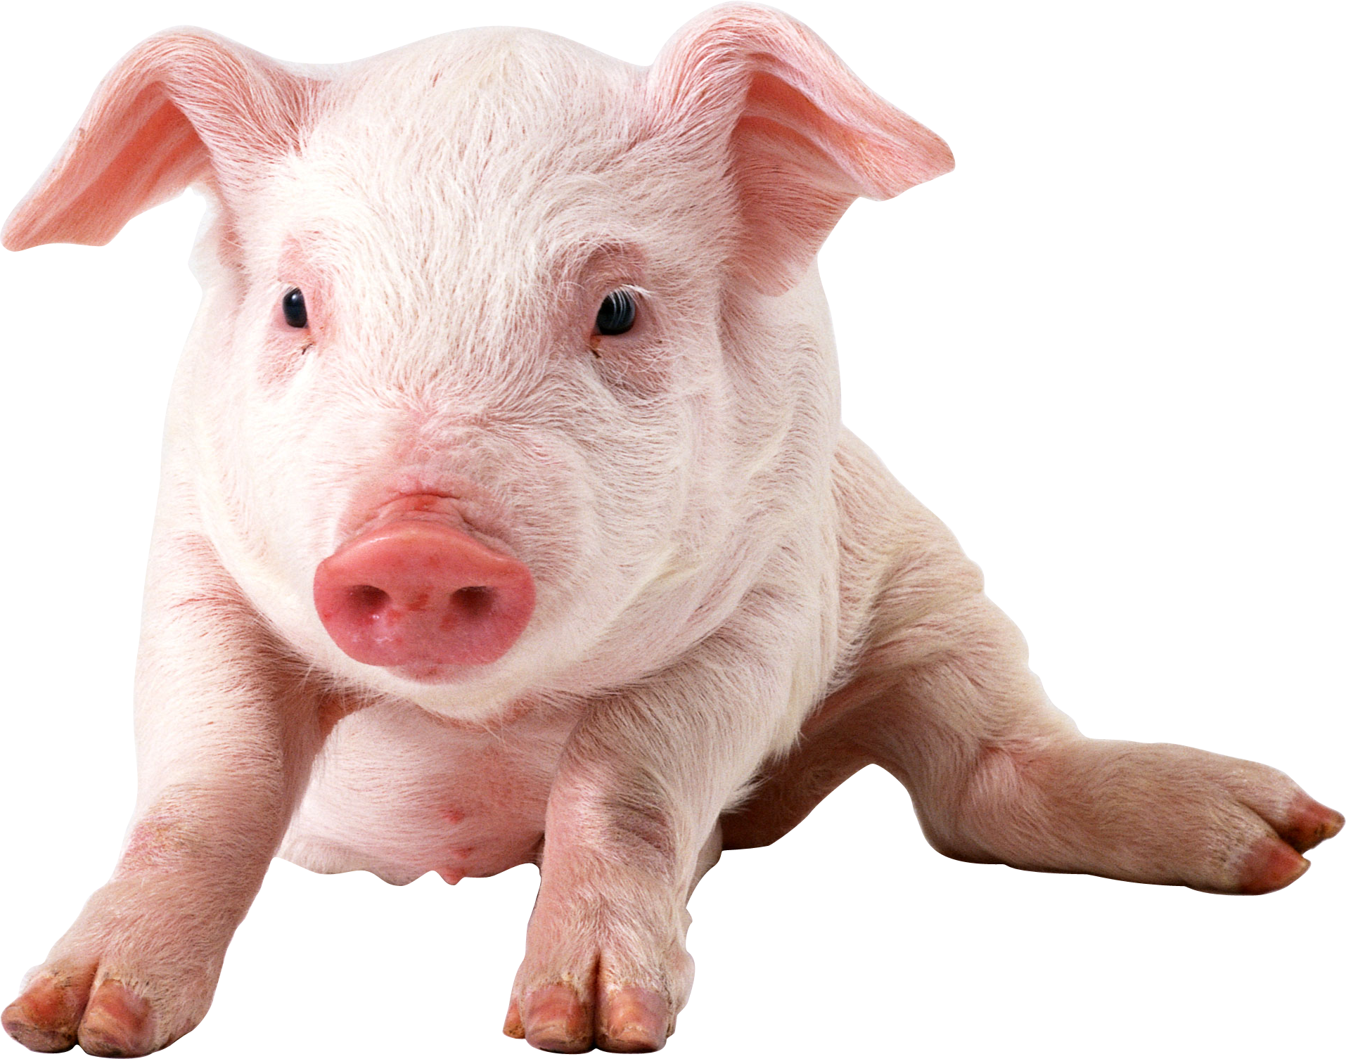
Farm
What animals live on a
Farm?

Slide 8
a
nimal
p
arts

Slide 9
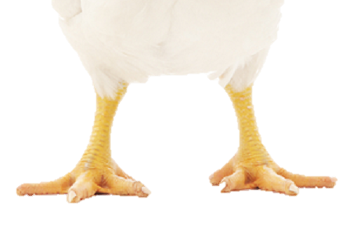
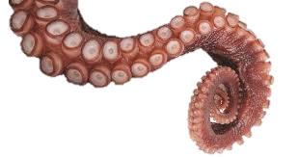
legs

Slide 10
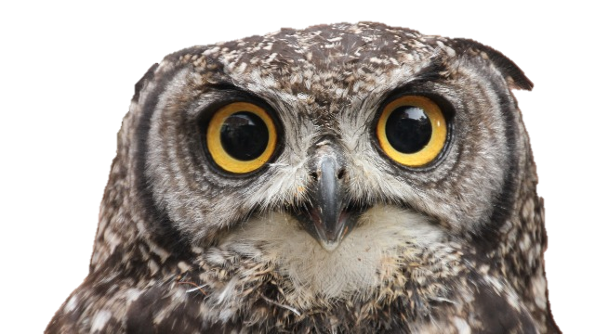
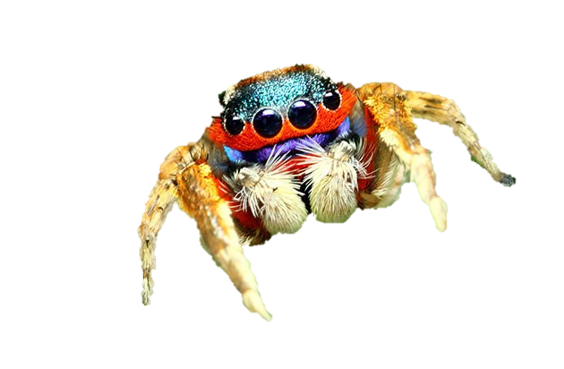
eyes

Slide 11
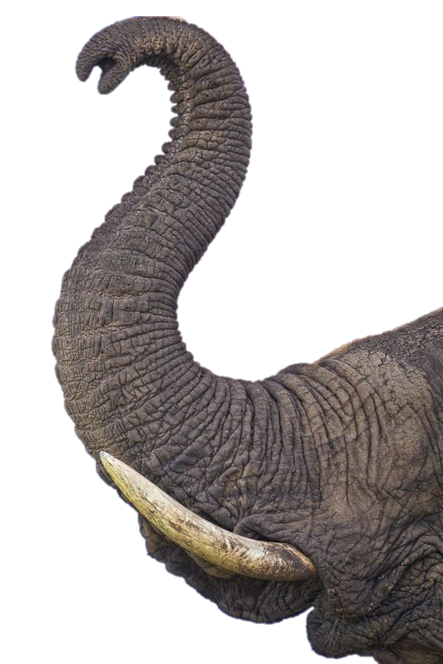
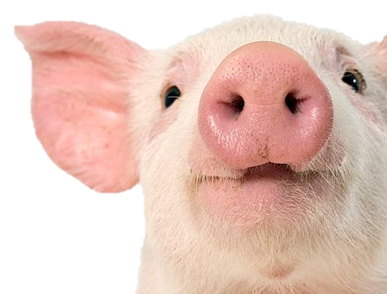
nose

Slide 12
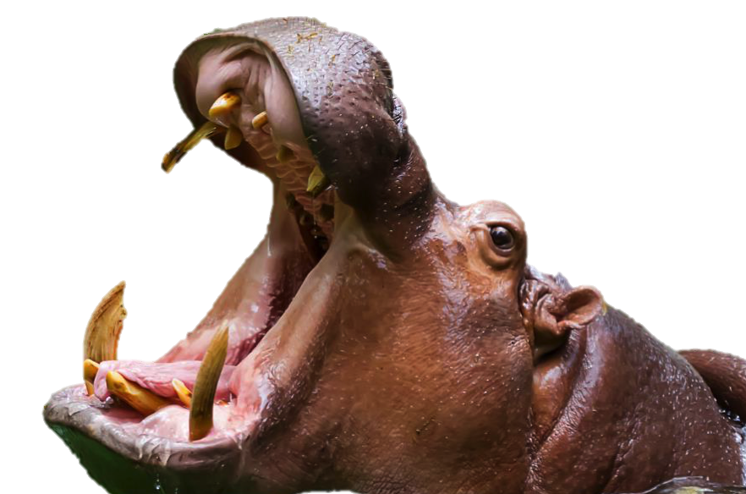
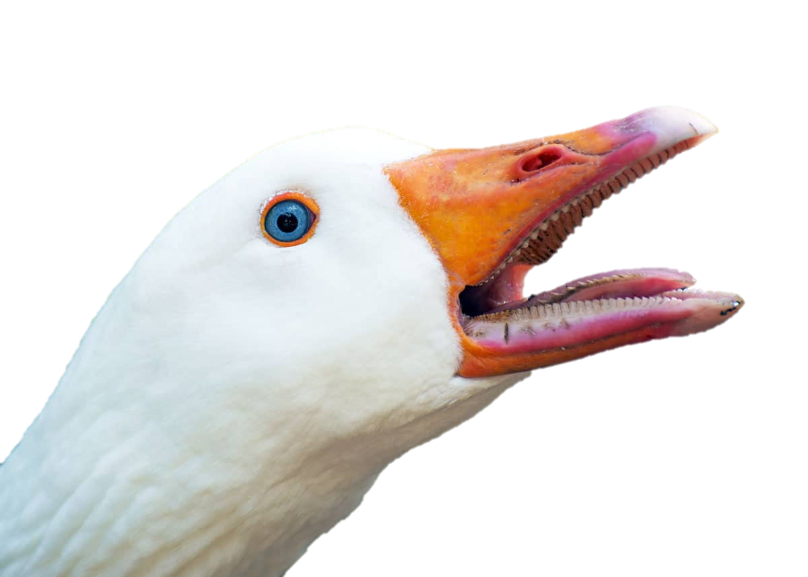
mouth

Slide 13
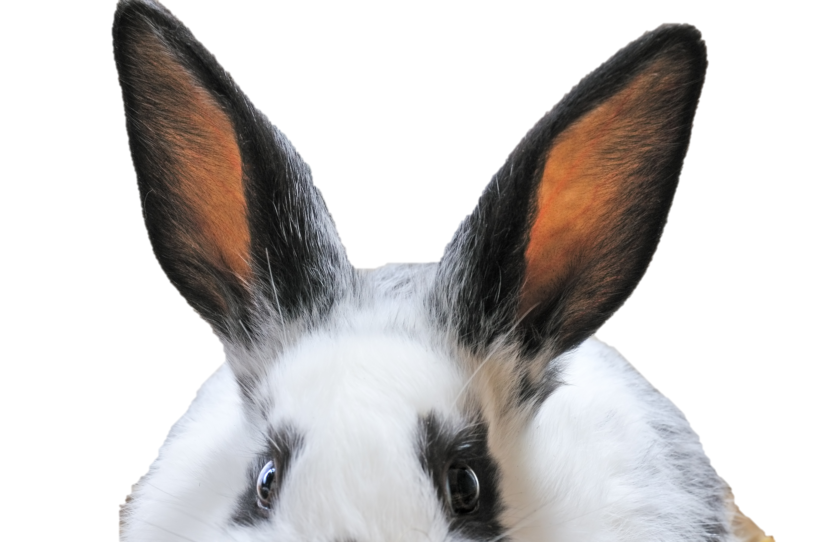
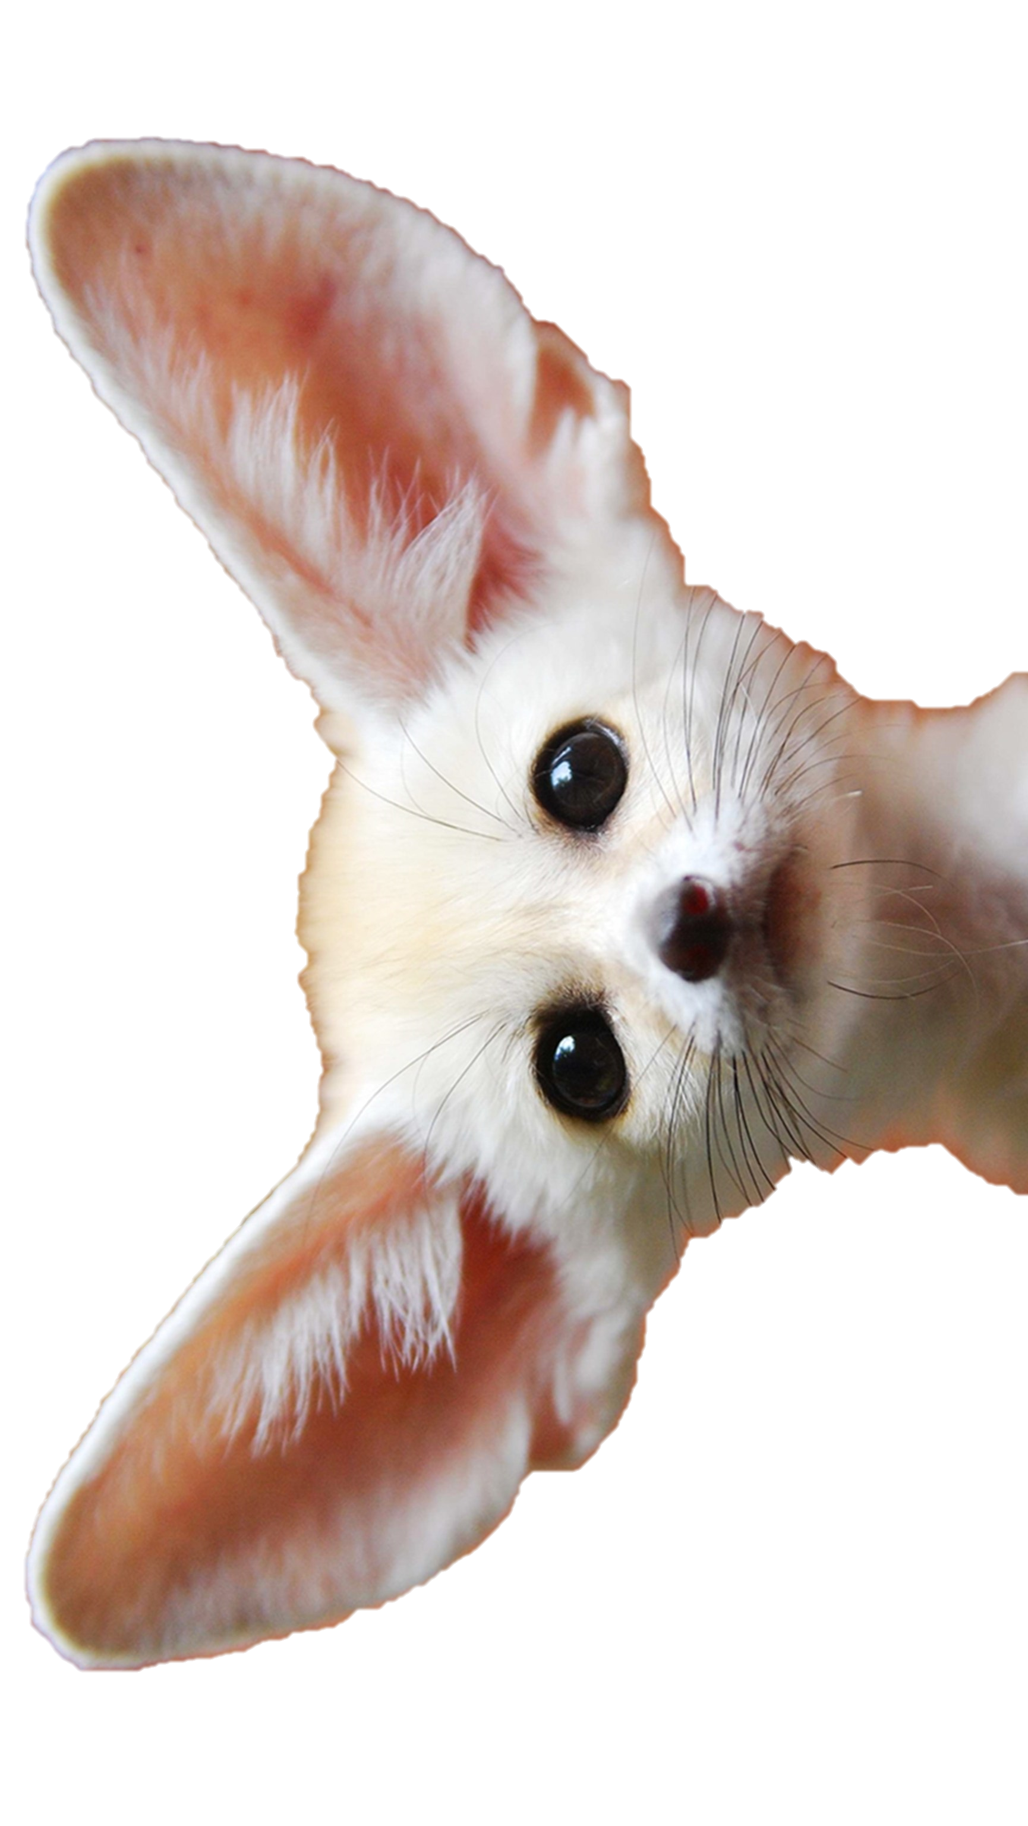
ears

Slide 14
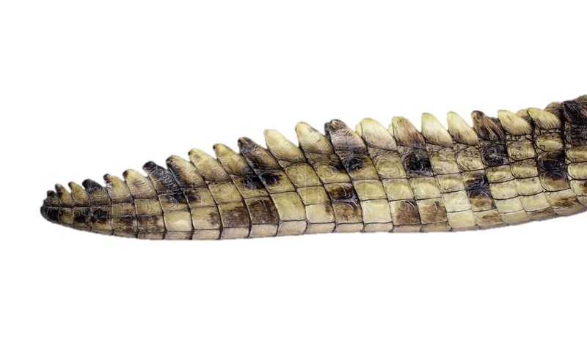
tail

Slide 15
Head
Body

Slide 16
eyes
tail
mouth
1.
ears
2.
ears
nose
3.
6.
eyes
mouth
4.
nose
tail
legs
5.
legs

Slide 17
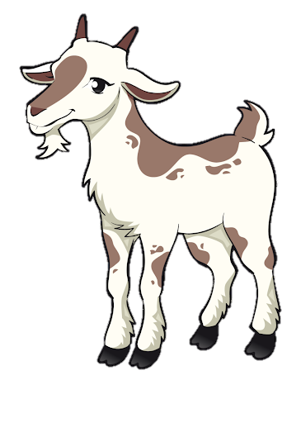
How many legs does the goat have?
The goat has ___ legs.
4

Slide 18
The goat has a __________.
tail
The goat has a __________.
mouth

Slide 19
M
ix
u
it
p

Slide 20
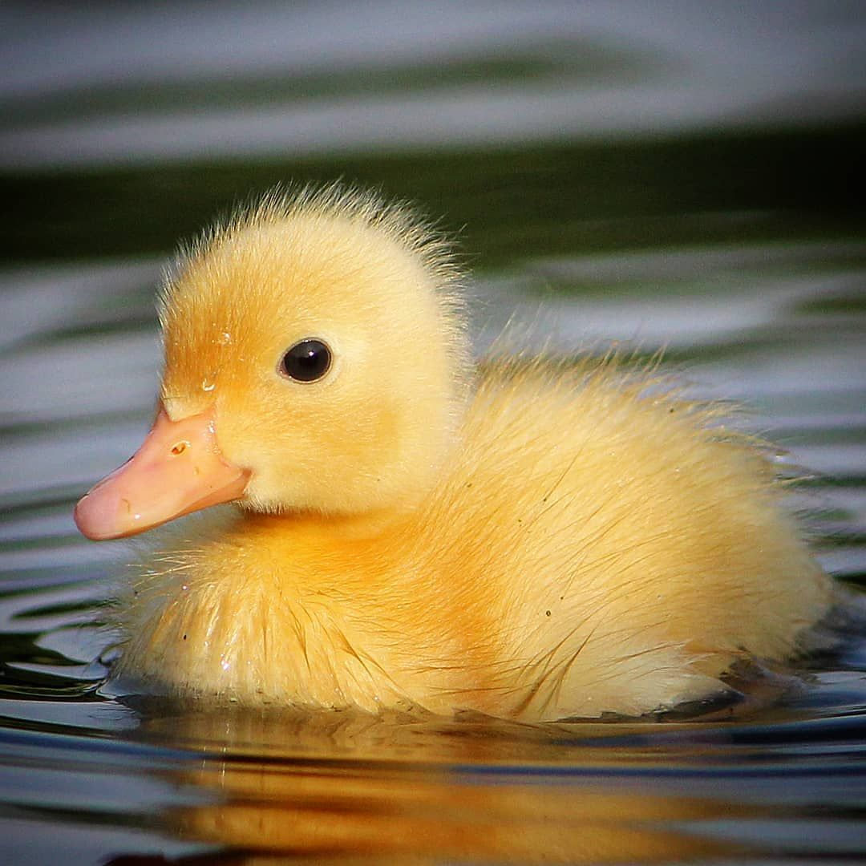
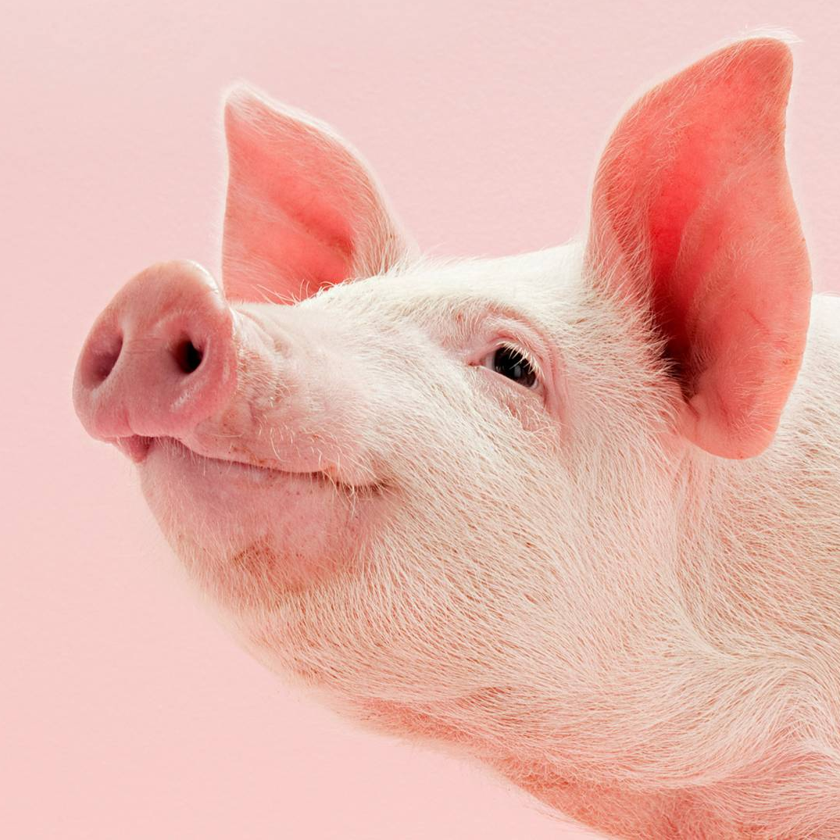
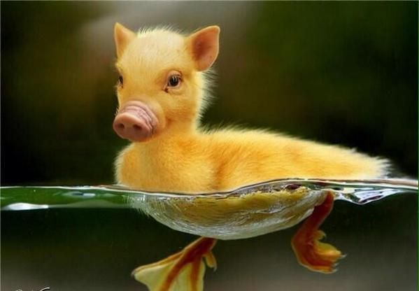
+
=

Slide 21
What parts are different?
Tail
Mouth
Ears
Eyes
Nose
Legs
Body
Head
Duck
Pig
Notes:
Level variation. Have students decide which body parts are from each animal in the mash

Slide 22
Tail
Mouth
Ears
Eyes
Nose
Legs
Body
Head
Rabbit
Eagle
Notes:
Level variation. Have students decide which body parts are from each animal in the mash

Slide 23
Head
Tail
Mouth
Eyes
Nose
Legs
Body
Whale
Penguin
Notes:
Level variation. Have students decide which body parts are from each animal in the mash

Slide 24
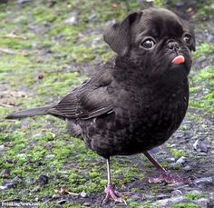
Tail
Mouth
Ears
Eyes
Nose
Legs
Body
Head
Bird
Dog
Notes:
Level variation. Have students decide which body parts are from each animal in the mash

Slide 25
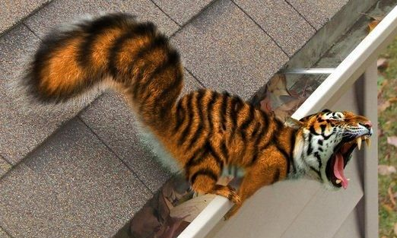
Tail
Mouth
Ears
Eyes
Nose
Legs
Body
Head
Squirrel
Tiger
Notes:
Level variation. Have students decide which body parts are from each animal in the mash

Slide 26
G
uess
the
A
nimal

Slide 27
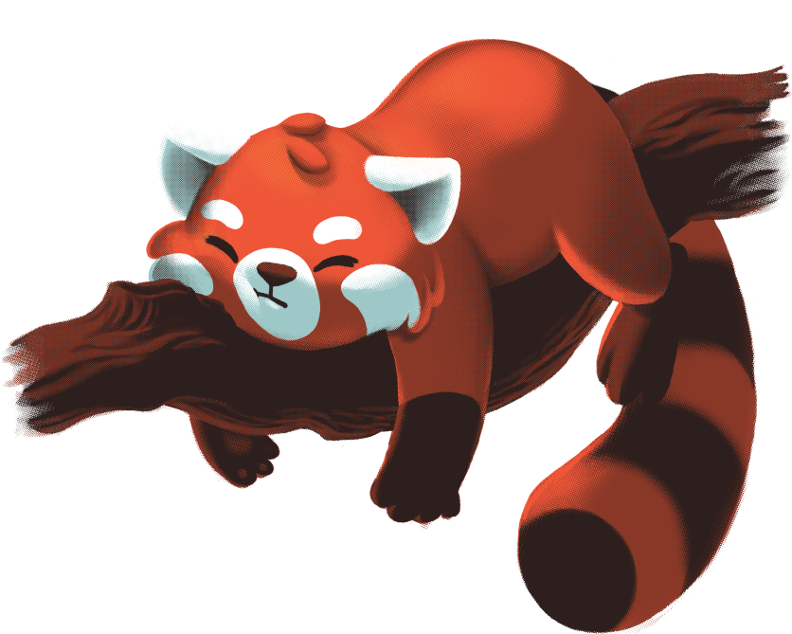
It lives in the forest.
It has a tail.
It has 4 legs.
It has a red body.

Slide 28
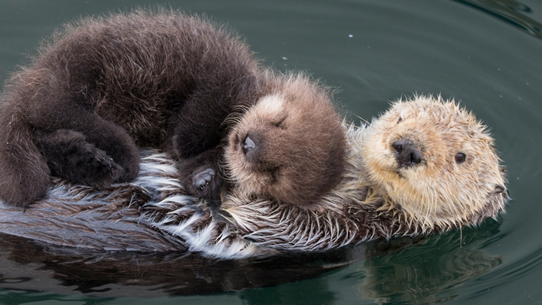
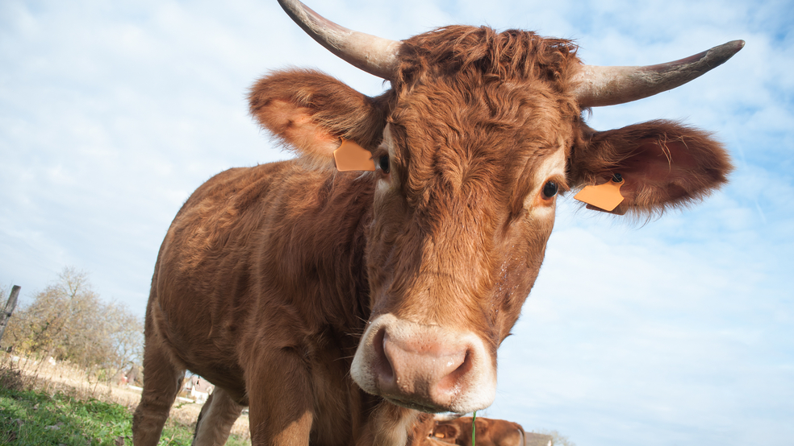
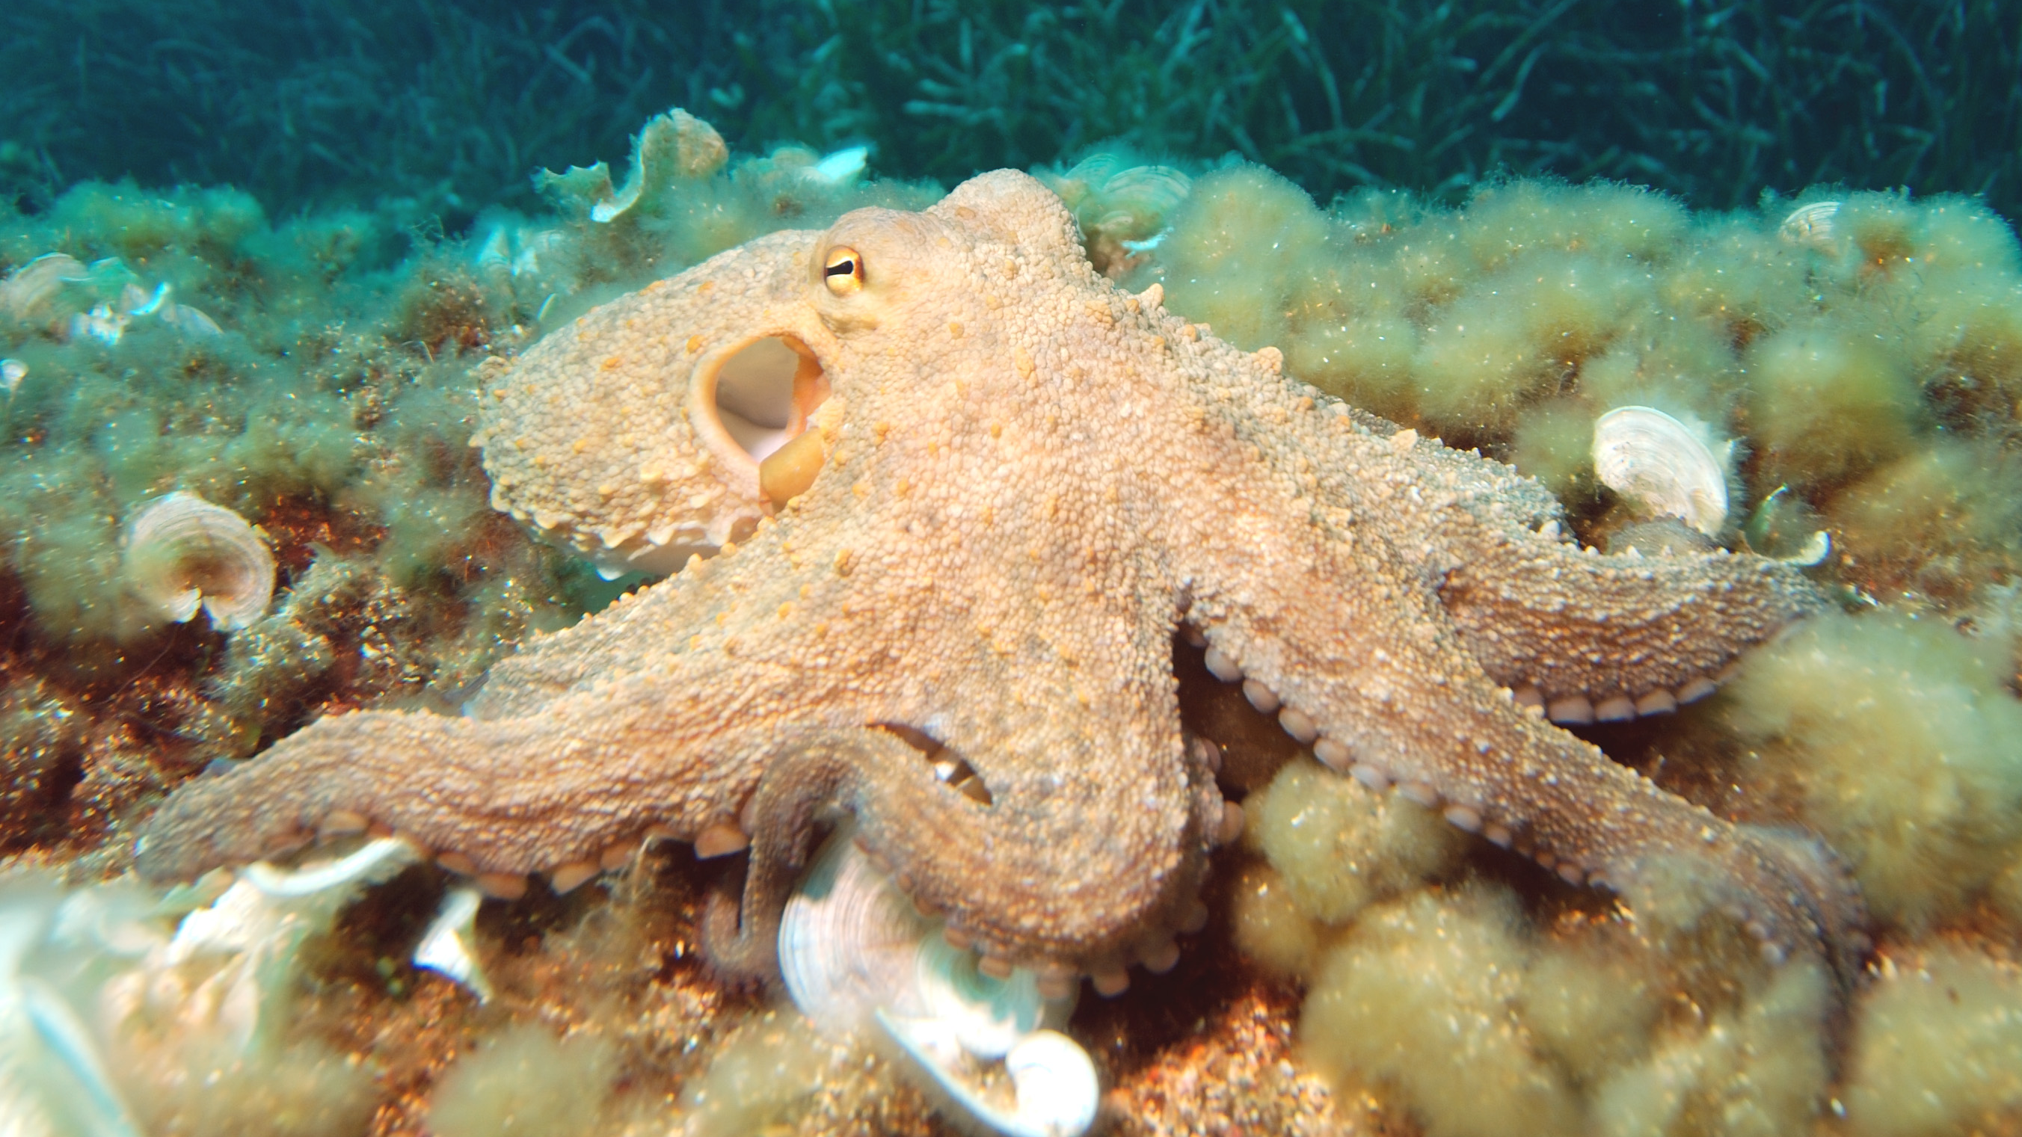
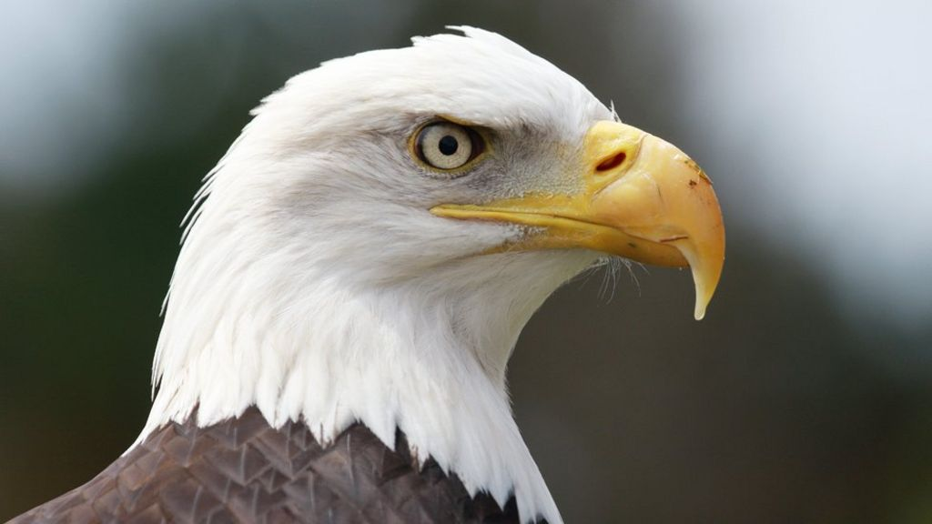
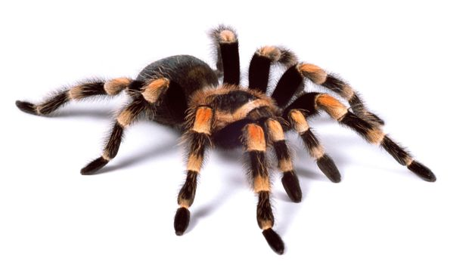
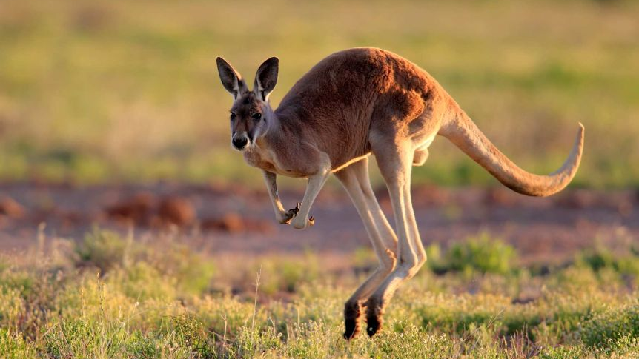
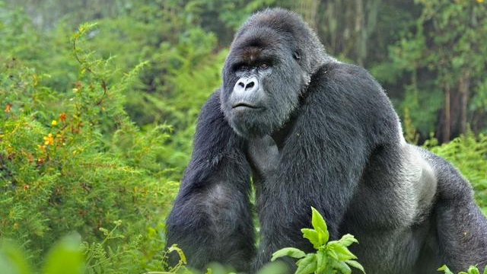
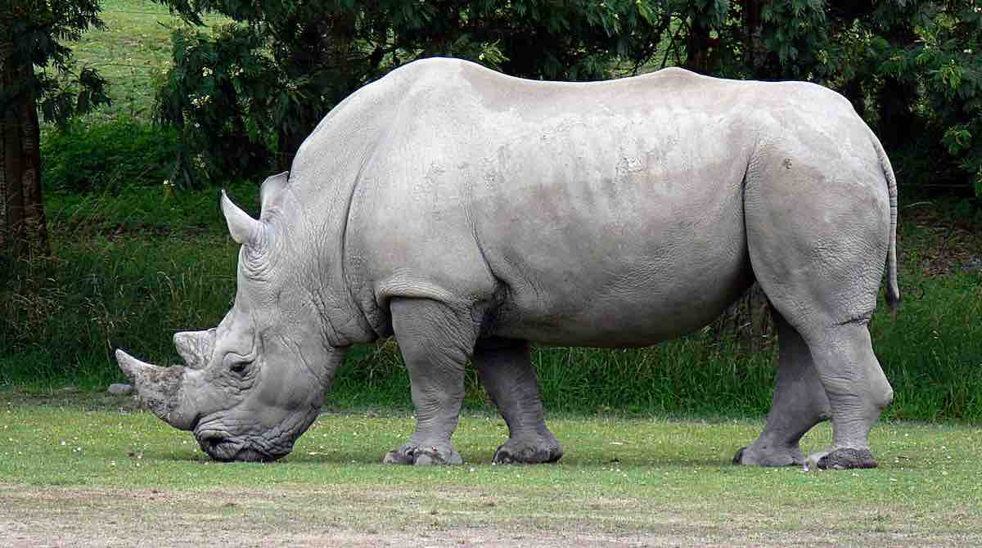
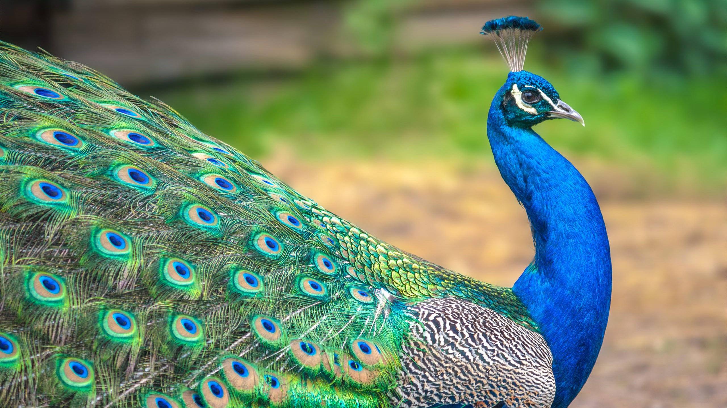
Reset
Notes:
Clicking on the animals makes them disappear. Give a clue and have the students remove choices to narrow their search.

Slide 29
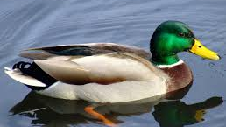
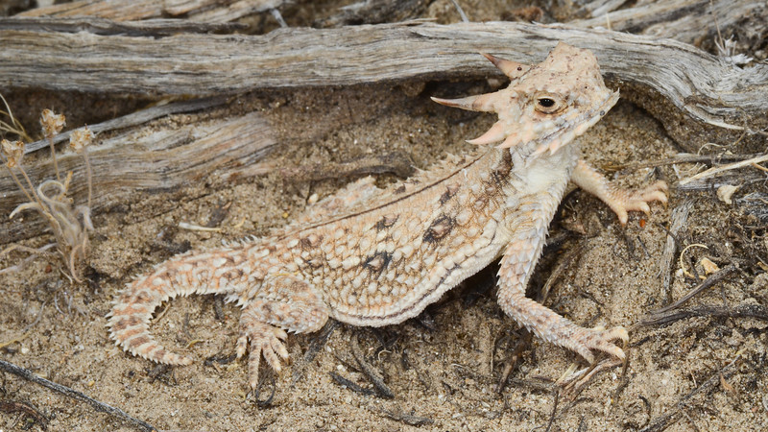
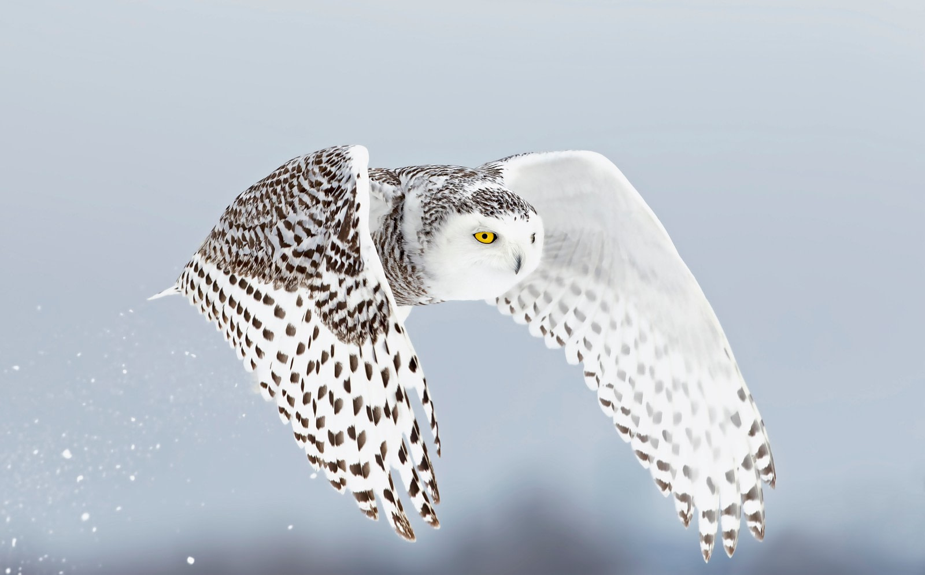
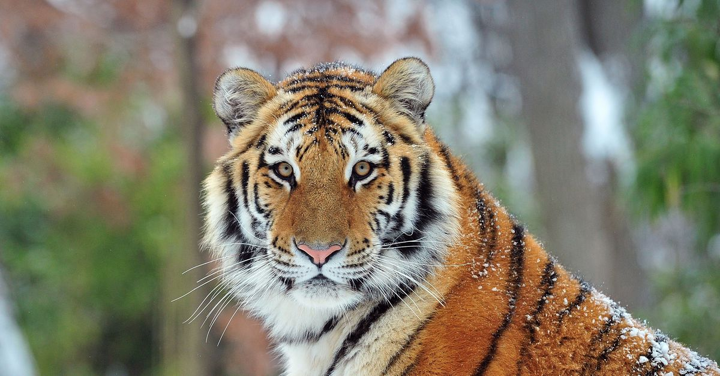
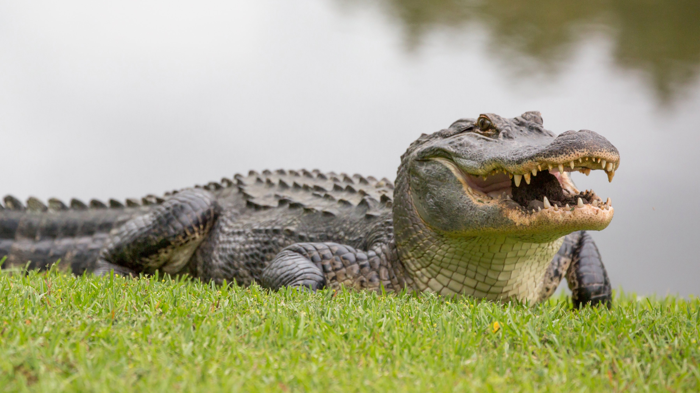
Reset
Notes:
Clicking on the animals makes them disappear. Give a clue and have the students remove choices to narrow their search.

