Slide 1
Hobbies

Slide 3
Key Expressions
What is your hobby?

Slide 4
Key Expressions
My hobby is…

Slide 5
Key Expressions
I like…

Slide 6
A hobby is…
something you like
something fun
something you do a lot

Slide 7
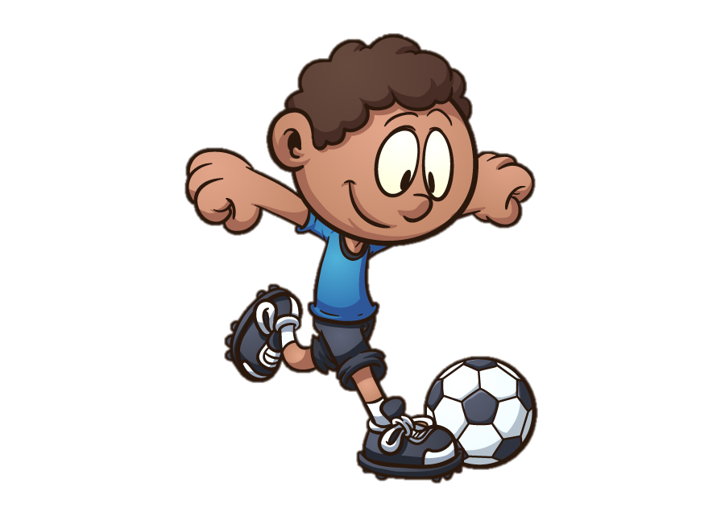
What is your hobby?
My hobby is playing soccer.

Slide 8
What is your hobby?
I like playing soccer.

Slide 9
What is your hobby?
My hobby is reading.

Slide 10
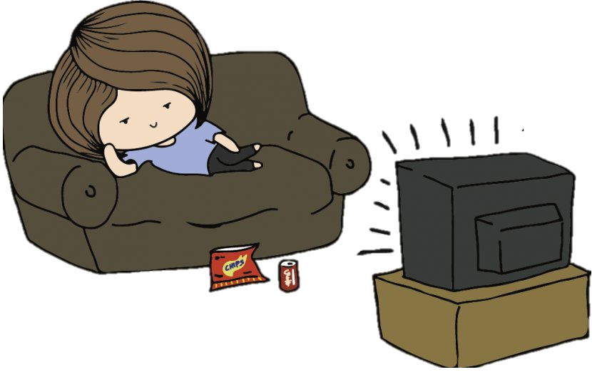
What is your hobby?
My hobby is watching TV.

Slide 11
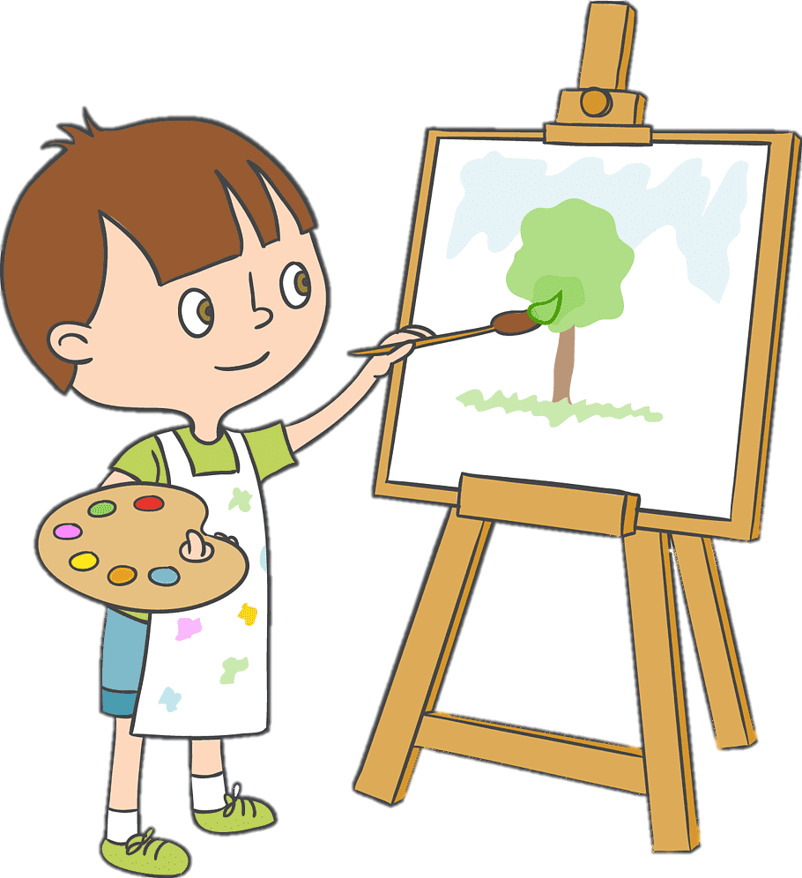
What is your hobby?
My hobby is painting.

Slide 12
What is your hobby?
My hobby is singing.

Slide 13
What is your hobby?
My hobby is listening to music.

Slide 14
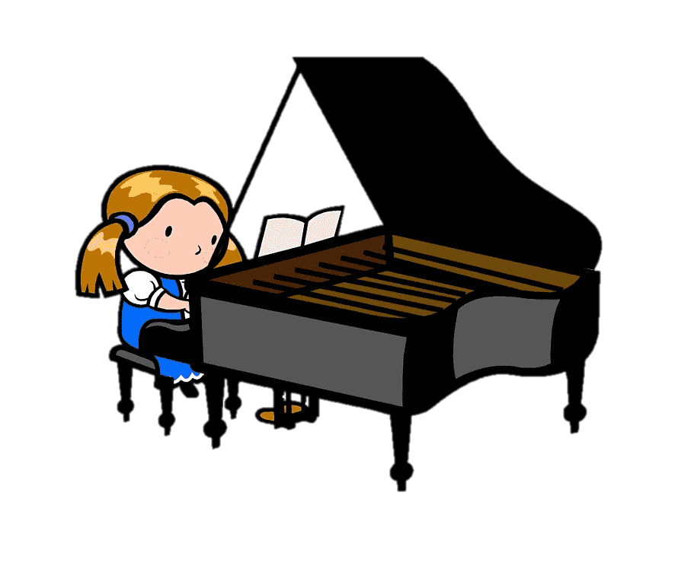
What is your hobby?
My hobby is playing piano.

Slide 15
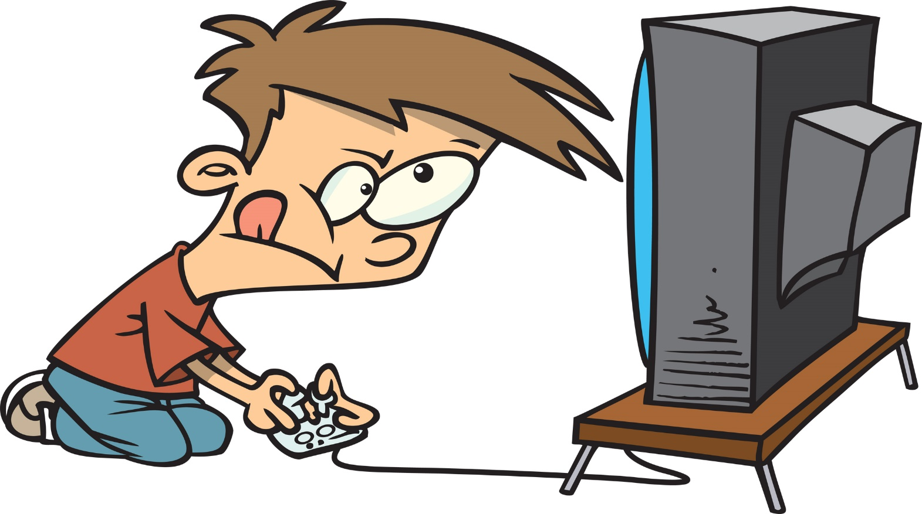
What is your hobby?
My hobby is playing video games.

Slide 16
What is your hobby?
My hobby is
taking pictures.

Slide 17
What is your hobby?
My hobby is cooking.

Slide 18
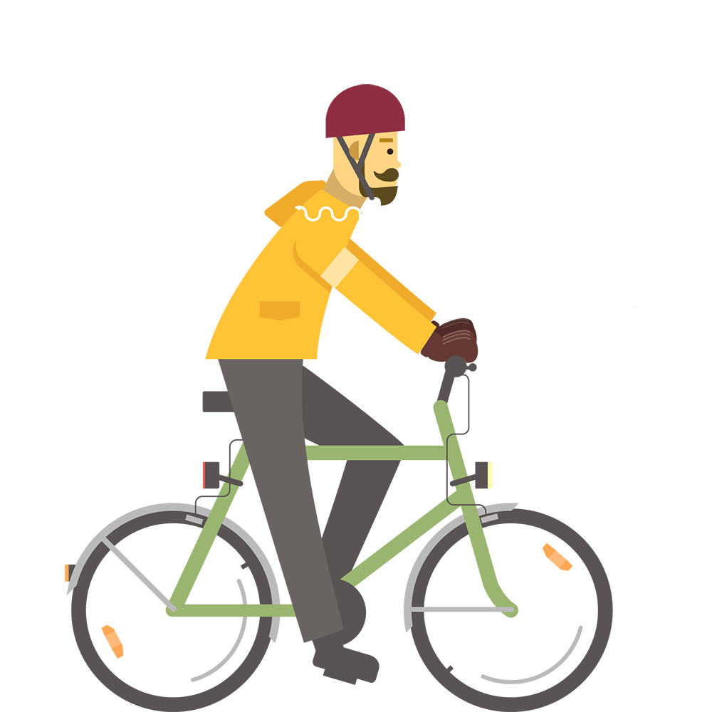
What is your hobby?
My hobby is cycling.

Slide 19
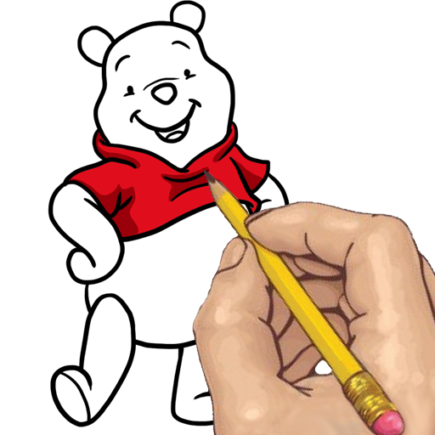
What is your hobby?
My hobby is drawing.

Slide 20
What is your hobby?
My hobby is camping.

Slide 21
What is your hobby?
My hobby is fishing.

Slide 22
What is the same?
fishing
playing video games
cycling
listening to music
singing
taking pictures
cooking
reading
playing soccer
drawing
playing piano
painting
watching TV
camping

Slide 23
What is the same?
fishing
playing video games
cycling
listening to music
singing
taking pictures
cooking
reading
playing soccer
drawing
playing piano
painting
watching TV
camping

Slide 24
playing the video games
listening to the music
taking the pictures
playing the soccer
playing the piano
watching the TV

Slide 25
Key Expressions
My hobbies are… and…

Slide 26
Key Expressions
My hobbies are playing guitar and hiking.

Slide 27
What is your hobby?

Slide 28
What is your hobby?
Guessing Game

Slide 29
What is your hobby?
Hint
Answer
My hobby is singing.

Slide 30
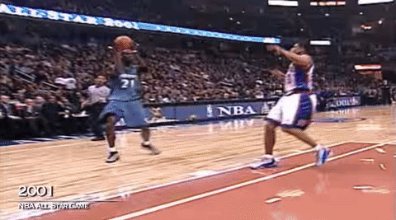
What is your hobby?
Hint
Answer
My hobby is playing basketball.

Slide 31
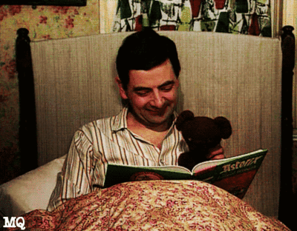
What is your hobby?
Hint
Answer
My hobby is reading books.

Slide 32
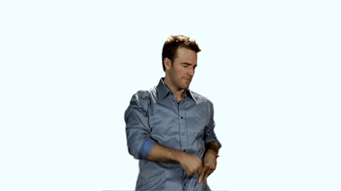
What is your hobby?
Hint
Answer
My hobby is dancing.

Slide 33
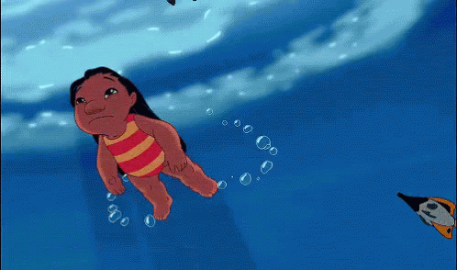
What is your hobby?
Hint
Answer
My hobby is swimming.

Slide 34
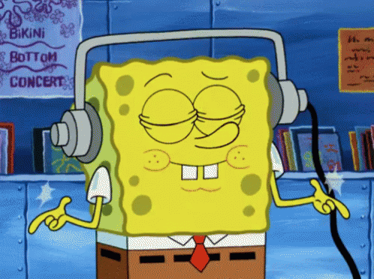
What is your hobby?
Hint
Answer
My hobby is listening to music.

Slide 35
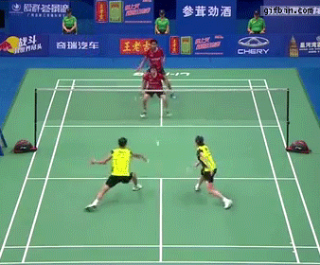
What is your hobby?
Hint
Answer
My hobby is playing badminton.

Slide 36
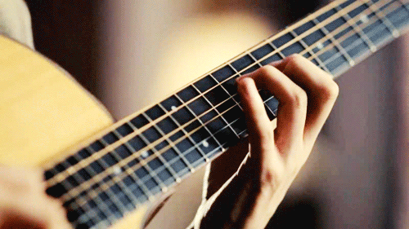
What is your hobby?
Hint
Answer
My hobby is playing guitar.

Slide 37
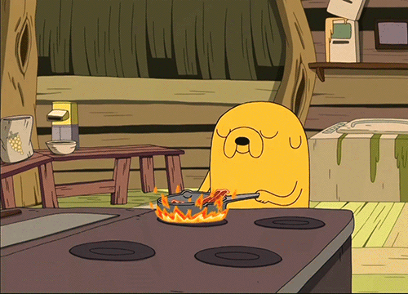
What is your hobby?
Hint
Answer
My hobby is cooking.

Slide 38
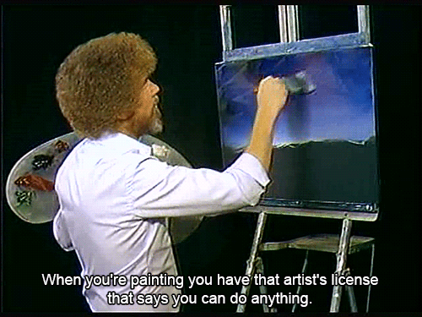
What is your hobby?
Hint
Answer
My hobby is painting.

Slide 39
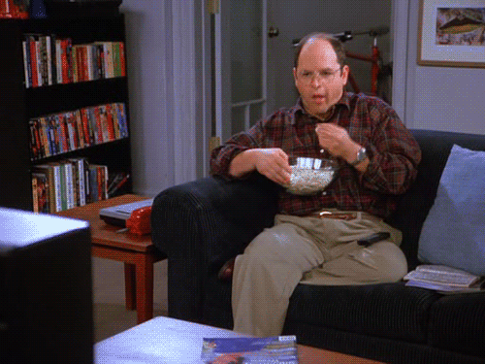
What is your hobby?
Hint
Answer
My hobby is watching TV.

Slide 40
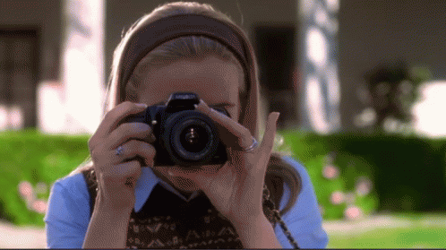
What is your hobby?
Hint
Answer
My hobby is taking pictures.

Slide 41
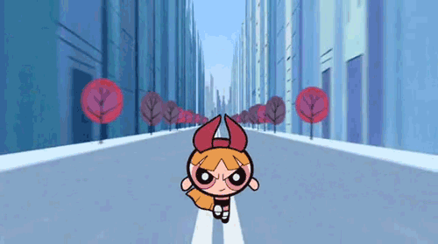
What is your hobby?
Hint
Answer
My hobby is running.

Slide 42
What hobby do you want to try?

Slide 43
Connect 4

