Slide 1
What is
my
Job
?

Slide 2
I am a
teacher

Slide 3
What is
my
JOB
?

Slide 4
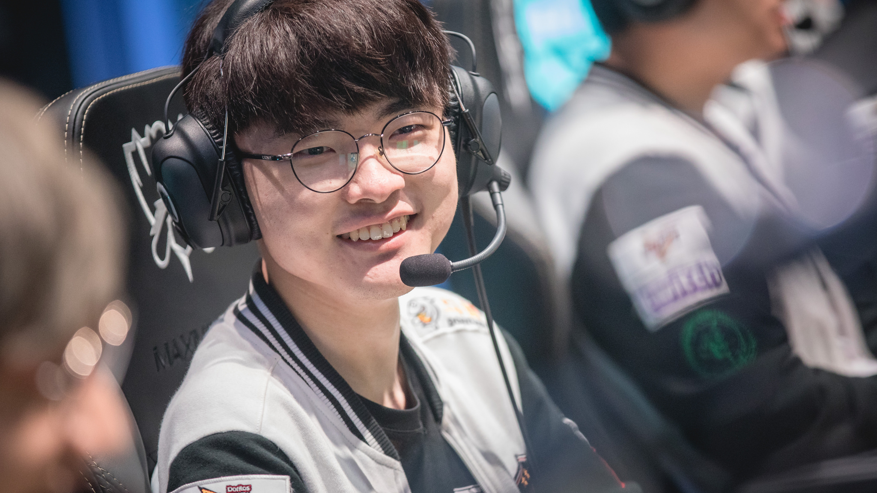
My name is Faker and I’m a pro gamer.

Slide 5
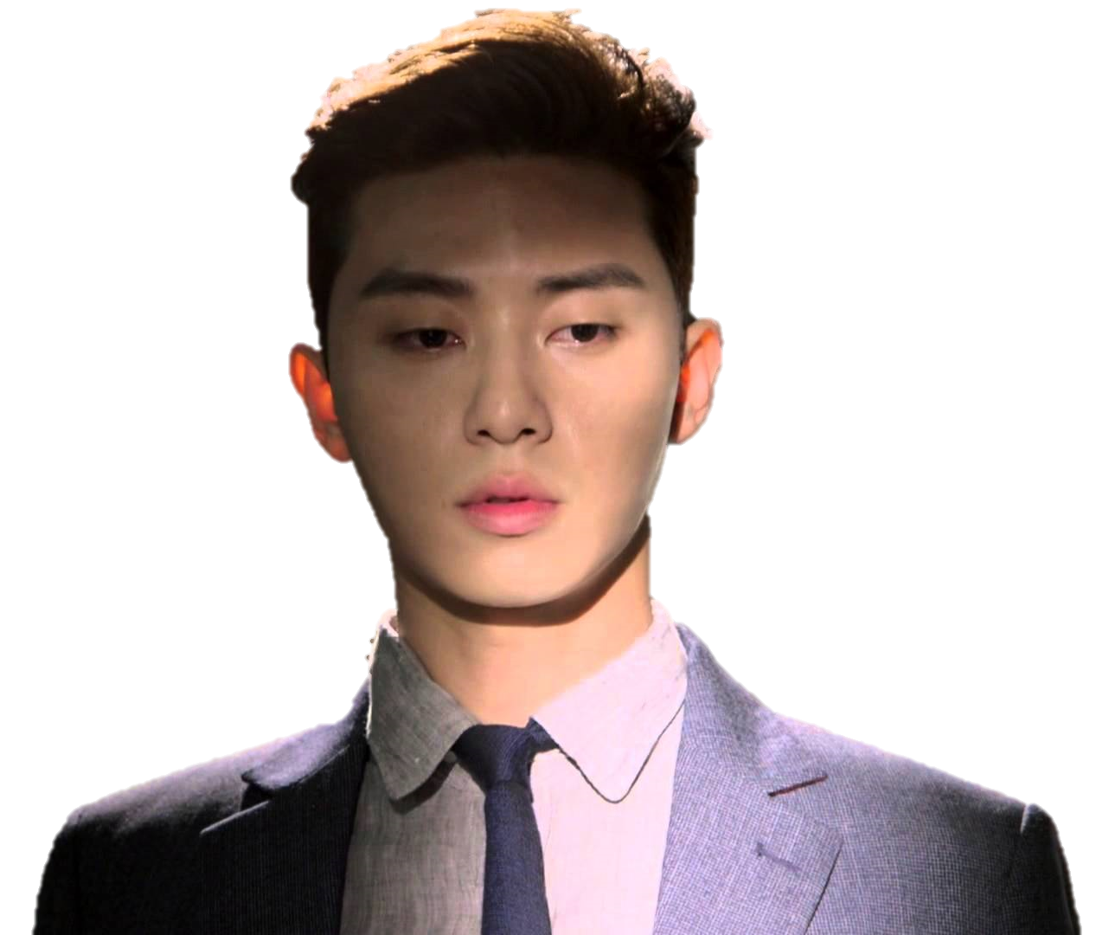
What is
my
JOB
?

Slide 6
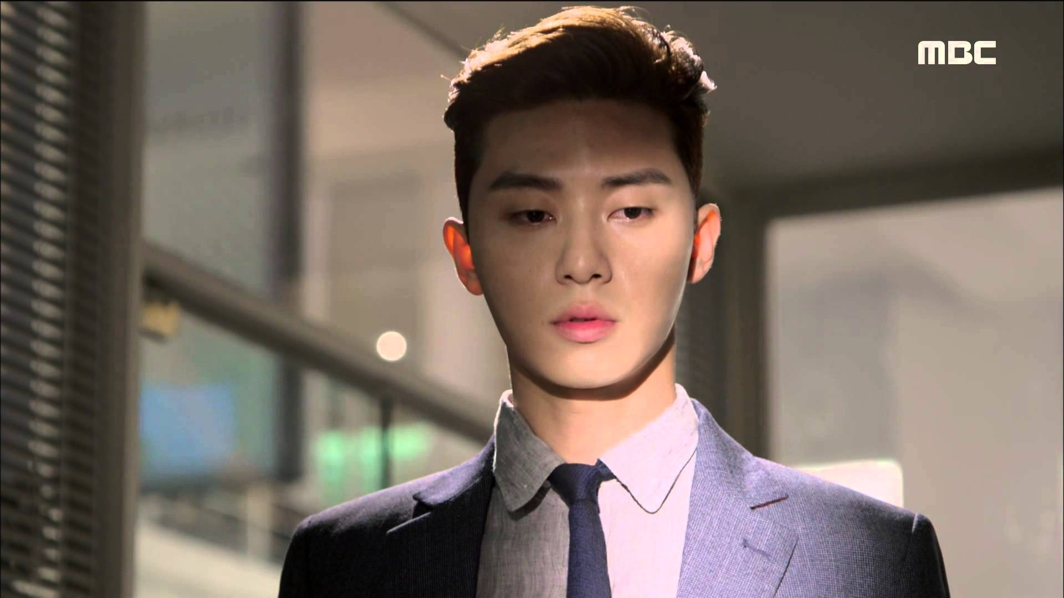
My name is Seojun and I’m a actor.

Slide 7
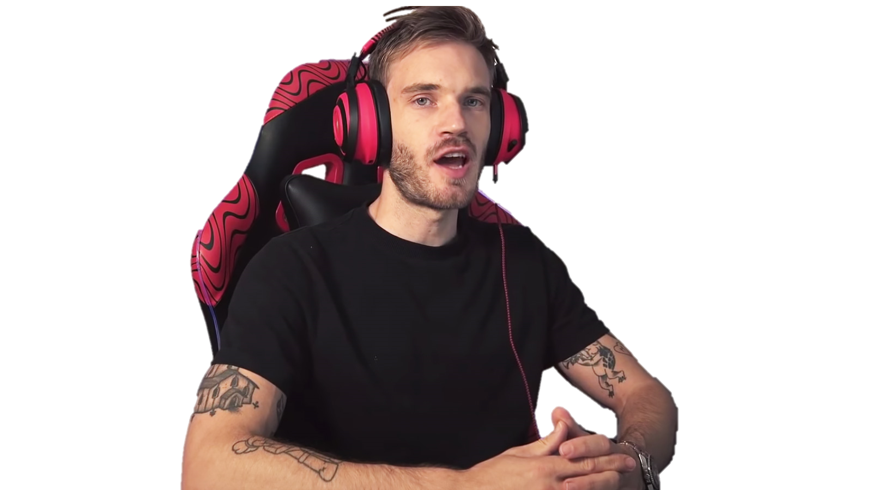
What is
my
JOB
?

Slide 8
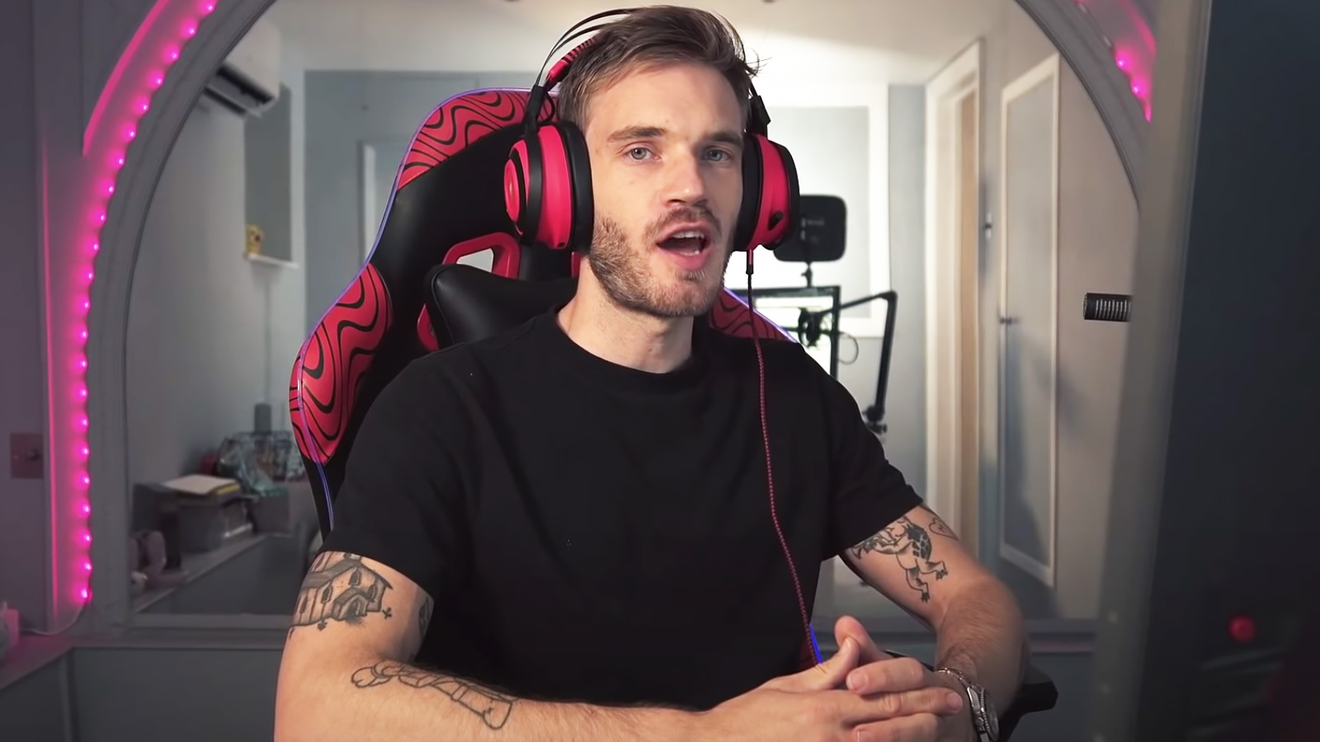
My name is Pewdiepie and I’m a Youtuber.

Slide 9
What is
my
JOB
?

Slide 10
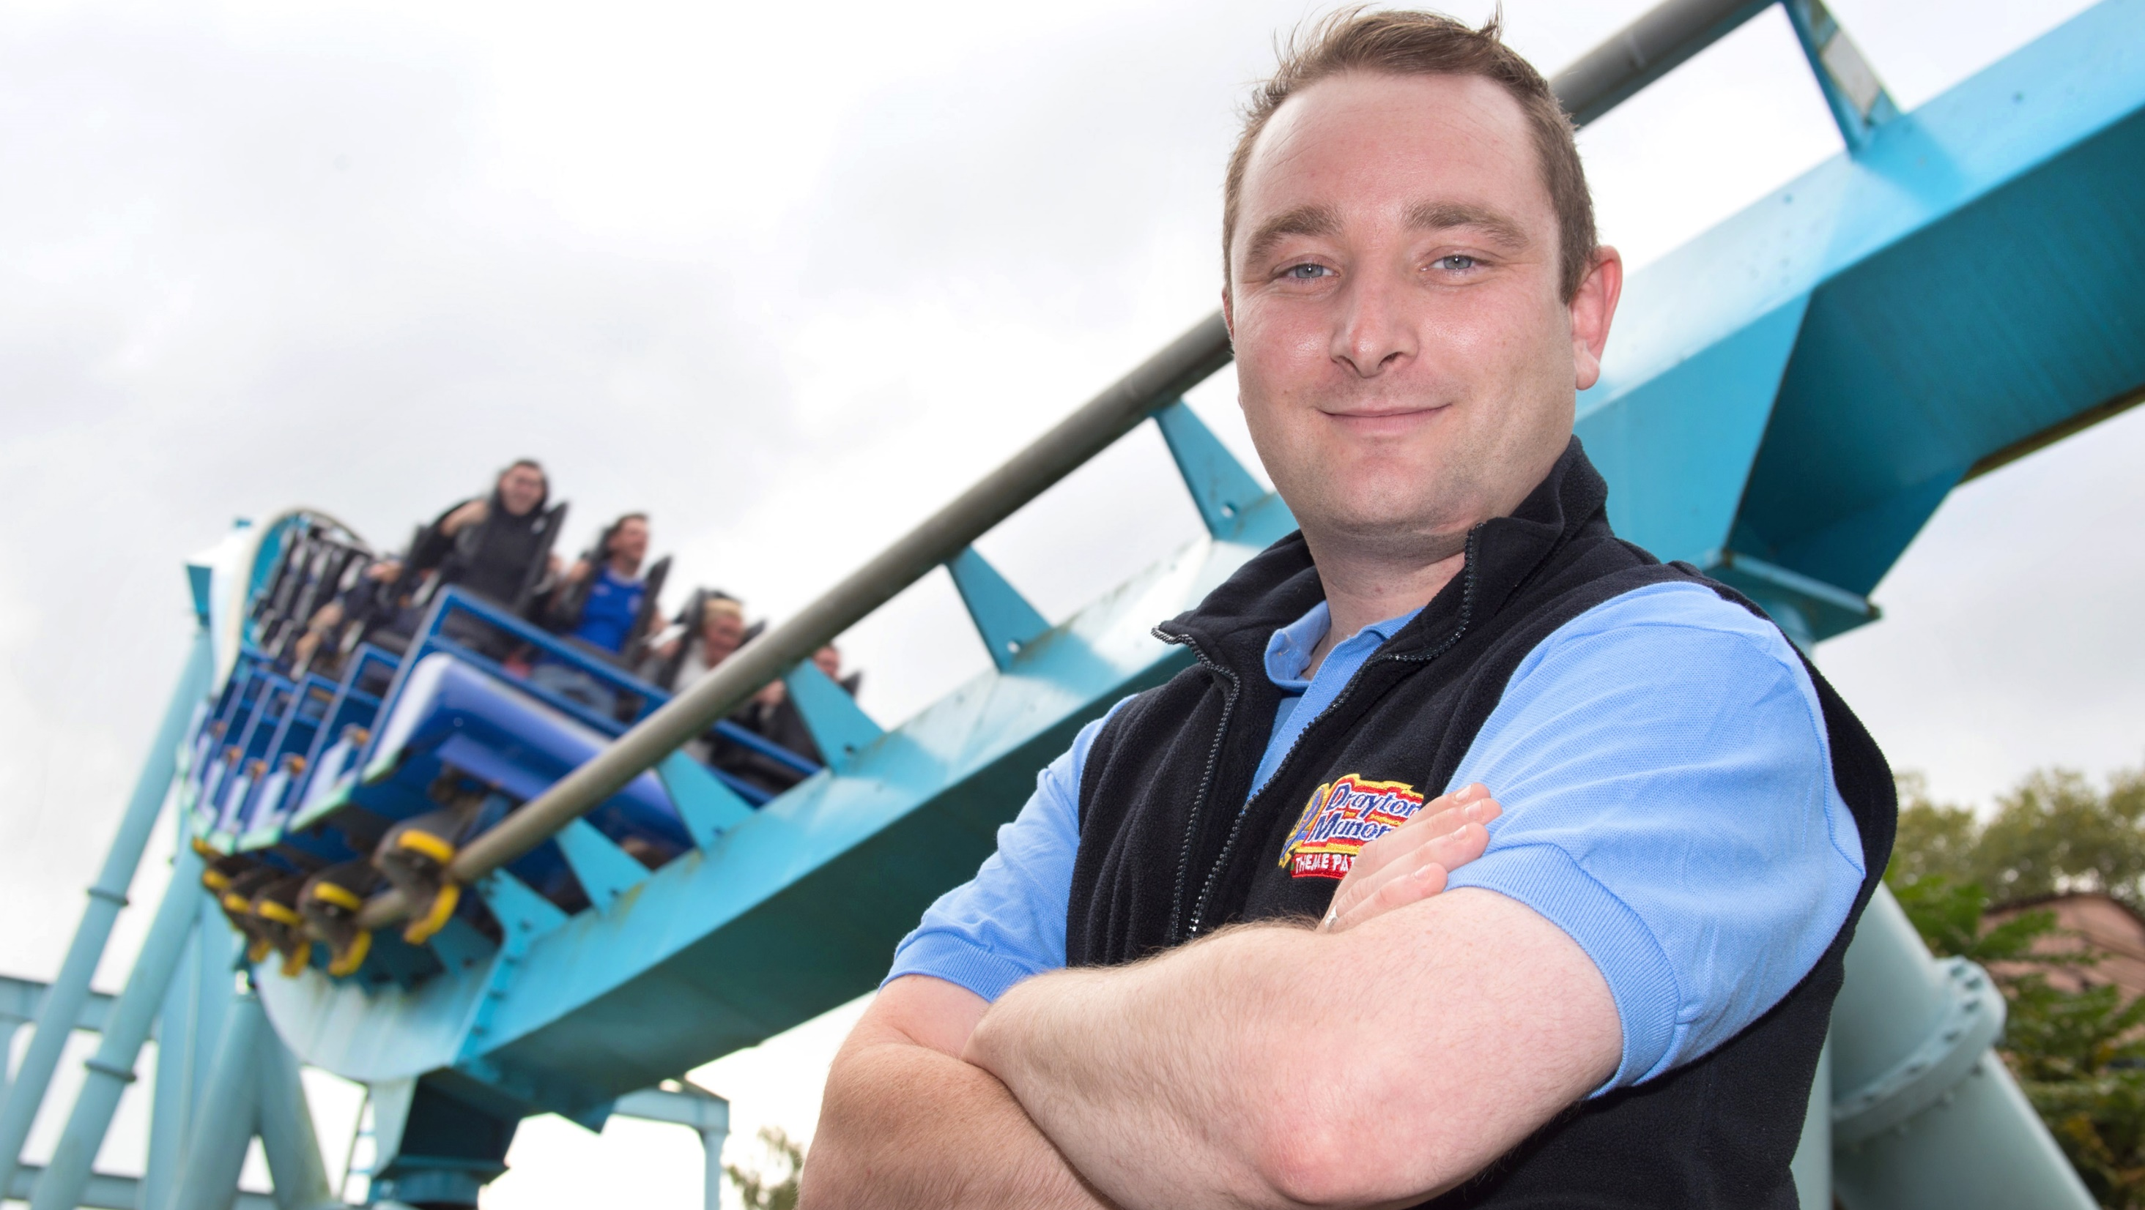
My name is John and I’m a roller coaster tester.

Slide 11
What is
my
Job
?

Slide 12
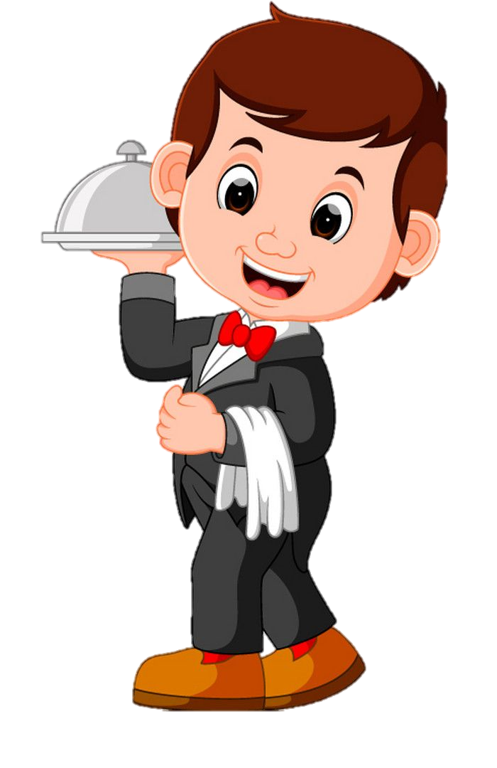
I am a
waiter

Slide 13
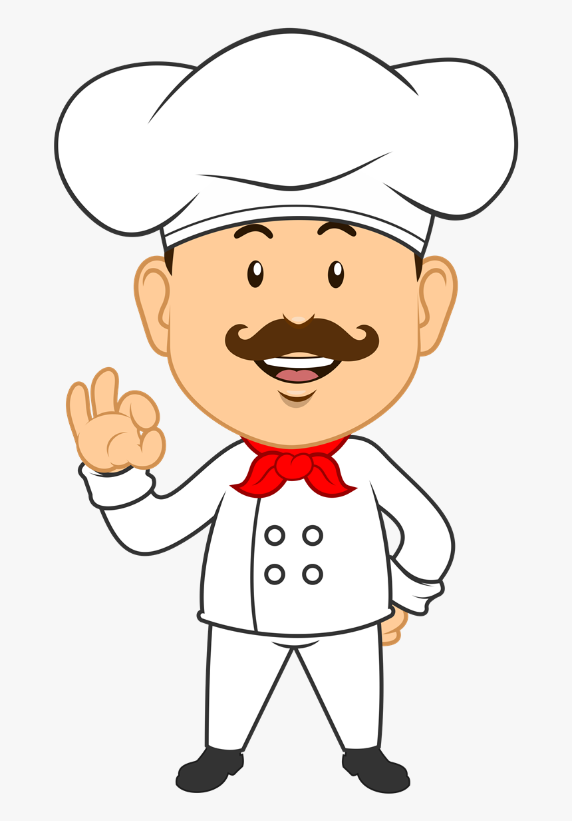
I am a
chef

Slide 14
I am a
baker

Slide 15
I am a
dentist

Slide 16
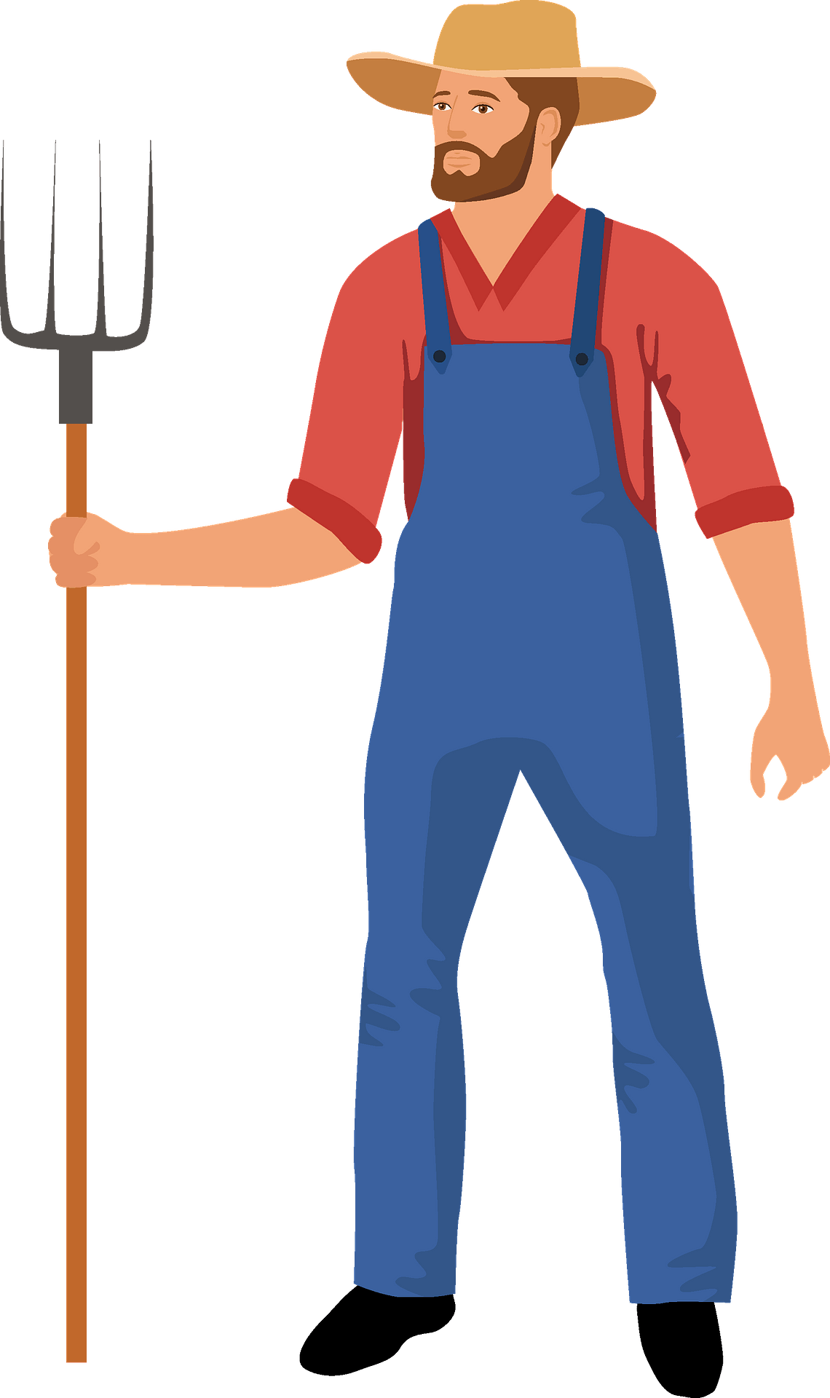
I am a
farmer

Slide 17
I am an
athlete

Slide 18
I am a
Veterinarian

Slide 19
We are
lawyers

Slide 20
What do you want to be?
I want to be a ____.

Slide 21
Guess
the
JOB

Slide 22
I visit many countries.
I take many people with me.
I am high in the sky.
I love to fly!

Slide 23
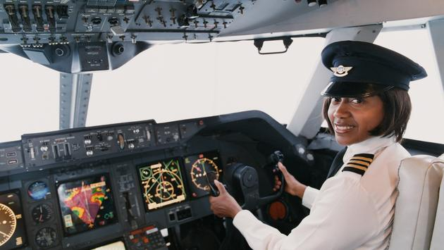
She is a pilot.

Slide 24
I love the city.
People ride in my car.
Sometimes my driving is bad.
My car has a sign on top.

Slide 25
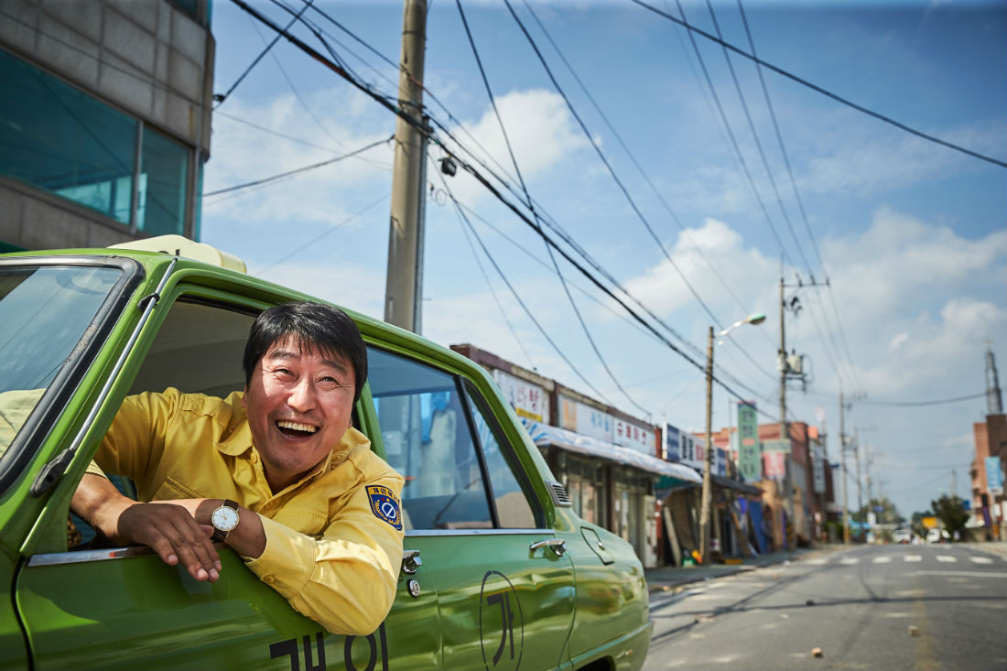
He is a taxi driver.

Slide 26
I am strong and brave.
I wear red and yellow colors.
I save people.
I put out fires.

Slide 27
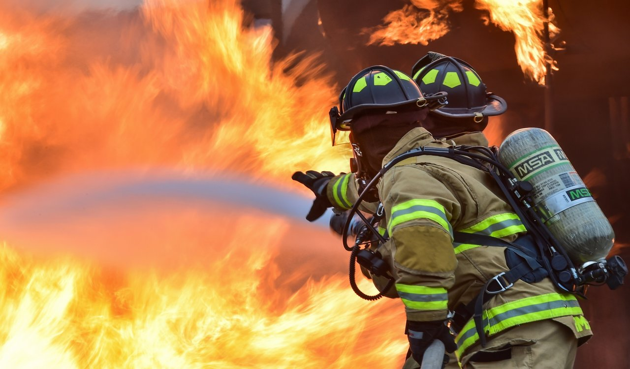
He is a firefighter.

Slide 28
I wear clean clothes.
I work day and night.
I carry your food.
Can I take your order?

Slide 29
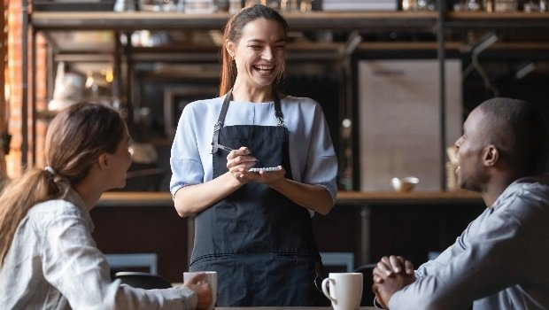
She is a waiter.

Slide 30
I am very smart.
I like helping people.
I wear a white coat.
I work at a hospital.

Slide 31
He is a doctor.

Slide 32
I am very busy.
My job is stressful.
I make delicious food.
I work in a restaurant.

Slide 33
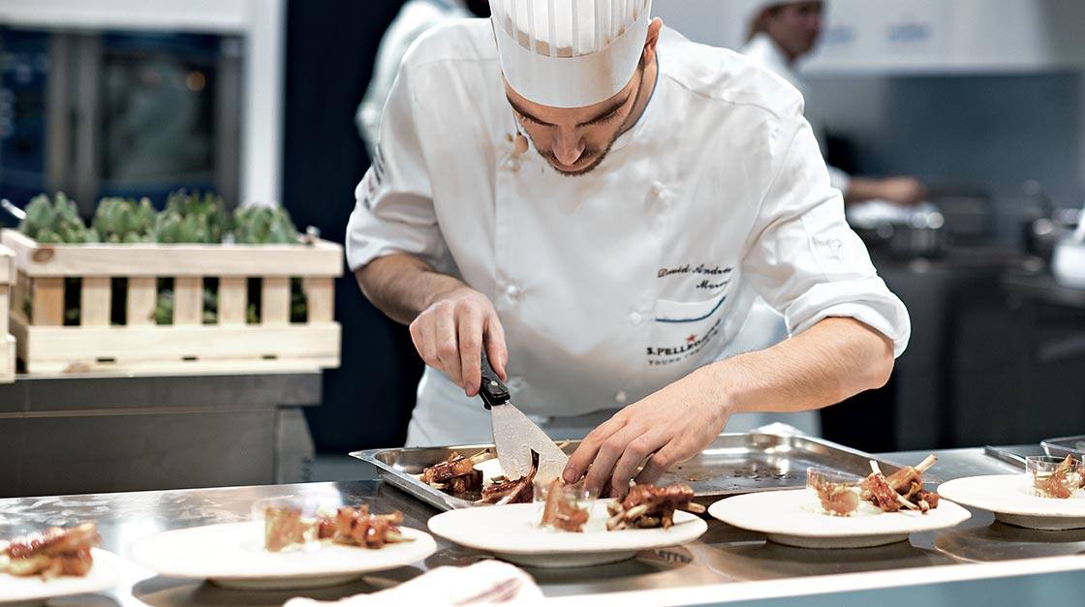
He is a chef.

Slide 34
I am famous.
I work on a team.
I am fast and strong.
I play sports.

Slide 35
She is an athlete.

Slide 36
I am very kind.
Students love me.
I love students.
I work at a school.

Slide 37
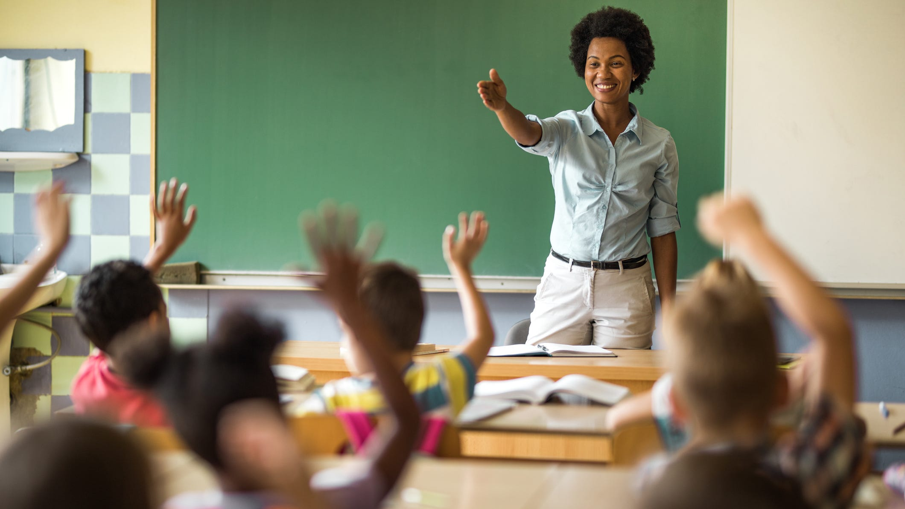
She is a teacher.

Slide 38
I am rich.
I help people with their problems.
I solve problems.
I defend people in court.

Slide 39
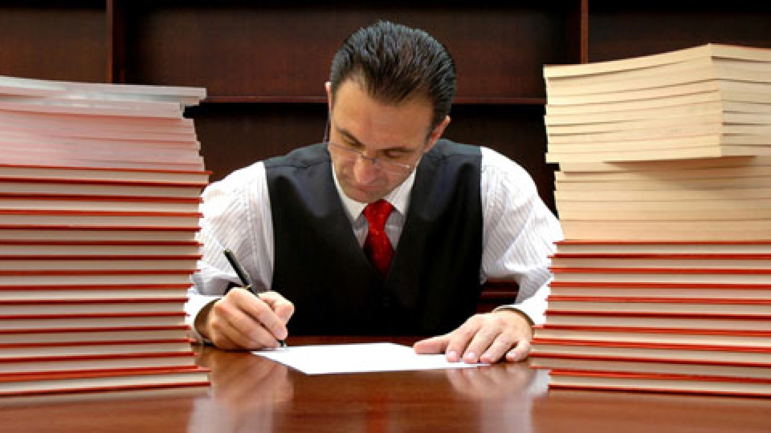
He is a lawyer.

Slide 40
I wake up early.
I love nature.
I grow things.
I drive a tractor.

Slide 41
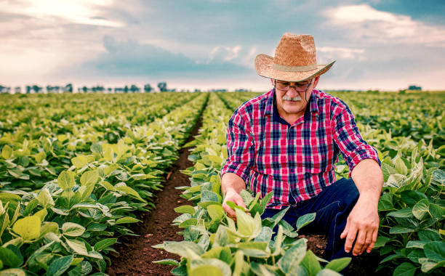
He is a farmer.

Slide 42
I am creative.
I have many styles.
I use many colors.
I paint and draw.

Slide 43
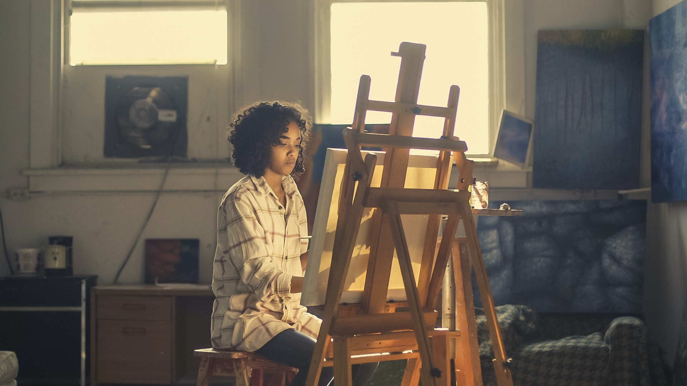
She is an artist.

Slide 44
I protect people.
My car has lights on top.
I have a gun.
I stop criminals.

Slide 45
He is a police officer.

Slide 46
What is your mother’s job?
She is a ______.

Slide 47
What is your father’s job?
He is a ______.

Slide 48
What is your job?
I am a ______.

