Slide 1
Jobs

Slide 2
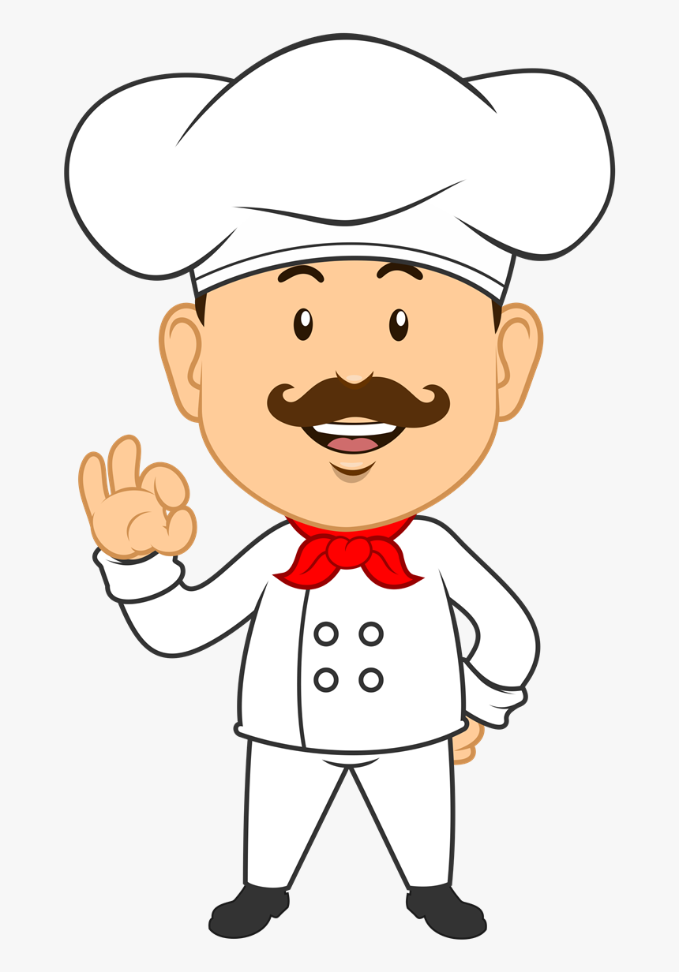
chef
cook

Slide 3
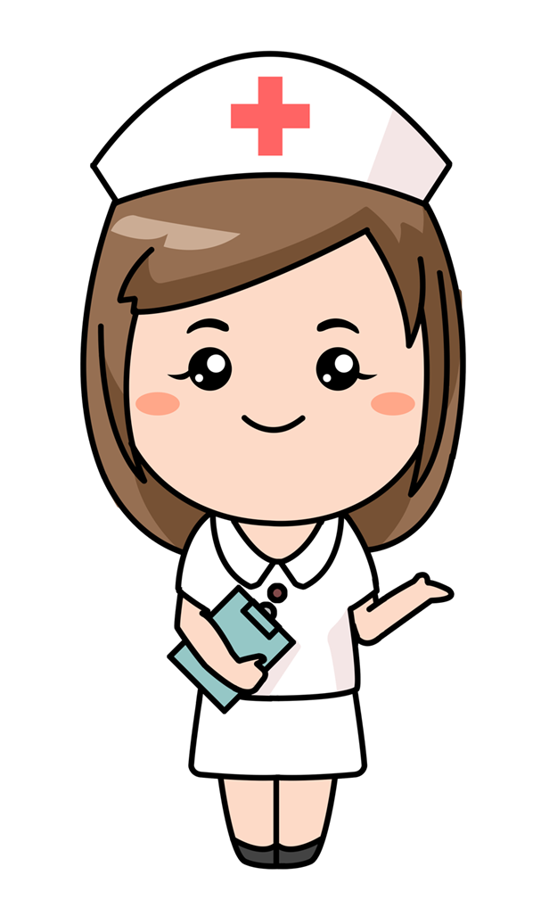
Nurse

Slide 4
Police
officer

Slide 5
teacher

Slide 6
Astronaut

Slide 7
doctor

Slide 8
singer

Slide 9
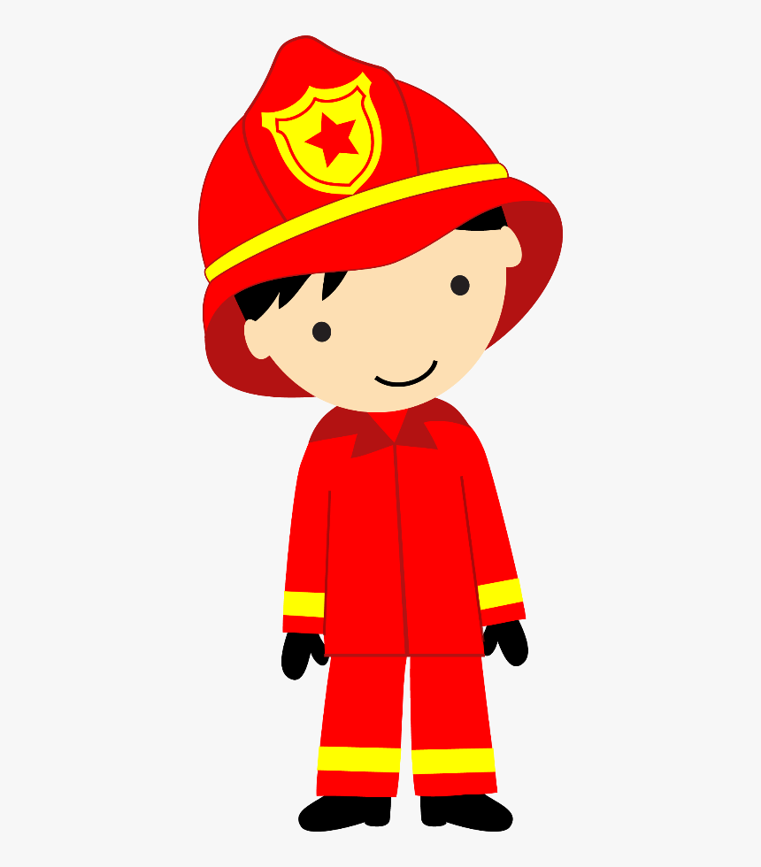
firefighter

Slide 10
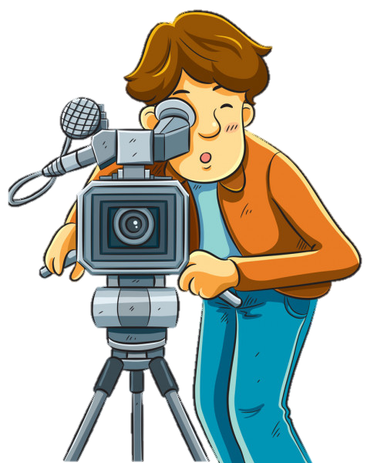
cameraman

Slide 11
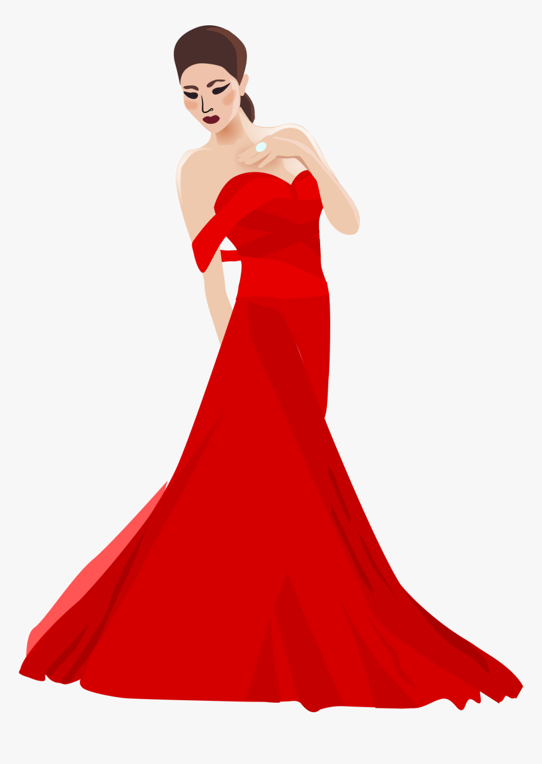
model

Slide 13
He is a doctor.

Slide 15
He is a singer.

Slide 17
He is a police officer.

Slide 18
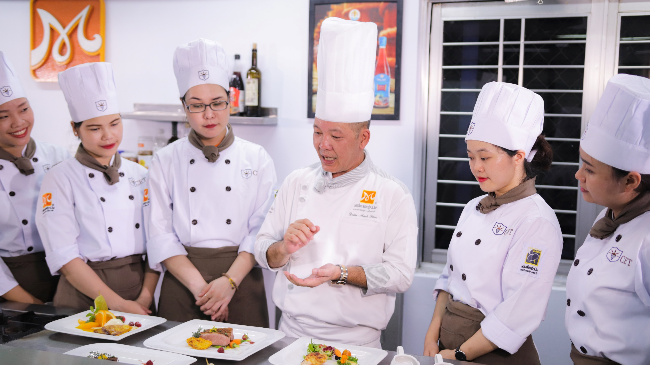

Slide 19
He is a chef.

Slide 20
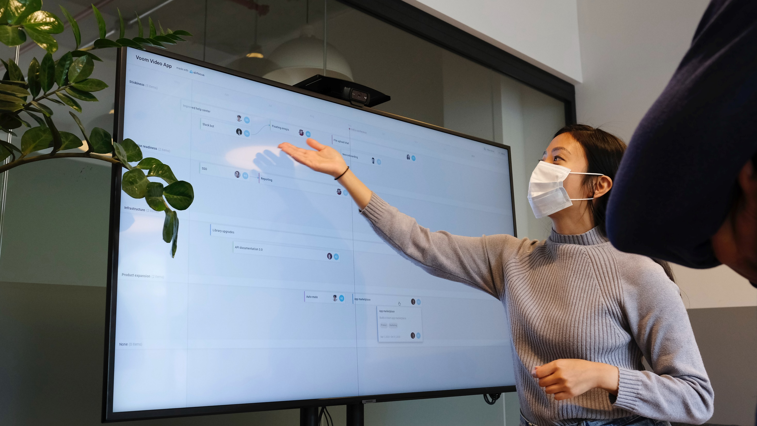

Slide 21
She is a teacher.

Slide 22
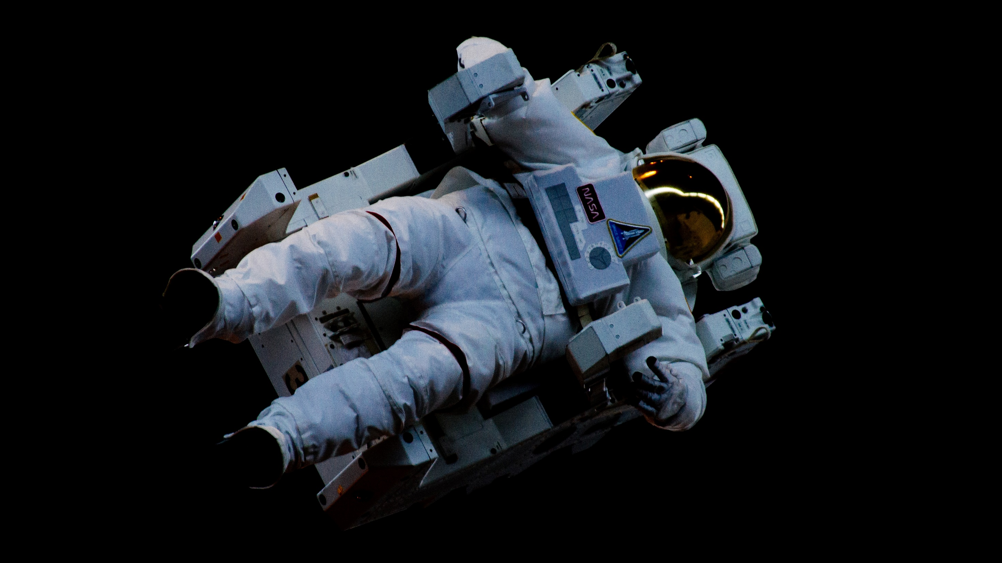

Slide 23
She is an astronaut.

Slide 24
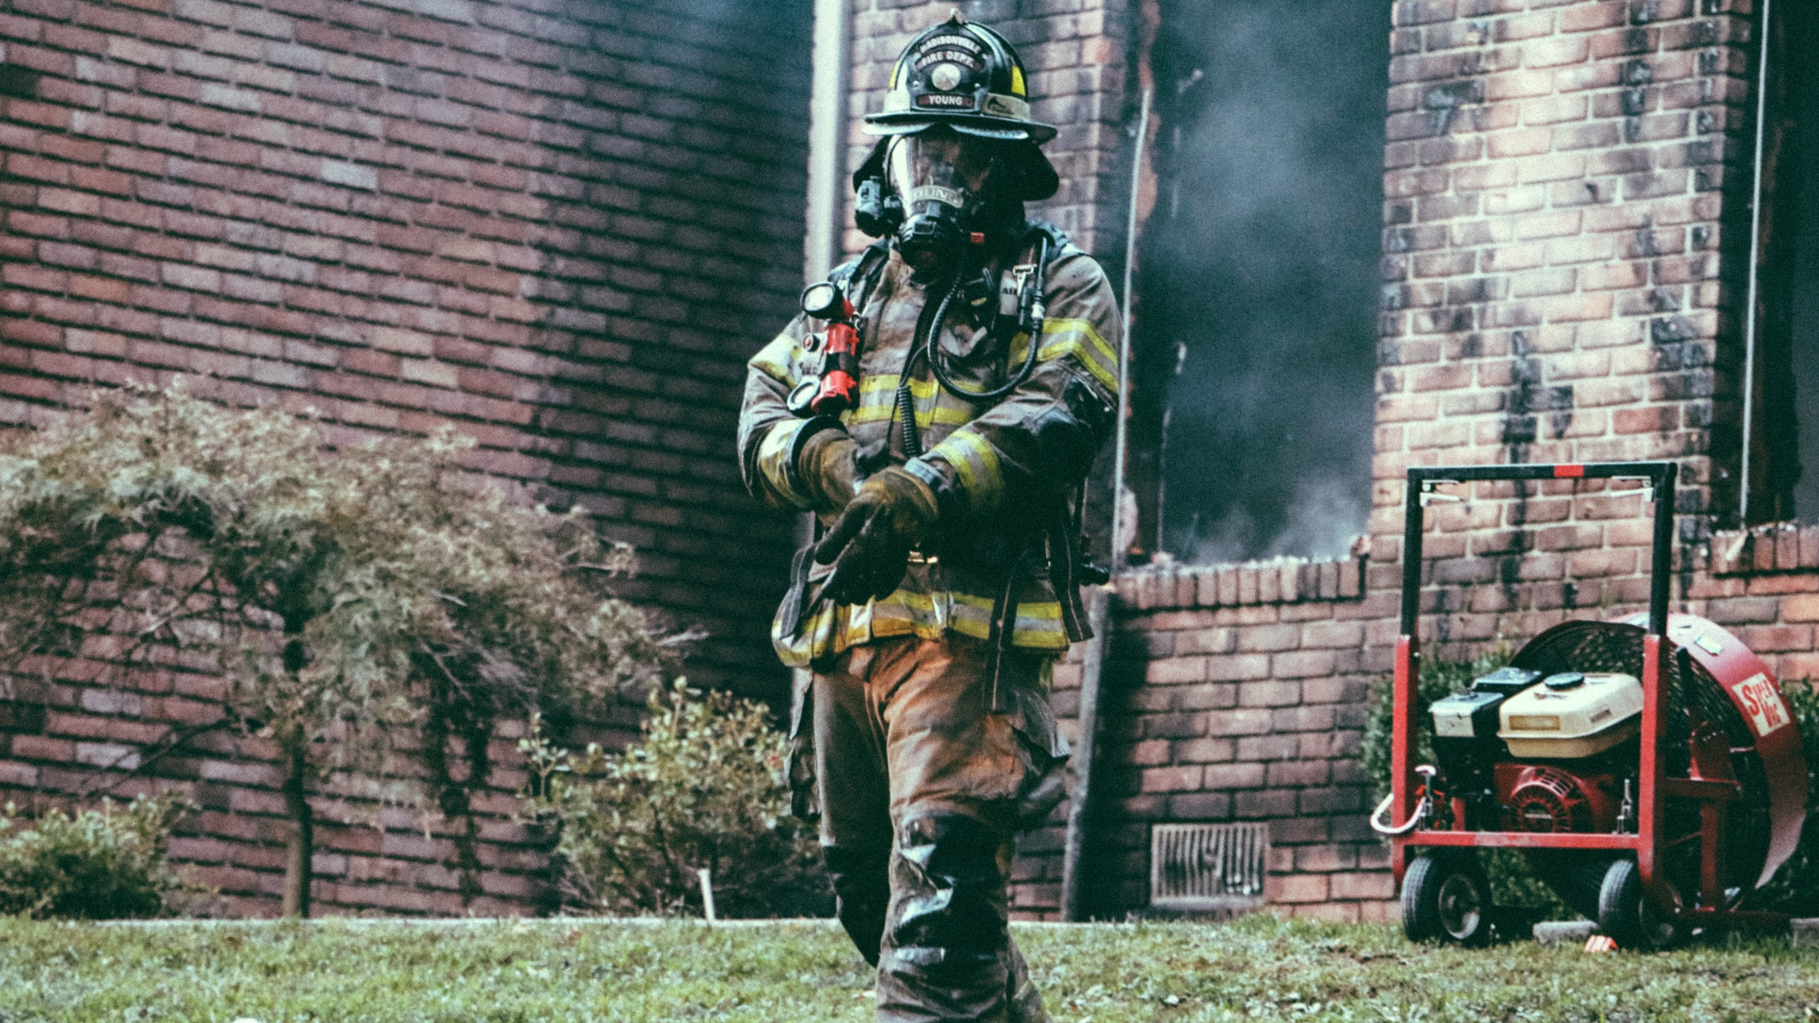

Slide 25
She is a firefighter.

Slide 26
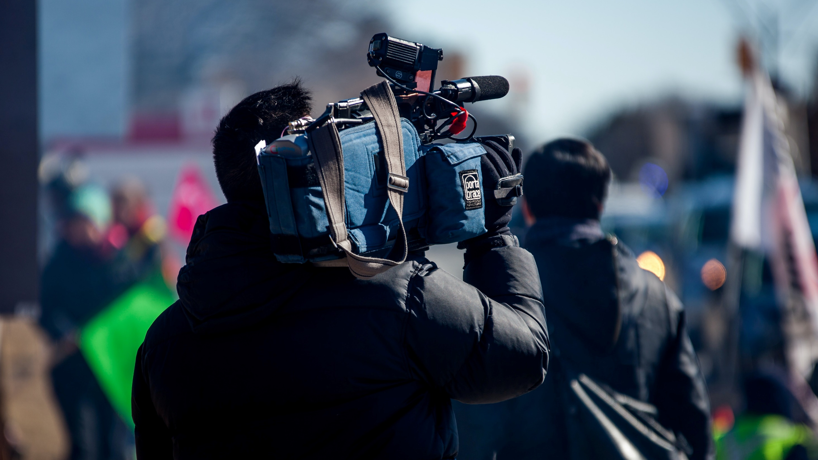

Slide 27
He is a cameraman.

Slide 28
What is your mother’s job?
She is a ______.

Slide 29
What is your father’s job?
He is a ______.

Slide 30
What is your job?
I am a ______.

Slide 31
What do you want to be?
I want to be a ____.

Slide 32
What is
missing?

Slide 33
Level 1

Slide 36
He is a police officer.

Slide 38
She is a singer.

Slide 40
He is a chef.

Slide 41
Level 2

Slide 44
She is a teacher.

Slide 46
She is a model.

Slide 48
He is a fire fighter.

Slide 49
Level 3

Slide 52
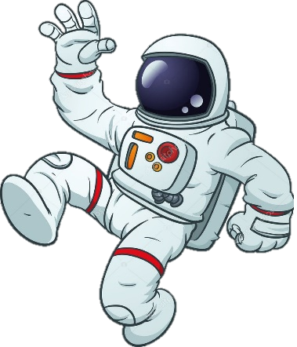
He is an astronaut.

Slide 54
He is a doctor.

Slide 56
She is a nurse.

