Slide 1
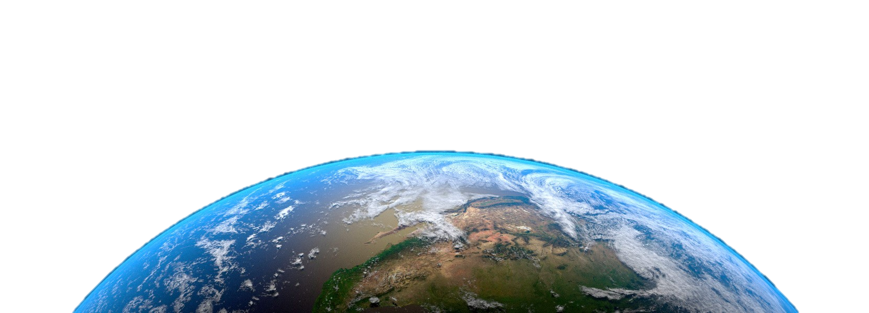
Earth
Let’s
help

Slide 2
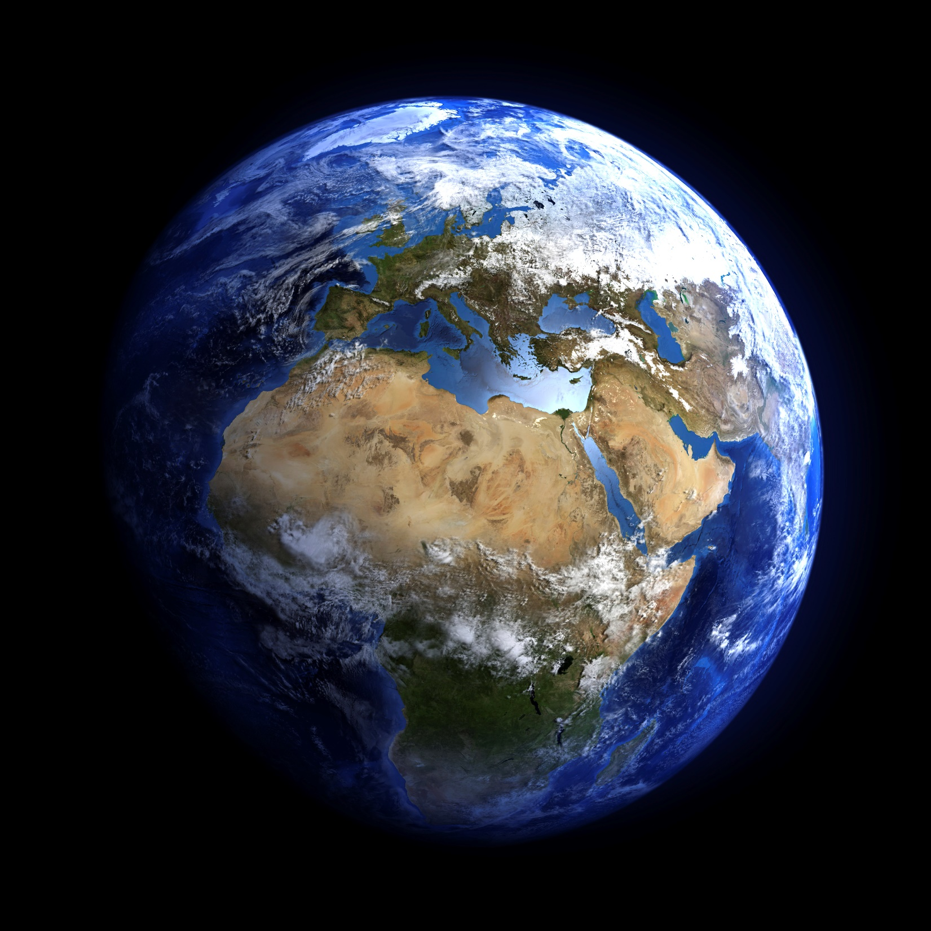
This is Earth.

Slide 3
This
_____ is Earth.

Slide 4
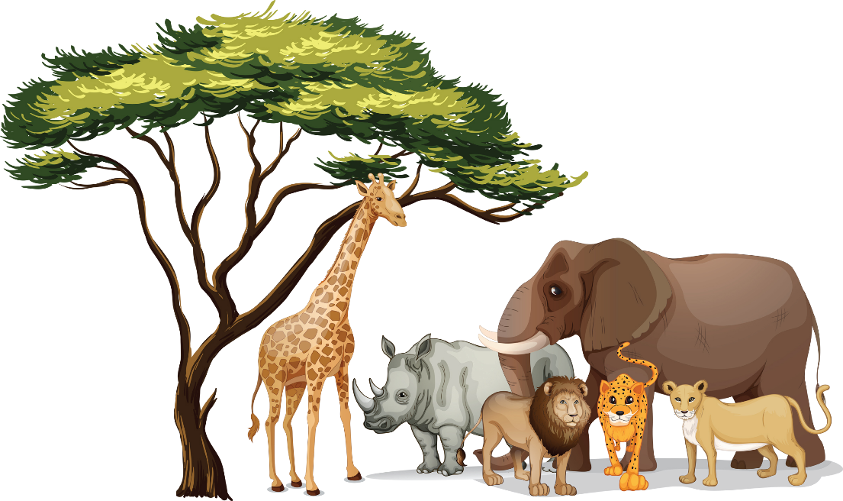
Who lives on Earth?
Animals
People

Slide 5
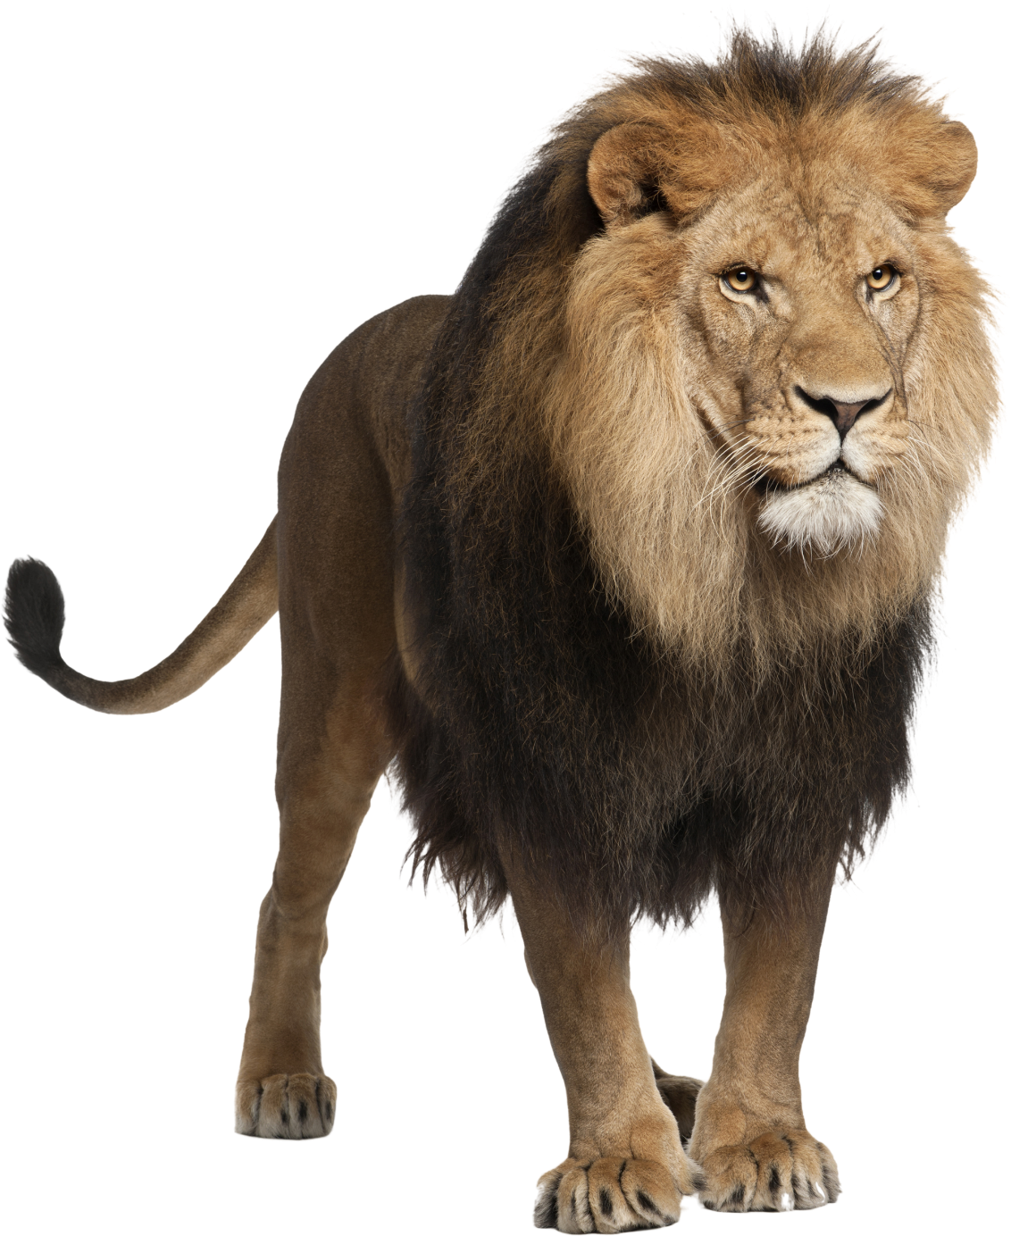
What is this?
This is a lion.

Slide 6
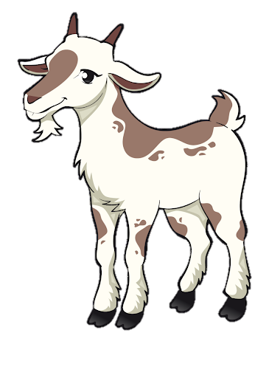
What is this?
This
____ is a goat.

Slide 7
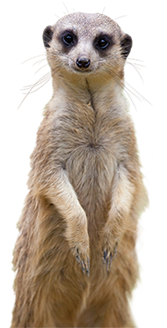
What is this?
This
____ is a meerkat.

Slide 8
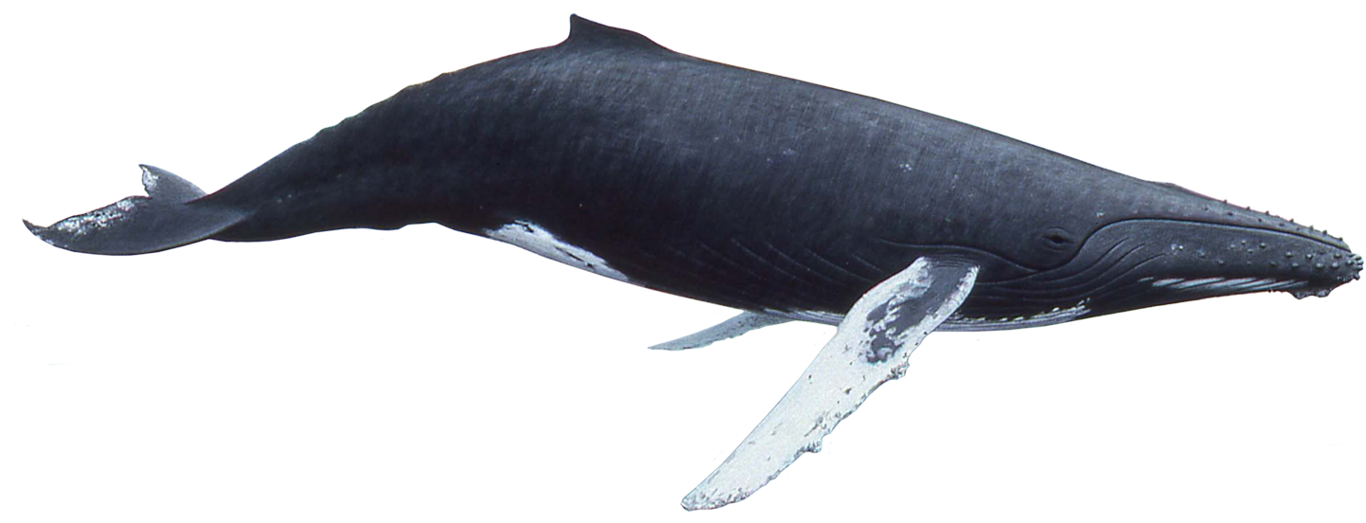
What is this?
This
whale
____ is a ______.

Slide 9
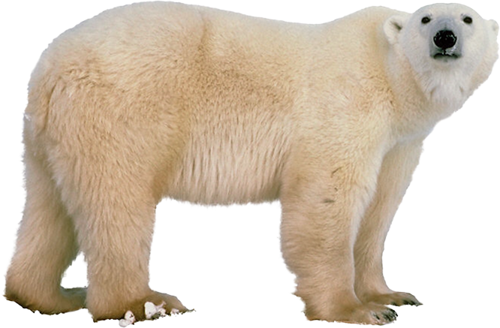
What is this?
____ is a _____ _____.
This
polar bear

Slide 10
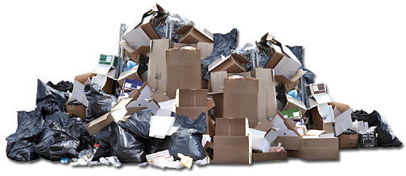
What is this?
This is trash.

Slide 11
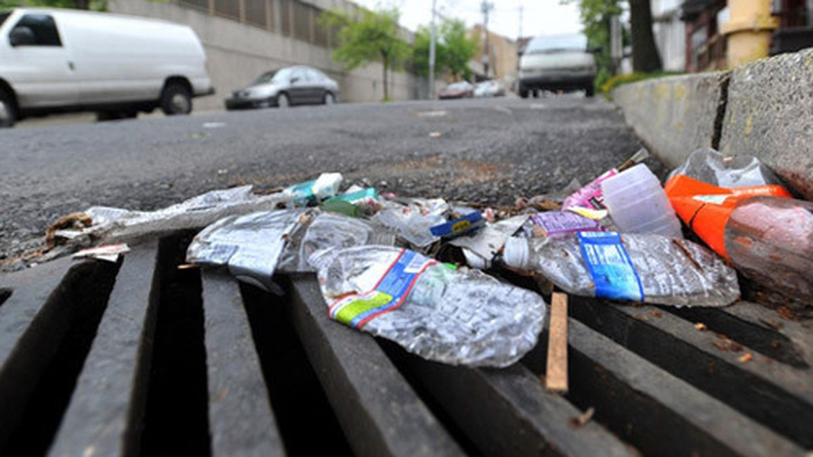
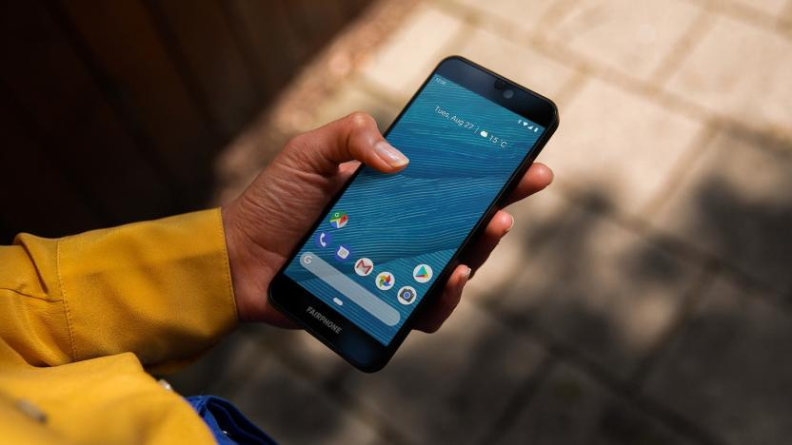
Yes, this is trash.
Is this trash?
No, this isn’t trash.
No, this is not trash.

Slide 12
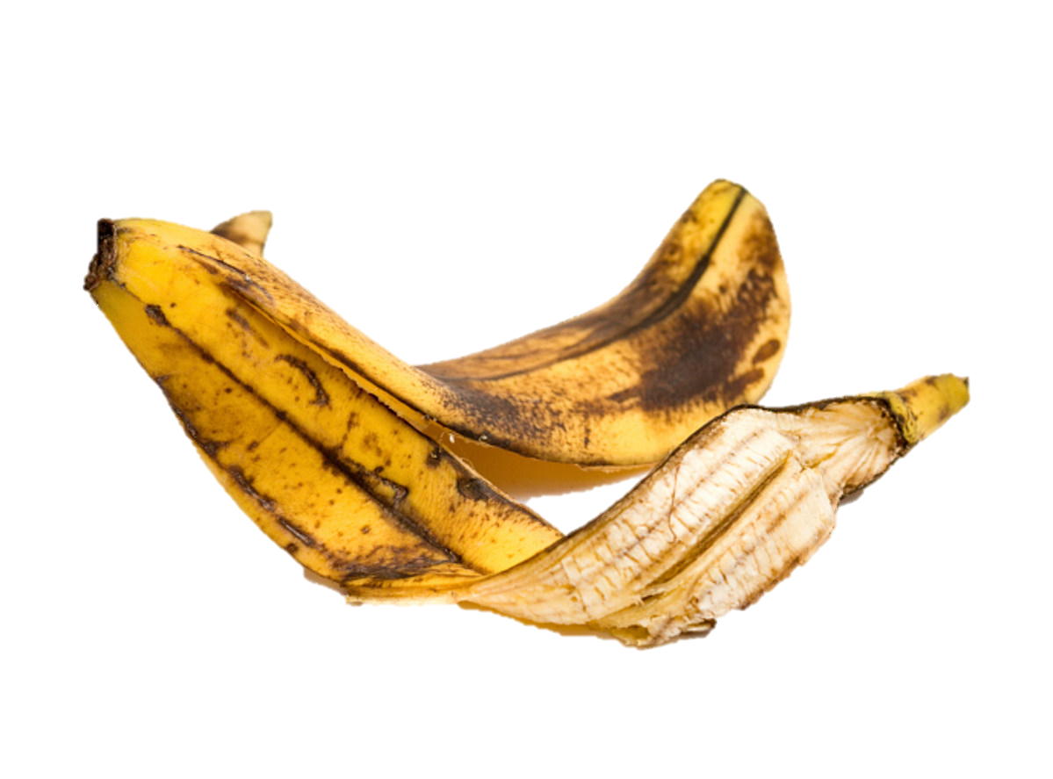
Is this trash?
is
Yes, this __ trash.

Slide 13
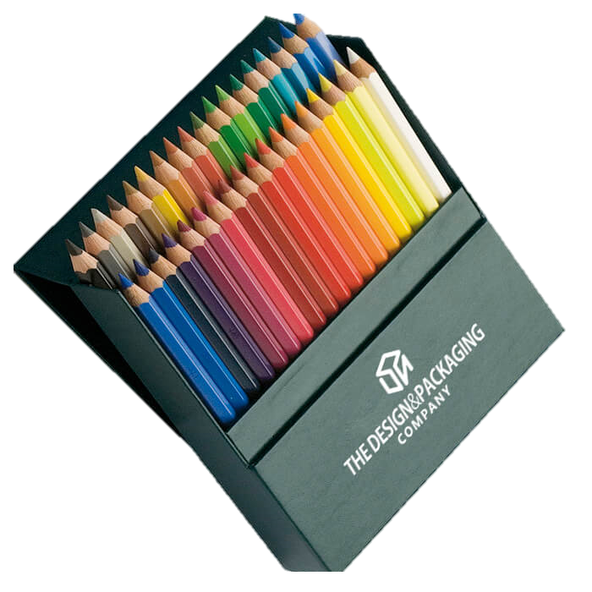
Is this trash?
isn’t
No, this _____ trash.

Slide 14
Is this trash?
Yes, this is trash.
No, this isn’t trash.

Slide 15
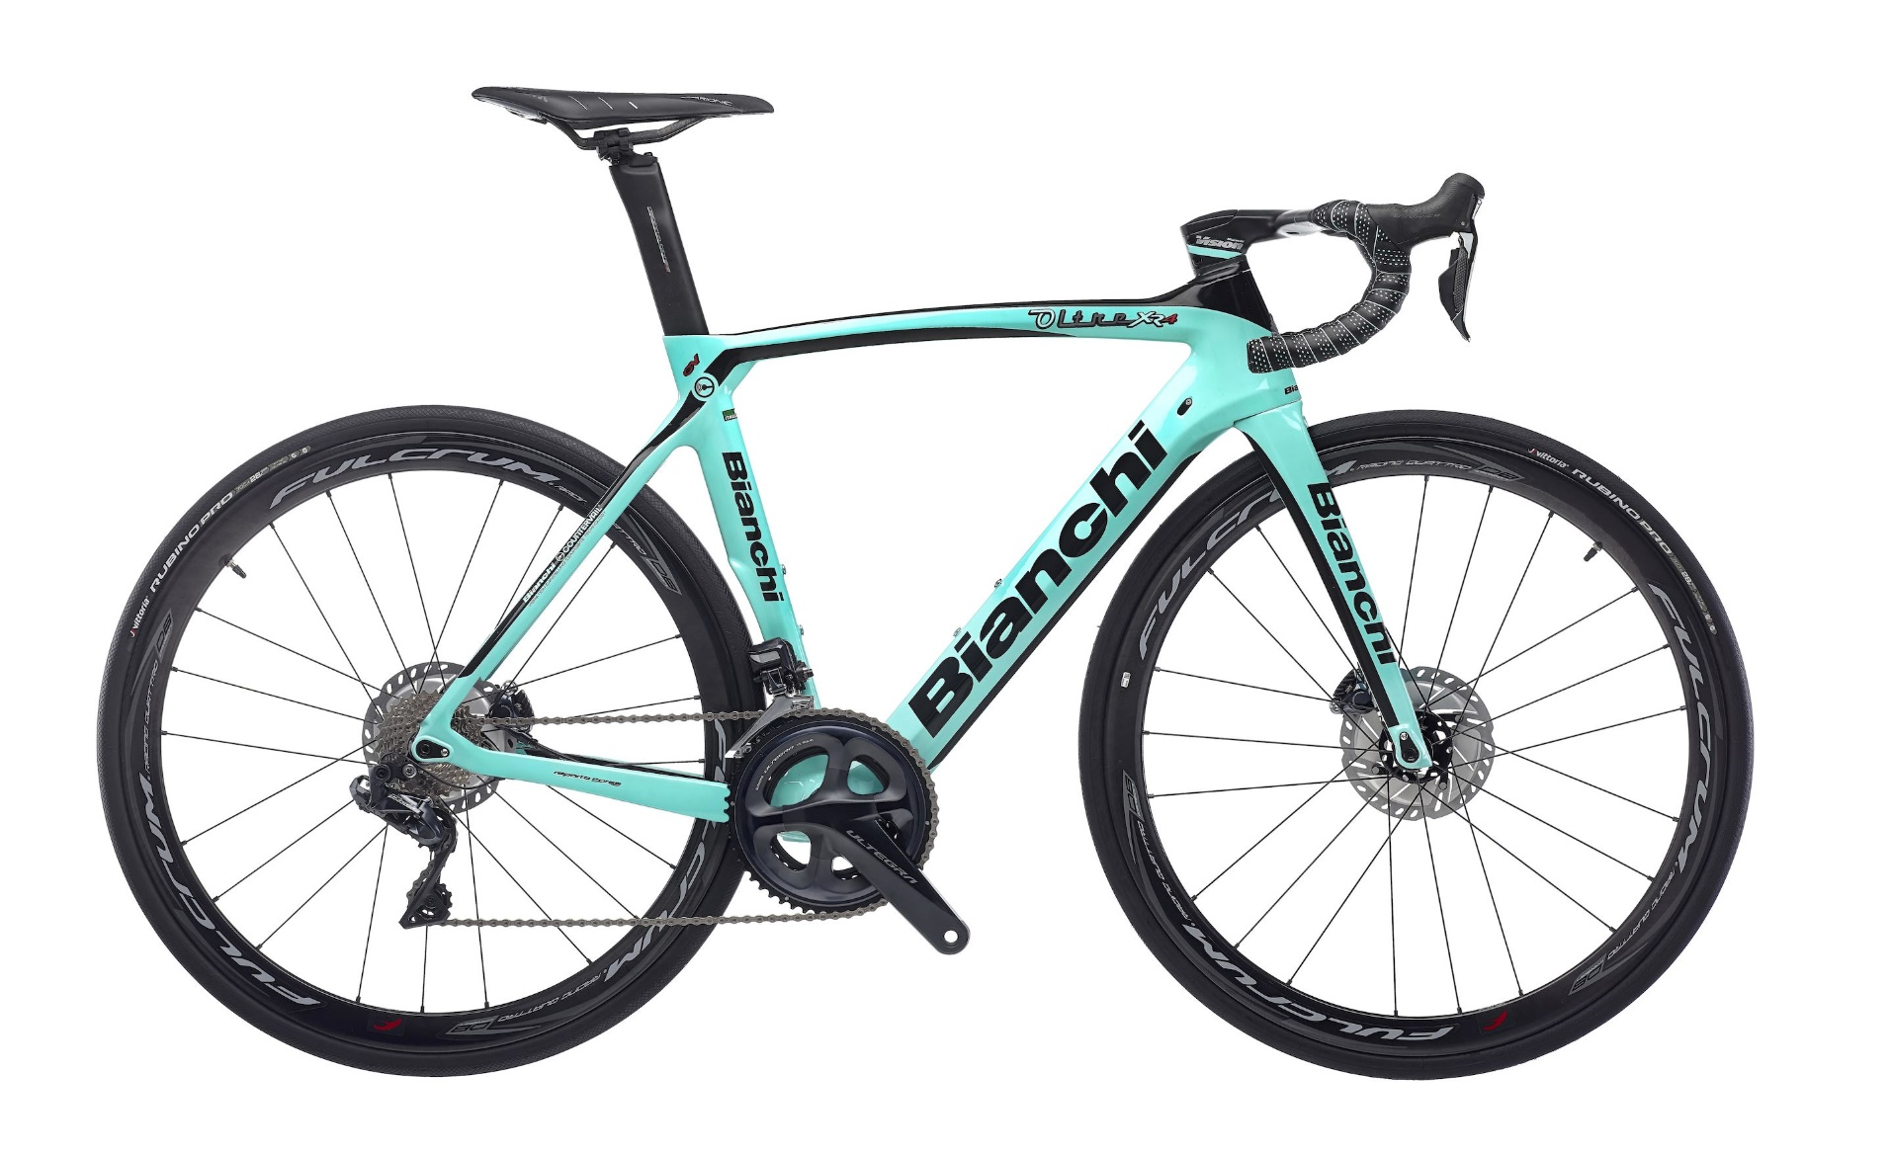
Is this trash?
Yes, this is trash.
No, this isn’t trash.

Slide 16
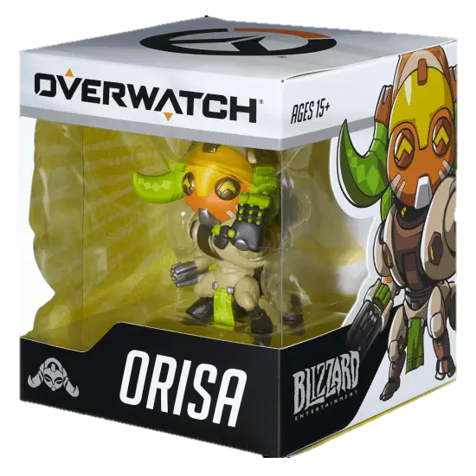
Is this trash?
Yes, this is trash.
No, this isn’t trash.

Slide 17
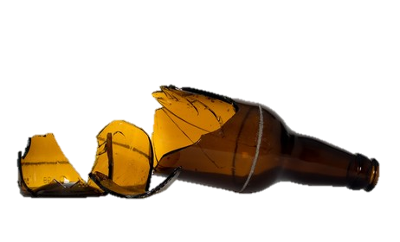
Is this trash?
Yes, this is trash.
No, this isn’t trash.

Slide 18
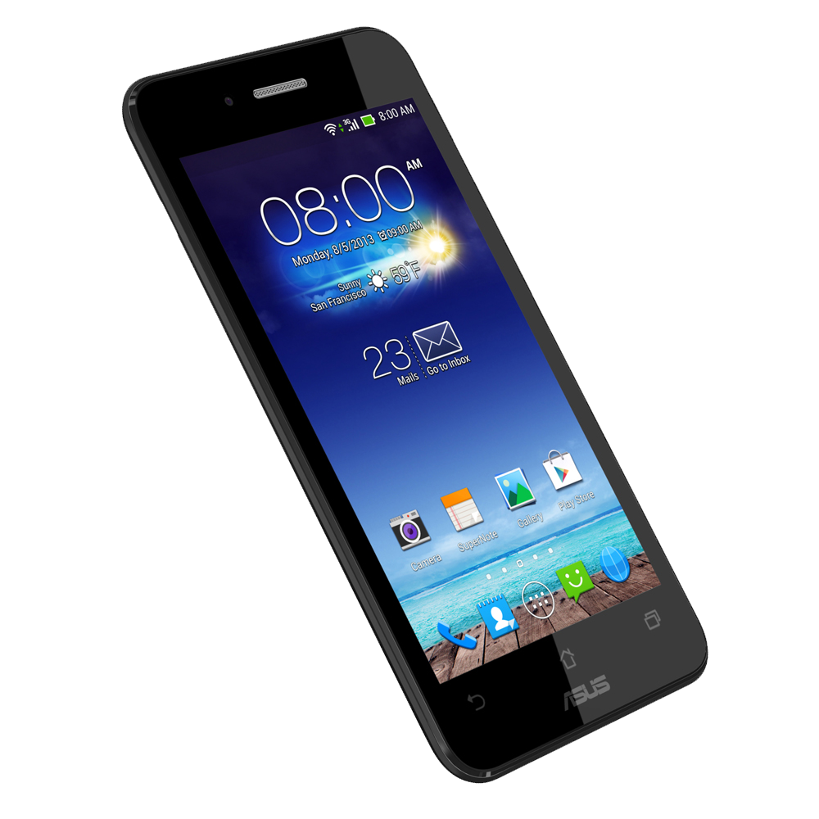
Is this trash?

Slide 19
Is this trash?

Slide 20
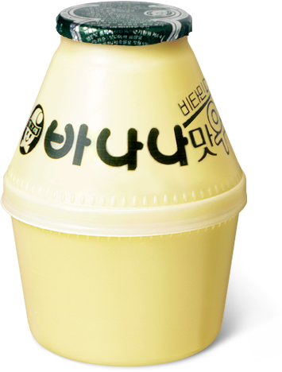
Is this trash?

Slide 21
RECYCLE

Slide 22
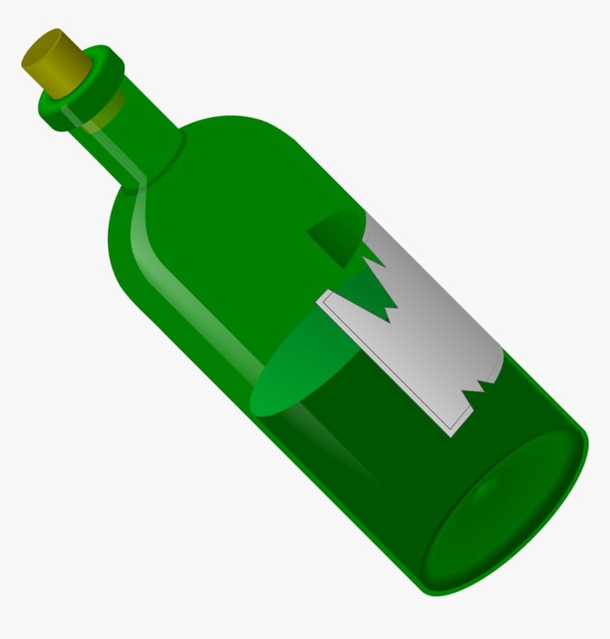
RECYCLE
RECYCLE
TRASH

Slide 23
Glass
RECYCLE
TRASH

Slide 24
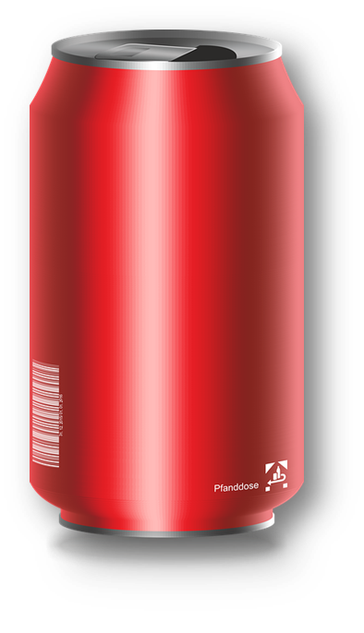
RECYCLE
TRASH

Slide 25
Cans
RECYCLE
TRASH

Slide 26
RECYCLE
TRASH

Slide 27
Paper
RECYCLE
TRASH

Slide 28
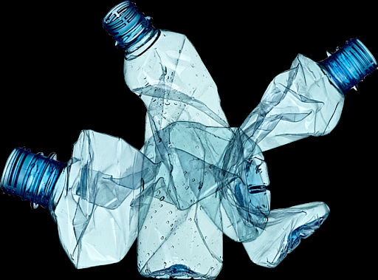
RECYCLE
TRASH

Slide 29
Plastic
RECYCLE
TRASH

Slide 30
Do you like trash?

Slide 31
Trash is
(역겨운)
gross

Slide 32
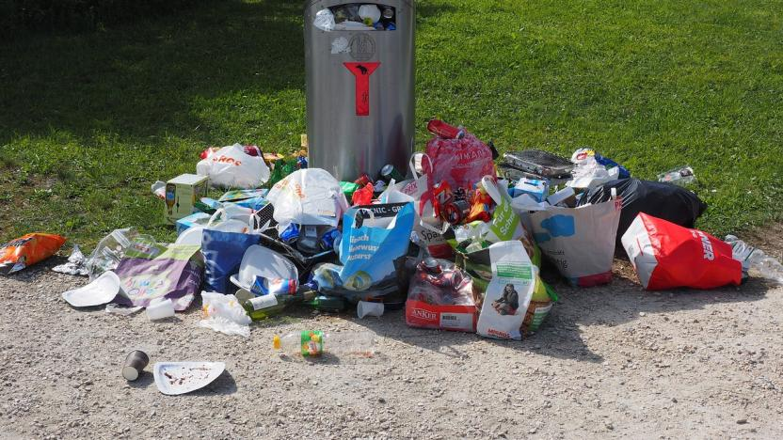
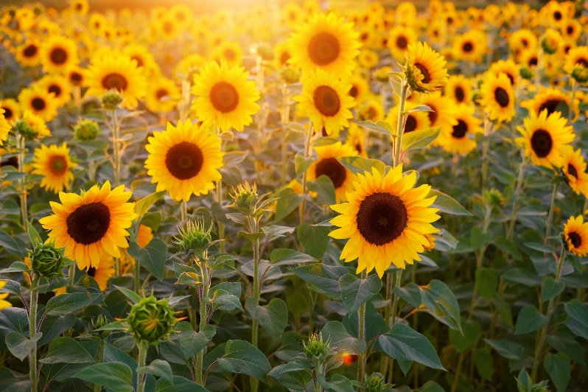
Yes, this is gross.
Is this gross?
No, this isn’t gross.
No, this is not gross.

Slide 33
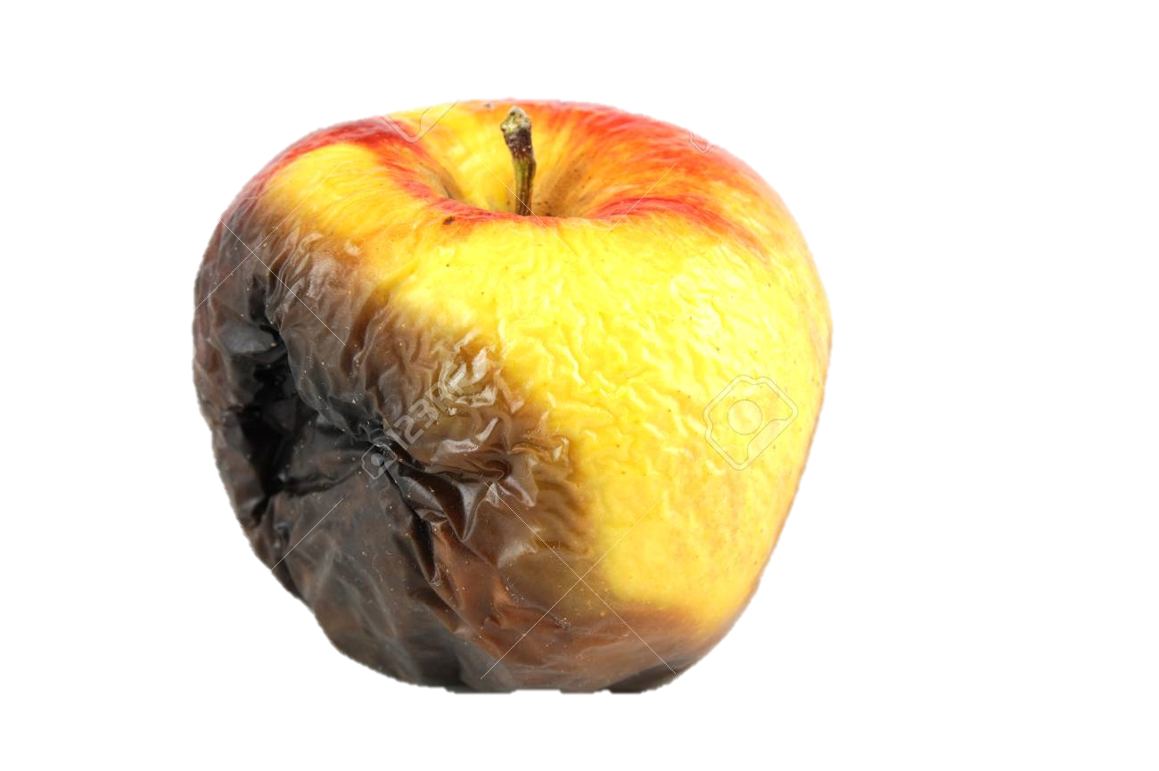
Is this gross?
is
Yes, this __ gross.

Slide 34
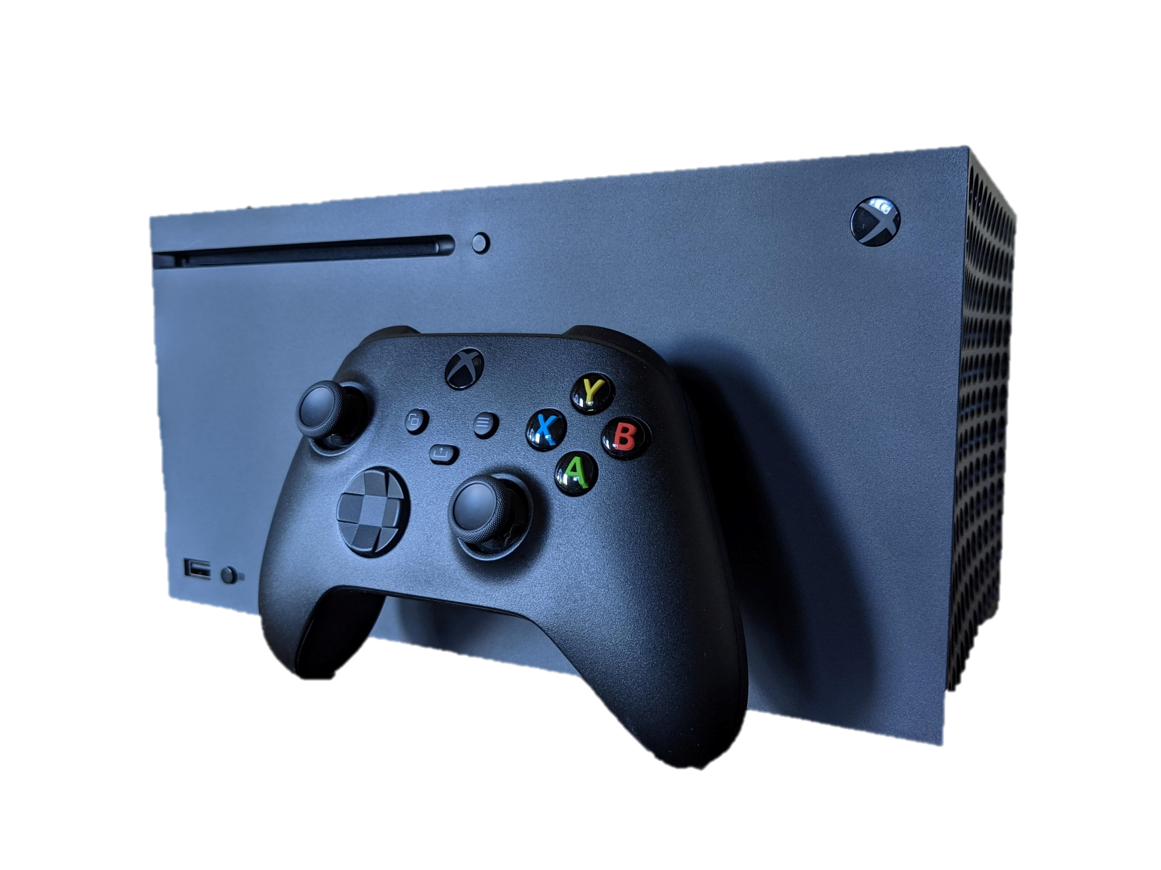
Is this gross?
isn’t
No, this _____ gross.

Slide 35
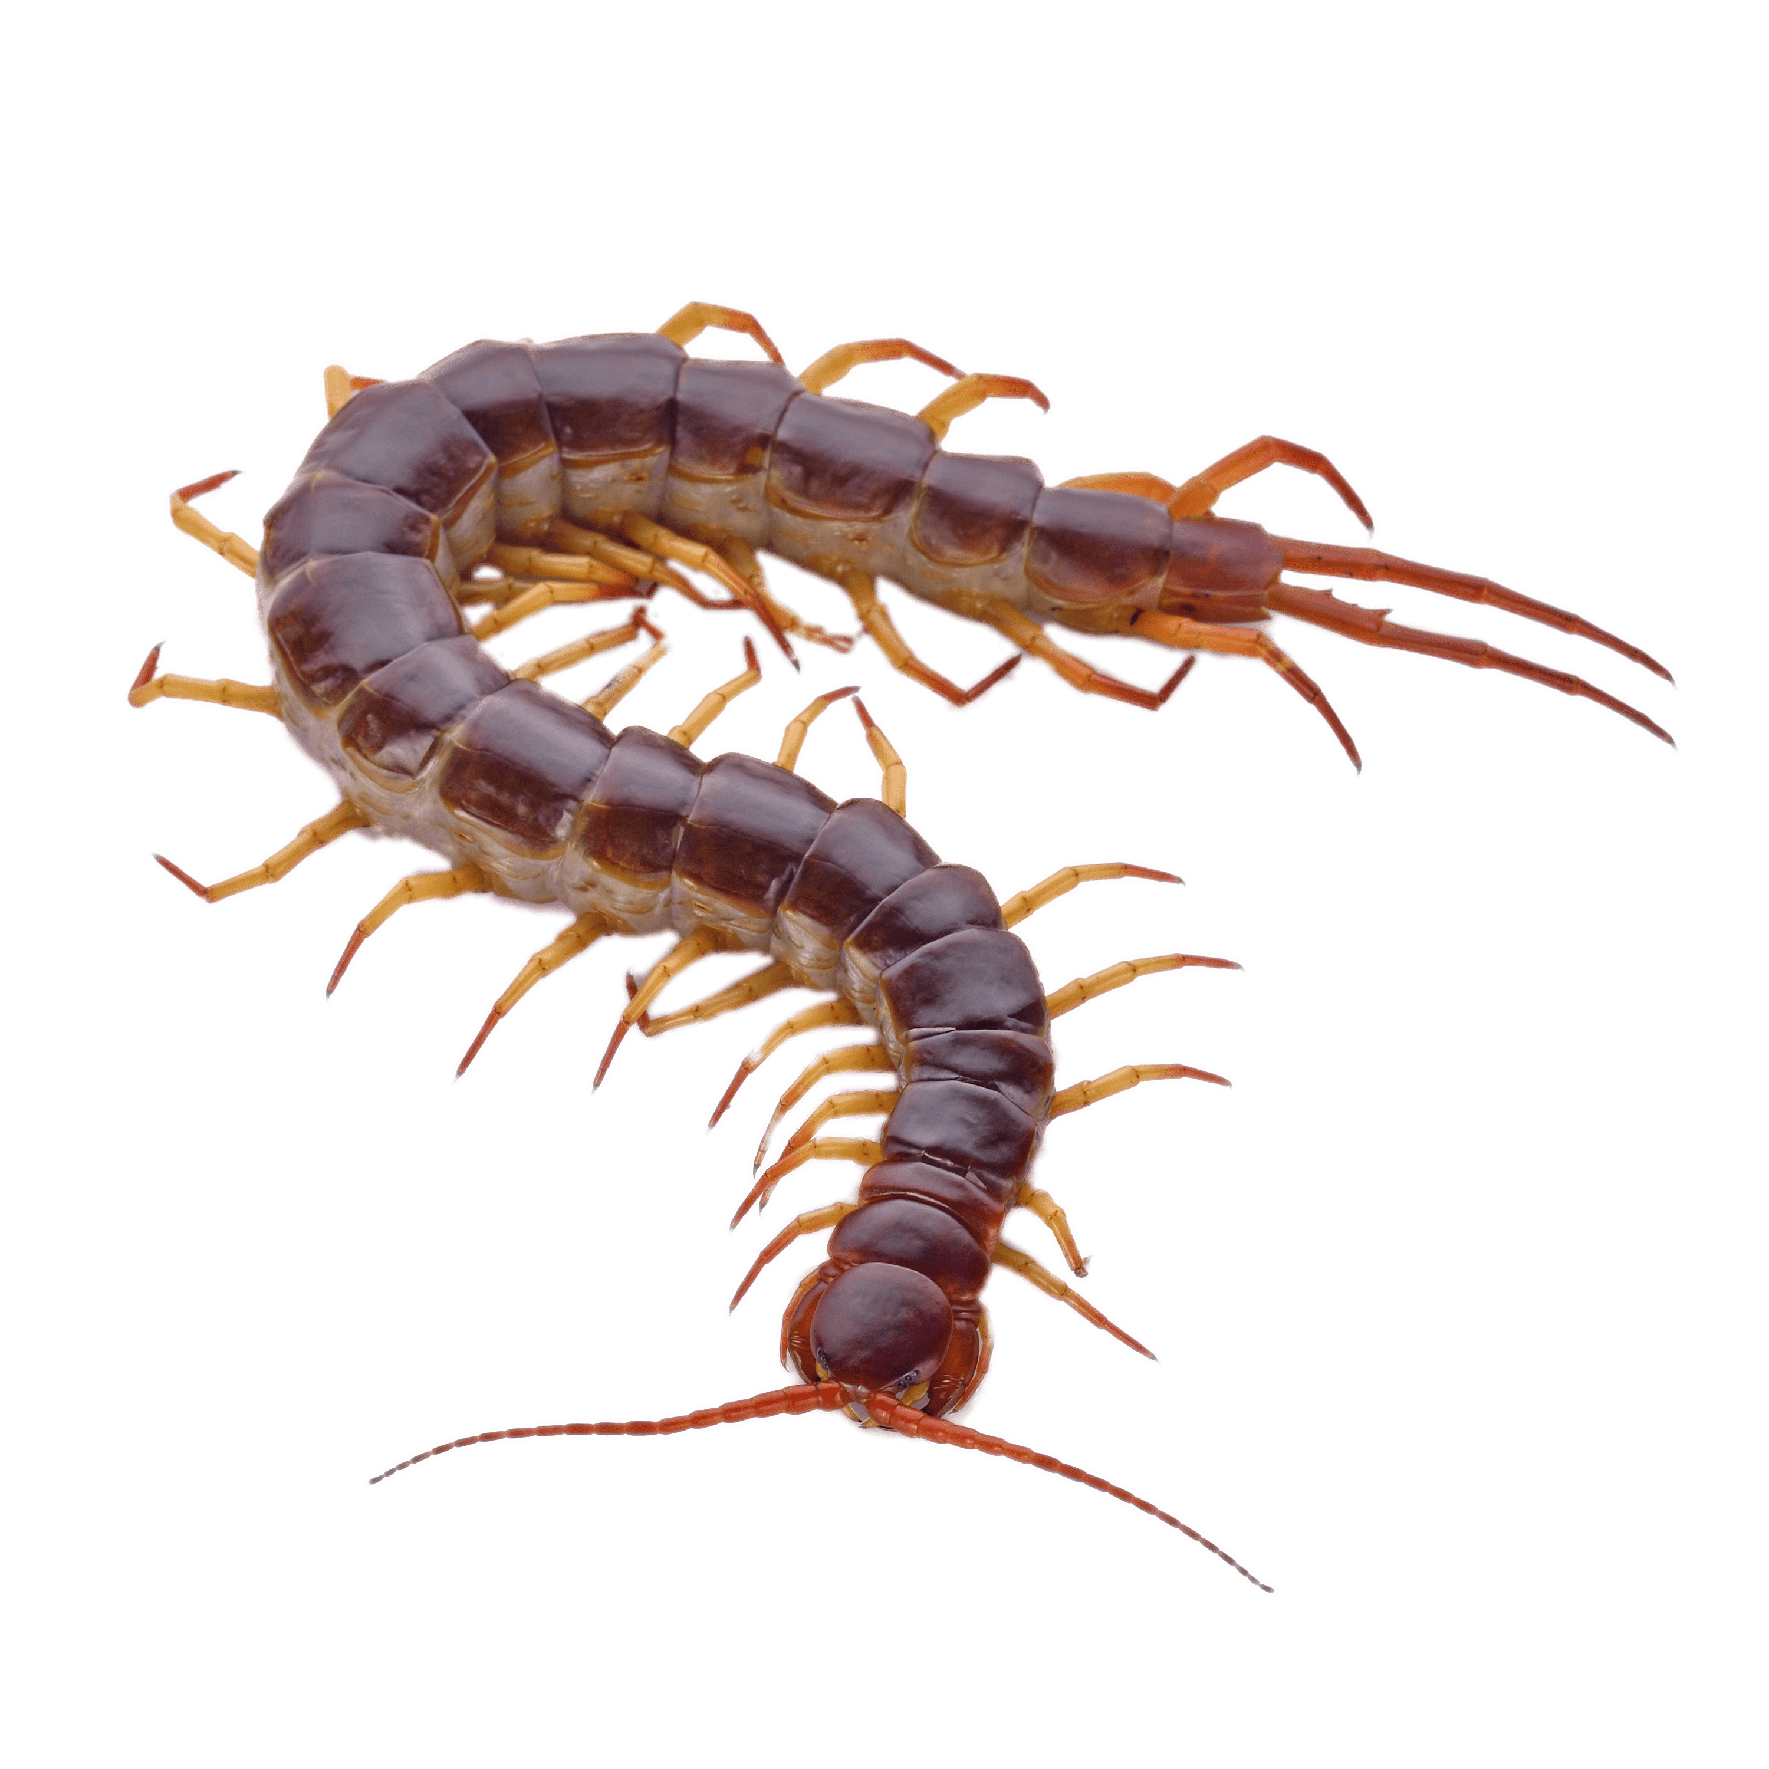
Is this gross?
Yes, this is gross.
No, this isn’t gross.

Slide 36
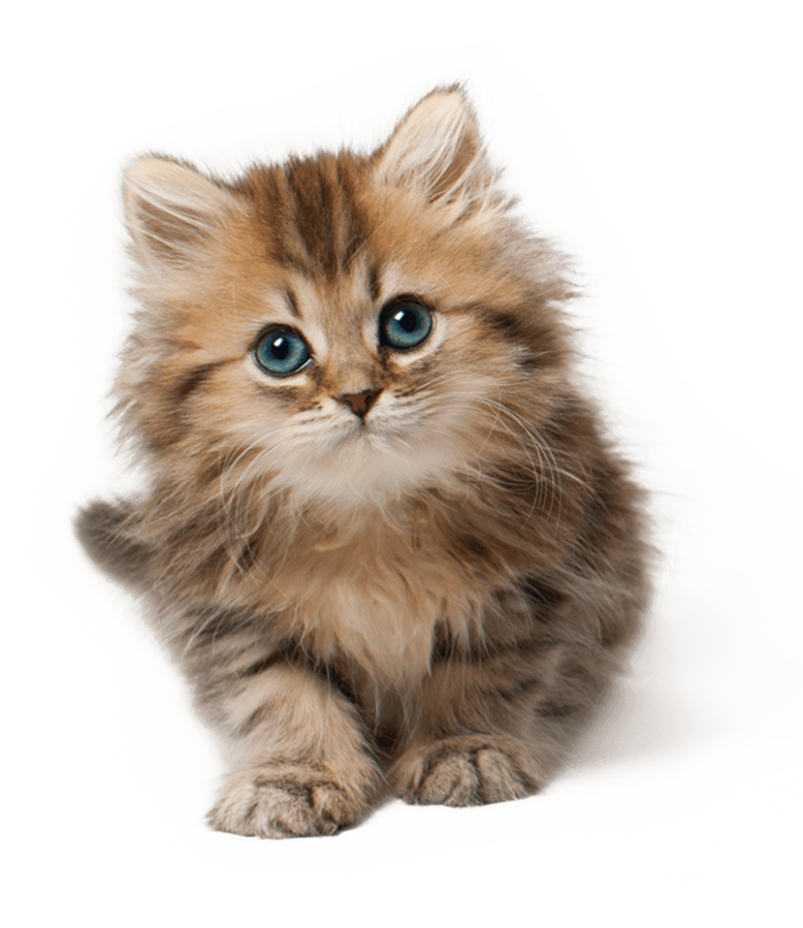
Is this gross?
Yes, this is gross.
No, this isn’t gross.

Slide 37
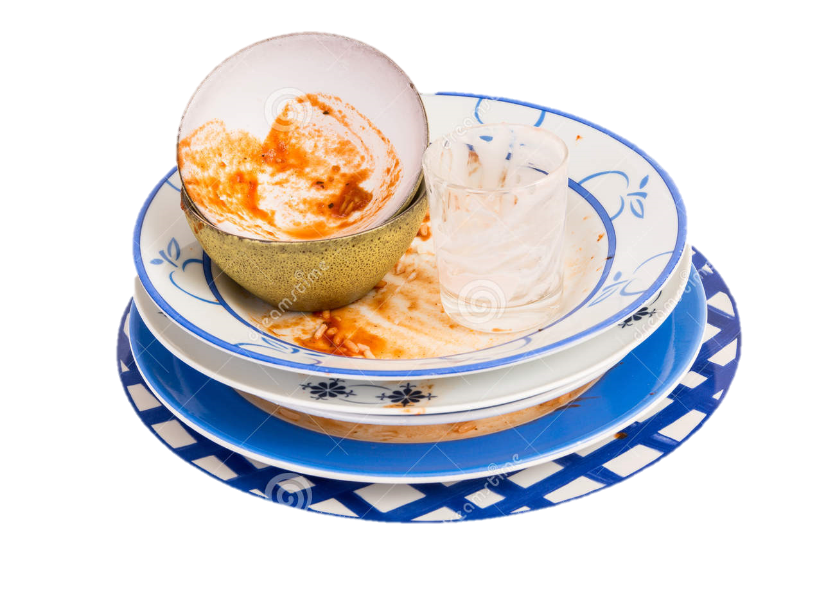
Is this gross?
Yes, this is gross.
No, this isn’t gross.

Slide 38
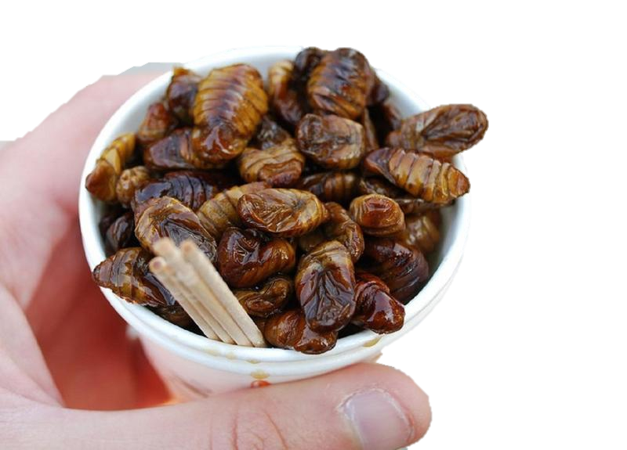
Is this gross?
Yes, this is gross.
No, this isn’t gross.

Slide 39
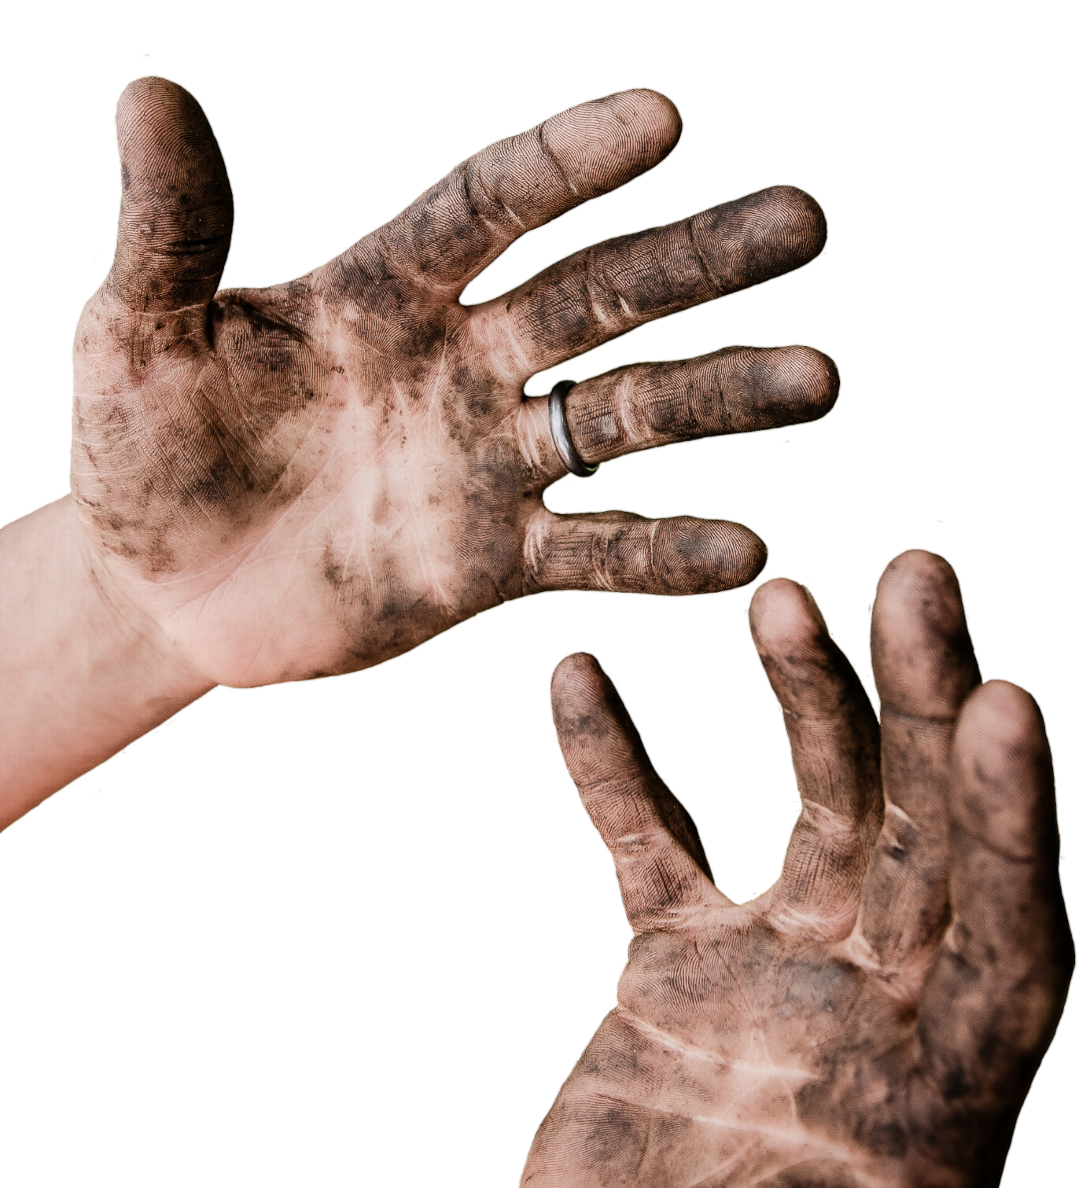
Is this gross?
No, this isn’t gross.
Yes, this is gross.

Slide 40
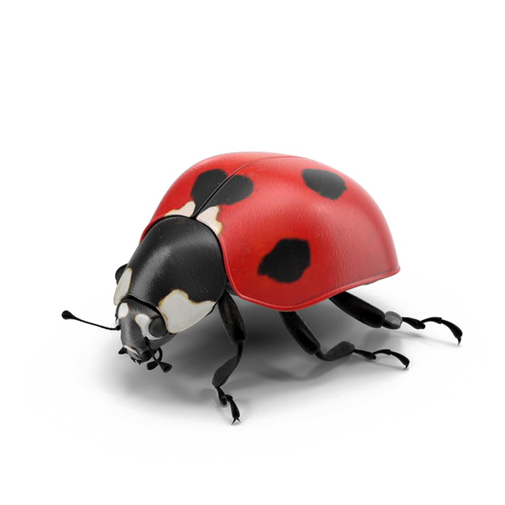
Is this gross?

Slide 41
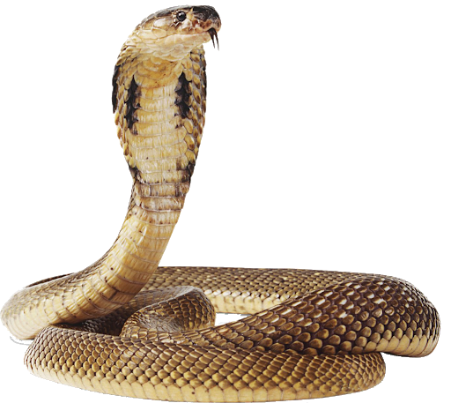
Is this gross?

Slide 42
Do animals like trash?

Slide 43
No, trash is
gross

Slide 44
Why do we put trash in the trash can?

Slide 45
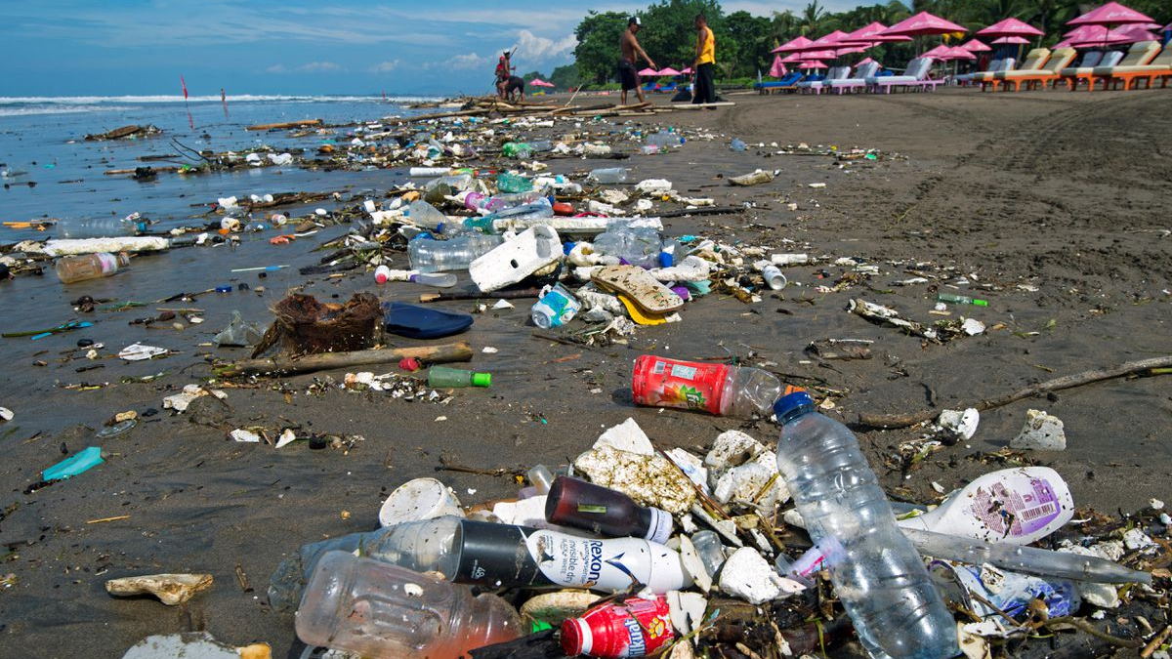

Slide 46
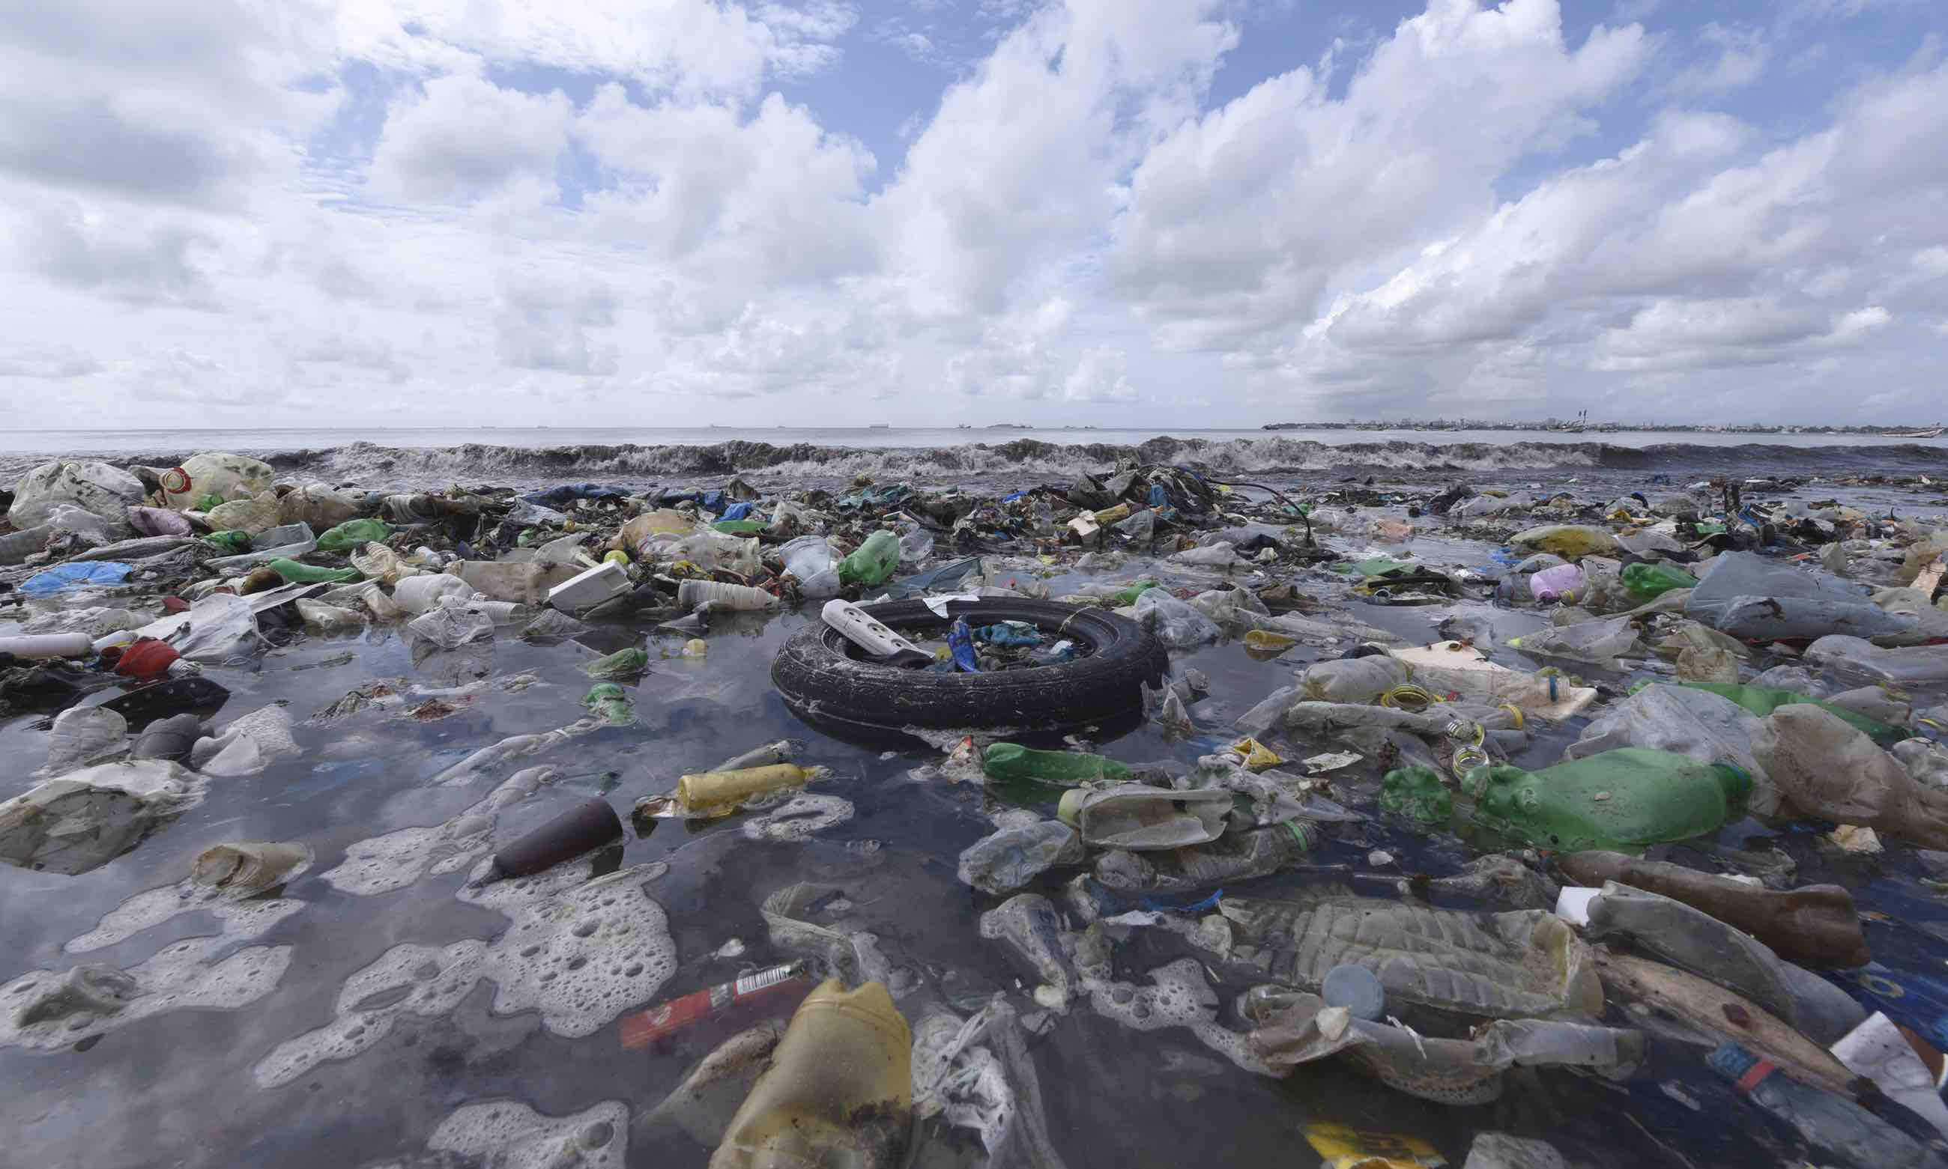

Slide 47
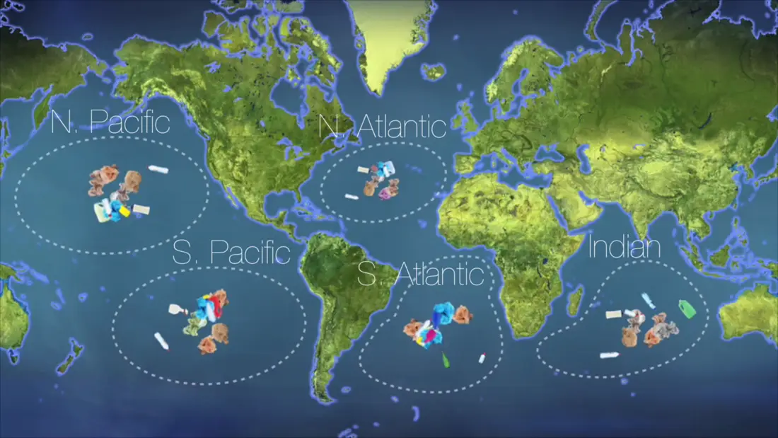

Slide 48
Animals eat
trash.

Slide 49
Why?

Slide 50
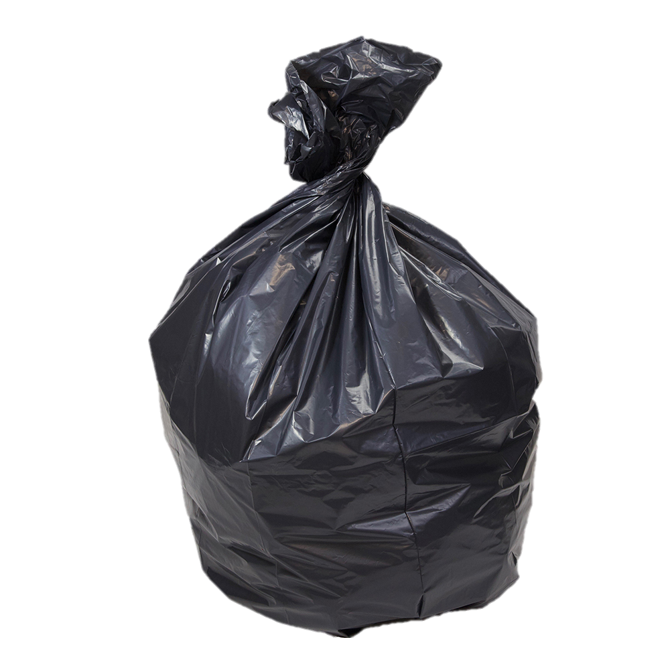
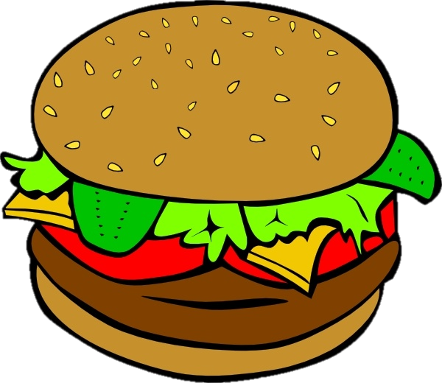
?
=
(그것은 음식처럼 보인다)

Slide 51
Game: What does it look like?
Guess (추측해)
Good guess = 1 point
Guess what teacher is thinking = 2 points
If you don’t know the word in English, guess in Korean! (영어를 모른다면 한국어로 맞춰보세요)

Slide 52
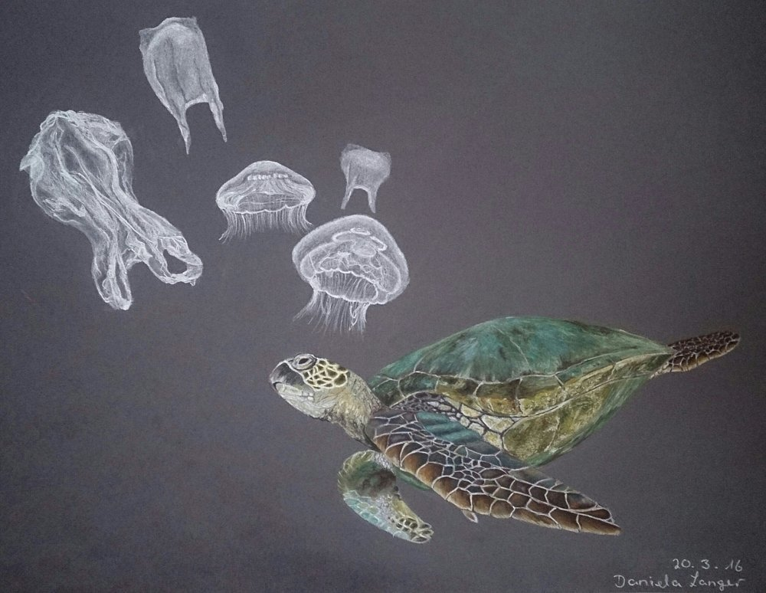
What does it look like?
It looks like jellyfish.
Notes:
For Example…..

Slide 53
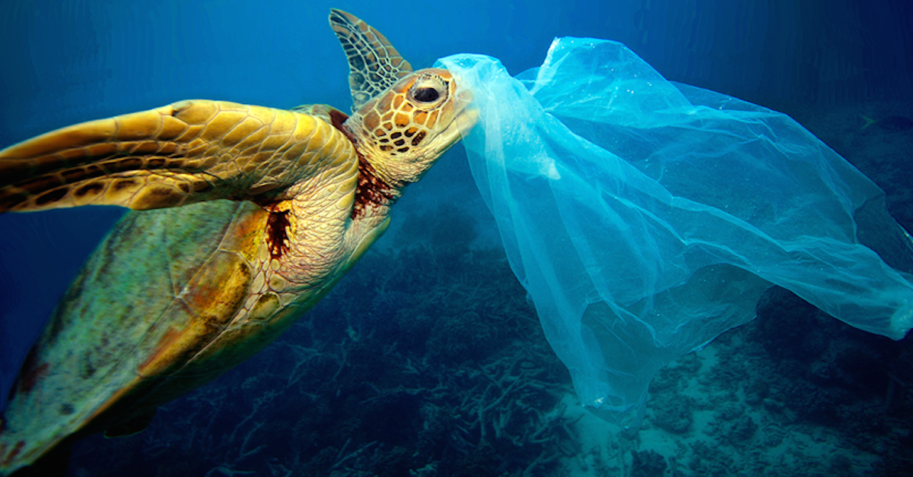

Slide 54
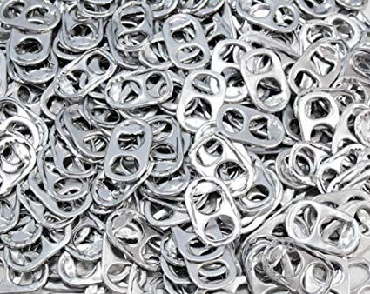
What does it look like?
Notes:
For Example…..

Slide 55
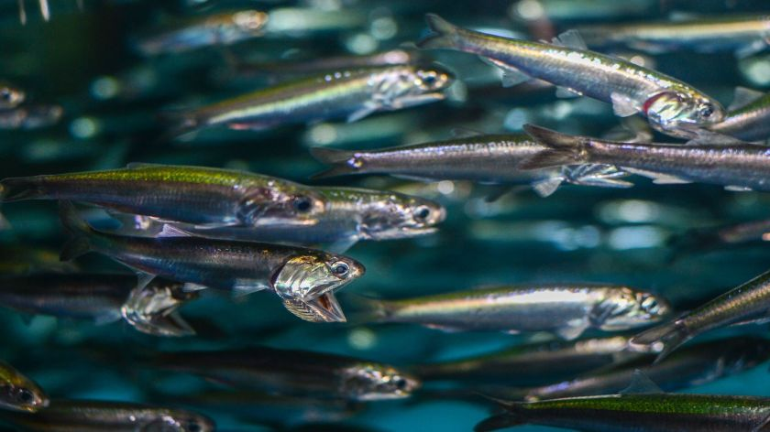
It looks like anchovy.
멸치 - Anchovy

Slide 56
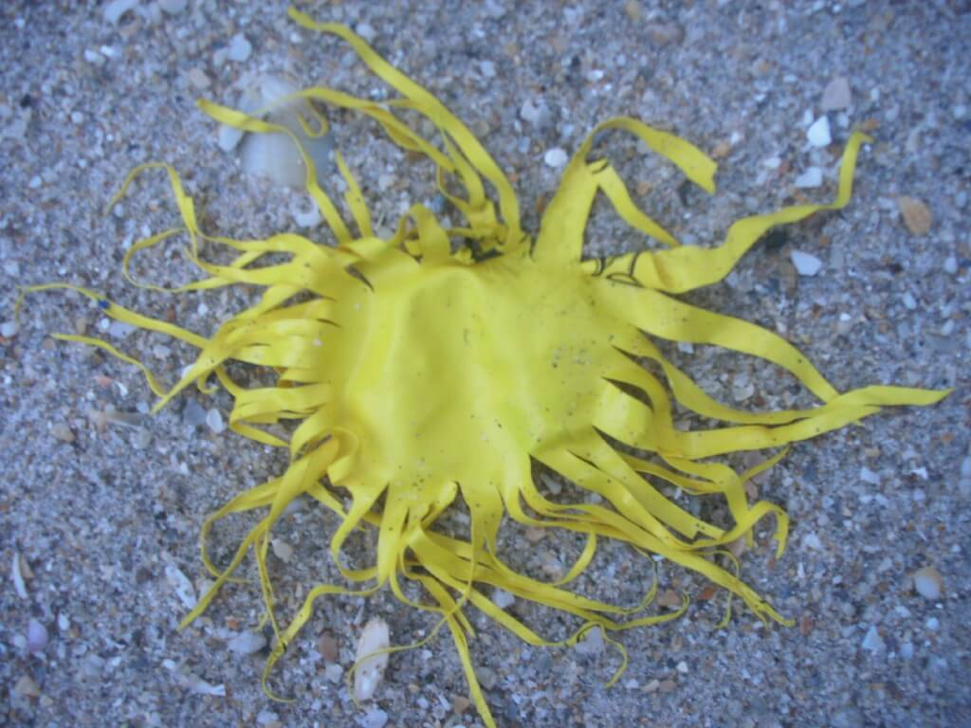
What does it look like?
balloon
Notes:
For Example…..

Slide 57
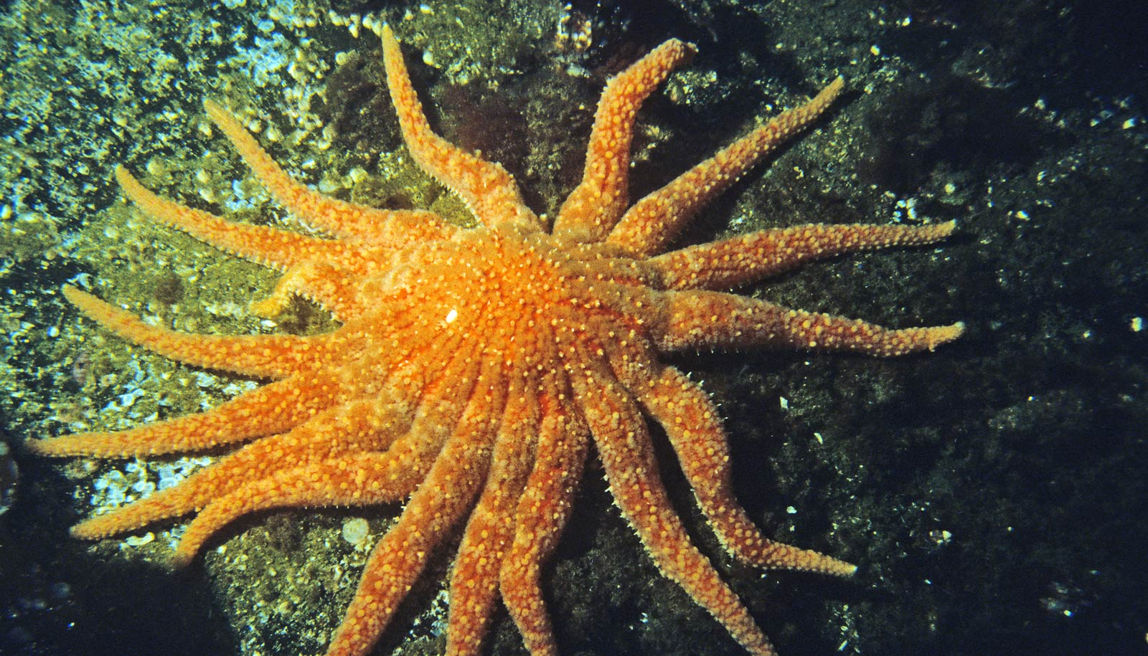
It looks like starfish.
불가사리 - Starfish

Slide 58
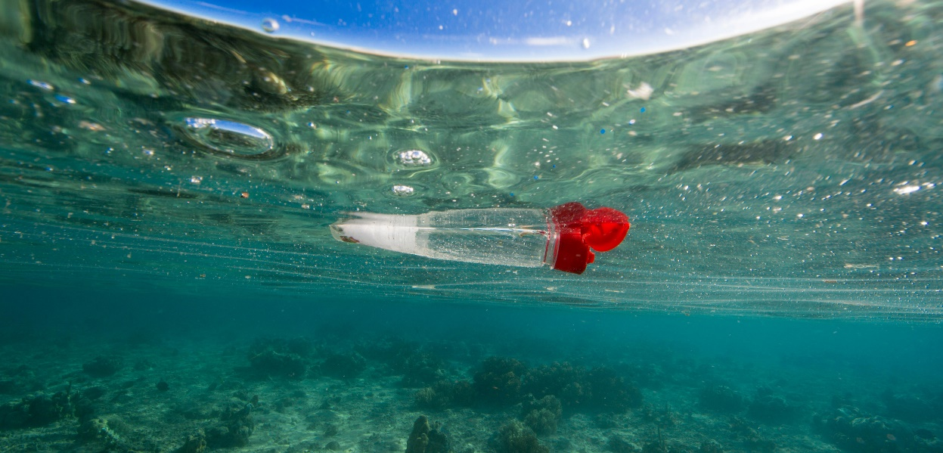
What does it look like?
Notes:
For Example…..

Slide 59
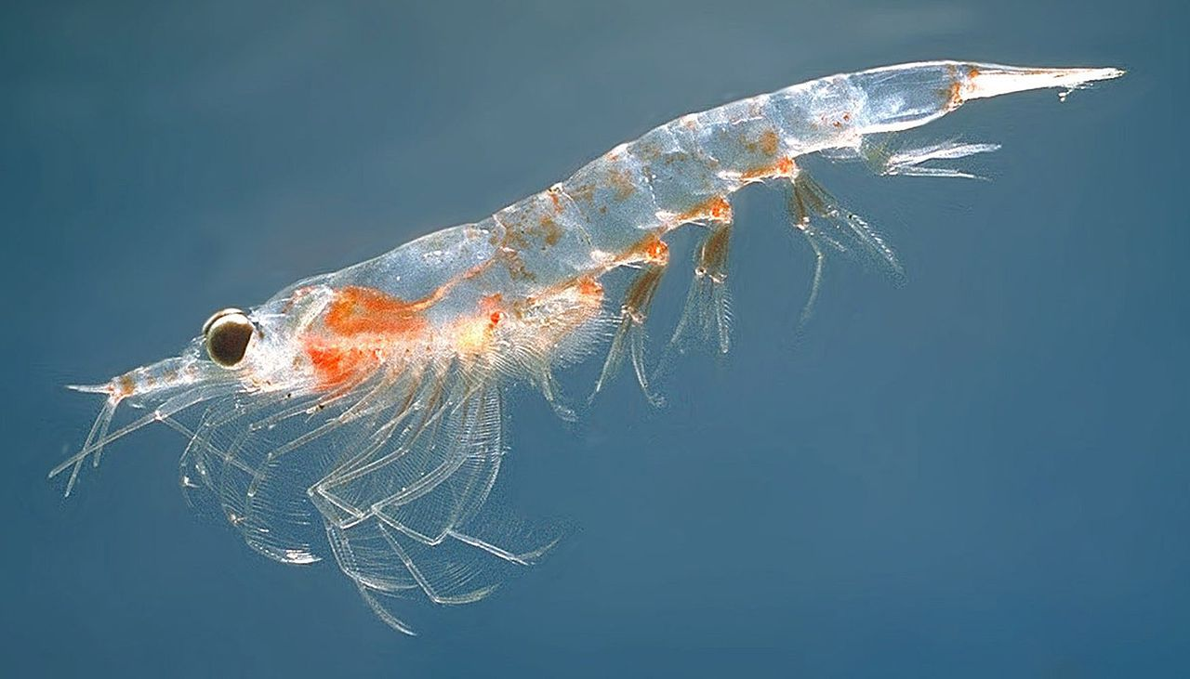
It looks like shrimp.
새우 – Shrimp

Slide 60
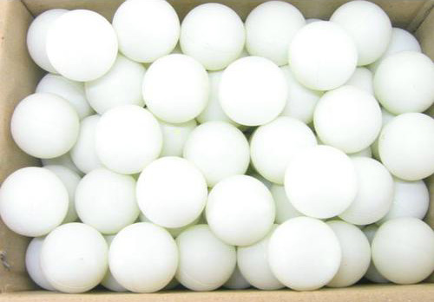
What does it look like?
ping pong balls
Notes:
For Example…..

Slide 61
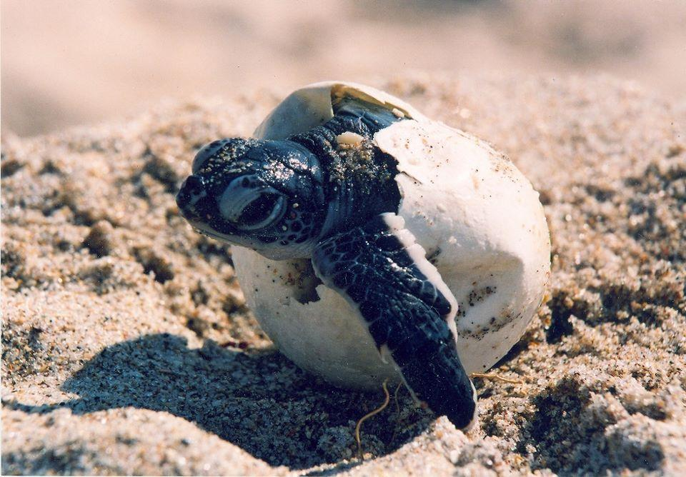
It looks like turtle eggs.
거북이 알 – turtle eggs

Slide 62
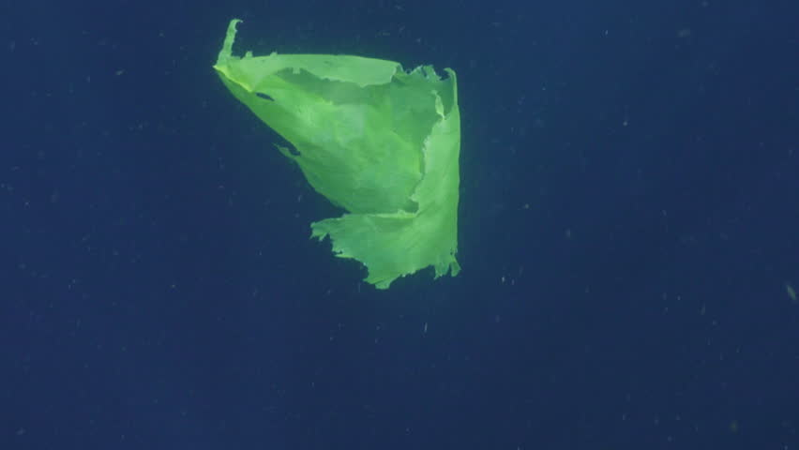
What does it look like?
Plastic bag
Notes:
For Example…..

Slide 63
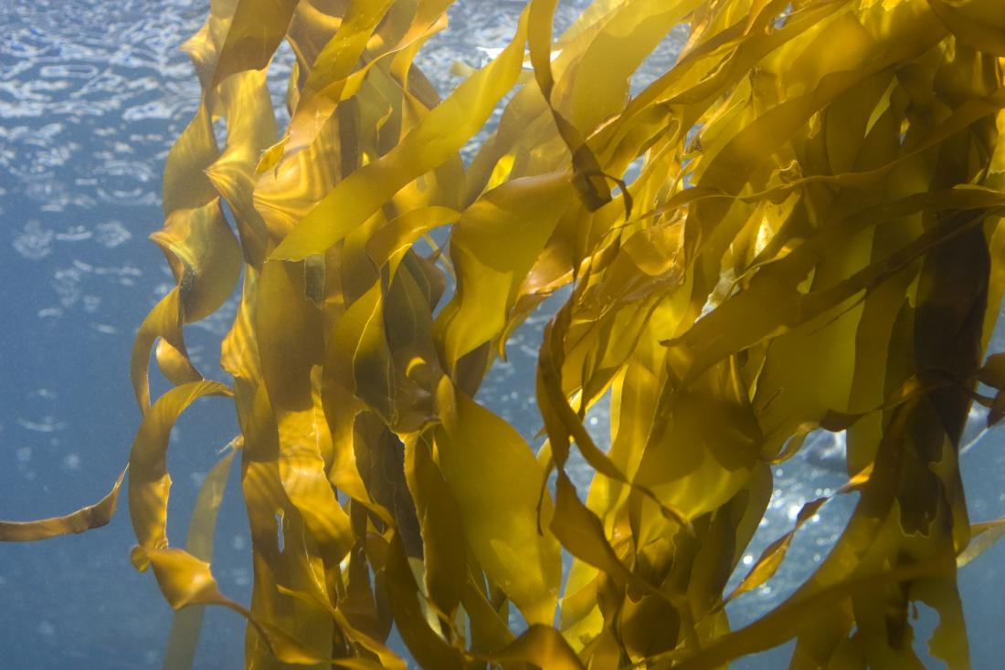
It looks like seaweed.
해초 - Seaweed

Slide 64
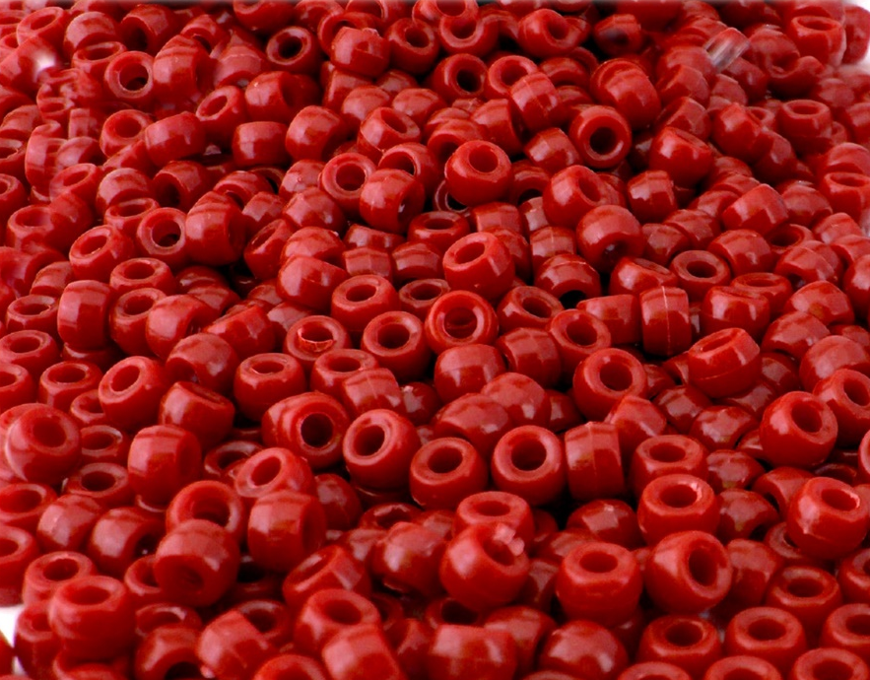
What does it look like?
Beads
Notes:
For Example…..

Slide 65
It looks like berries.
산딸기 – berries

Slide 66
What does it look like?
Clear beads
Notes:
For Example…..

Slide 67
It looks like fish eggs.
생선 알 – fish eggs

Slide 68
What does it look like?
Straws
Notes:
For Example…..

Slide 69
What does it look like?
Packing Peanuts
Notes:
For Example…..

Slide 70
It looks like grubs.
유충 - Grubs

Slide 71
It looks like reeds.
갈대 - Reeds

Slide 72
What does it look like?
Plastic fibers
Notes:
For Example…..

Slide 73
It looks like roots.
뿌리 - Roots

Slide 74
How can we help Earth?

Slide 75
____ the
trash in the _________.
Put
trash can

