Slide 1
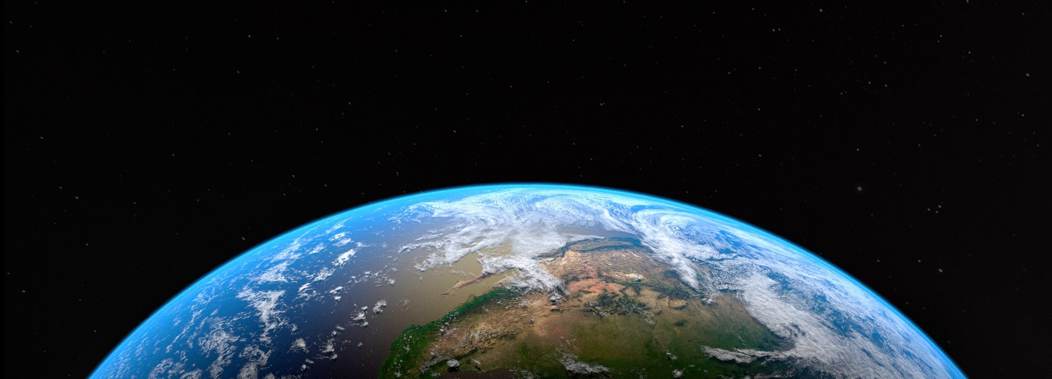
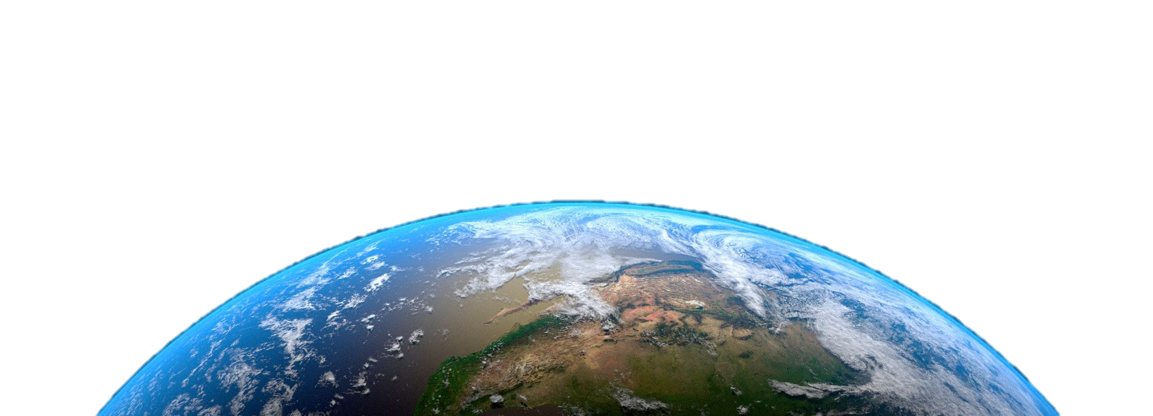
Earth
Let’s
help

Slide 2
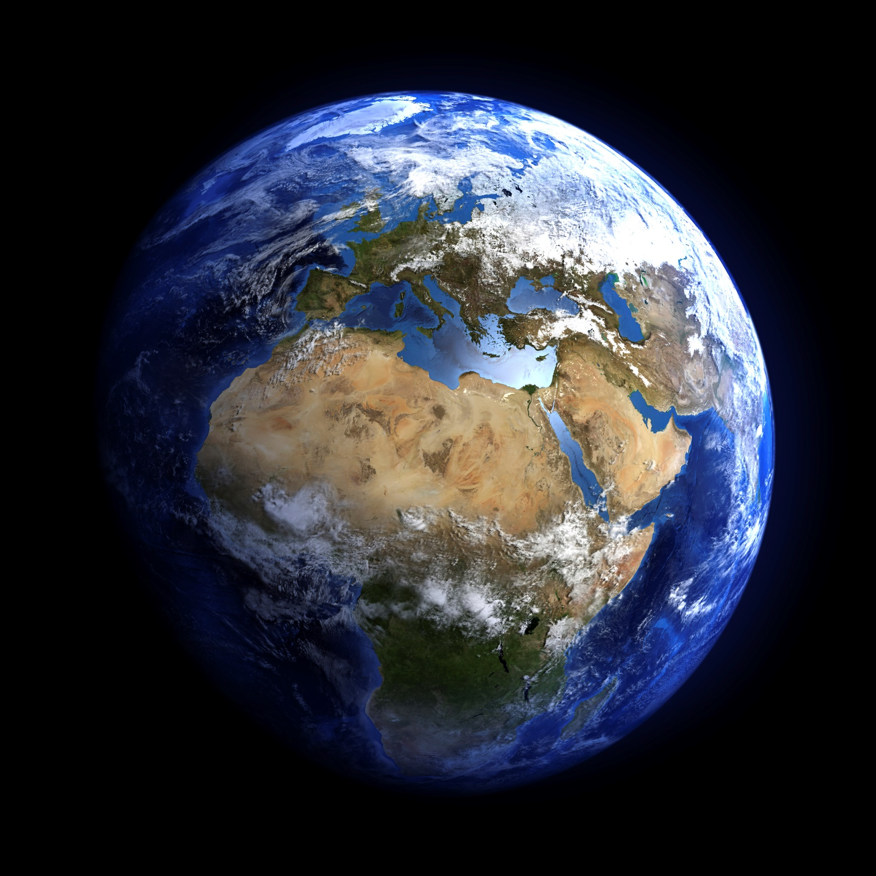
This is Earth.

Slide 3
This
_____ is Earth.

Slide 4
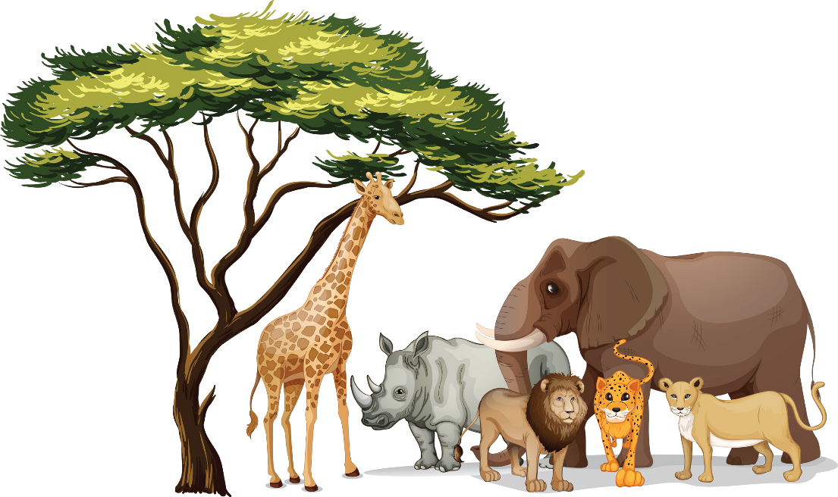

Who lives on Earth?
Animals
People

Slide 5
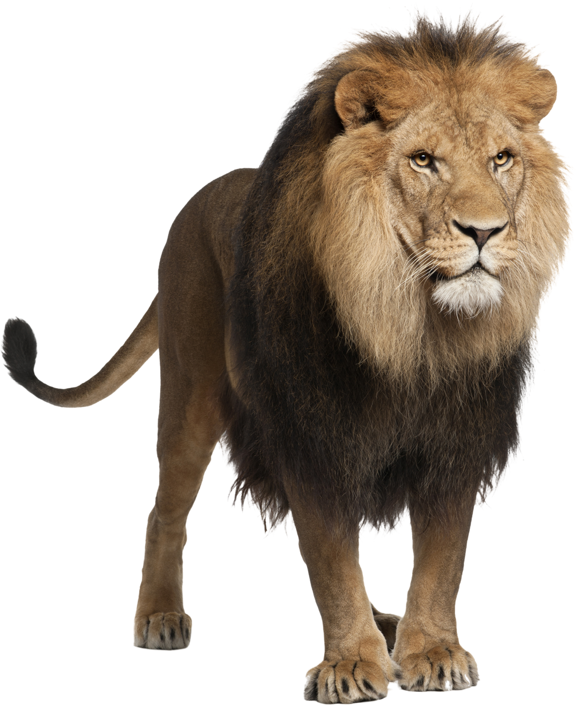
What is this?
This is a lion.

Slide 6
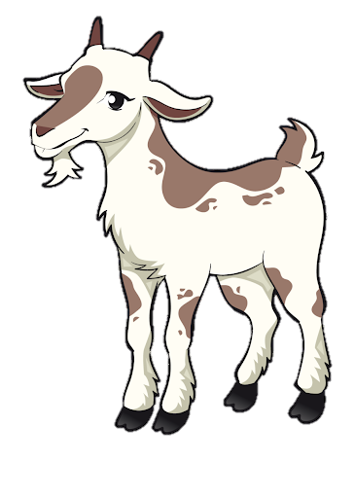
What is this?
This
____ is a goat.

Slide 7
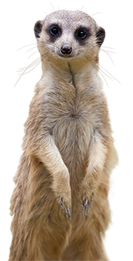
What is this?
This
____ is a meerkat.

Slide 8
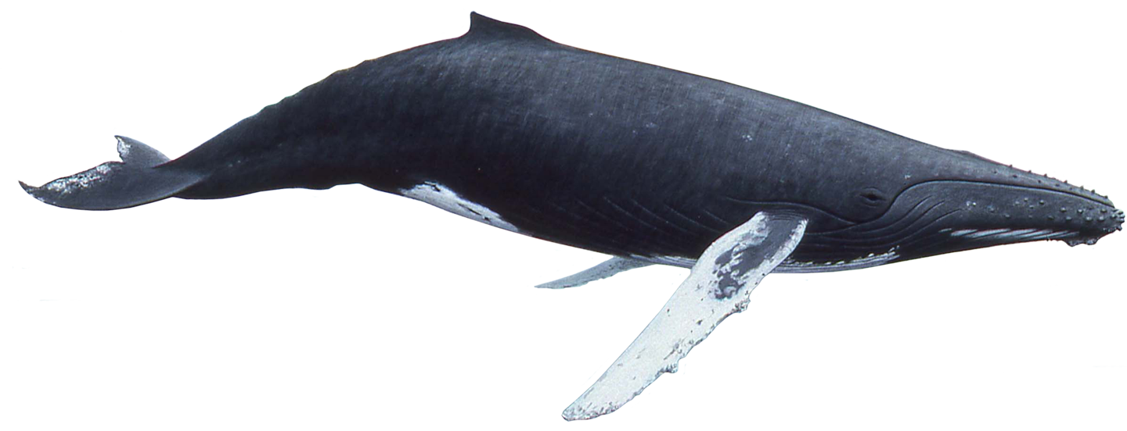
What is this?
This
whale
____ is a ______.

Slide 9
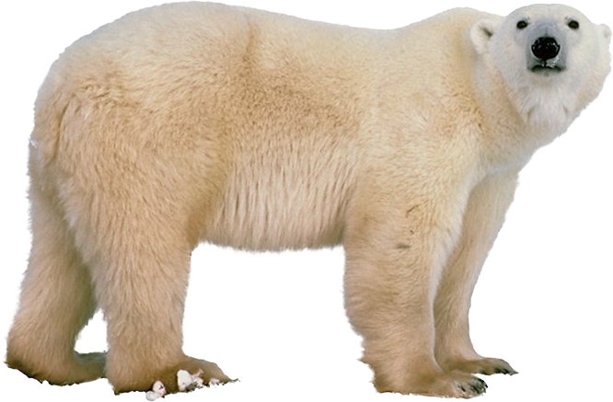
What is this?
____ is a _____ _____.
This
polar bear

Slide 10
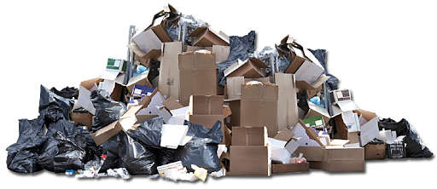
What is this?
This is trash.

Slide 11
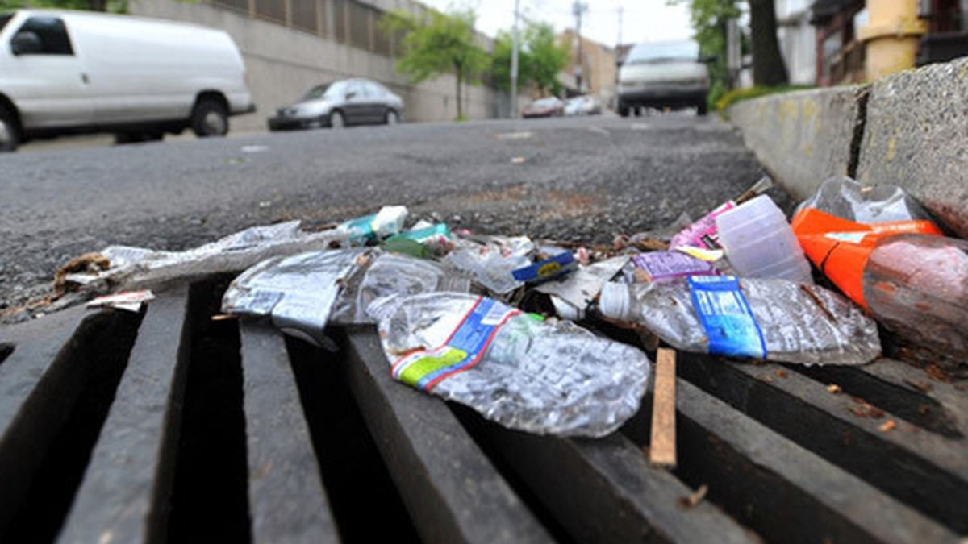
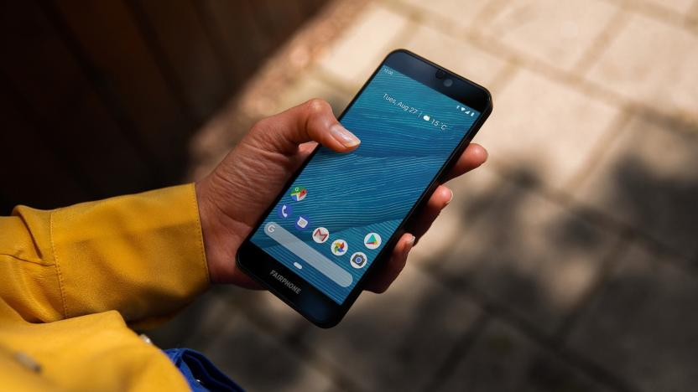
Yes, this is trash.
Is this trash?
No, this isn’t trash.
No, this is not trash.

Slide 12
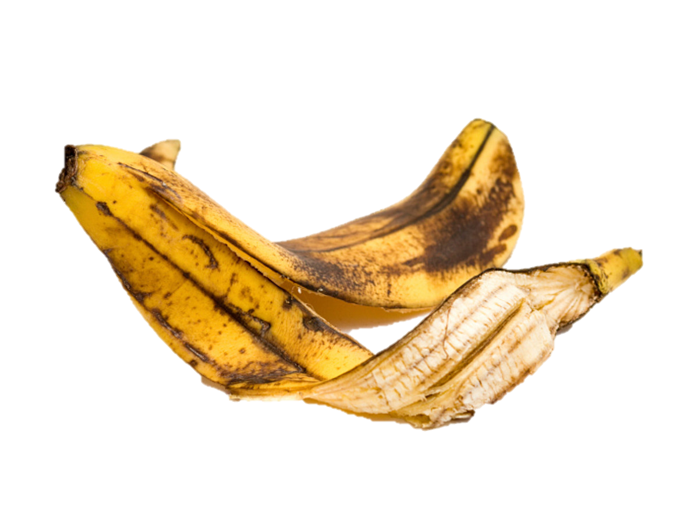
Is this trash?
is
Yes, this __ trash.

Slide 13
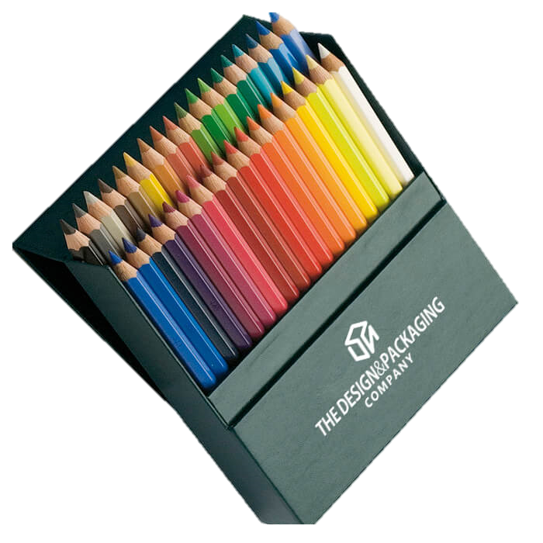
Is this trash?
isn’t
No, this _____ trash.

Slide 14

Is this trash?
Yes, this is trash.
No, this isn’t trash.

Slide 15
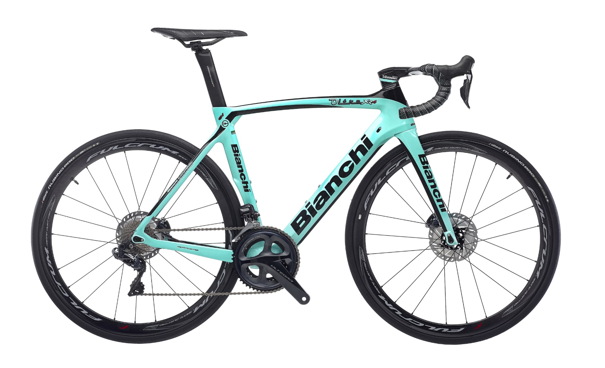
Is this trash?
Yes, this is trash.
No, this isn’t trash.

Slide 16
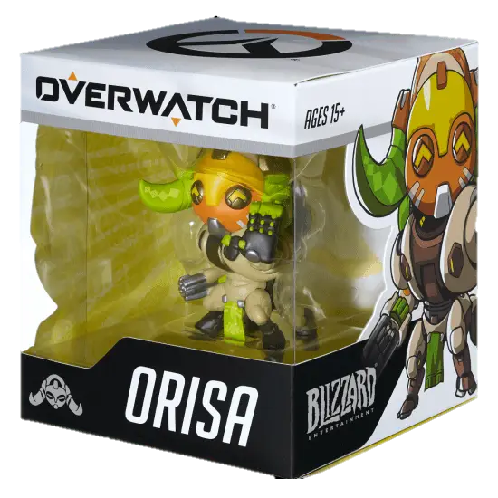
Is this trash?
Yes, this is trash.
No, this isn’t trash.

Slide 17
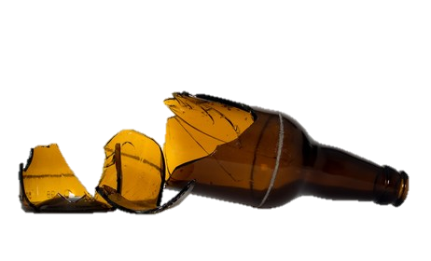
Is this trash?
Yes, this is trash.
No, this isn’t trash.

Slide 18
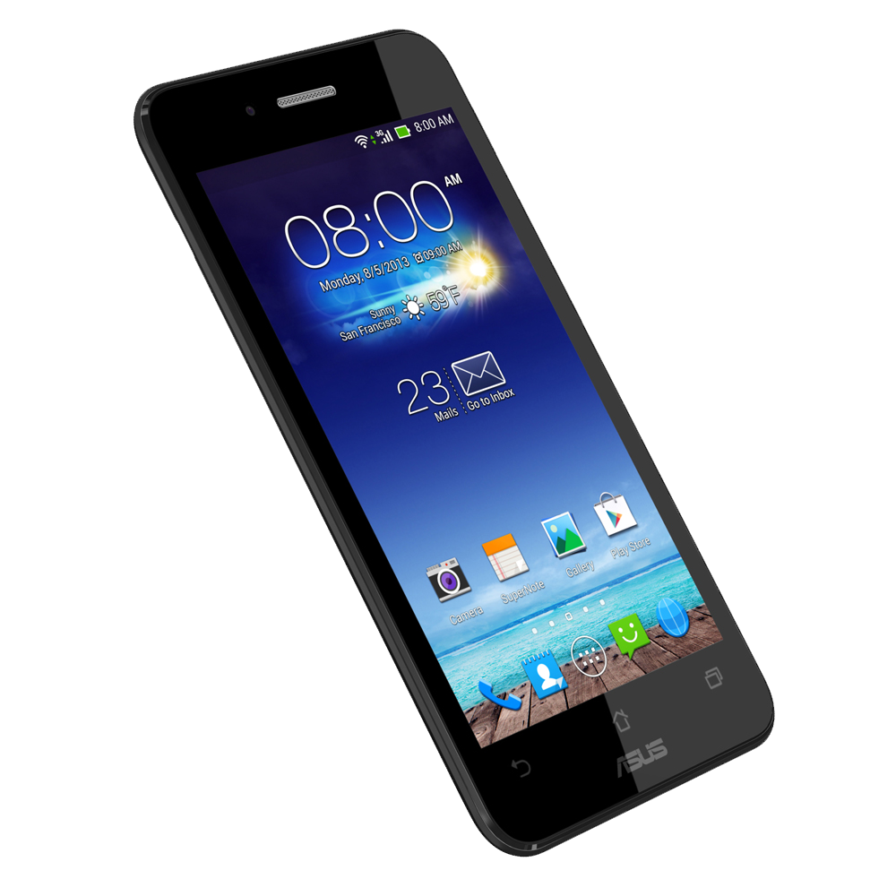
Is this trash?

Slide 19
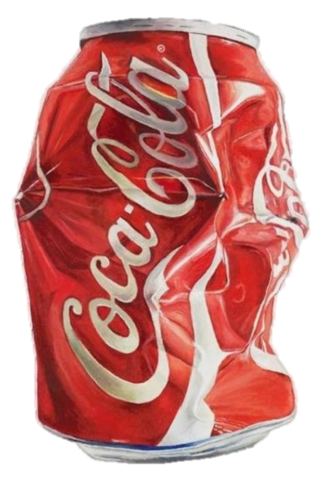
Is this trash?

Slide 20
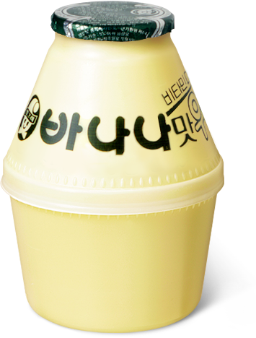
Is this trash?

Slide 21

Do you
like trash?

Slide 22
Trash is
(역겨운)
gross

Slide 23
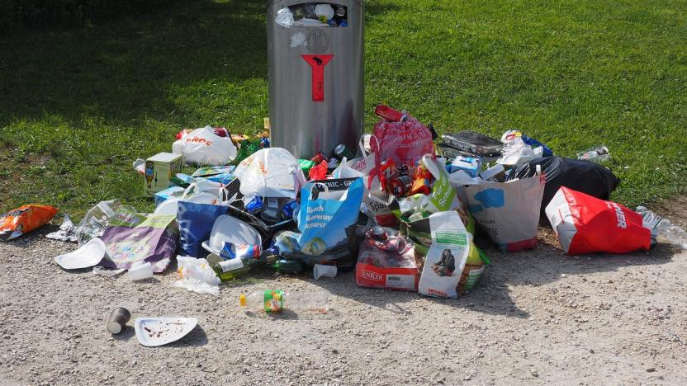
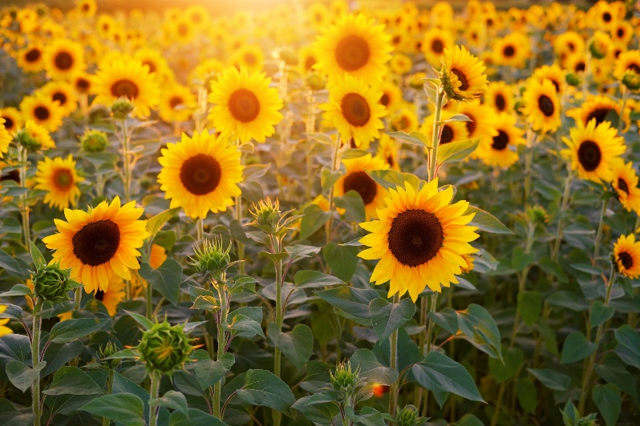
Yes, this is gross.
Is this gross?
No, this isn’t gross.
No, this is not gross.

Slide 24
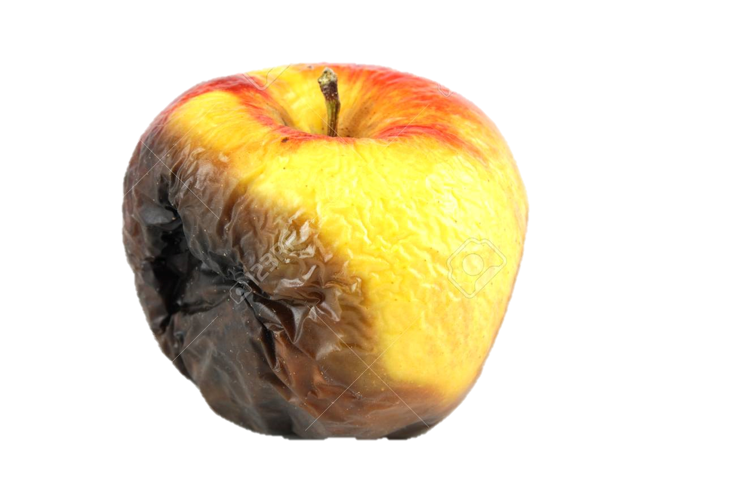
Is this gross?
is
Yes, this __ gross.

Slide 25
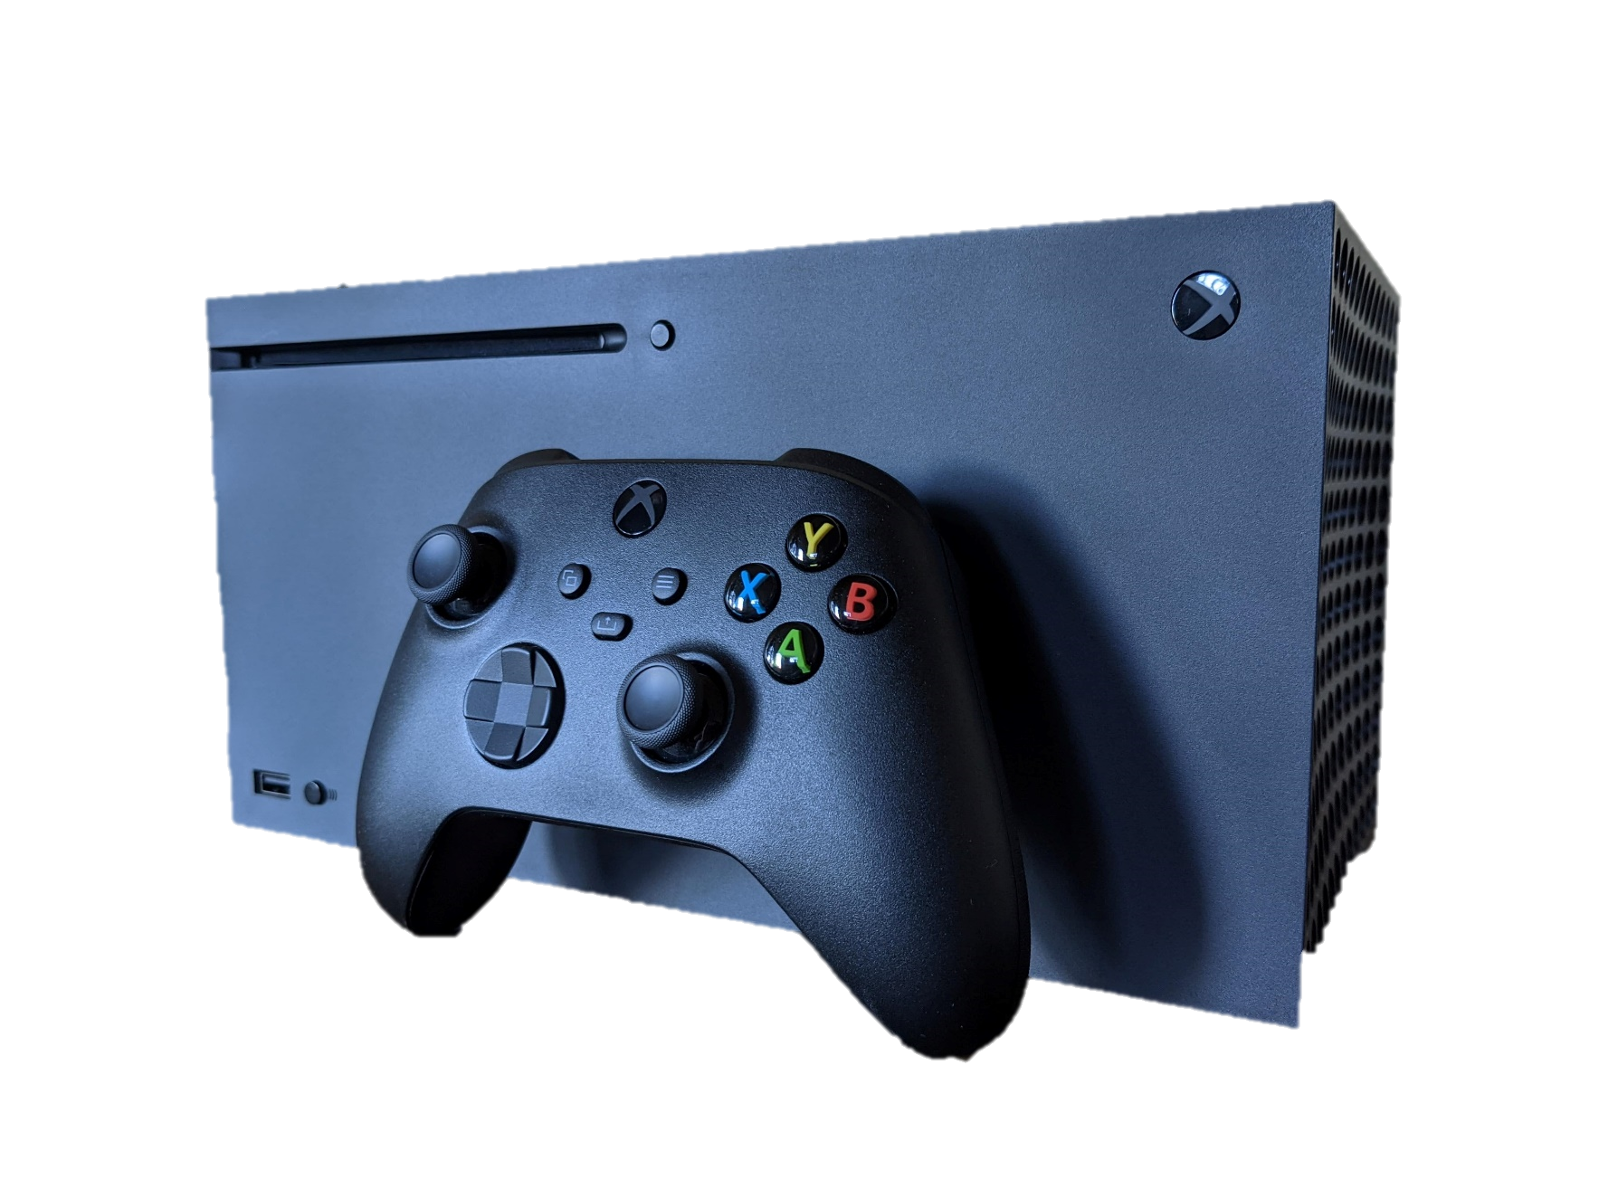
Is this gross?
isn’t
No, this _____ gross.

Slide 26
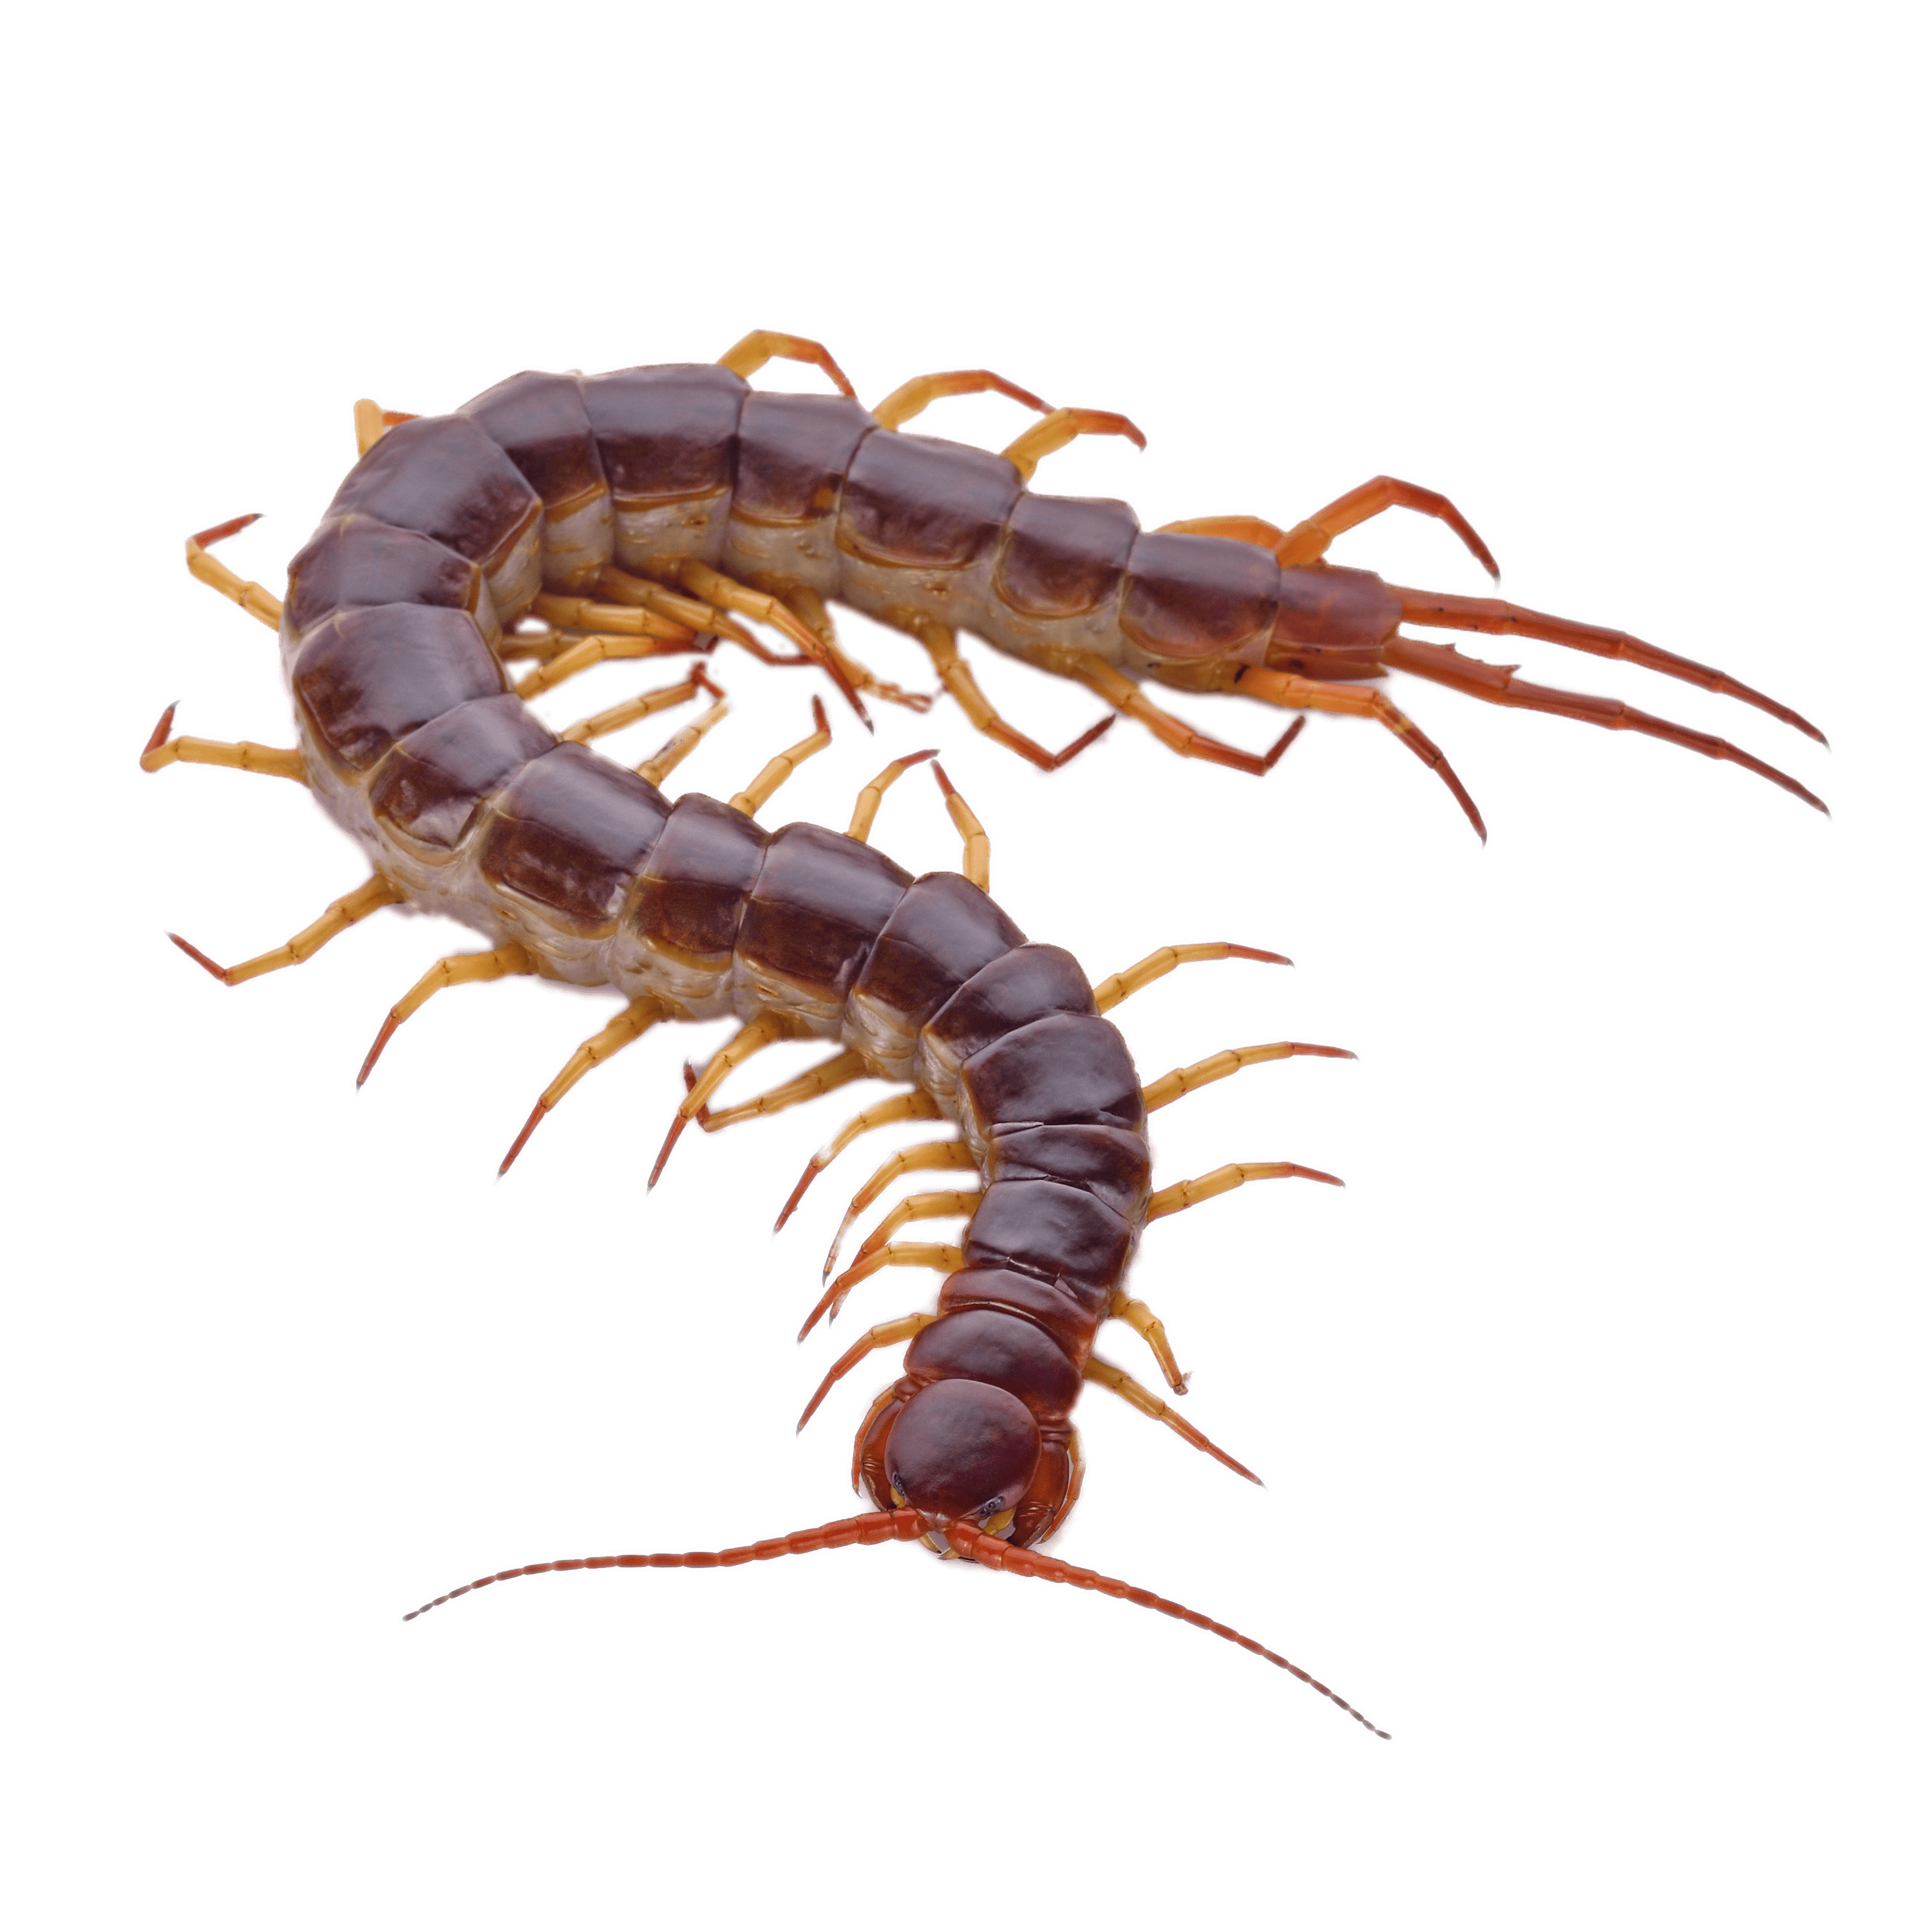
Is this gross?
Yes, this is gross.
No, this isn’t gross.

Slide 27
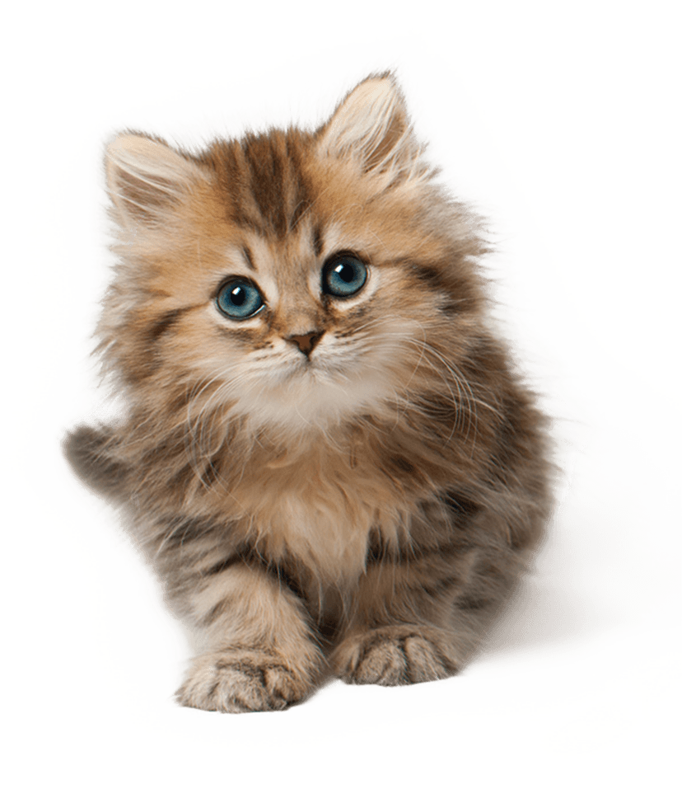
Is this gross?
Yes, this is gross.
No, this isn’t gross.

Slide 28
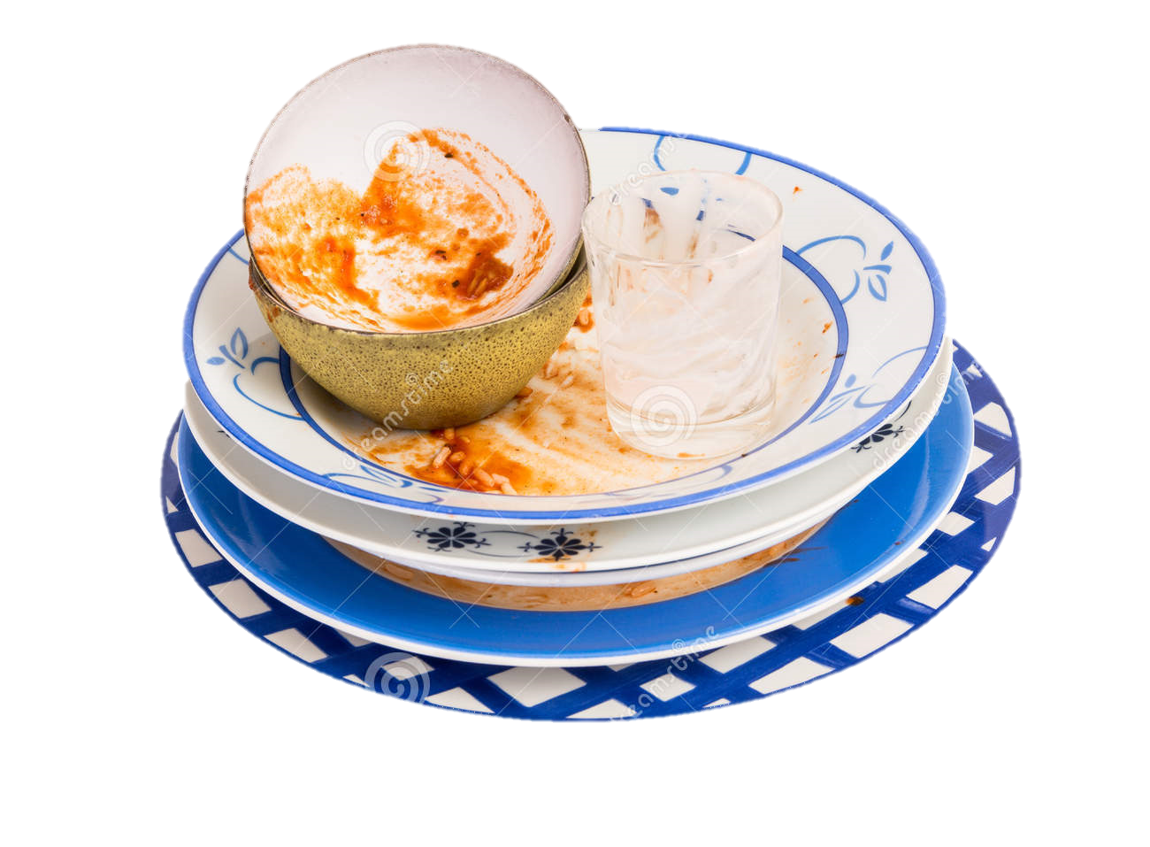
Is this gross?
Yes, this is gross.
No, this isn’t gross.

Slide 29
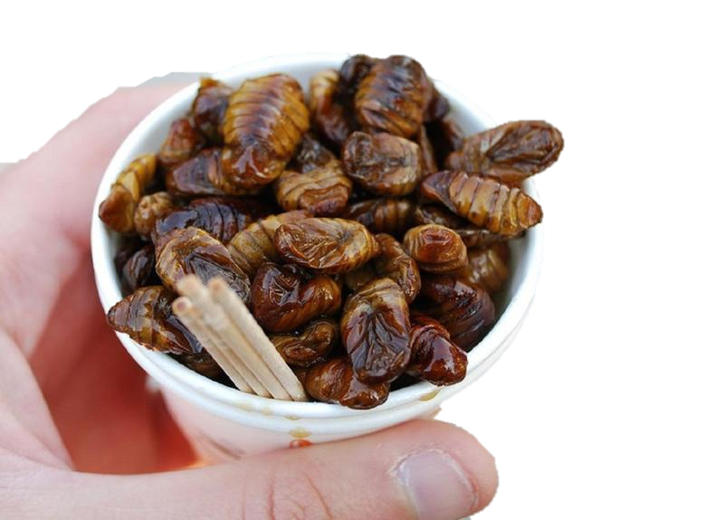
Is this gross?
Yes, this is gross.
No, this isn’t gross.

Slide 30
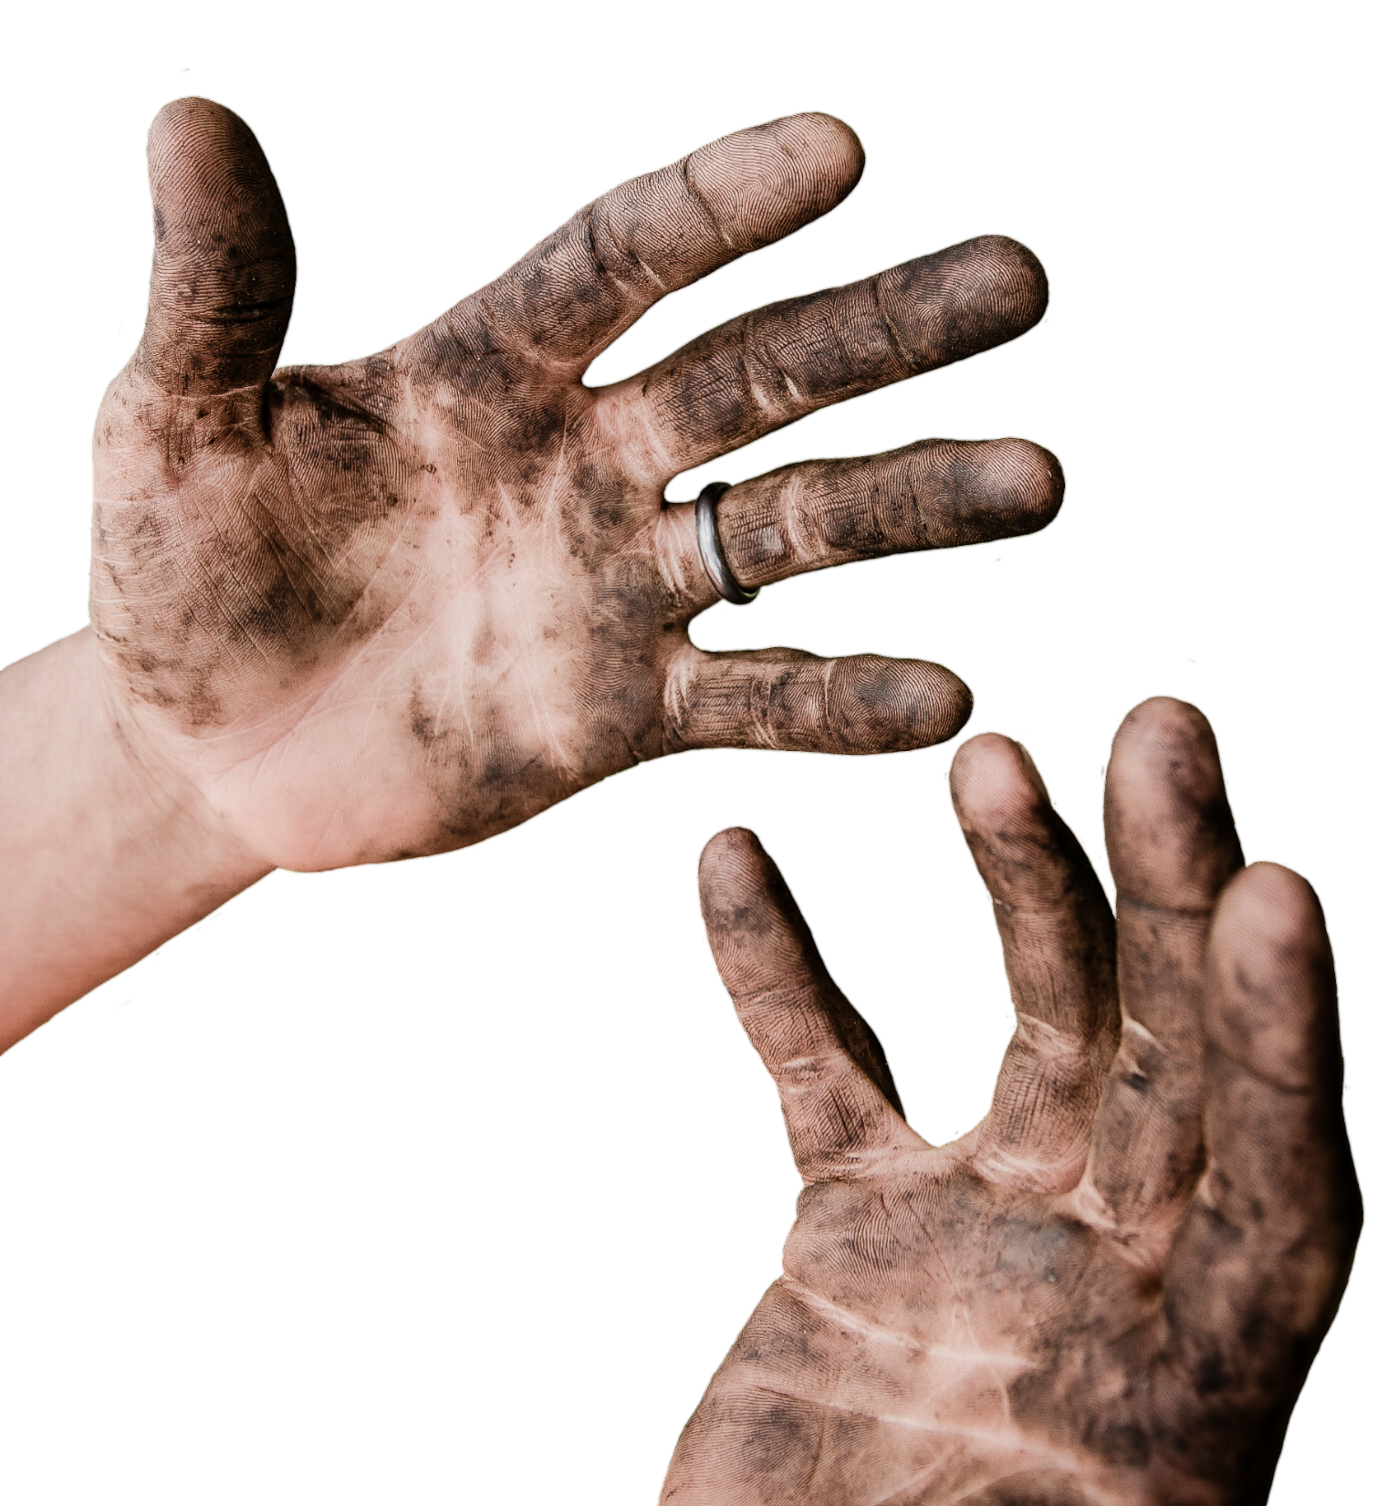
Is this gross?
No, this isn’t gross.
Yes, this is gross.

Slide 31
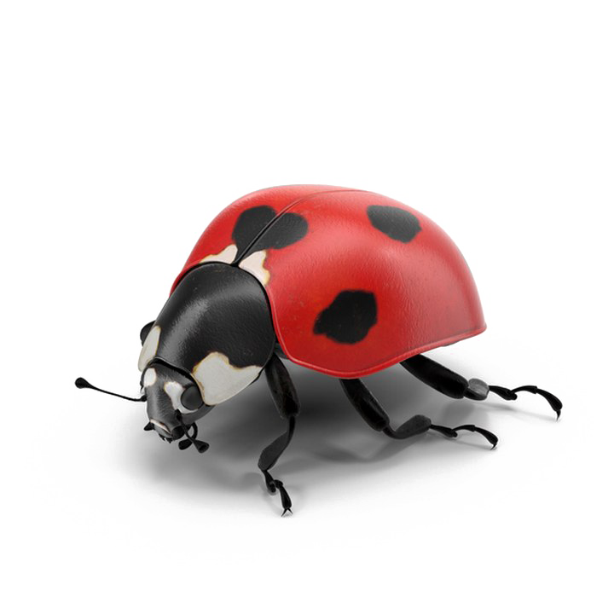
Is this gross?

Slide 32
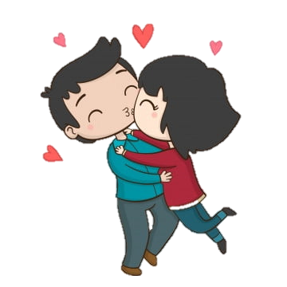
Is this gross?

Slide 33
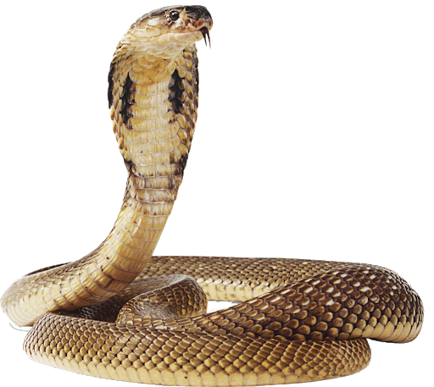
Is this gross?

Slide 34

Do animals
like trash?

Slide 35
No, trash is
gross

Slide 36

Why do we put trash in the trash can?

Slide 37
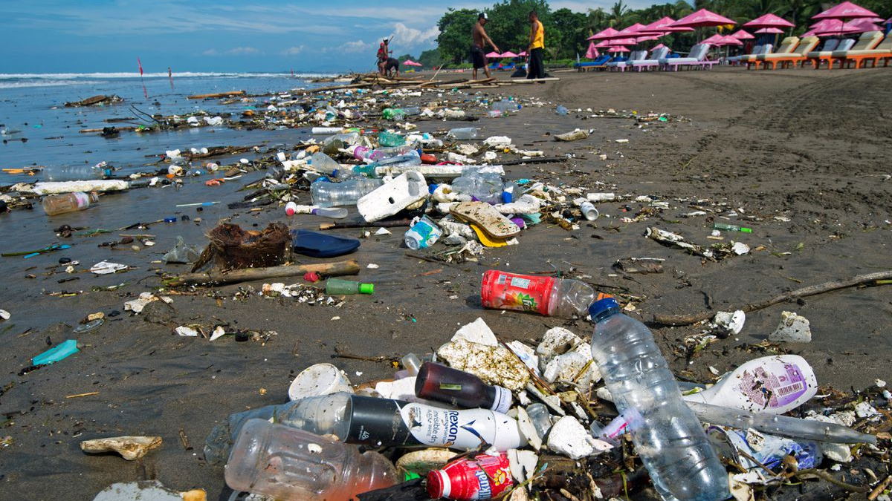

Slide 38
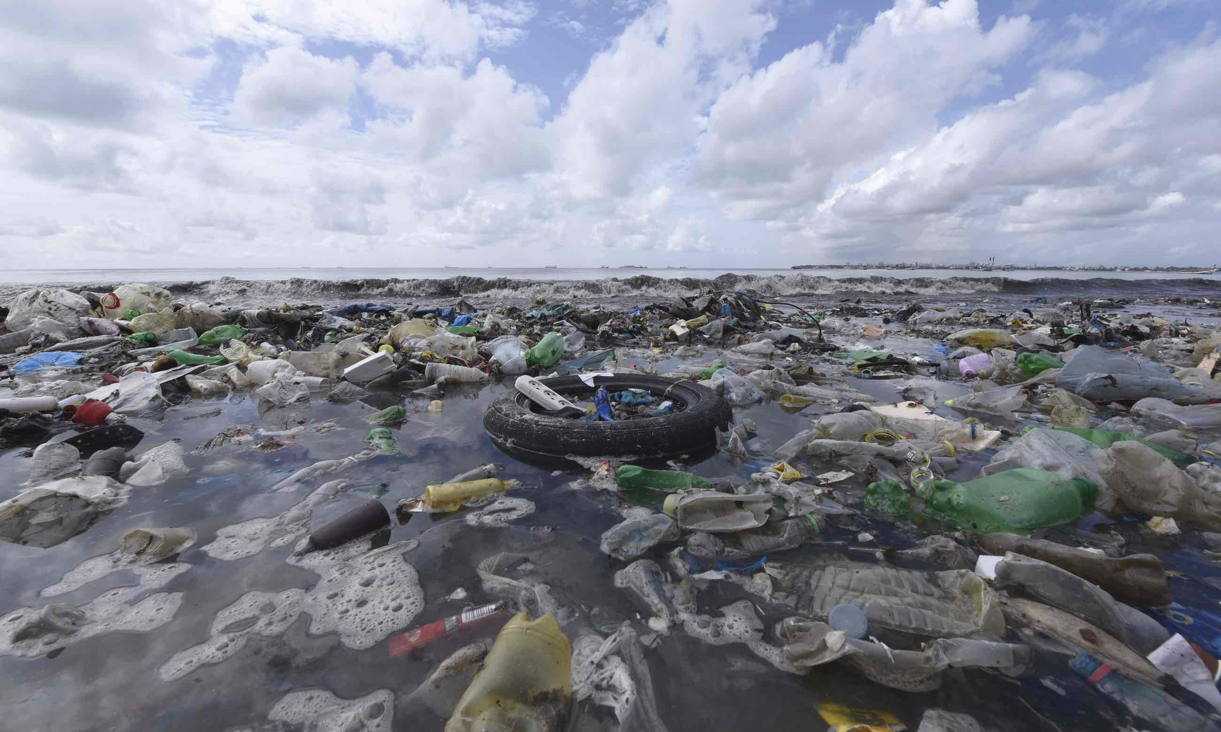

Slide 39
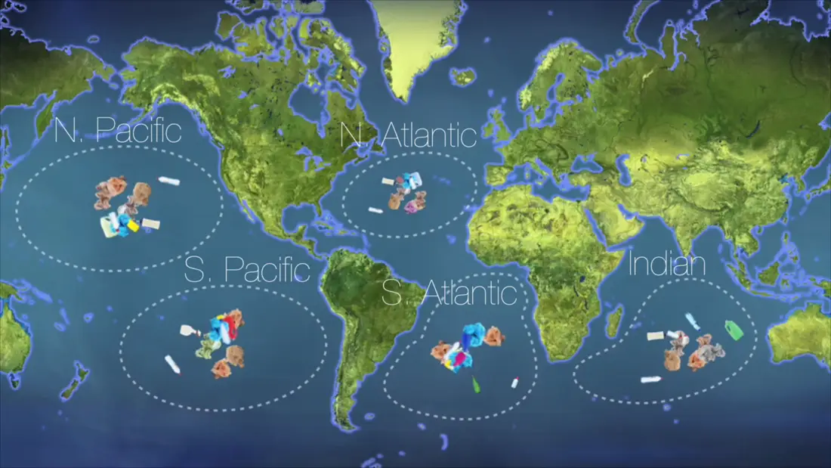

Slide 40
Animals
eat
trash.

Slide 41
Why?

Slide 42
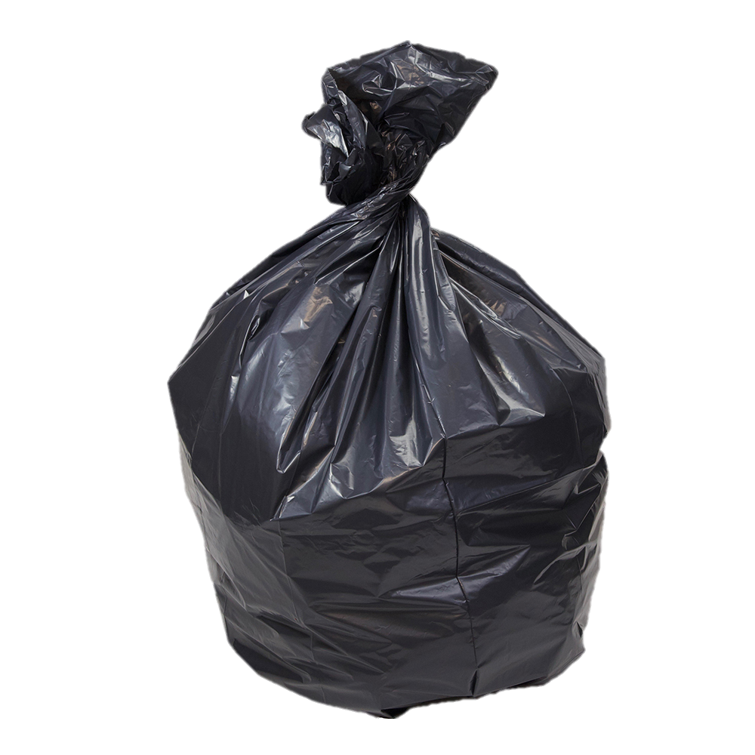
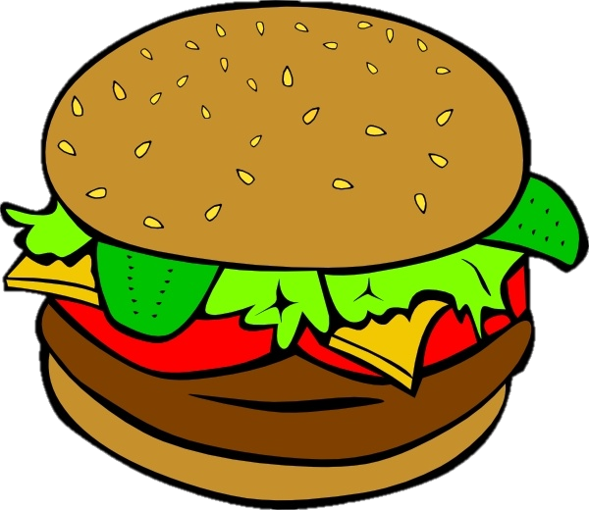
?
=
(그것은 음식처럼 보인다)

Slide 43
Game: What does it look like?
Guess (추측해)
Good guess = 1 point
Guess what teacher is thinking = 2 points
If you don’t know the word in English, guess in Korean!
(영어를 모른다면 한국어로 맞춰보세요)

Slide 44
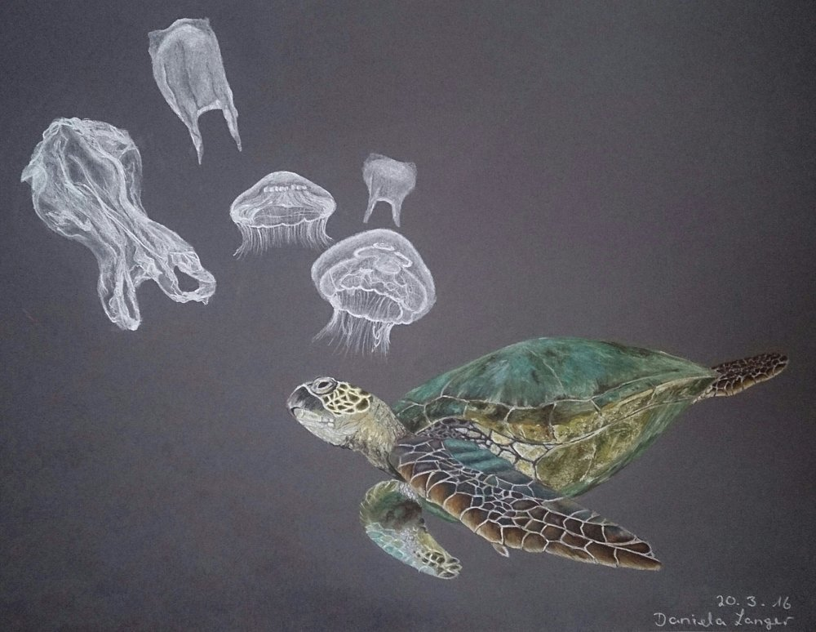
What does it look like?
It looks like jellyfish.
Notes:
For Example…..

Slide 45
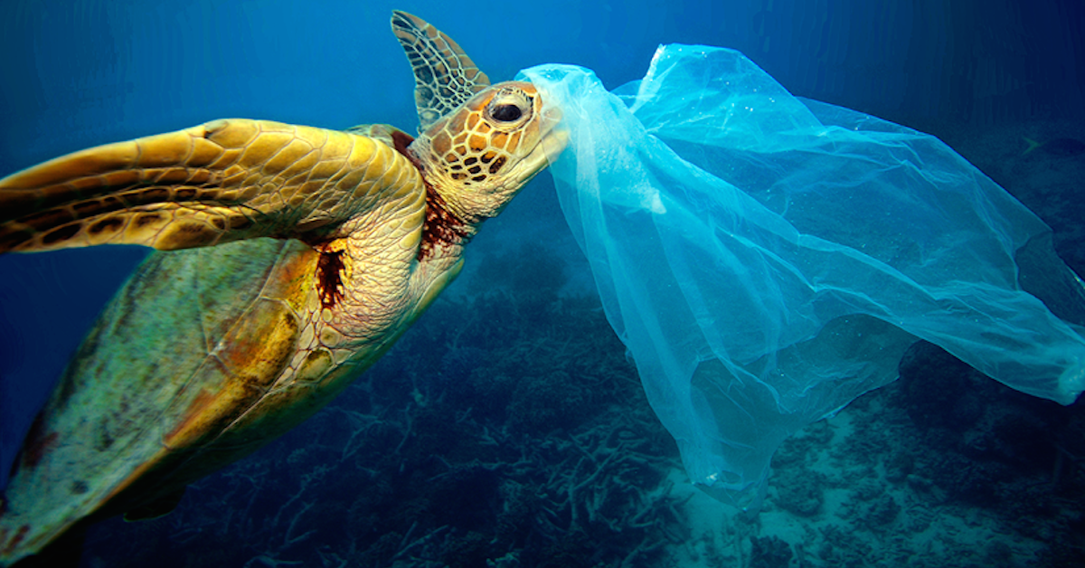
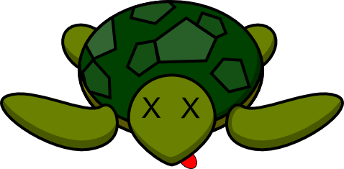

Slide 46
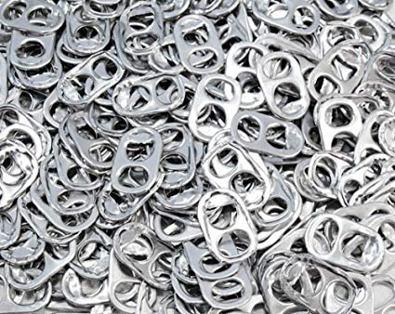
What does it look like?
Notes:
For Example…..

Slide 47
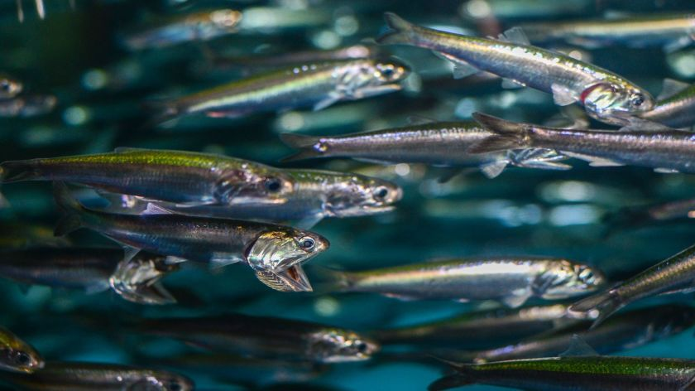
It looks like anchovy.
멸치 - Anchovy

Slide 48
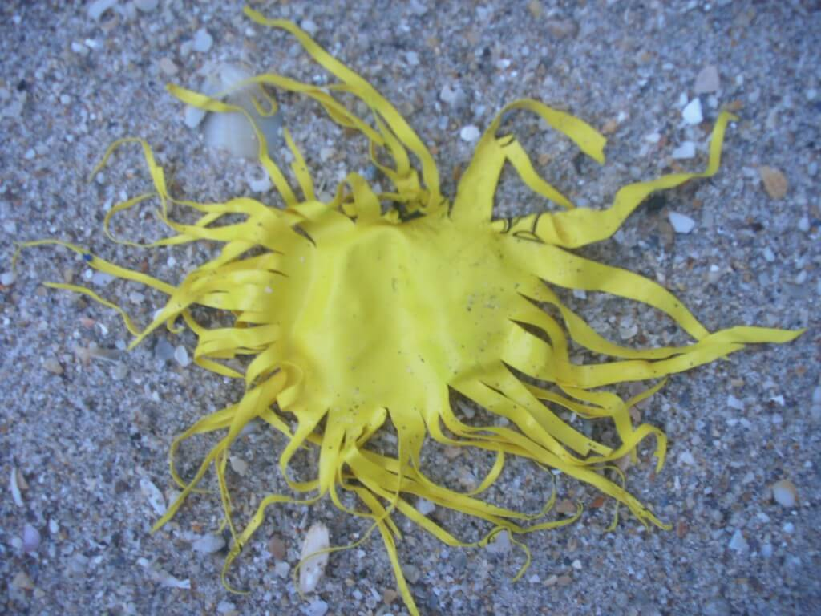
What does it look like?
balloon
Notes:
For Example…..

Slide 49
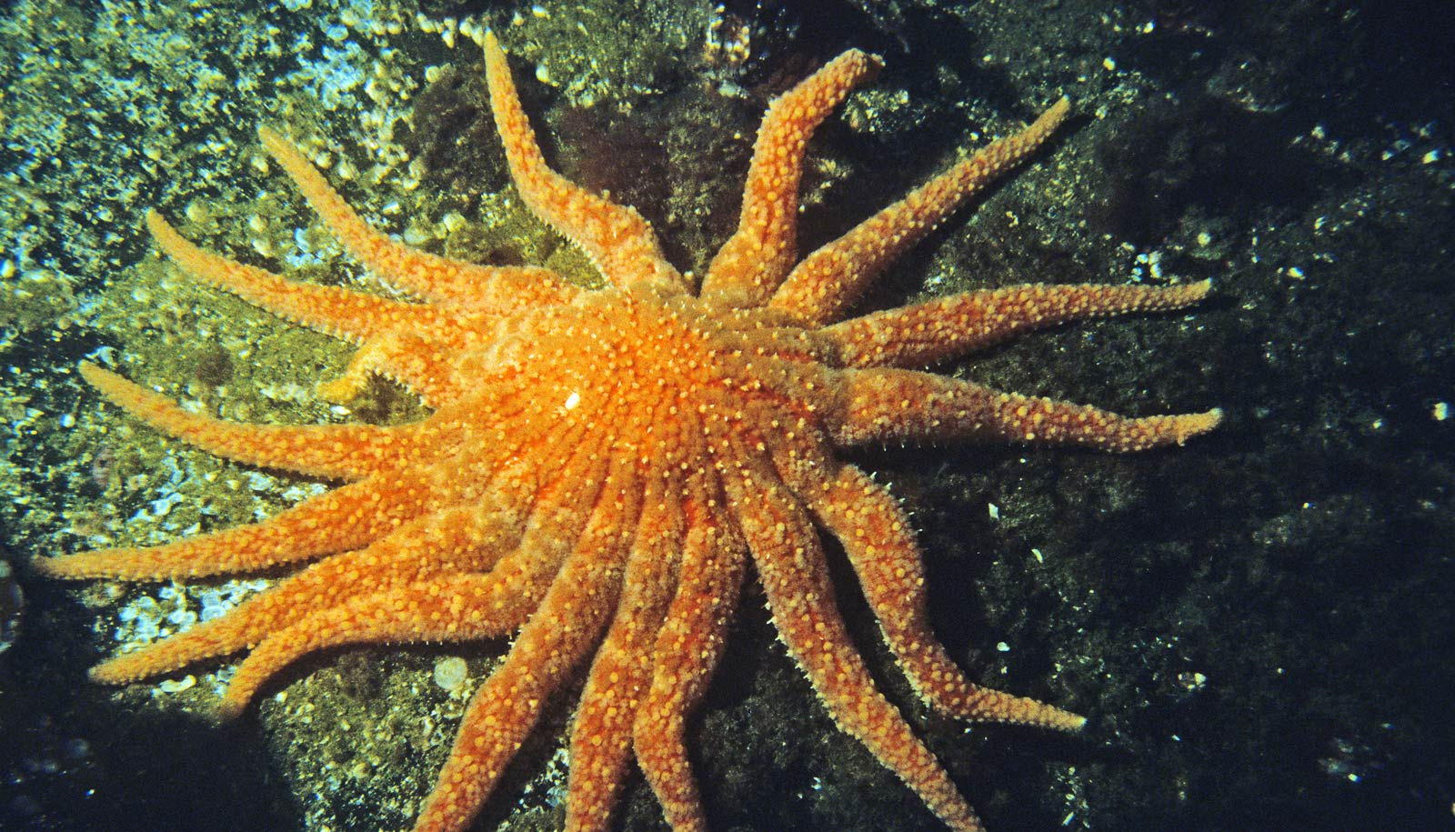
It looks like starfish.
불가사리 - Starfish

Slide 50
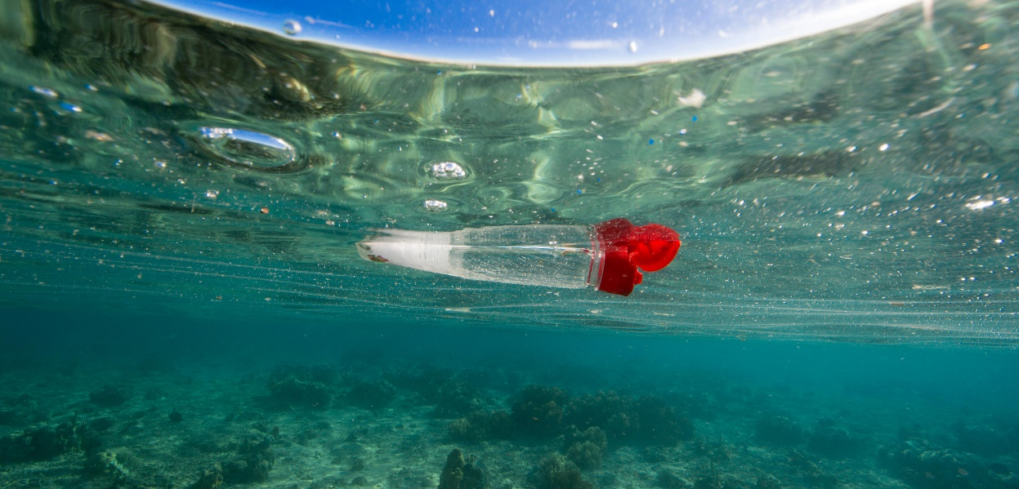
What does it look like?
Notes:
For Example…..

Slide 51
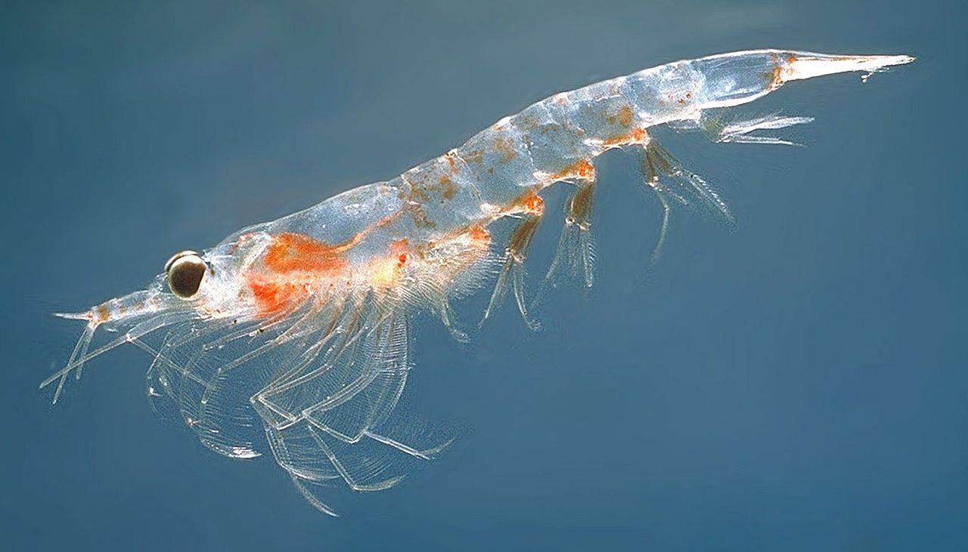
It looks like shrimp.
새우 – Shrimp

Slide 52
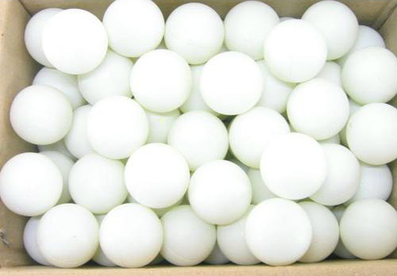
What does it look like?
ping pong balls
Notes:
For Example…..

Slide 53
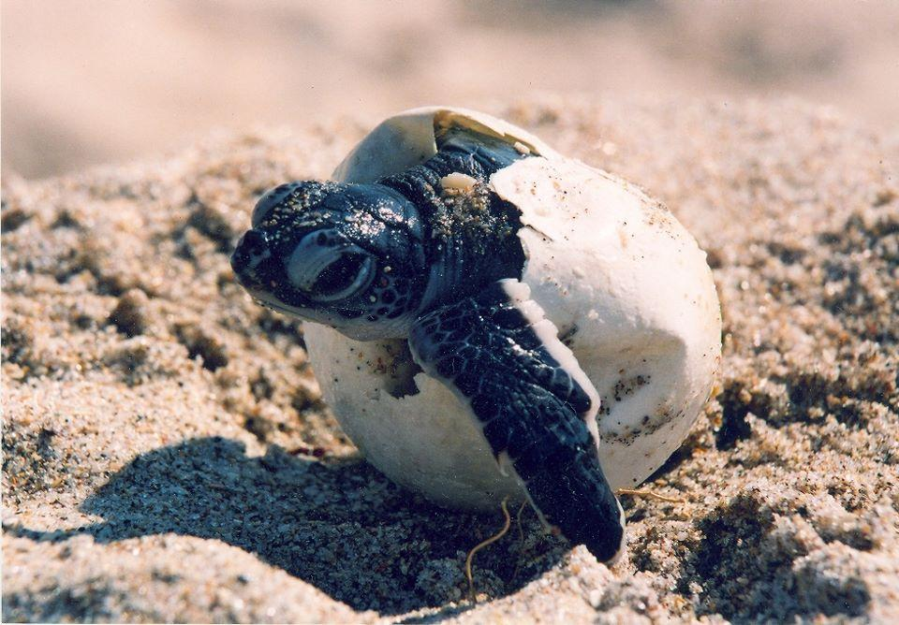
It looks like turtle eggs.
거북이 알 – turtle eggs

Slide 54
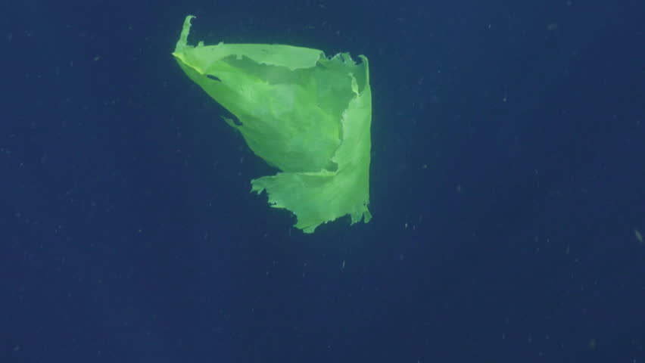
What does it look like?
Plastic bag
Notes:
For Example…..

Slide 55
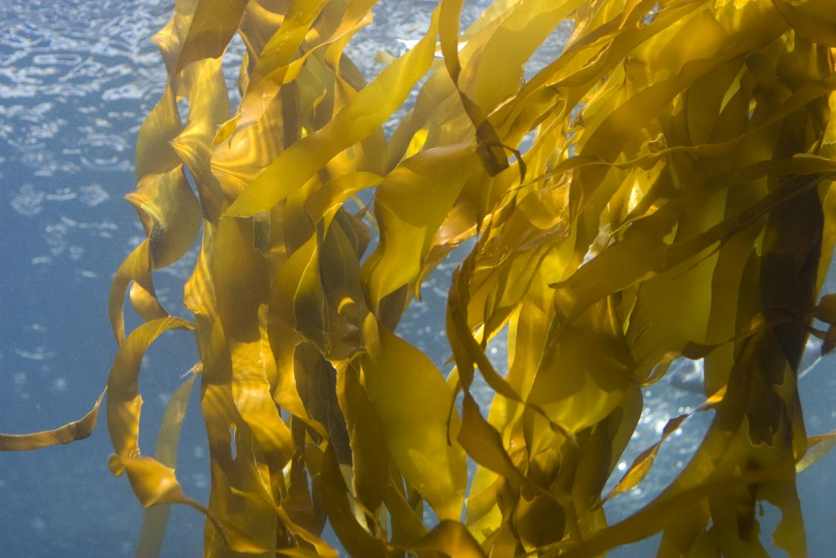
It looks like seaweed.
해초 - Seaweed

Slide 56

What does it look like?
Packing Peanuts
Notes:
For Example…..

Slide 57

It looks like grubs.
유충 - Grubs

Slide 58

What does it look like?
Beads
Notes:
For Example…..

Slide 59

It looks like berries.
산딸기 – berries

Slide 60

What does it look like?
Clear beads
Notes:
For Example…..

Slide 61

It looks like fish eggs.
생선 알 – fish eggs

Slide 62

What does it look like?
Straws
Notes:
For Example…..

Slide 63

It looks like reeds.
갈대 - Reeds

Slide 64

What does it look like?
Plastic fibers
Notes:
For Example…..

Slide 65

It looks like roots.
뿌리 - Roots

Slide 66
How can we help Earth?

Slide 67

____ the
trash in the _________.
Put
trash can

