Slide 1

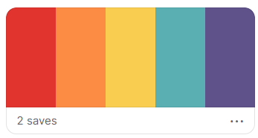
Trying
New
Things

Slide 2
TODAY

Slide 3
A portrait of you
I am. I can. I will.
Your garden

Slide 4
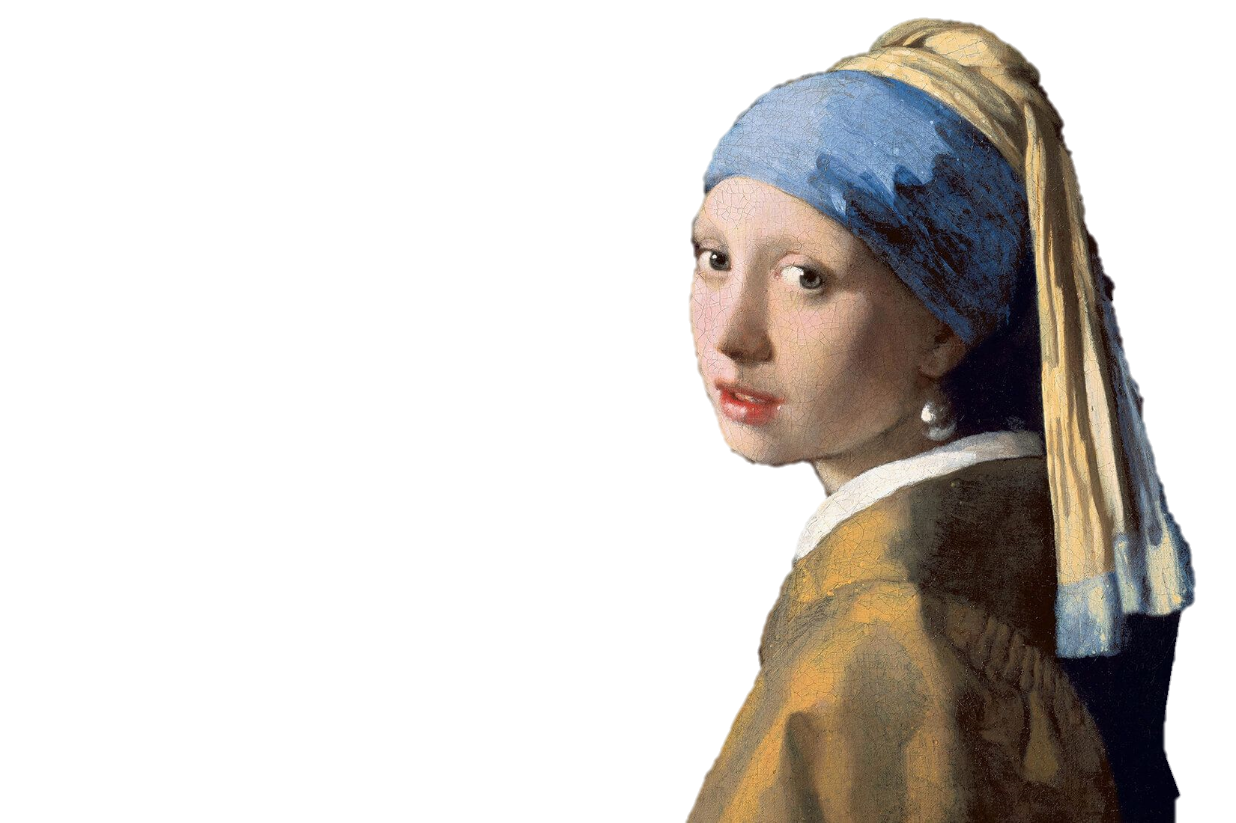
Your
Portrait

Slide 5


My hobby is _______________.
playing piano
I like playing piano.
I like to play piano.

Slide 6
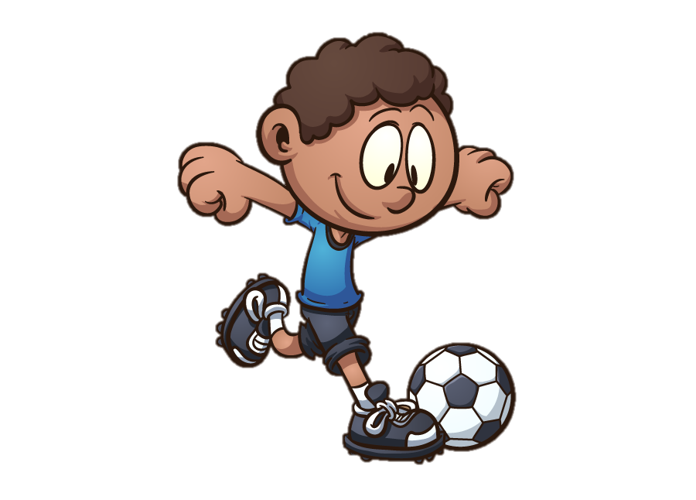

I like to _____ _______.
play
soccer

Slide 7

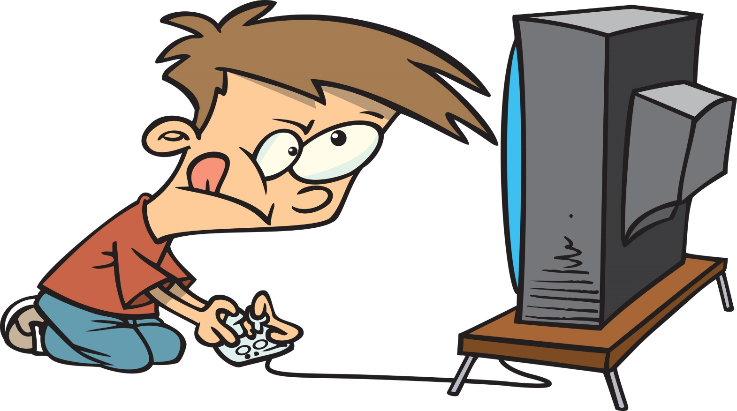
I like to _____ _____________.
play
video games

Slide 8

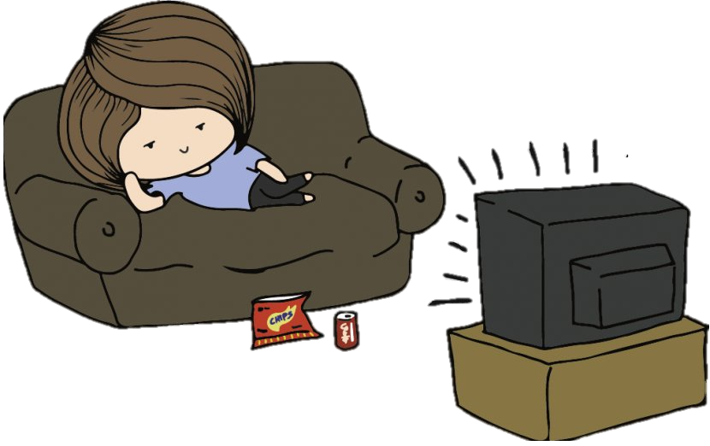
I like to _______ ____.
watch
TV

Slide 9


I like to _________
_______.
listen to
music

Slide 10


I like to ___ __________.
go
shopping

Slide 11


I like to ______ ____________.
go to
the movies

Slide 12


I like to _____.
read

Slide 13
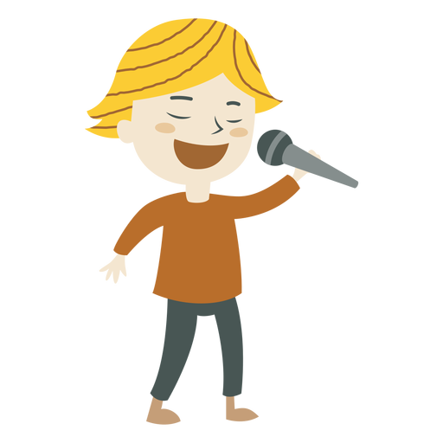

I like to _____.
sing

Slide 14
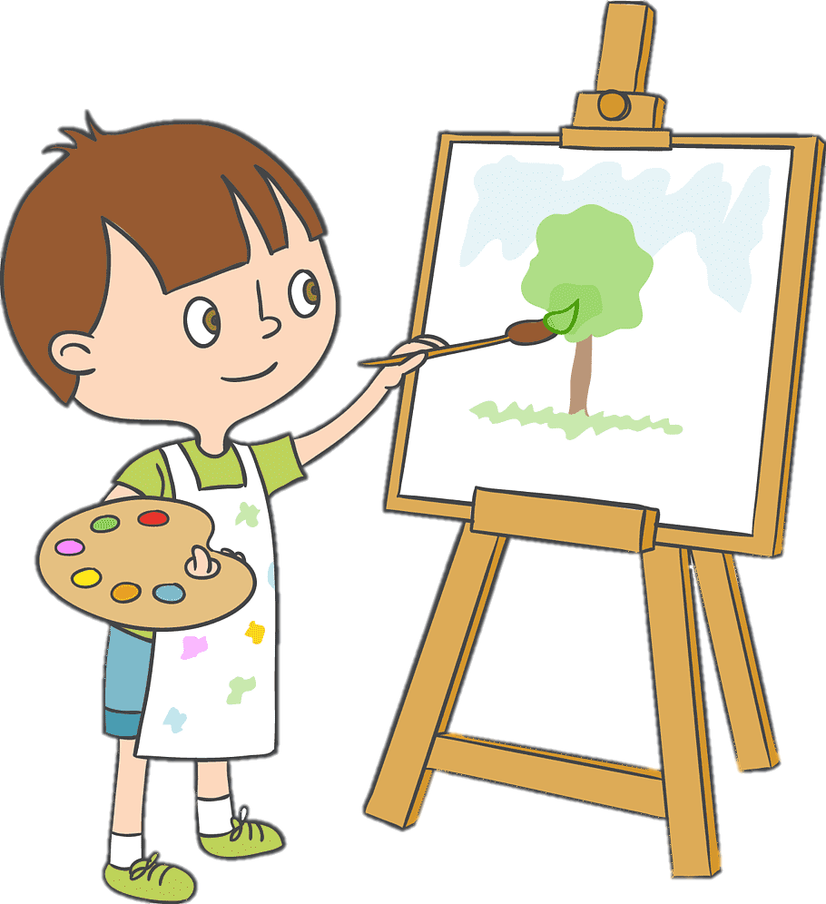

I like to ______.
paint

Slide 15
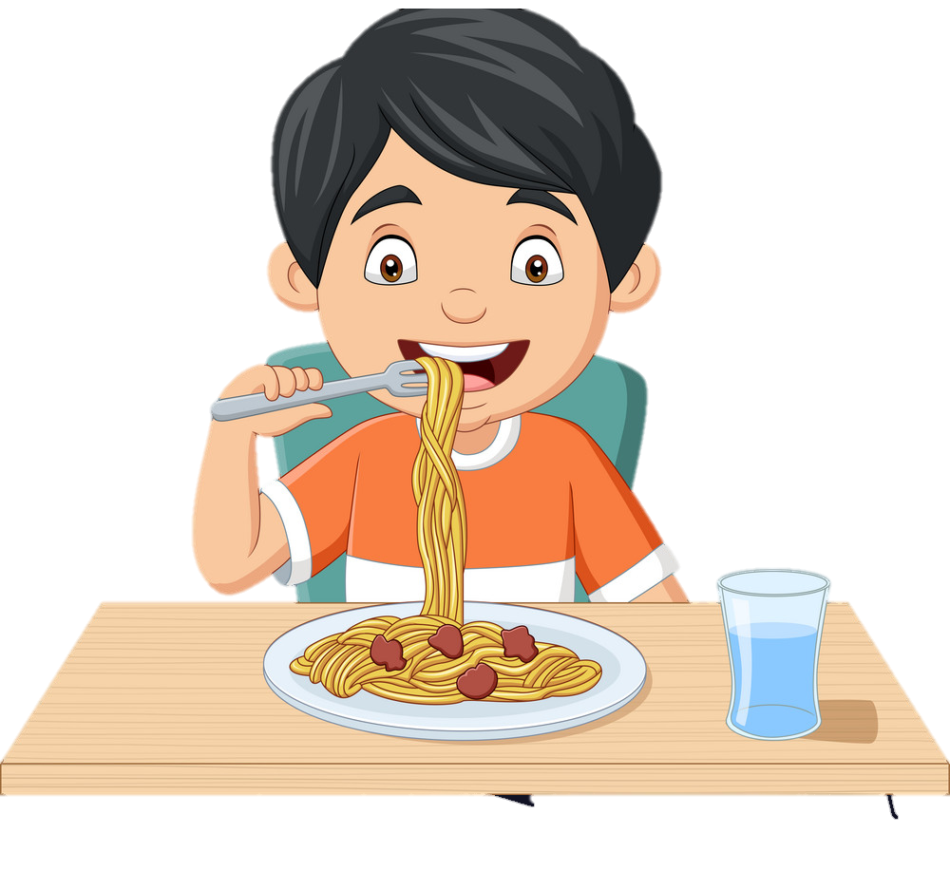

I like to ___________________.
eat expensive food

Slide 16

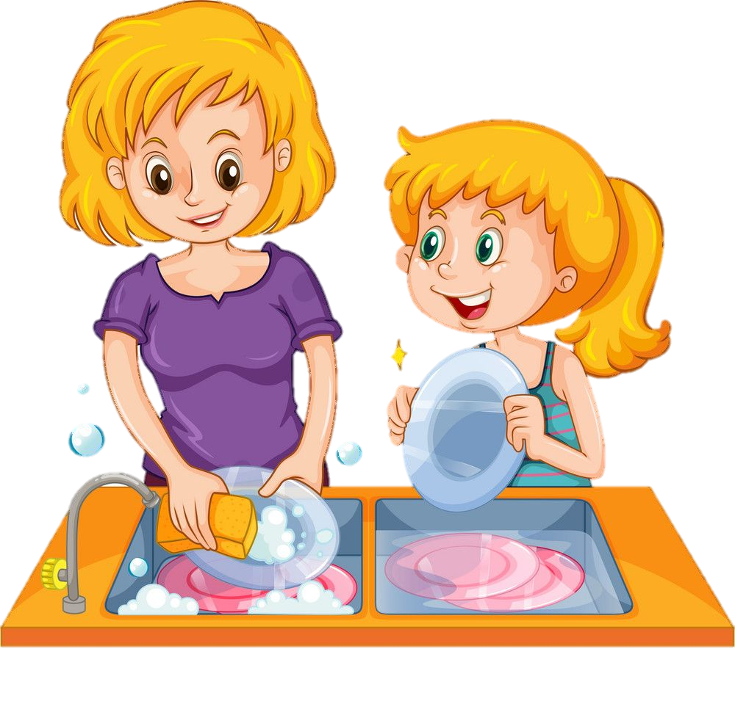
help
I like to _______
___________.
my mother

Slide 17

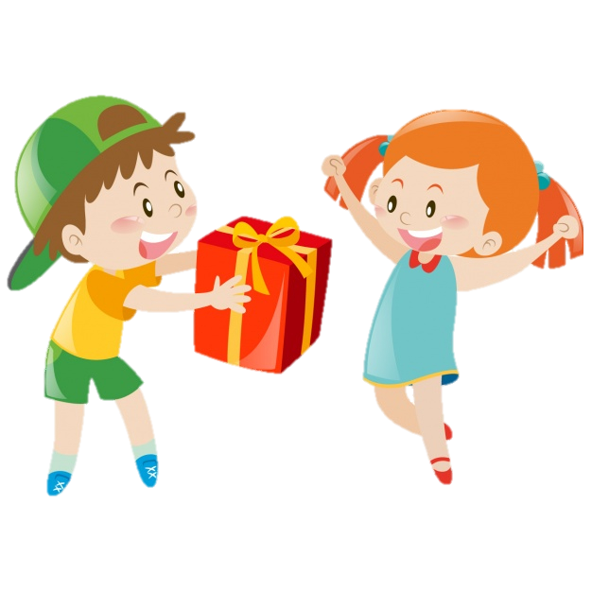
I like to __________.
give gifts

Slide 18

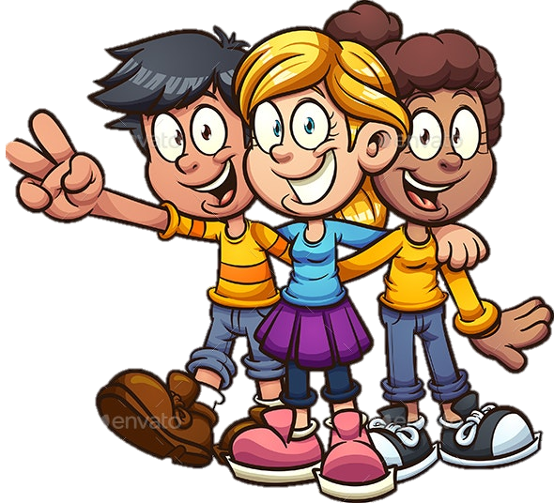
I like to ______________________.
hang out with friends

Slide 19

How about you?

Slide 20
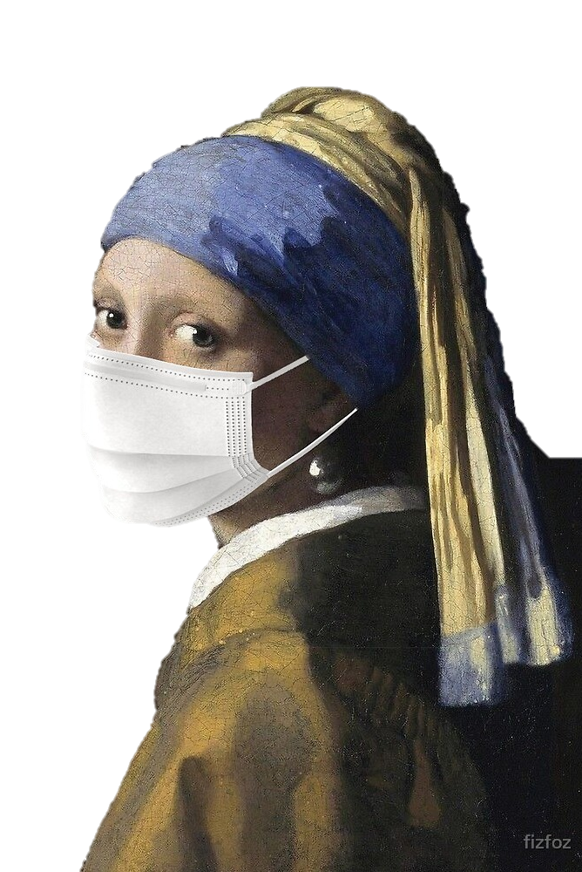
I am
I can
I will

Slide 21
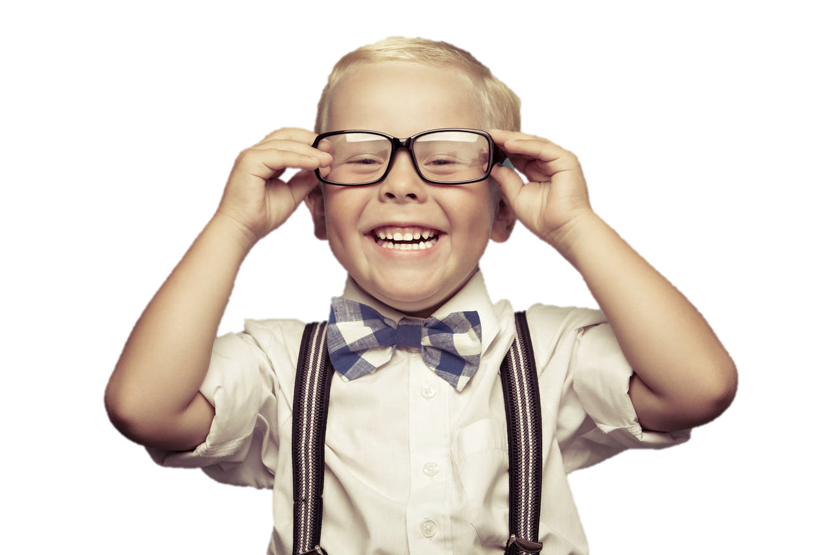
I am _______
smart

Slide 22
I am _______
loyal
rude
충성스러운
무례한
happy
bossy
silly
sneaky
행복
이래라저래라하는
유치한
교활한, 엉큼한
sad
brave
clever
confused
슬퍼
용감한
영리한
분명치 않은
kind
lazy
funny
excited
친절한
게으른
웃게 하는 사람
신난, 흥분한
angry
curious
loud
quiet
화난
호기심이 많은
시끄러운
조용한
mean
wise
smart
persistent
못되게 구는
현명한
똑똑한
집요한

Slide 23
How about you?

Slide 24
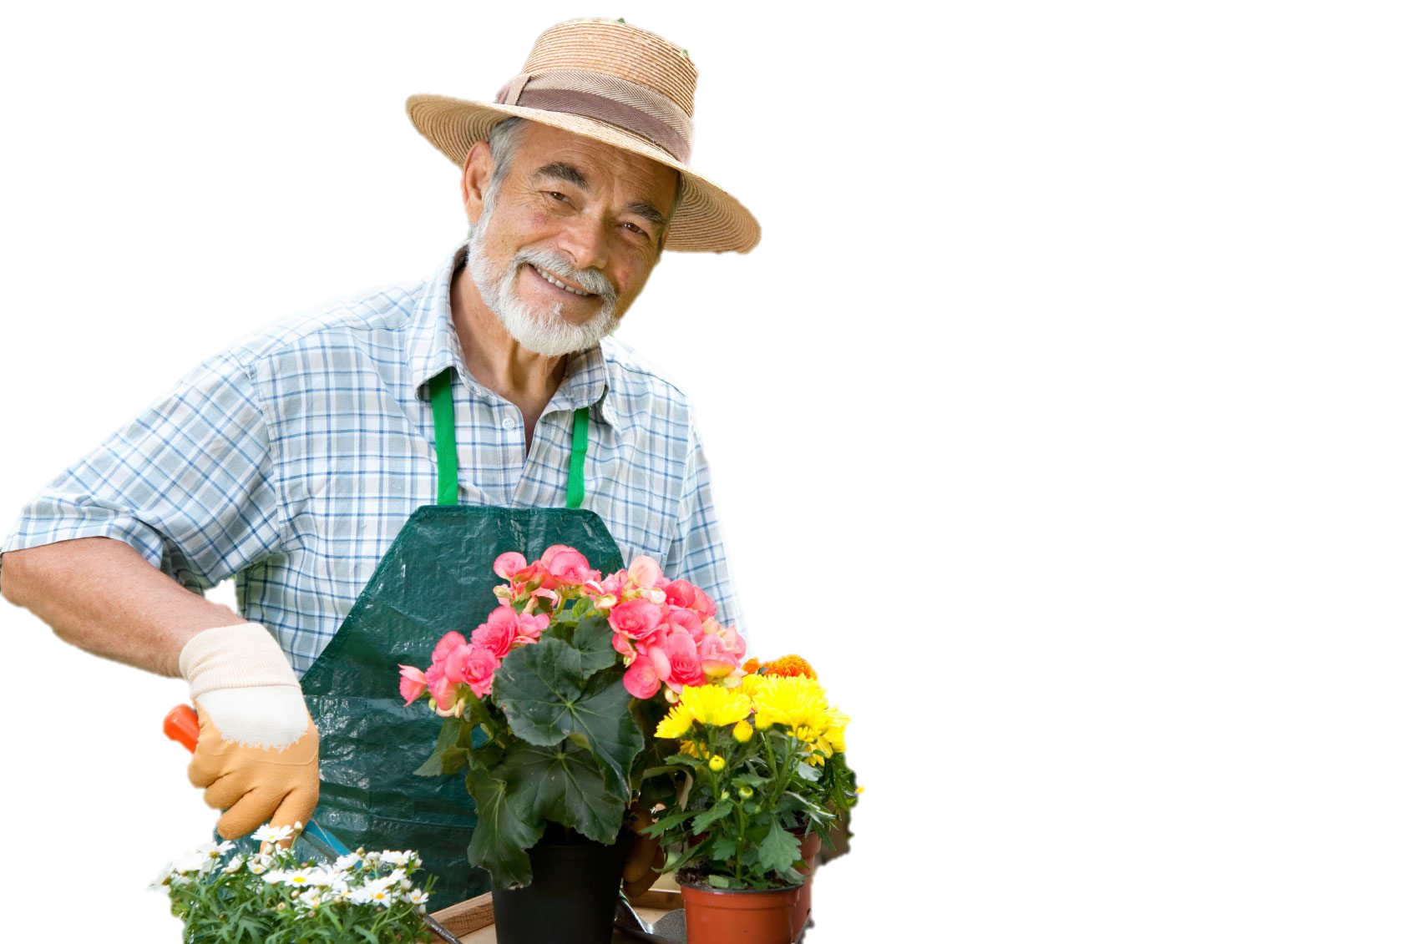

I can _____________
grow flowers

Slide 25


fly
I can’t ___.

Slide 26


I can grow flowers.
I can’t fly.

Slide 27


I can make pizza.
I can’t eat crab.

Slide 28

I can ______.
I can’t _____.

Slide 29

I can ______.
I can’t _____.

Slide 30

I can ______.
I can’t _____.

Slide 31

I can ______.
I can’t _____.
English.

Slide 32
What can you do?

Slide 33
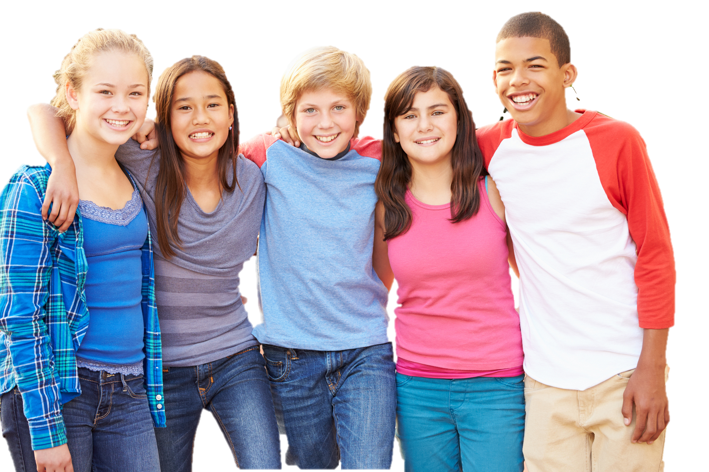
I will _________________
meet my friends

Slide 34
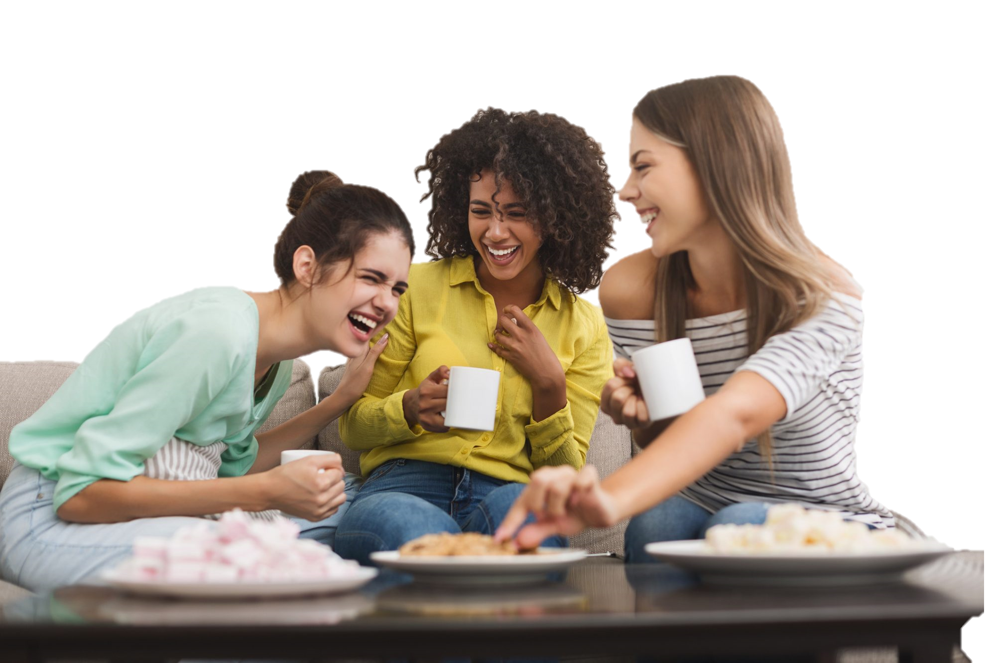

I will ______________.
speak English

Slide 35

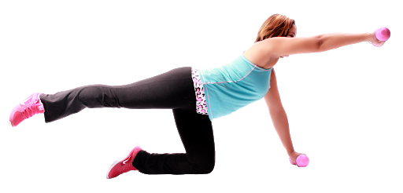
I will ______________.
exercise more

Slide 36









play trumpet
play drums
play tennis
play guitar
play piano
dance
swim
sing
golf
ski
I will learn how to ________________.

Slide 37
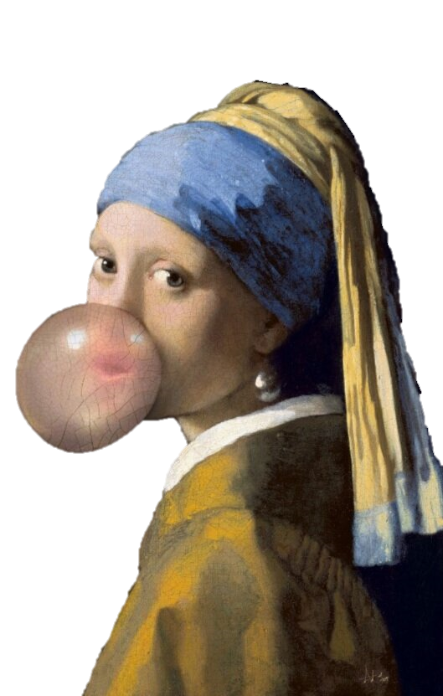
My
Garden
of
LEARNING

Slide 38





Climbing
Seoraksan
Walk to the next city
Cooking Hamburgers
It was hard.
I liked it.
I did it.
It was hard.
I liked it.
I did it.
It was hard.
I liked it.
I did it.

Slide 39
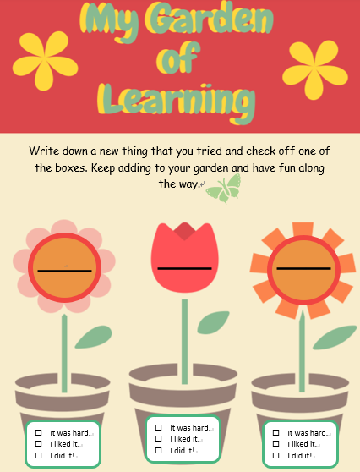
Your turn!

Slide 40
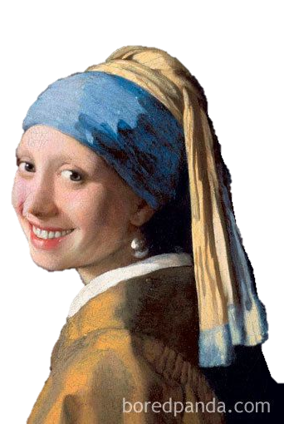
Have a
Nice
Weekend

