Slide 1
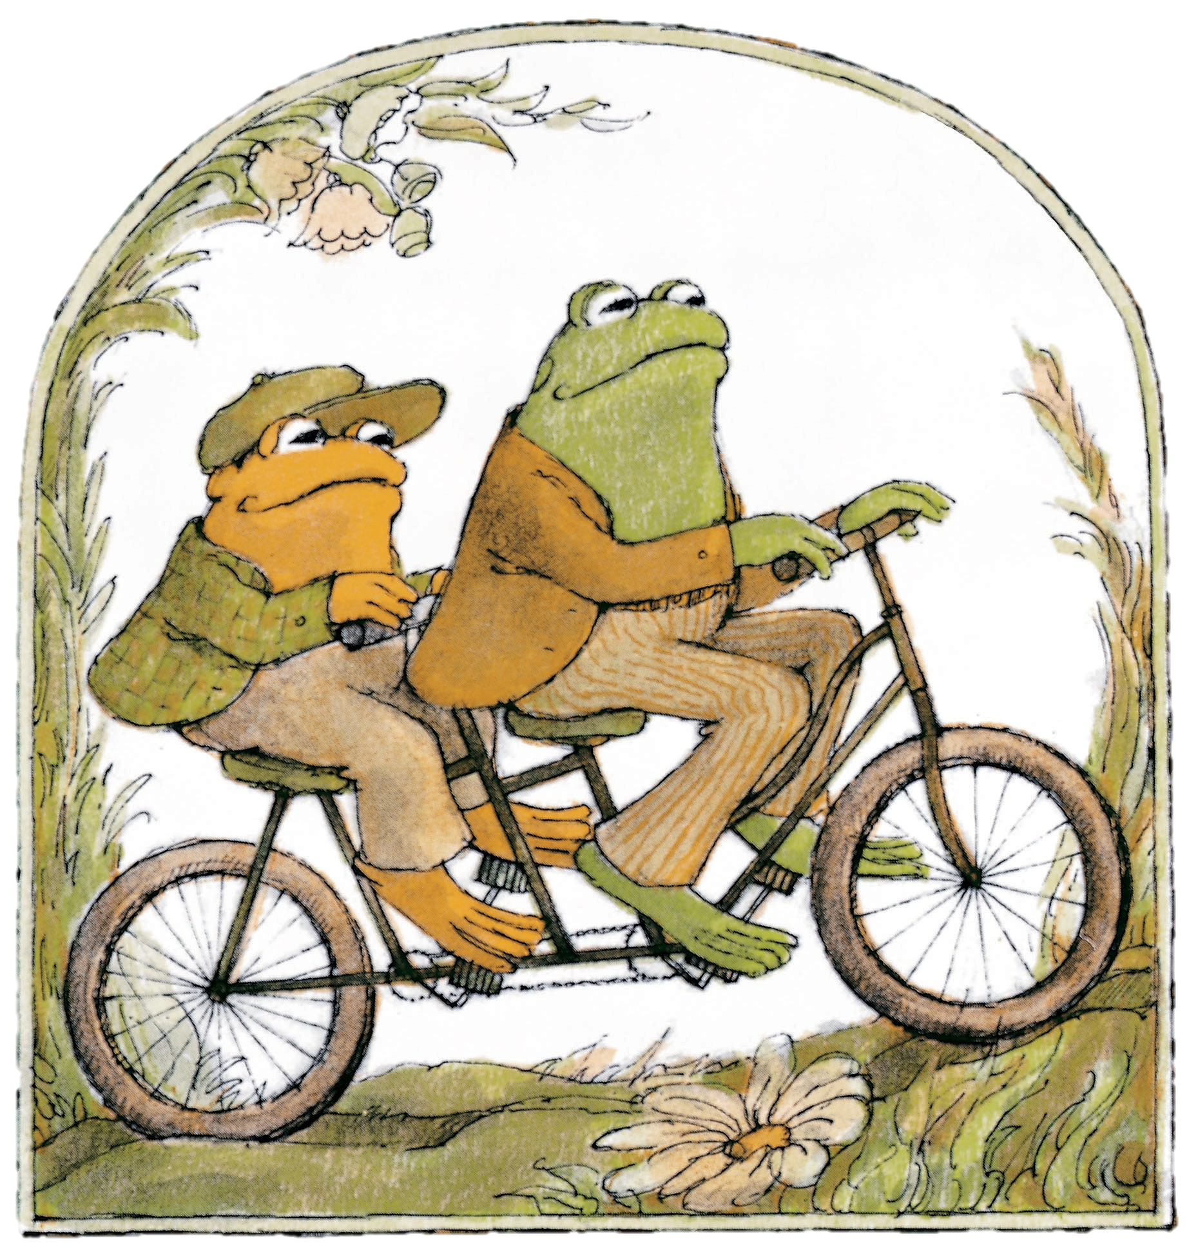
Frog
and
Toad

Slide 2
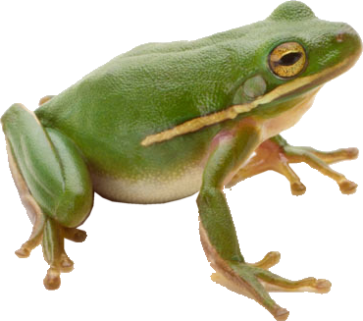
frog

Slide 3
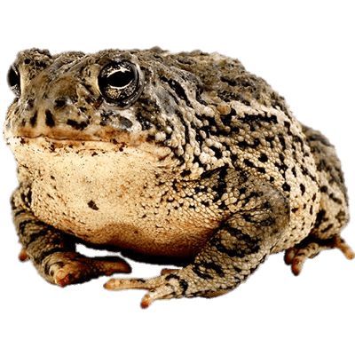
toad

Slide 4
What is different?
toad
frog

Slide 5
think
thinking
thought

Slide 6
What do you think about frogs?

Slide 7
What do you think about toads?

Slide 8
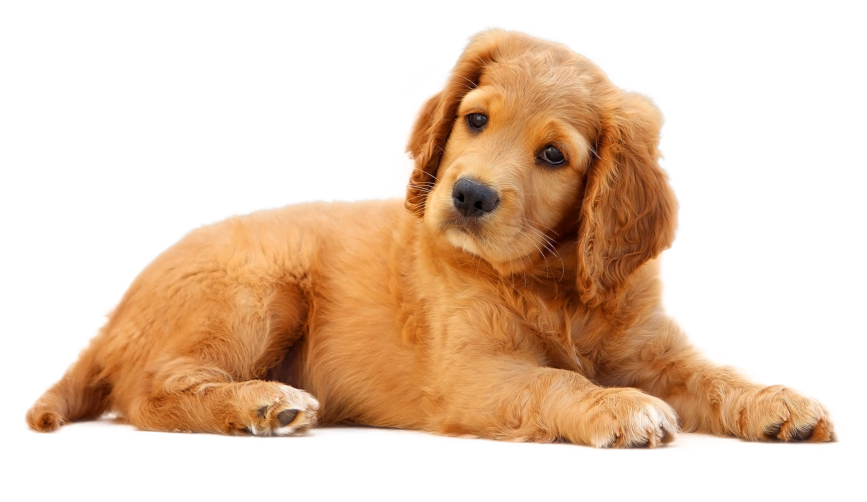
What do you think about dogs?

Slide 9
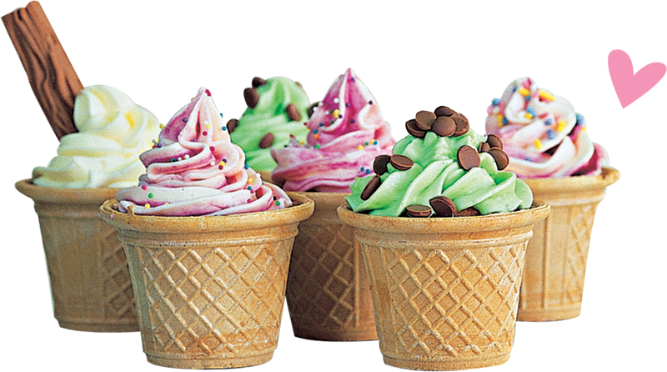
What do you think about ice cream?

Slide 10
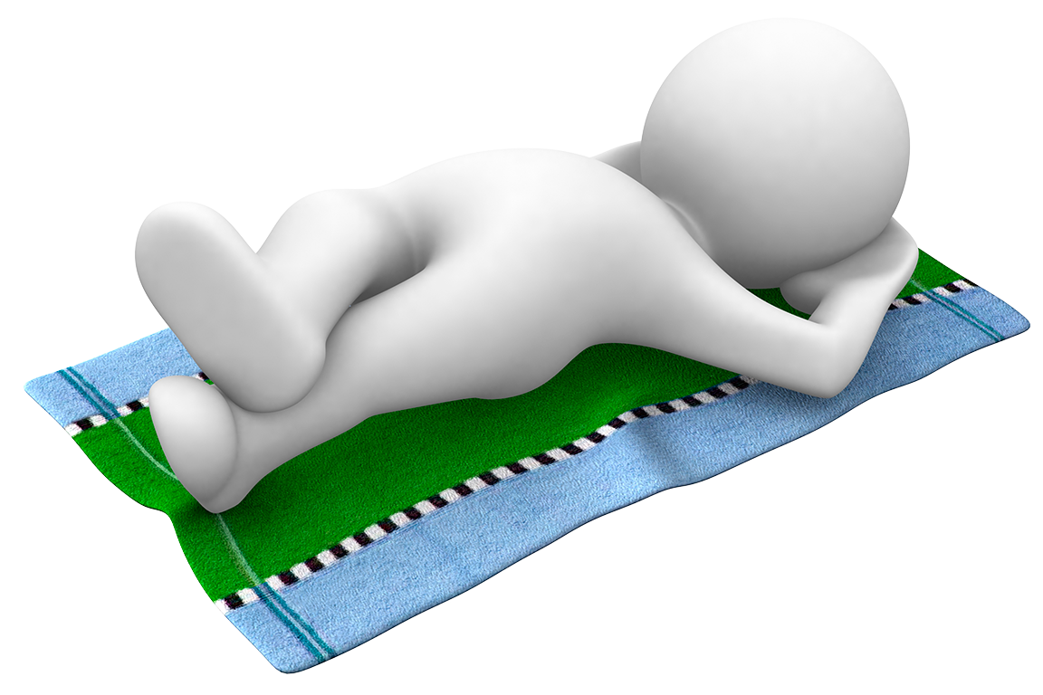
What do you think about resting?

Slide 11
remember
remembering
remembered

Slide 12
Sometimes it is difficult to remember.

Slide 13
How can you remember?

Slide 14
tell
a story
telling
told

Slide 15
Frog
and
Toad

Slide 16
I’m toad.
I’m toad.

Slide 17
One day in summer Frog was not feeling well.
Toad said, “Frog, you are looking quite green.”
“But I always look green,” said Frog. “I am a frog.”
“Today you look very green even for a frog,” said Toad.
“Get into my bed and rest.”

Slide 18
Toad made Frog a cup of tea.
Frog drank the tea, and then he said, “Tell me a story while I am resting.”

Slide 19
“All right,” said Toad.
“Let me think of a story to tell you.”
Toad thought and thought.
But he could not think of a story to tell Frog.

Slide 20
“I will go out on the front porch and walk up and down,” said Toad.
“Perhaps that will help me to think of a story.”
Toad walked up and down on the porch for a long time. But he could not think of a story to tell Frog.

Slide 21
Then Toad went into the house and stood on his head.
“Why are you standing on your head?” asked Frog.
“I hope that if I stand on my head, it will help me to think of a story,” said Toad.

Slide 22
Toad stood on his head for a long time.
But he could not think of a story to tell Frog.

Slide 23
Then Toad poured a glass of water over his head.
“Why are you pouring water on your head?” asked Frog.
“I hope that if I pour water over my head, it will help me to think of a story,” said Toad.
Toad poured many glasses of water over his head.
But he could not think of a story to tell Frog.

Slide 24
Then Toad began to bang his head against the wall.
“Why are you banging your head against the wall?” asked Frog.
“I hope that if I bang my head against the wall hard enough, it will help me to think of a story,” said Toad.

Slide 25
“I am feeling much better now, Toad,” said Frog. “I do not think I need a story anymore.”
“Then you get out of bed and let me get into it,” said Toad, “because now I feel terrible.”
Frog said, “Would you like me to tell you a story Toad?”
“Yes,” said Toad, “if you know one.”

Slide 26
“Once upon a time,” said Frog, “there were two good friends, a frog and a toad.
The frog was not feeling well.
He asked his friend the toad to tell him a story.
The toad could not think of a story.

Slide 27
“He walked up and down on the porch, but he couldn’t think of a story.
He stood on his head, but he could not think of a story.
He poured water over his head, but he could not think of a story.

Slide 28
“He banged his head against the wall, but he still could not think of a story.
Then the toad did not feel so well, and the frog was feeling better.
So, the toad went to bed and the frog got up and told him a story.
The end.”

Slide 29
But Toad did not answer.
He had fallen asleep.

Slide 30
REVIEW

Slide 31
How did Frog feel at the
start of the story?

Slide 32
He felt terrible.

Slide 33
How does Frog feel at the
end of the story?

Slide 34
He feels much better.

Slide 35
Now how does Toad feel?

Slide 36
Now he feels terrible.

Slide 37
Why does Toad feel terrible?

Slide 38
He banged his head against the wall.

Slide 39
What did Toad do to
think of a story?

Slide 40
He walked up and down.
He stood on his head.
He poured water on his head.
He banged his head against the wall.

Slide 41
What story did Frog tell Toad?

Slide 42
He said what happened.

Slide 43
MAKE a STORY

Slide 44
mad lib
Two Animals

Slide 45
mad lib
Four actions
the animals can do

Slide 46
mad lib
Three feelings

Slide 47
_______ and _______

Slide 48
Once upon a time, there were two good friends, a ________ and a ________.
The ________ was feeling ________.
He asked his friend the toad to tell him a story.
The ________ could not think of a story.

Slide 49
He __________________________,
but he couldn’t think of a story.
He __________________________,
but he could not think of a story.
He __________________________,
but he could not think of a story.

Slide 50
He __________________________,
but he still could not think of a story.
Then the ________ felt ________, and the ________ was feeling ________.
So, the ________ went to bed and the ________ got up and told him a story.

Slide 51
The End

Slide 52
VOCABULARY

Slide 53
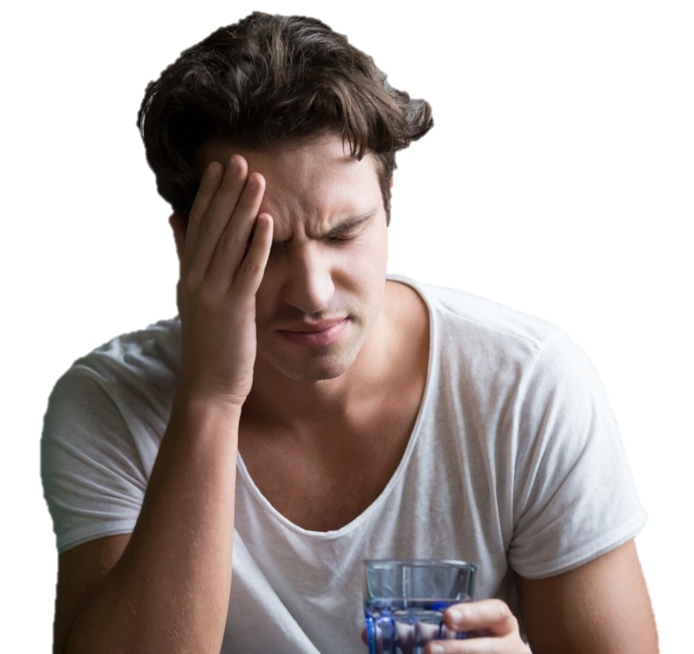
You look green.
sick

Slide 54
walk
up and down
walking
walked

Slide 55
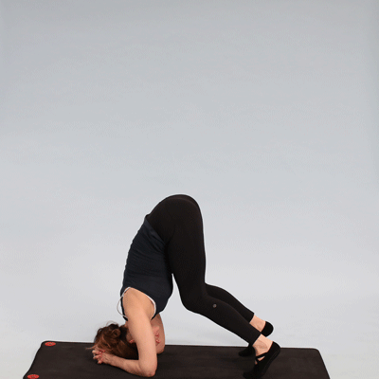
stand
on your head
standing
stood

Slide 56
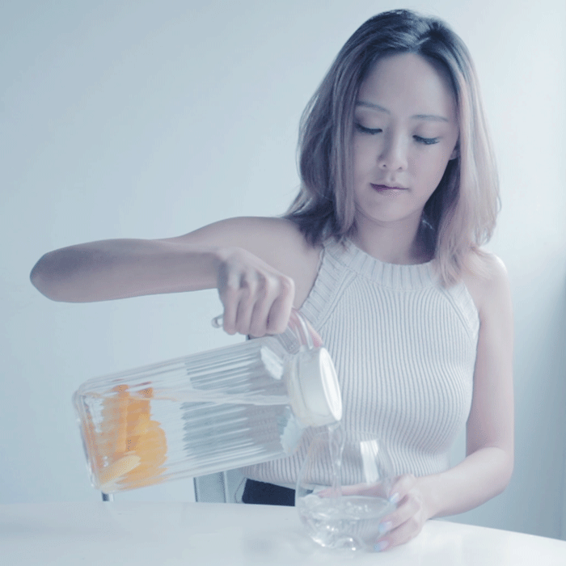
pour
a glass of water
pouring
poured

Slide 57
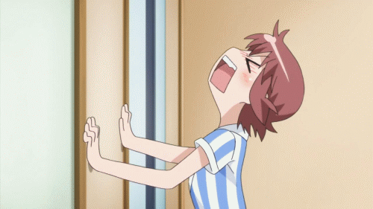
bang
your head against a wall
banging
banged

Slide 58
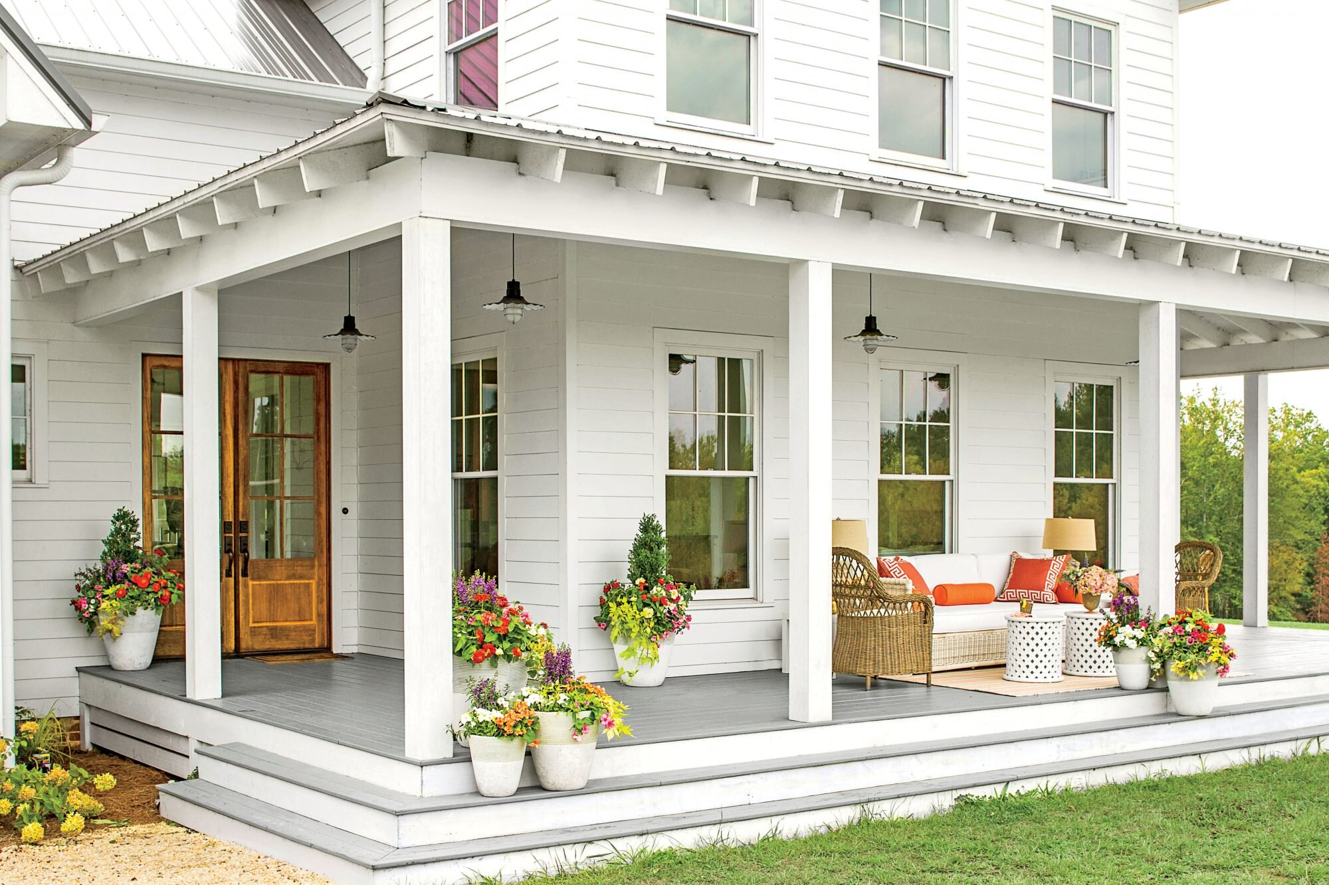
porch
Outside room

Slide 59
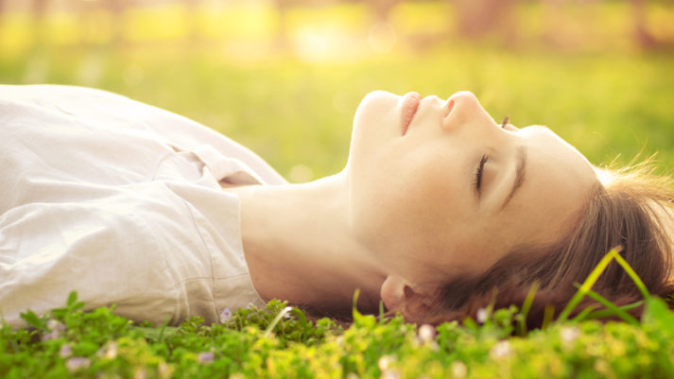
rest
Relax / Sleep

Slide 60
rest
Relax / Sleep

Slide 61
rest
Relax / Sleep

Slide 62
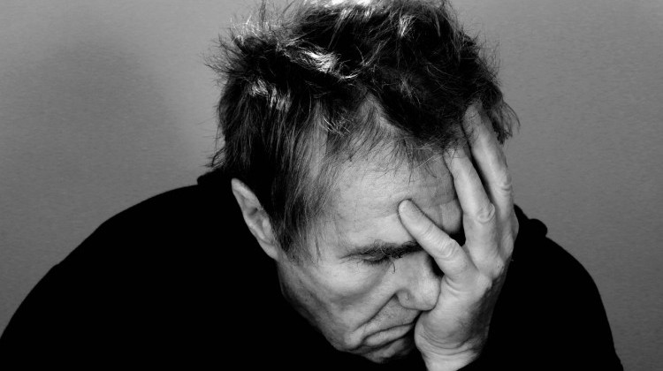
Very bad
Sad, sick, upset
terrible

