Slide 1
1
2
3
4
5
6
7
8
9
10

Slide 2
Fruit

Slide 3
apple

Slide 4
banana

Slide 5
carrot

Slide 6
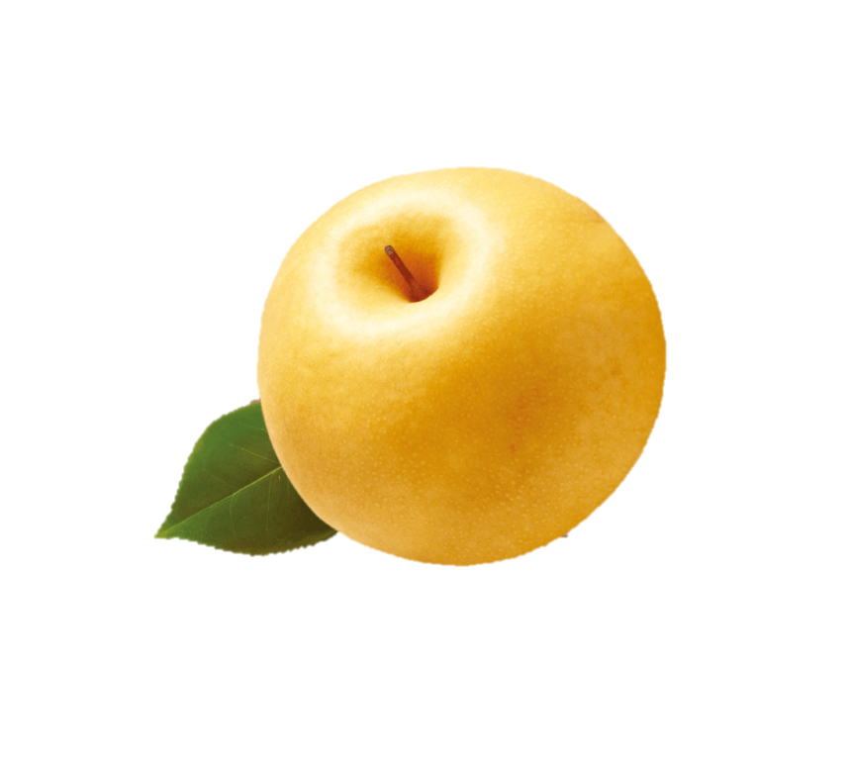
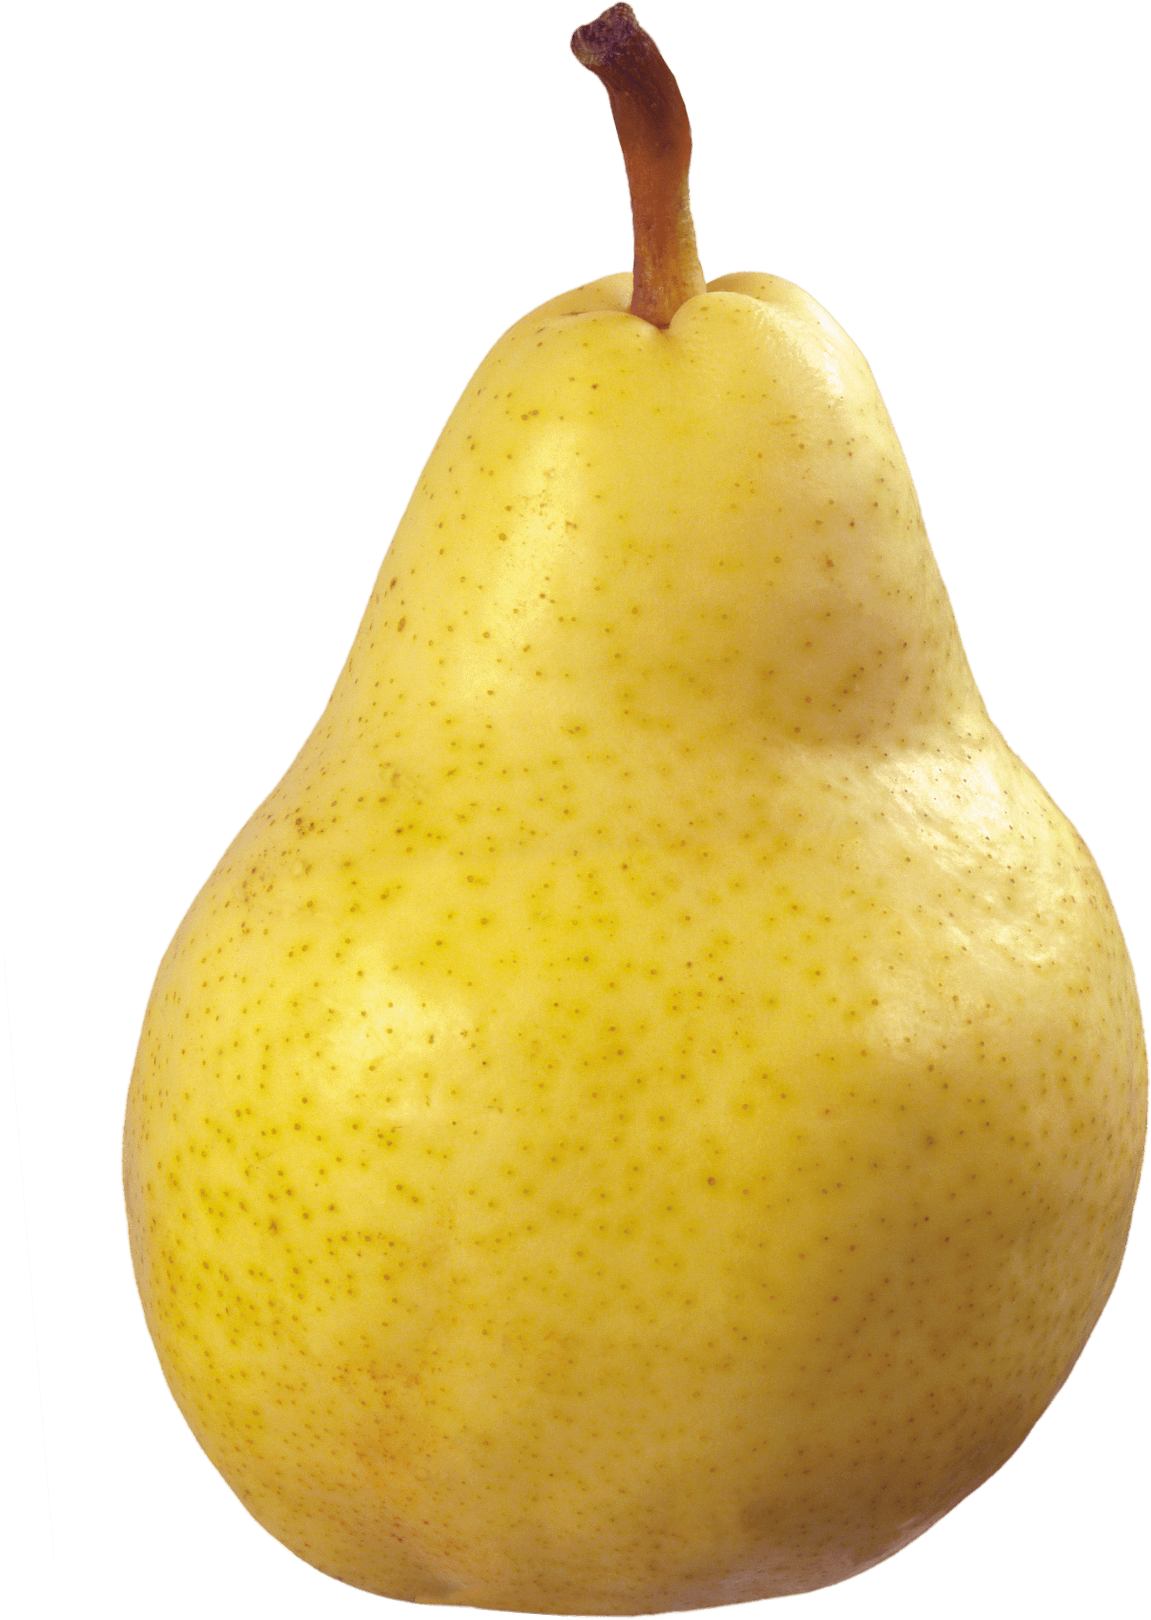

Slide 7
pear

Slide 8
tomato

Slide 9
potato

Slide 10
strawberry

Slide 11
watermelon

Slide 12
How
many?

Slide 13
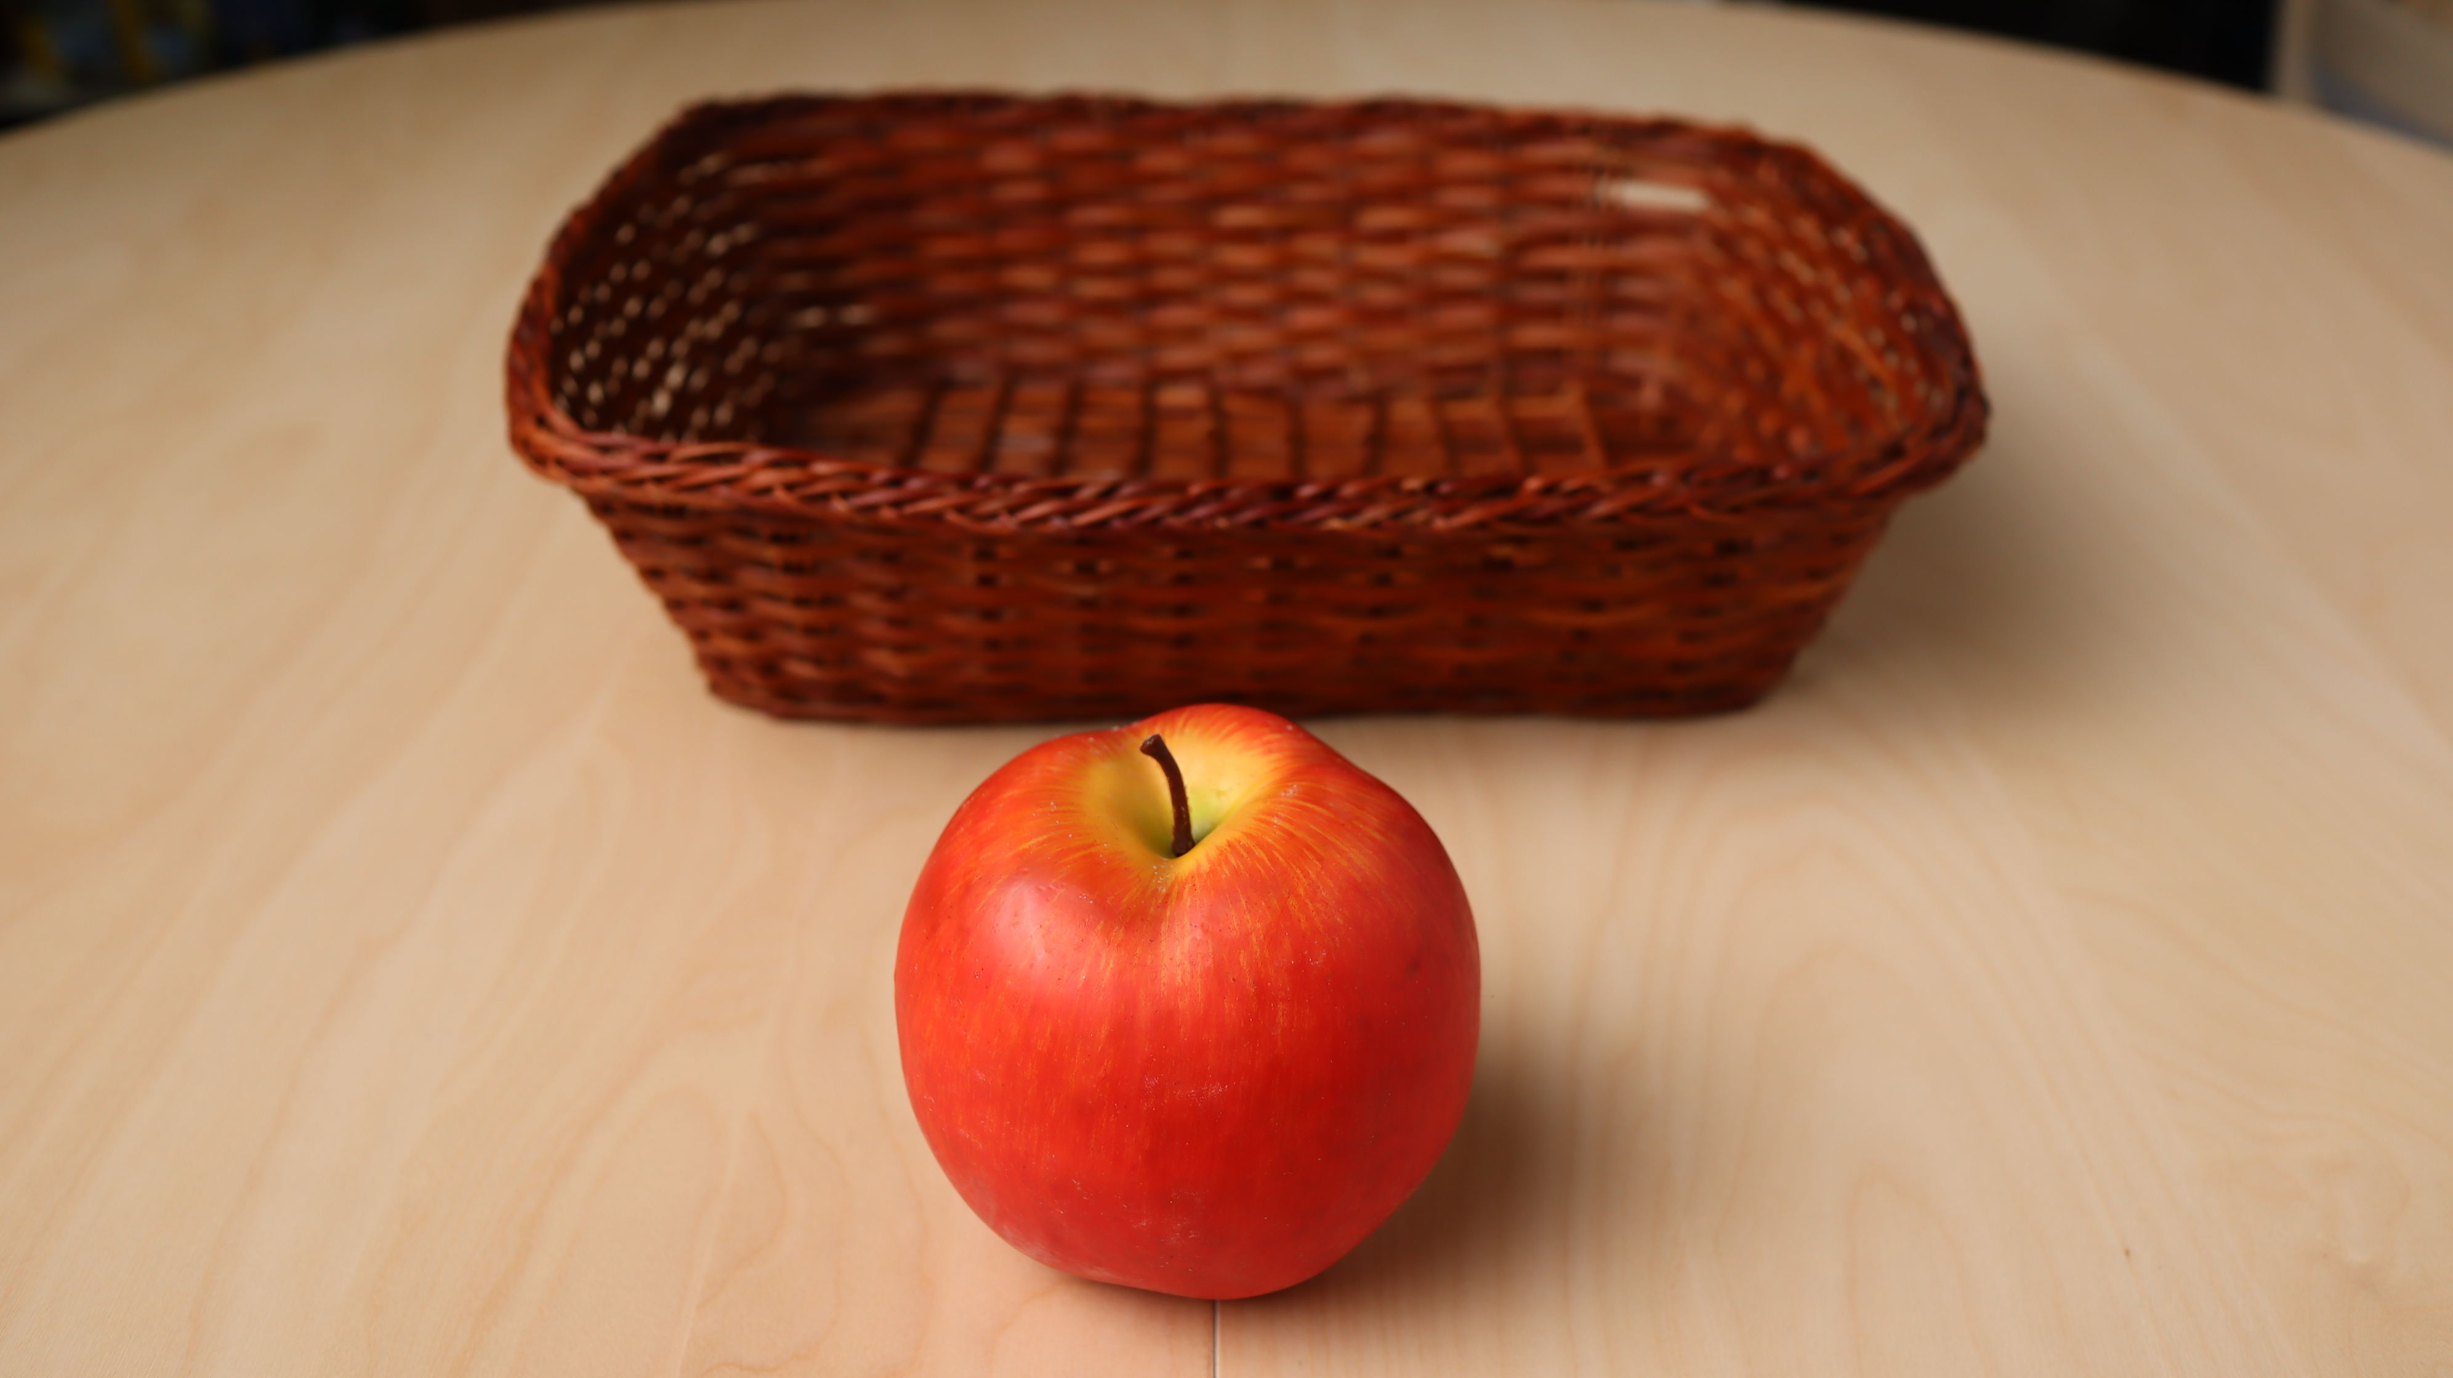

Slide 14
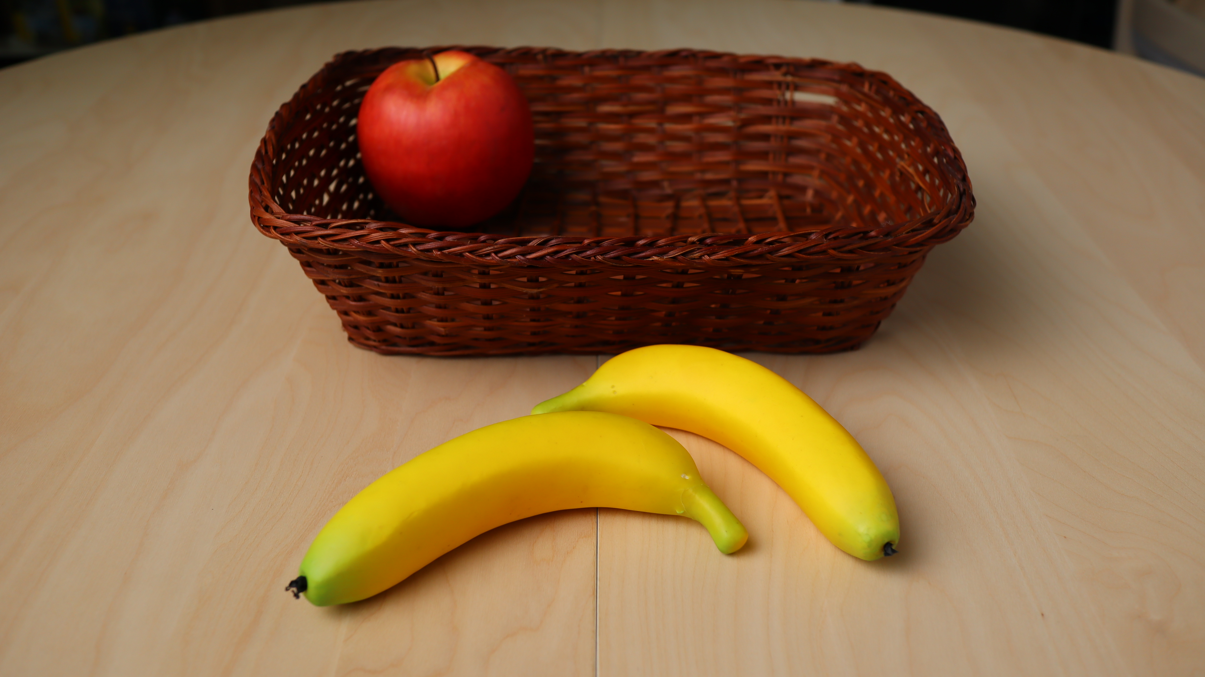

Slide 15
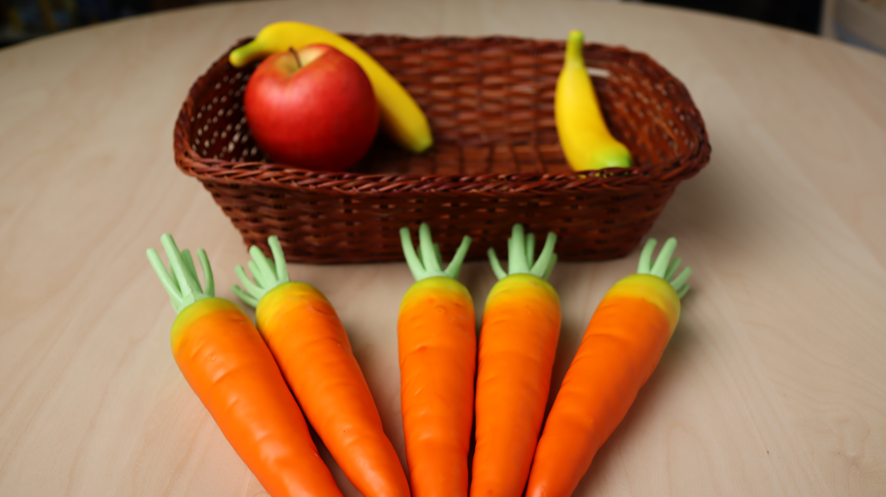

Slide 16
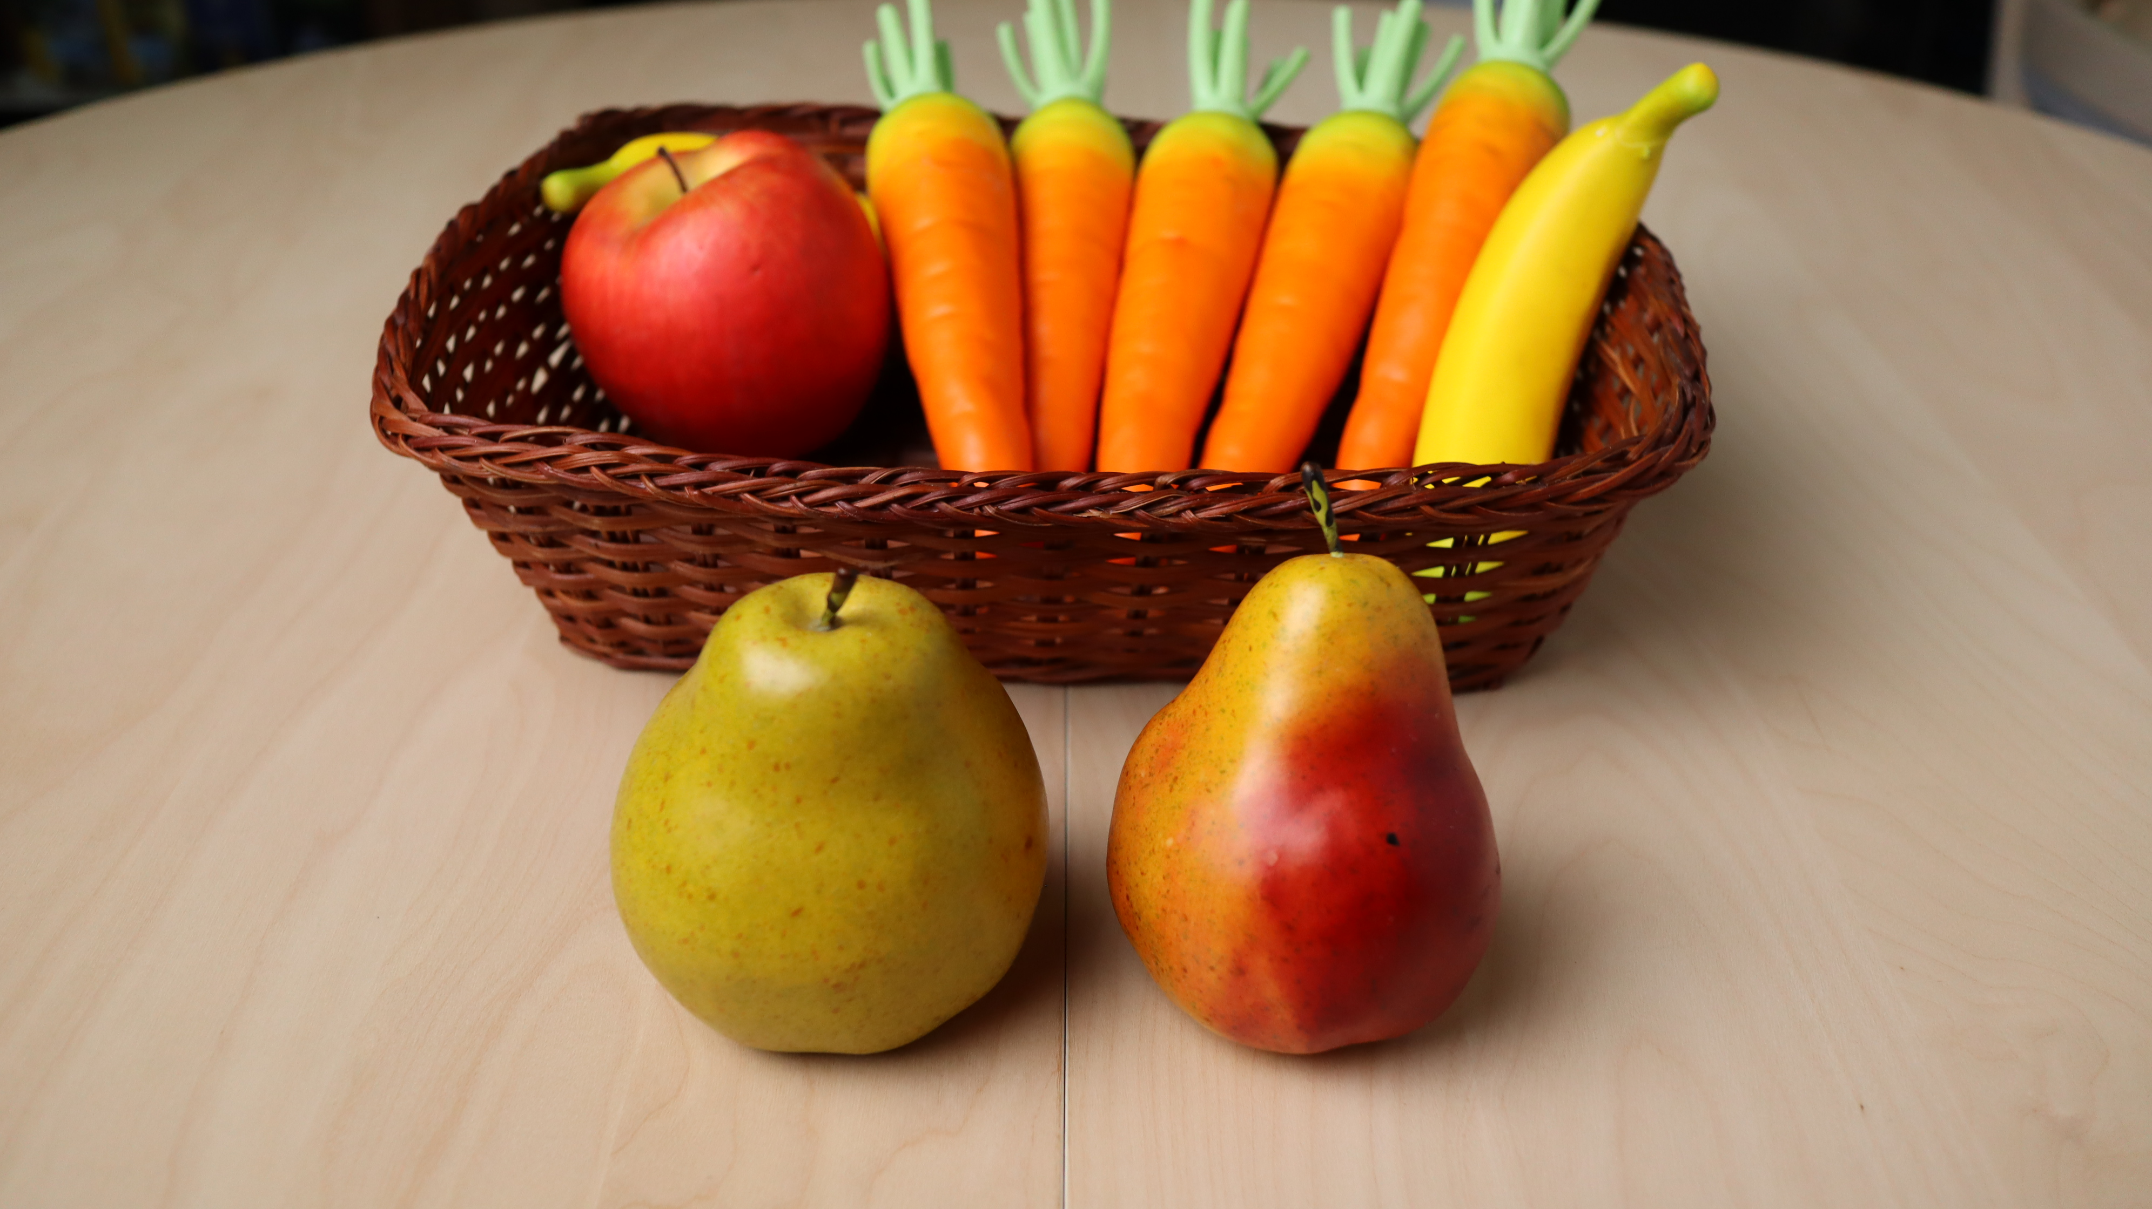

Slide 17
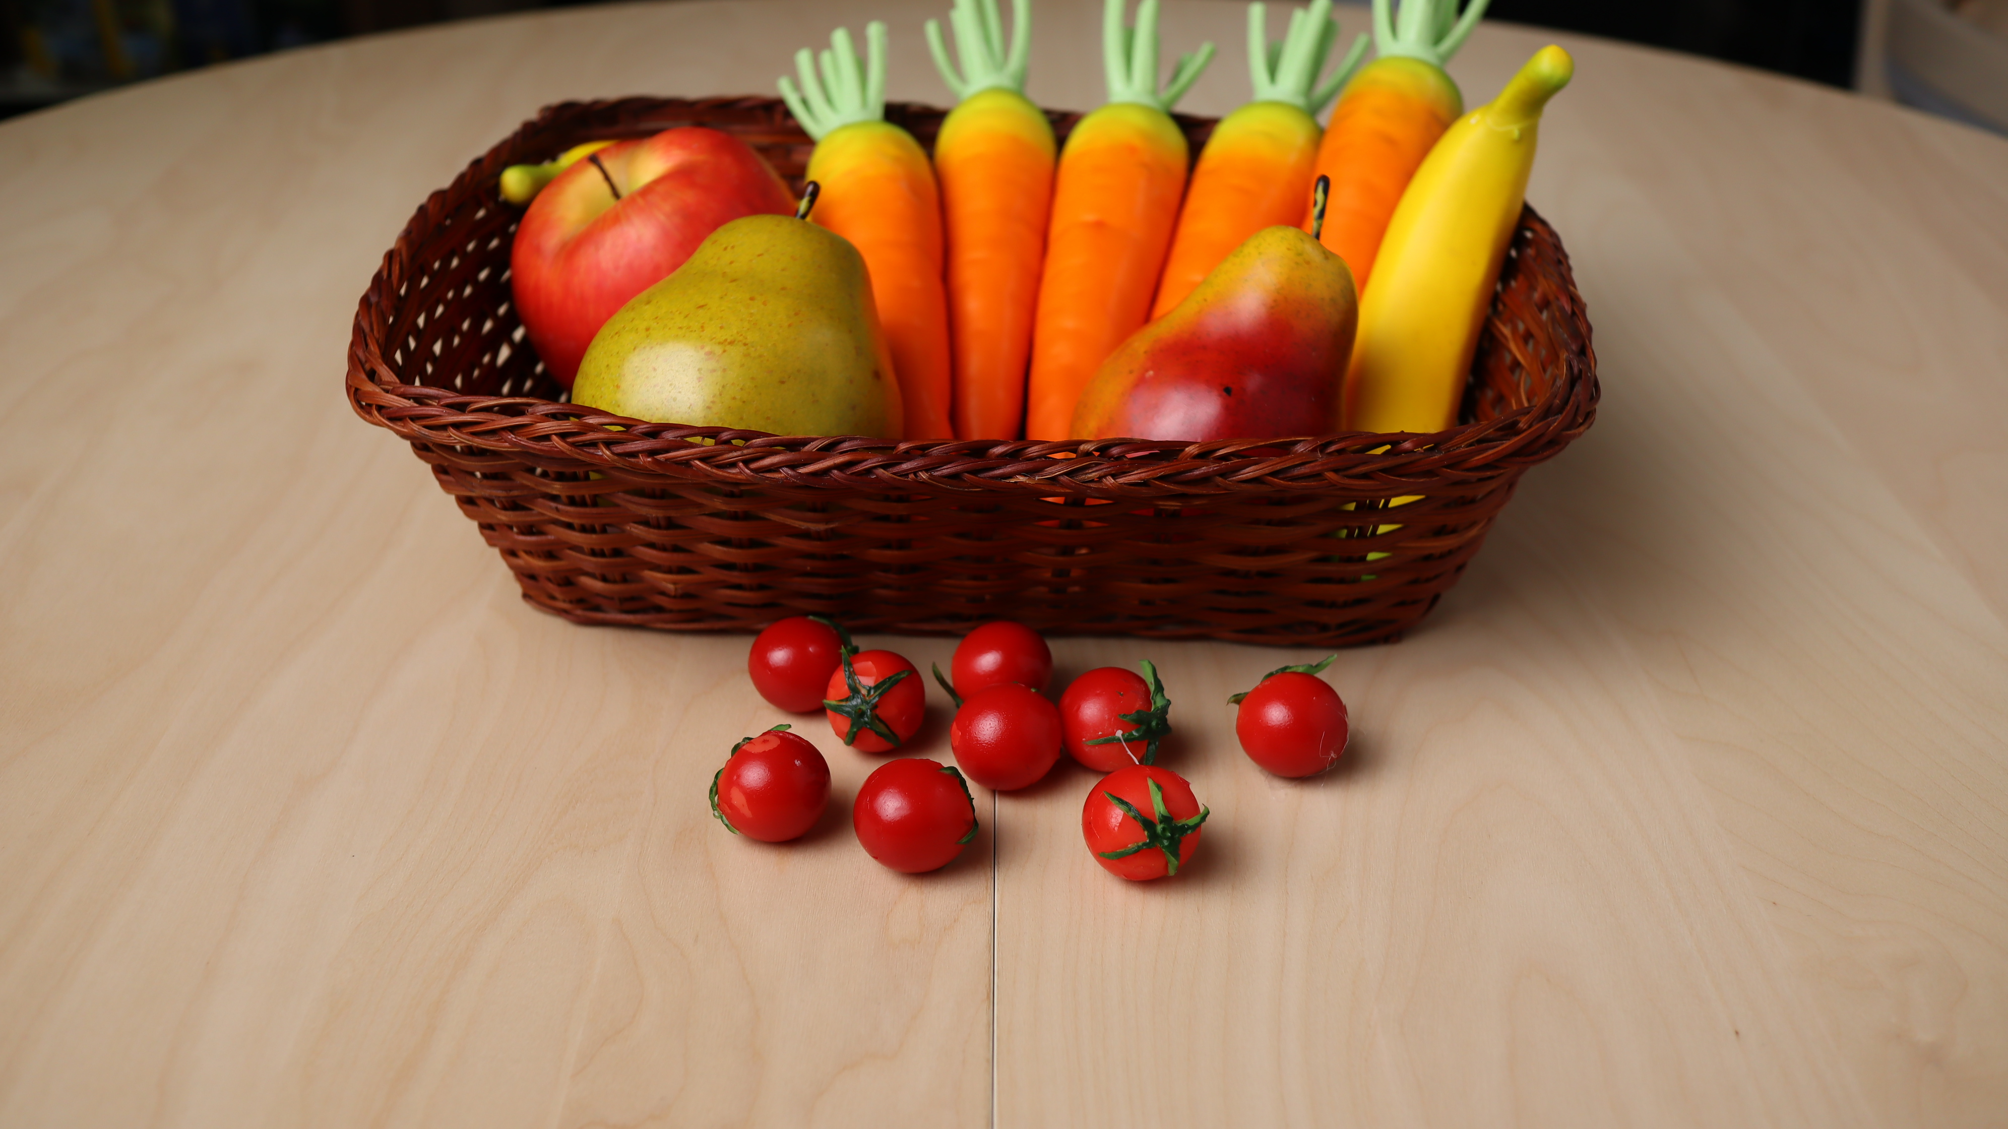

Slide 18
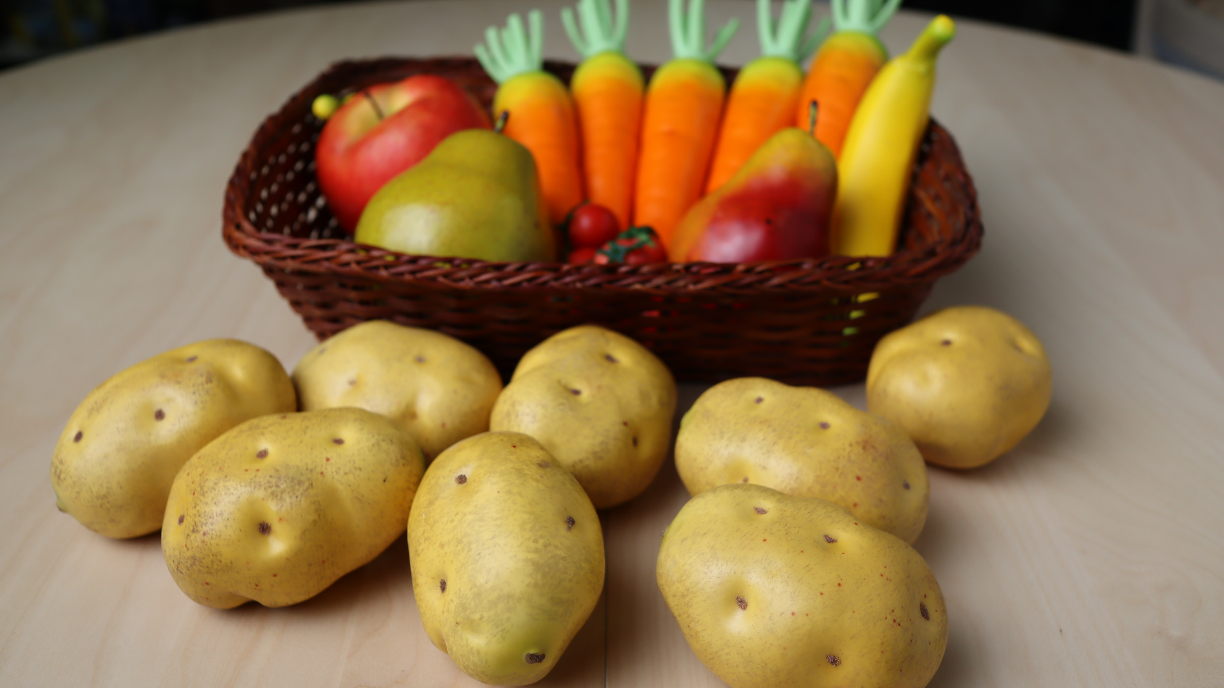

Slide 19
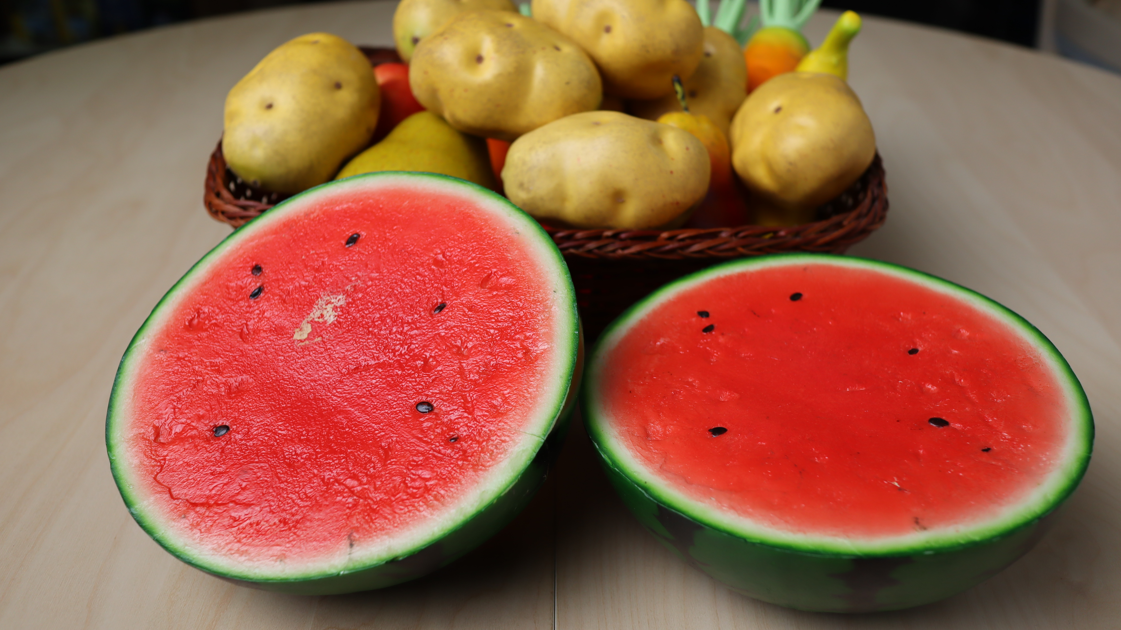

Slide 20
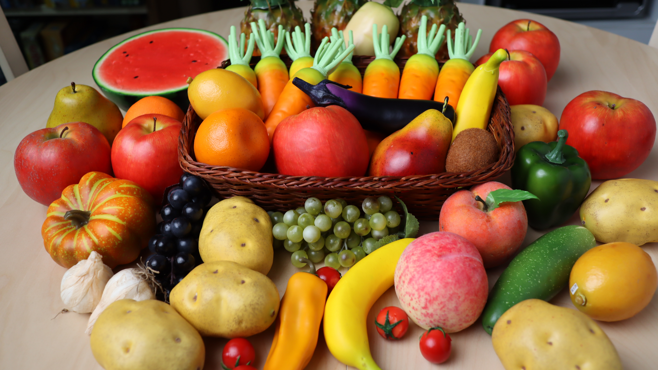

Slide 21
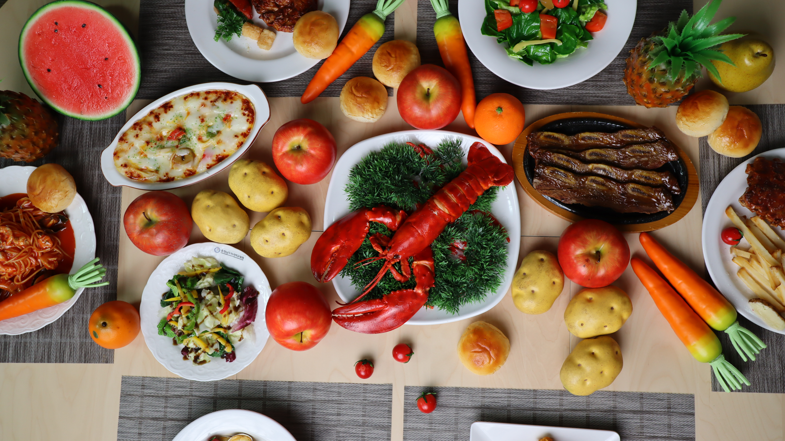

Slide 22
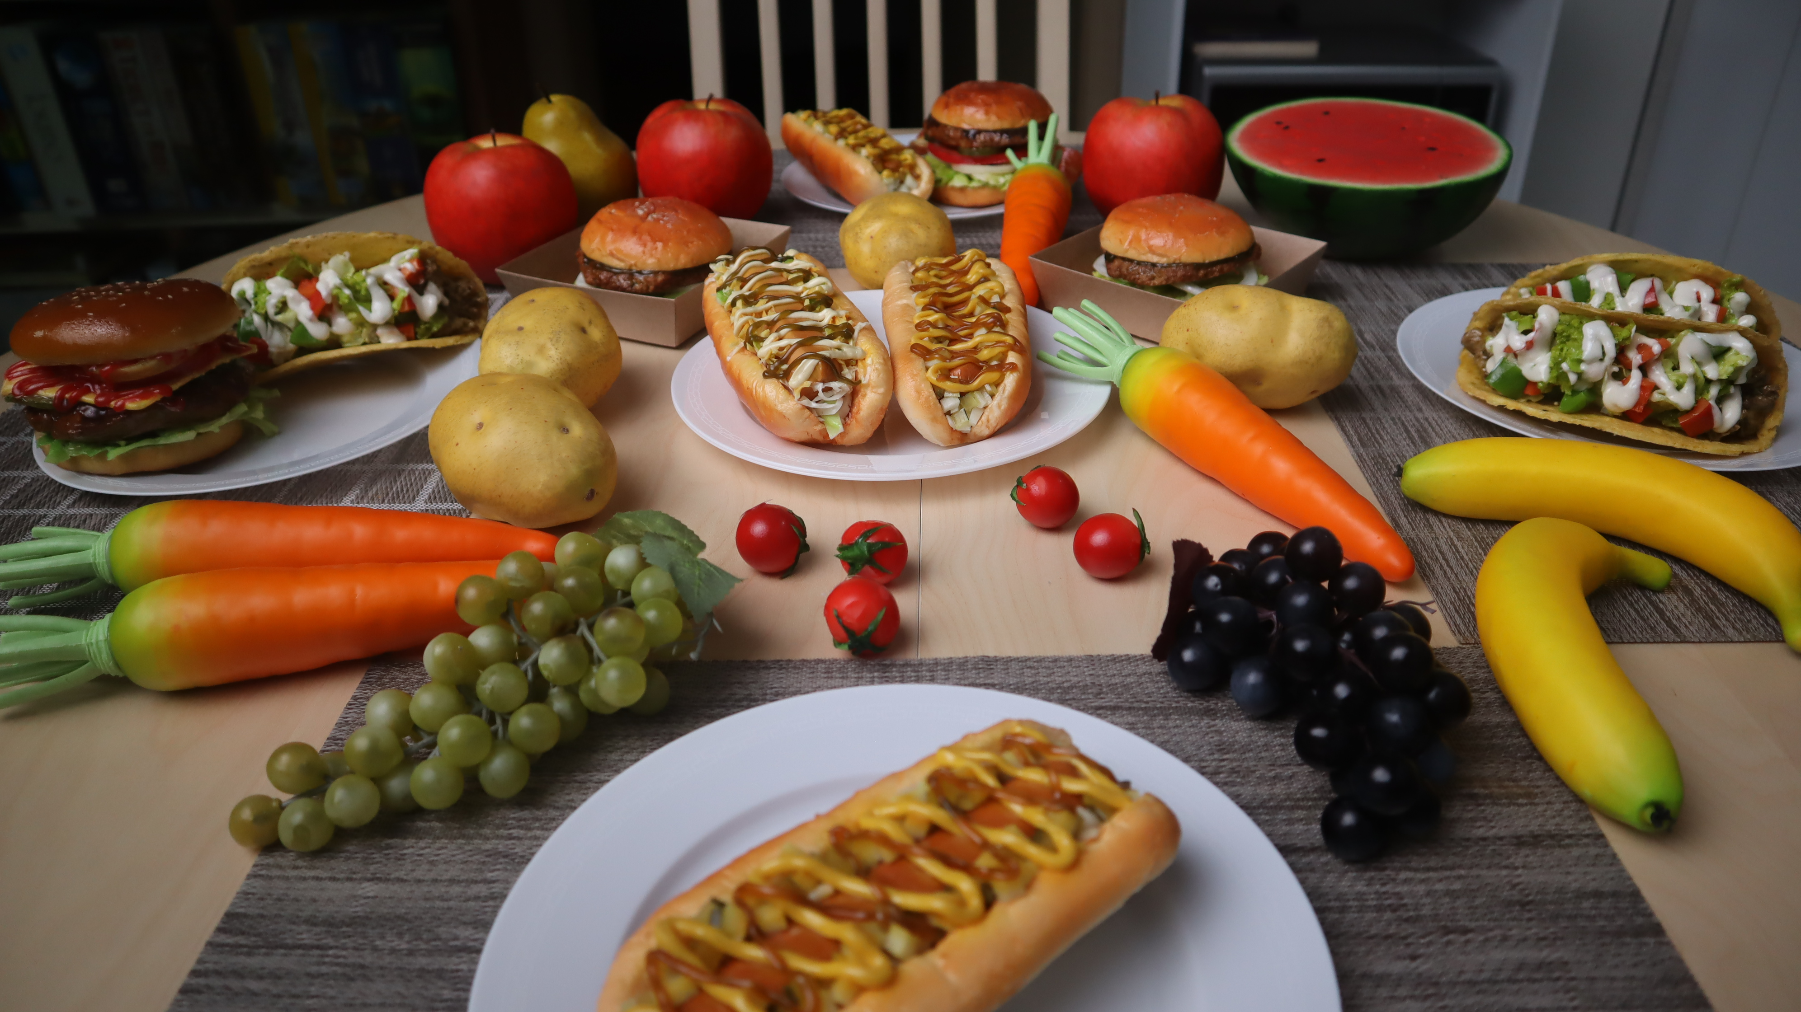

Slide 23
