Slide 1


TIM
TIMOTHY JACK SCHILSTRA

Slide 2

Where am I from?

Slide 3
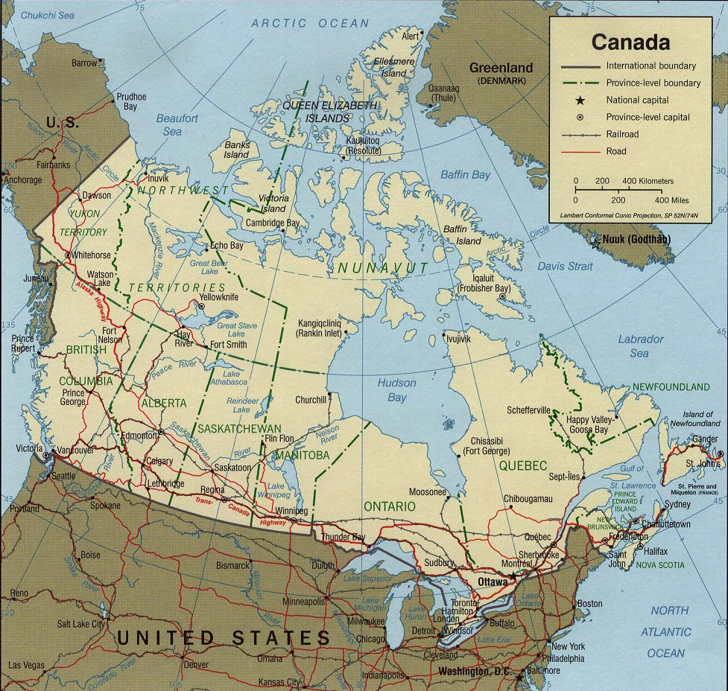
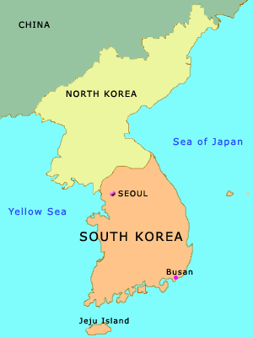

Slide 4
How many are there in my family?

Slide 5
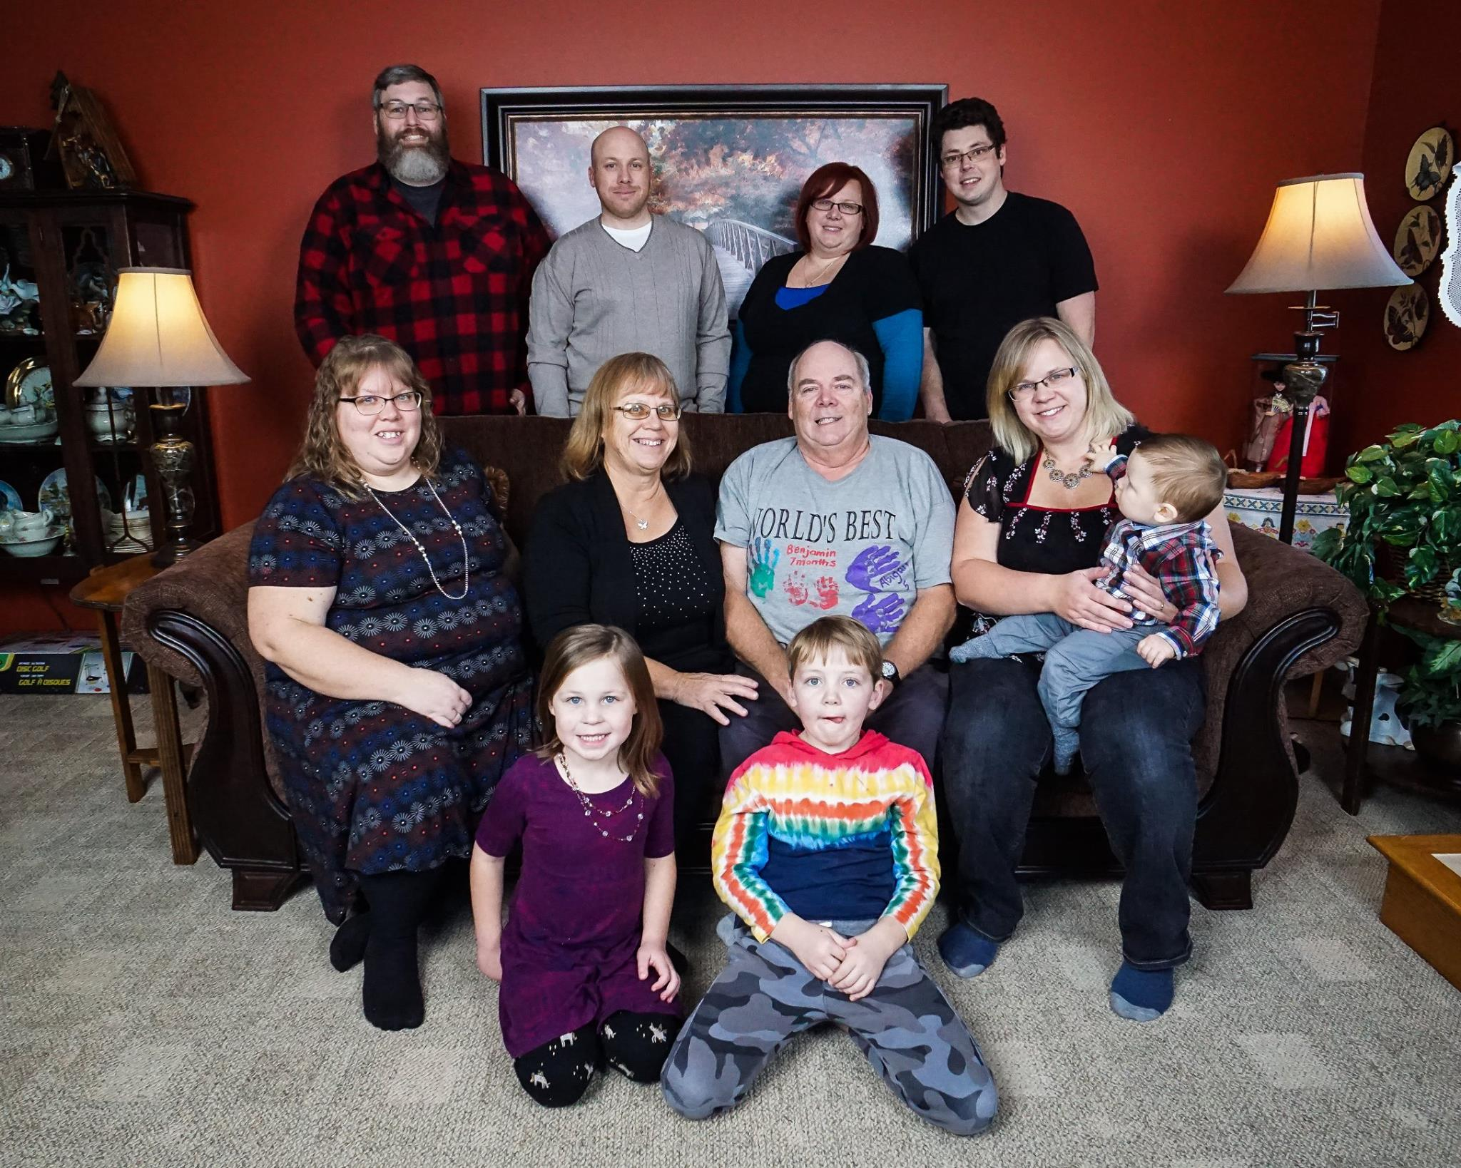
My Family

Slide 6
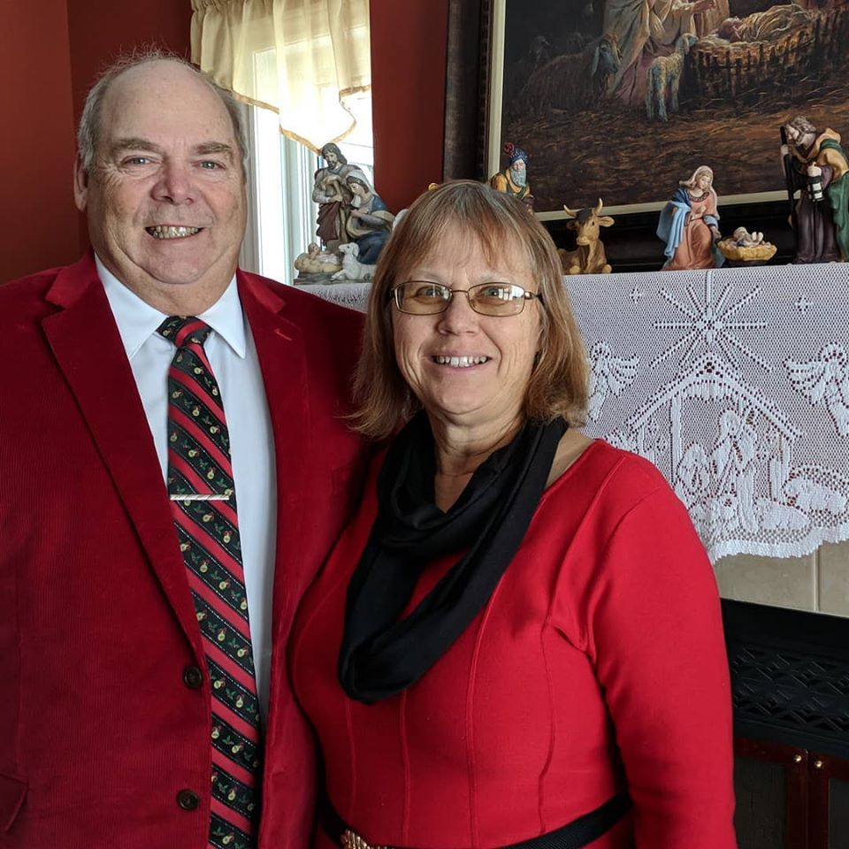
Nelly and Harold

Slide 7
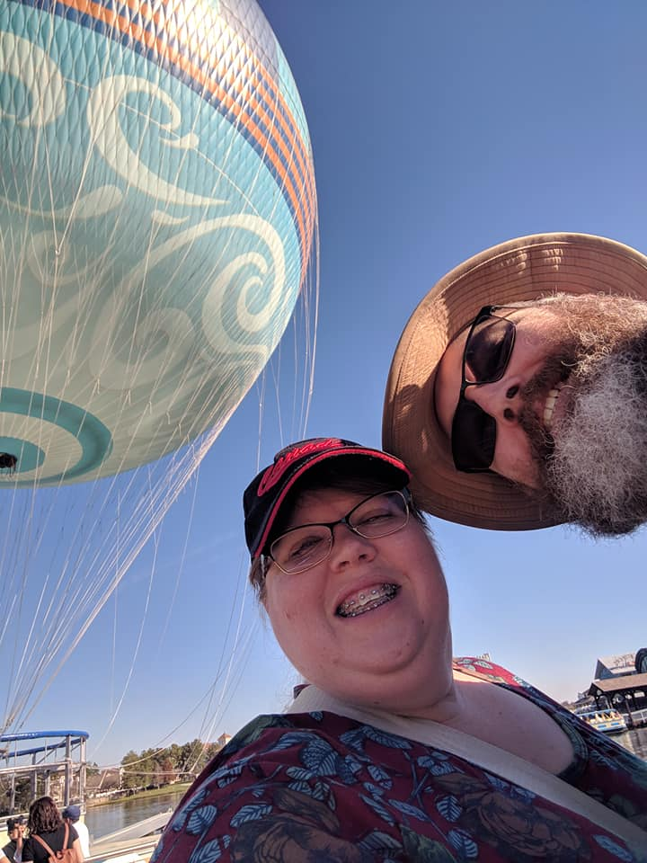
Debbie and Dave

Slide 8
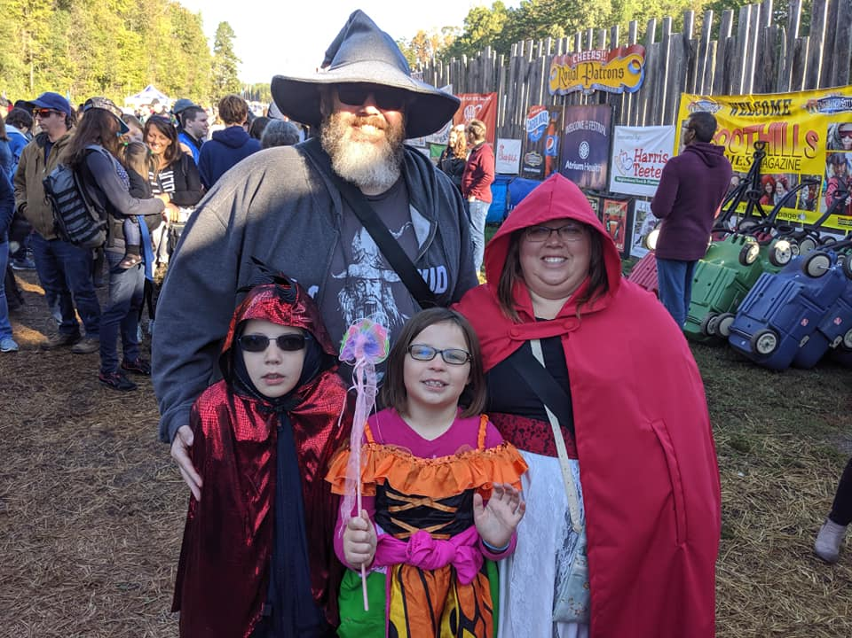
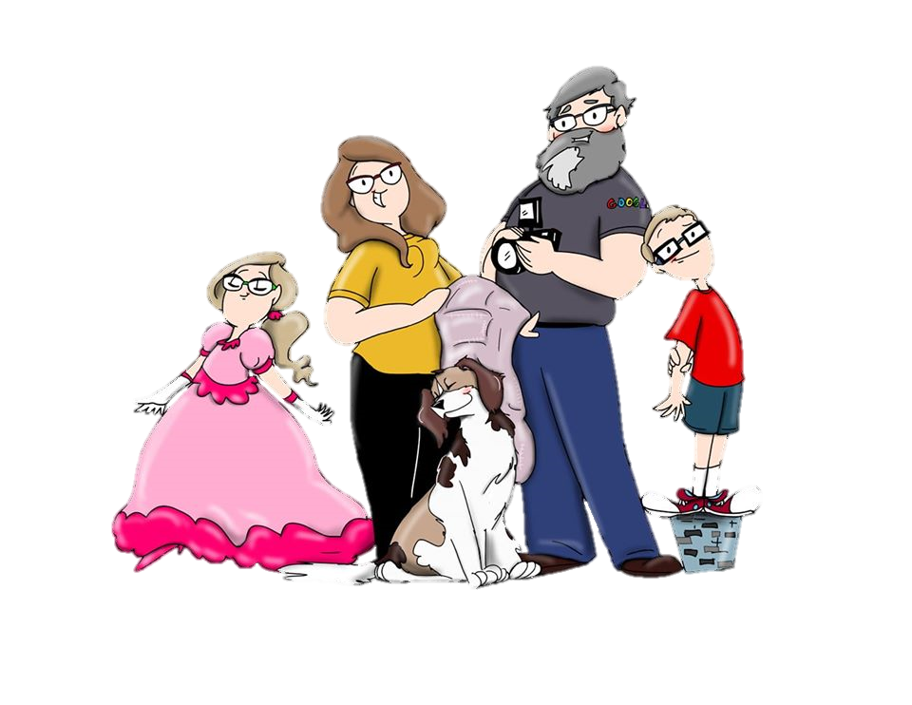
Zeke and Abigail

Slide 9

Amanda

Slide 10
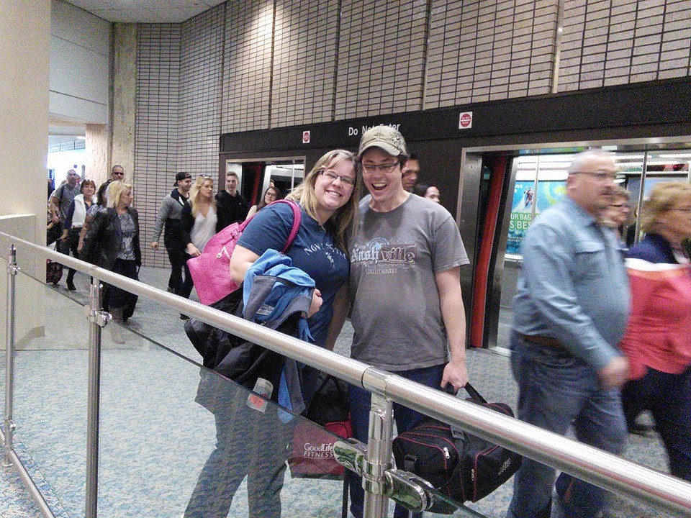
Melissa and Bob

Slide 11
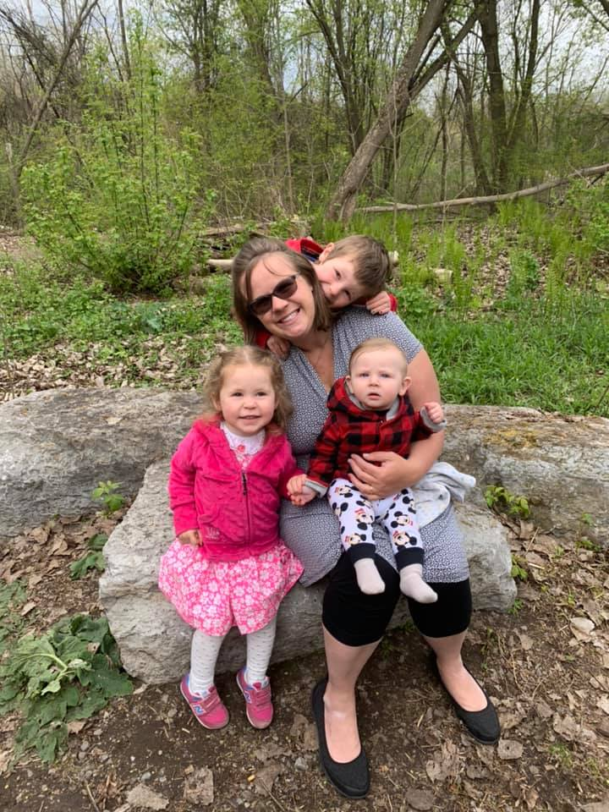
Benjamin
Lydia
Harold

Slide 12
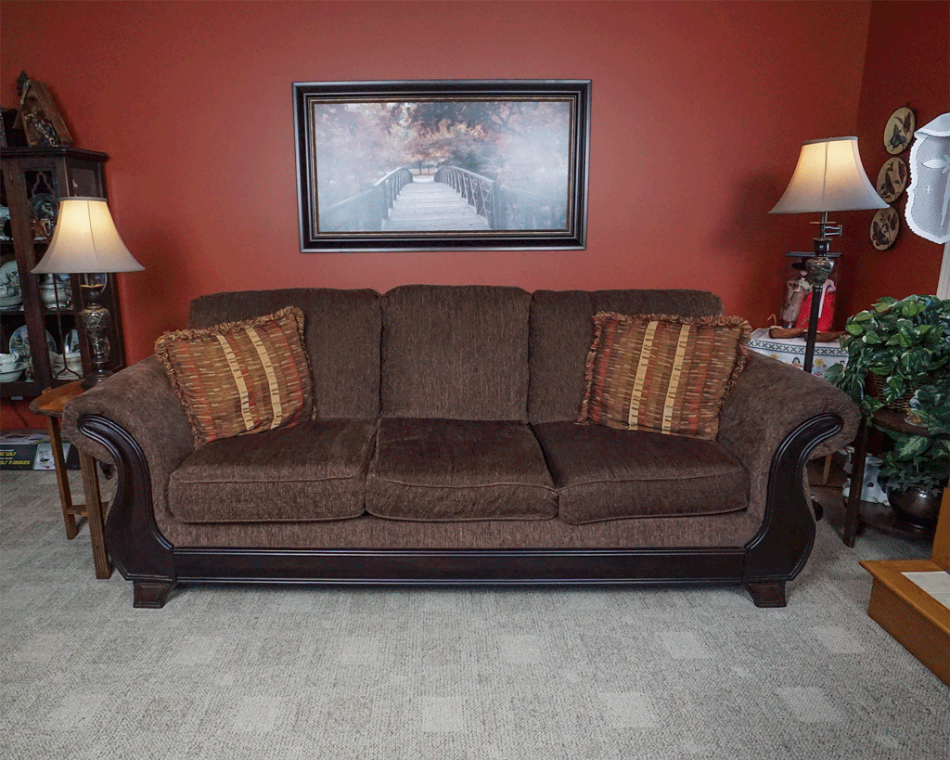

Slide 13
How long have I lived in Korea?

Slide 14
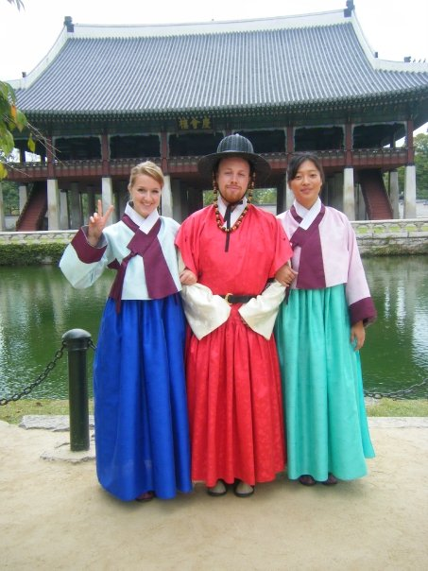
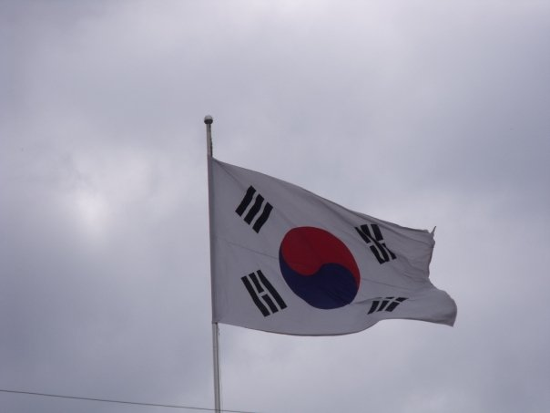
Mr.S in Korea
2009

Slide 15

Yuseong Bio-Science and Technology High School

Slide 16
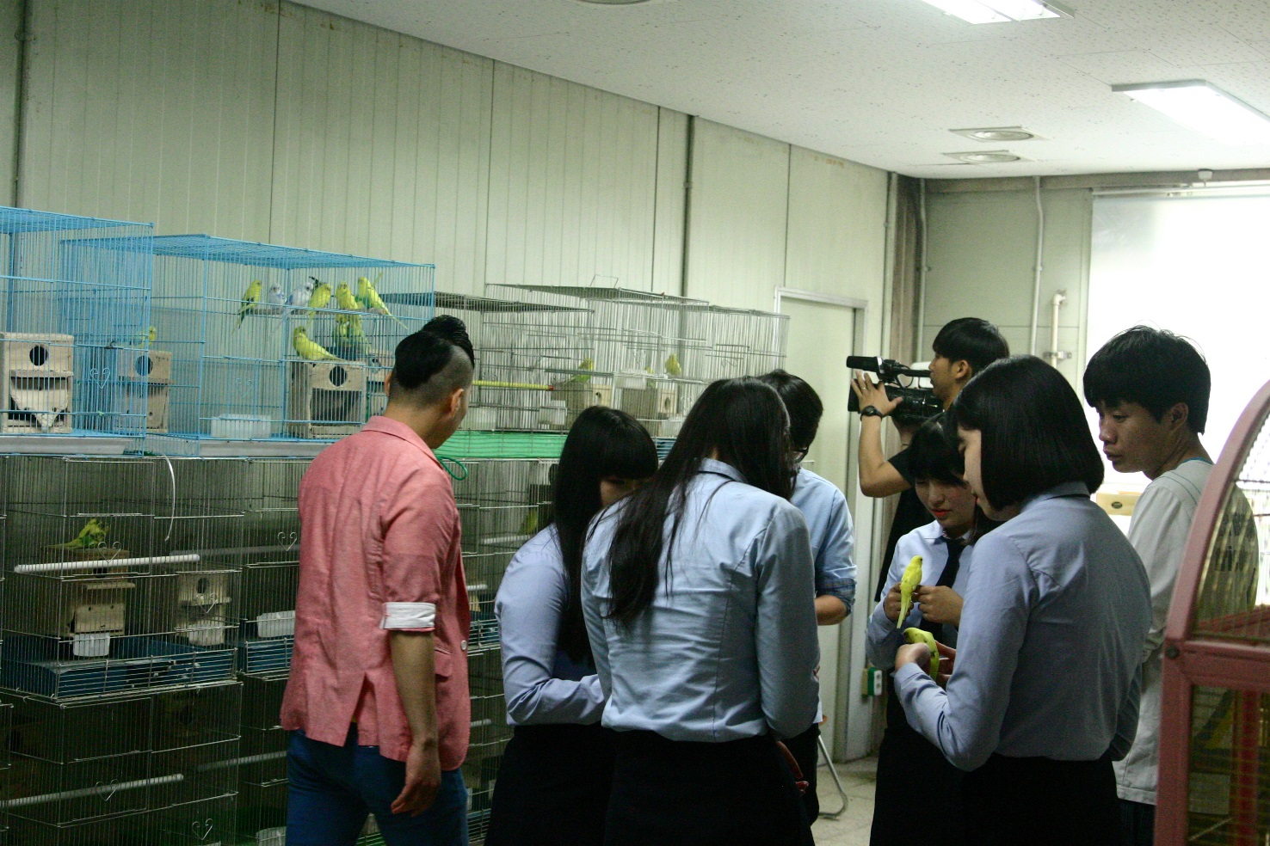
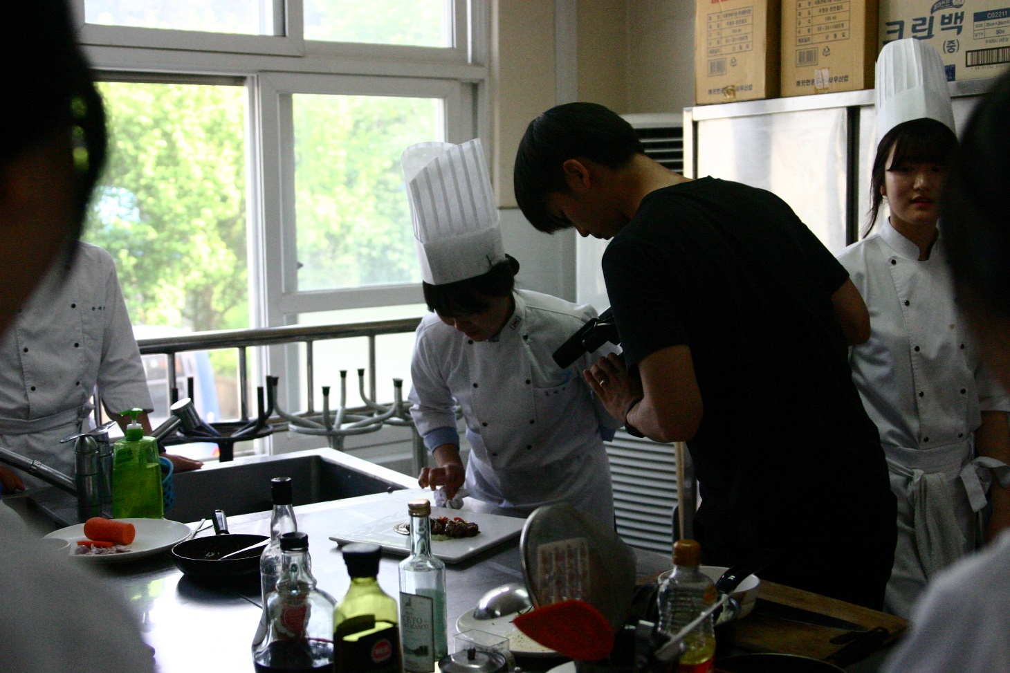
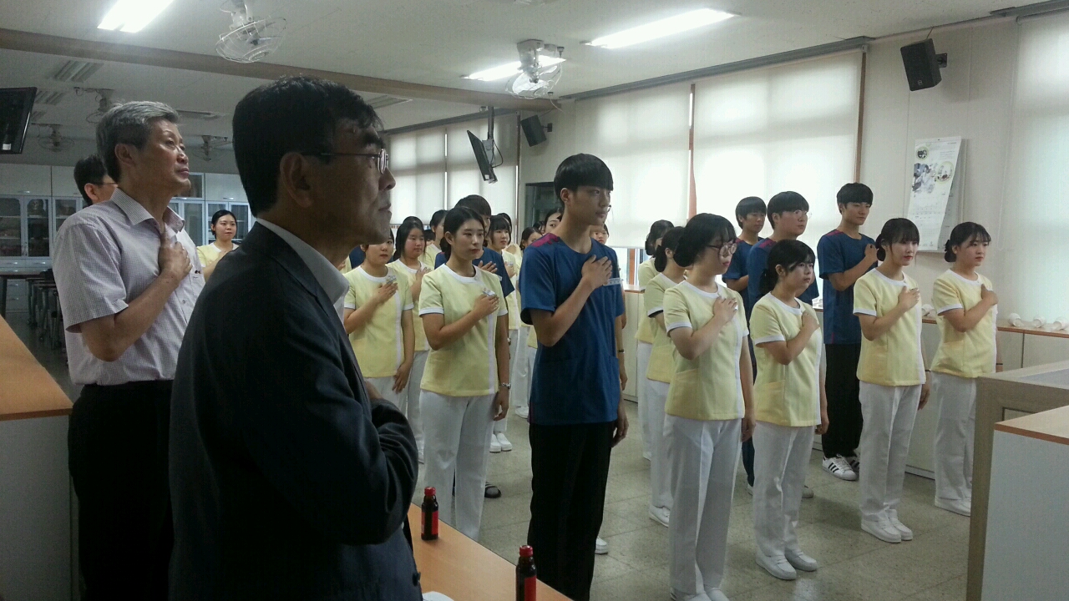
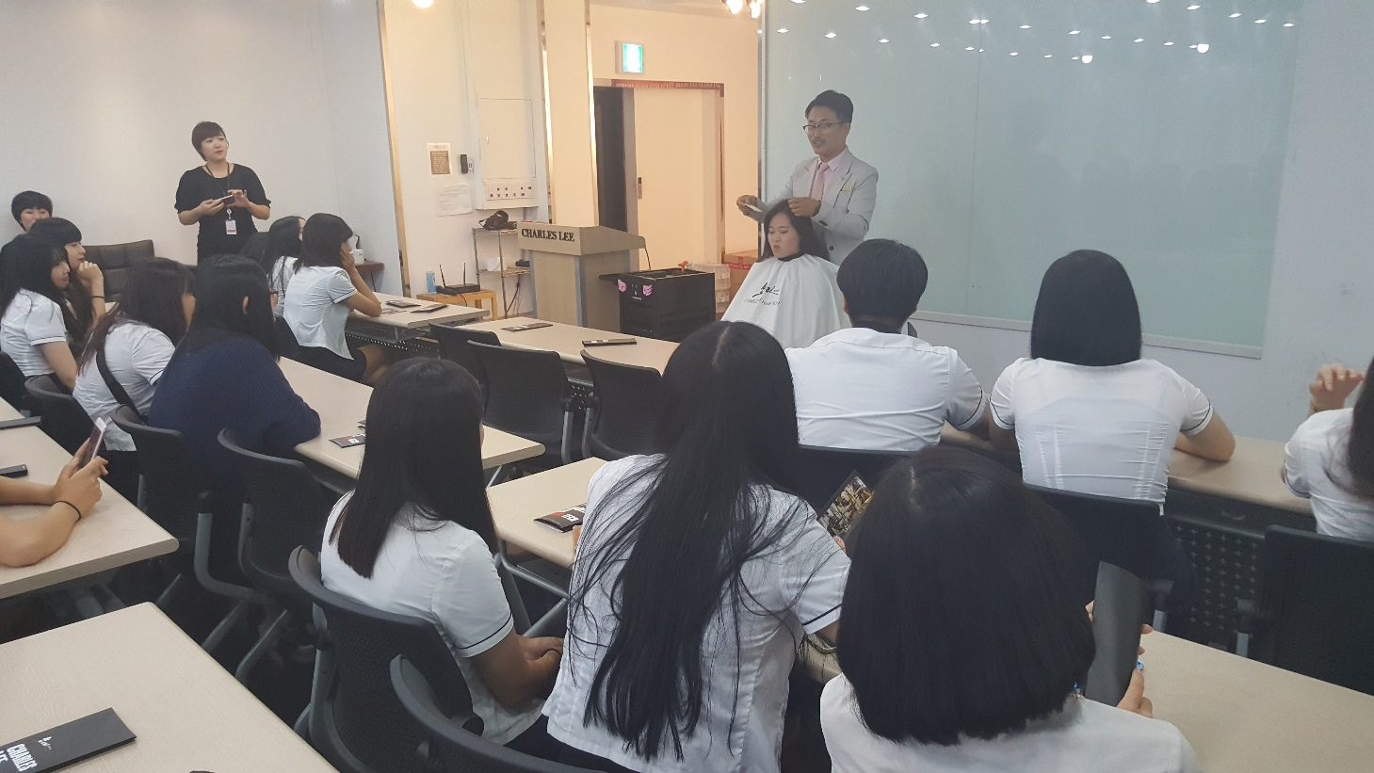

Slide 17
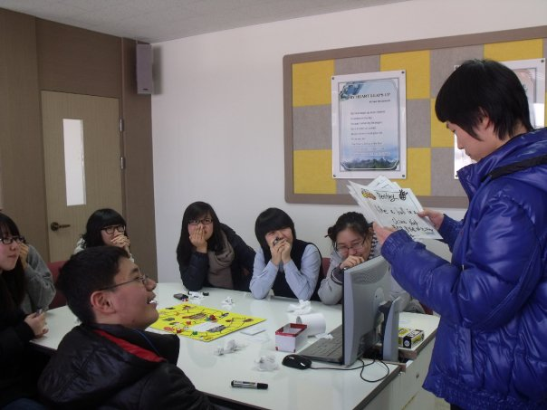
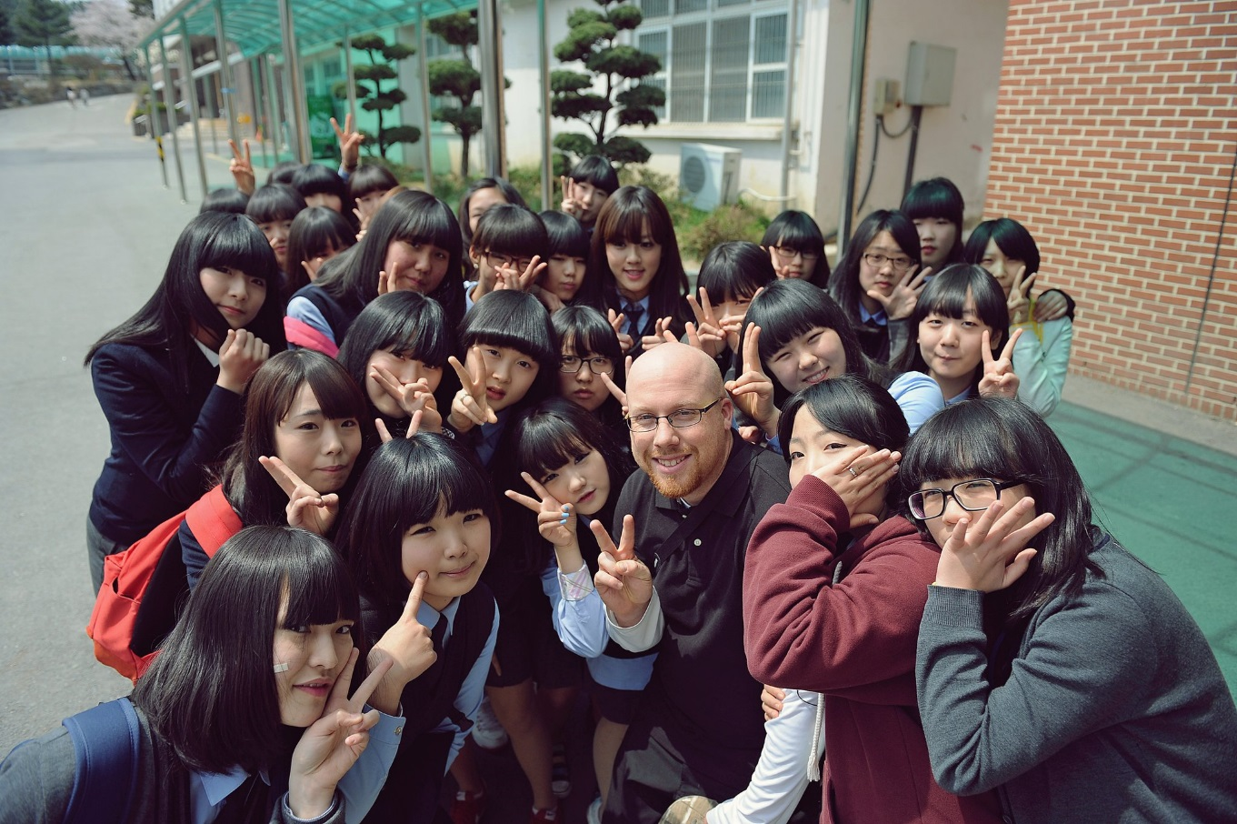

Slide 18

Eoeun Elementary School

Slide 19
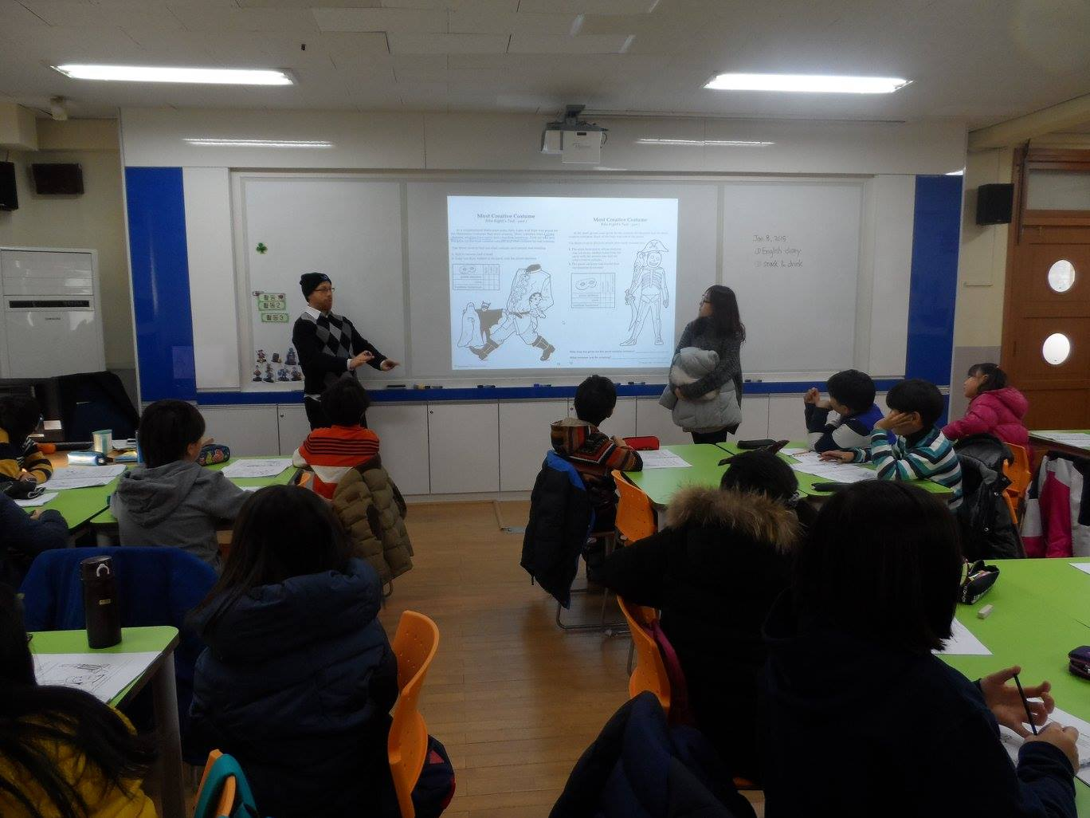
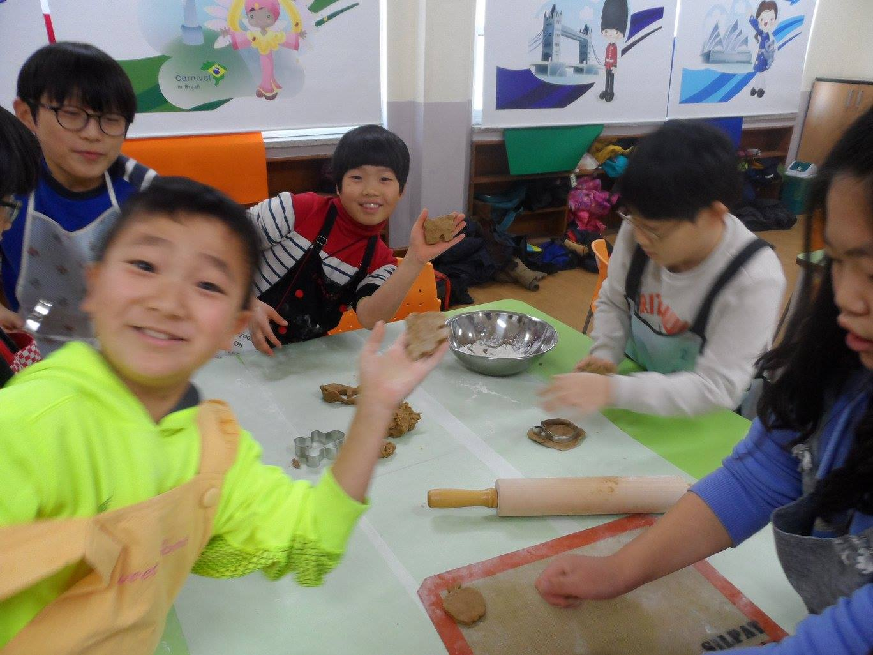

Slide 20

Shinhan High School

Slide 21
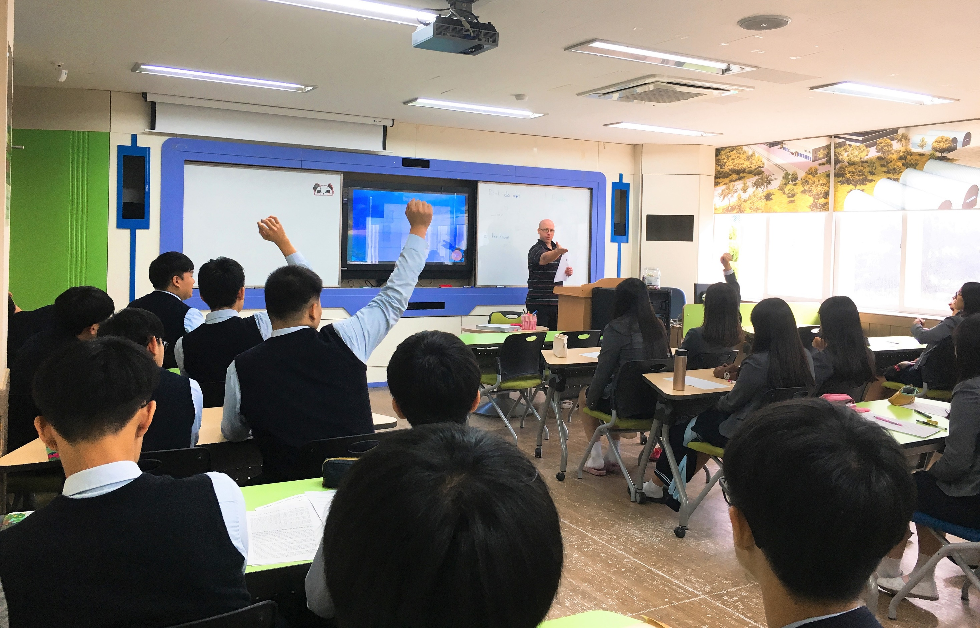
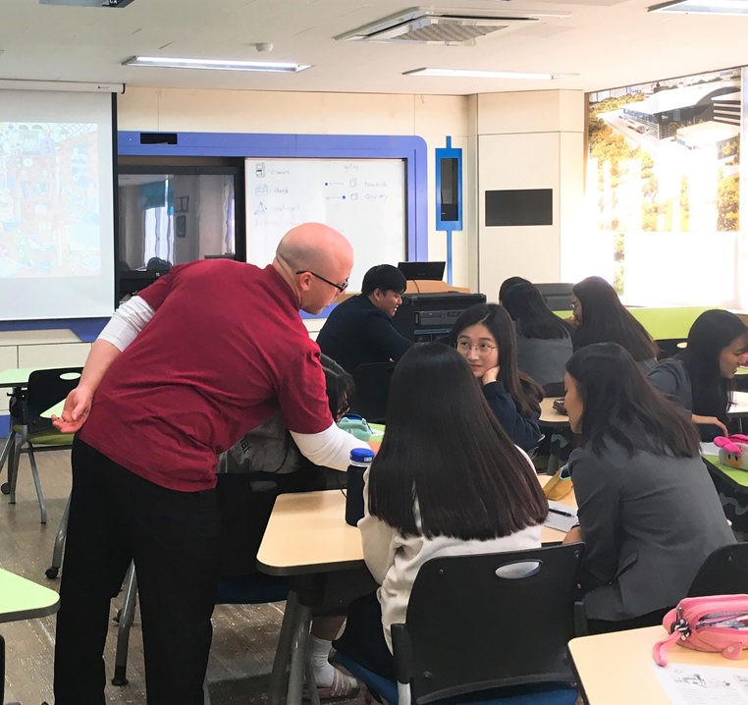

Slide 22
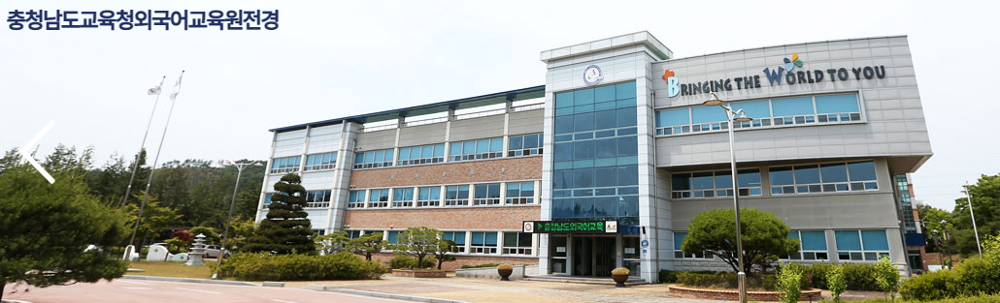
COEILI

Slide 23
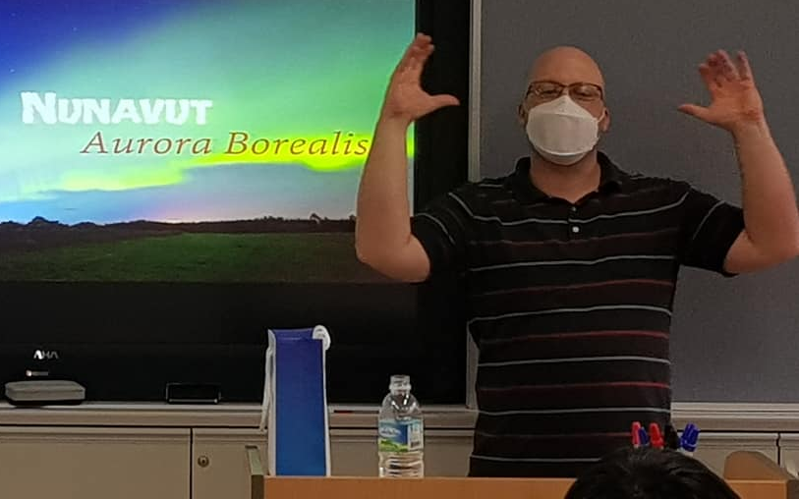
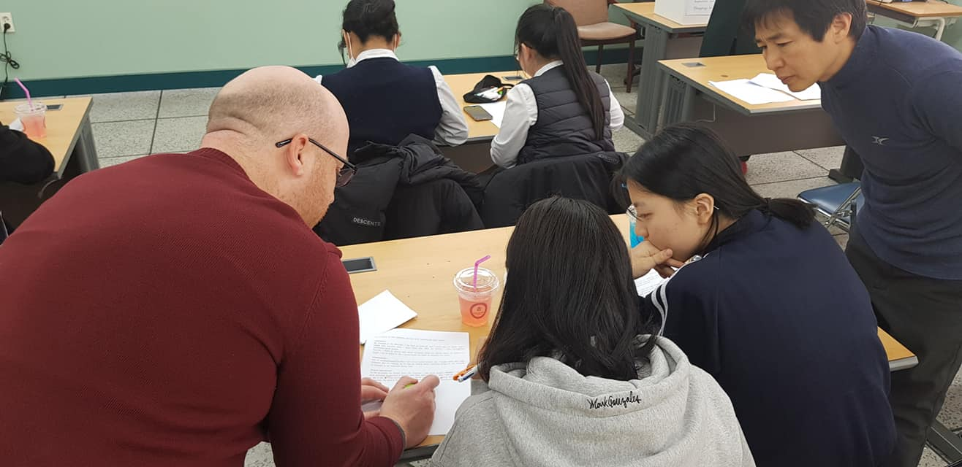
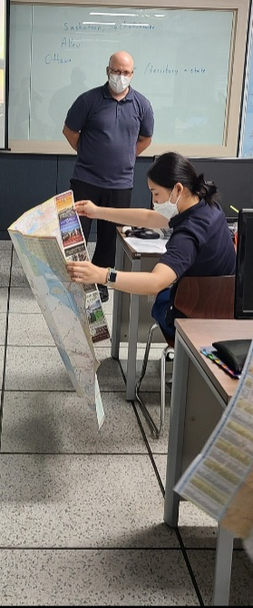
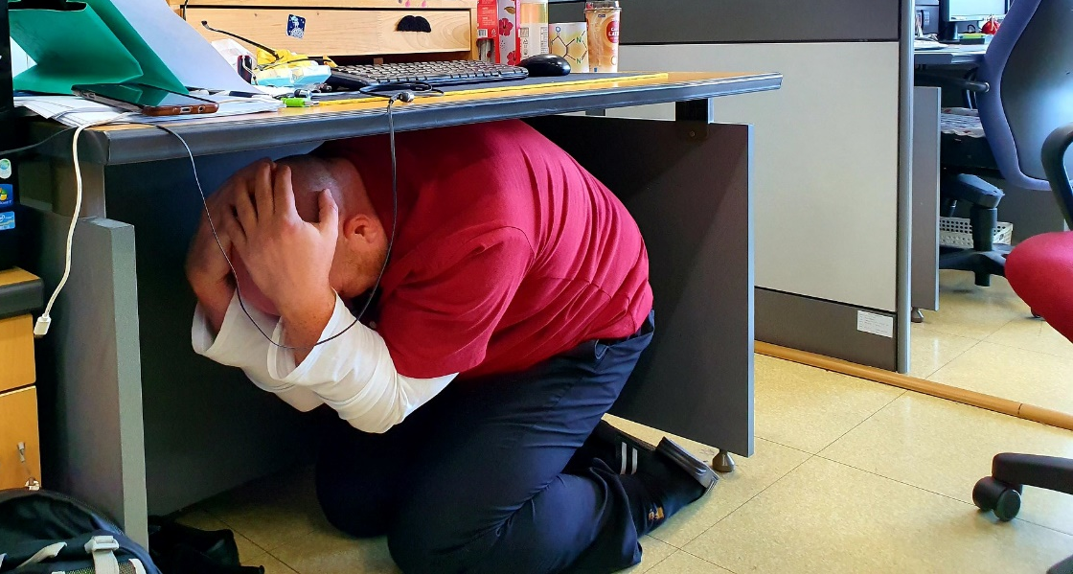
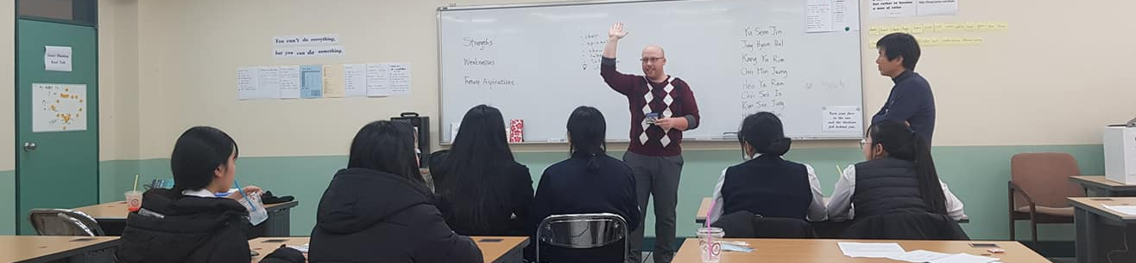

Slide 24
What kind of student I like?

Slide 25


Slide 26
What was my major?

Slide 27
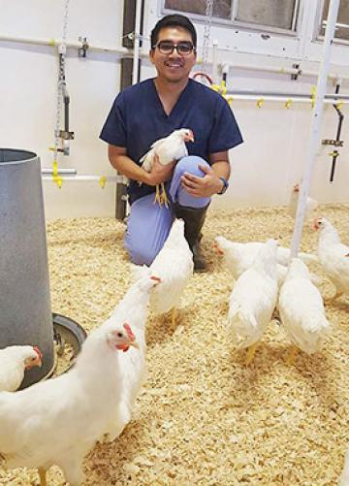


Slide 28
What was I like as a high school student?

Slide 29


Slide 30
What was my first job?

Slide 31
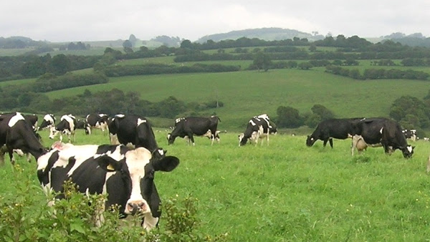
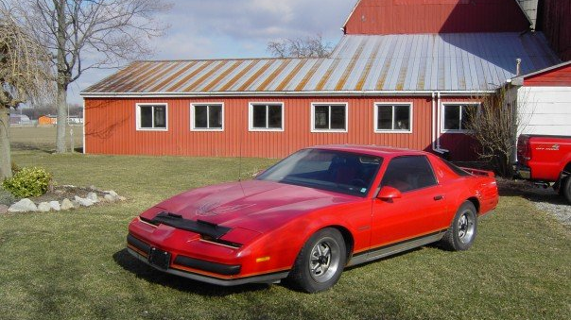
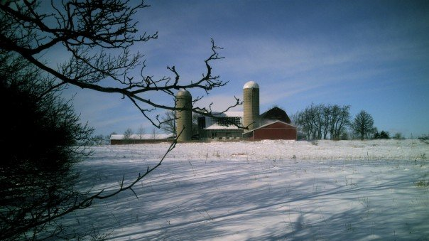

Slide 32
What is my favorite
Korean Food?

Slide 33
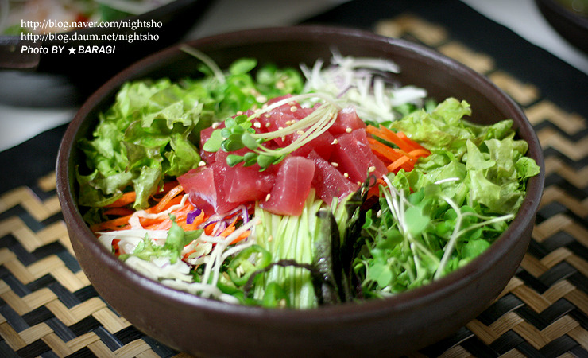
What is my favorite Korean Food?

Slide 34
What are my hobbies?

Slide 35
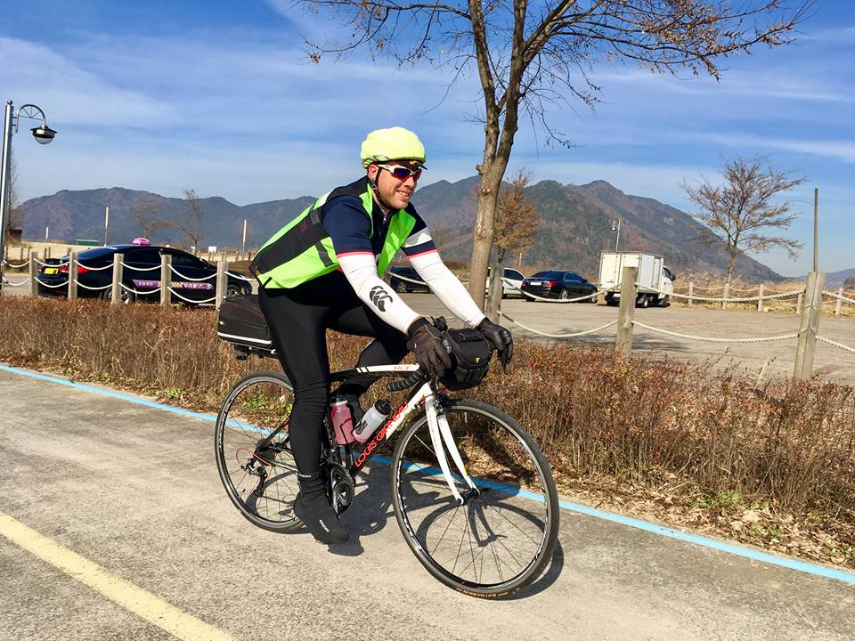

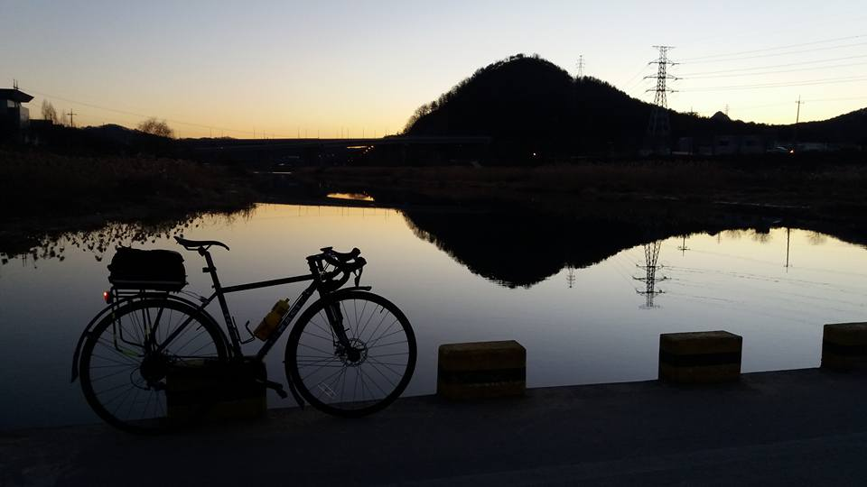

Slide 36
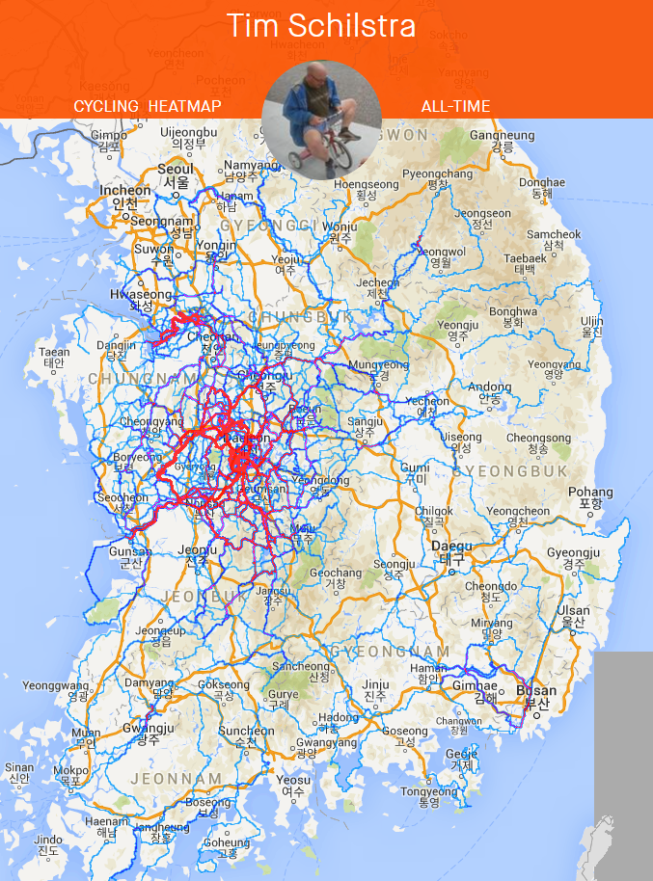

Slide 37
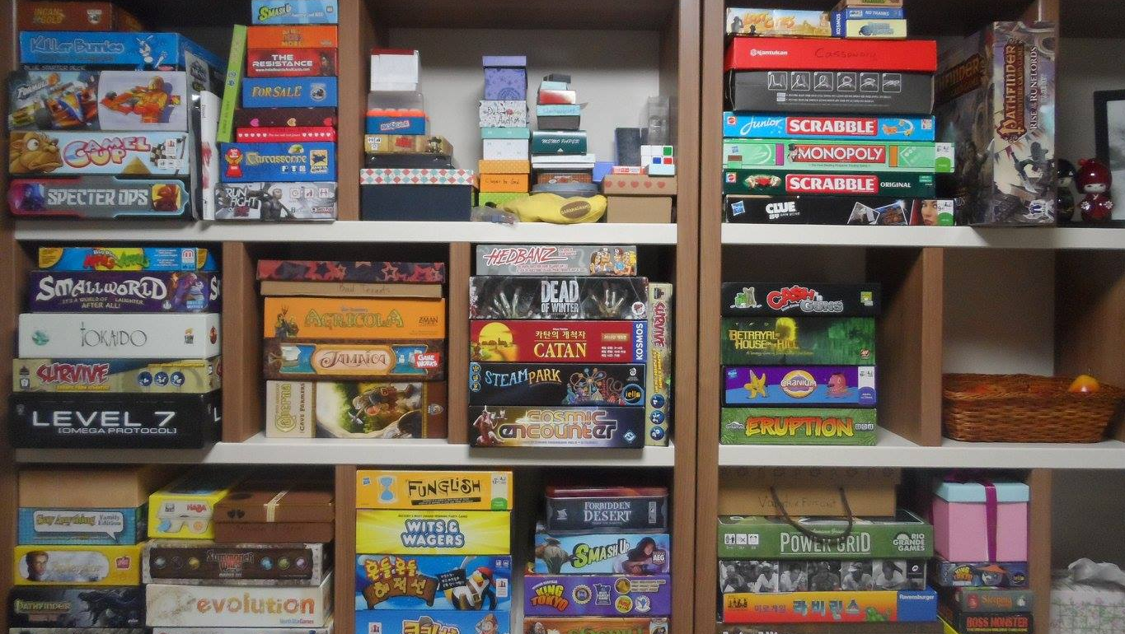

Slide 38


Slide 39
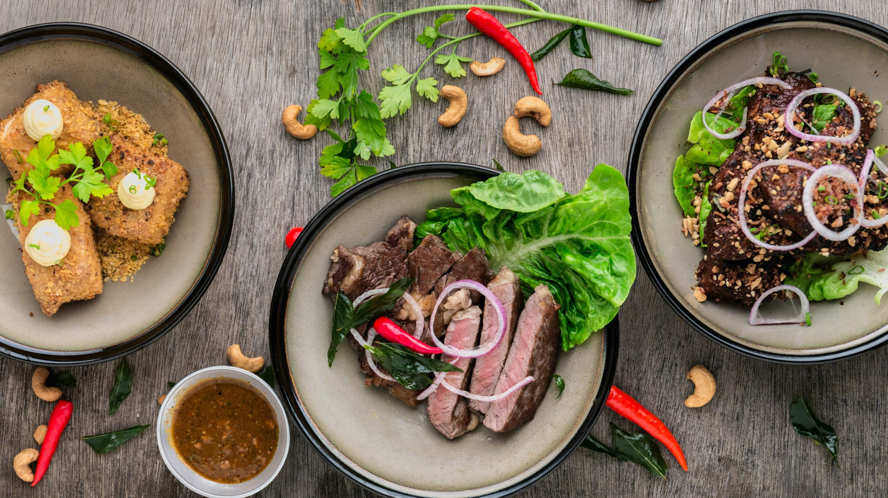

Slide 40
What is my favorite animal?

Slide 41
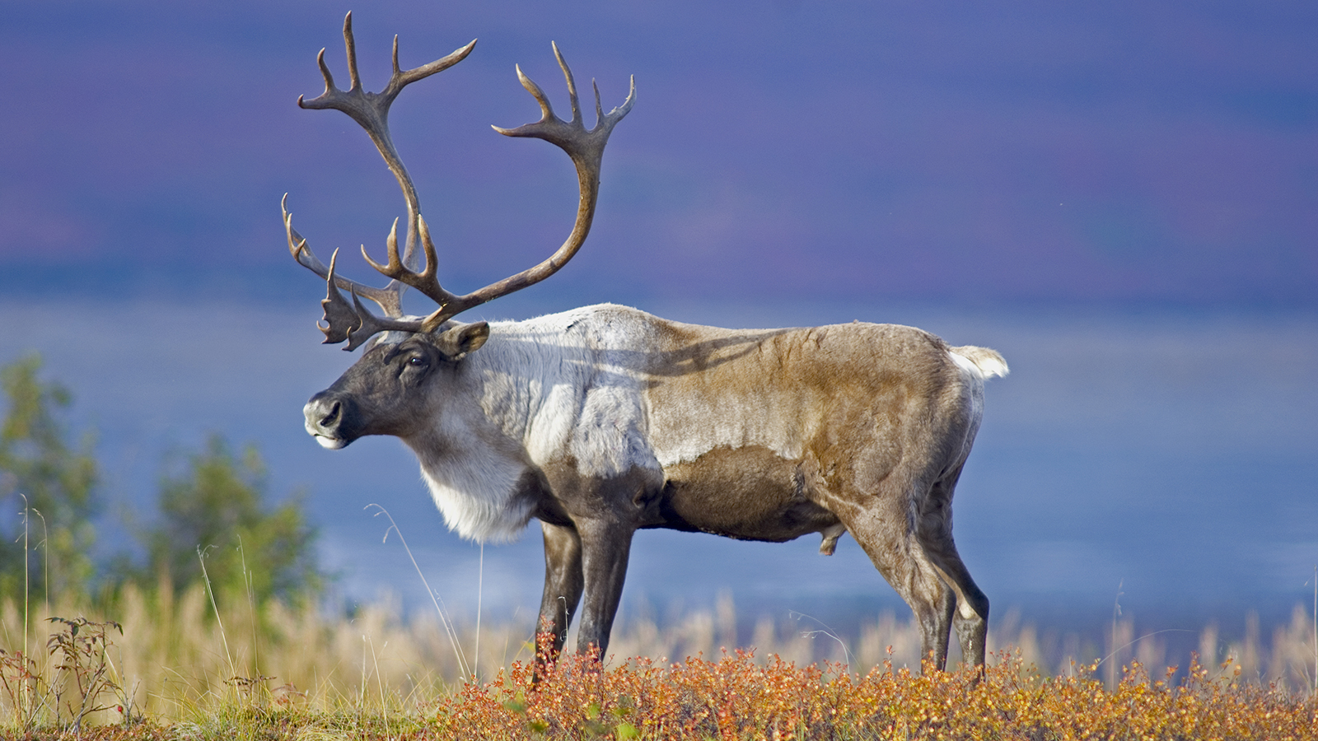
What is my favorite animal?

Slide 42
What is the strangest place I have been?

Slide 43
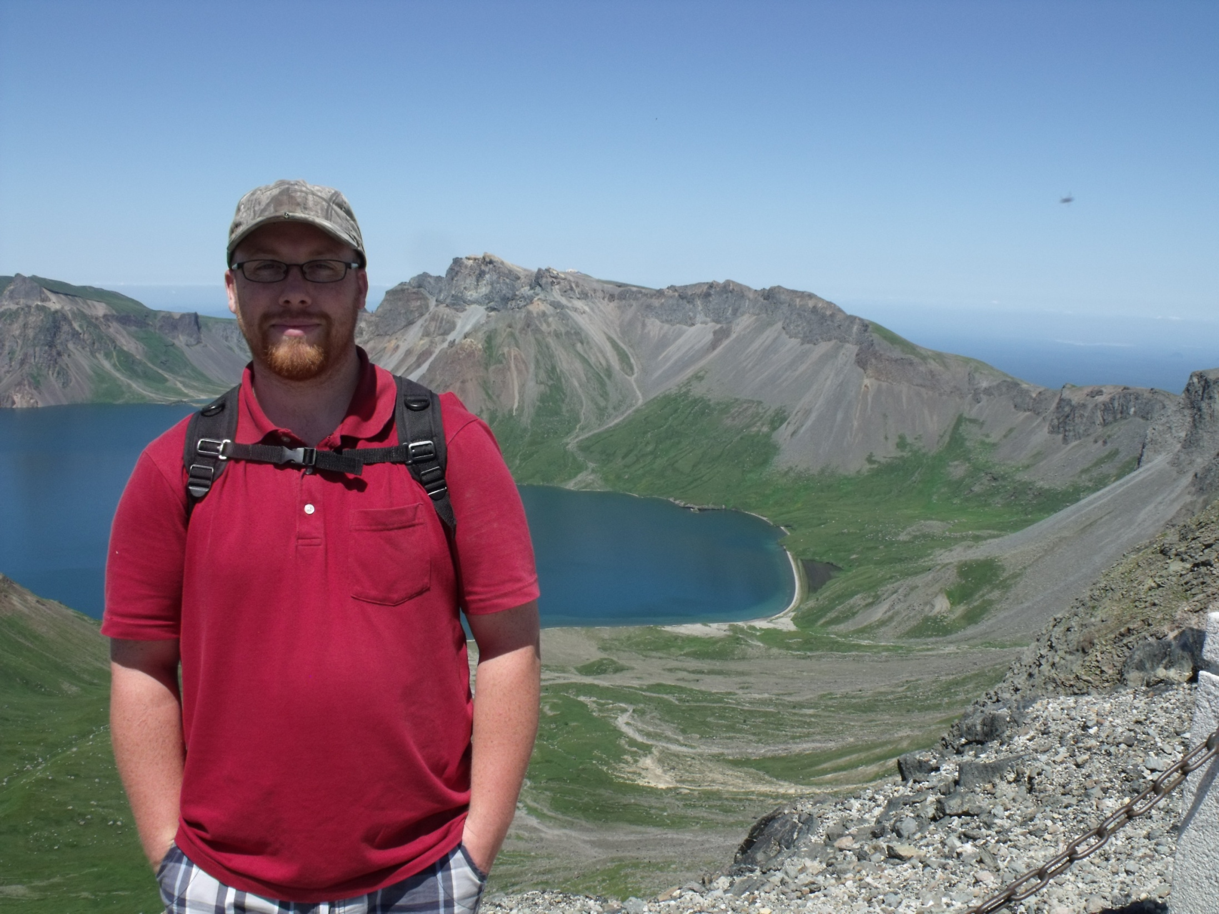

Slide 44

GOALS
SPEAKING III

Slide 45
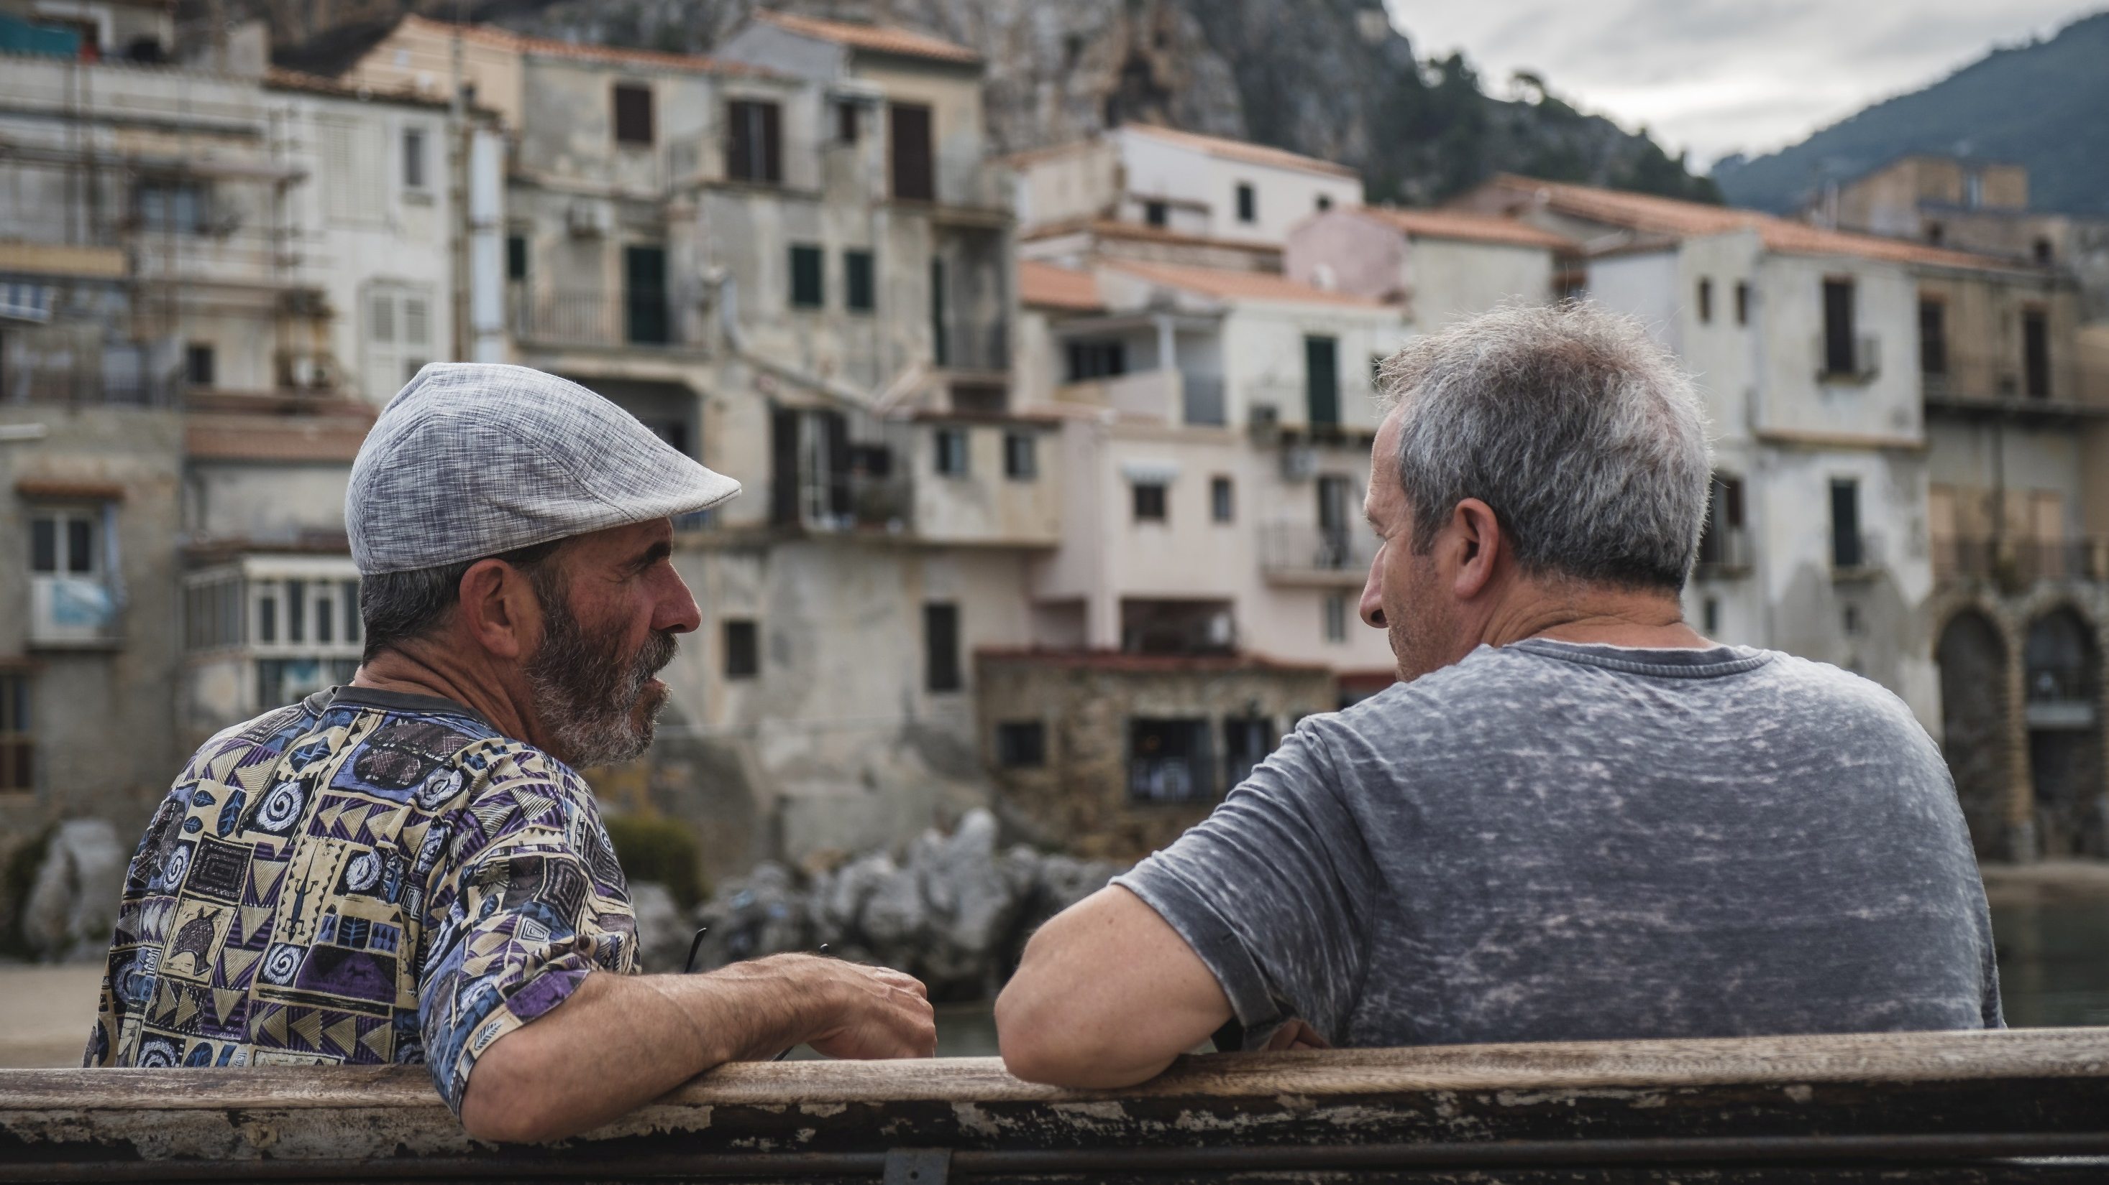
SPEAKING ACIVITIES
practice

Slide 46

SPEAKING SKILLS
Human Library

Slide 47
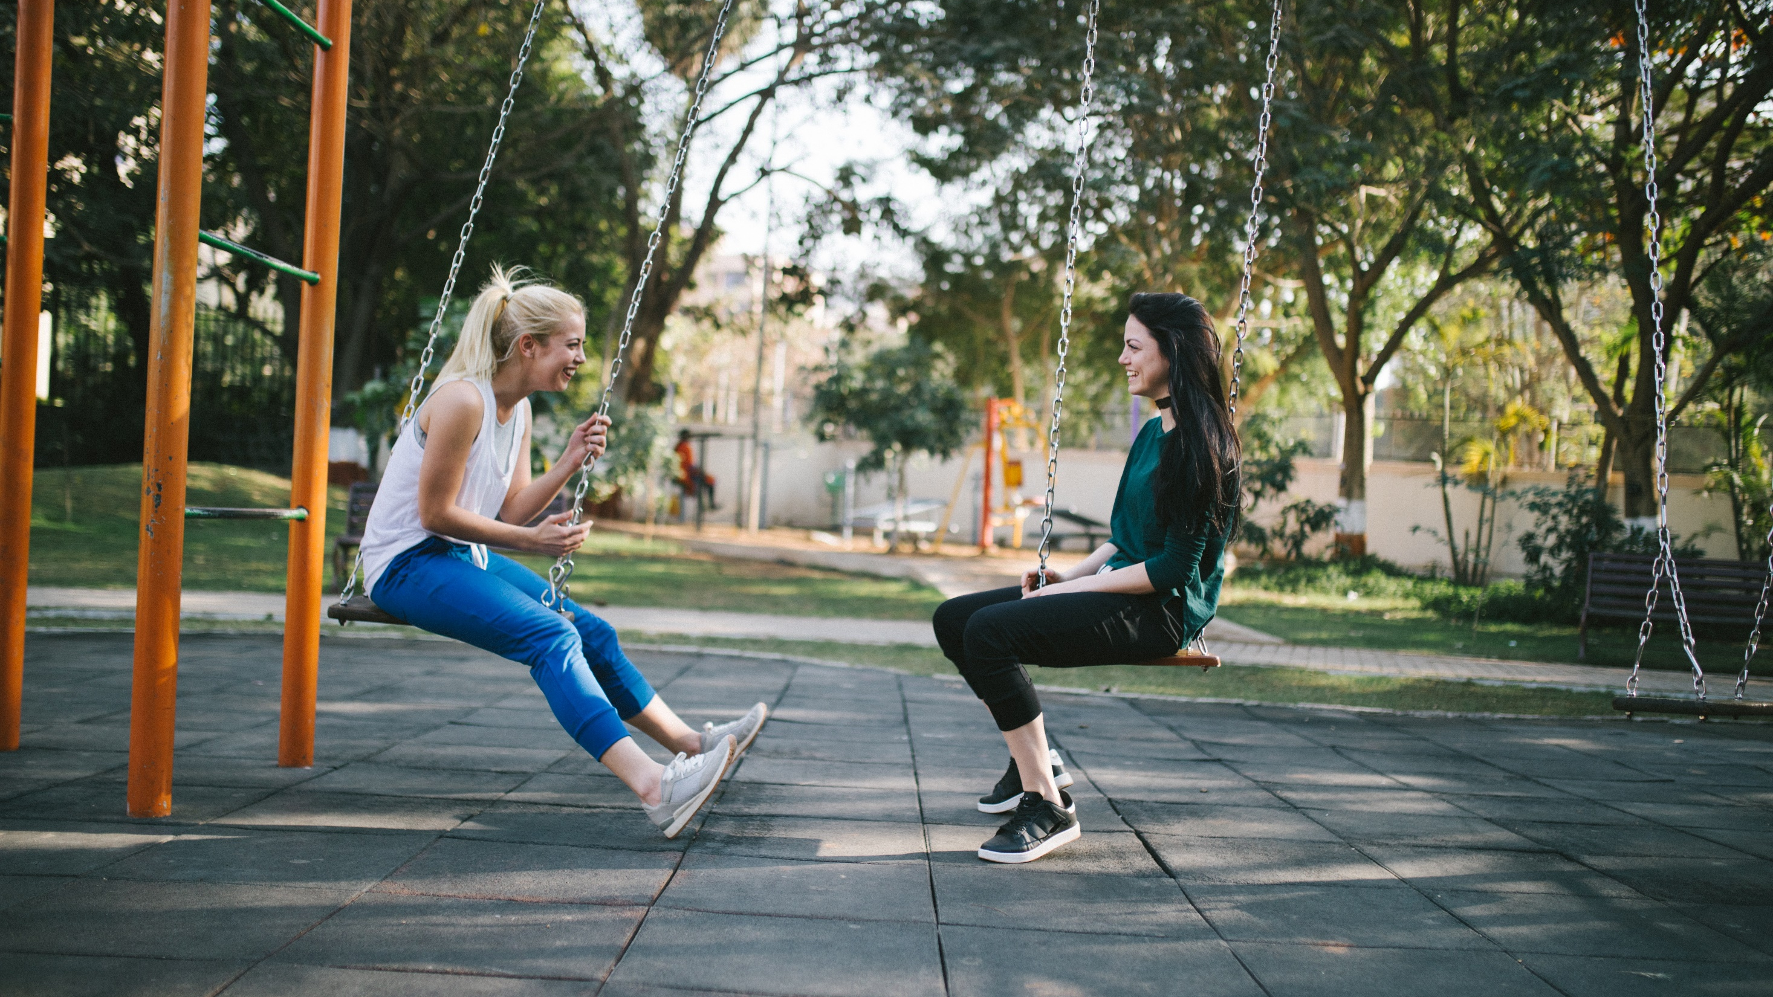
CONVERSATION
talk and games

Slide 48





ESL
ToyBox

Slide 49
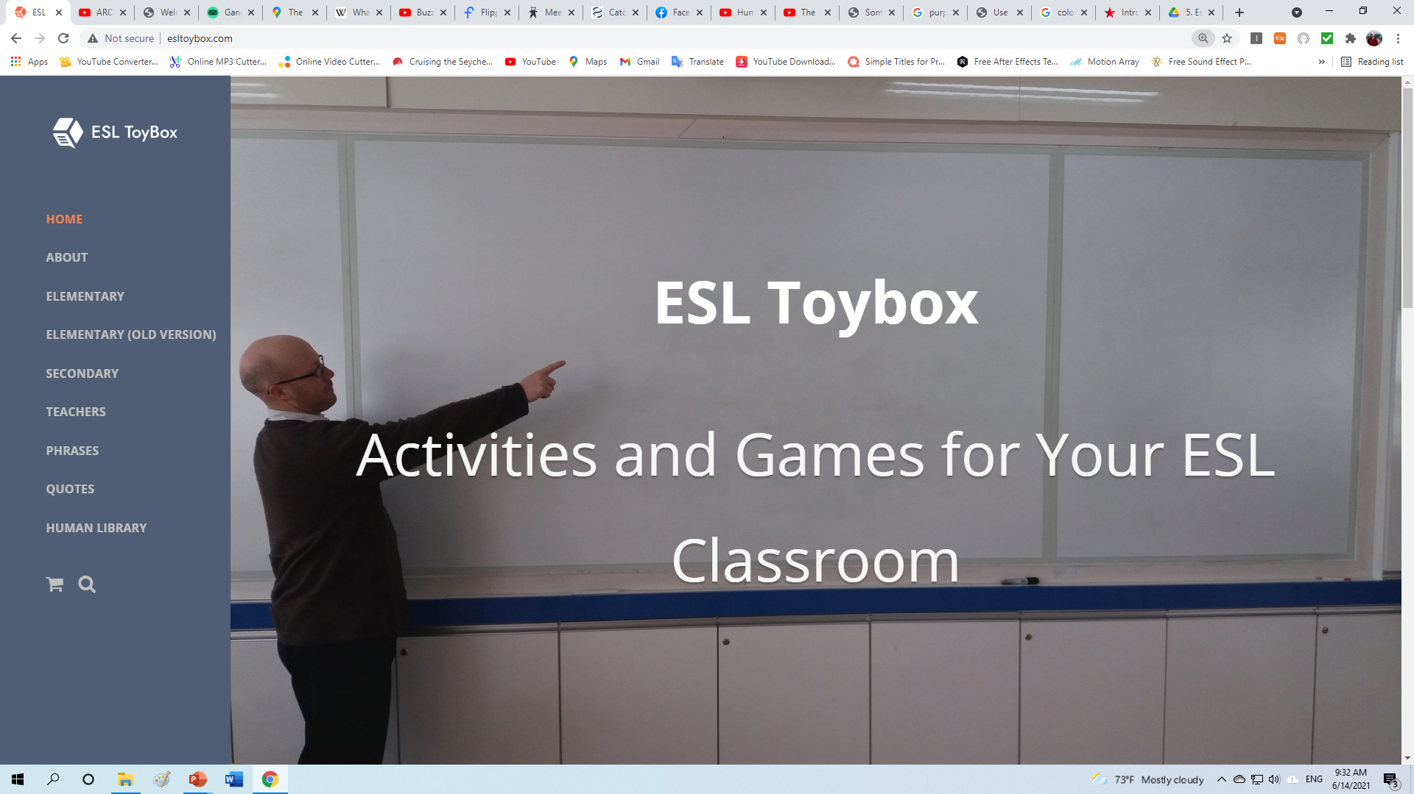

Slide 50
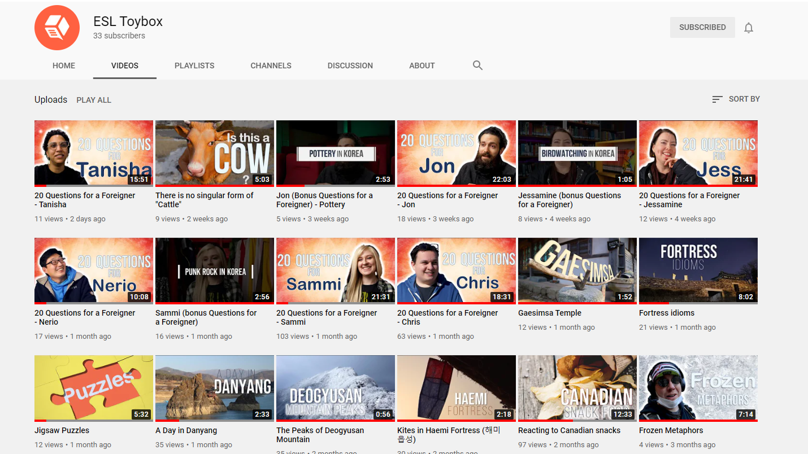

Slide 51



Slide 52

https://create.kahoot.it/share/duplicate-of-introduction-questions/15c26cfd-b368-4c43-a565-088278fee87b

