Slide 1
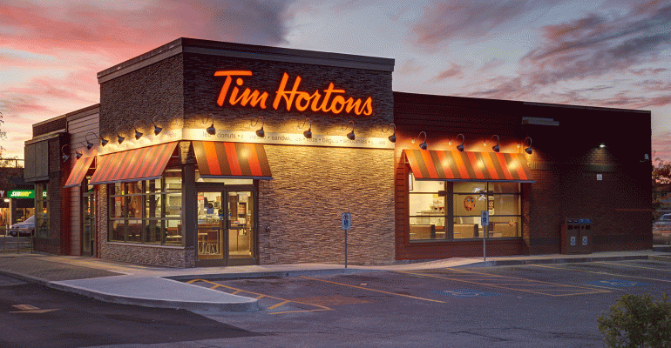

Slide 2
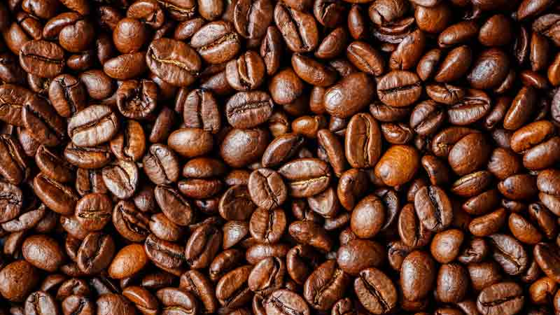
Can I get a double-double?

Slide 3
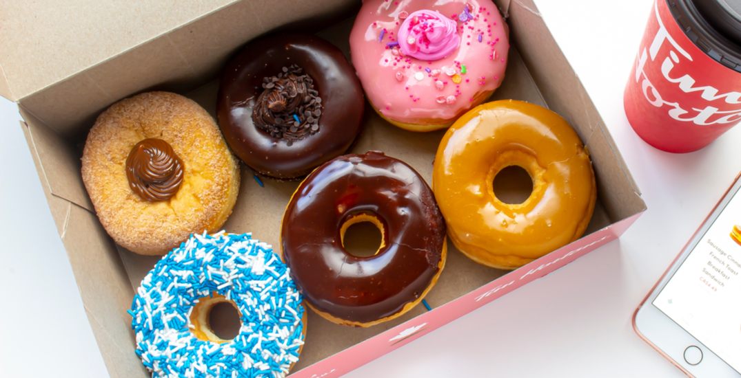
Doughnuts
Donuts

Slide 4
Old-fashion

Slide 5
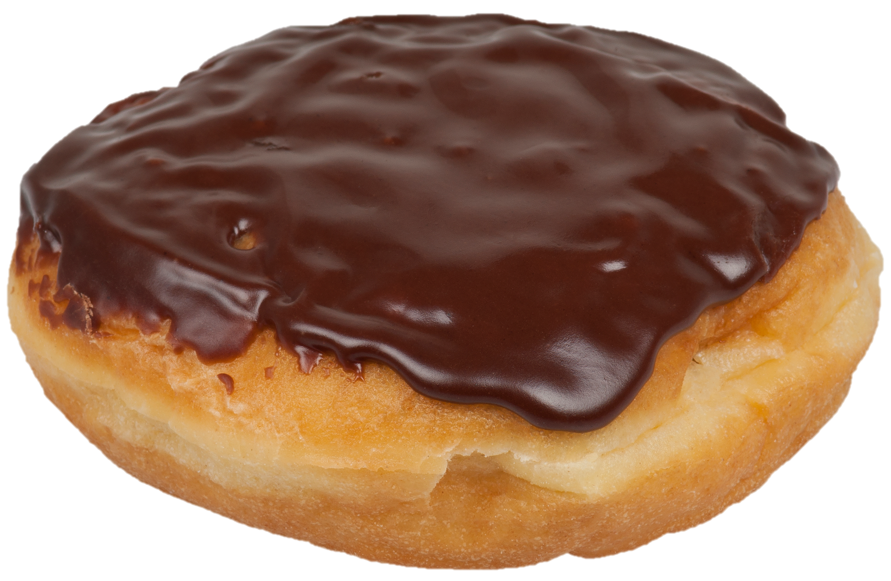
Boston Cream

Slide 6
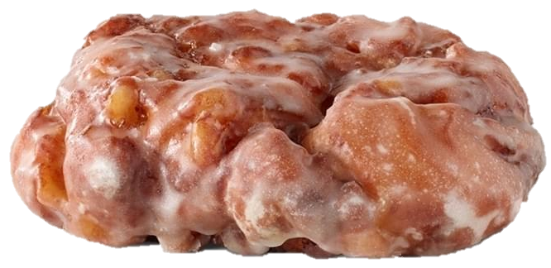
Apple Fritter

Slide 7
Chocolate Dip

Slide 8
Maple Dip

Slide 9
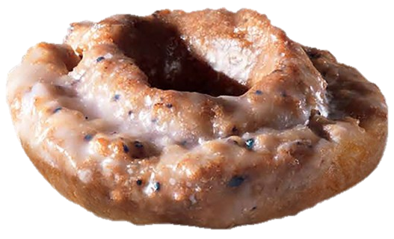
Blueberry

Slide 10
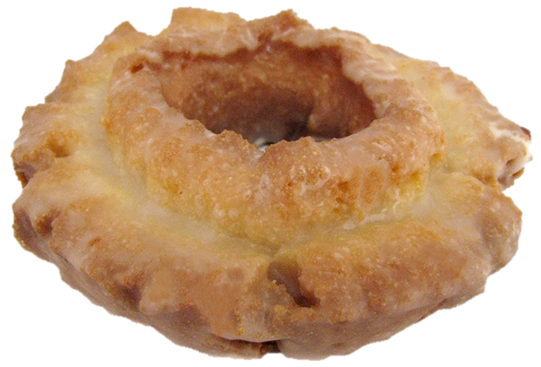
Maple glazed

Slide 11
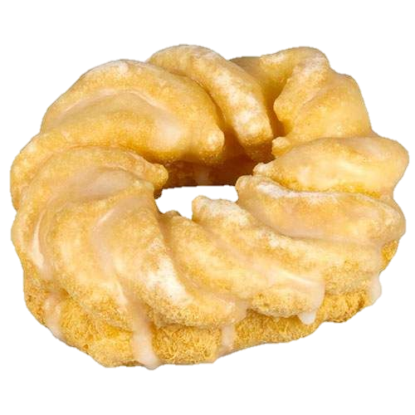
Cruller

Slide 12
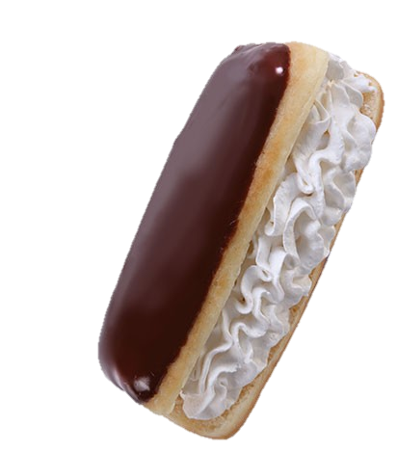
Éclair

Slide 13
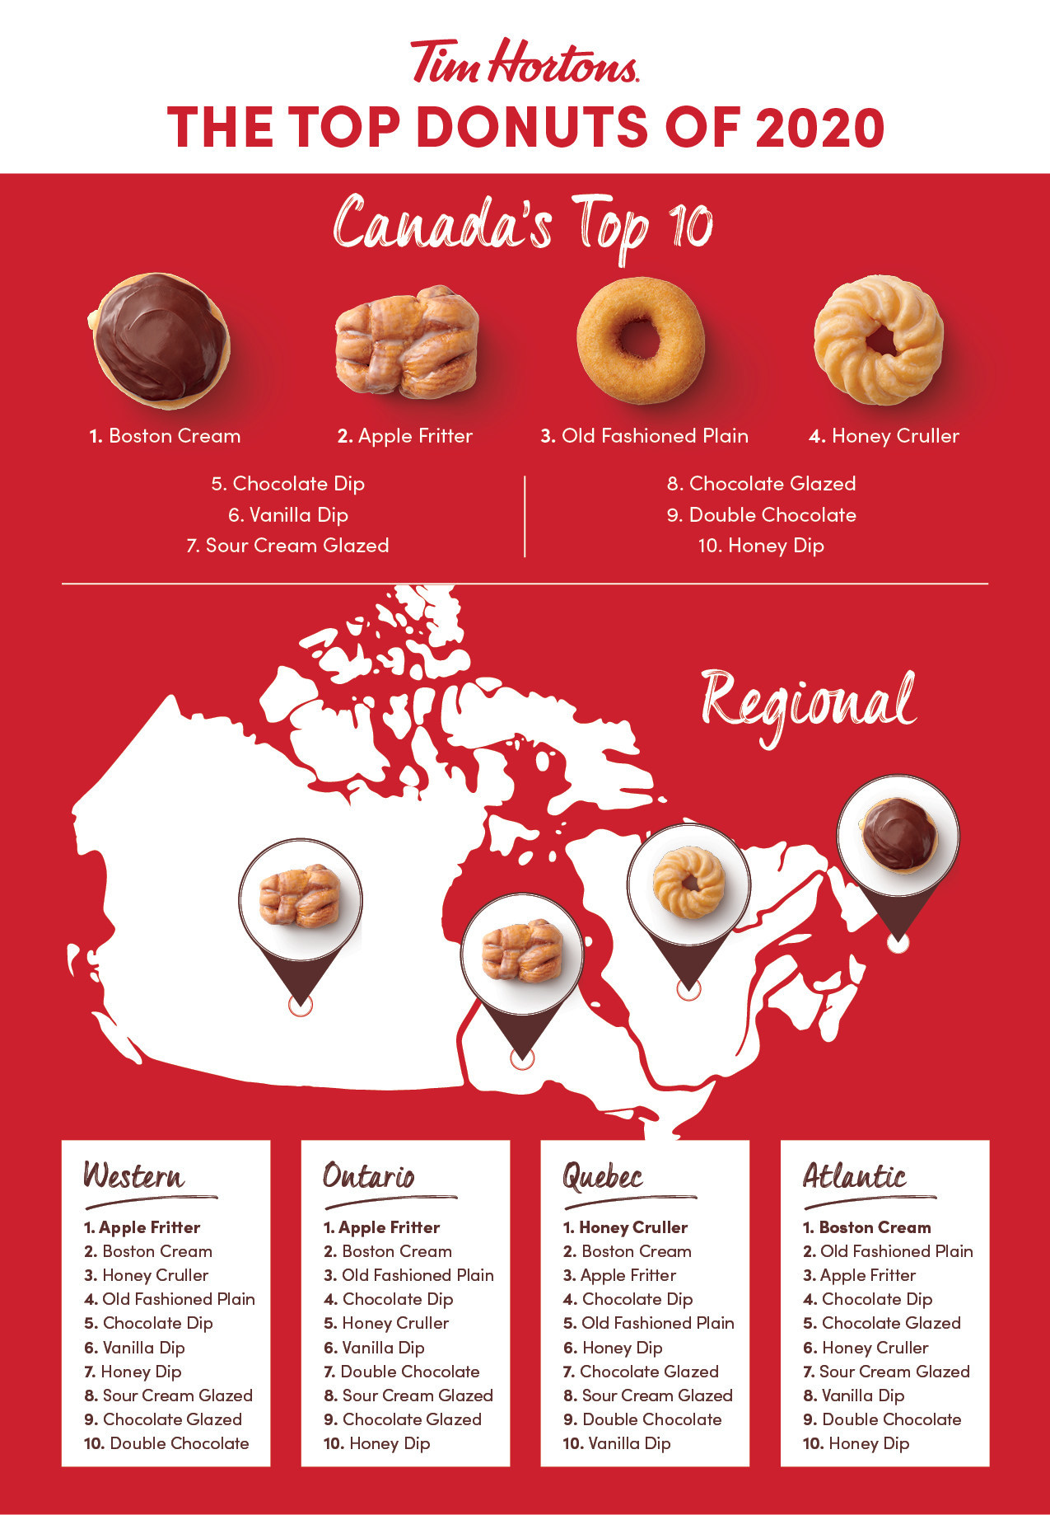
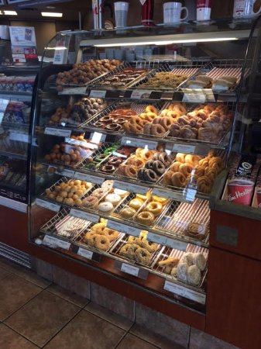

Slide 14
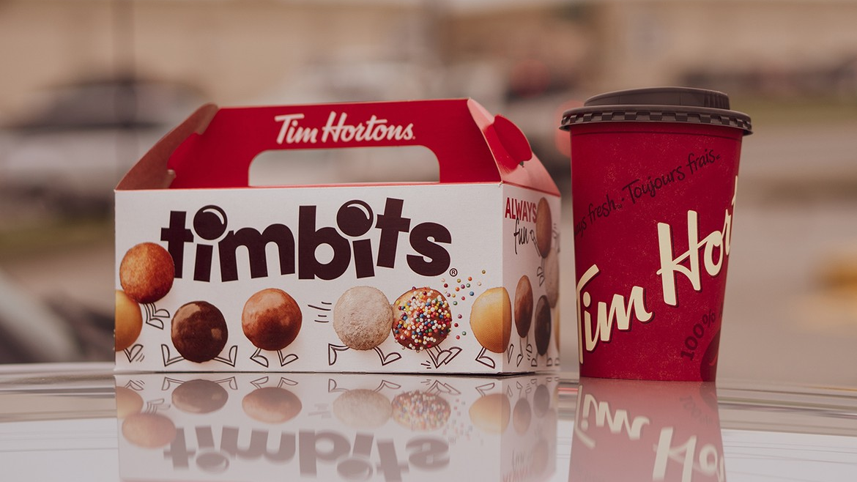

Slide 15
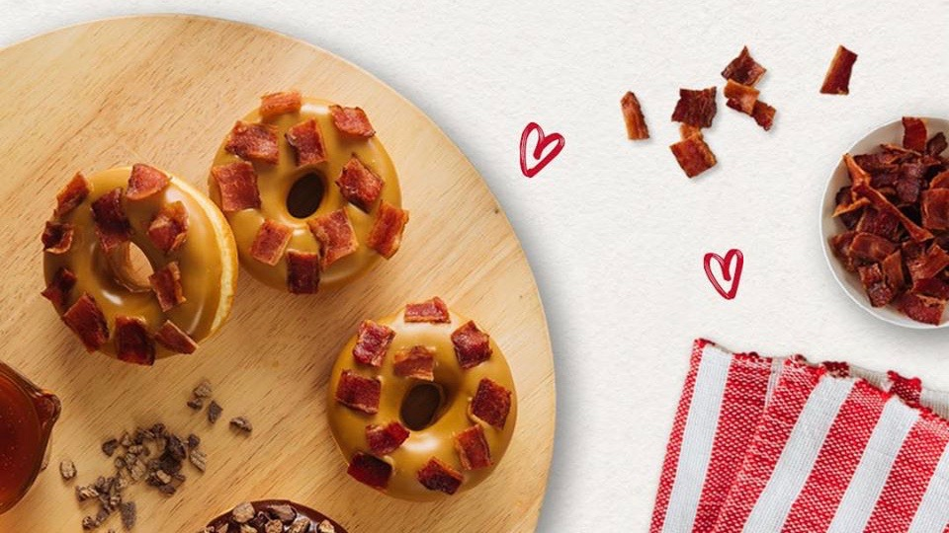
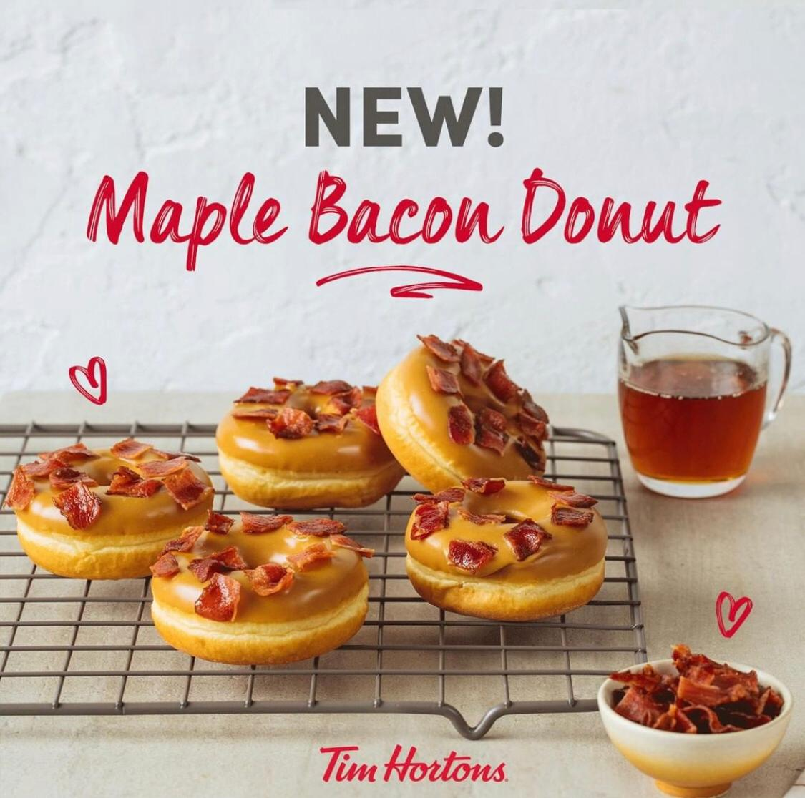

Slide 16
Hi, can I help you?

Slide 17
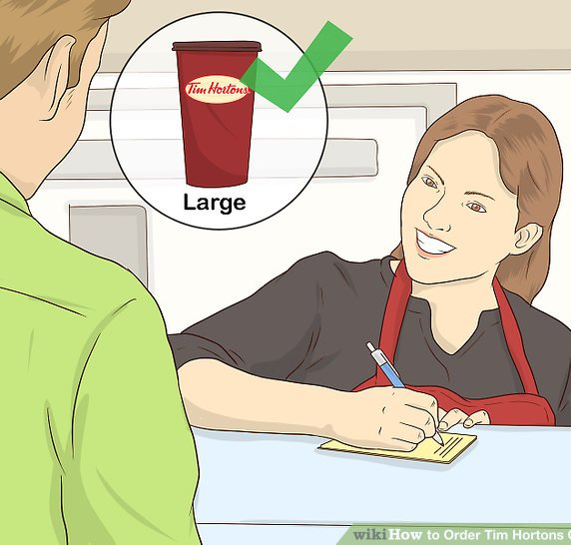
Size
S
M
L
XL

Slide 18
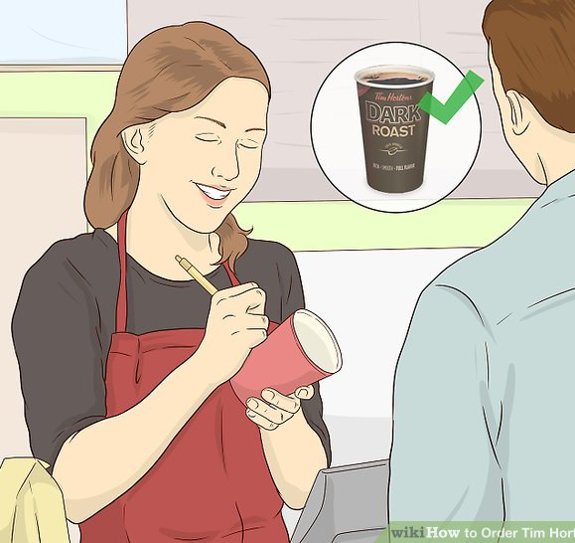
Blend
original
dark roast
decaf
French vanilla

Slide 19
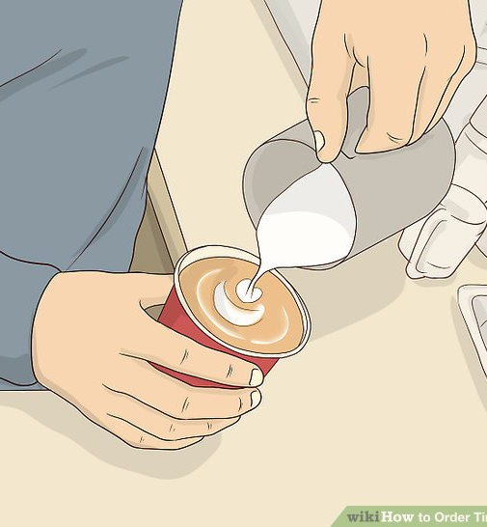
Additives
milk
cream
sugar
sweetener

Slide 20
Size
1 milk = 15mL

Slide 21
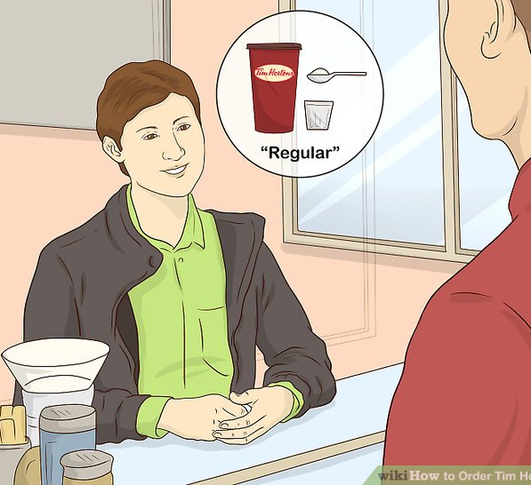
Regular
1 milk
1 sugar

Slide 22
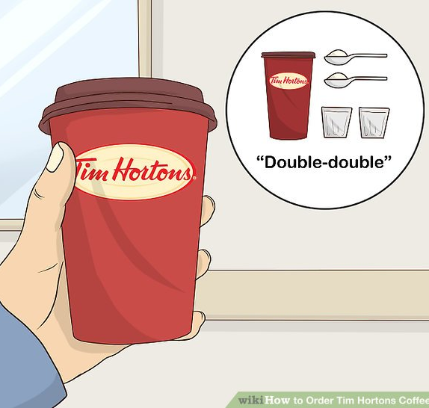
Double-double
2 cream
2 sugar

Slide 23
Triple-triple
3 cream
3 sugar

Slide 24
Four by Four
4 cream / milk
4 sugar / sweetener

Slide 25
Three cream, Two sugars
3 cream
2 sugar

Slide 26
Black
0 cream
0 sugar

Slide 27
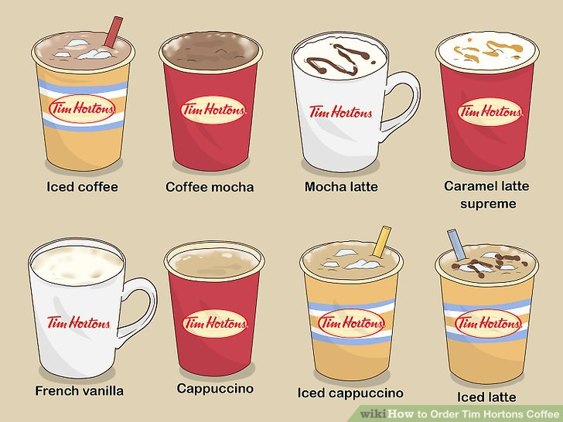

Slide 28
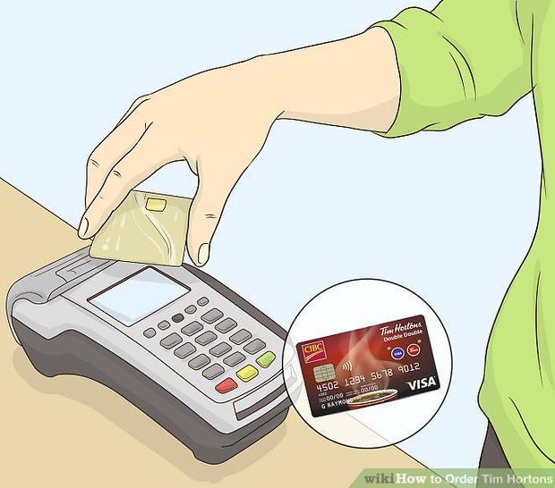
Credit or Debit?
credit card
debit card

Slide 29
For here
or To go

Slide 30
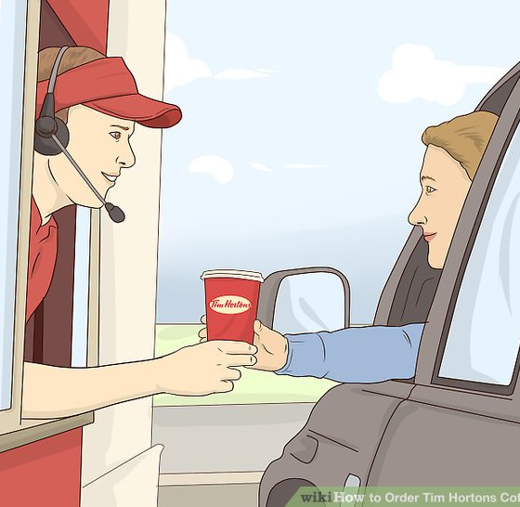

Slide 31
Role Play
Hi, can I help you?
May I have a large original double-double and a cruller?
Sure. Will you be paying with cash or credit card?
Debit, please.
For here or to go?
For here please.

Slide 33
https://www.wikihow.com/Order-Tim-Hortons-Coffee
https://wendihiebert.com/2009/08/04/how-to-order-and-behave-at-tim-hortons-to-make-the-world-a-better-place/#:~:text=Ordering%20coffee%20and%20tea%3A,is%20called%20a%20Triple%20Triple
https://youtu.be/yJ0HZam3UJo
https://www.reddit.com/r/TimHortons/comments/e7m1zy/i_heard_tim_hortons_counts_1_cream_as_more/
https://www.thestar.com/opinion/contributors/2020/01/29/your-double-double-coffee-has-more-sugar-than-you-think-and-thats-a-problem.html

Slide 34
ESL toybox
www.esltoybox.com

