Slide 1
Human
library

Slide 2
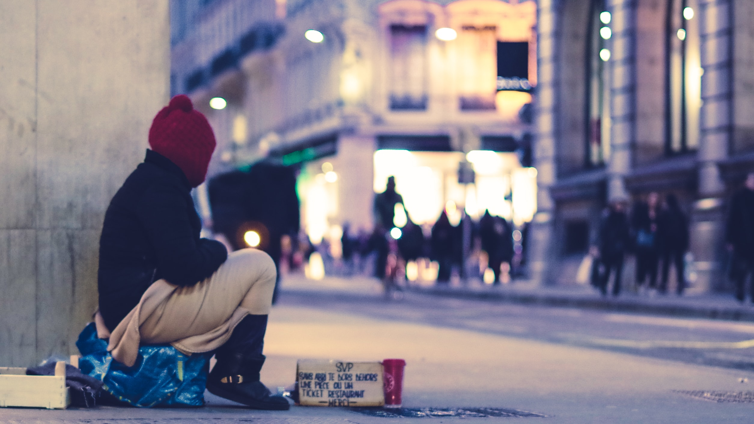

Slide 3
social
privilege

Slide 4
BRAINSTORM
What is privilege?

Slide 5
high
Social class
low

Slide 6
old
age
young

Slide 7
citizenship

Slide 8
handicapped
Disability
able-bodied

Slide 9
Asian
Black
race
Caucasian

Slide 10
female
Gender
male

Slide 11
rich
wealth
poor

Slide 12
high
IQ
low

Slide 13
tall
Height
short

Slide 14
straight
Sexual
orientation
LGBTQ+

Slide 15
Buddhism
Religion
Islam
Hindu
Christianity

Slide 16
Benefits
Of privilege

Slide 17
policing
income
BRAINSTORM
education
human rights
power
accessibility
desirability
acceptance
travel
opportunities

Slide 18
Human
library

Slide 19
Challenge prejudice,
reduce discrimination,
discuss taboo topics openly.

Slide 20
key
Terms

Slide 21
religion
ageism
sexism
citizenship
Research
social status
sexual orientation
intelligence
disability
wealth
body image

Slide 22
Ask / teach

Slide 23
Content
Warning

Slide 24
Something that might upset the viewer / reader.

Slide 25
BRAINSTORM
Taboo
subjects

Slide 26
Death
Suicide
Self-harm
Graphic images
Violence / murder
Sexual violence / rape
Pedophilia
Sex / masturbation
Homophobia, transphobia, sexism
Food and drink / eating disorders
Dysphoria, body image
Taboo
subjects

Slide 27
A trigger warning is more specific.

Slide 28
Inclusive
Language

Slide 29
Language that avoids being offensive.

Slide 30
Identity-First Language
An autistic person.

Slide 31
Person-First Language
A person with autism.

Slide 32
PFL > IFL
(except deaf / autistic communities)

Slide 33
Preferred Labels
How people want to be referred to

Slide 34
Active Voice
Avoid passive voice for power-based violence.

Slide 35
He assaulted her.
She was assaulted by him.

Slide 36
Adjectives > Nouns
A Canadian person > A Canadian

Slide 37
Person > Man
Salesperson > Salesman

Slide 38
Universal Phrases
It’s easy > It’s a layup

Slide 39
Gender Neutral
Y’all > You guys

Slide 40
Growth Mindset
People can change

Slide 41
Call out discrimination
Point out when someone is being inappropriate

Slide 42
Inclusive
teaching

Slide 43
A student tells you that they are gay. They want dating advice.

Slide 44
Some of your students are from other countries. Their Korean / English level is low.

Slide 45
A student tells you that they are non-binary. They don’t feel accepted by society.

Slide 46
There is a new student that requires a wheelchair. Your school doesn’t have an elevator.

Slide 47
Inclusive Teaching
https://sites.lsa.umich.edu/inclusive-teaching/an-introduction-to-content-warnings-and-trigger-warnings/
Examples of Privilege
https://uca.edu/training/files/2017/11/Privilege-What-Does-It-Mean-Handout.pdf
Human Library
https://humanlibrary.org/
Disability Glossary
https://idpwd.org/key-terms/
Content Warning
https://www.themix.org.uk/mental-health/looking-after-yourself/a-guide-to-content-and-trigger-warnings-37946.html

Slide 48
Inclusive Language
https://online.rider.edu/online-bachelors-degrees/liberal-studies/guide-to-using-inclusive-language/
70 Inclusive Language Principles
https://medium.com/diversity-together/70-inclusive-language-principles-that-will-make-you-a-more-successful-recruiter-part-1-79b7342a0923

Slide 49
Special Books with Special Kids
https://www.youtube.com/channel/UC4E98HDsPXrf5kTKIgrSmtQ
Reel Truth Documentaries
https://www.youtube.com/channel/UCFrO-dKhooOuTtix5dia2_g
Invisible People
https://www.youtube.com/user/invisiblepeopletv
Only Human
https://www.youtube.com/channel/UCkRmoZiR_SOssKA89m1eYJg
Real Stories
https://www.youtube.com/channel/UCu4XcDBdnZkV6-5z2f16M0g

Slide 50
ESL toybox
www.esltoybox.com

