Slide 1
Taboo
words

Slide 2
words
Attached to
emotion

Slide 3
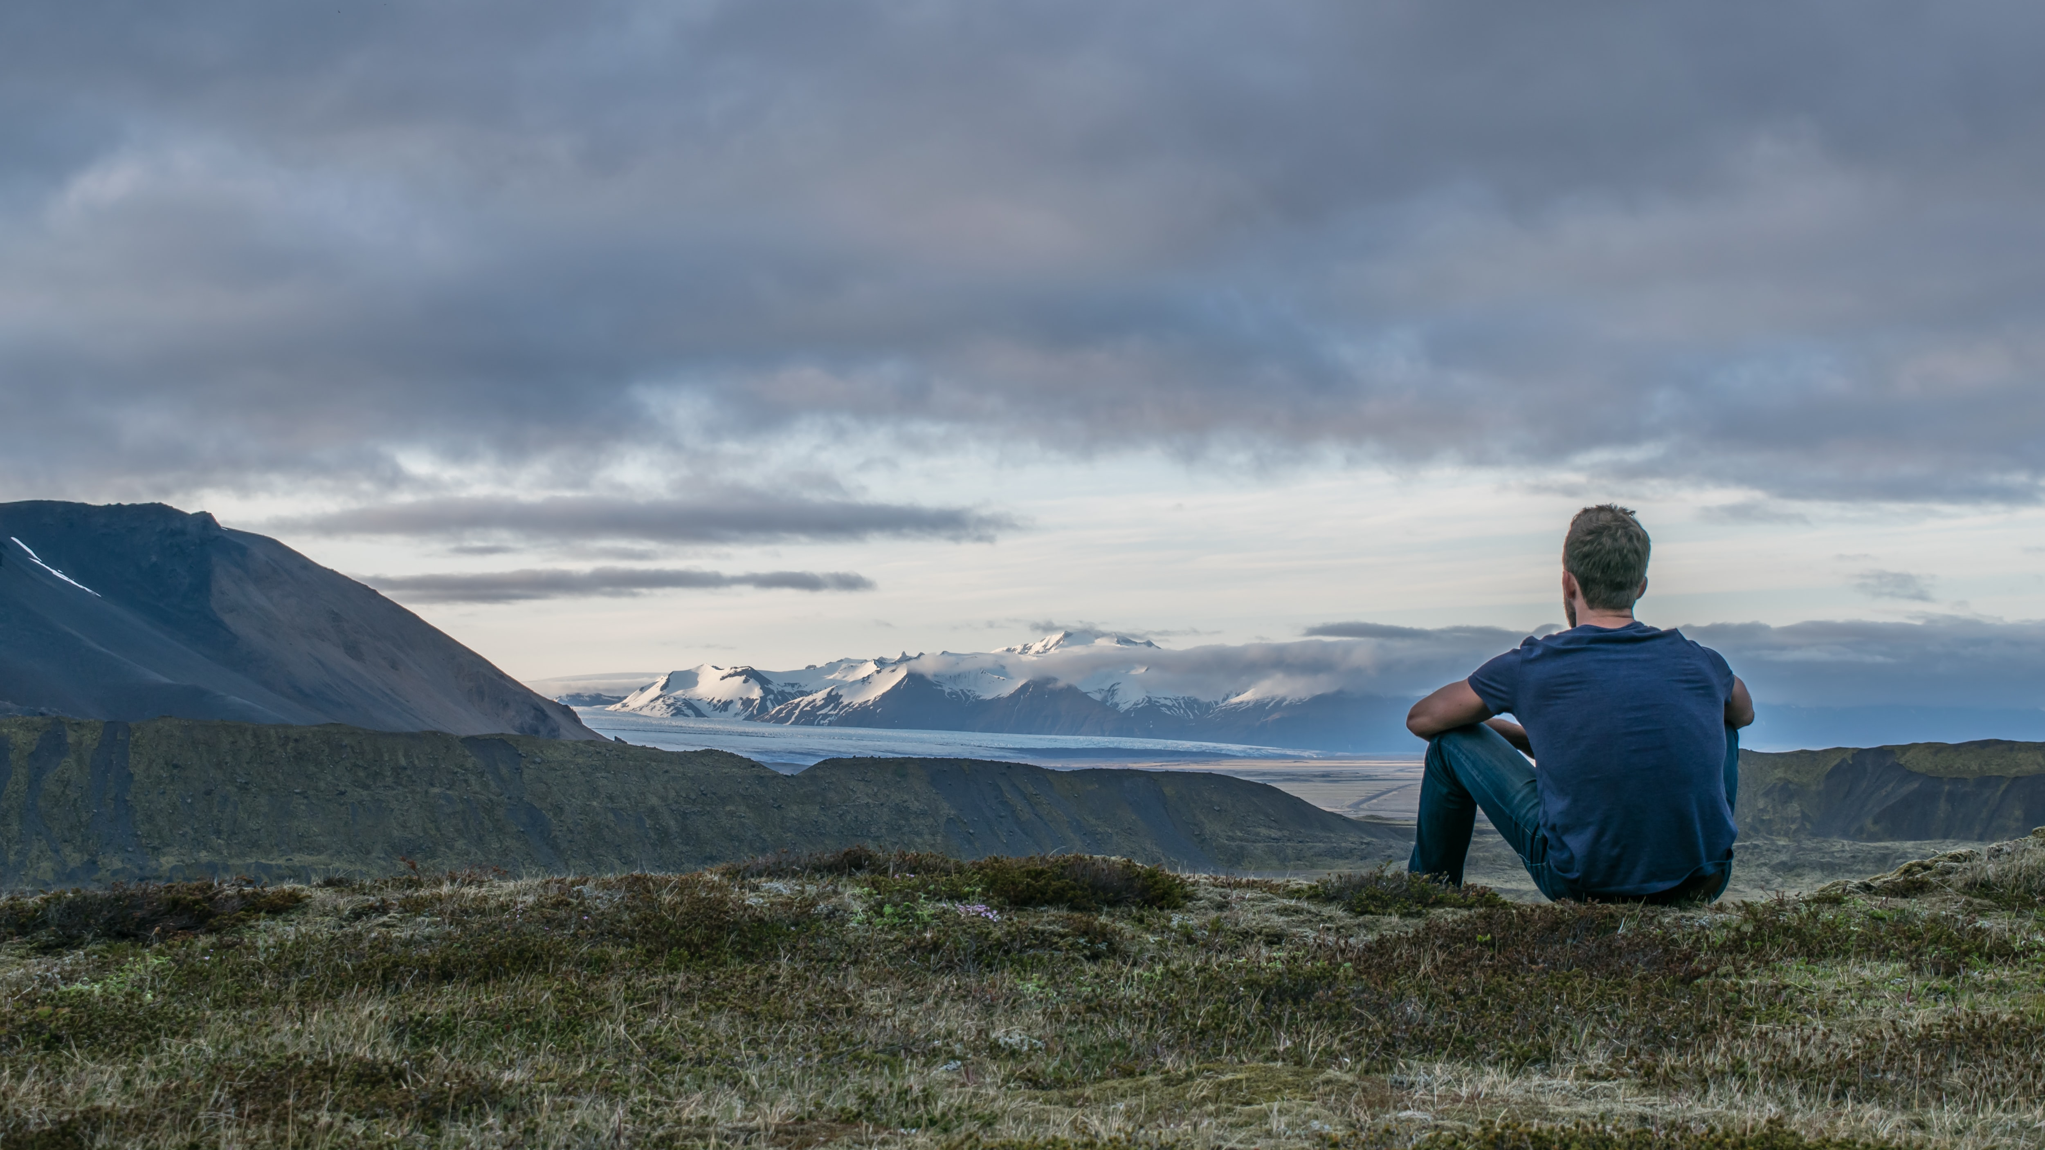
connected to past

Slide 4
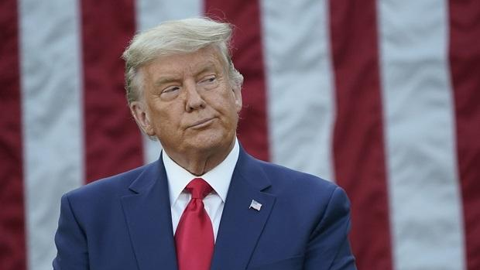
stupid vs uneducated

Slide 5
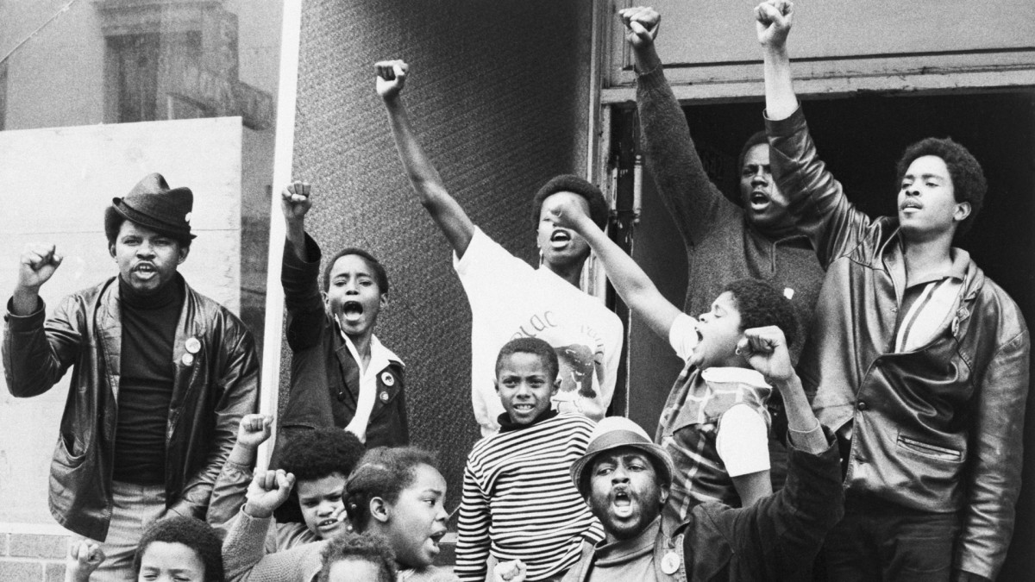
culture markers

Slide 6
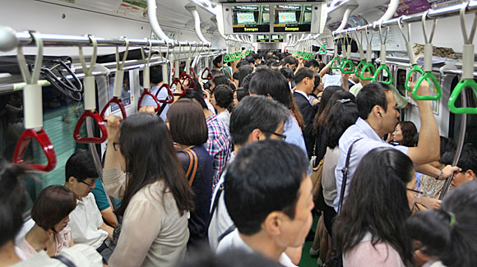
context

Slide 7
Profanity
Swear words
Curse words

Slide 8
Edmund Leach
Dirty words (sex, excretion)
Religious Words (Christ, OMG)
Animal Abuse (Bitch, Cow)

Slide 9
bad?
Why is profanity

Slide 10
Should language be
limited ?

Slide 11
What
feelings
do they convey?

Slide 12
four
letter
words

Slide 13
formal
vs
informal

Slide 14
People who swear
are more intelligent
have larger vocabularies
less stressed

Slide 15
The 7 Most Popular Curse Words
F*** (34.73%)
1
S*** (15.04%)
2
A** (14.48%)
3
N**** (9.68%)
4
H*** (4.46%)
5
The top 7 curse words account for over 80% of total usage.
W**** (1.82%)
6
D*** (1.67%)
7

Slide 16
words
have
power

Slide 17
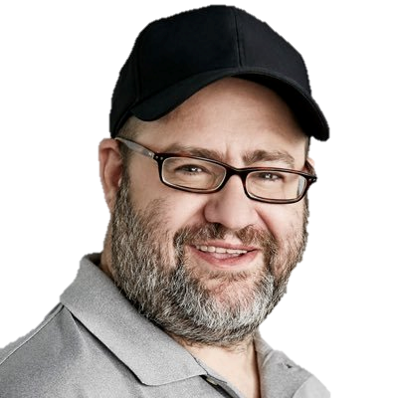
“Words are singularly the most powerful force available to humanity. We can choose to use this force constructively with words of encouragement, or destructively using words of despair. Words have energy and power with the ability to help, to heal, to hinder, to hurt, to harm, to humiliate and to humble.”
- Yehuda Berg

Slide 18
Why?
Connection to past events
Cultural
Intention

Slide 19
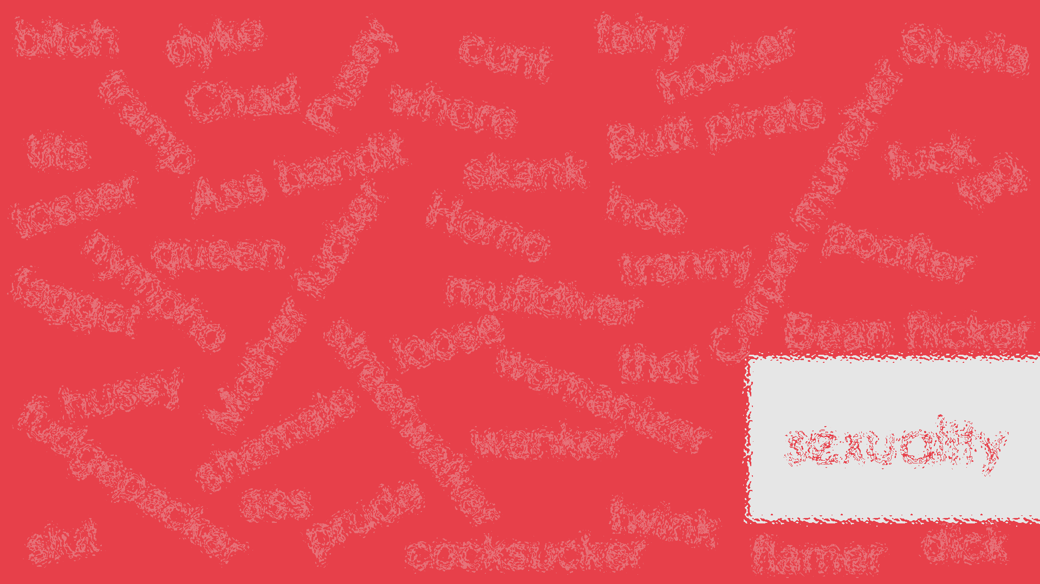
bitch
dyke
fairy
cunt
hooker
Sheila
Pussy
Chad
whore
tramp
Butt pirate
tits
fuck
Ass bandit
skank
fag
tosser
Carpet muncher
hoe
Homo
queen
poofter
tranny
nympho
muffdiver
faggot
Mother fucker
loose
Bean flicker
thot
hussy
womanizer
shemale
streetwalker
sexuality
wanker
fudgepacker
ass
prude
twink
slut
cocksucker
dick
flamer

Slide 20
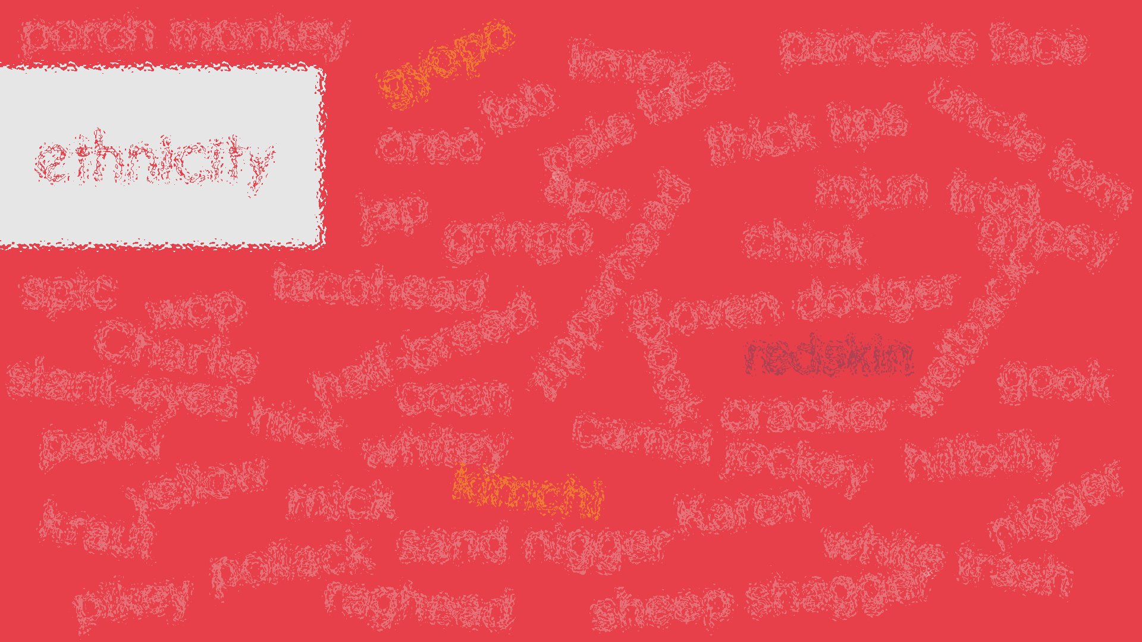
porch monkey
pancake face
gyopo
limey
fob
pale face
thick lips
ethnicity
oreo
uncle tom
ape
injun
frog
jap
gringo
chink
gypsy
spic
tacohead
zipperhead
wop
oven dodger
wetback
Charlie
half-breed
spook
redskin
slant-eyes
gook
coon
hick
cracker
pakki
whitey
camel jockey
hillbilly
yellow
kimchi
mick
Karen
nigger
kraut
sand nigger
pollack
white trash
pikey
raghead
sheep shagger

Slide 21
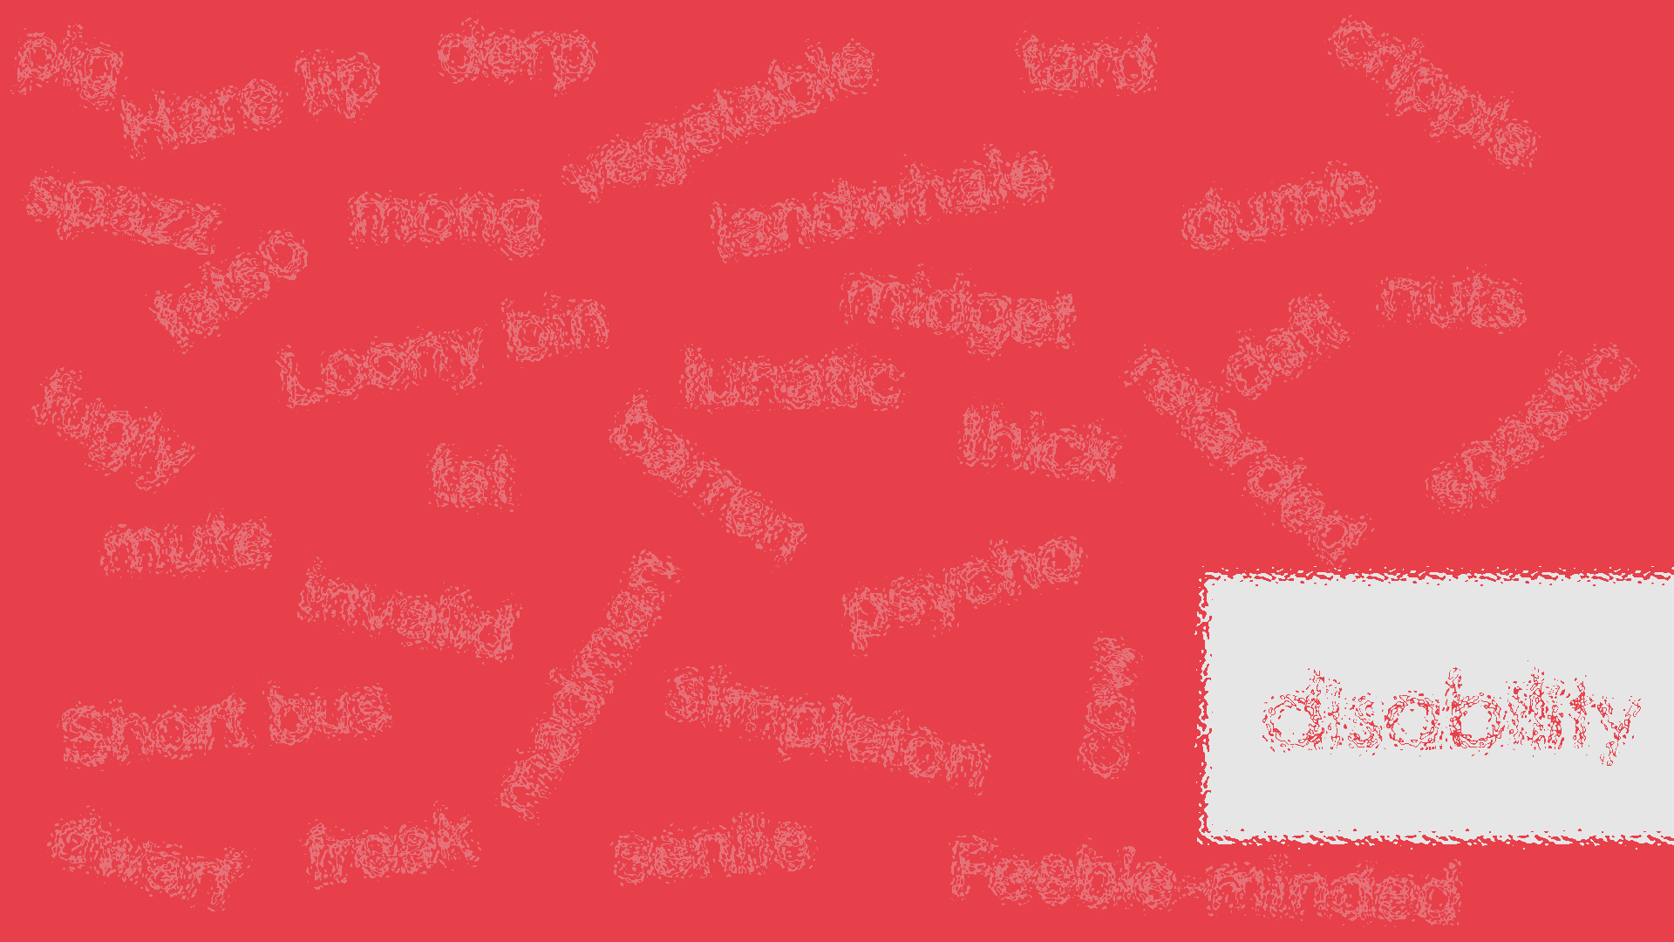
pig
derp
tard
Hare lip
cripple
vegetable
spazz
mong
landwhale
dumb
fatso
nuts
midget
Loony bin
daft
lunatic
fugly
spastic
thick
retarded
fat
barren
mute
psycho
invalid
madman
disability
Short bus
simpleton
cow
dwarf
freak
senile
Feeble-minded

Slide 22
Unintentionally Offensive
Joking with friends
What doesn’t concern you might concern someone else

Slide 23
Political
correctness
In speech

Slide 24
euphemisms
A word used to avoid using another word.

Slide 25
To die…
Bit the dust
Bought the farm
Kicked the bucket
She’s in a better place
Departed
Croaked
Passed away

Slide 26
Fart
Cut the cheese
Breaking wind
Ripped a big one
Lay an egg
Flatulence
Pass gas

Slide 27
Old
Well-seasoned
Over the hill
Experienced
Senior citizen
Geriatric

Slide 28
Fat
Big-boned
Rotund
Plump
Portly
Chubby
Overweight
“dad bod”

Slide 29
Stupid
Less able
Aloof
Slow
Simple
Affable
Dimwitted

Slide 30
Stupid
Not the brightest bulb
Not the sharpest knife in the drawer
Not the sharpest tool in the shed
Not playing with a full deck of cards
A few sandwiches short of a picnic
Dumber than a bag of rocks

Slide 31
Pregnant
I’m late
Eating for two
A bun in the oven
Knocked up
In the family way
Prego

Slide 32
Getting Fired
Laid off
Let go
A victim of downsizing
Sacked

Slide 33
stoopid
altered swear words
a55
$h1t
f*ck
@ss
b!tch
l3itch
sh!t
p*ssy
c0ck
dik
bi+ch

Slide 34
No filter
No direct contact
online harassment

Slide 35
Taboo
Taboo
Taboo

Slide 36
Step 1: make
Write five words that the other team can’t say.

Slide 37
Step 2: describe
Get your team to guess the word without saying the taboo words.

Slide 38
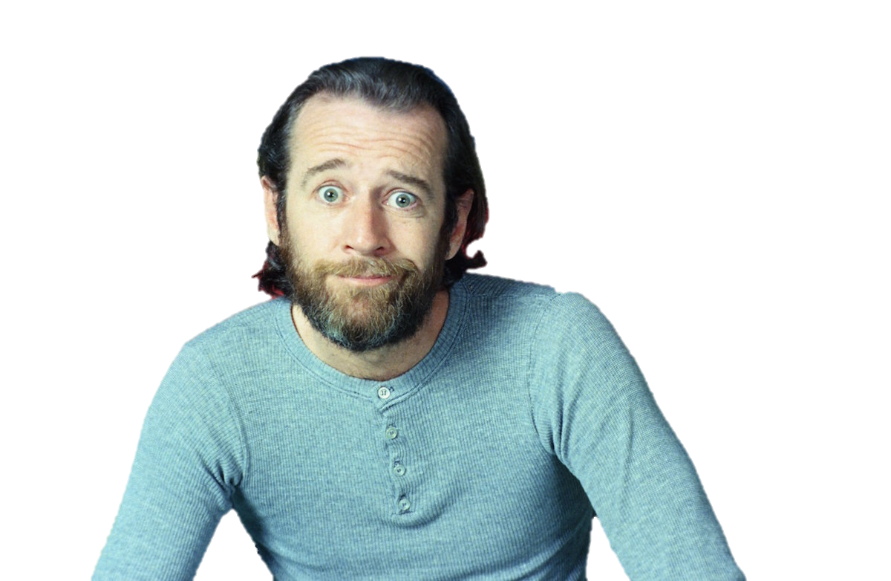
Words you can’t say
https://youtu.be/kyBH5oNQOS0

Slide 39
ESL toybox
www.esltoybox.com

Slide 40
The Definition of Taboo Language
https://www.thoughtco.com/taboo-language-1692522
Taboo Words in English
https://www.bespeaking.com/taboo-words-english/
A to Z of Offensive Disablist Language
https://www.anti-bullyingalliance.org.uk/sites/default/files/field/attachment/Ato-Z-of-Offensive-language-FINAL.pdf
Avoiding Ableist Language
http://web.augsburg.edu/english/writinglab/Avoiding_Ableist_Language.pdf
The Power of Spoken Words
https://www.huffpost.com/entry/the-power-of-spoken-words_b_6324786

Slide 41
How We Swear on Twitter
https://www.fastcompany.com/3026596/140-characters-of-fck-sht-and-ss-how-we-swear-on-twitter
7 Words You Can’t Say on TV
https://youtu.be/kyBH5oNQOS0

