Slide 1

Euphemisms
Let’s talk about the birds and the bees.

Slide 2
Foreplay
Seduction and getting ready for sex.

Slide 3
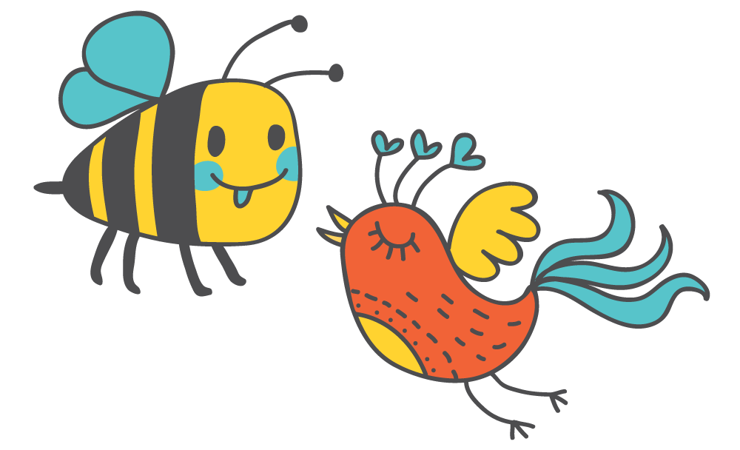
Let’s talk about the birds and the bees.
sex

Slide 4
In English it can be taboo to talk about sex. So, we often use euphemisms to soften our language.
“can’t talk about it”

Slide 5
Even the word “sex” is a bit taboo.
Jim Goad lists 400 euphemisms for “sex”
https://thoughtcatalog.com/jim-goad/2014/12/400-euphemisms-for-sexual-intercourse/

Slide 6
Positive euphemisms for “sex”
Knocking boots
Afternoon delight
Roll in the hay
Nooky
Horizontal tango
Riding it
Scoring
Humping
Whoopee
Sleeping with
Copulate
Mating
Take to bed
Going all the way
Making Love
Sleeping together
Getting laid
Getting some
Getting Lucky
Getting it on
Getting busy
Doing it
A quickie
Hooking up
Having relations with
Hanky Panky
One night stand
Knowing someone in the biblical sense

Slide 7
Negative euphemisms for “sex”
Porking
Sleeping around
Getting ass
Having an affair
Ravish
To bone someone
Fucking
Screwing
Banging
Shagging
Nailing someone
Doing the nasty
Pounding it
Bumping uglies
Tap that ass
Smack that ass
Fornication
Getting boned
Plowing
Making the beast with two backs

Slide 8
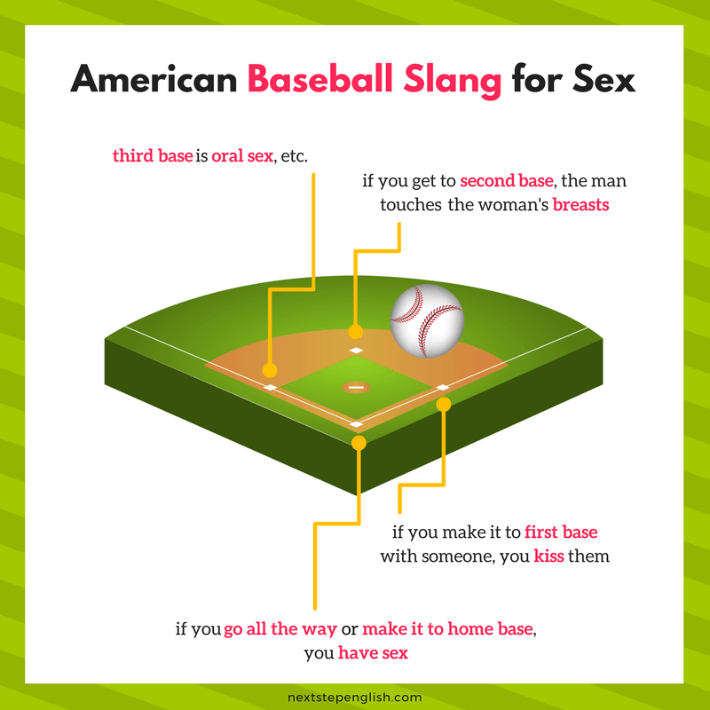
Baseball Metaphor
https://nextstepenglish.com/love-words-english-funny-euphemisms-sex/

Slide 9
Get Busy
Time to do it (sex)

Slide 10
Let’s start by looking at body parts
Name the body part.

Slide 11
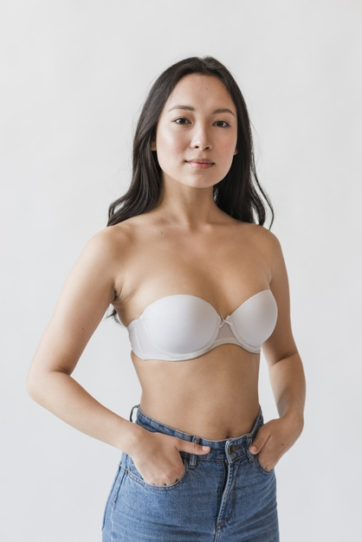

Tatas
Breasts

Slide 12
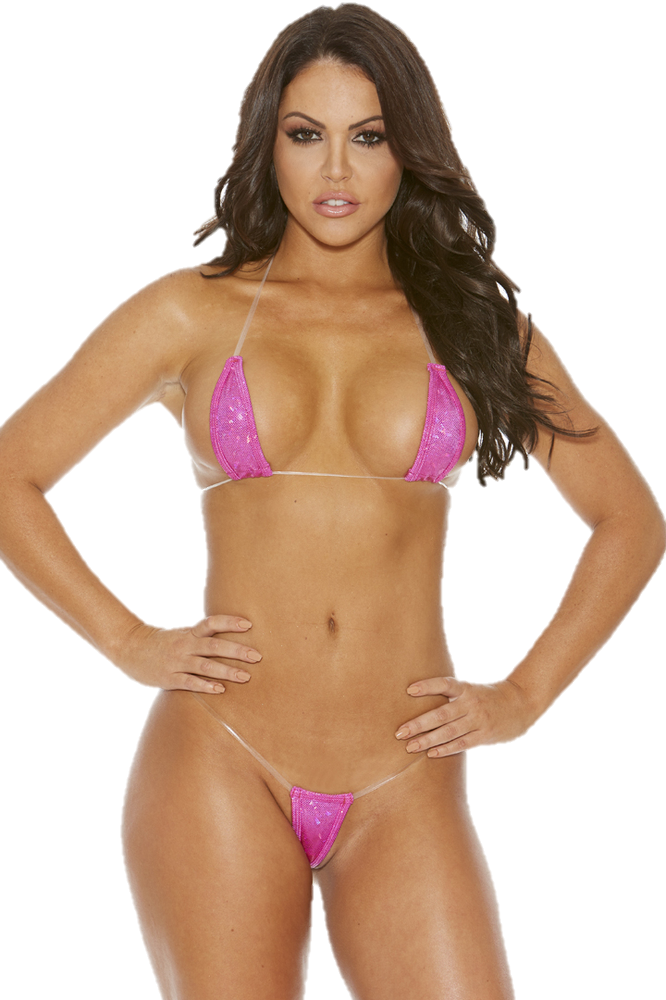

Box
Vagina

Slide 13

Rear
Butt

Slide 14
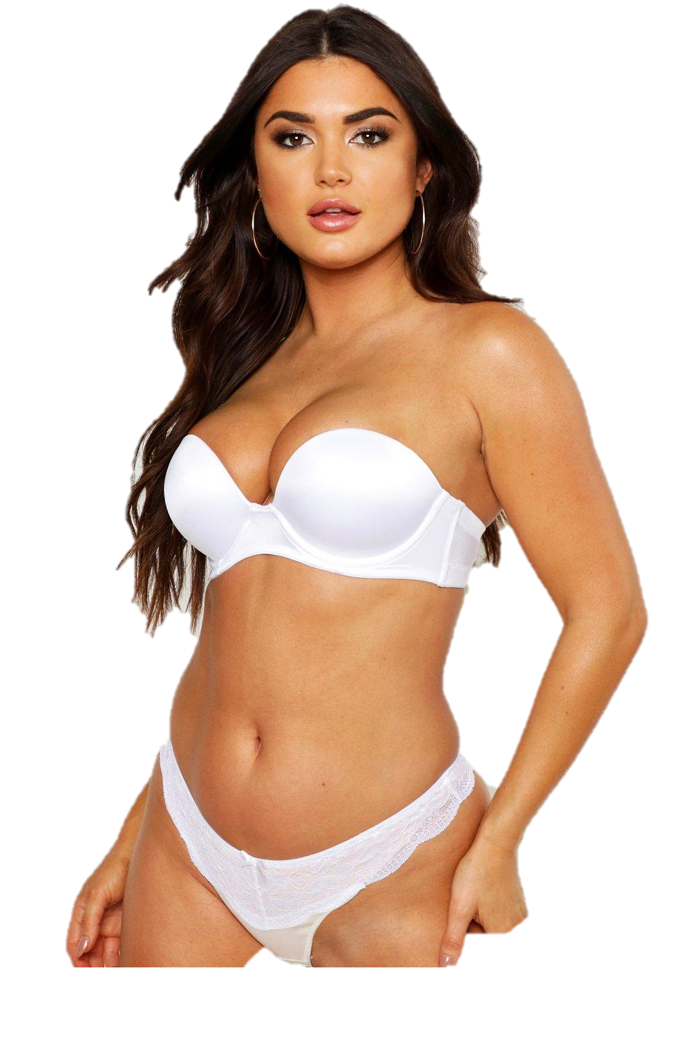

Large personality
Large Breasts

Slide 15
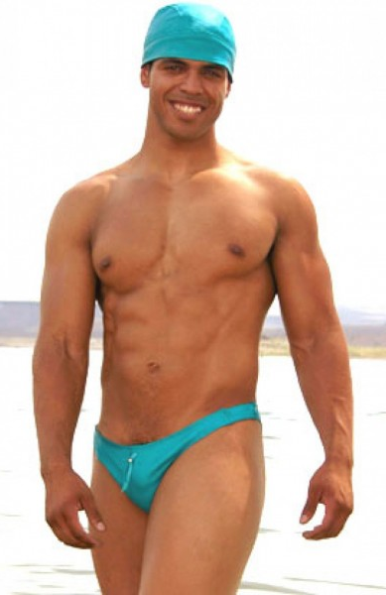
Schlong
Penis

Slide 16
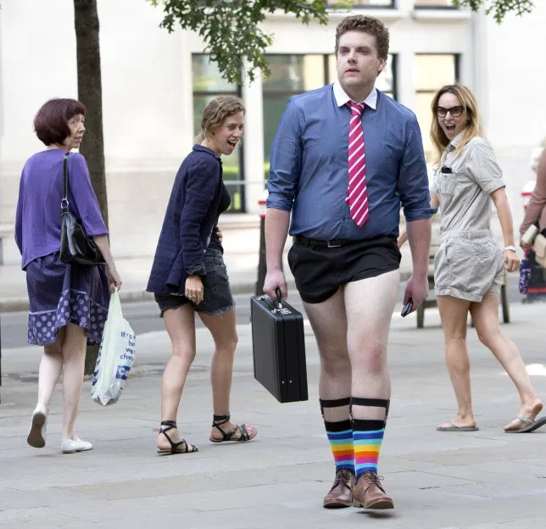

Trouser Stick
Penis

Slide 17
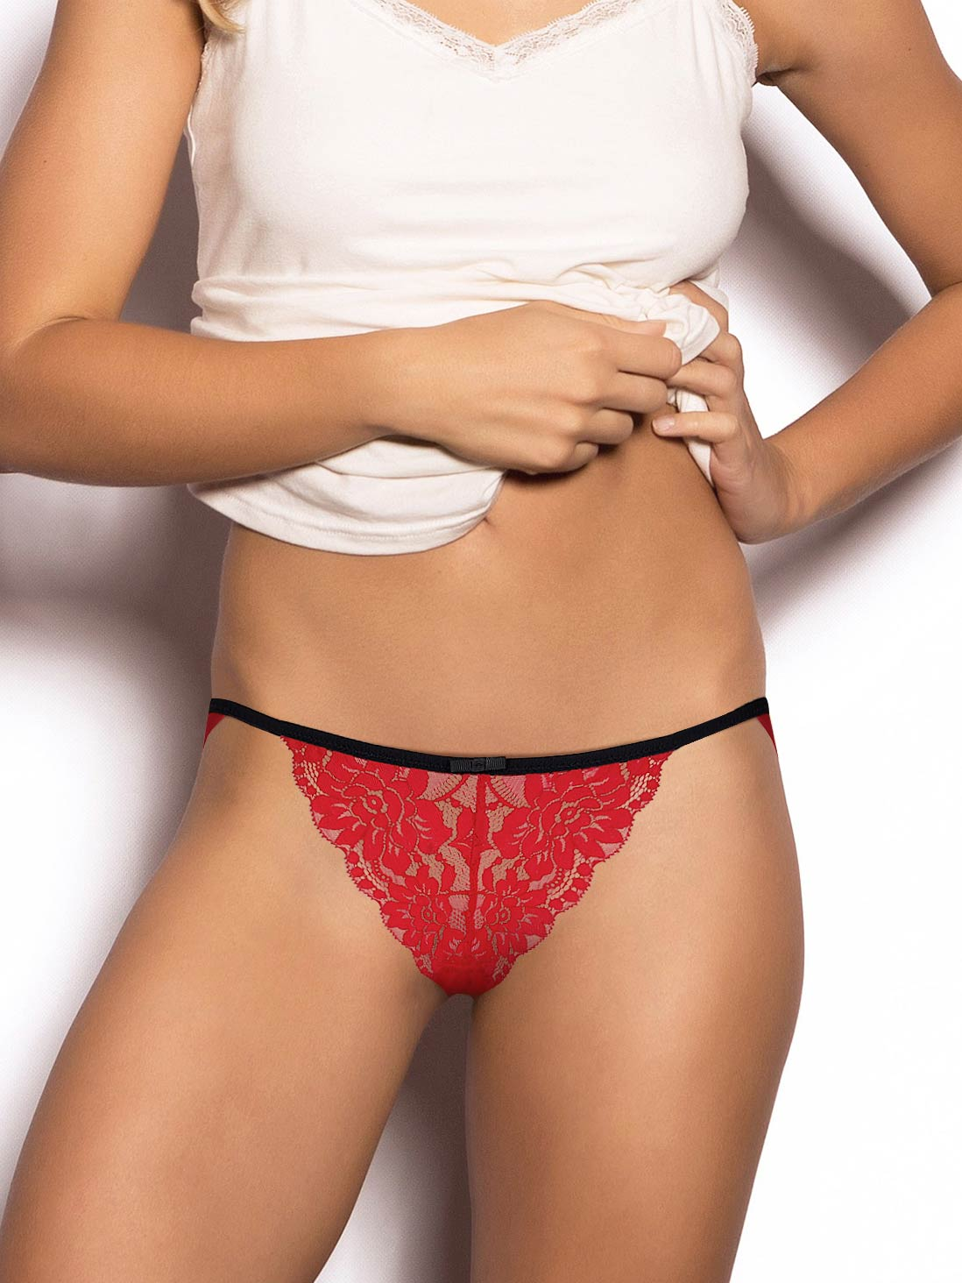
Poontang
Vagina

Slide 18
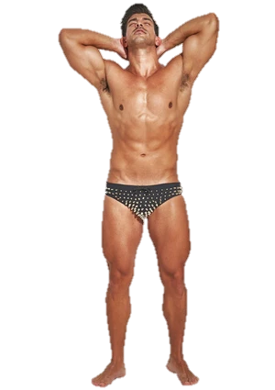
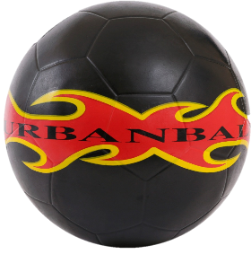
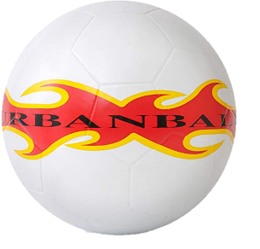
Balls
Testicles

Slide 19
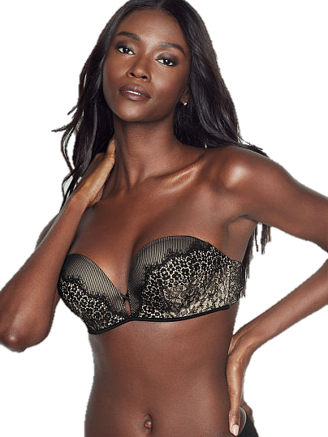

Balloons
Fun bags / Fun balloons
Breasts

Slide 20
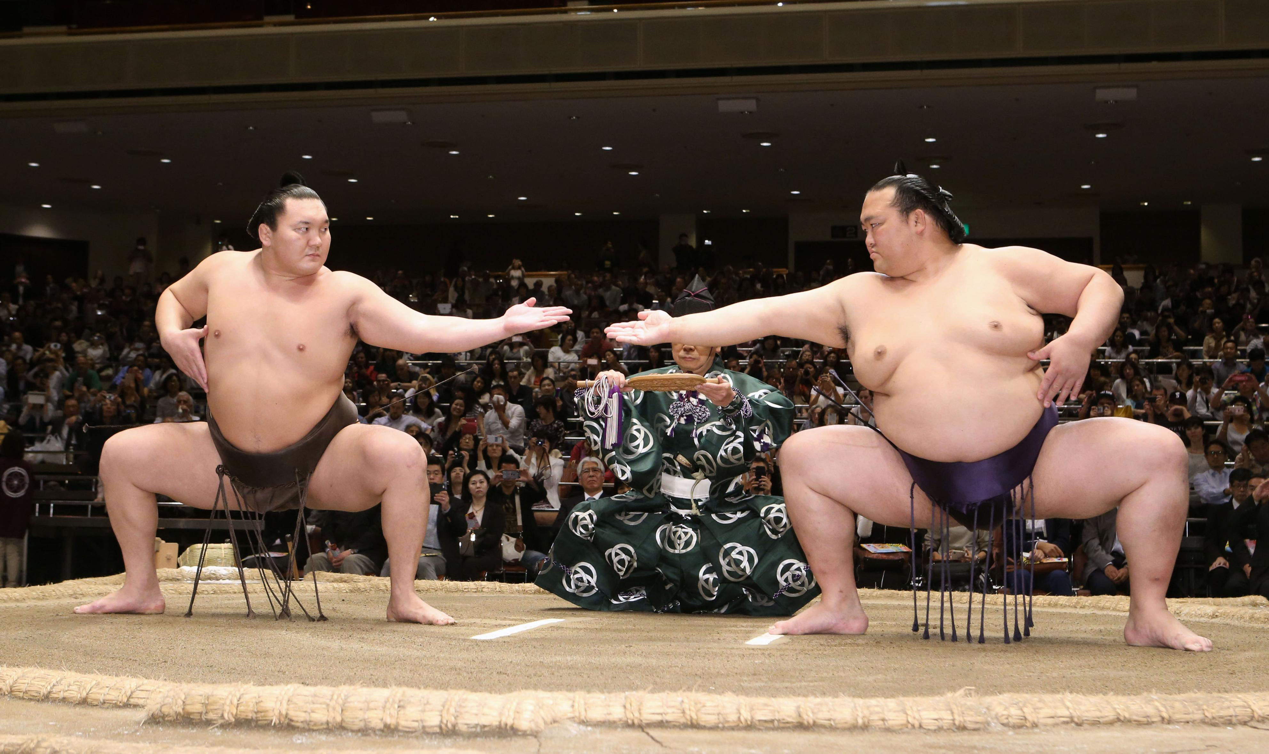
Bollocks
Testicles

Slide 21

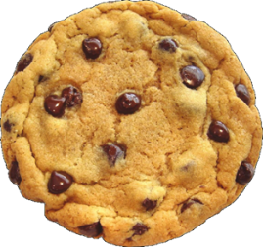
Cookie
Vagina

Slide 22


Package
Testicles (sometimes penis)

Slide 23
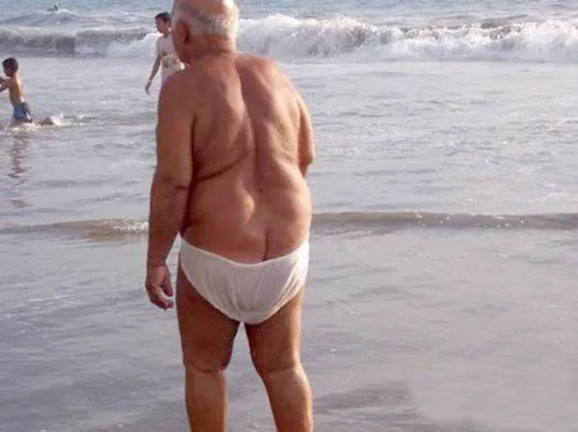
Derriere
Butt

Slide 24

Badunkadonk
Butt

Slide 25
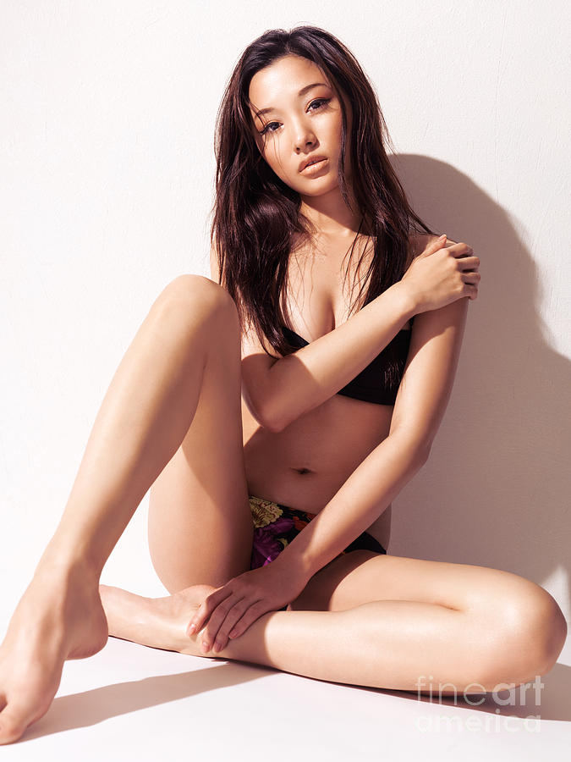

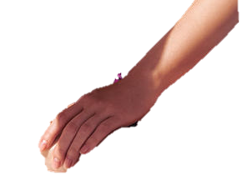
Muff
Vagina (public hair)

Slide 26
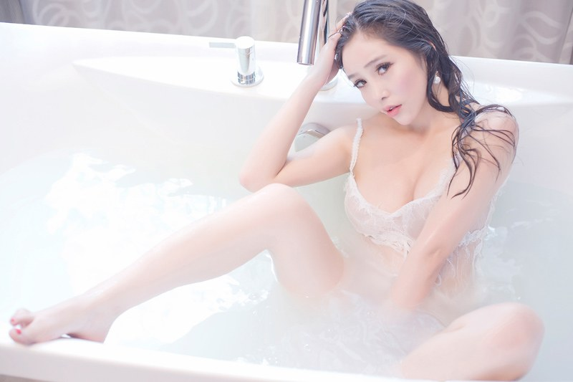

Love tunnel
Vagina

Slide 27
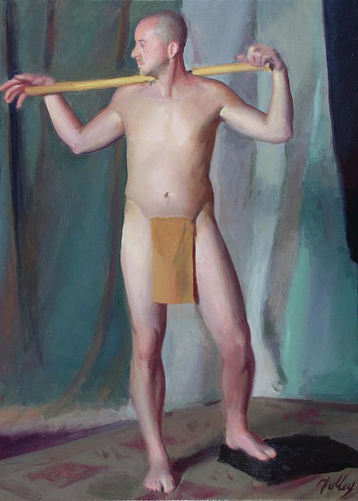
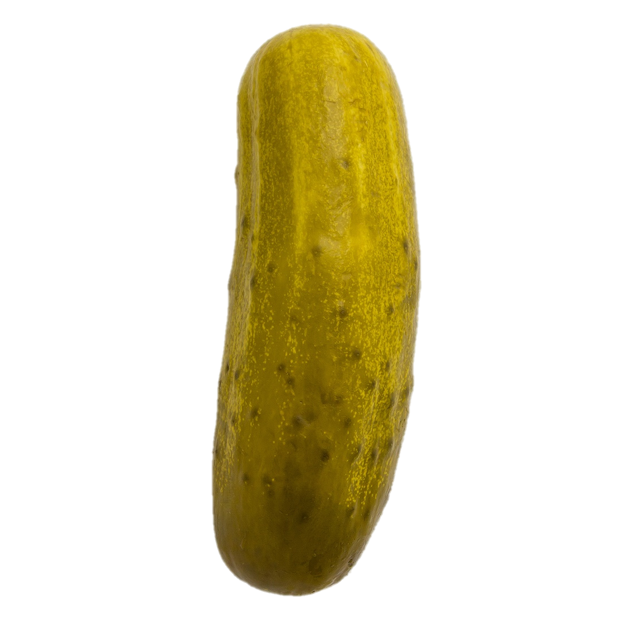
Pickle
Penis

Slide 28

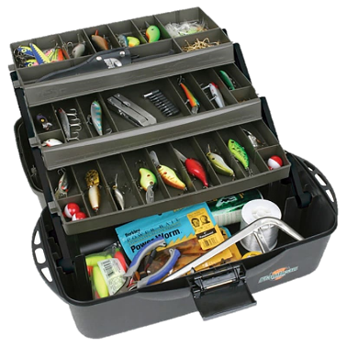
Wedding tackle
Testicles

Slide 29
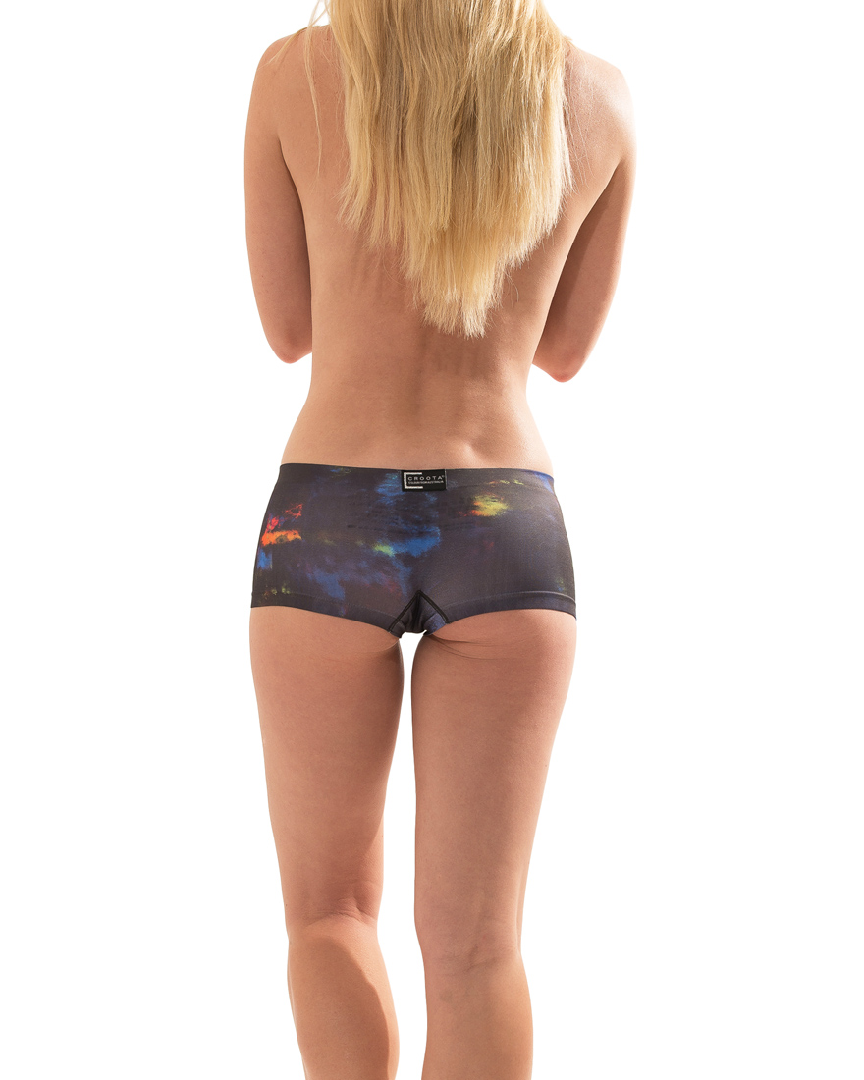
Tukhus
Butt

Slide 30

Coochie
Vagina

Slide 31
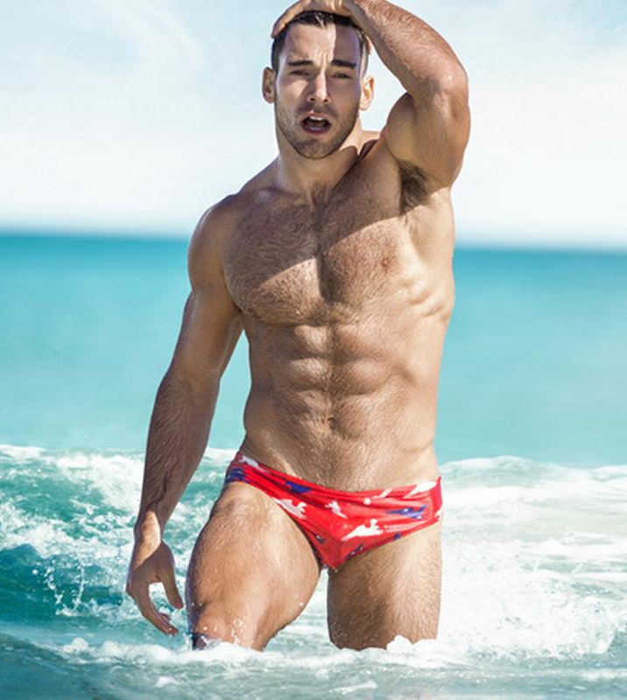
Scrotum
Testicles

Slide 32
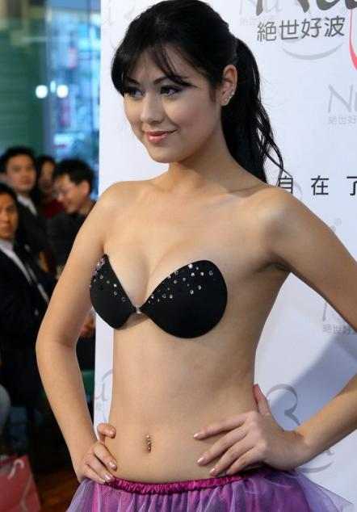
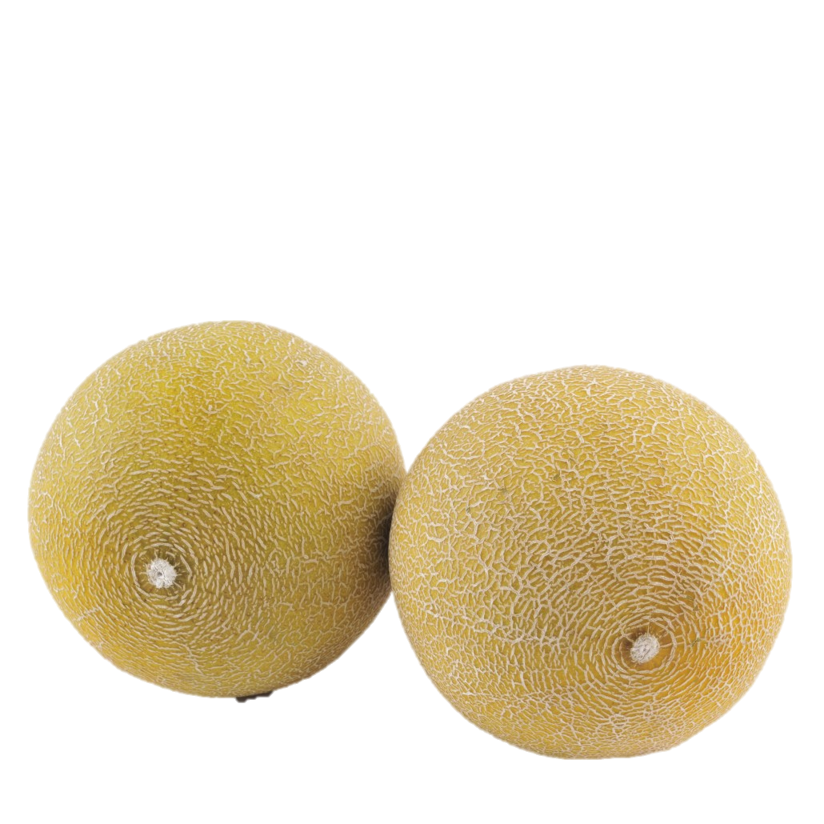
Melons
Watermelons if large
Breasts

Slide 33
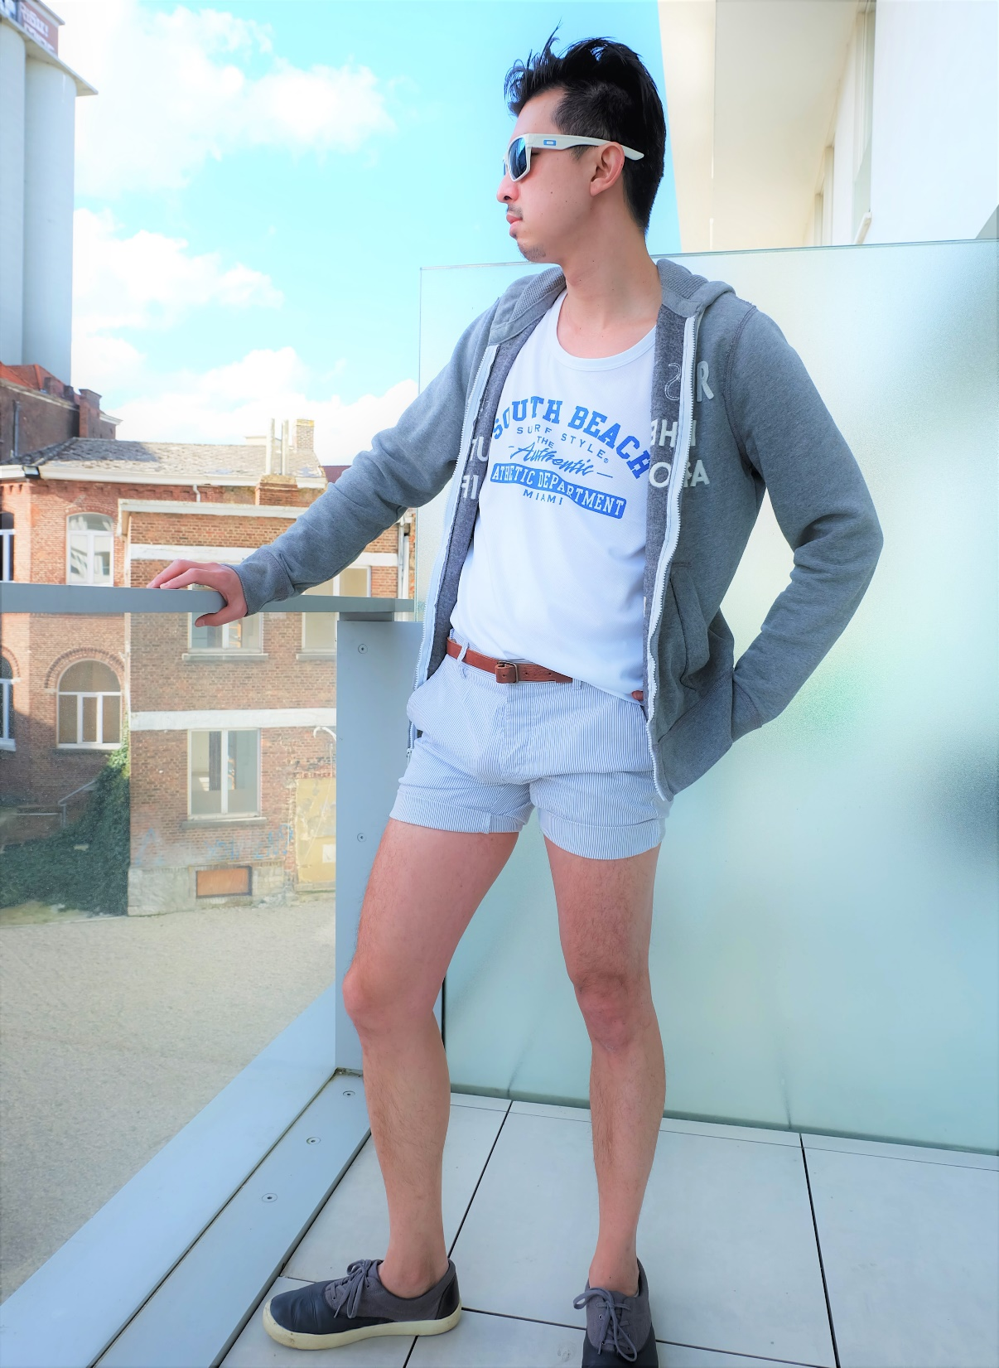
The boys
Testicles

Slide 34
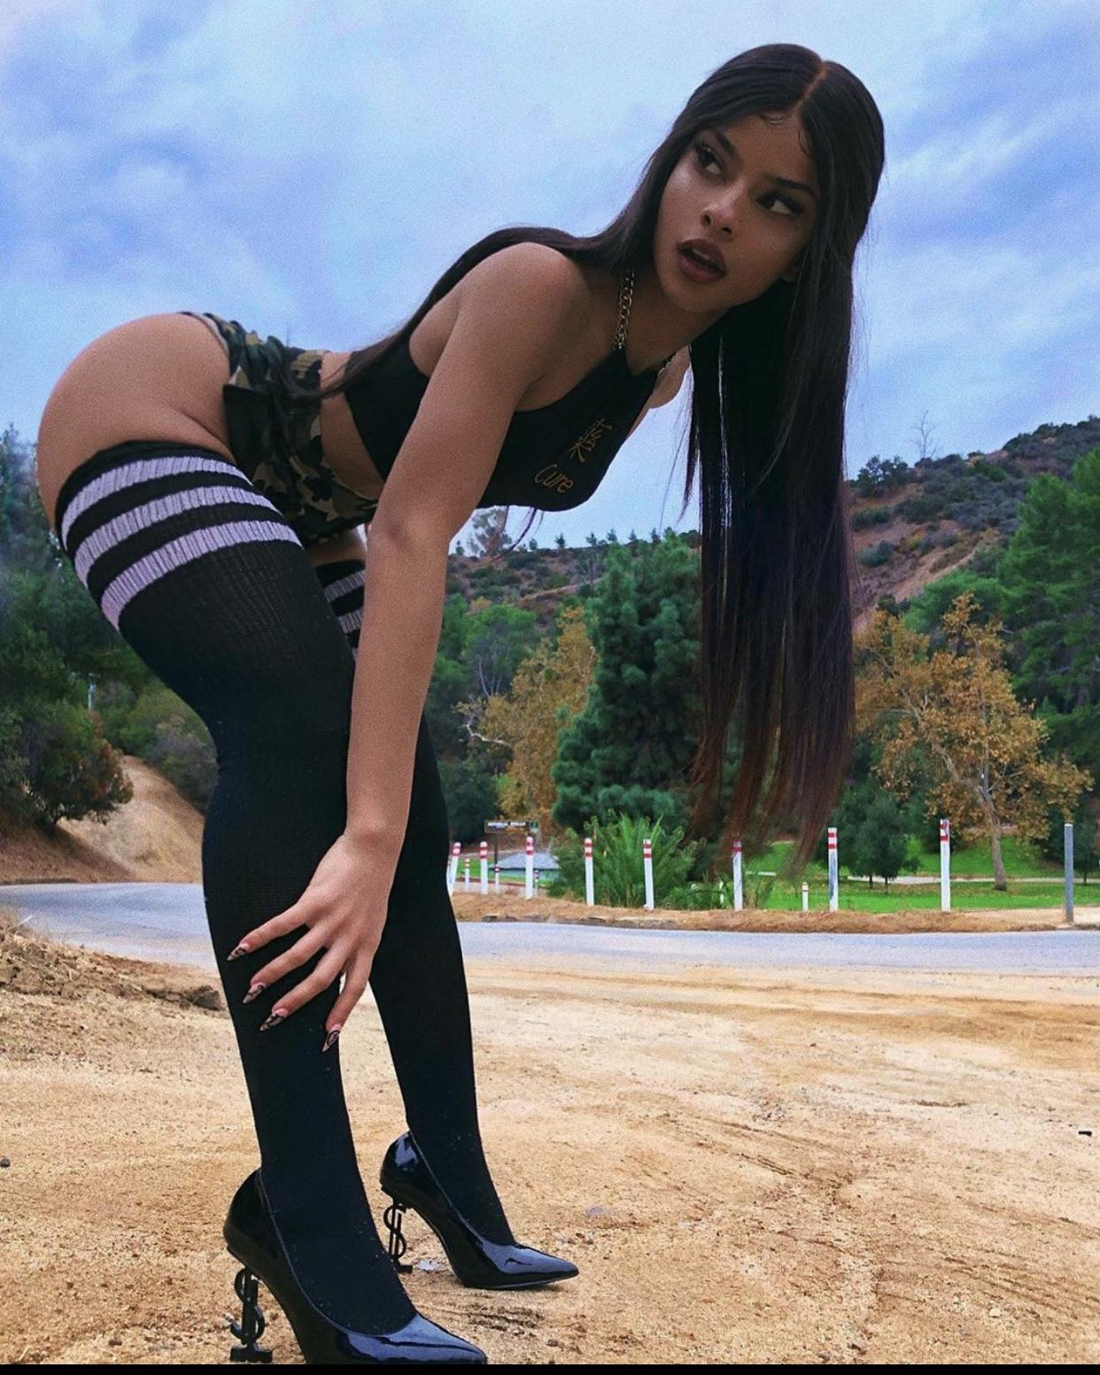
Rump
Butt

Slide 35

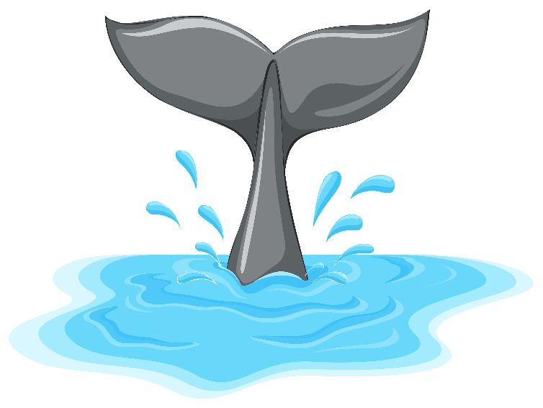
Tail
Butt

Slide 36
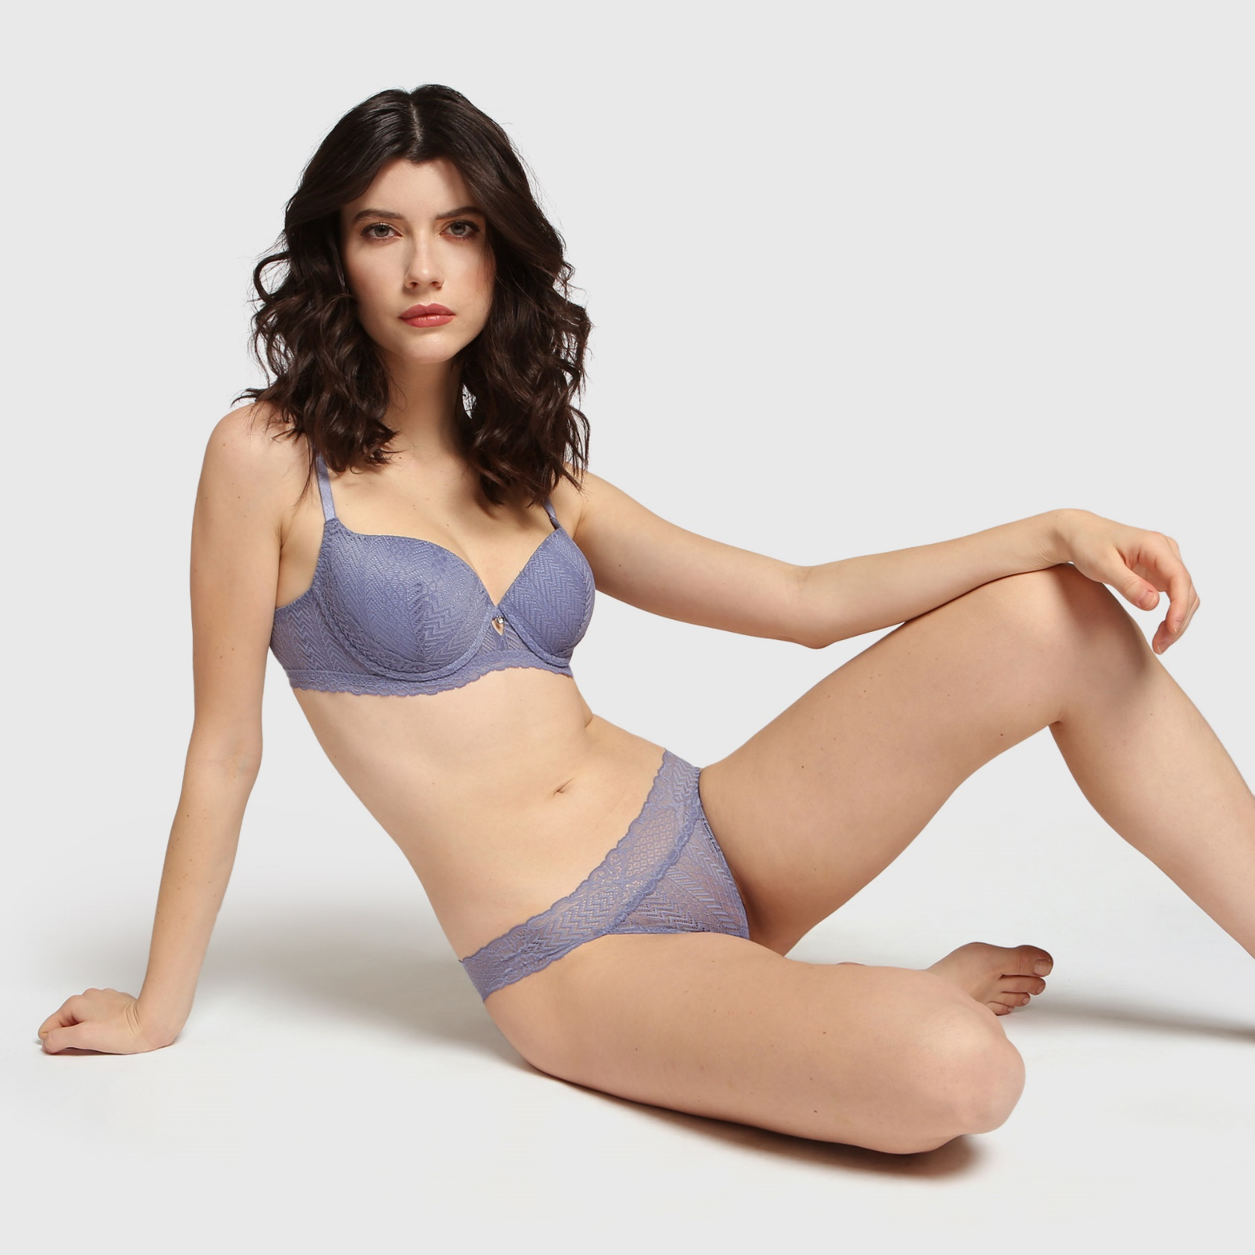
Twat
Vagina

Slide 37

Buttocks
Butt

Slide 38

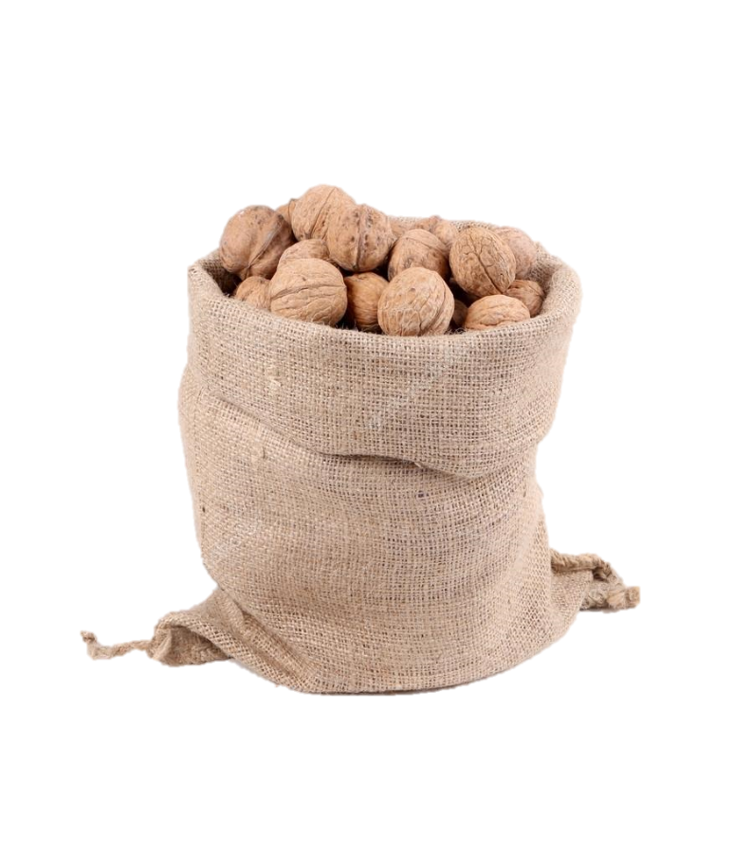

Nutsack
Testicles

Slide 39
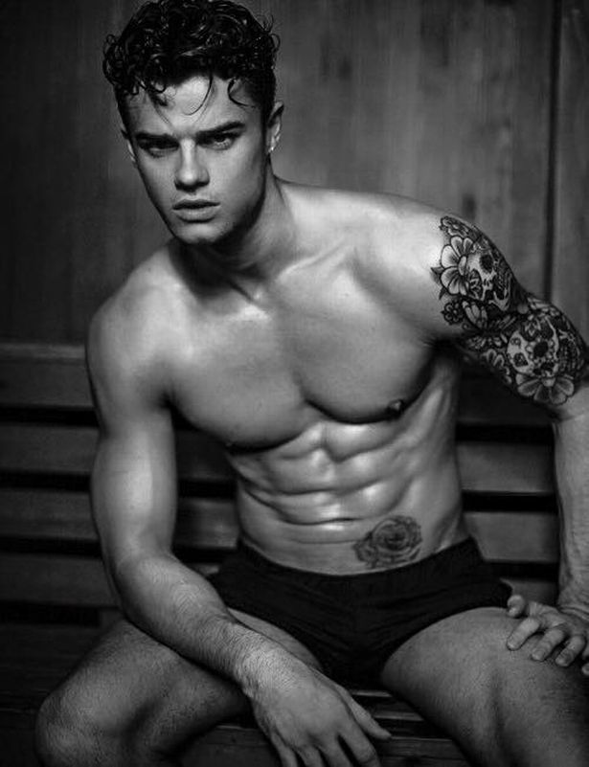
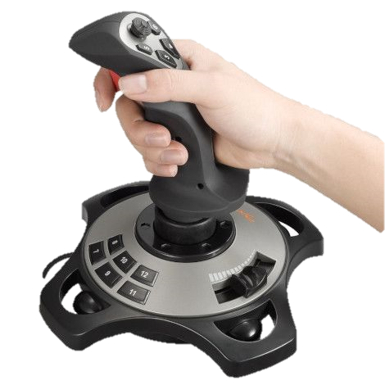
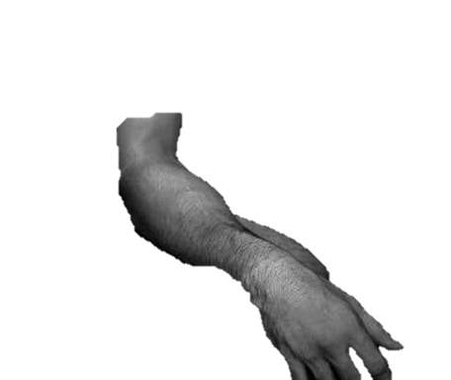
Joystick
Penis

Slide 40
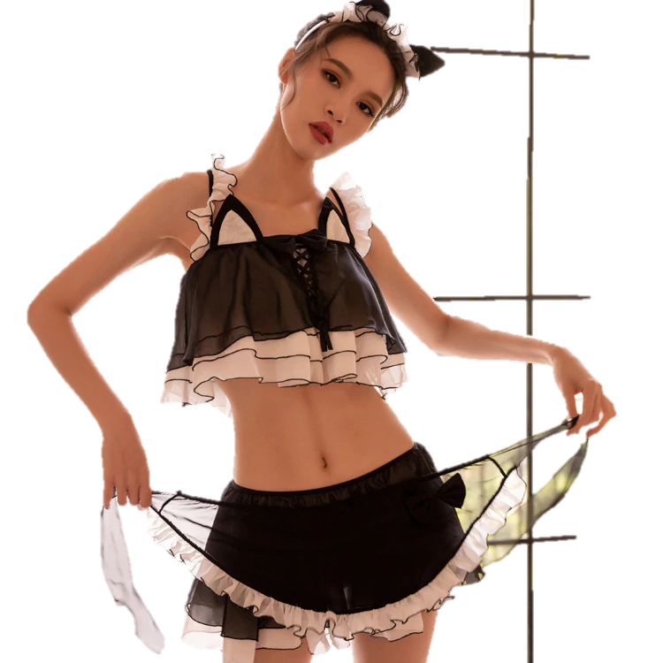

Headlights
Breasts

Slide 41

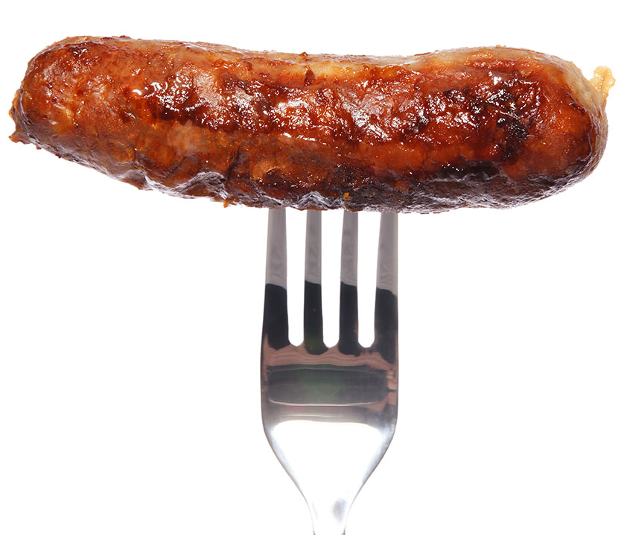
Sausage
Penis

Slide 42
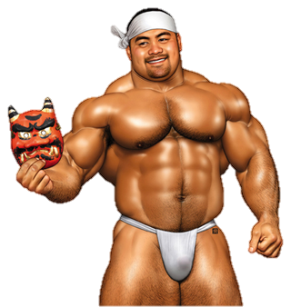

The D
Penis (short for dick)

Slide 43
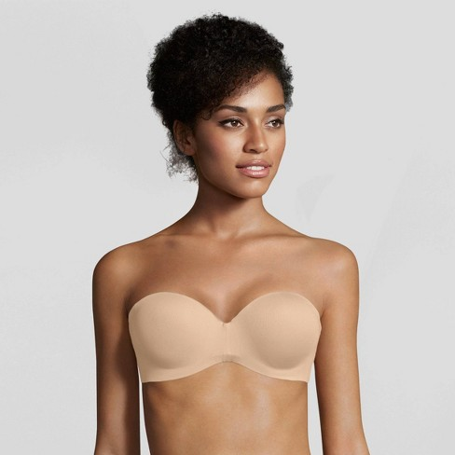

Bosom
Breasts

Slide 44
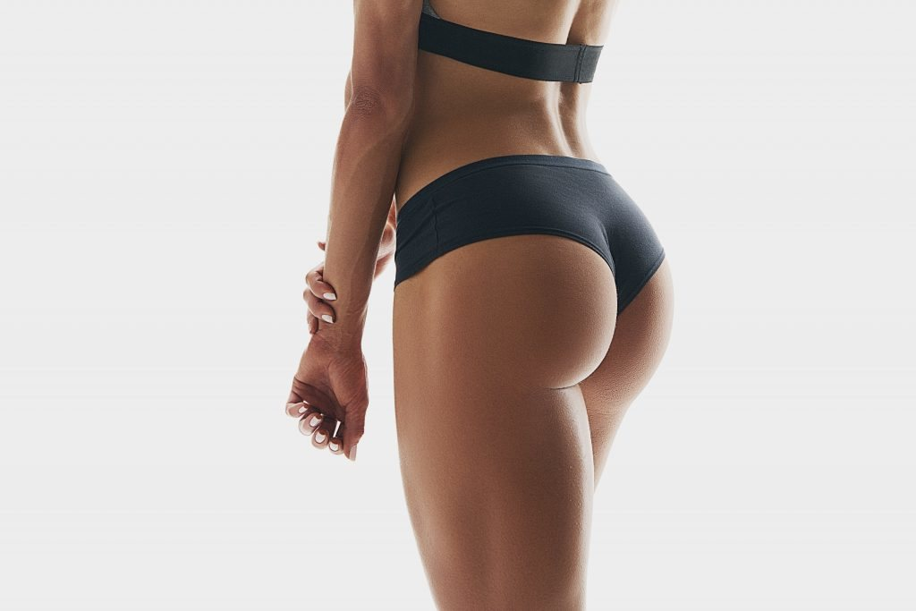
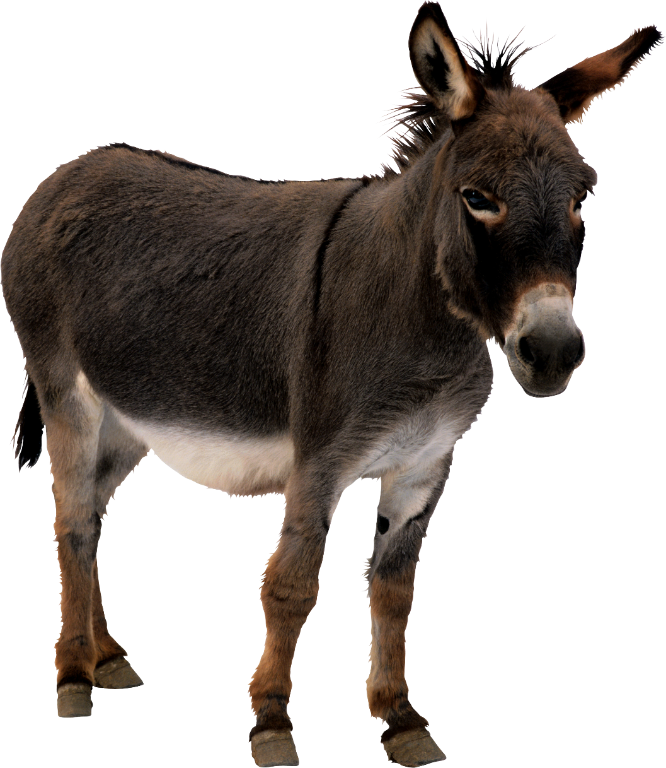
Ass
Butt

Slide 45
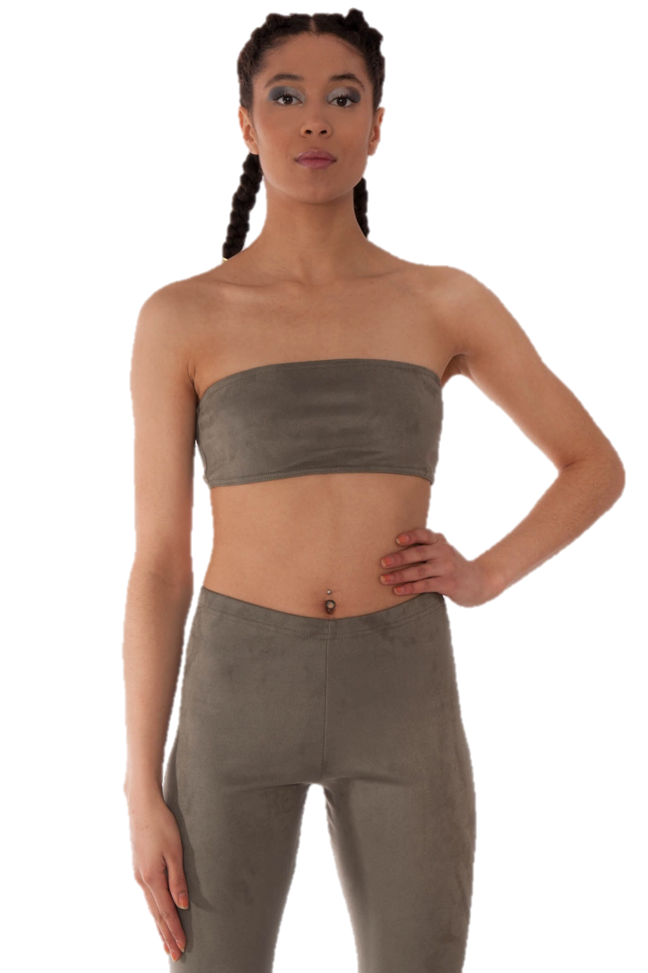


The girls
(the twins)
Breasts

Slide 46
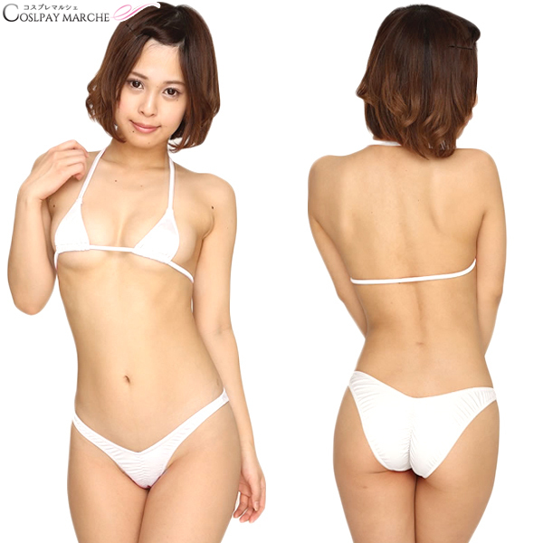
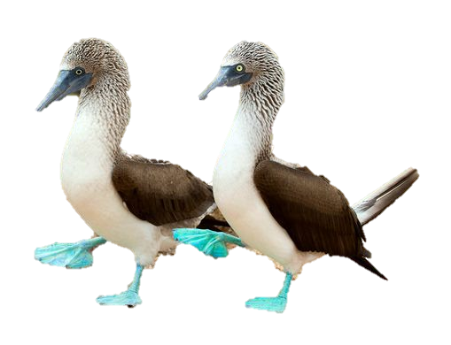
Boobies
Breasts

Slide 47

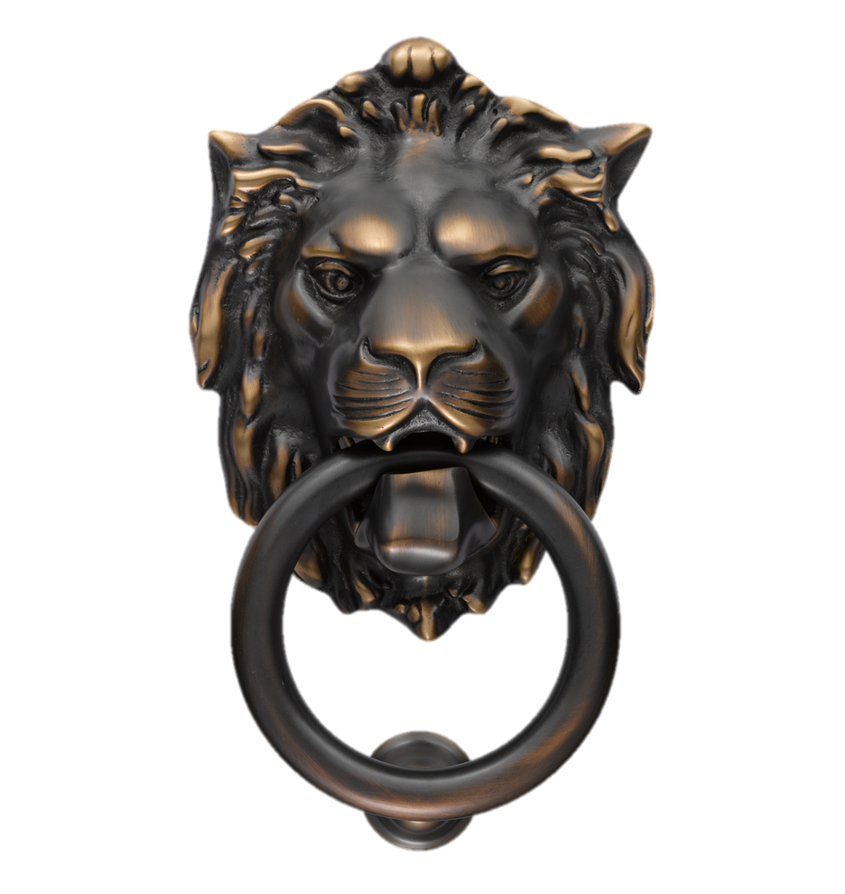
Knockers
Breasts

Slide 48

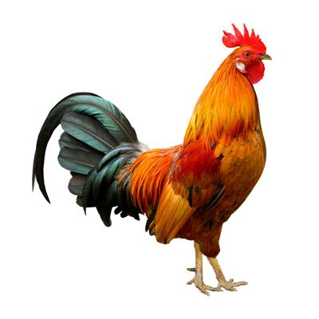
Cock
Penis

Slide 49
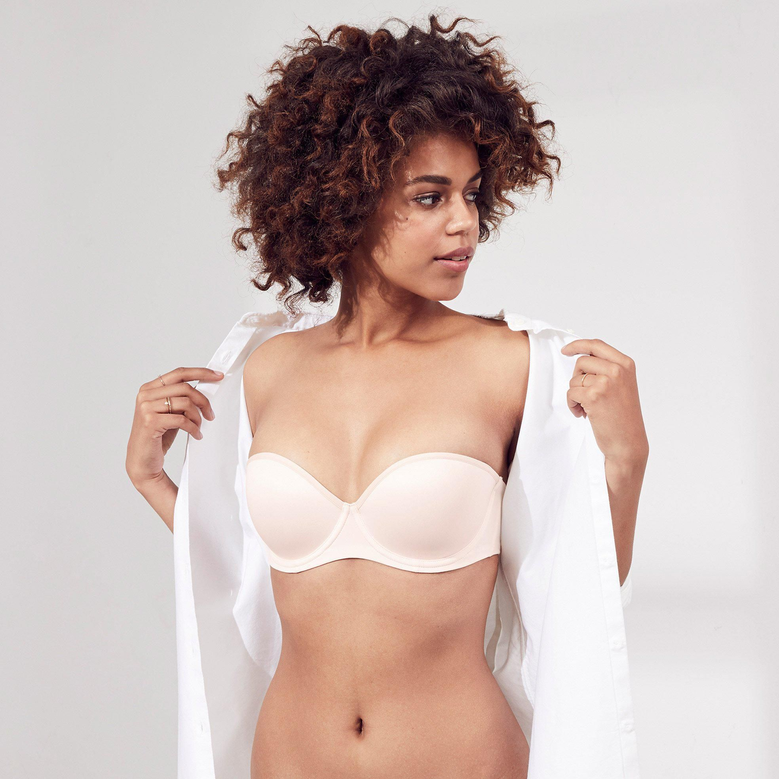
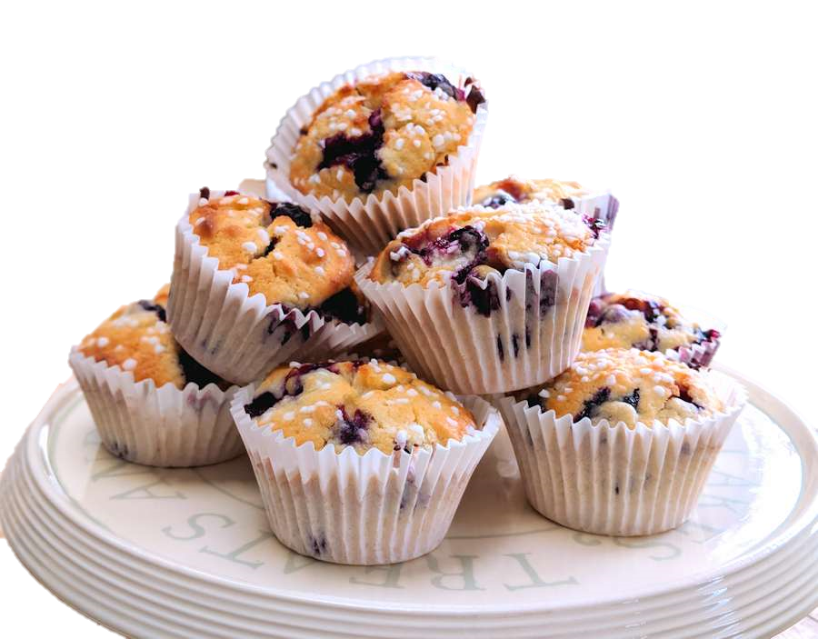
Love muffins
Breasts

Slide 50
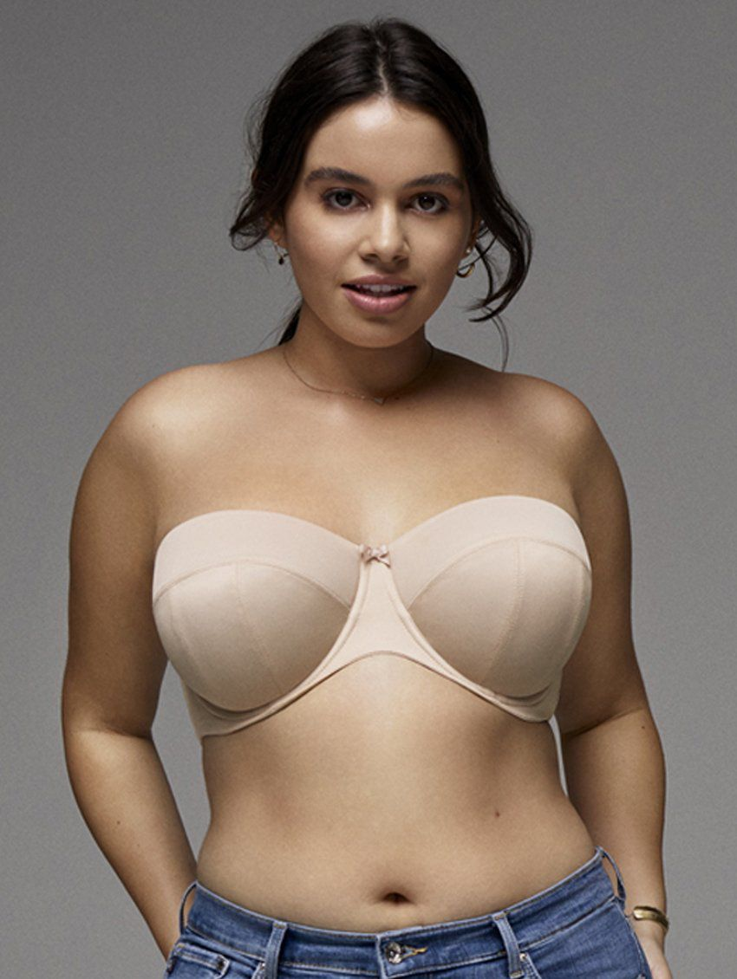
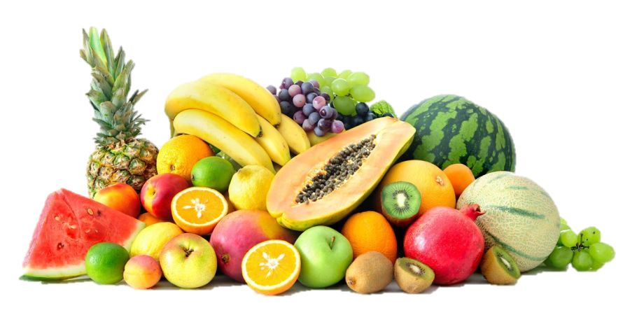
Peaches, Tomatoes, Avocados
Depends on size
Breasts

Slide 51
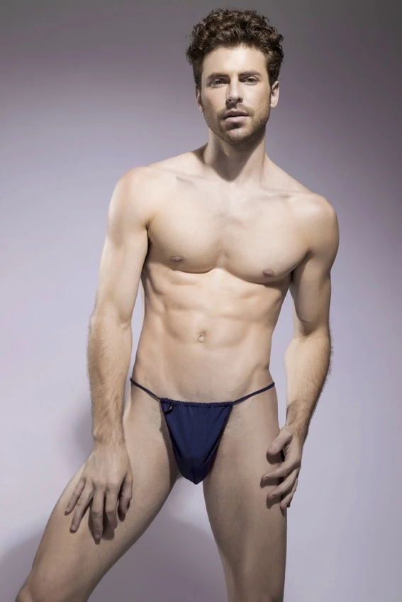
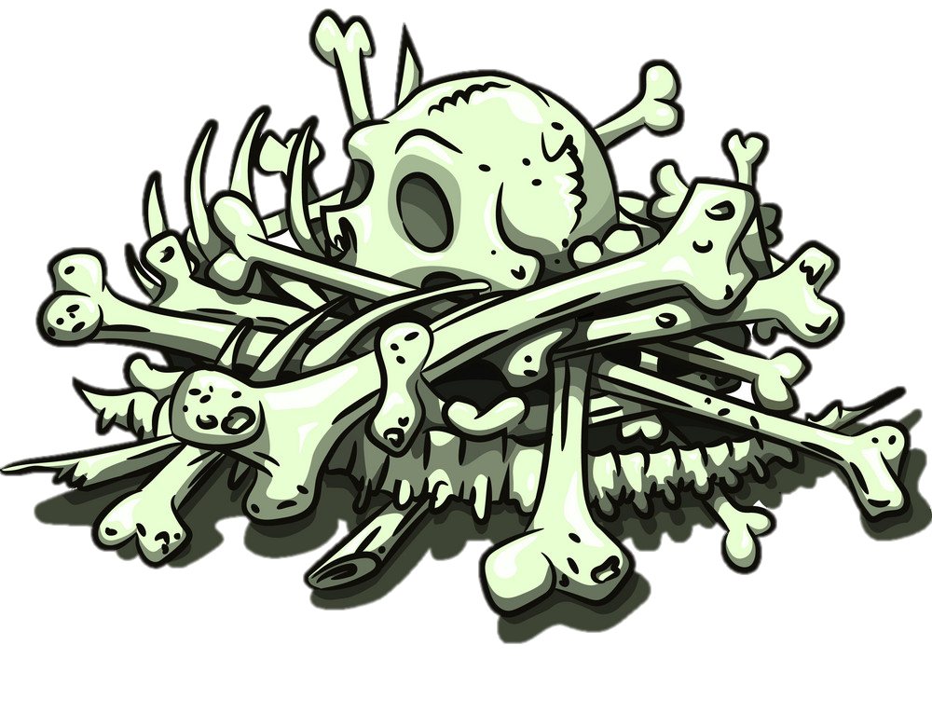
Boner
Erect Penis

Slide 52


One eyed Monster
Penis

Slide 53


Purple headed monster
Penis

Slide 54

Tush / tushie
Butt

Slide 55

Cooter
Vagina

Slide 56


Honkers
Breasts

Slide 57

Nads
Testicles

Slide 58

Junk in the Trunk
Large butt

Slide 59


Jugs
Breasts

Slide 60


Dick
Penis

Slide 61

Vajayjay
Vagina

Slide 62

Backside
Butt

Slide 63


Backdoor
Butt

Slide 64

Cunt
Vagina

Slide 65


Pecker
Penis

Slide 66

Shaft
Penis

Slide 67


Wang
Penis

Slide 68


Snake
Penis

Slide 69


Pussy
Vagina

Slide 70


Pink taco
Vagina

Slide 71


Moon
Butt

Slide 72


Weiner
Penis

Slide 73

Lady parts
(girly bits)
Vagina

Slide 74



Willie
Penis

Slide 75


Sack
Testicles

Slide 76


Buns
Butt

Slide 77


Booty
Butt

Slide 78


Anaconda
Penis

Slide 79


Hooters
Breasts

Slide 80


Clam
Vagina

Slide 81


Slit
Vagina

Slide 82


Tits
Breasts

Slide 83


Family jewels
Breasts

Slide 84


Nuts
Testicles

Slide 85

Arse
Butt

Slide 86


Money maker
Butt

Slide 87


Assets
Breasts (or butt)

Slide 88


Johnson
Penis

Slide 89


Disco stick
Penis

Slide 90


Snatch
Vagina

Slide 91


Beaver
Vagina (pubic hair)

Slide 92


Muffin
Vagina

Slide 93

Dangly bits
Testicles

