Slide 1
BARTERING

Slide 2
BARTERING
exchange goods or services for other goods or services without using money.

Slide 3
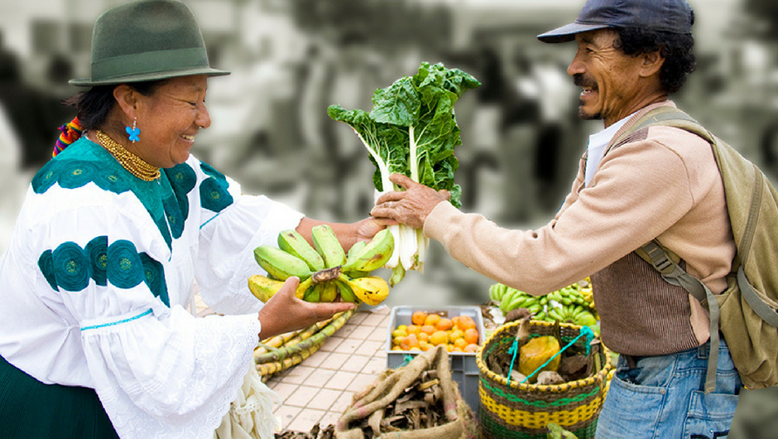
BARTERING
exchange goods or services for other goods or services without using money.

Slide 4
HAGGLE

Slide 5
ALTERNATIVE MONEY
Cows, Buckskins, Chocolate, Tobacco, Shells, Tea Bricks
Canadian Tire Money, BitCoin

Slide 6
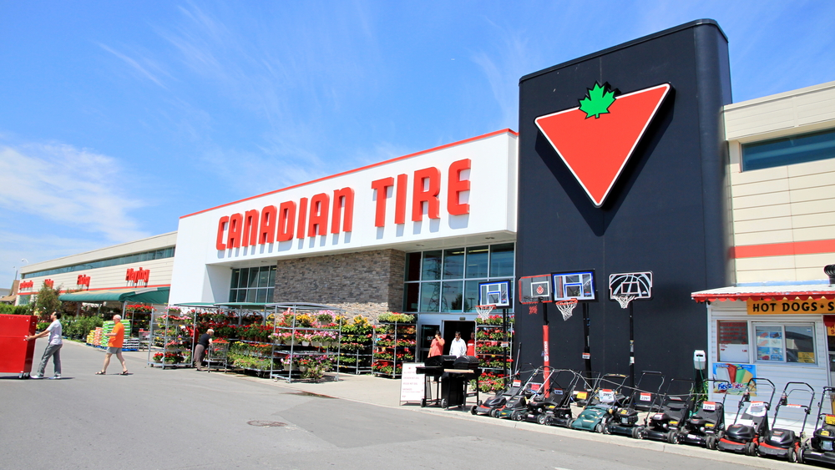
ALTERNATIVE MONEY
Cows, Buckskins, Chocolate, Tobacco, Shells, Tea Bricks
Canadian Tire Money, BitCoin

Slide 7
SWAP

Slide 8
CONDITIONAL SENTENCES
If you give me ________, I will give you __________.

Slide 9
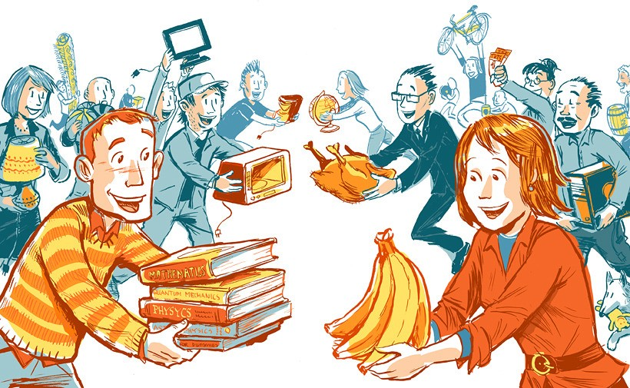
CONDITIONAL SENTENCES
If you give me ________, I will give you __________.

Slide 10
EXCHANGE

Slide 11
WE STUDIED
Pathos, value, negotiation
A good salesperson wants to solve a problem

Slide 12
WE STUDIED
Pathos, value, negotiation
A good salesperson wants to solve a problem

Slide 13
TRADE

Slide 14
BORROW vs LEND
Can I borrow a pencil.
Can you lend me an eraser.

Slide 15
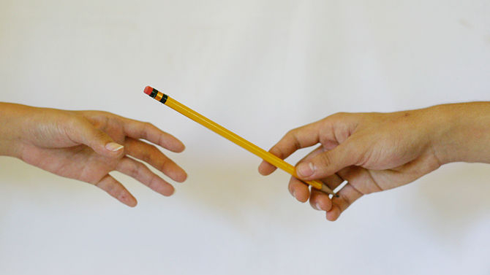
BORROW vs LEND
Can I borrow a pencil.
Can you lend me an eraser.

Slide 16
one RED paperclip

Slide 17
Fish-shaped Pen
July 14, 2005

Slide 18
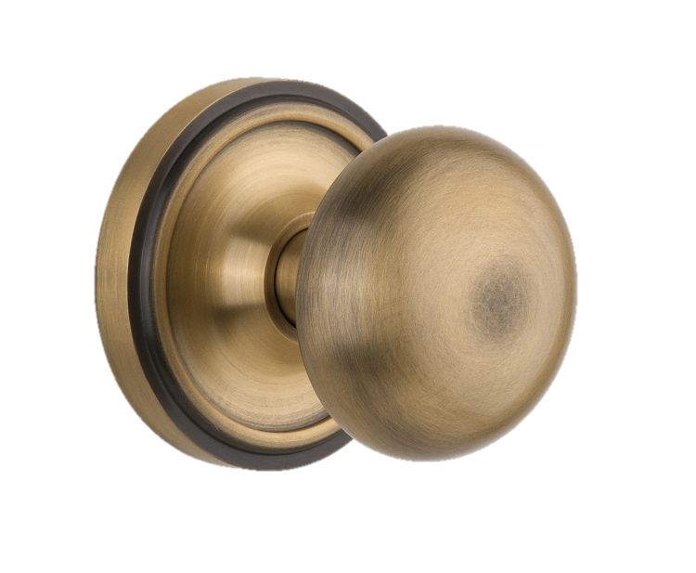
Hand-sculpted
Doorknob
July 14, 2005

Slide 19
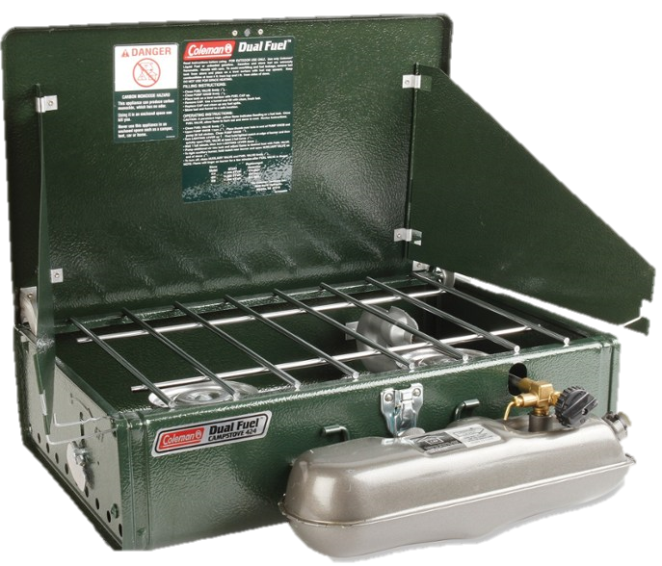
July 25, 2005
Coleman
Camp Stove

Slide 20
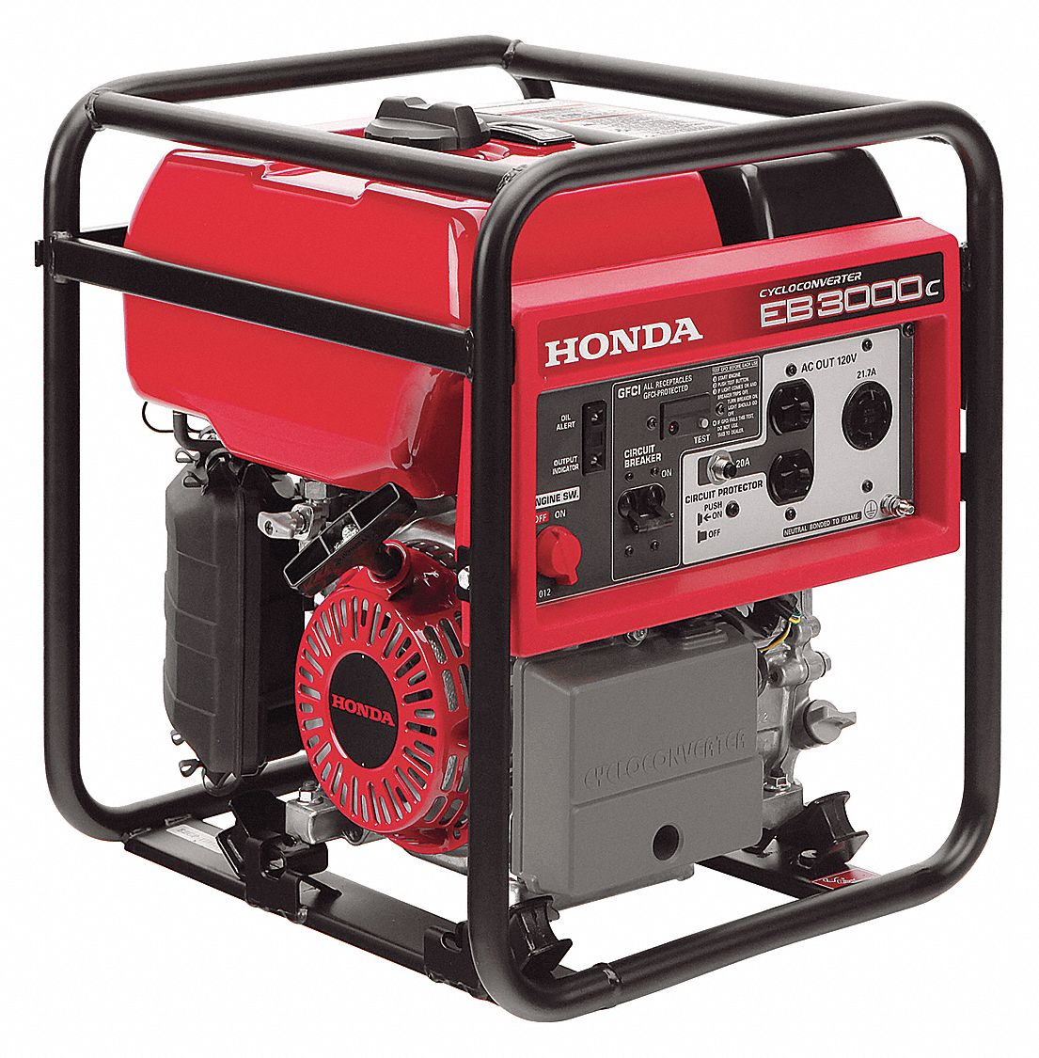
Honda Generator
Sept. 24, 2005

Slide 21
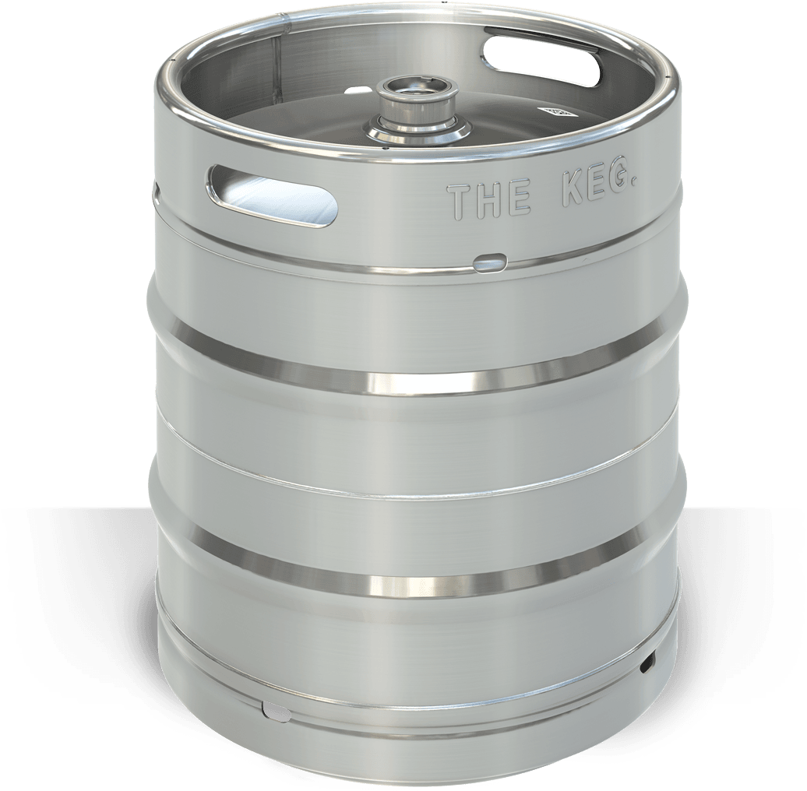
“Instant Party”
Nov. 16, 2005

Slide 22
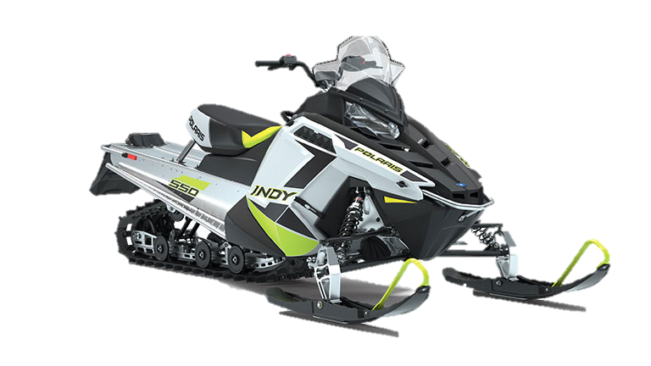
Ski-Doo
Dec. 8, 2005

Slide 23
December 2005
Two-person
Trip to Yahk, BC

Slide 24
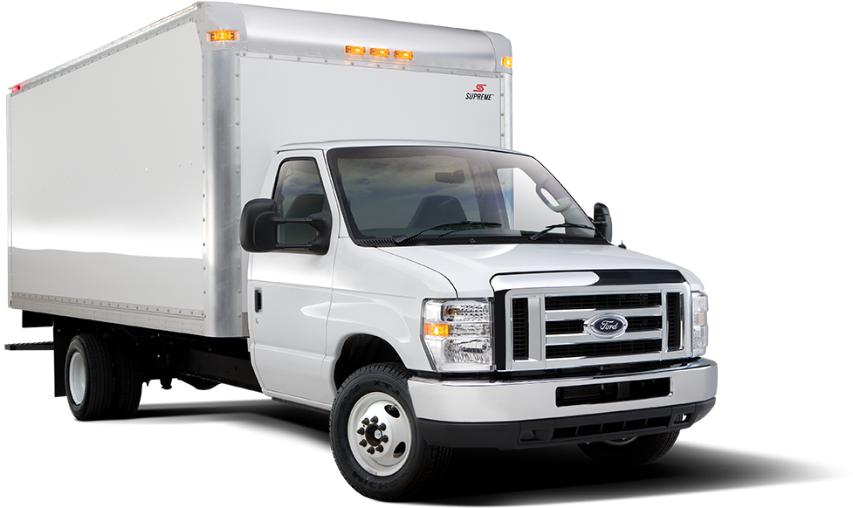
Box Truck
Jan. 7, 2006

Slide 25
Recording
Contract (music)
Feb. 22, 2006

Slide 26
April 11, 2006
1-Year Rent in
Phoenix, ARI

Slide 27
Afternoon
w/ Alice Cooper
April 26, 2006

Slide 28
May 26, 2006
KISS motorized
snow globe

Slide 29
June 2, 2006
Film Role
(Donna on Demand)

Slide 30
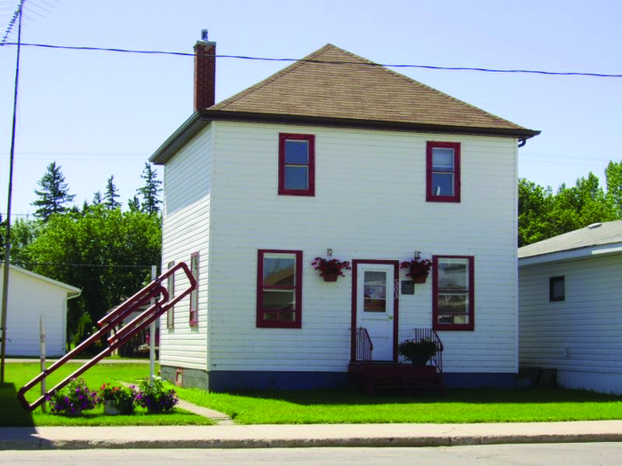
July 5, 2006
Two-story Farmhouse
(Kipling, Sask.)

Slide 31
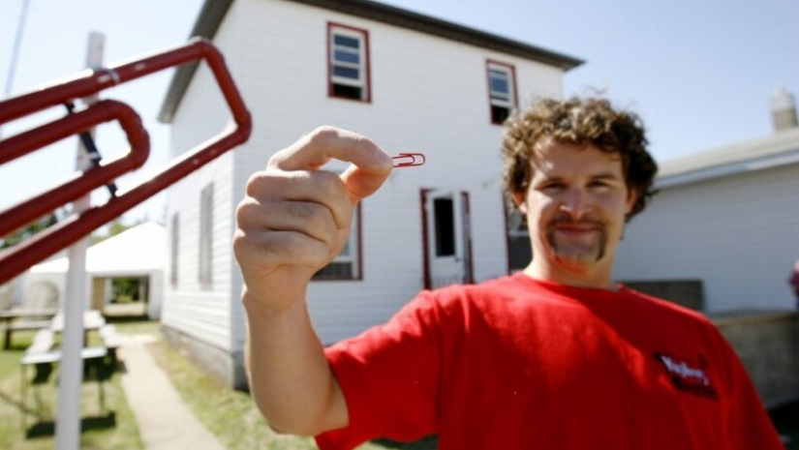

Slide 32
YOUR TURN
Deals are permanent.
Use conditionals to make deals with NTs / KTs
Back by end of class

Slide 33
http://oneredpaperclip.blogspot.com/
https://www.moneycrashers.com/best-bartering-swapping-websites/
https://www.bbc.com/worklife/article/20200821-the-rise-of-bartering-in-a-changed-world

