Slide 1
Web Based Activities
For use in the English classroom

Slide 2

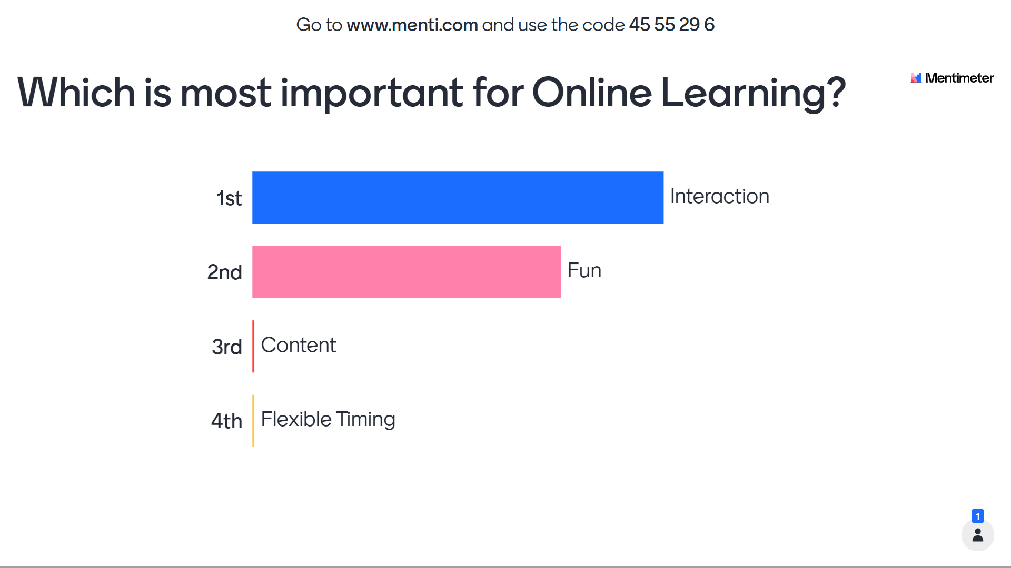

Slide 3


Slide 4

Kahoot!

Slide 5


Slide 6


Slide 7


Slide 8
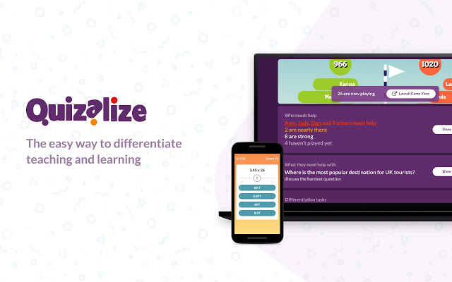

Slide 9


Slide 10



Slide 11


Slide 12
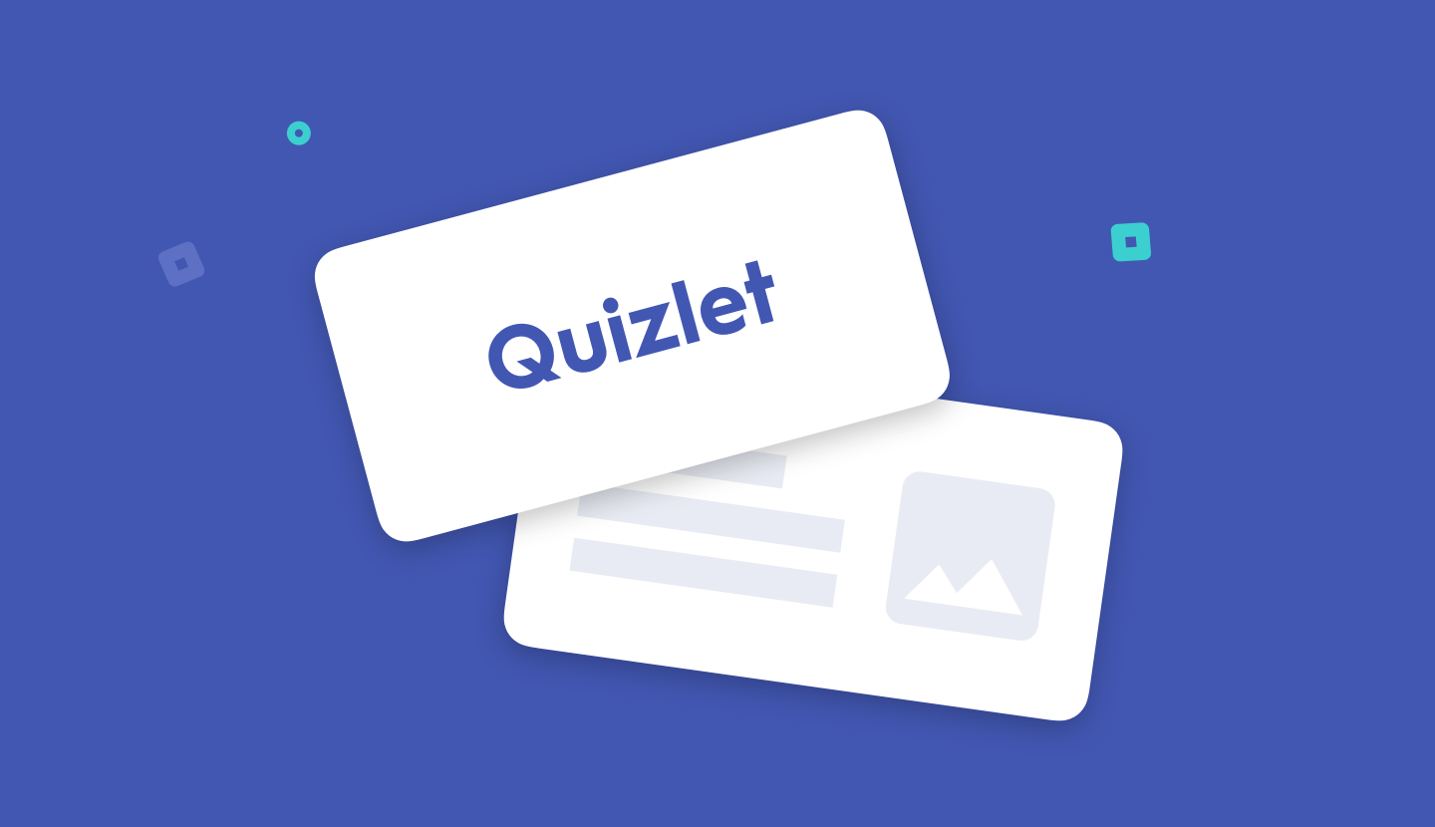
Quizelet

Slide 13
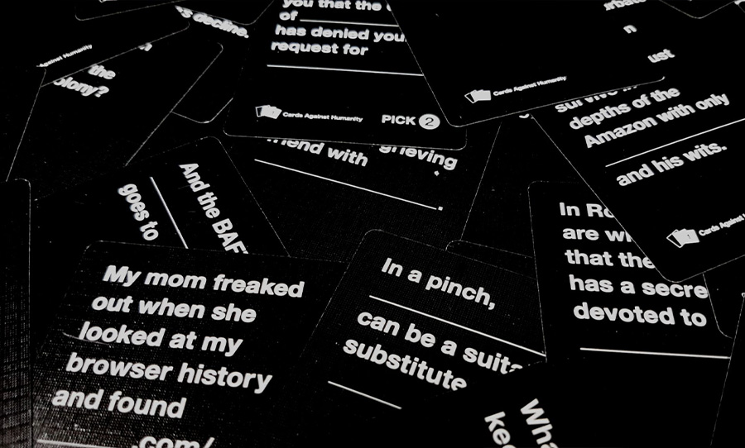
Cards Against Humanity

Slide 14
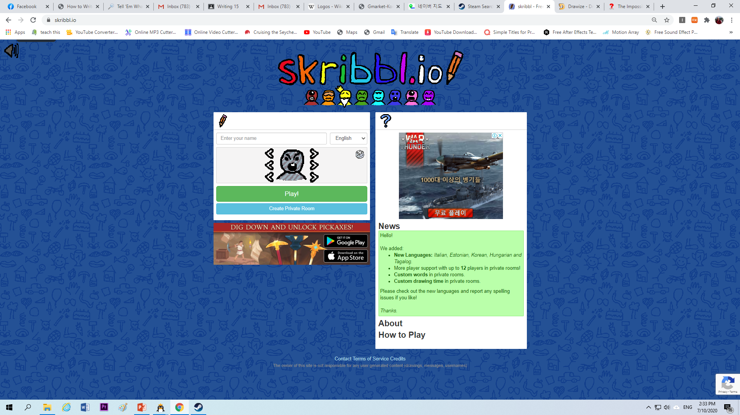


Slide 15


Slide 16



Slide 17

Steam
store.steampowered.com

Slide 18

Scribblenauts

Slide 19

Use Your Words

Slide 20


Slide 21

Jackbox
jackboxgames.com

Slide 22
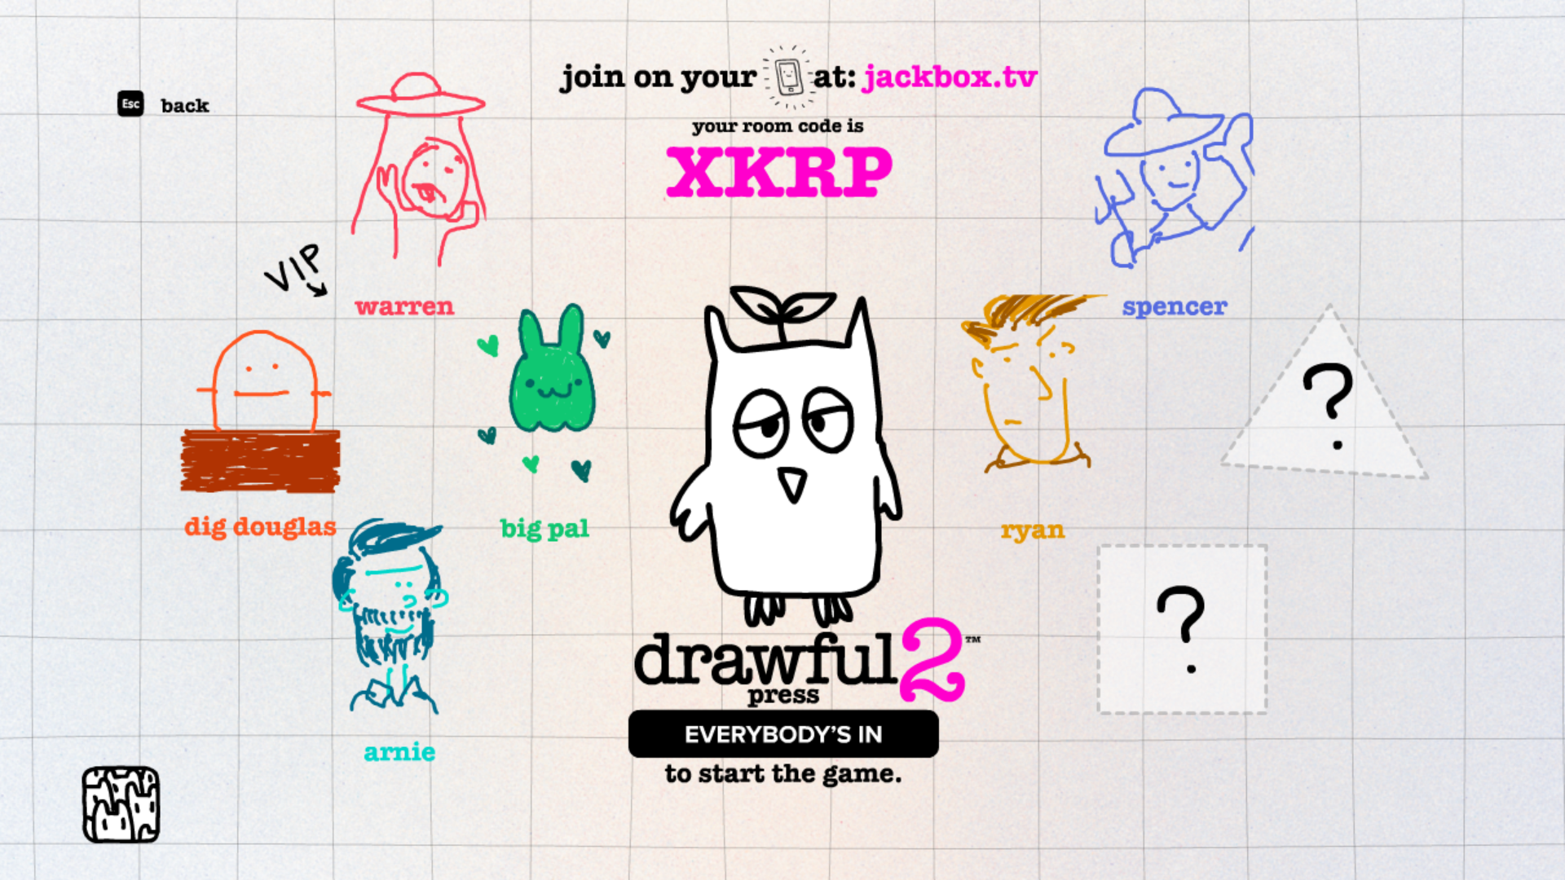
Drawful

Slide 23

Lie Swatter

Slide 24

Word Spud

Slide 25

You Don’t Know Jack

Slide 26
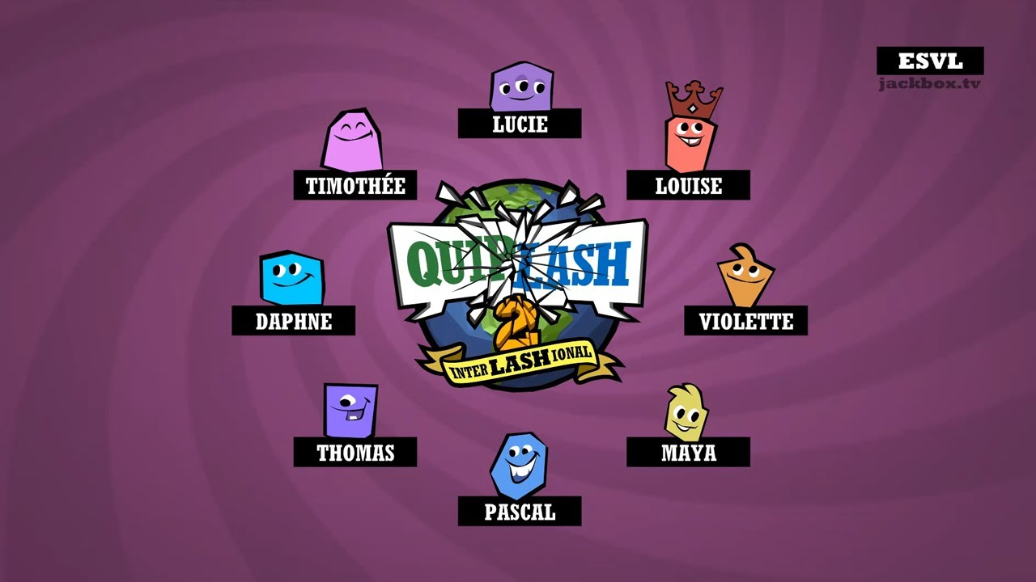

Slide 27
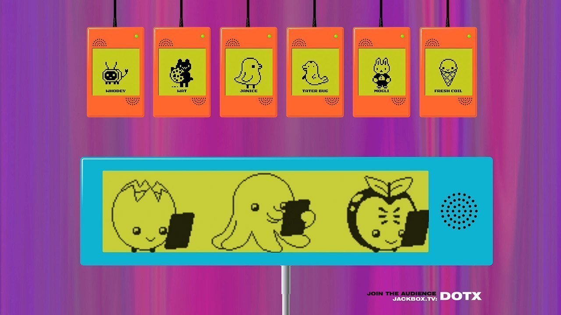
Earwax

Slide 28
https://ditchthattextbook.com/game-show-classroom-comparing-kahoot-quizizz-quizlet-live-and-quizalize/
https://technologypursuit.edublogs.org/2019/05/27/kahoot-quizizz-gimkit-what-should-i-use/

Slide 29
ESL toybox
www.esltoybox.com

