Slide 1
Meaning-Based ESL

Slide 2
Flingledobe and Pribin (Lavoie, 1989)
Last Serny, Flingledobe and Pribin were in the Berdlink treppening gloopy caples and cleaming burly greps. Suddenly, a ditty strezzle boofed into Flingledobe’s tresk. Pribin glaped. “Oh Flingledobe,” he chifed, “that ditty strezzle is tunning in your grep!”
Lavoie, R.D. Understanding Learning Disabilities - How Difficult Can It Be? PBS Video. Alexandria, VA. 1989
Notes:
https://www.youtube.com/watch?v=Q3UNdbxk3xs

Slide 3
Flingledobe and Pribin (Lavoie, 1989)
Last Serny, Flingledobe and Pribin were in the Berdlink treppening gloopy caples and cleaming burly greps. Suddenly, a ditty strezzle boofed into Flingledobe’s tresk. Pribin glaped. “Oh Flingledobe,” he chifed, “that ditty strezzle is tunning in your grep!”
When did they go to Berdlink?

Slide 4
Flingledobe and Pribin (Lavoie, 1989)
Last Serny, Flingledobe and Pribin were in the Berdlink treppening gloopy caples and cleaming burly greps. Suddenly, a ditty strezzle boofed into Flingledobe’s tresk. Pribin glaped. “Oh Flingledobe,” he chifed, “that ditty strezzle is tunning in your grep!”
When did they go to Berdlink?

Slide 5
Flingledobe and Pribin (Lavoie, 1989)
Last Serny, Flingledobe and Pribin were in the Berdlink treppening gloopy caples and cleaming burly greps. Suddenly, a ditty strezzle boofed into Flingledobe’s tresk. Pribin glaped. “Oh Flingledobe,” he chifed, “that ditty strezzle is tunning in your grep!”
Where did Flingledobe and Pribin treppen?

Slide 6
Flingledobe and Pribin (Lavoie, 1989)
Last Serny, Flingledobe and Pribin were in the Berdlink treppening gloopy caples and cleaming burly greps. Suddenly, a ditty strezzle boofed into Flingledobe’s tresk. Pribin glaped. “Oh Flingledobe,” he chifed, “that ditty strezzle is tunning in your grep!”
Where did Flingledobe and Pribin treppen?

Slide 7
Flingledobe and Pribin (Lavoie, 1989)
Last Serny, Flingledobe and Pribin were in the Berdlink treppening gloopy caples and cleaming burly greps. Suddenly, a ditty strezzle boofed into Flingledobe’s tresk. Pribin glaped. “Oh Flingledobe,” he chifed, “that ditty strezzle is tunning in your grep!”
What boofed into Flingledobe’s tresk?

Slide 8
Flingledobe and Pribin (Lavoie, 1989)
Last Serny, Flingledobe and Pribin were in the Berdlink treppening gloopy caples and cleaming burly greps. Suddenly, a ditty strezzle boofed into Flingledobe’s tresk. Pribin glaped. “Oh Flingledobe,” he chifed, “that ditty strezzle is tunning in your grep!”
What boofed into Flingledobe’s tresk?

Slide 9
Flingledobe and Pribin (Lavoie, 1989)
Last Serny, Flingledobe and Pribin were in the Berdlink treppening gloopy caples and cleaming burly greps. Suddenly, a ditty strezzle boofed into Flingledobe’s tresk. Pribin glaped. “Oh Flingledobe,” he chifed, “that ditty strezzle is tunning in your grep!”
What kind of caples did Flingledobe and Pribin treppen?

Slide 10
Flingledobe and Pribin (Lavoie, 1989)
Last Serny, Flingledobe and Pribin were in the Berdlink treppening gloopy caples and cleaming burly greps. Suddenly, a ditty strezzle boofed into Flingledobe’s tresk. Pribin glaped. “Oh Flingledobe,” he chifed, “that ditty strezzle is tunning in your grep!”
What kind of caples did Flingledobe and Pribin treppen?

Slide 11
Flingledobe and Pribin (Lavoie, 1989)
Last Serny, Flingledobe and Pribin were in the Berdlink treppening gloopy caples and cleaming burly greps. Suddenly, a ditty strezzle boofed into Flingledobe’s tresk. Pribin glaped. “Oh Flingledobe,” he chifed, “that ditty strezzle is tunning in your grep!”
What did the ditty strezzle do to Flingledobe’s tresk?

Slide 12
Flingledobe and Pribin (Lavoie, 1989)
Last Serny, Flingledobe and Pribin were in the Berdlink treppening gloopy caples and cleaming burly greps. Suddenly, a ditty strezzle boofed into Flingledobe’s tresk. Pribin glaped. “Oh Flingledobe,” he chifed, “that ditty strezzle is tunning in your grep!”
What did the ditty strezzle do to Flingledobe’s tresk?

Slide 13
Flingledobe and Pribin (Lavoie, 1989)
Last Serny, Flingledobe and Pribin were in the Berdlink treppening gloopy caples and cleaming burly greps. Suddenly, a ditty strezzle boofed into Flingledobe’s tresk. Pribin glaped. “Oh Flingledobe,” he chifed, “that ditty strezzle is tunning in your grep!”
What was Pribin’s reaction at that point?

Slide 14
Flingledobe and Pribin (Lavoie, 1989)
Last Serny, Flingledobe and Pribin were in the Berdlink treppening gloopy caples and cleaming burly greps. Suddenly, a ditty strezzle boofed into Flingledobe’s tresk. Pribin glaped. “Oh Flingledobe,” he chifed, “that ditty strezzle is tunning in your grep!”
What was Pribin’s reaction at that point?

Slide 15
Flingledobe and Pribin (Lavoie, 1989)
Last Serny, Flingledobe and Pribin were in the Berdlink treppening gloopy caples and cleaming burly greps. Suddenly, a ditty strezzle boofed into Flingledobe’s tresk. Pribin glaped. “Oh Flingledobe,” he chifed, “that ditty strezzle is tunning in your grep!”
What do you think happened next?

Slide 16
Flingledobe and Pribin (Lavoie, 1989)
Last Serny, Flingledobe and Pribin were in the Berdlink treppening gloopy caples and cleaming burly greps. Suddenly, a ditty strezzle boofed into Flingledobe’s tresk. Pribin glaped. “Oh Flingledobe,” he chifed, “that ditty strezzle is tunning in your grep!”
Why do you think Flingledobe and Pribin went to Berlink?

Slide 17
Flingledobe and Pribin (Lavoie, 1989)
Last Serny, Flingledobe and Pribin were in the Berdlink treppening gloopy caples and cleaming burly greps. Suddenly, a ditty strezzle boofed into Flingledobe’s tresk. Pribin glaped. “Oh Flingledobe,” he chifed, “that ditty strezzle is tunning in your grep!”
Are they likely to return? Why? Why not?

Slide 18
Flingledobe and Pribin (Lavoie, 1989)
There is no meaning.
It shows how we can use syntax to gain information.
Did you really learn anything?

Slide 19
Accuracy
Fluency

Slide 20
Fluency
Fluency is the ability to produce language in a coherent, effortless way.

Slide 21
Fluency
When teaching for fluency, there is less emphasis on being correct and more emphasis on using the language. The goal of fluency-based teaching is comprehension. Students are better able to understand meaning through this approach. Fluency-based teaching has been shown to be more useful for learning a language, but it might not always be the best technique for teaching Korean high school students.

Slide 23
Fluency
When we focus on fluency activities we:
reflect natural language use.
deal with grammar implicitly.
encourage free production of the language. reflect automatic performance.
produce language that is not always predictable.
require the use of improvising, paraphrasing, repair and reorganization.
require real communication.

Slide 24
Accuracy
Accuracy is the ability to produce grammatically and lexically accurate English sentences.

Slide 25
Accuracy
In accuracy-based teaching, the emphasis is on being correct. Proper grammar and sentence structure is prioritized over understanding. Accuracy-based teaching is quite common in Korea as students prepare to take the SATs. It is also much easier to make test questions for accuracy rather than fluency.

Slide 27
Accuracy
When we focus on accuracy activities we:
focus on forming correct examples of language use.
Produce language in a controlled way.
Deal with grammar explicitly.
Insist on receiving grammatically correct and complete sentences.
Practice language out of context. Small samples of language.
Do not require authentic communication.

Slide 28
Discuss
What is more important in learning a foreign language: fluency or accuracy?

Slide 29
Accuracy
Fluency
Grammar exercises
Conversation
Role-play
Drills
Debate
Spelling Quizzes
Comprehension Check Questions

Slide 30
Bloom’s
Taxonomy

Slide 32
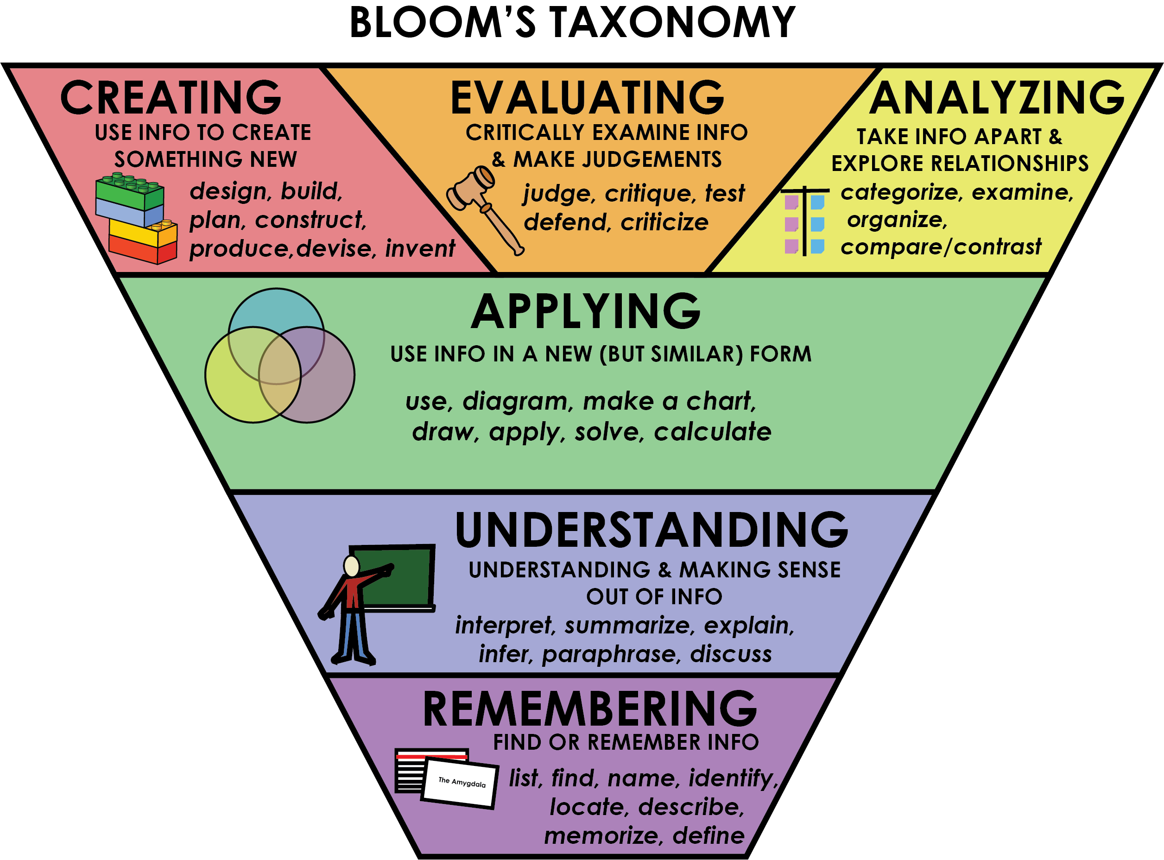

Slide 33
CyberTruck

Slide 34
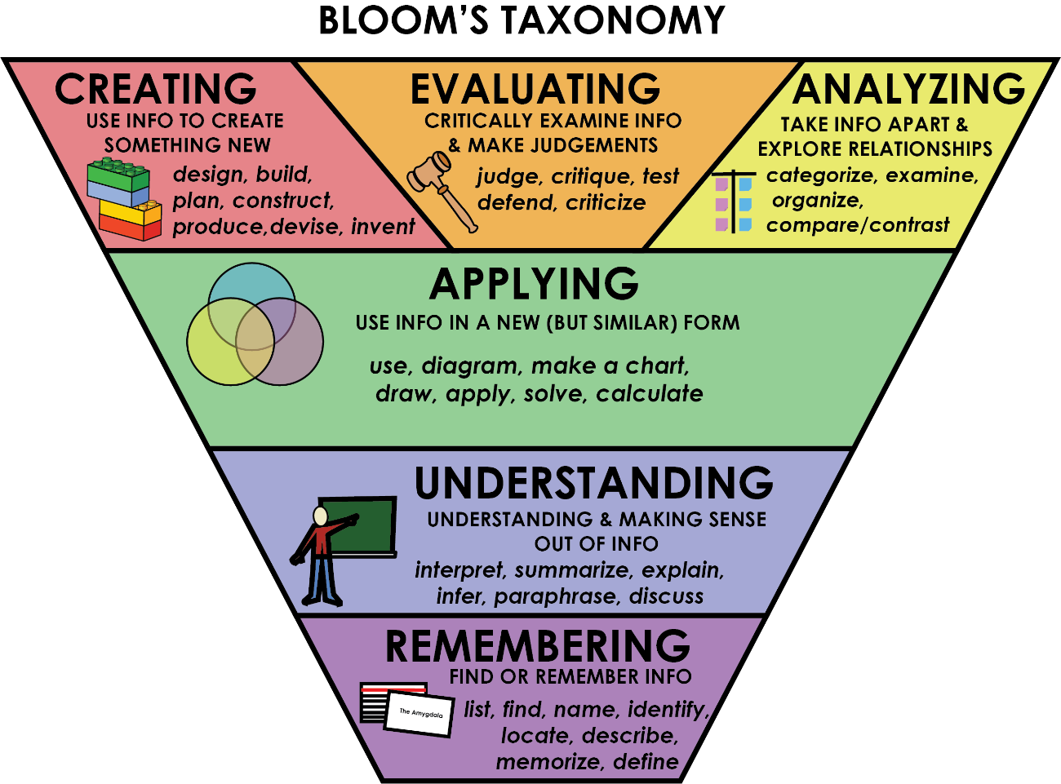
TESLA Cybertruck
Create a question for each step of Bloom’s taxonomy.

Slide 35
TESLA CYBERTRUCK

Slide 37
TESLA CYBERTRUCK

Slide 38
TESLA Cybertruck
Create a question for each step of Bloom’s taxonomy.

Slide 39
Word Salad
are
between
consists
continuously
corresponding
curve
draws
variation
graph
if
isolate
known
making
only
often
with
one
points
relationship
set
table
values
variables
Lavoie, R.D. Understanding Learning Disabilities - How Difficult Can It Be? PBS Video. Alexandria, VA. 1989
Notes:
https://www.youtube.com/watch?v=Q3UNdbxk3xs

Slide 40
Word Salad
If the known relationship between the variables consists of a table of corresponding values, the graph consists only of the corresponding set of isolated points. If the variables are known to vary continuously, one often draws a curve to show the variation.
Notes:
https://www.youtube.com/watch?v=Q3UNdbxk3xs

Slide 42
e duy m
me chi
qeer, saip Bi
eso
nd
lly, “I
“Bleas
cke
n a
o
o
e a d
becid
uitm
j
panbd
odsta
p
eqt
y
ecom
r.

Slide 43
“Bleas
e duy m
eso
me chi
cke
n a
nd
qeer, saip Bi
lly, “I
“Please buy me some chicken and beer,” said Billy. “I
becid
eqt
o
p
uitm
y
o
panbd
ecom
e a d
odsta
r.
j
decided to quit my job and become a popstar.

Slide 44
Lavoie, R.D. Understanding Learning Disabilities - How Difficult Can It Be? PBS Video. Alexandria, VA. 1989

Slide 45
“Come on.” said Betsy. “We have to
pick up this popcorn. We pop it have another can of popcorn.”

Slide 46
https://cft.vanderbilt.edu/guides-sub-pages/blooms-taxonomy/
Lavoie, R.D. Understanding Learning Disabilities - How Difficult Can It Be? PBS Video. Alexandria, VA. 1989
https://www.youtube.com/watch?v=Q3UNdbxk3xs
https://depts.washington.edu/dbpeds/fat-city-workshop-transcript.pdf
https://youtu.be/Q3UNdbxk3xs

Slide 47
ESL toybox
www.esltoybox.com

