Slide 1
Wolves
Change
Rivers

Slide 2
Suneung Question
By the early 1990s, gray wolves (A) had begun / have begun to disappear from Yellowstone National Park in the US, and this resulted in a growing elk population. The elk ate too many leaves from the trees, which reduced shade along the rivers and creeks. This caused water temperatures to increase and the populations of many fish species in the park (B) declined / had declined. To restore balance to Yellowstone’s ecosystem, sixty-six gray wolves from Canada were released into the park. As a result, the number of elk quickly dropped. Now, the ecosystem has returned to its natural balance. This story shows how crucial some species are for the health of an entire ecosystem. If we (C) respect / will respect all species equally, we’ll be able to continue to enjoy the natural world.

Slide 3
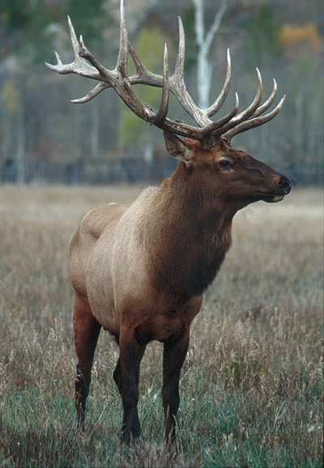
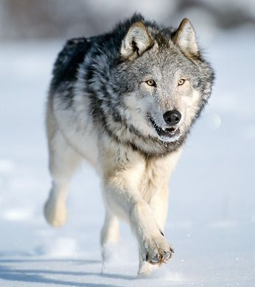
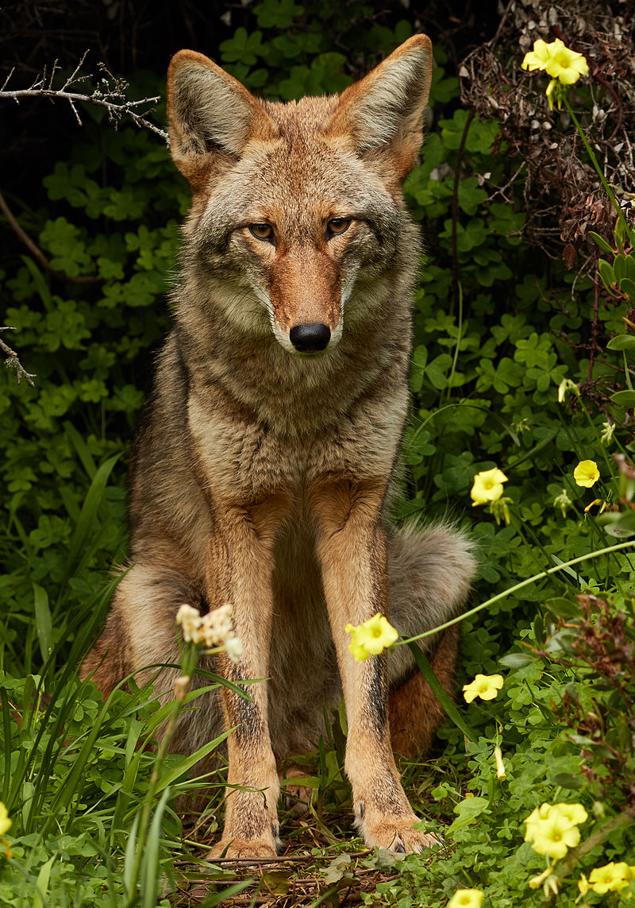
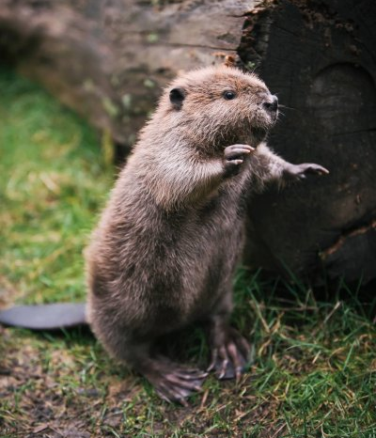
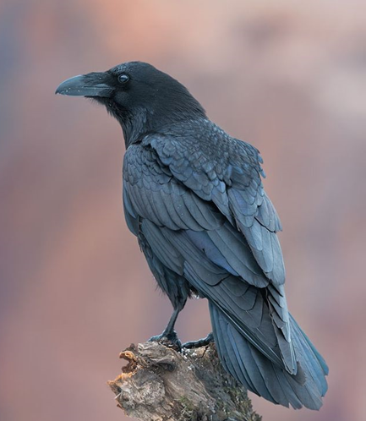
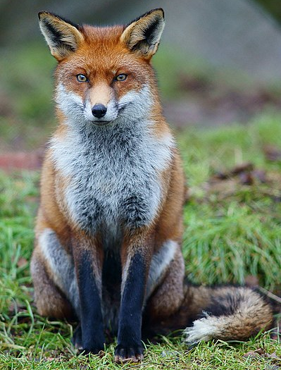
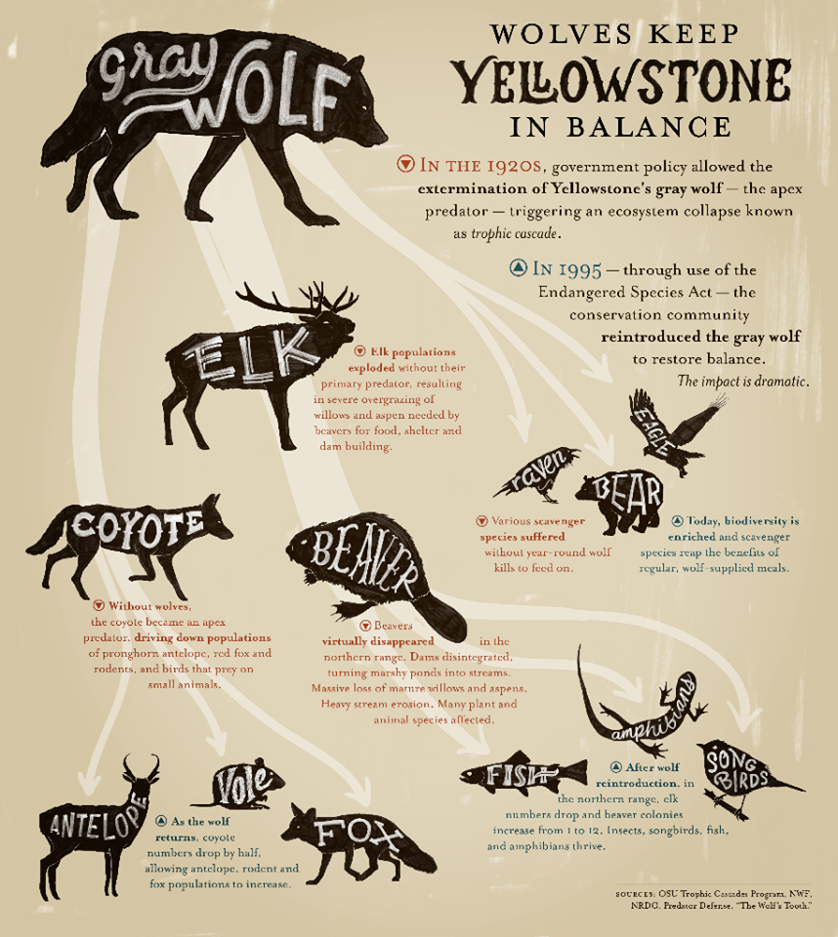
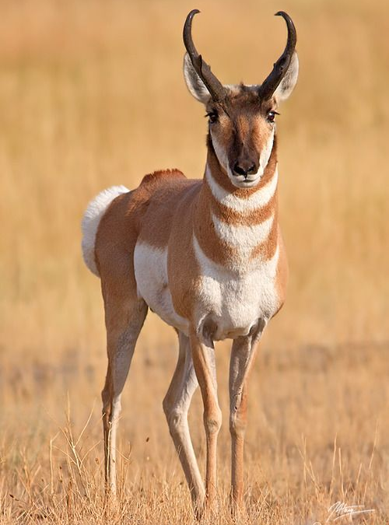
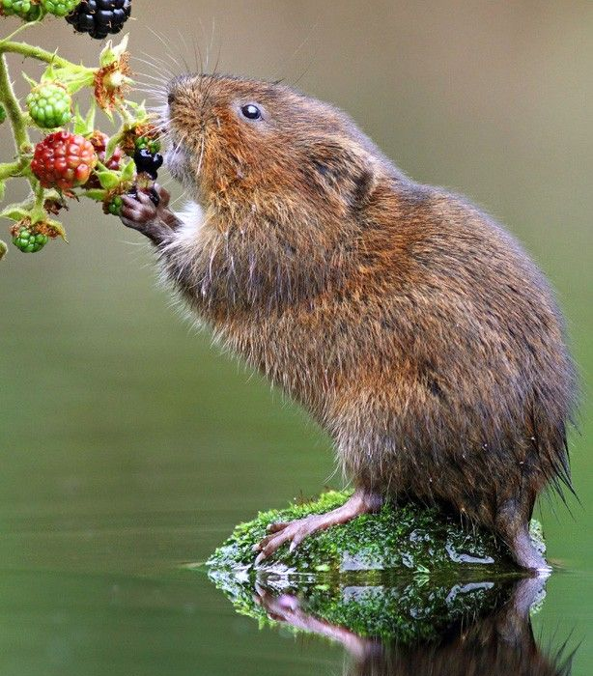
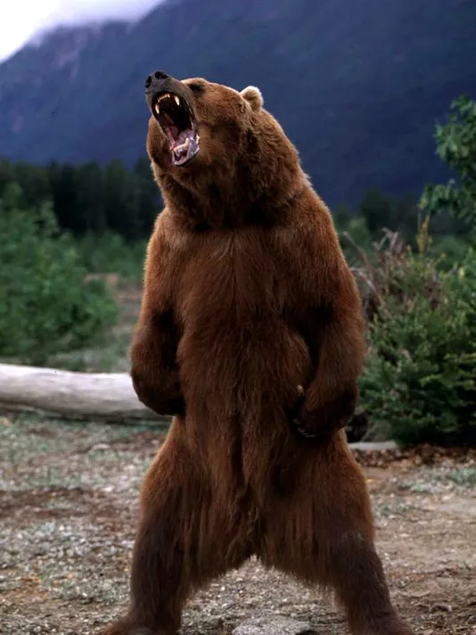

Slide 5
FOOD
CHAIN

Slide 6
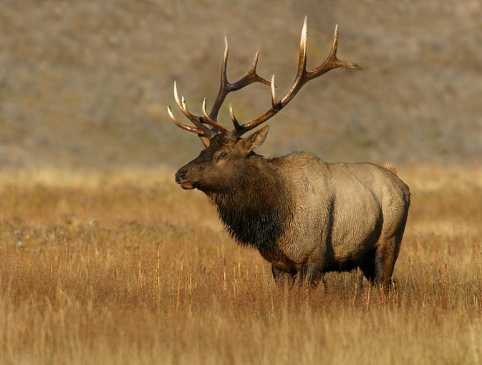
Who ate the elk?
wolves

Slide 7
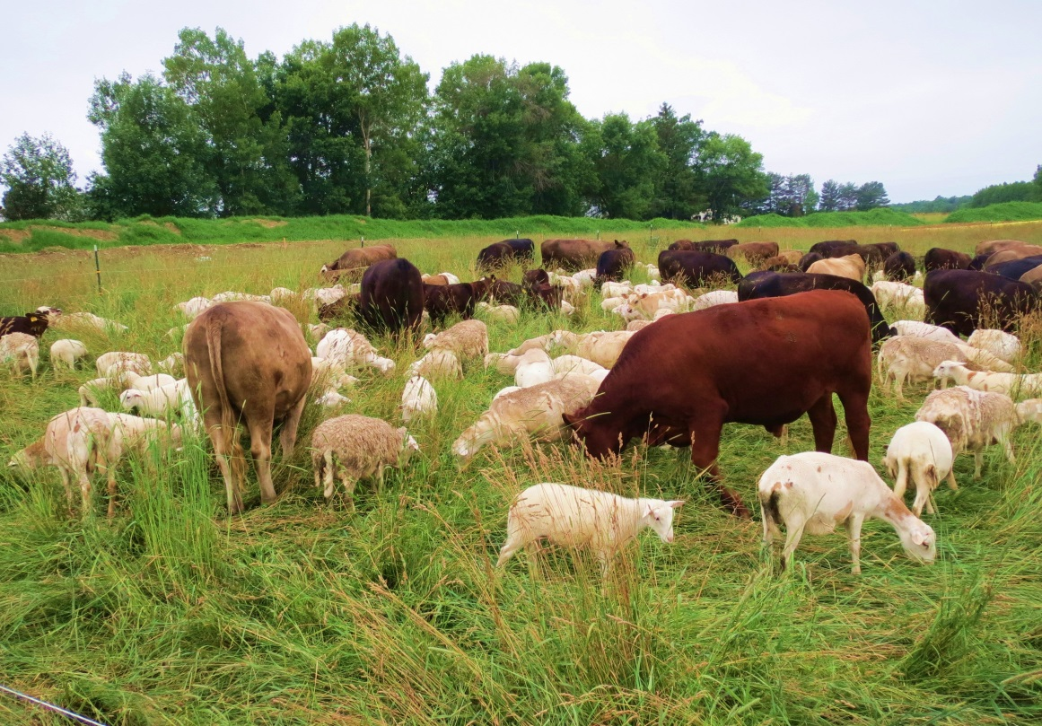
Who ate the farm animals?
wolves

Slide 8
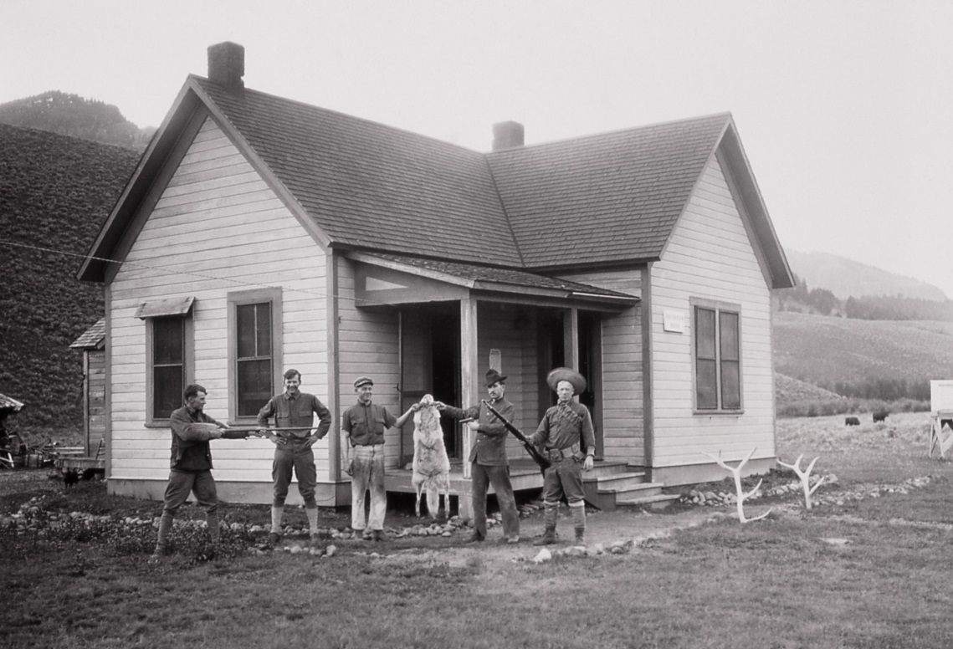
What did the farmers do?
They killed
the wolves

Slide 9
What happened when the wolves disappeared?
too many elk

Slide 10
Why is that bad?
Elk eat too much grass / trees.

Slide 11
What would happen if we reintroduced gray wolves.

Slide 12
Wolves
Change
Rivers

Slide 13
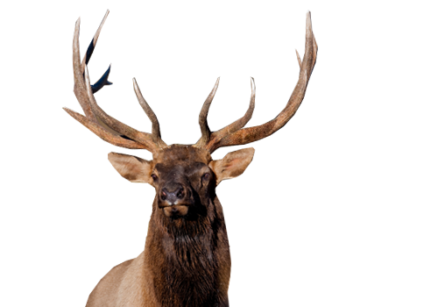
Make a list of changes that happened in the park.

Slide 14
By the early 1990s, gray wolves (a) had begun / have begun to disappear from Yellowstone National Park in the US, and this resulted in a growing elk population.
By this time / Before this time

Slide 15
By the early 1990s, gray wolves (a) had begun / have begun to disappear from Yellowstone National Park in the US, and this resulted in a growing elk population.
What happened before the 1990s?

Slide 16
By the early 1990s, gray wolves (a) had begun / have begun to disappear from Yellowstone National Park in the US, and this resulted in a growing elk population.
Where did it happen?

Slide 17
By the early 1990s, gray wolves (a) had begun / have begun to disappear from Yellowstone National Park in the US, and this resulted in a growing elk population.
What was the result?

Slide 18
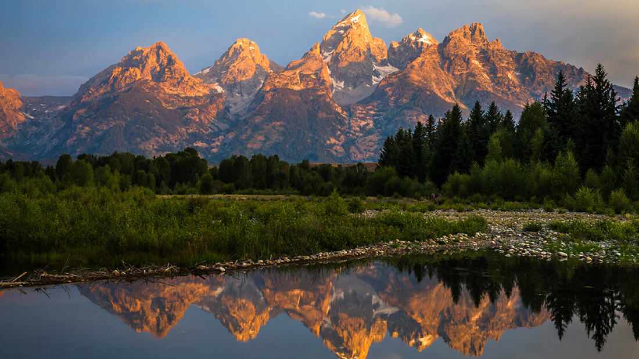

Slide 19
The elk ate too many leaves from the trees, which reduced shade along the rivers and creeks.
Why was shade reduced?

Slide 20
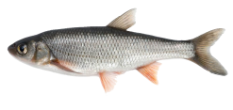
This caused water temperatures to increase and the populations of many fish species in the park (b) declined / had declined.
The elk ate the leaves
What caused it?

Slide 21
This caused water temperatures to increase and the populations of many fish species in the park (b) declined / had declined.
What happened?

Slide 22
This caused water temperatures to increase and the populations of many fish species in the park (b) declined / had declined.
What happened?

Slide 23
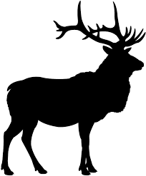
To restore balance to Yellowstone’s ecosystem, sixty-six gray wolves from Canada were released into the park.

Slide 24
As a result, the number of elk quickly dropped.

Slide 25
Now, the ecosystem has returned to its natural balance. This story shows how crucial some species are for the health of an entire ecosystem.

Slide 26
Now, the ecosystem has returned to its natural balance. This story shows how crucial some species are for the health of an entire ecosystem.

Slide 27
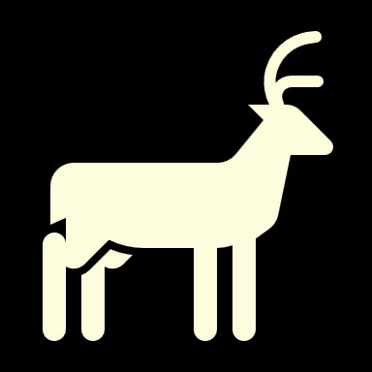

Slide 28
If we (c) respect / will respect all species equally, we’ll be able to continue to enjoy the natural world.
How can we respect all species?

Slide 29
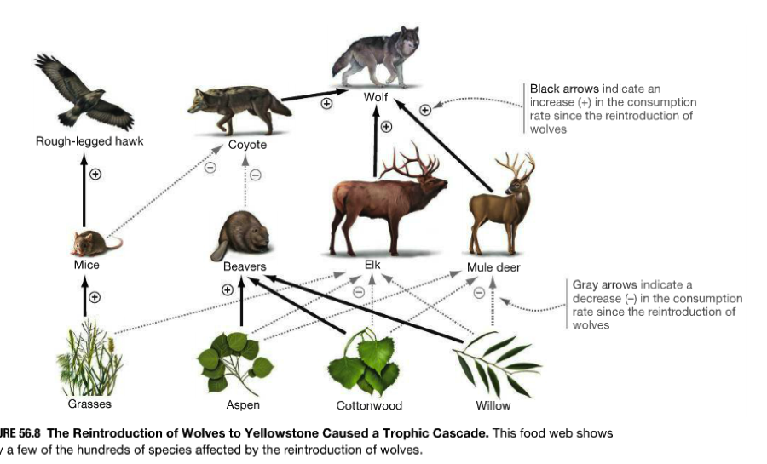

Slide 30
Circle the good changes that happened in the park.

Slide 31
Wolves
Change
Rivers
https://www.youtube.com/watch?v=ysa5OBhXz-Q

Slide 32
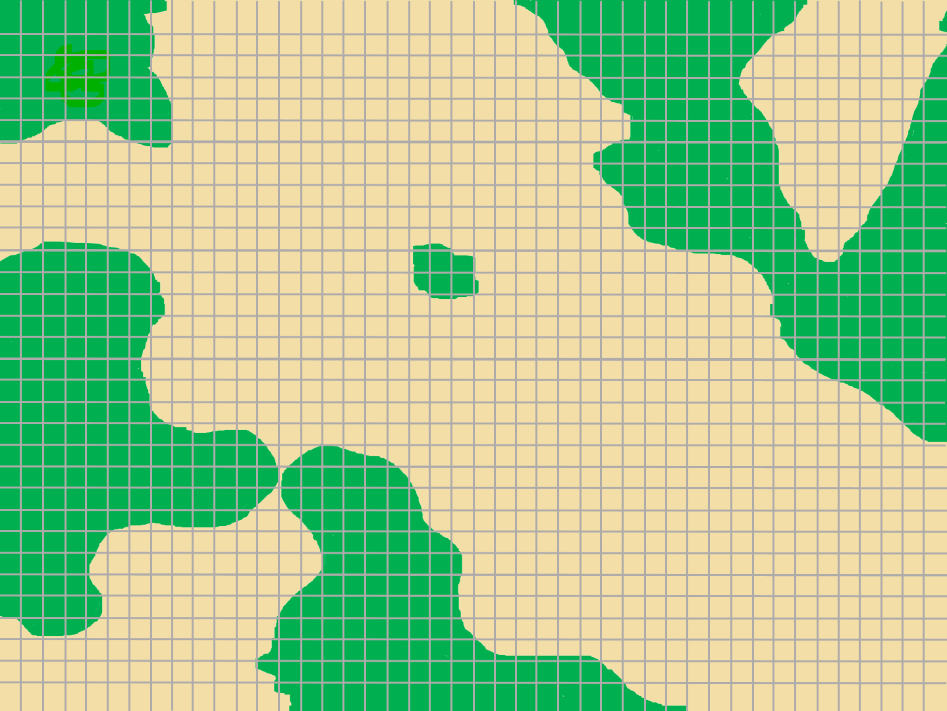
trees

Slide 36
ESL toybox
www.esltoybox.com

Slide 37
Earth Justice – Yellowstone in the Balance
https://earthjustice.org/features/infographic-wolves-keep-yellowstone-in-the-balance
How Wolves Change Rivers
https://youtu.be/ysa5OBhXz-Q

