Slide 1
Museum of Bad Art
http://museumofbadart.org/

Slide 2
Museum of Bad Art

Slide 3
Art is…

Slide 4
Art is…
expensive

Slide 5
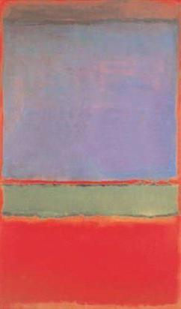
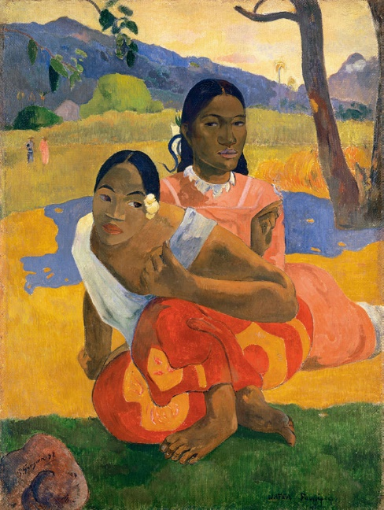
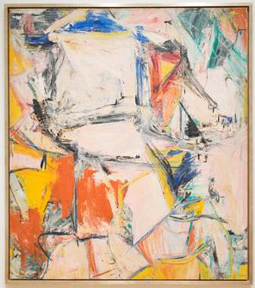
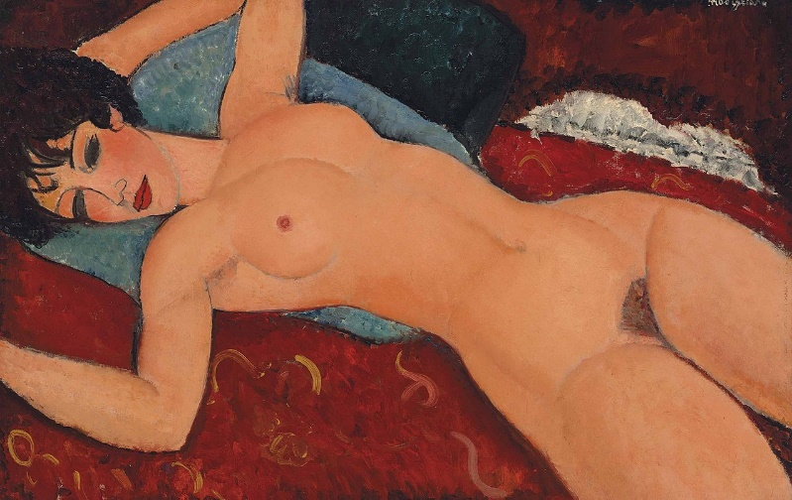
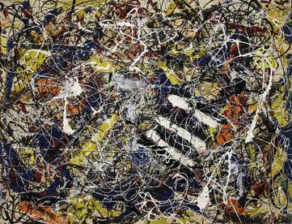
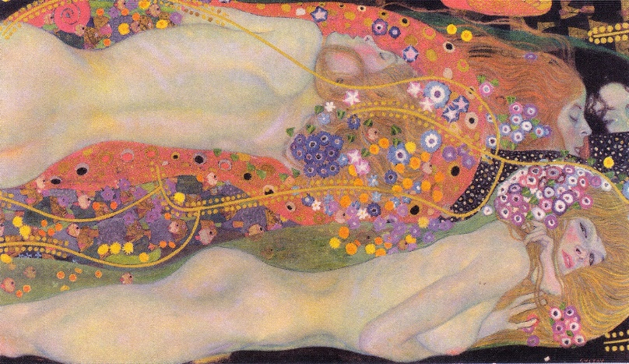
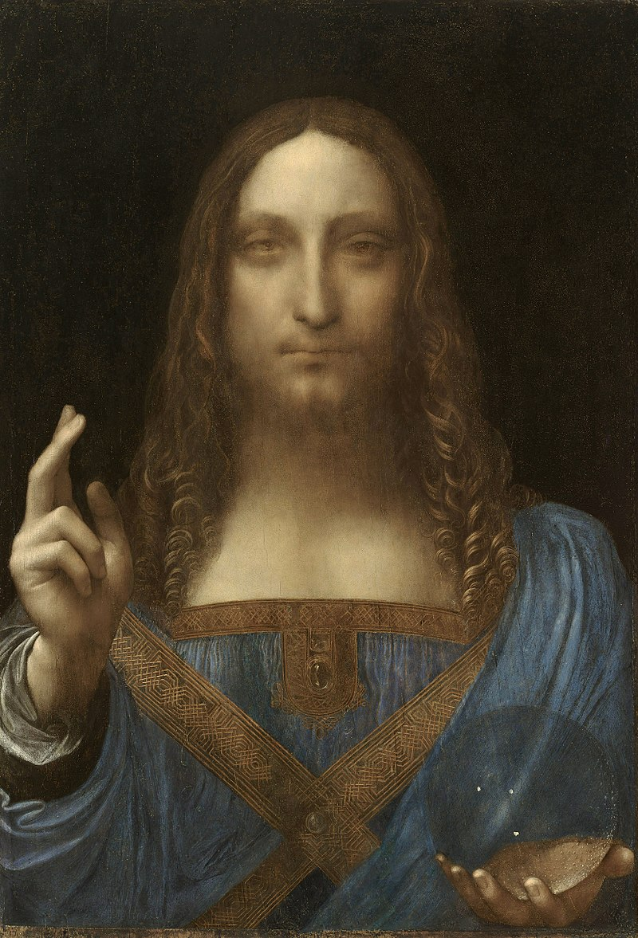
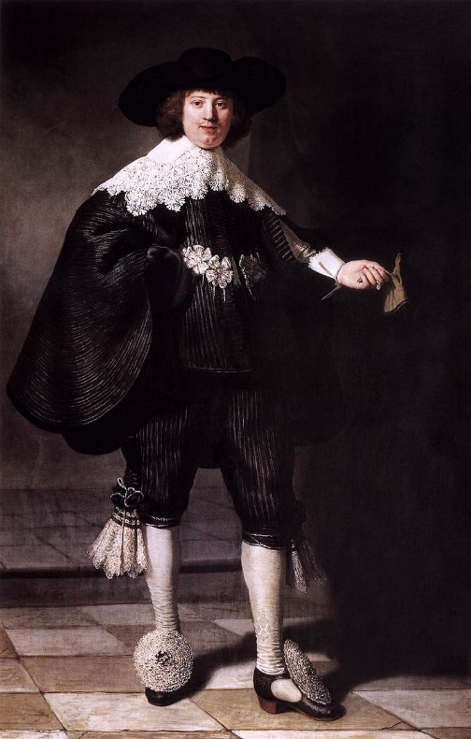
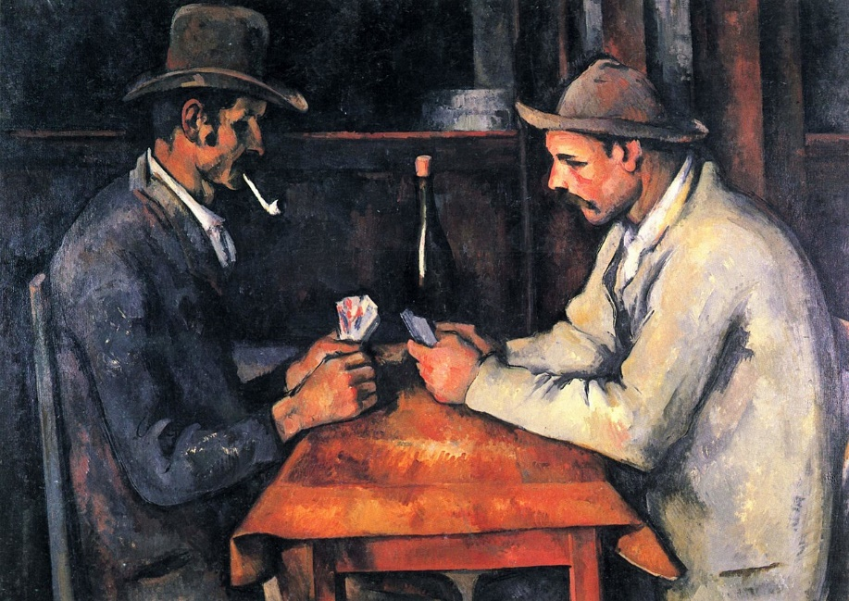
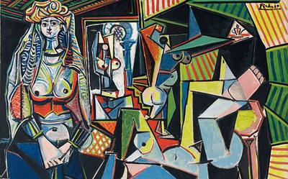

Slide 6
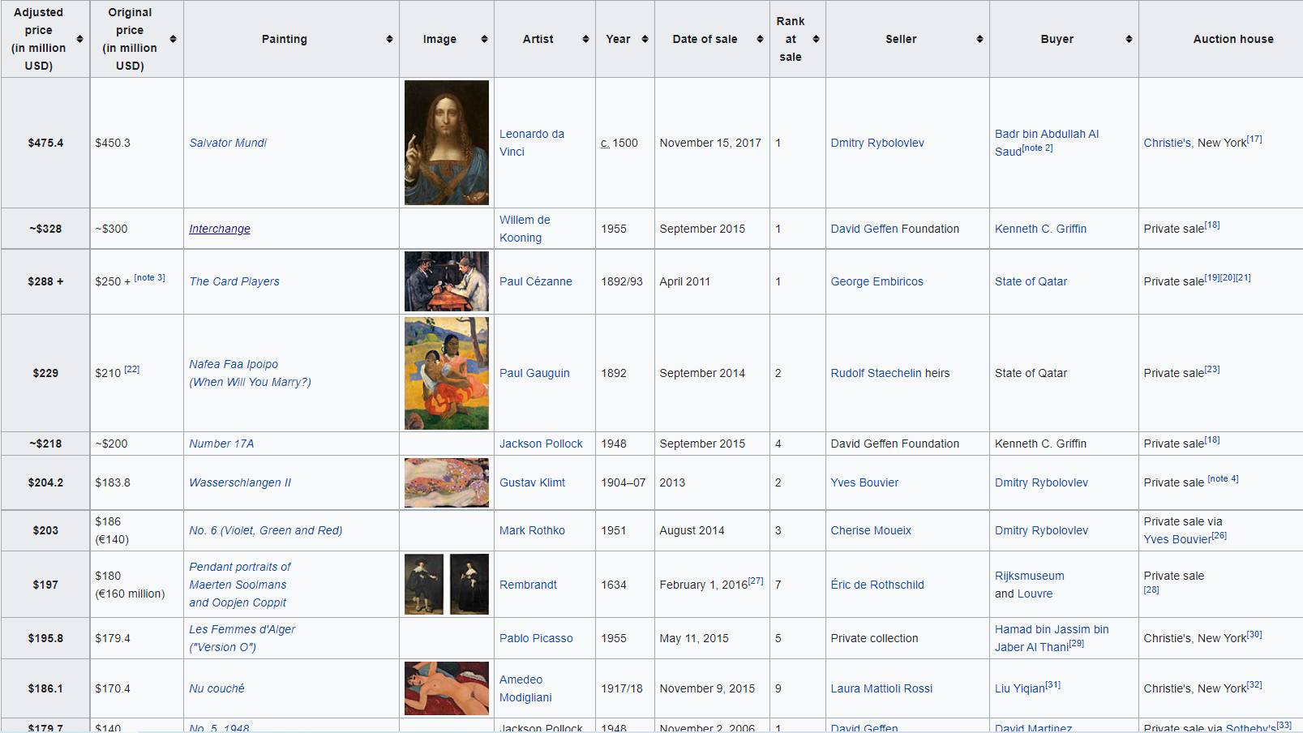

Slide 7
Art is…
Subjective

Slide 8
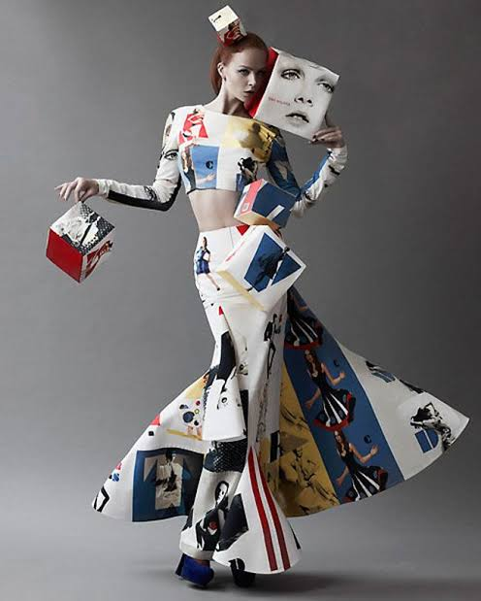
is this
art
?

Slide 9
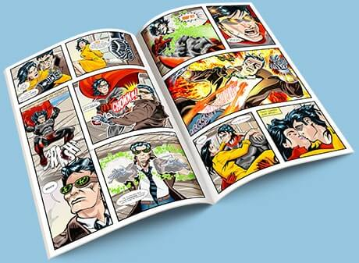
is
this
art
?

Slide 10
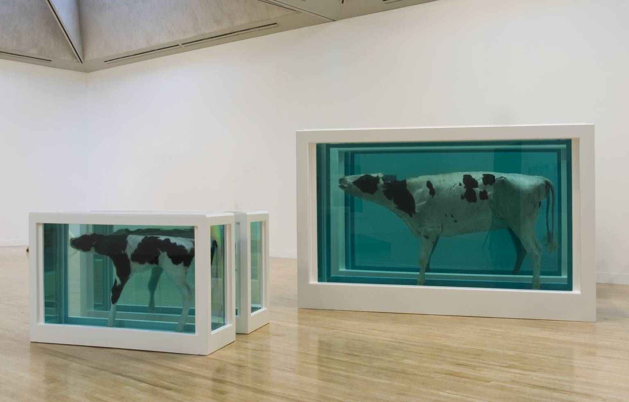
is this art
?

Slide 11
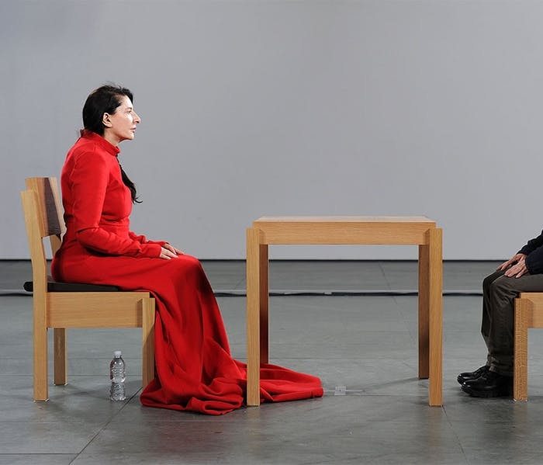
is this art
?

Slide 12
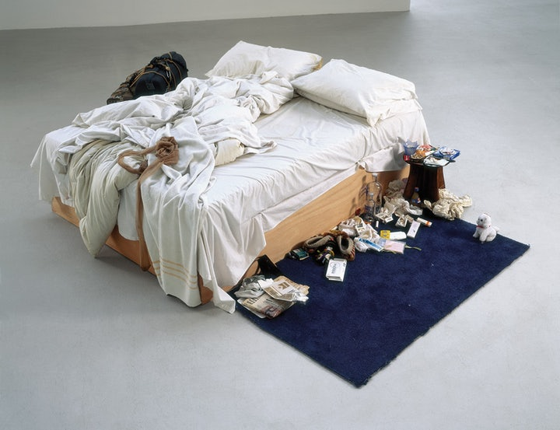
is this art ?

Slide 13
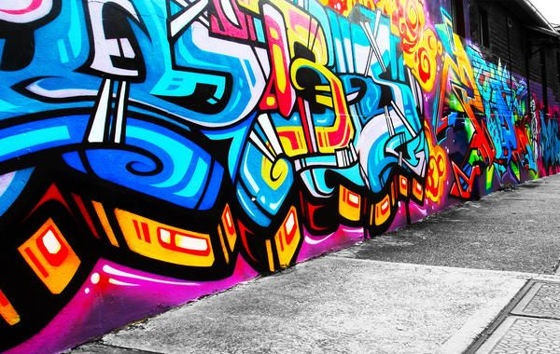
is this art
?

Slide 14
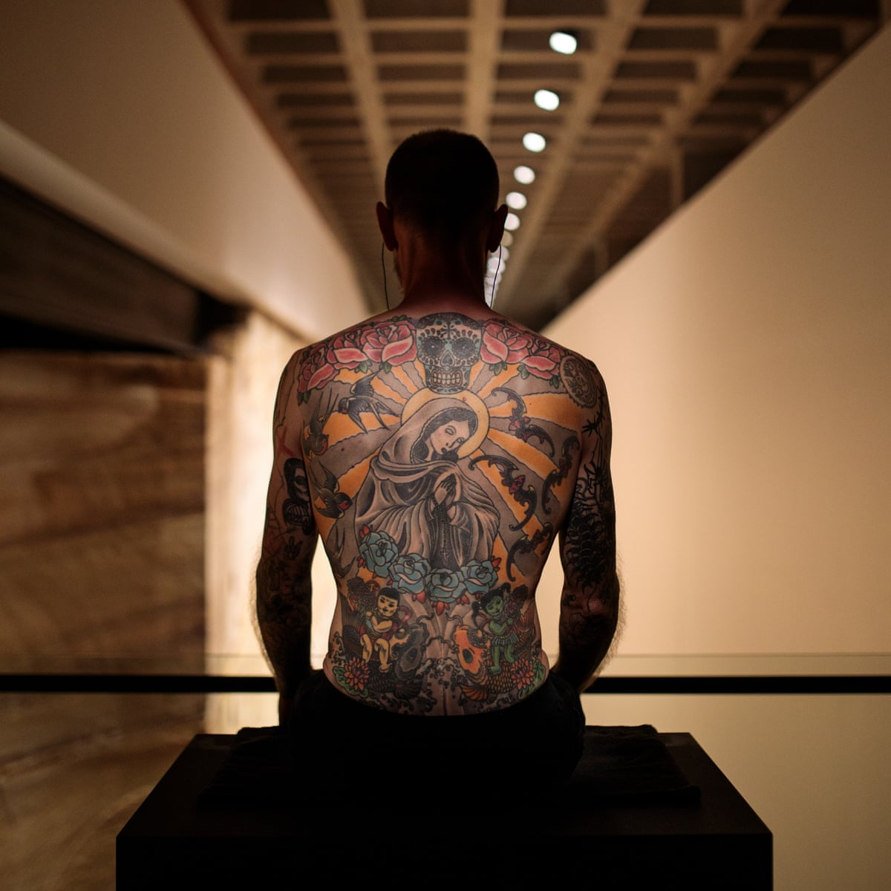
is this art
?

Slide 15
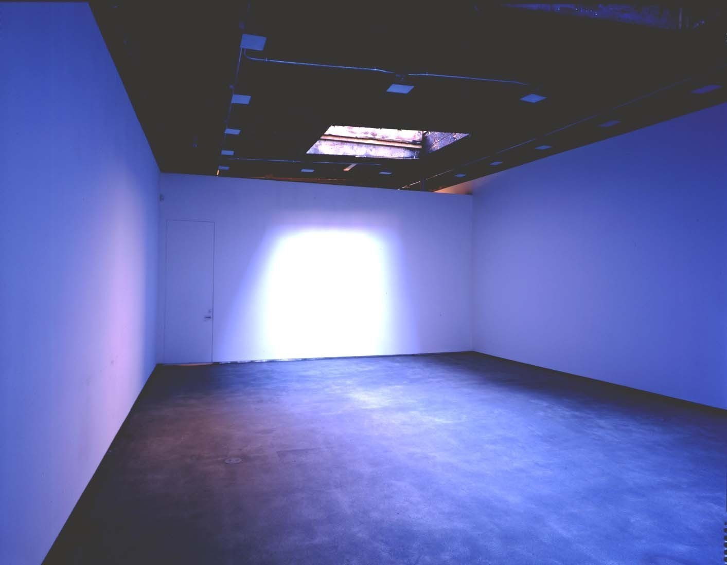
is this art
?

Slide 16
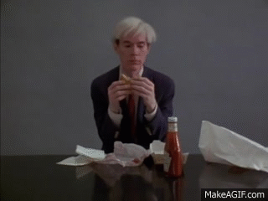
is this art
?

Slide 17
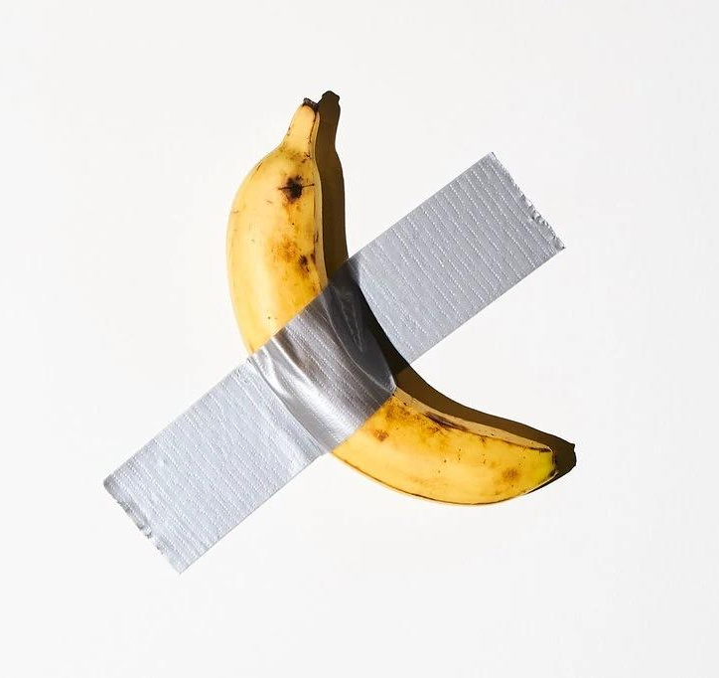
is this
art?

Slide 18
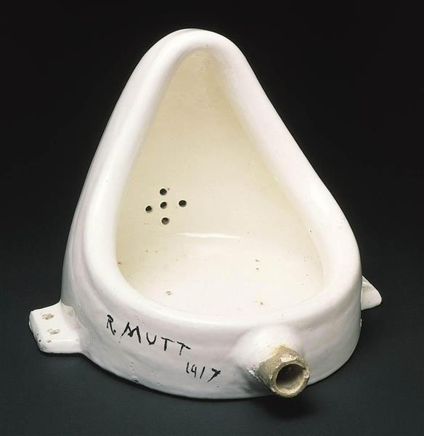
is this art
?

Slide 19
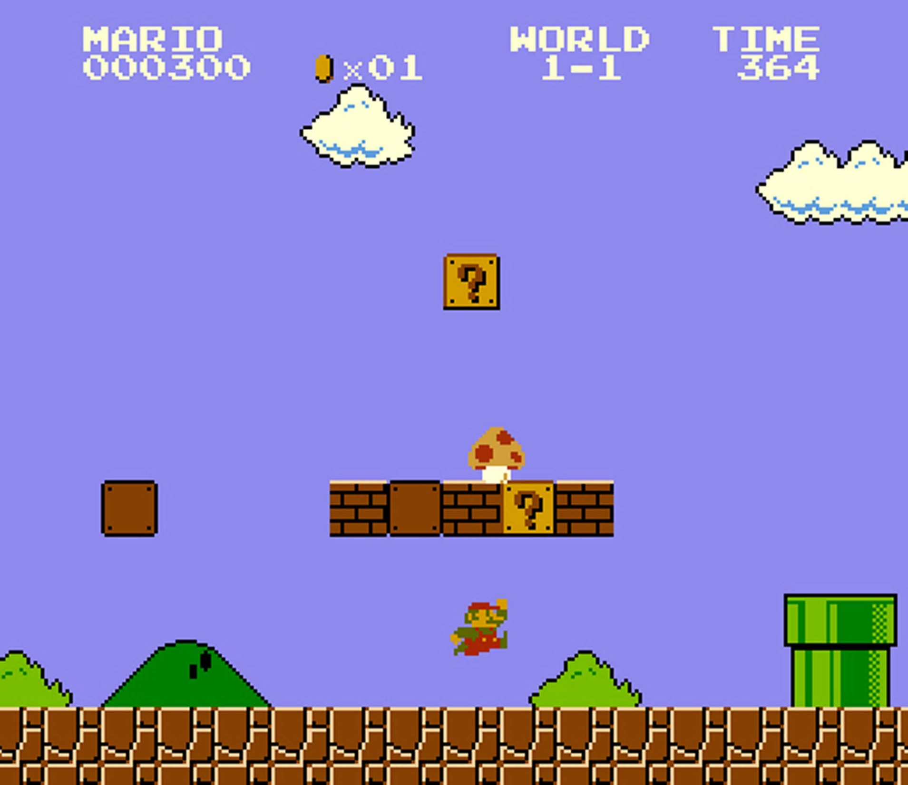
is this art
?

Slide 20
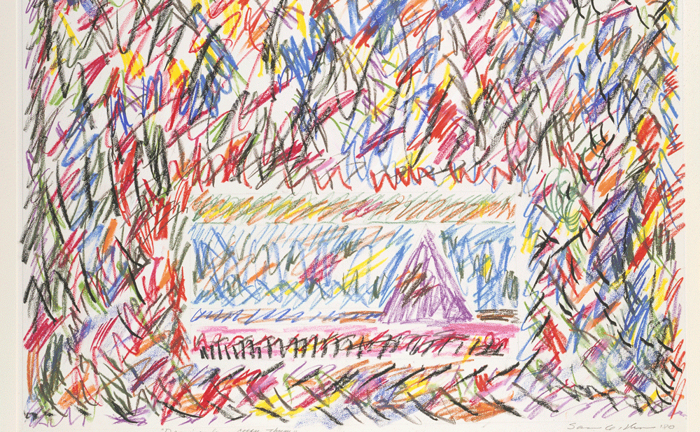
is this art
?
https://www.vox.com/policy-and-politics/2019/9/16/20856316/poll-yougov-art-ideology-trump

Slide 21
Art is…
Emotional

Slide 22
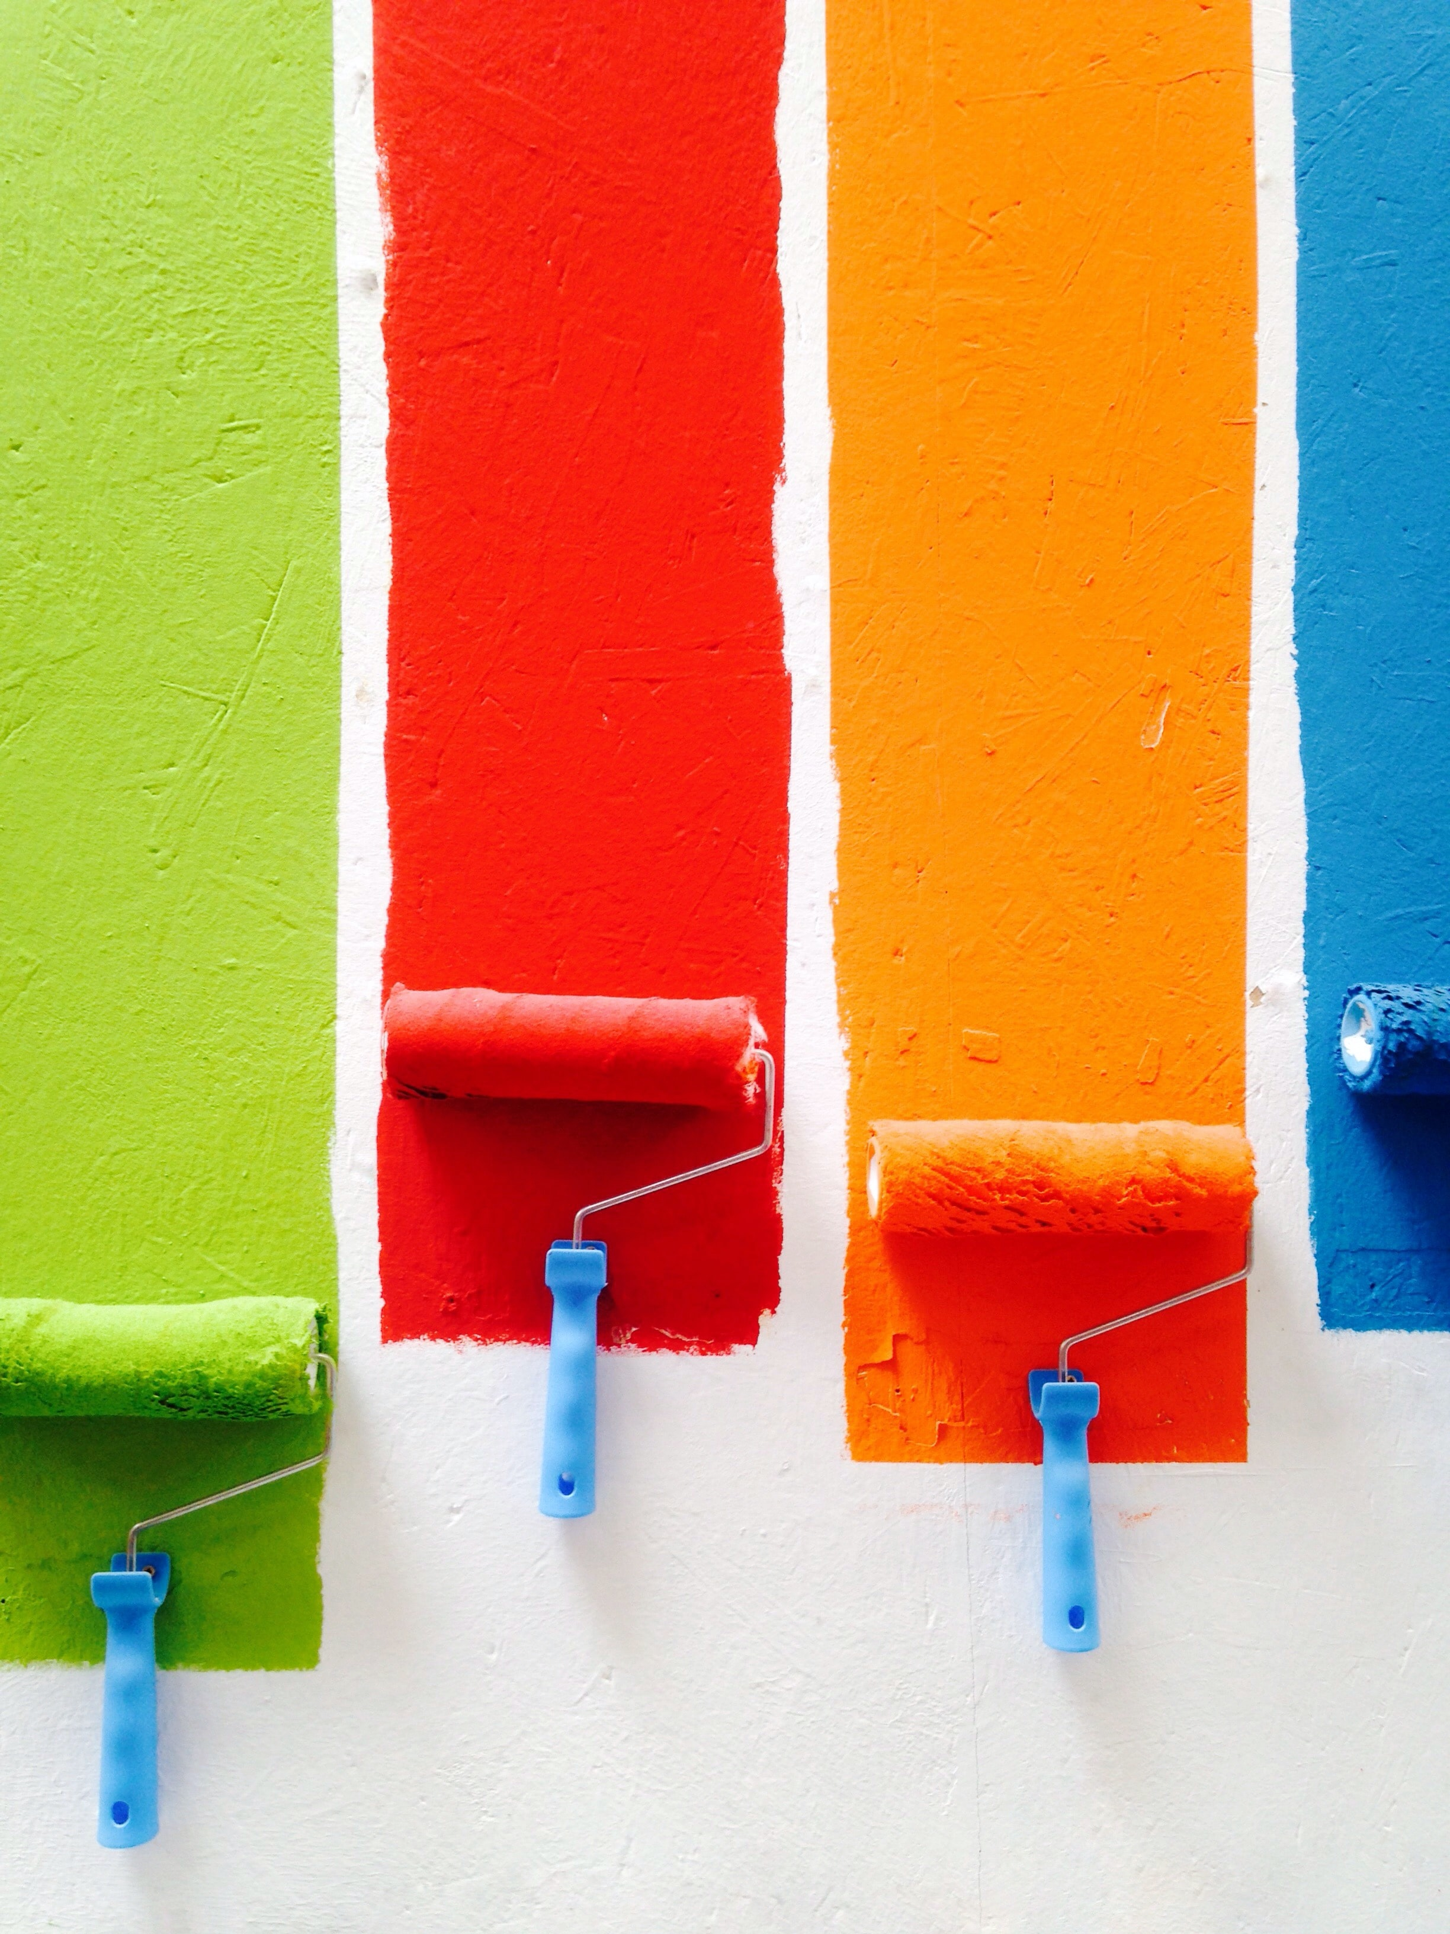
Color choice

Slide 23
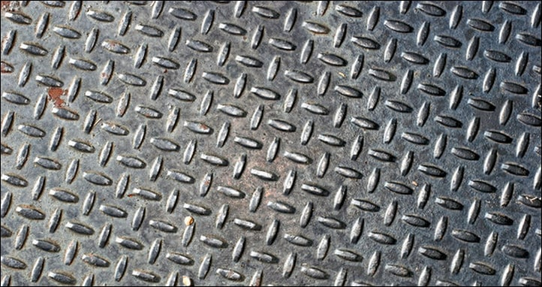
texture

Slide 24
shape

Slide 25
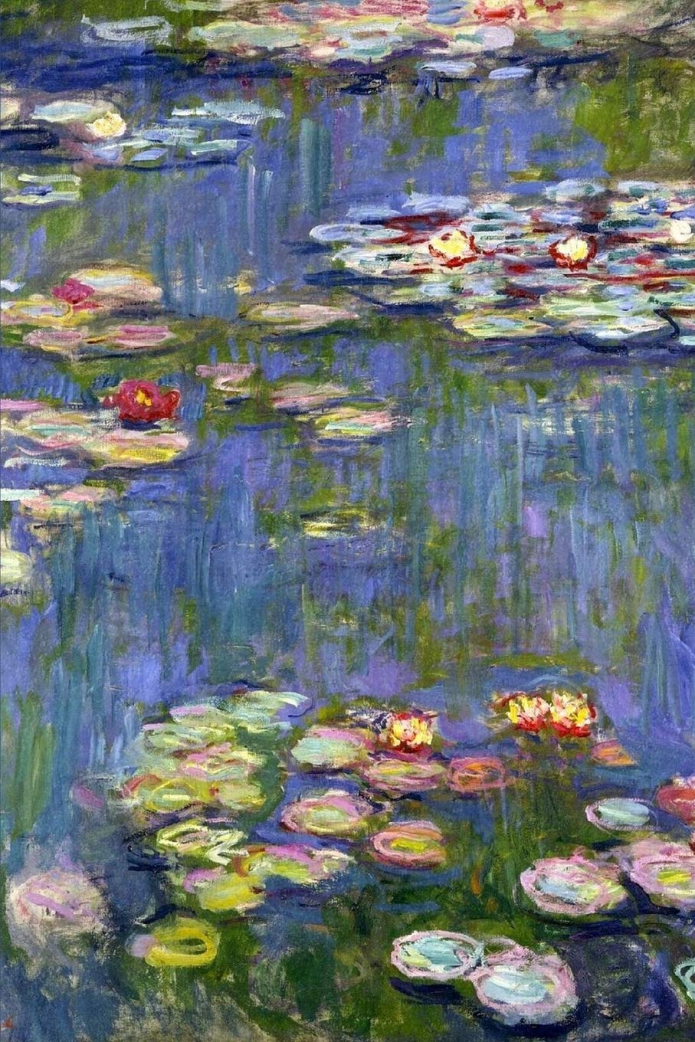
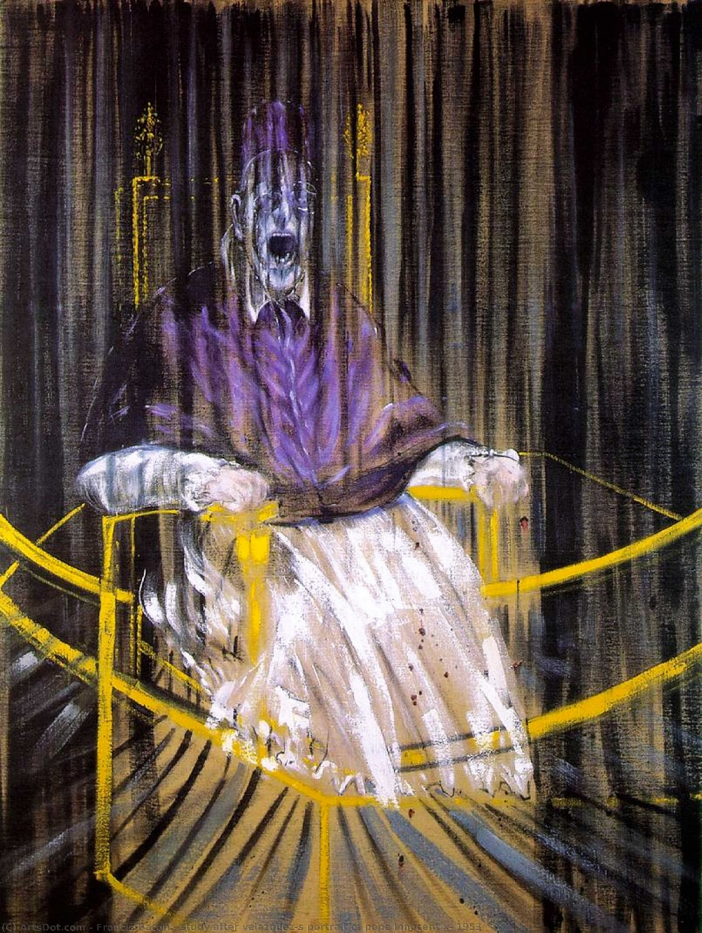
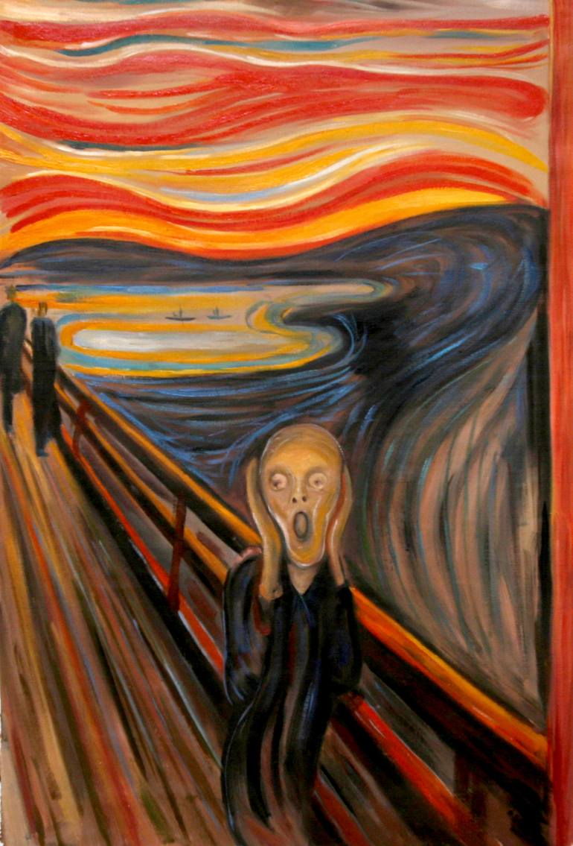
content
Paint strokes, texture, shapes, content, meaning

Slide 26
Art is…
interpretive

Slide 27
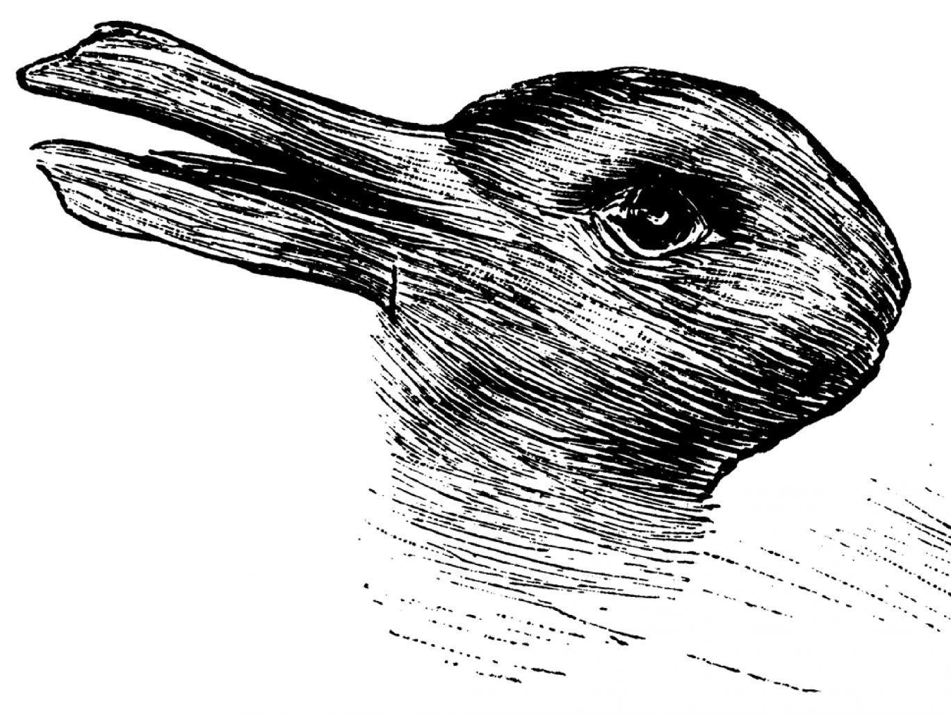

Slide 28
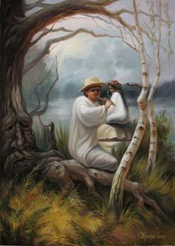

Slide 29
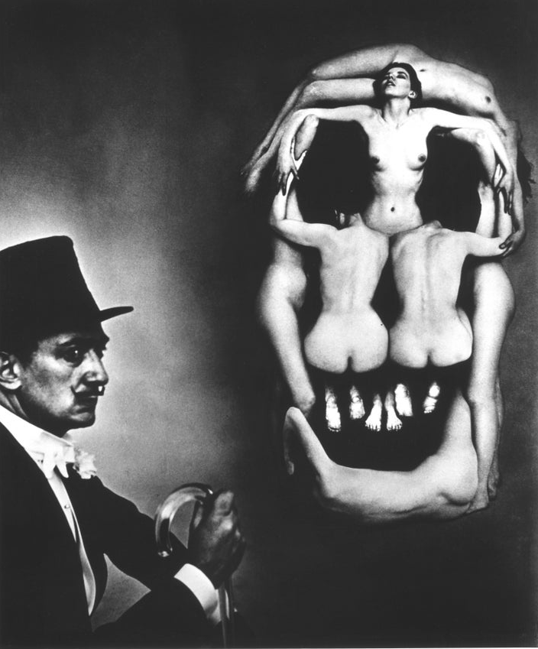

Slide 30
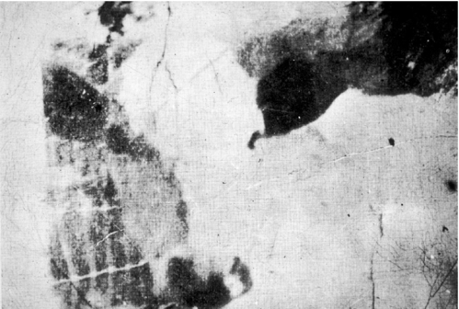

Slide 32
Art is…
meaningful

Slide 33
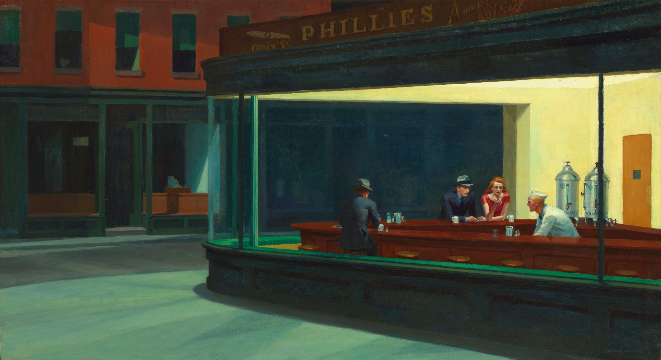
Edward Hopper – Nighthawks (1942)

Slide 34
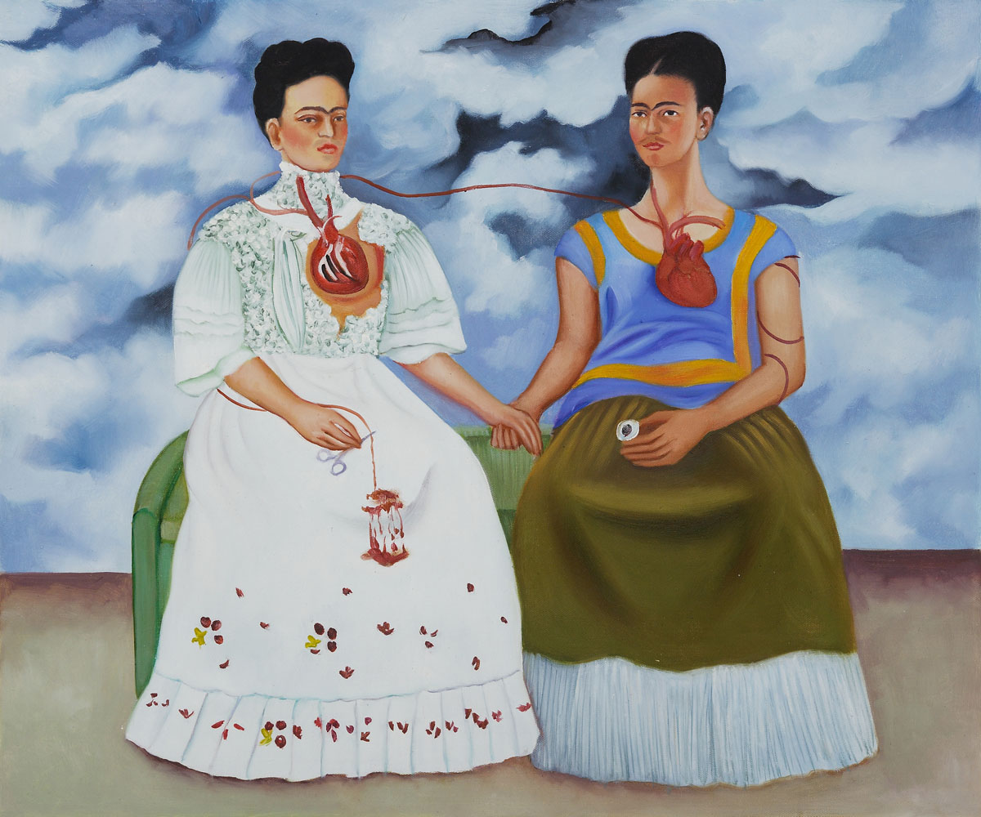
Frida Kahlo – The Two Fridas (1939)

Slide 35
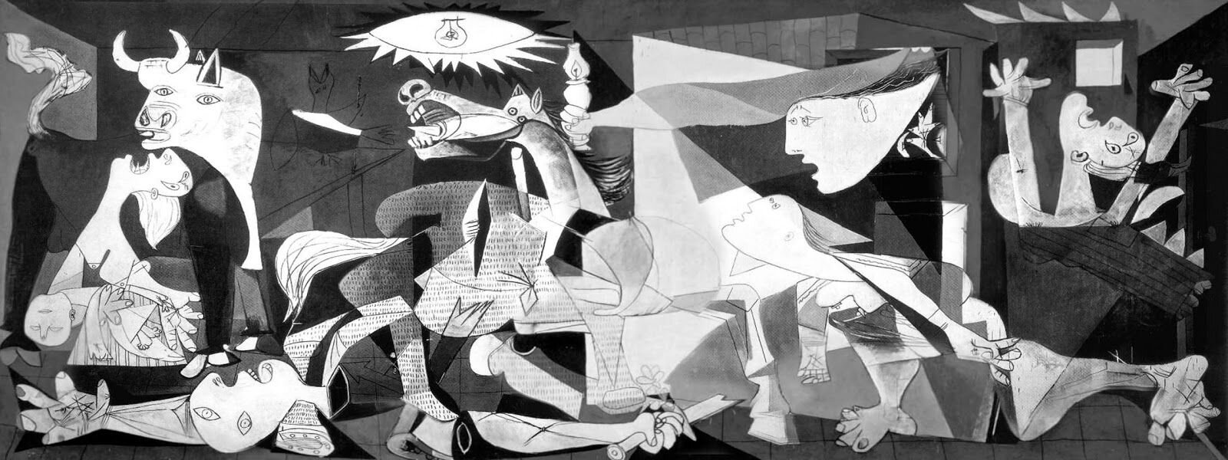
Pablo Picasso – Guernica (1937)

Slide 36
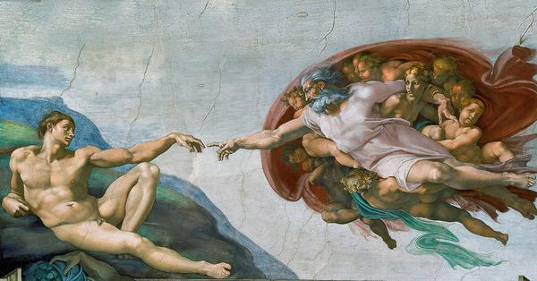
Michelangelo – The Creation of Adam (1512)

Slide 37
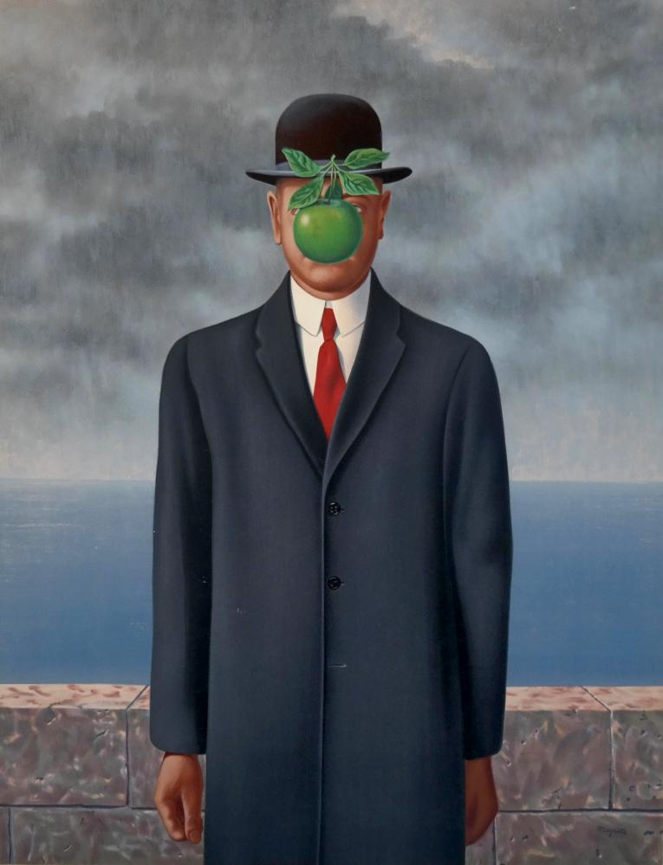
Rene Magritte – The Son of Man (1964)

Slide 38
choose
A PAINTING

Slide 39
Choose a Painting
Look at the paintings around the classroom.
Choose one that has meaning for you.
Explain why you chose that painting and the meaning
It’s not just what you see but HOW you see it.

Slide 40
ESL toybox
www.esltoybox.com

Slide 41
https://www.vox.com/policy-and-politics/2019/9/16/20856316/poll-yougov-art-ideology-trump
http://museumofbadart.org/

