Slide 1
A fake
ARTIST
goes to
New York
https://www.youtube.com/watch?v=k2z8l9k38mk

Slide 3
Rules
Each player has a different color
There is one white card for each player

Slide 4
Rules
Choose a Question Master (QM), who:
Writes the same word on most of the white cards
On one card, writes “fake”

Slide 5
Rules
You can draw on your turn
just one line
each player draws twice

Slide 6
Rules
After drawing, all players vote on who is the fake artist.
If the fake artist is not exposed, then the fake artist wins!
If the fake artist is exposed, they lose… HOWEVER….

Slide 7
Rules
The fake artist can guess what the drawing is.
If they guess it correctly, they win.
So, don’t make the drawing obvious.

Slide 8
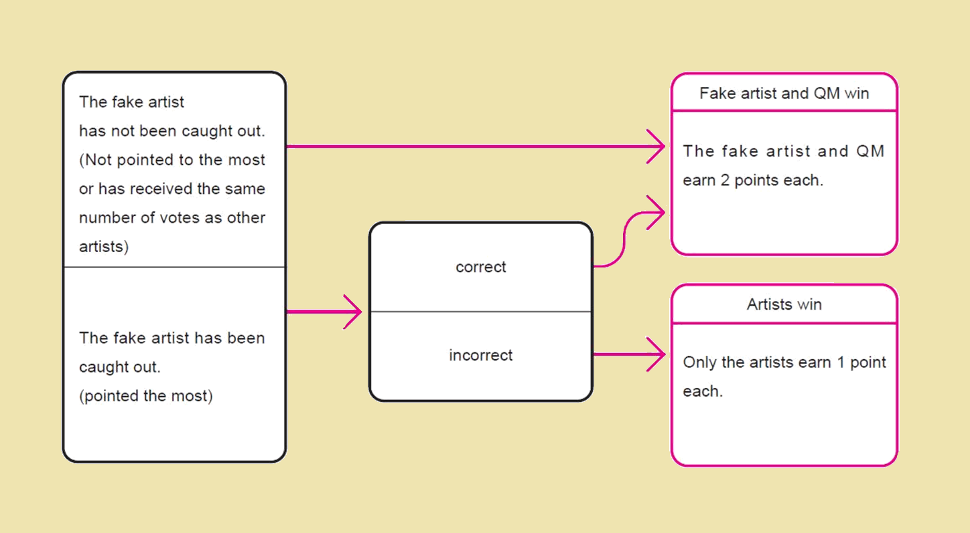

Slide 9
