Slide 1
Love
anguages
https://www.5lovelanguages.com/

Slide 2
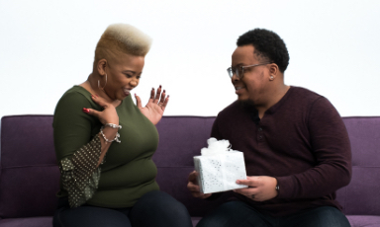
Quality Time
5 Love Languages

Slide 3
Words of Affirmation
5 Love Languages

Slide 4
Acts of Service
5 Love Languages

Slide 5
Receiving Gifts
5 Love Languages

Slide 6
Physical Touch
5 Love Languages

Slide 7
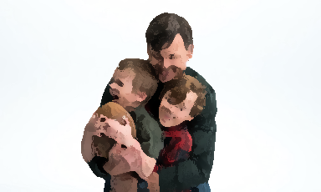
Quality Time
It is all about giving the other person your undivided attention.

Slide 8
Words of Affirmation
Some people like it when you use words.

Slide 9
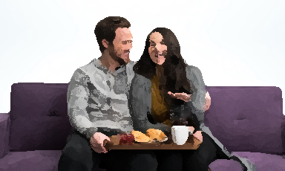
Acts of Service
Actions speak louder than words

Slide 10
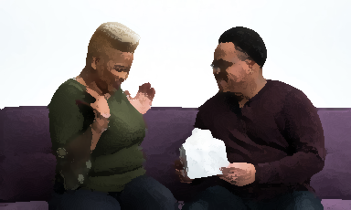
Receiving Gifts
Receiving a heartfelt gift is what makes them feel most loved.

Slide 11
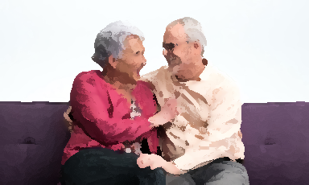
Physical Touch
Nothing speaks more deeply than appropriate physical touch.

Slide 12
5 Love Languages
Results?

Slide 13
https://www.5lovelanguages.com/quizzes/results/941a54e7-2815-4717-9b17-c30803e79cb7

Slide 14
https://www.mindbodygreen.com/articles/what-is-my-love-language-quiz

Slide 15
https://www.psychologies.co.uk/tests/whats-your-love-language.html

Slide 16
r/datingadvice
Advice?

Slide 17
ESL toybox
www.esltoybox.com

Slide 18
r/relationship advice
https://www.reddit.com/r/dating_advice/
Love Language Test
https://www.5lovelanguages.com/

