Slide 1
Gifts

Slide 2
Making a Wishlist
What GIFTS would you like to RECEIVE?

Slide 3
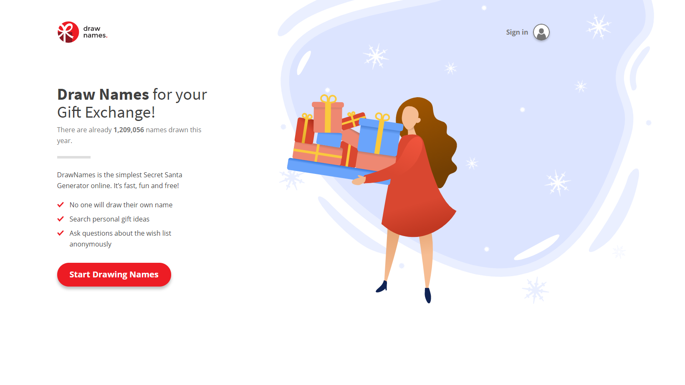
drawnames

Slide 4
What can you say?
When you give a gift

Slide 5
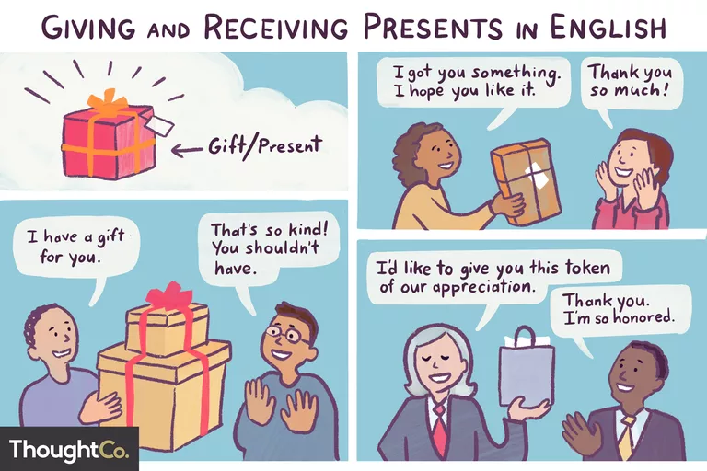

Slide 6
Informal
I got you something. I hope you like it.
Look what I have for you!
I thought you might like this for...
Happy Birthday! Here's a little (gift/present) for you.
Enjoy!
It's only something small, but I hope you like it.
Here's a little present for you.
Guess what I bought you!

Slide 7
Formal
_________, I'd like to give you this (present/gift).
_________, This is a present that (I/we/staff) got you.
I'd like to present you with this... (very formal, used when giving an award or special present)
In the name of _________, I'd like to give you this present. (also very formal)
Here is a token of our appreciation.

Slide 9
Compliments
You are looking for that ONE piece of TRUTH.

Slide 10
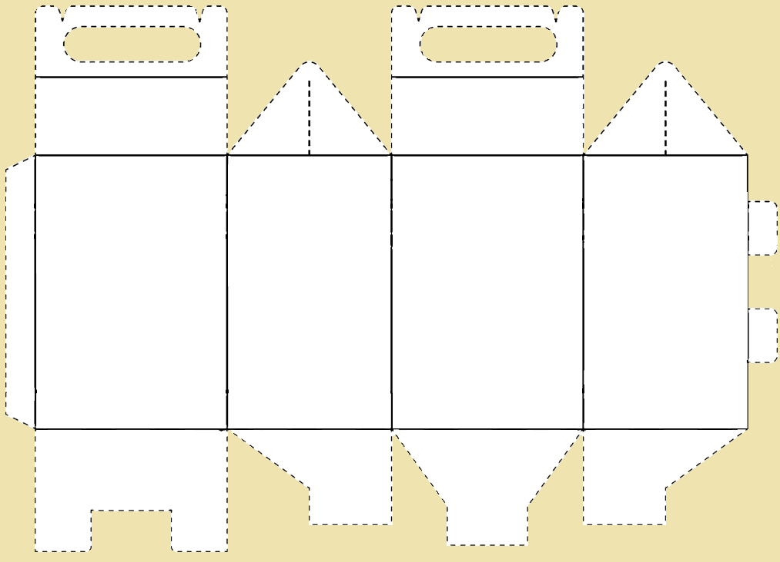
Gift Giving Game

Slide 11
Secret Santa
Rules
Put your name in the hat (app)
Take a name (app)
You must find a gift for that person
Cut something from the magazine that they would like
Put it in the ‘gift box’

Slide 12
Non-Physical Gifts
Gifts are not always physical
High Five
Hug
Help
Homemade
Favors
Friendship/Lover gift certificates
Love

Slide 13
What makes a gift good?
Discuss
What are quality gifts?
What is meaningful?
What do you like?

Slide 15
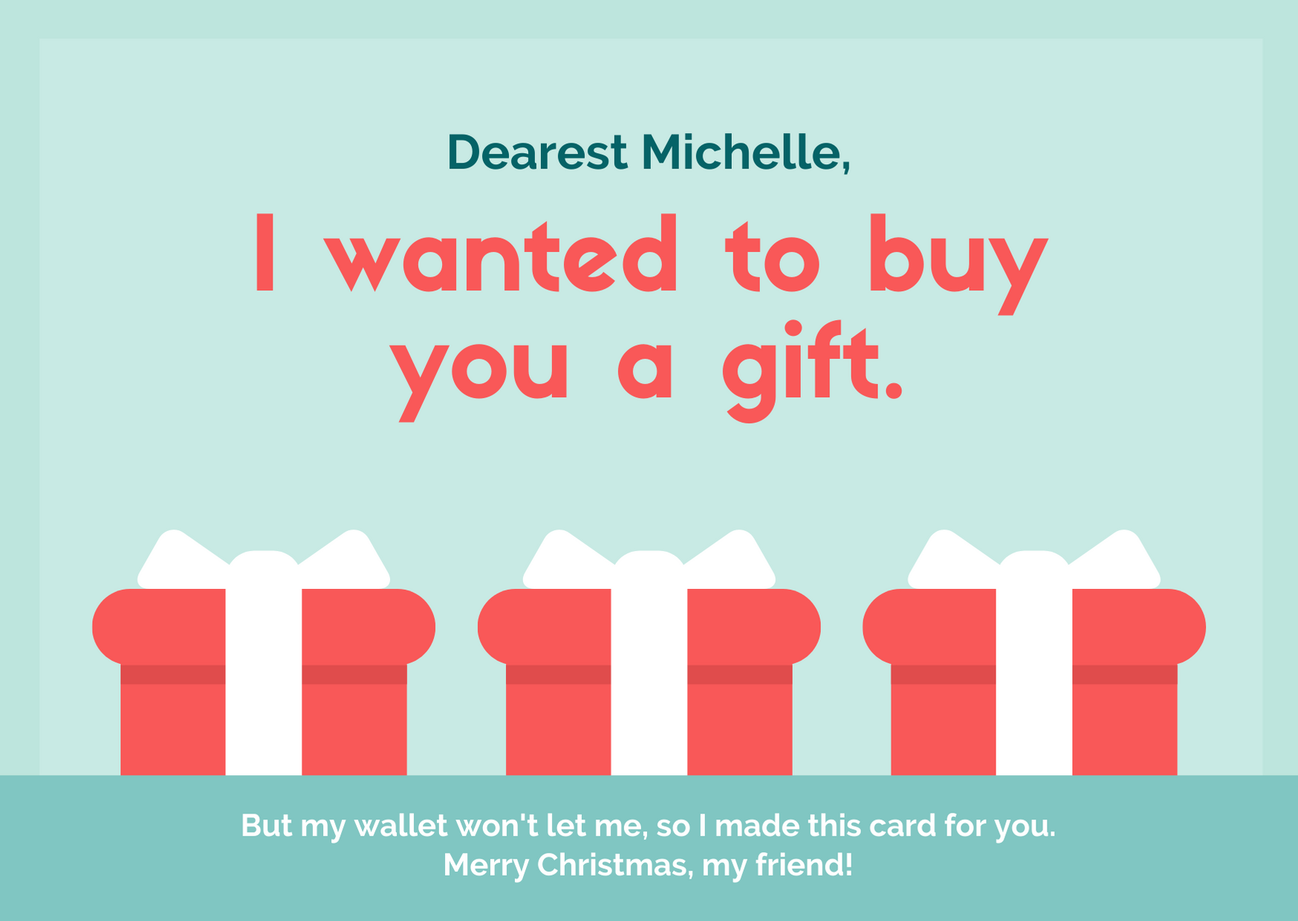
trainees,

Slide 16
Learn What do Say in English When You Give or Receive a Gift
https://www.thoughtco.com/giving-and-receiving-presents-in-english-1212057
Draw Names for your Gift Exchange!
https://www.drawnames.com/

Slide 17
ESL toybox
www.esltoybox.com

