Slide 1
Good Morning
Good evening and Good night!
https://www.youtube.com/watch?v=0rELYuM7QlU

Slide 2
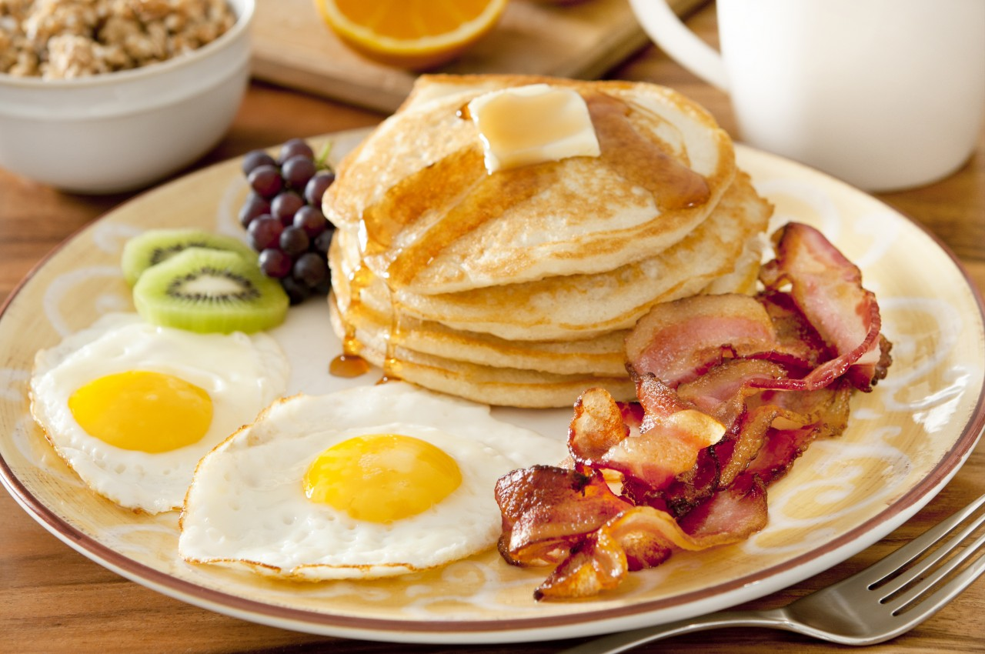
Good Morning, What is that delicious smell?

Slide 3
What are some more breakfast foods?

Slide 4
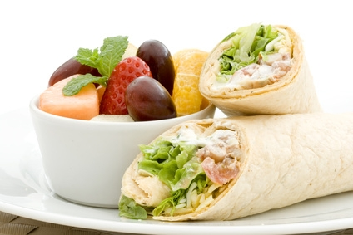
What can you eat in the afternoon?

Slide 5
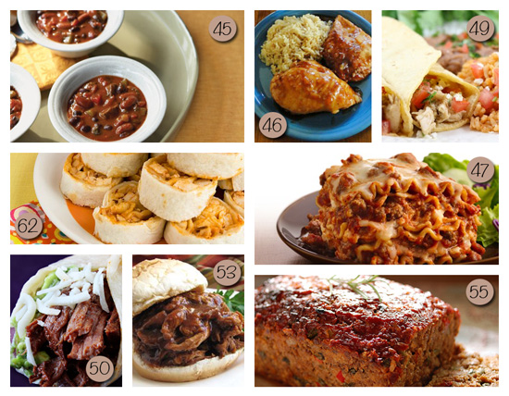
What is your favorite dinner food?

Slide 6
Good evening / Good night.
What is the difference?

Slide 7
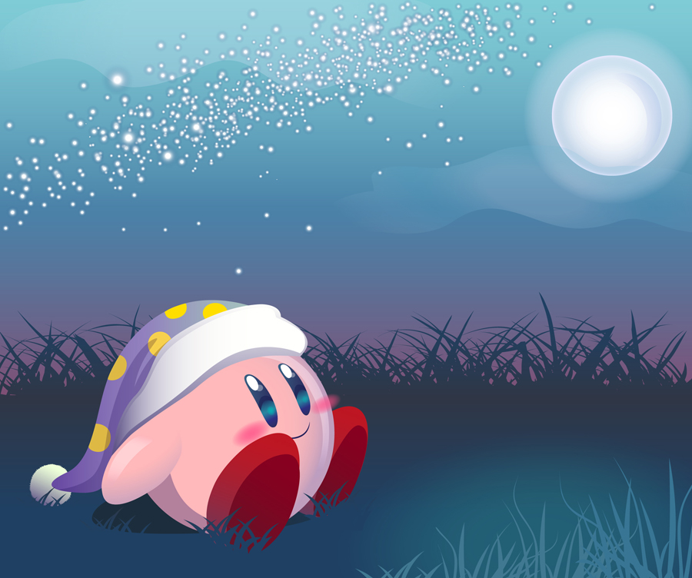
Good Night
Sleep

Slide 8
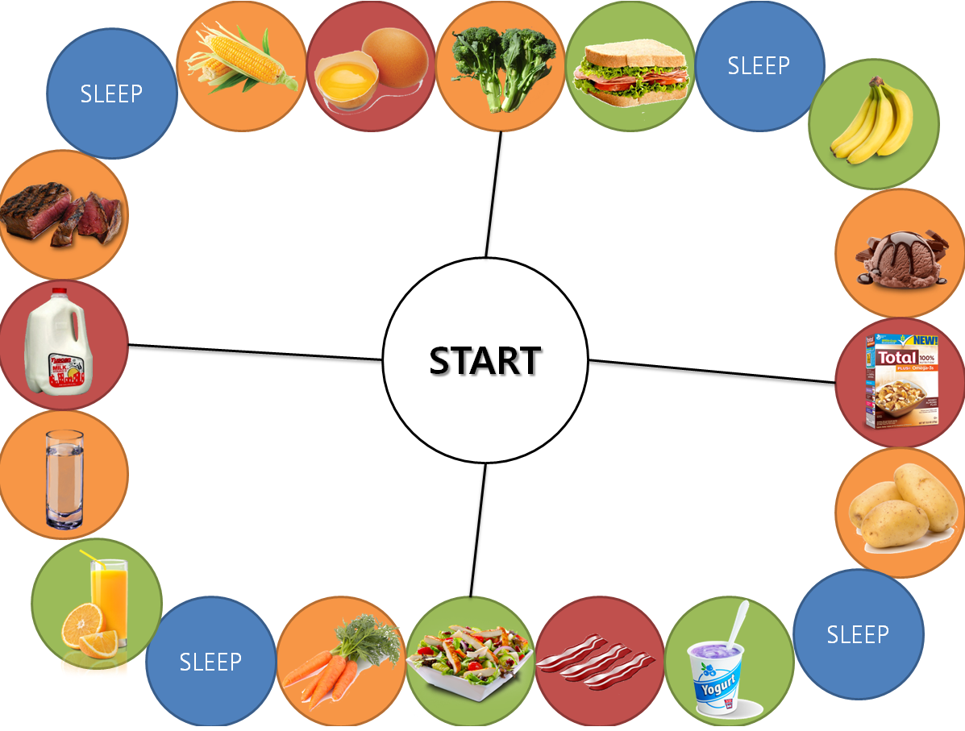
Good Morning
Board Game

Slide 9
Goal
Be the first to finish the checklist
(체크리스트를 가장 먼저 끝내는 사람)
OR
Have the most points at the end of class
(포인트 가장 많이 모은 사람)

Slide 10
On your turn:
You can do one of the following:
( 다음 3가지 중 한가지만 할 수 있습니다) :
Move – (up to 3 spaces) You can’t move AND eat.
(최대 3칸까지 움직일 수 있습니다)
2. Eat – cross it off the checklist if possible
(체크리스트에서 없애기)
3. Sleep – same as eating (2번과 같음)

Slide 11
Eating and Sleeping
You may only eat or sleep when it is that time. When I say:
(다음 4가지 인사를 선생님이 할 때 eat이나 sleep할 수 있습니다)
Good Morning – eat breakfast food
Good Afternoon – eat lunch food
Good Evening – eat dinner food
Good Night – sleep

Slide 12
Points:
1 point for each check (food or sleep)
Bonus Points (completed sets):
+5 points for all breakfast
+7 points for all lunch
+10 points for all dinner
+5 points for all sleep

Slide 13
Ready?
http://www.classtools.net/random-name-picker/index.php

