Slide 1
Over, Under and Through
https://www.youtube.com/watch?v=XKu3NE7Omkw

Slide 2
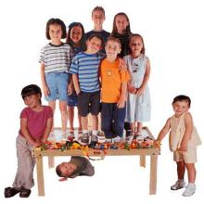
On

Slide 3
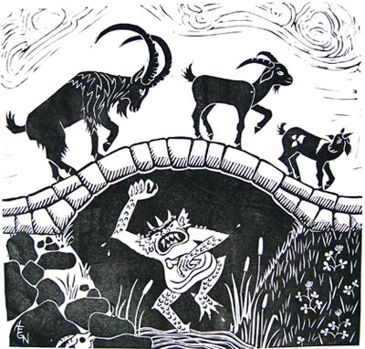
Under

Slide 4
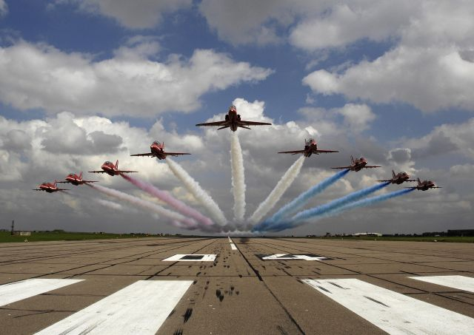
Over / Above

Slide 5
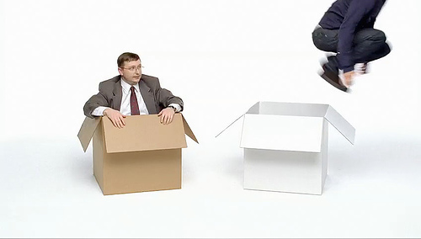
In / Out

Slide 6

Behind / In front / between

Slide 7

Through

Slide 8

Beside

Slide 9
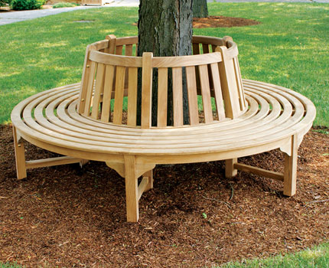
Around

Slide 10
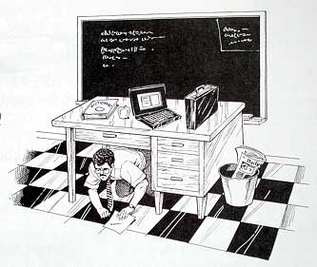

Slide 11
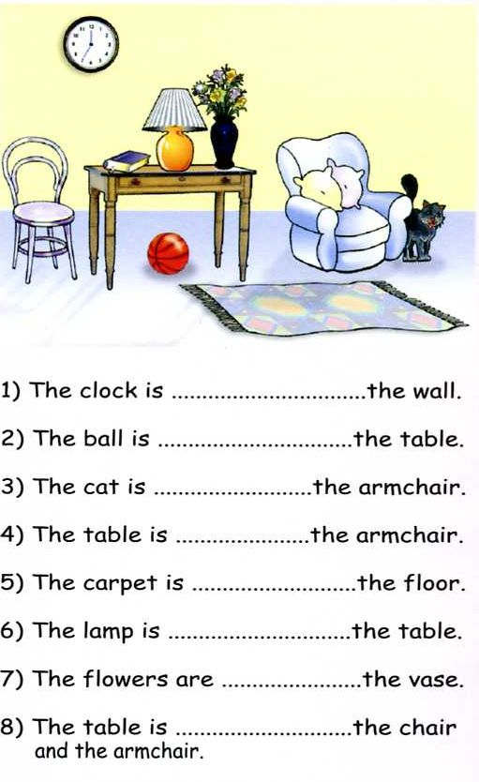
The clock is on the wall.
The ball is under the table.
The cat is beside the
armchair.
The table is near the
armchair.
The carpet is on the floor.
The lamp is on the table.
The flowers are in the vase.
The table is between the
chair and the armchair.

Slide 12
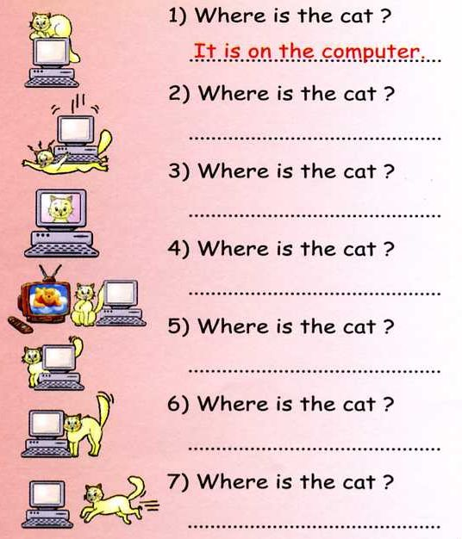
It is under the computer
It is in the computer
It is between the computer and tv.
It is behind the computer
It is beside the computer
It is going towards the computer

Slide 13

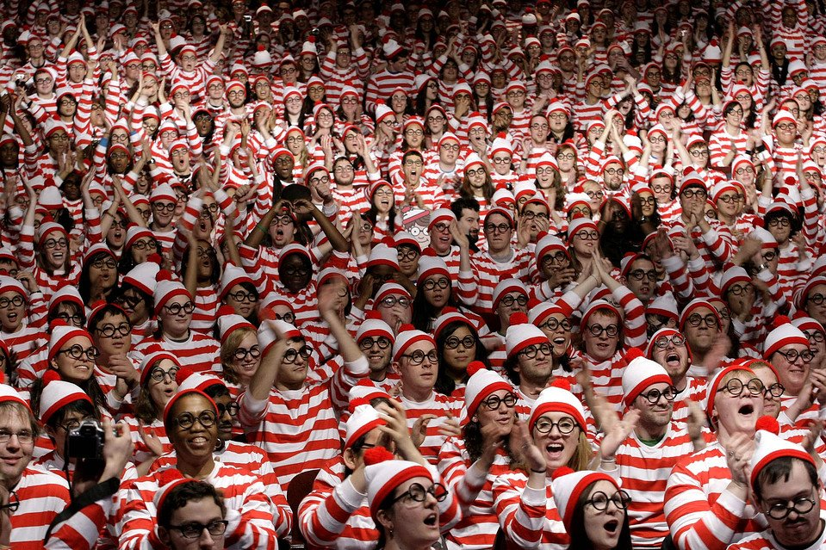
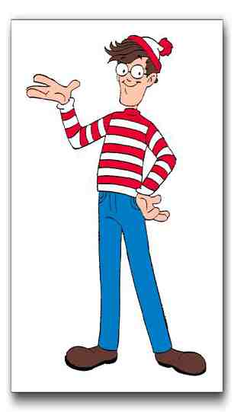
Where’s Waldo (Wally)
If you find Waldo, raise your hand.
You must describe (over, under, etc.) where he is.
No pointing.

Slide 14


Slide 15
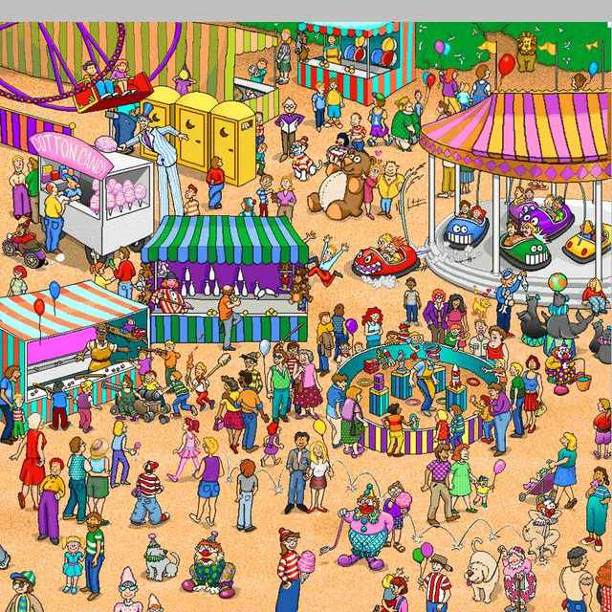

Slide 16
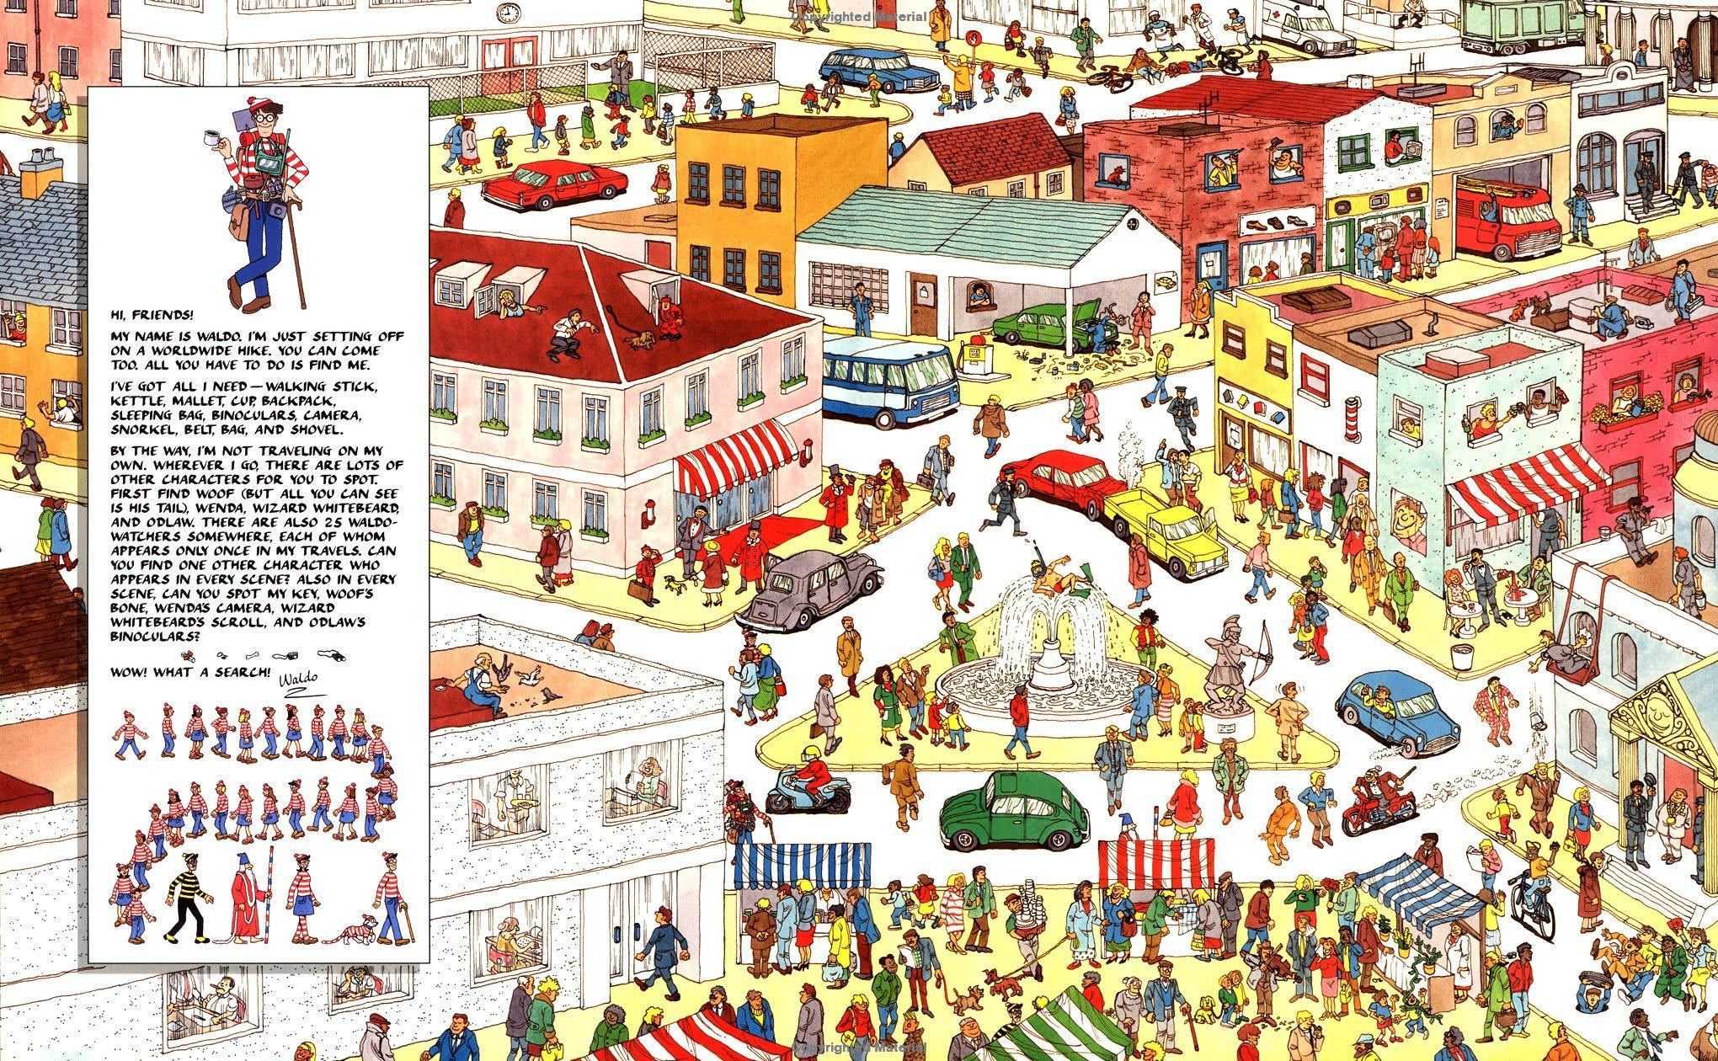

Slide 17
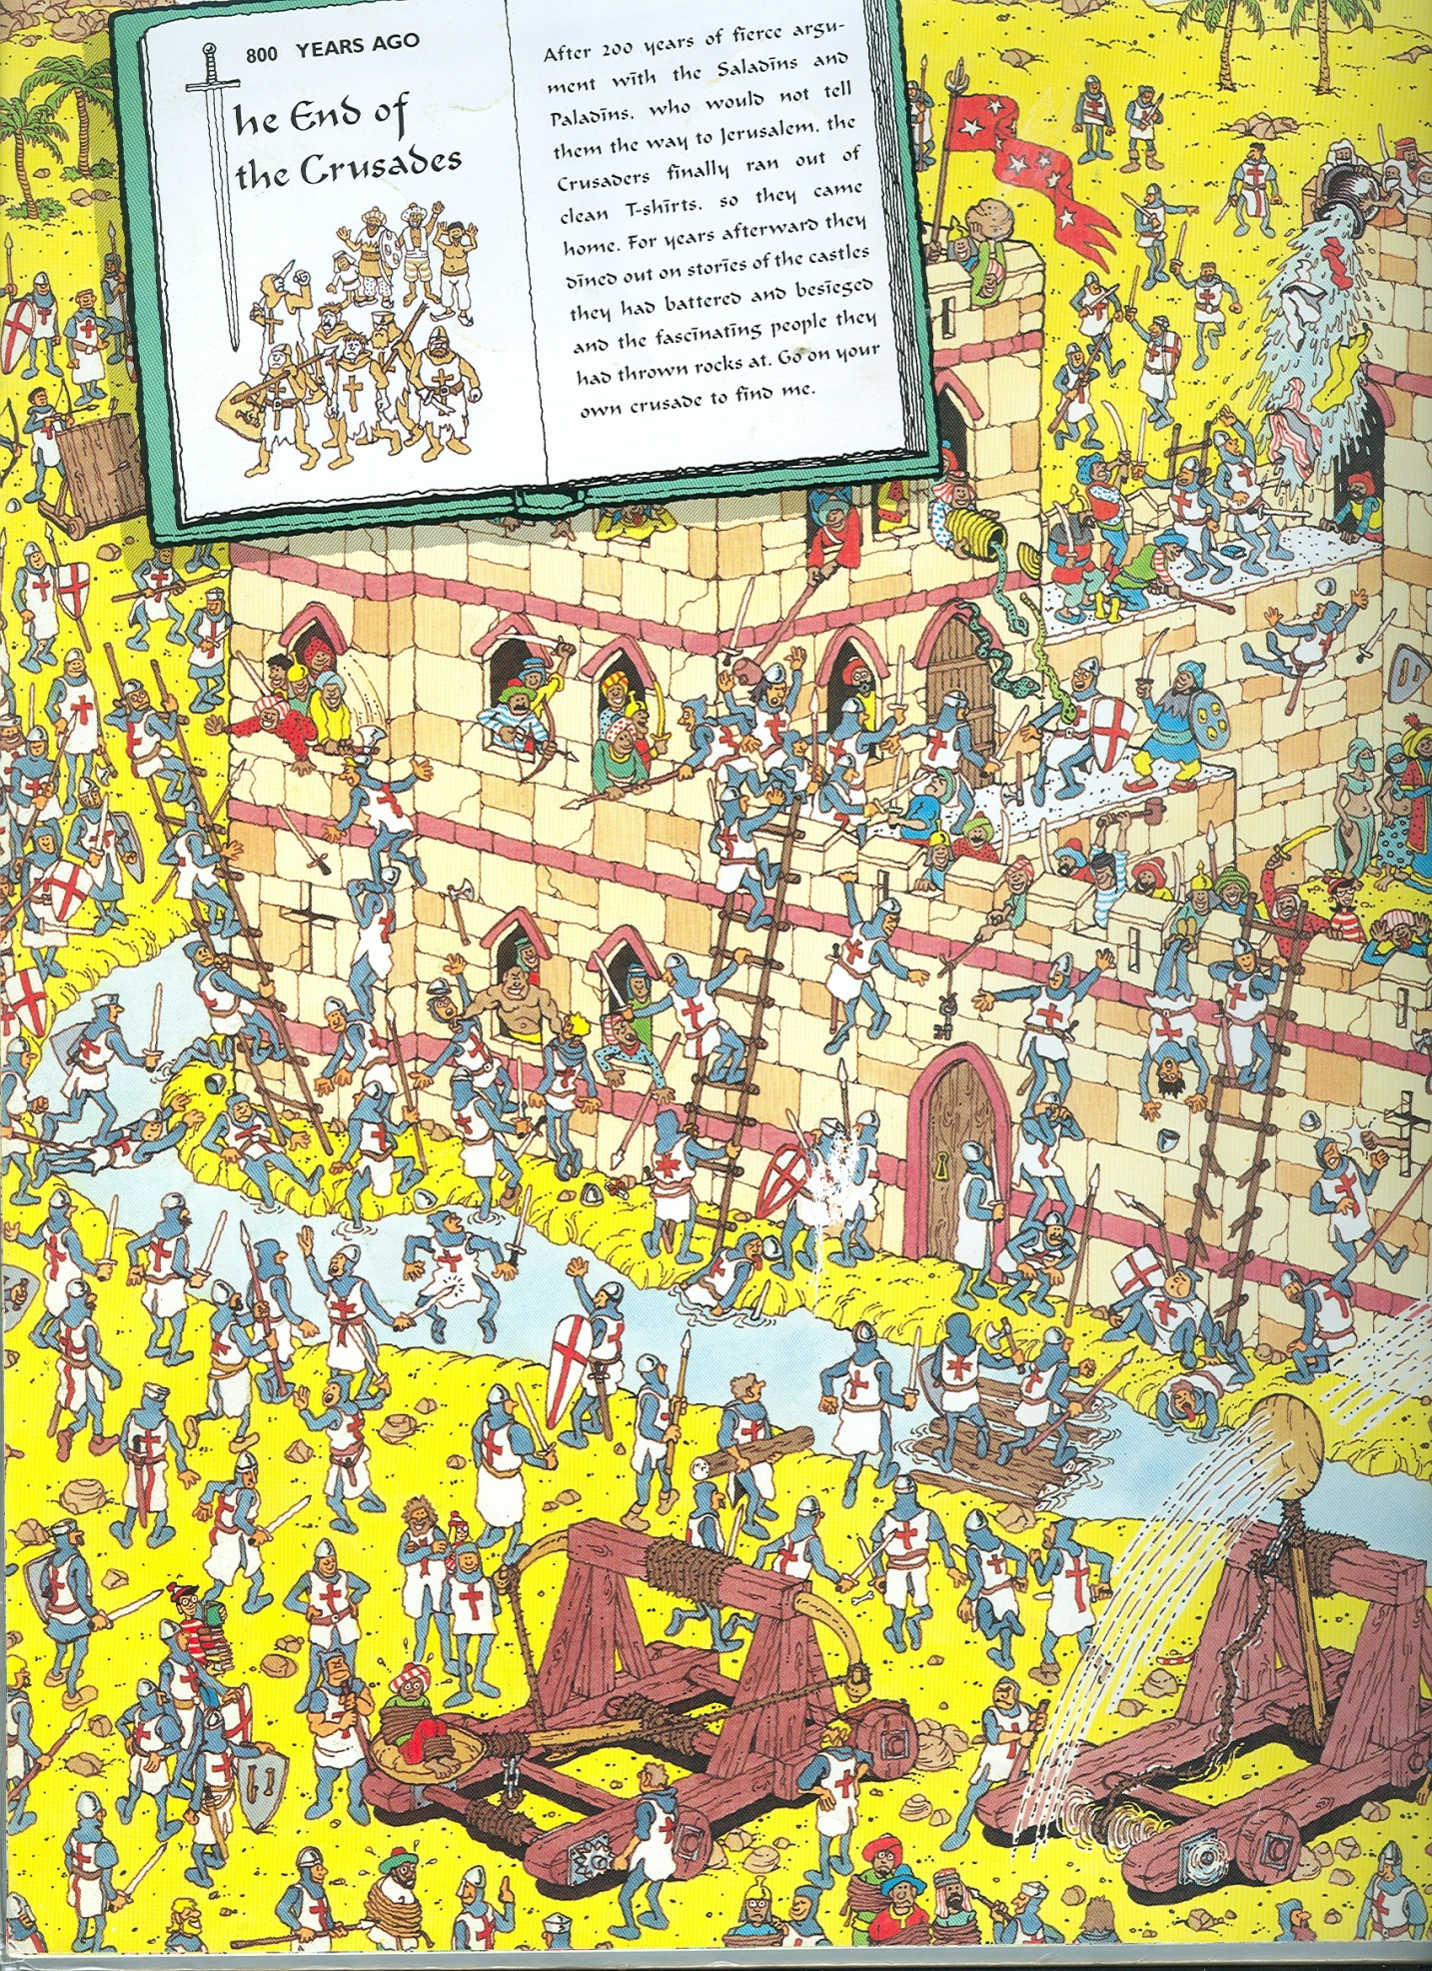

Slide 18
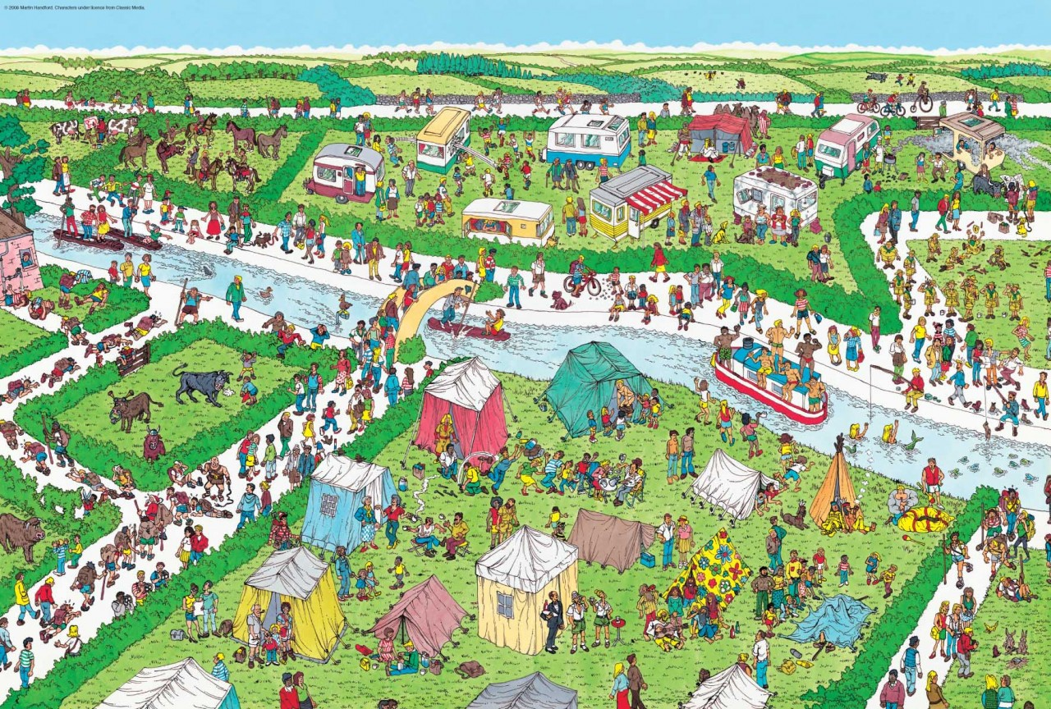

Slide 19
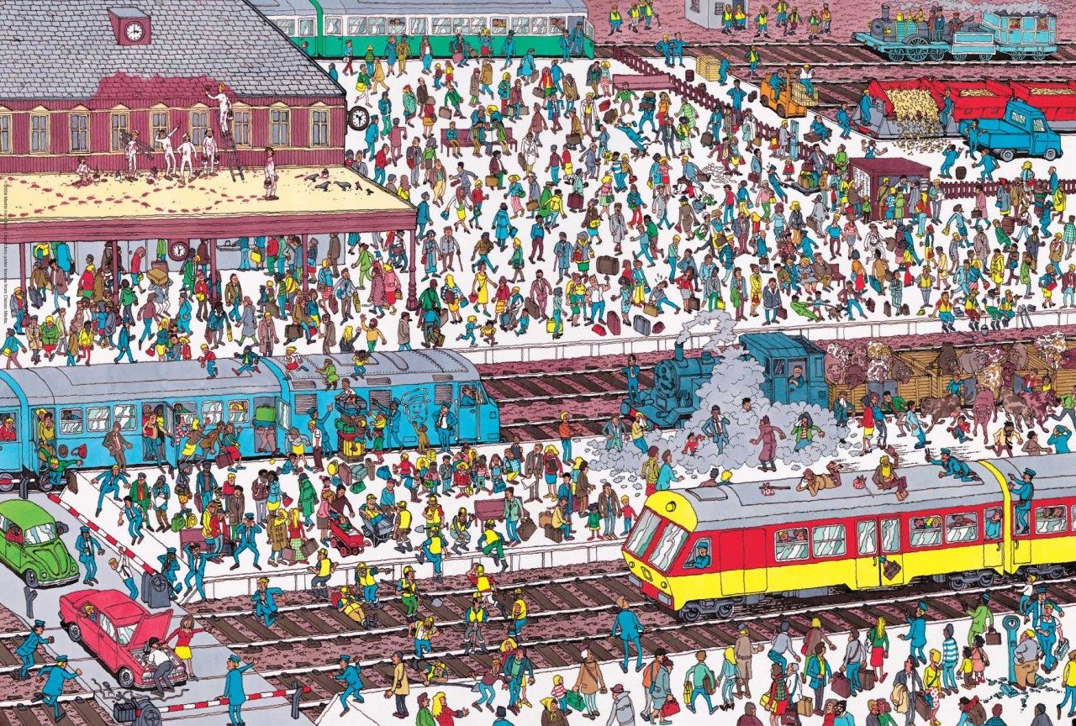

Slide 20
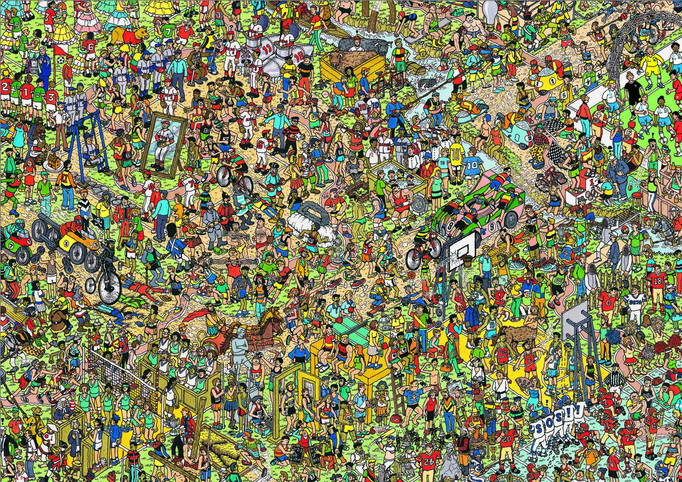

Slide 21
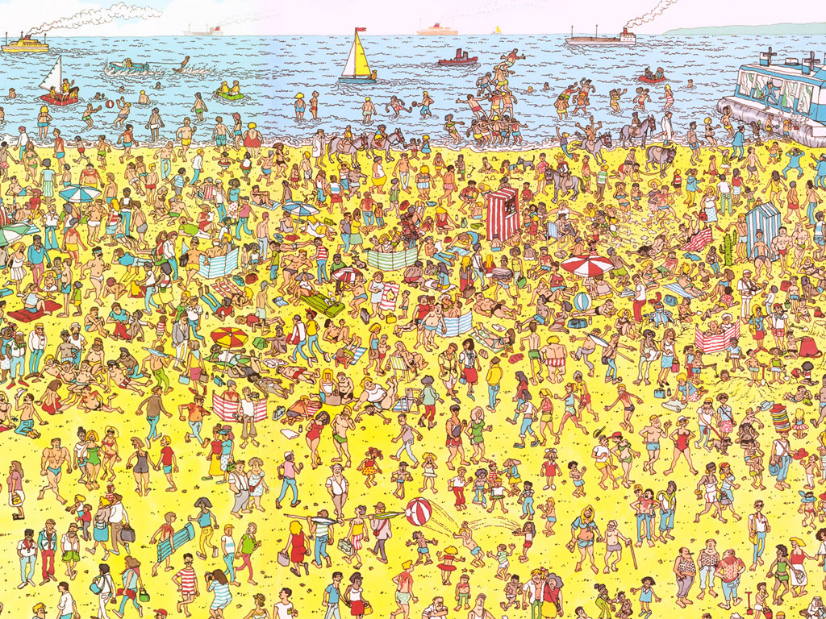

Slide 22
