Slide 1
What did you do?

Slide 2
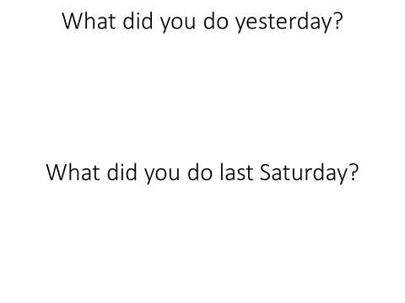
Rules (part 1):
Write what you did on the cards.
Fold the paper and put it in the bag.

Slide 3
Rules (part 2):
Don’t guess your own answer!
One student (leader) will come to the front
The class will ask one of the questions (Yesterday / last Saturday)
The leader will answer using what is written on the cards.
The other students must guess who wrote it.

