Slide 1
What’s This / That?
Guess what is hidden in the picture
Say, “It’s a ________.”

Slide 2
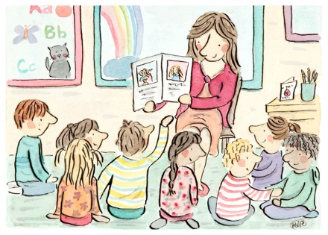
What’s this?
It’s a book.

Slide 3
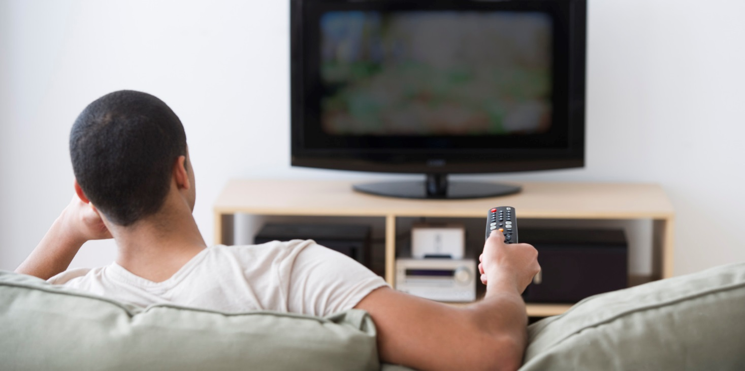
What’s this?
It’s a TV.

Slide 4

What’s this?
It’s a ruler.

Slide 5
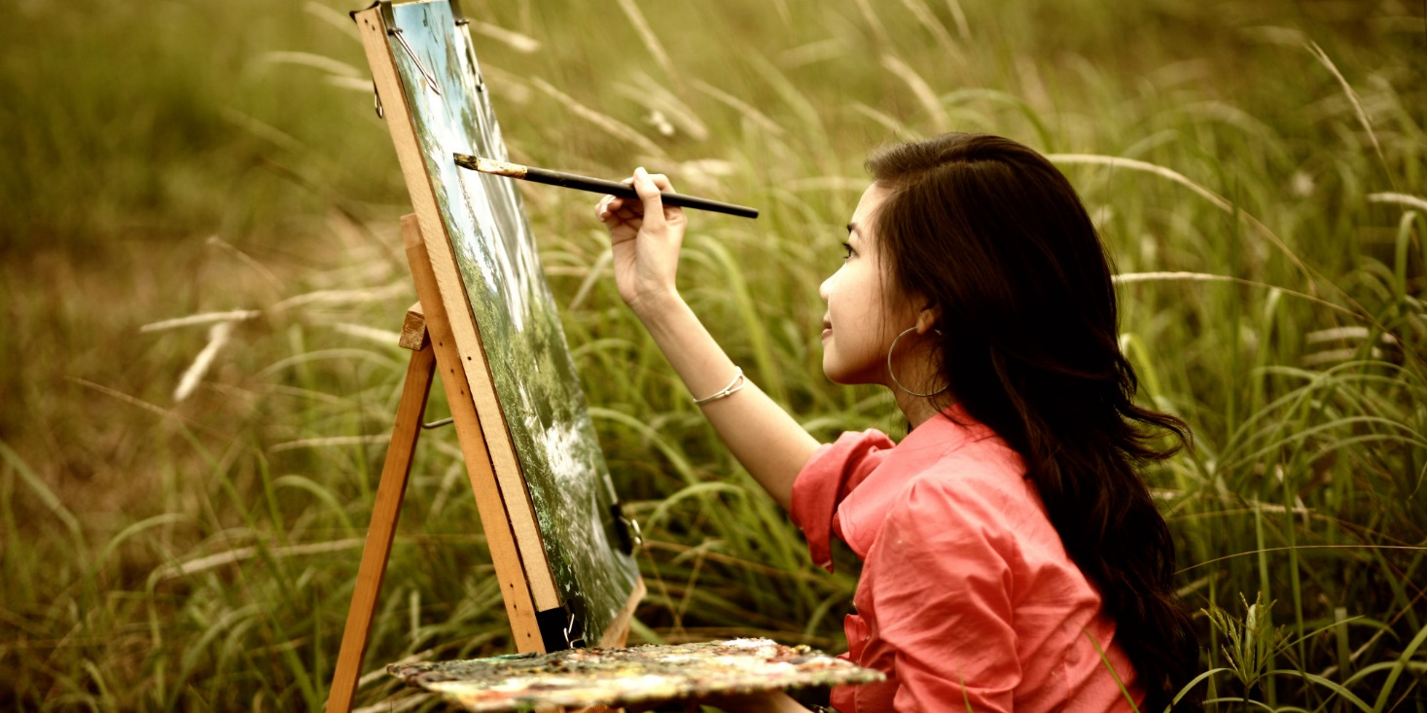
What’s this?
It’s a brush.

Slide 6

What’s this?
It’s an airplane.

Slide 7
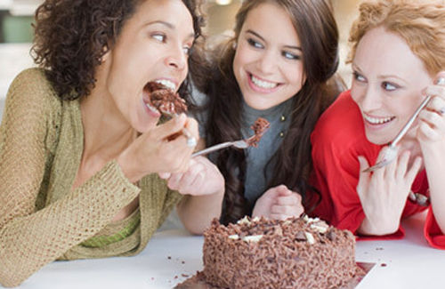
It’s a cake.
What’s this?

Slide 8
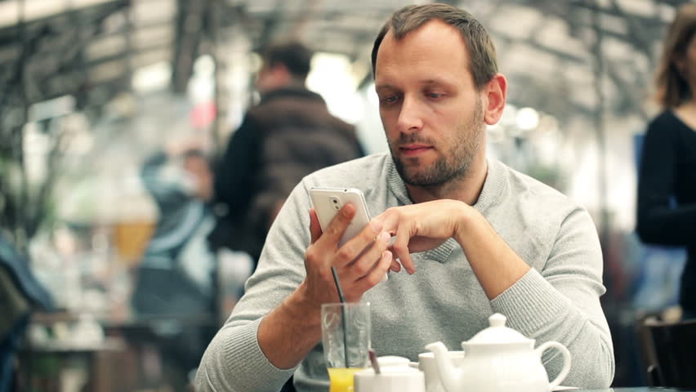
What’s this?
It’s a phone.

Slide 9
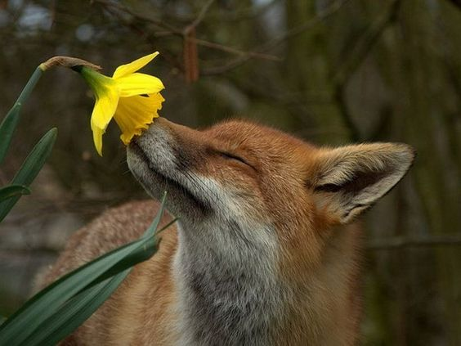
What’s this?
It’s a flower.

Slide 10
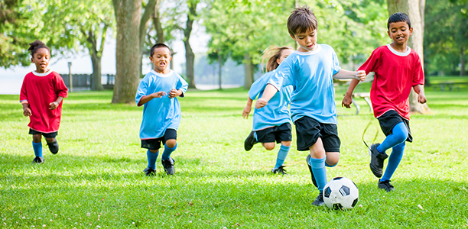
It’s a soccer ball.
What’s this?

Slide 11
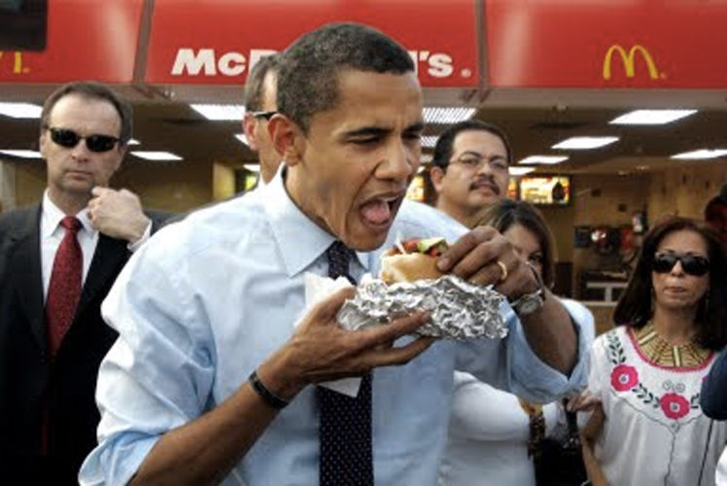
What’s this?
It’s a hamburger.

Slide 12
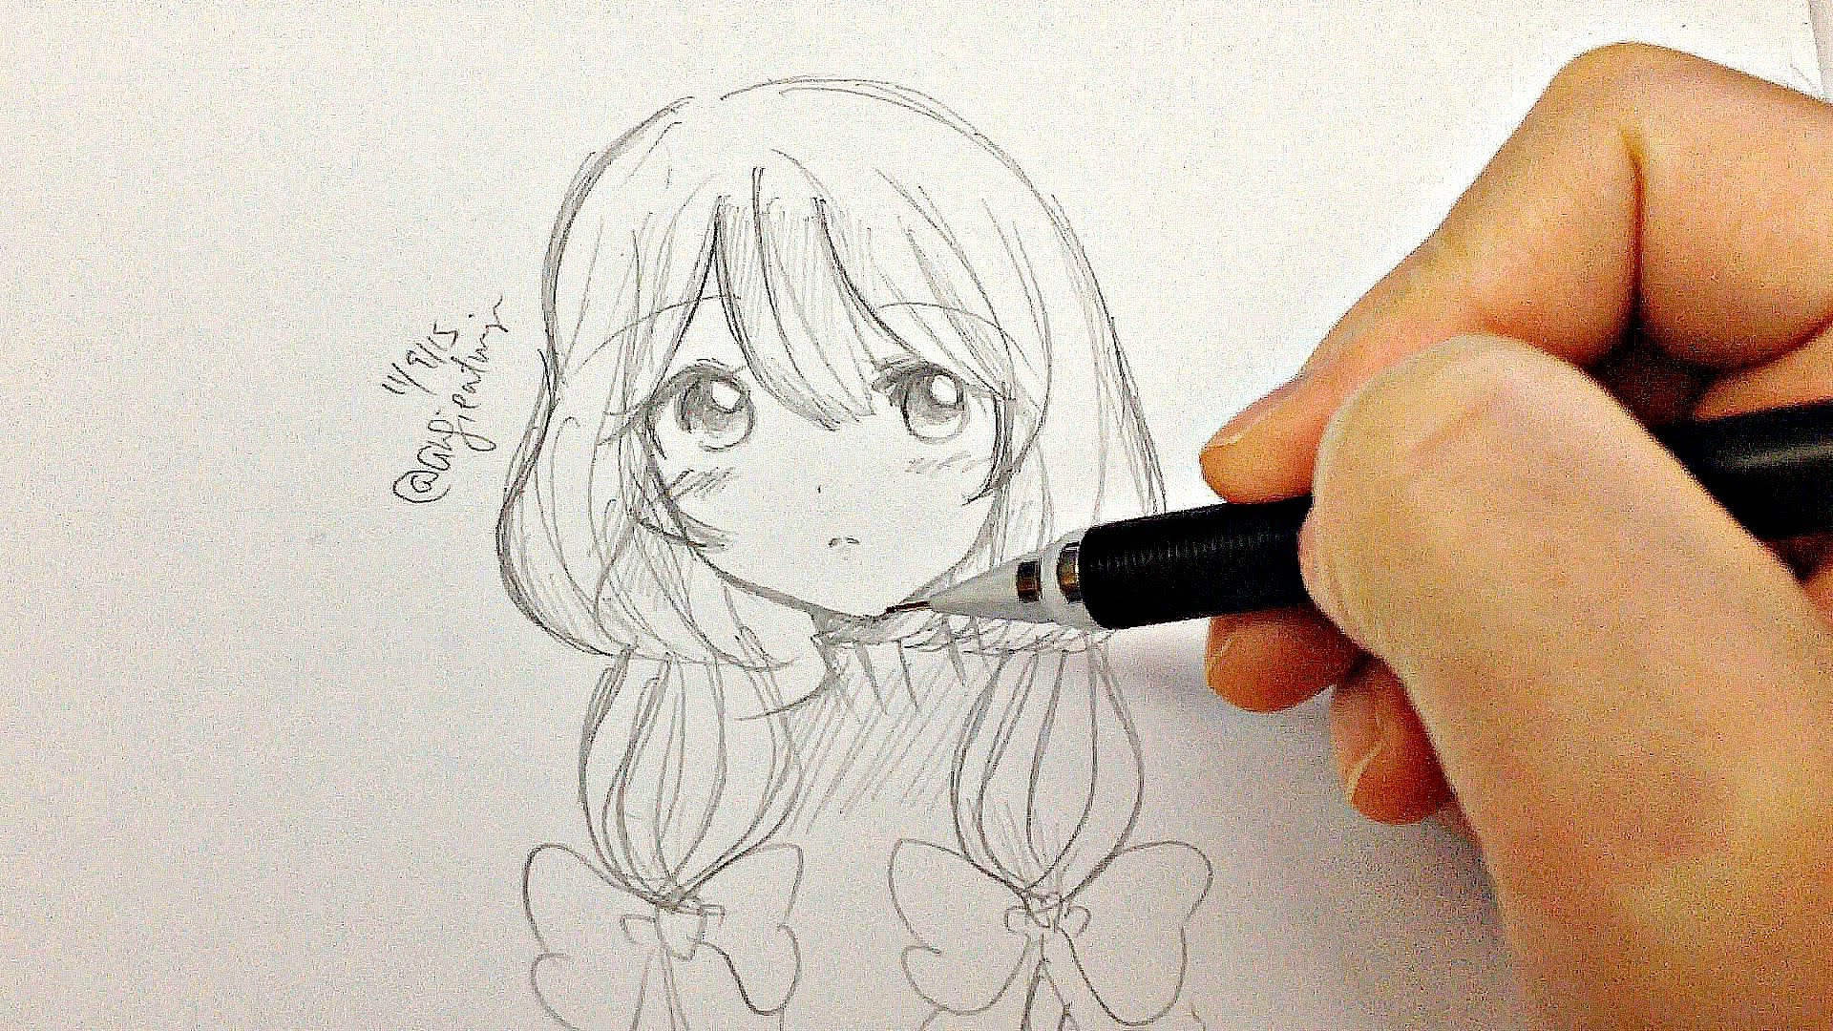
What’s this?
It’s a pencil.

Slide 13
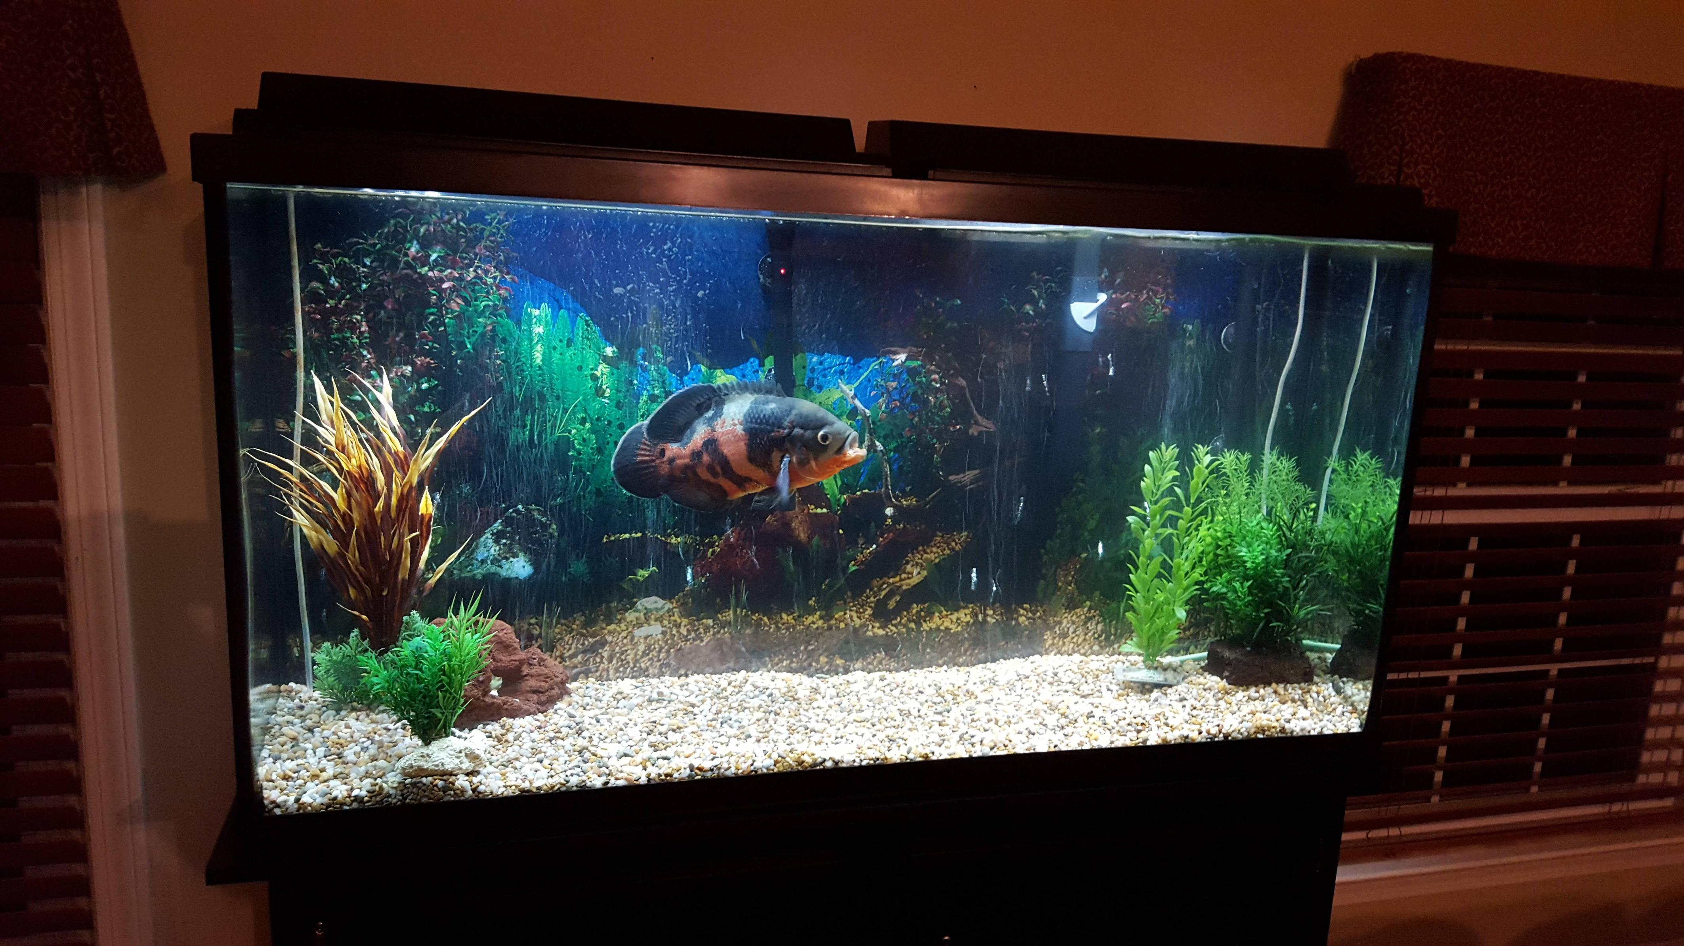
What’s this?
It’s a fish.

Slide 14
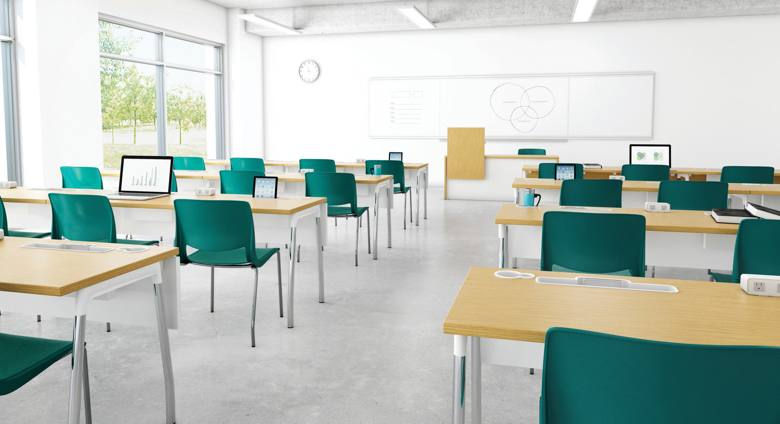
What’s this?
It’s a clock.

Slide 15
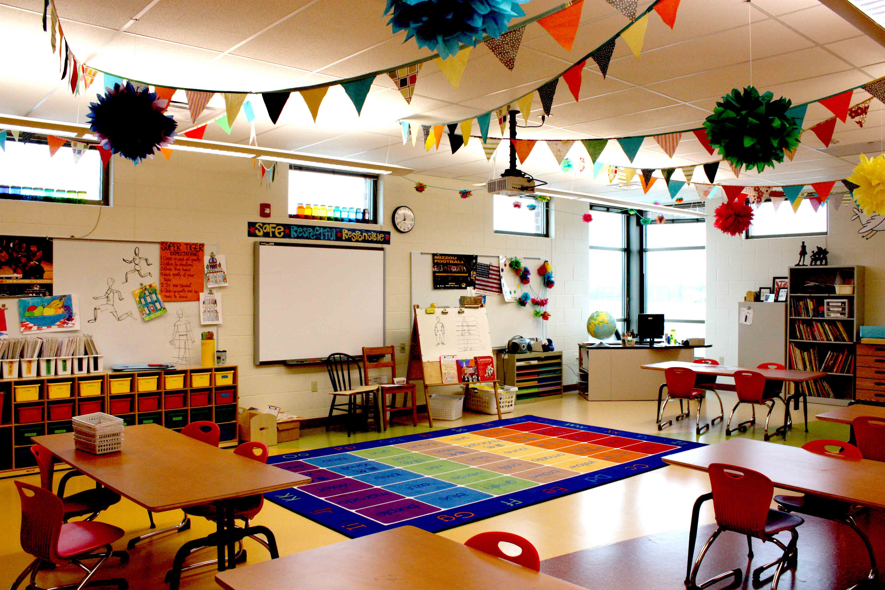
It’s a chair.
What’s this?

Slide 16

It’s an apple.
What’s this?

Slide 17
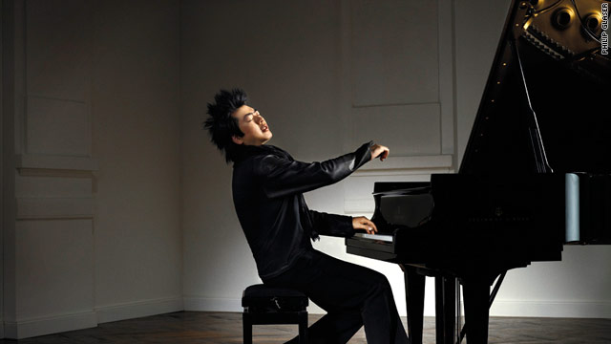
What’s this?
It’s a piano.

Slide 18
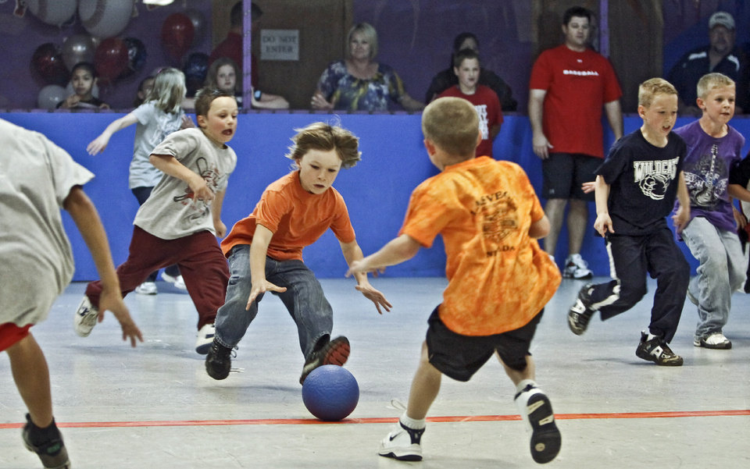
It’s a ball.
What’s this?

Slide 19

What’s this?
It’s a computer.

Slide 20
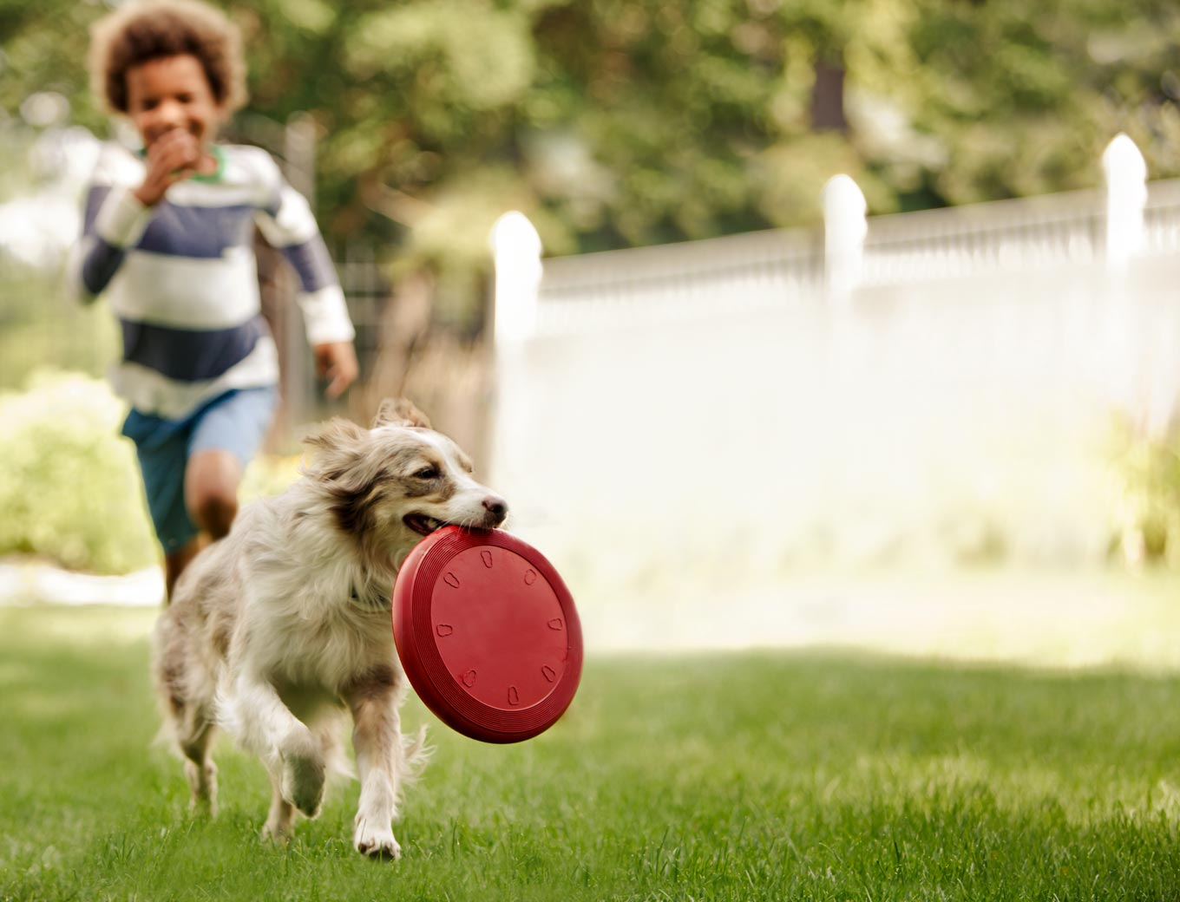
What’s this?
It’s a dog.

Slide 21
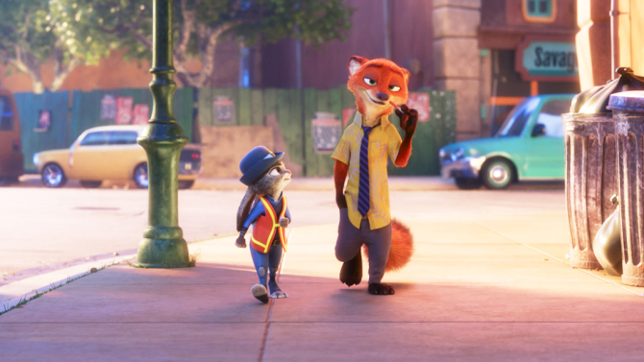
What’s this?
It’s a rabbit.

Slide 22
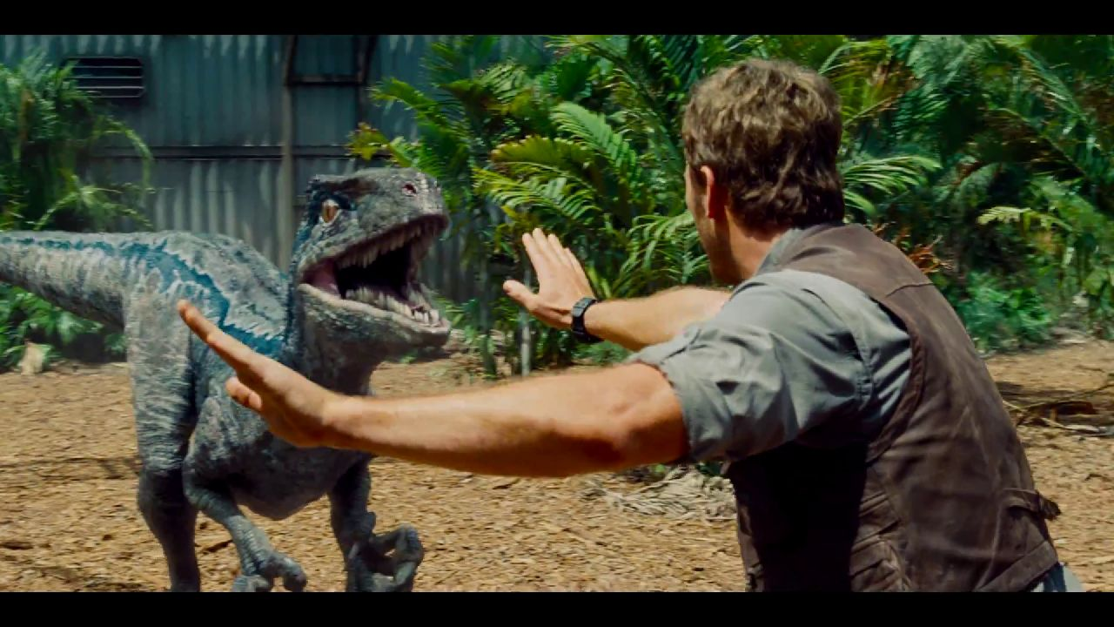
What’s this?
It’s a dinosaur.

Slide 23
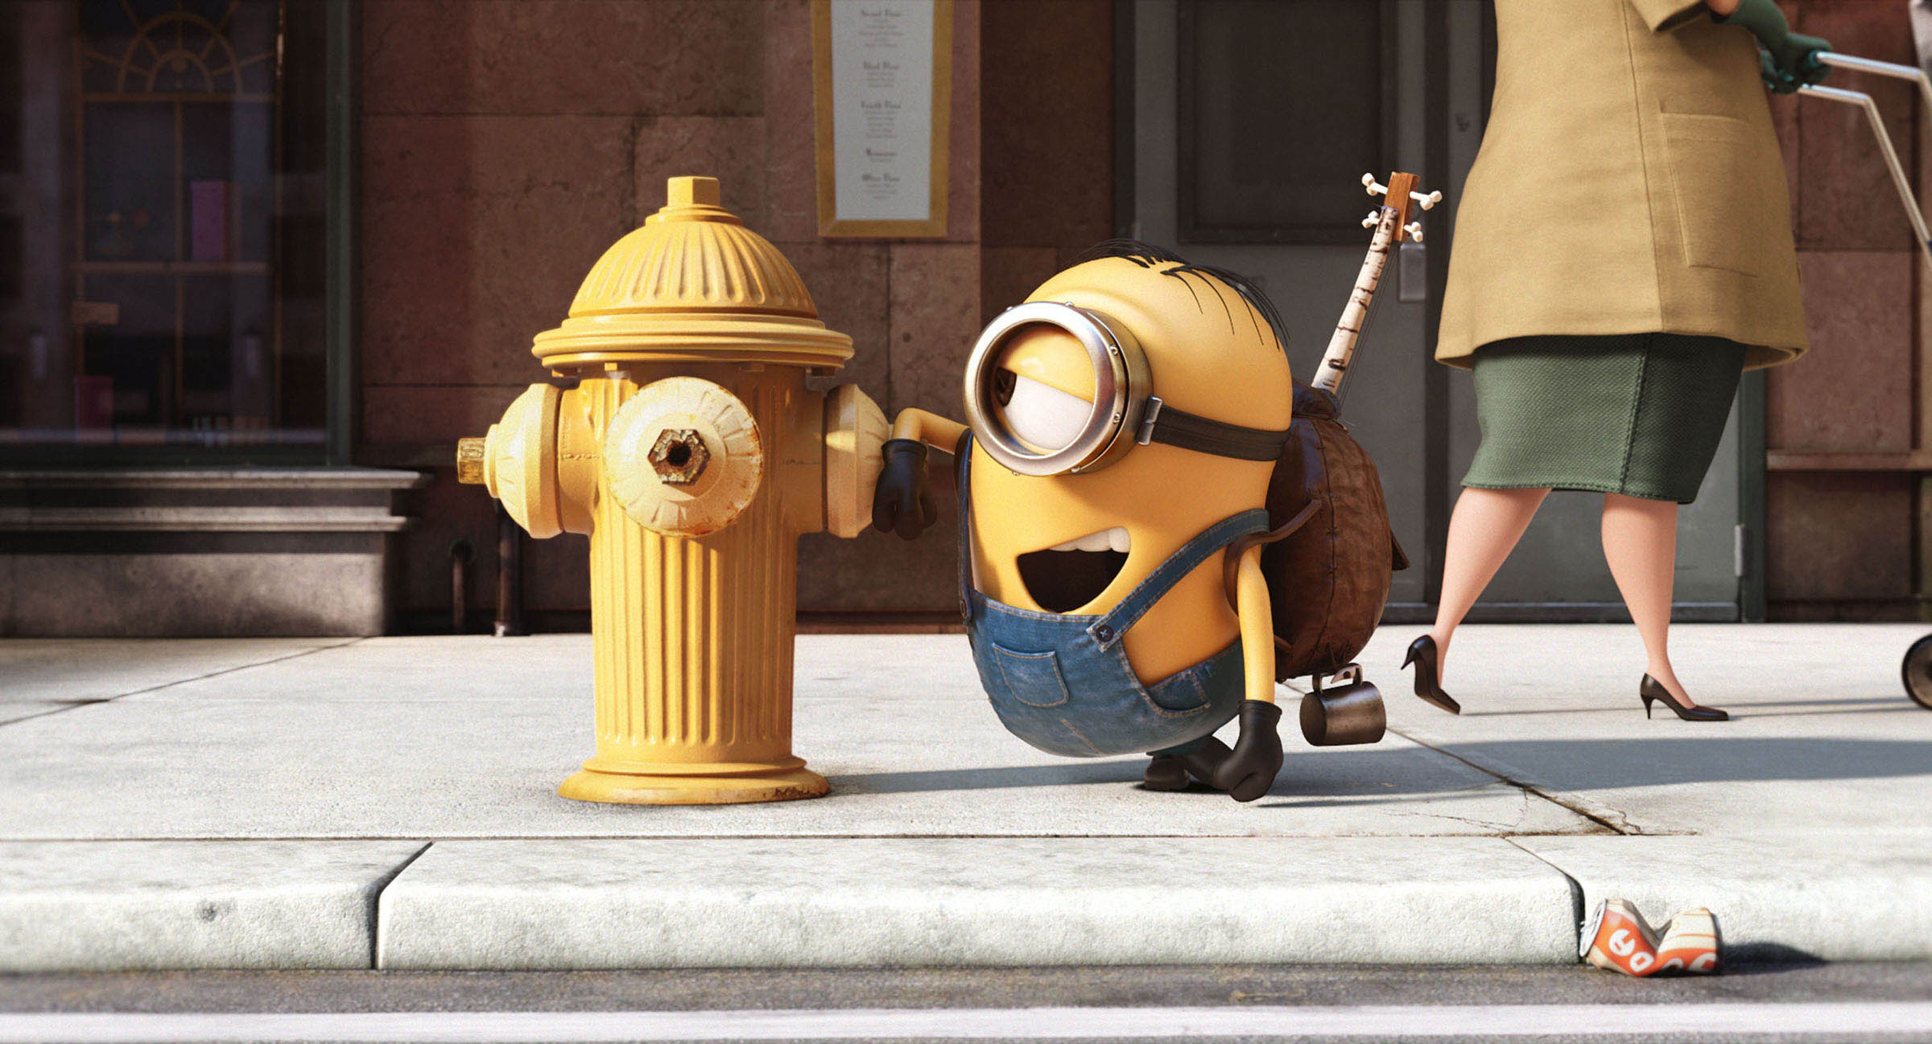
What’s this?
It’s a minion.

Slide 24
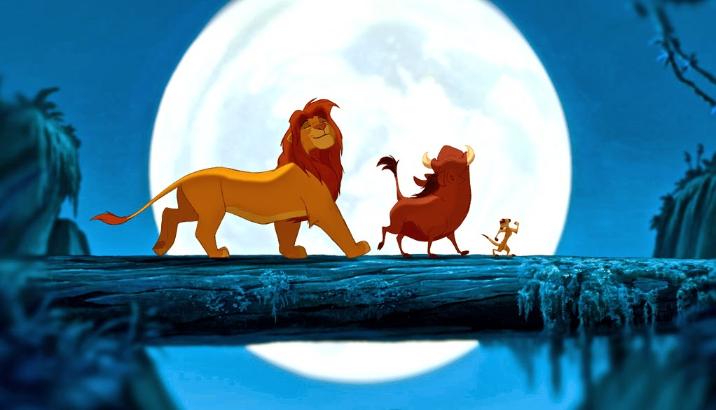
What’s this?
It’s a lion.

Slide 25
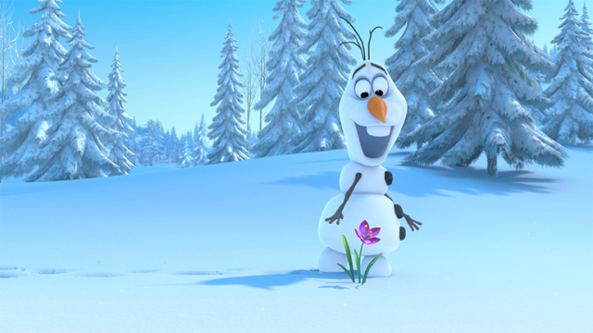
It’s a flower.
What’s this?

