Slide 1
Who is she?

Slide 2
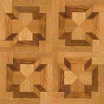

Next Slide
Remove Box

Slide 3

Next Slide
Remove Box

Slide 4
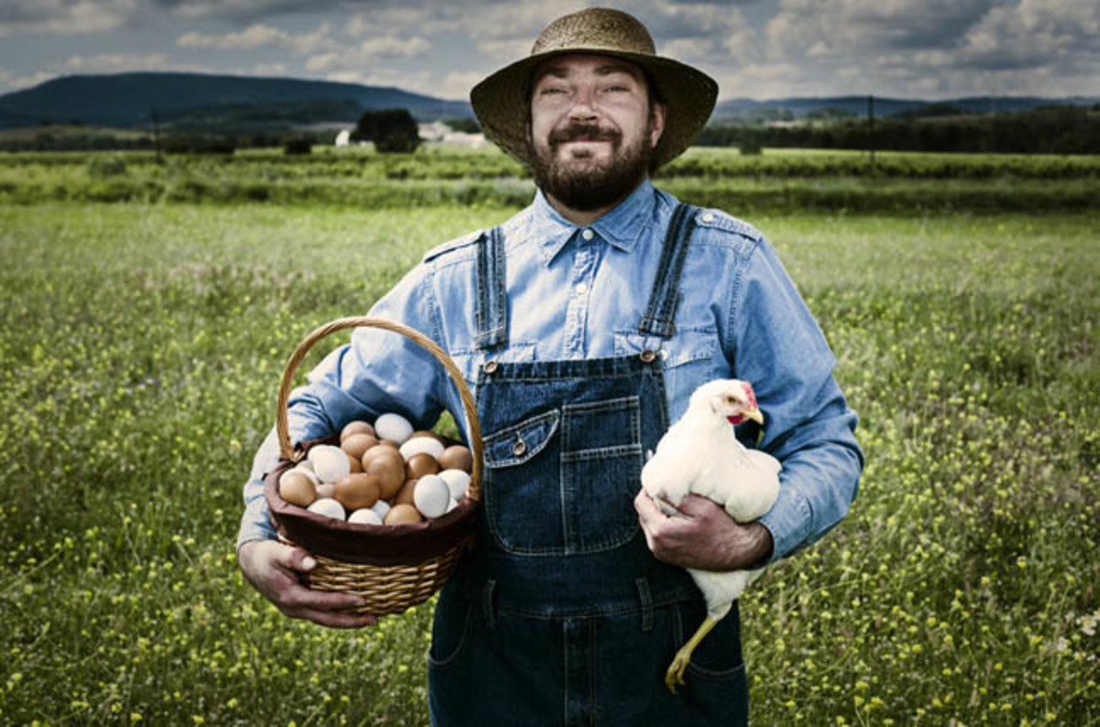
Next Slide
Remove Box

Slide 5

Next Slide
Remove Box

Slide 6

Next Slide
Remove Box

Slide 7
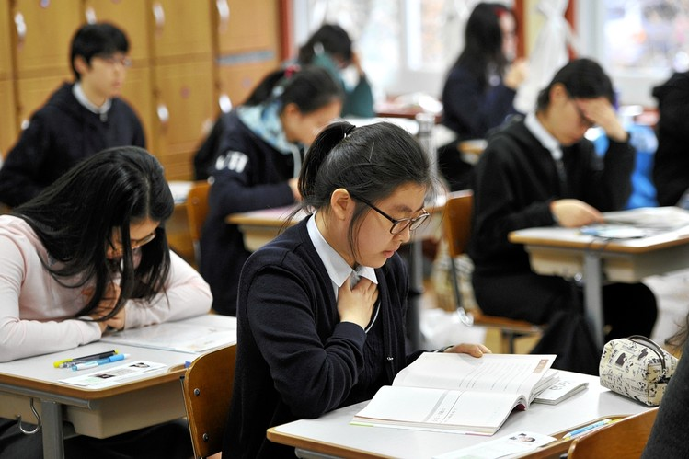
Next Slide
Remove Box

Slide 8

Next Slide
Remove Box

Slide 9
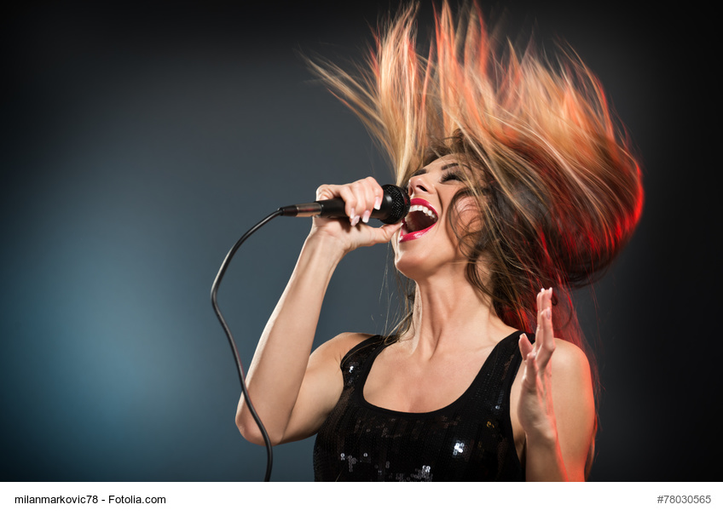
Next Slide
Remove Box

Slide 10

Next Slide
Remove Box

Slide 11
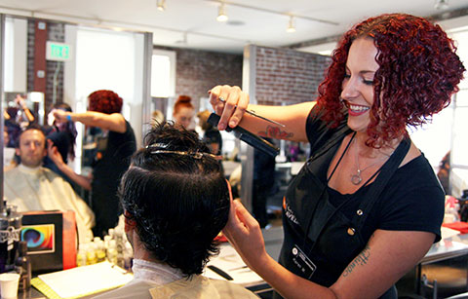
Next Slide
Remove Box

Slide 12
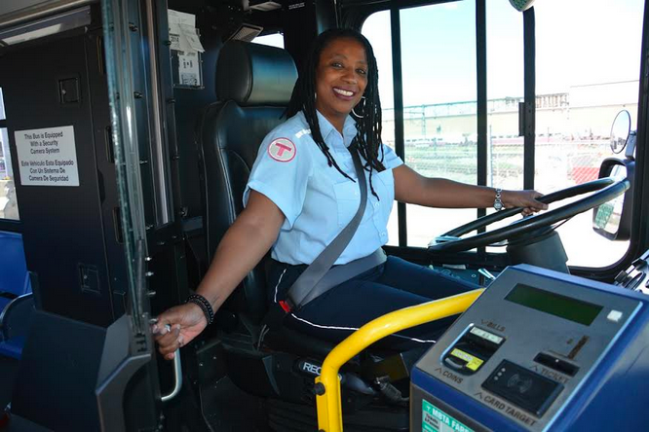
Next Slide
Remove Box

Slide 13
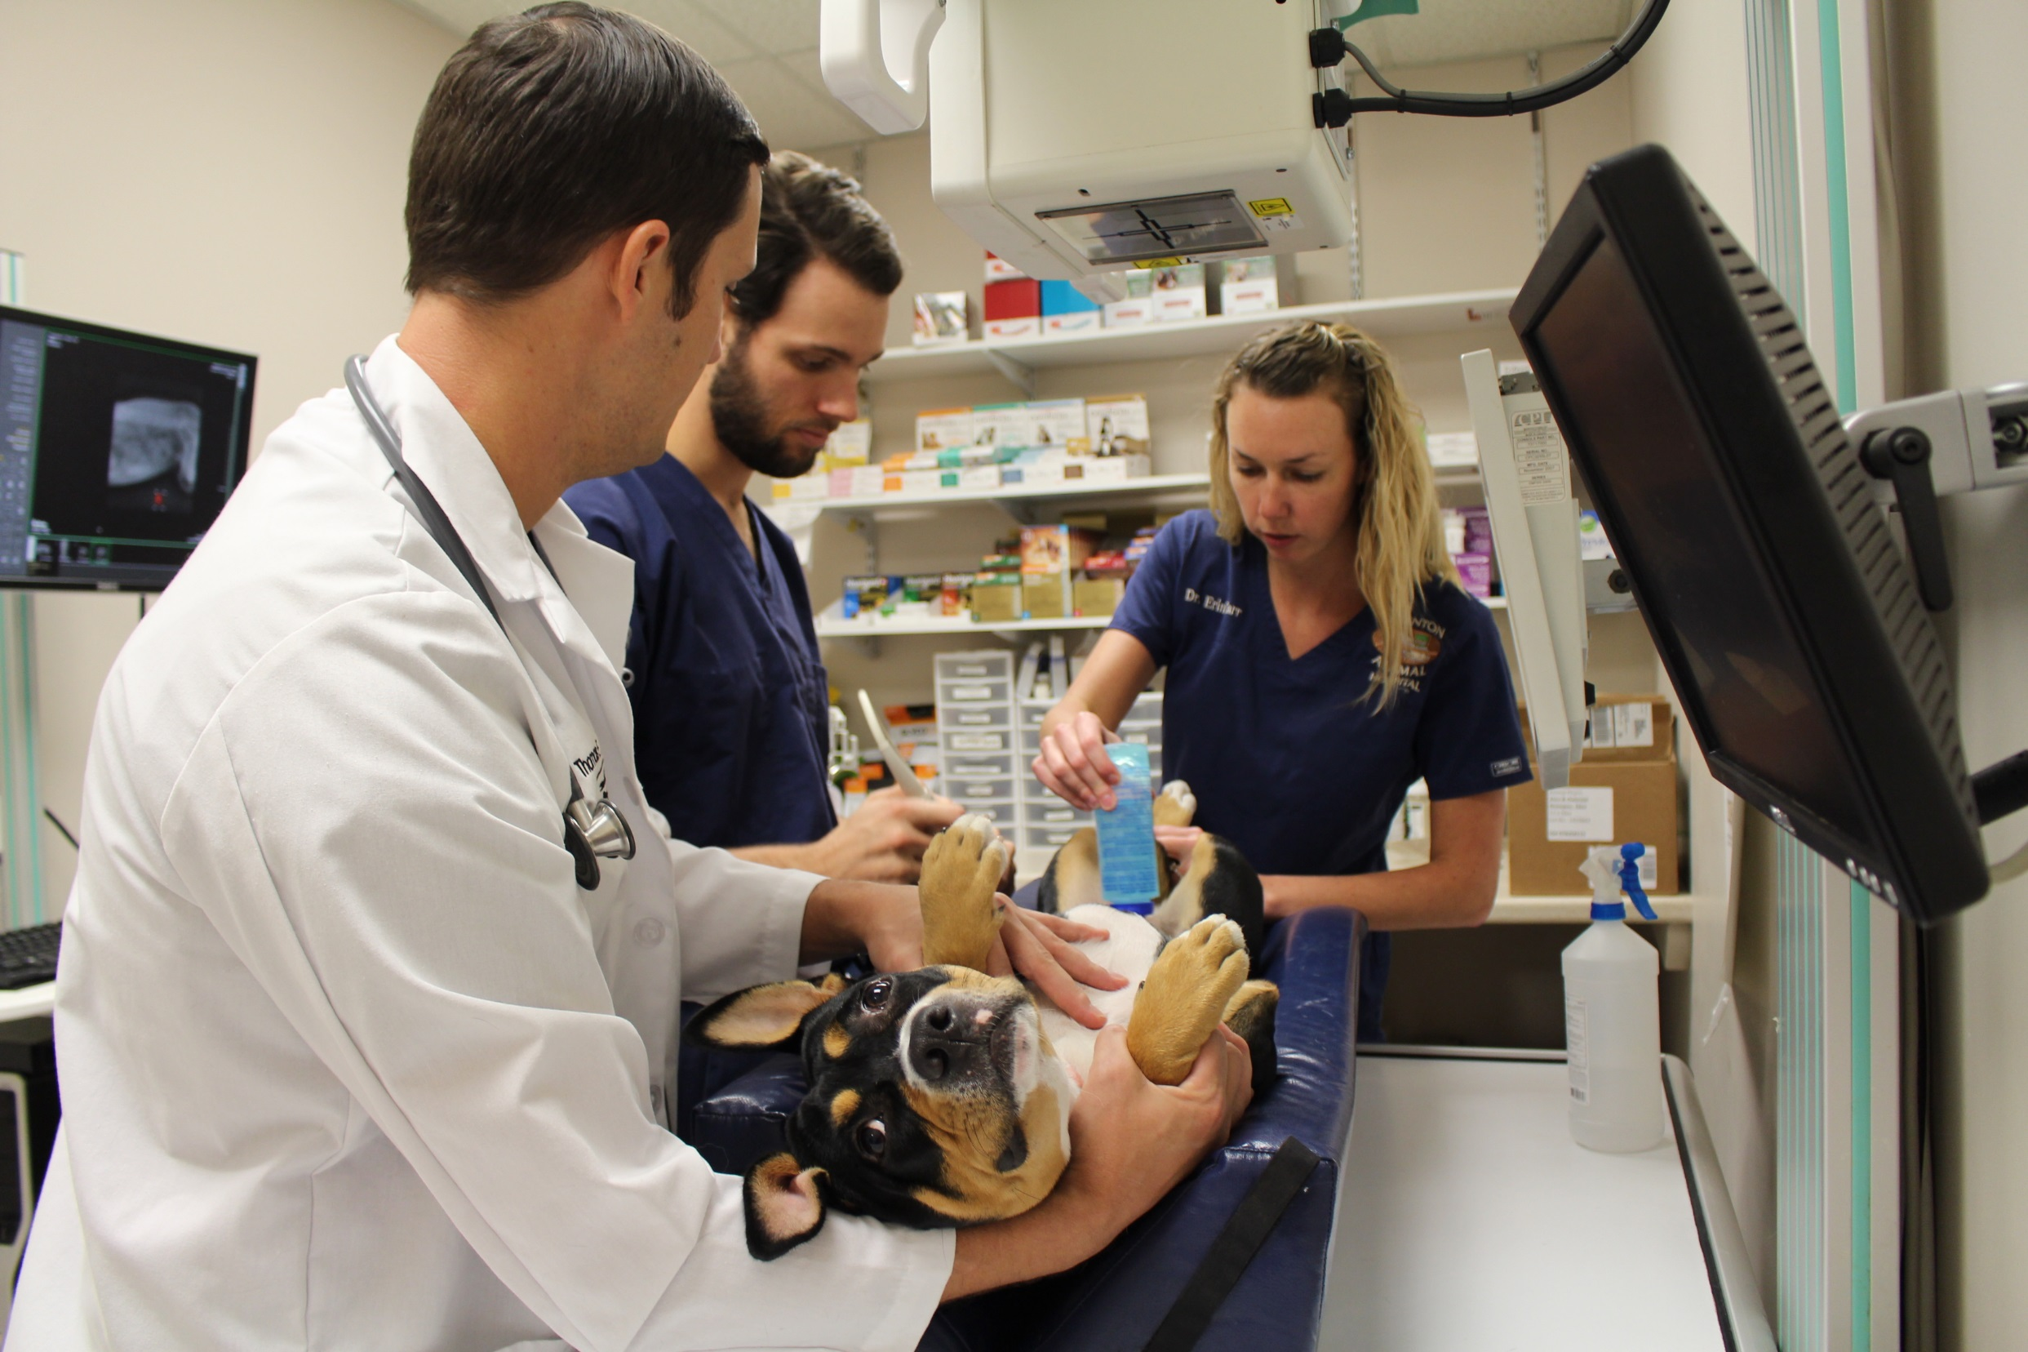
Next Slide
Remove Box

Slide 14

Next Slide
Remove Box

Slide 15
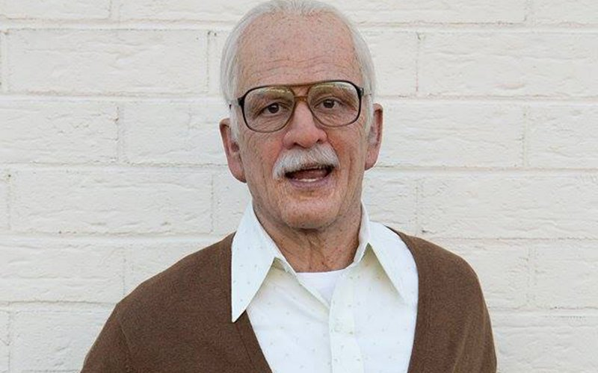
Next Slide
Remove Box

Slide 16

Next Slide
Remove Box

Slide 17
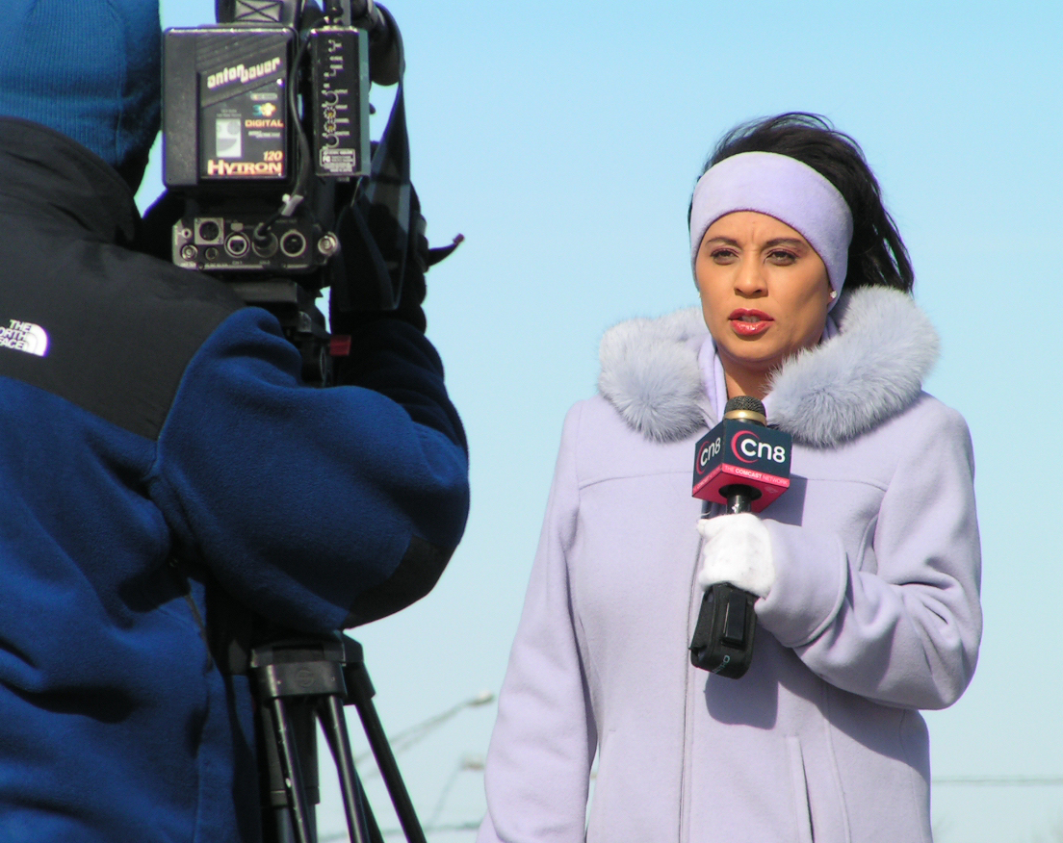
Next Slide
Remove Box

Slide 18

Next Slide
Remove Box

Slide 19

Next Slide
Remove Box

Slide 20
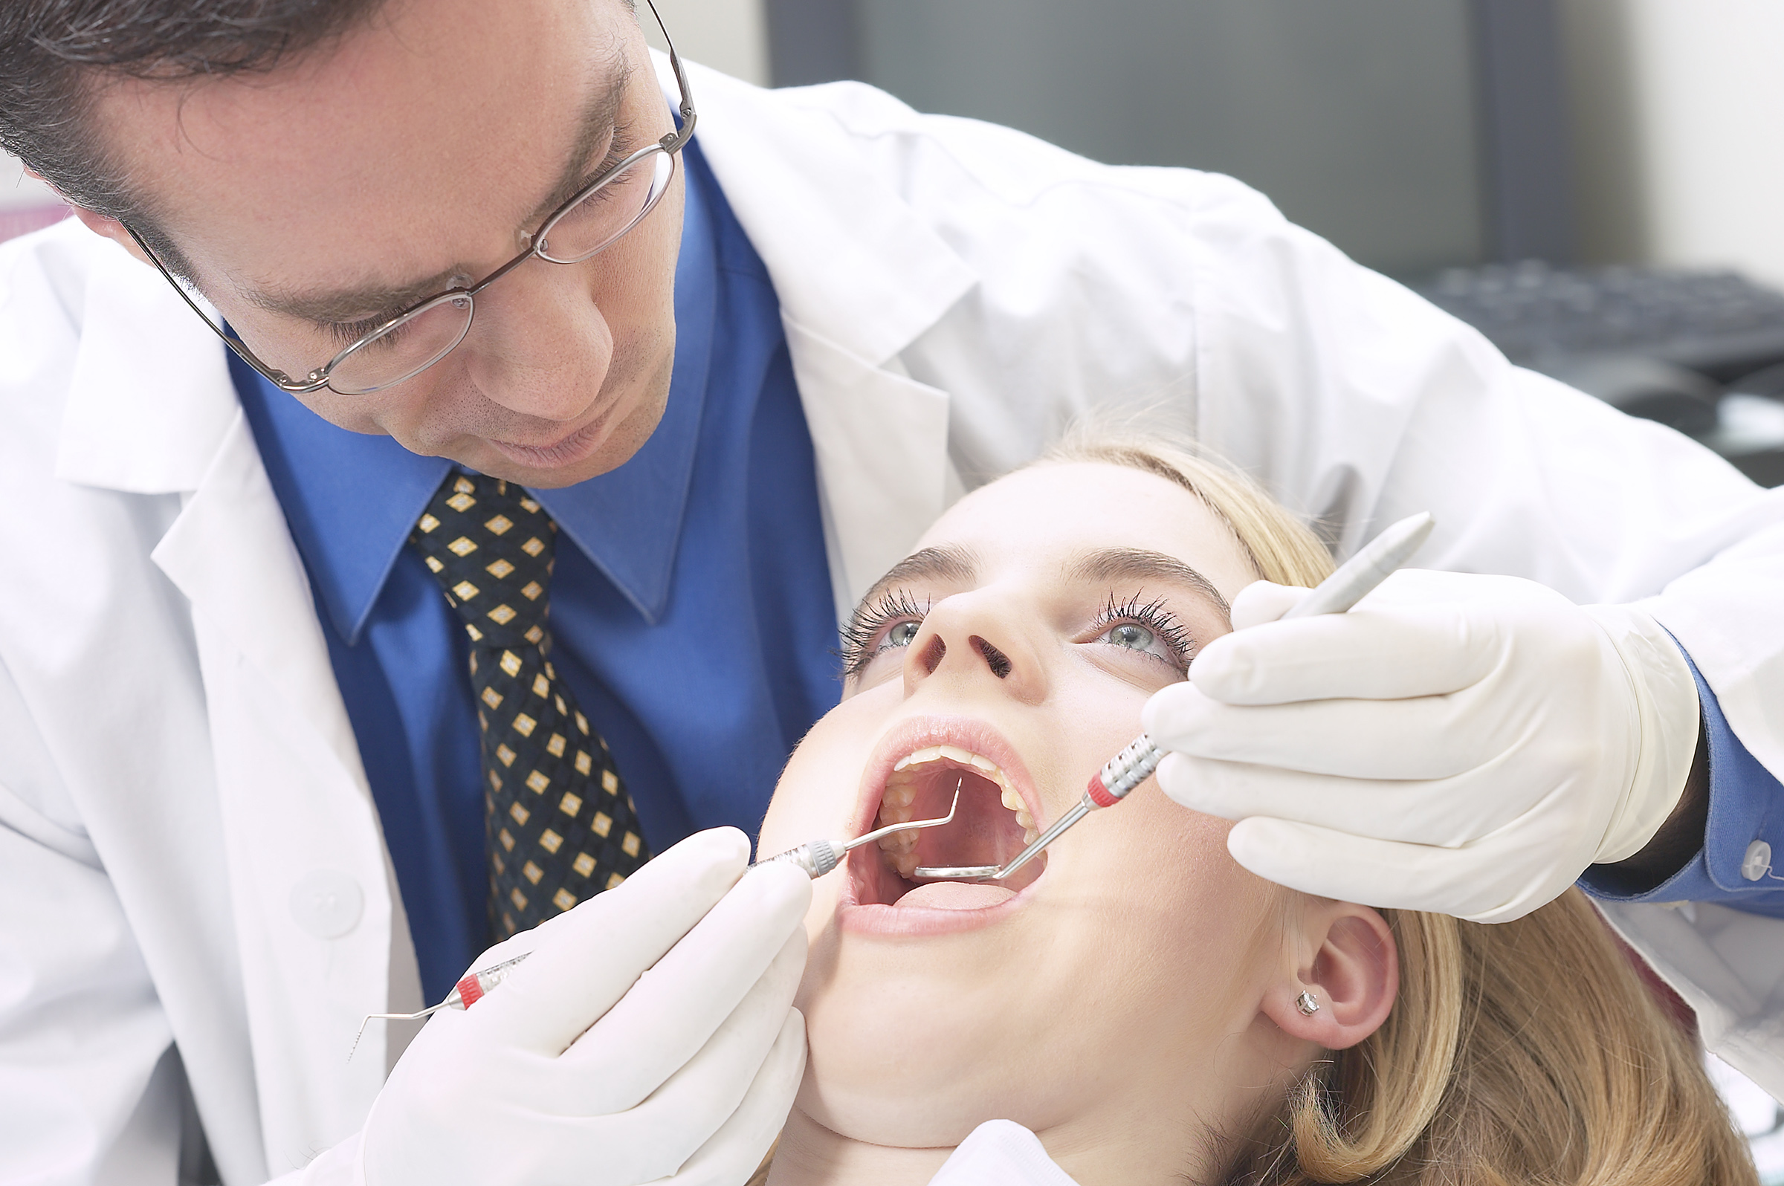
Next Slide
Remove Box

Slide 21
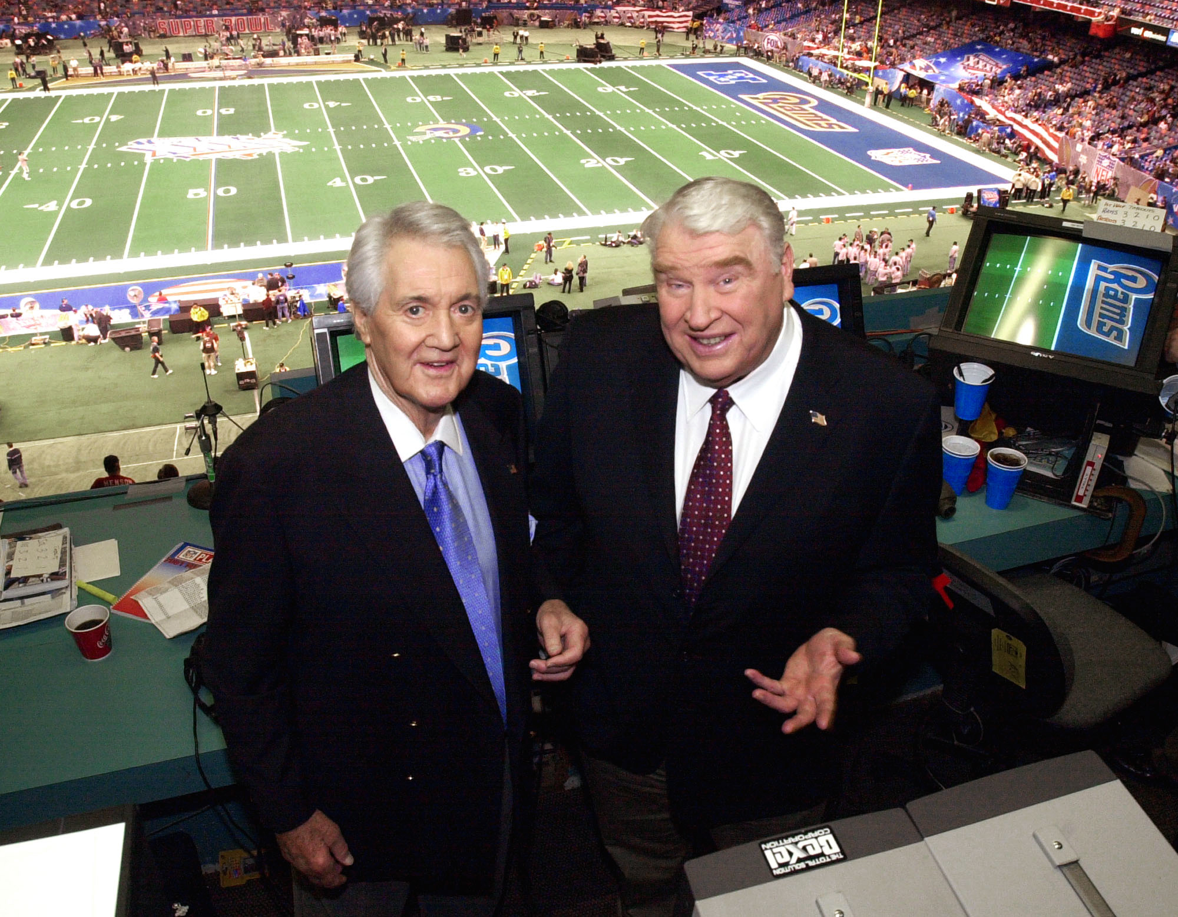
Next Slide
Remove Box

Slide 22

Next Slide
Remove Box

Slide 23
Next Slide
Remove Box

Slide 24
Next Slide
Remove Box

