Slide 1
He’s a dancer.
https://www.youtube.com/watch?v=n-0DJzxUdTE

Slide 2
Key Phrases:
Who is she?
  Who is he?
This is my ____________.
She’s a ______________.
  He’s a ________________.

Slide 3
Instructions:
I will ask, “Who is he / she?”
You can answer using:
  This is my __________________.
  or
  He/She’s a(an) ___________________.

Slide 4
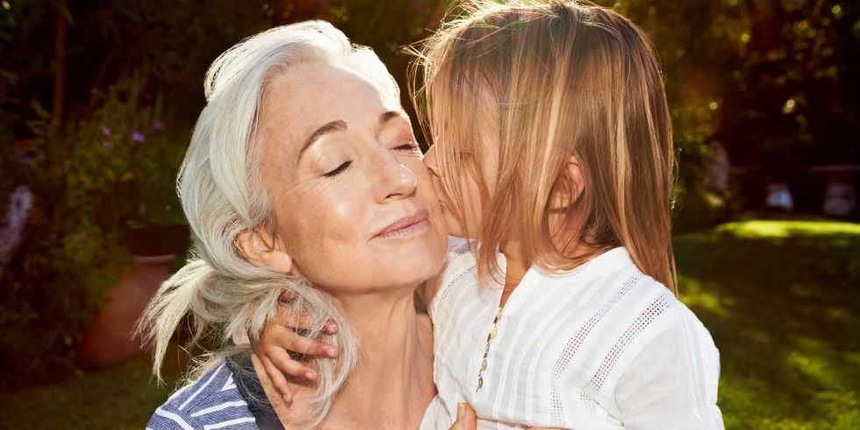
Who is she?
See Answer

Slide 5
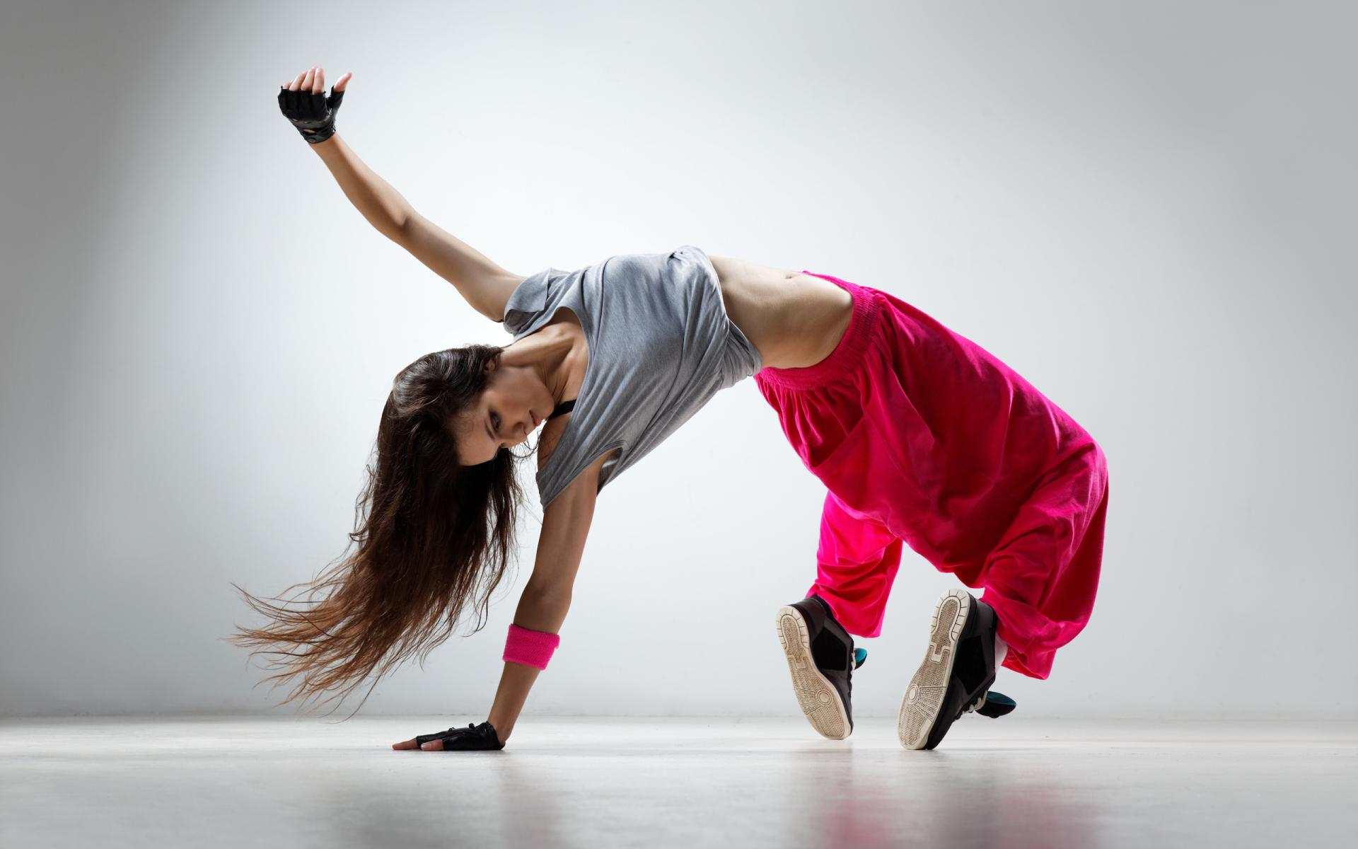
Who is she?
See Answer

Slide 6

Who is he?
See Answer

Slide 7

Who is she?
See Answer

Slide 8
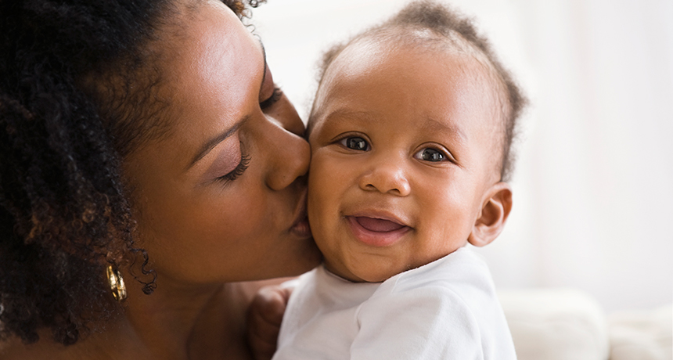
Who is she?
See Answer

Slide 9
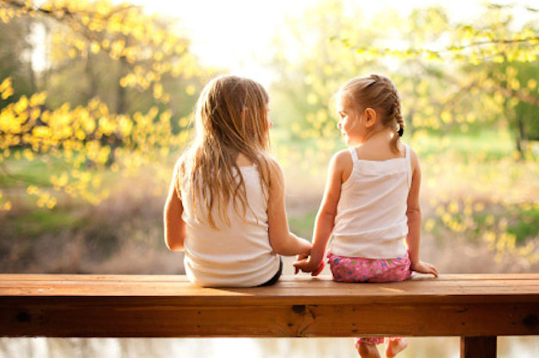
Who is she?
See Answer

Slide 10
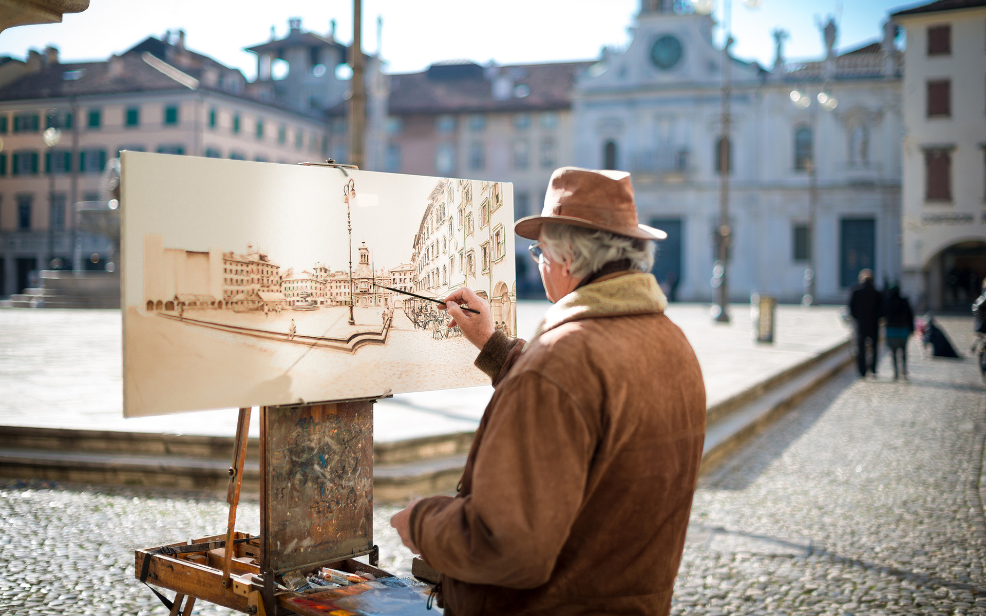
Who is he?
See Answer

Slide 11
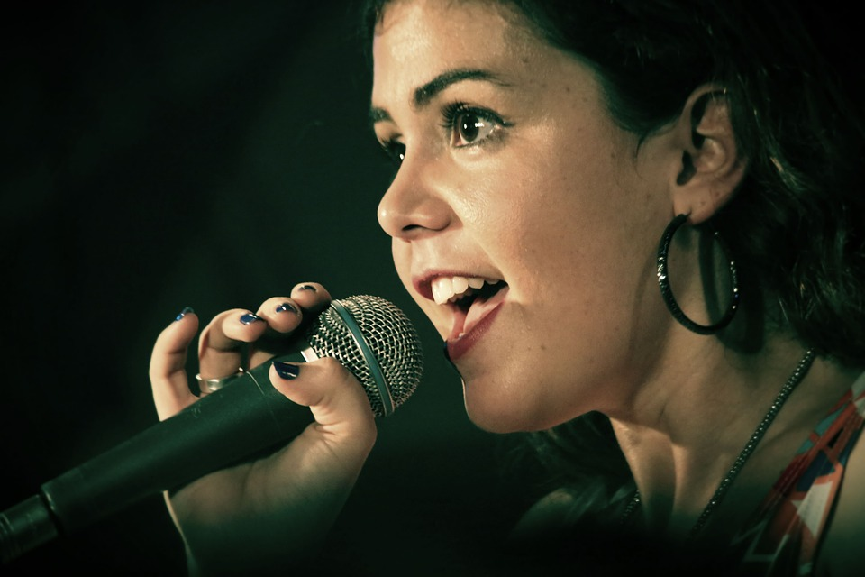
Who is she?
See Answer

Slide 12
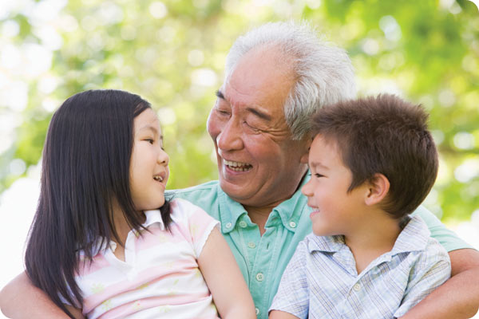
Who is he?
See Answer

Slide 13
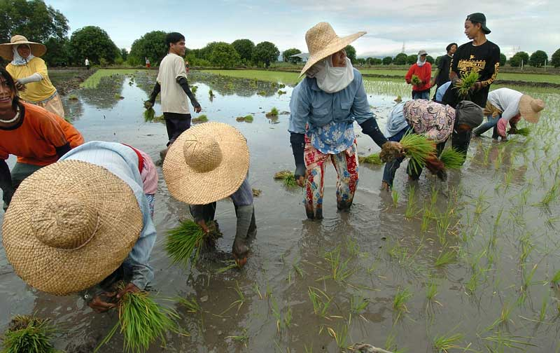
Who is he?
See Answer

Slide 14
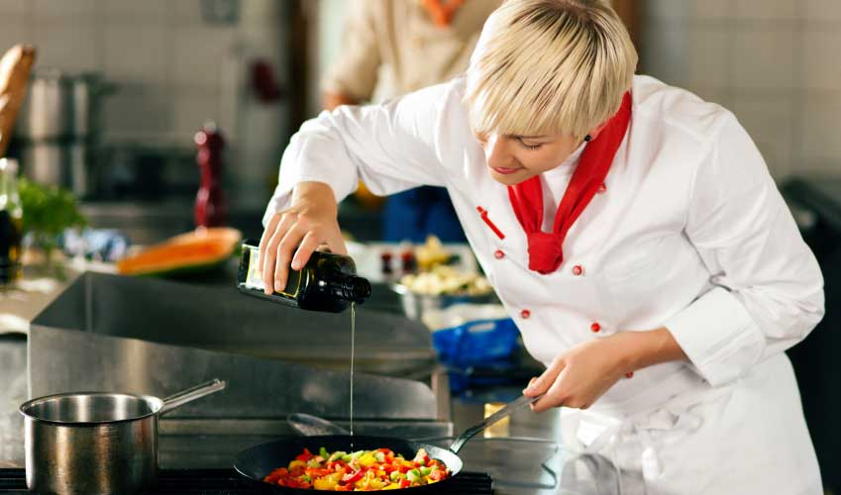
Who is she?
See Answer

Slide 15

Who is he?
See Answer

Slide 16

Who is he?
See Answer

Slide 17
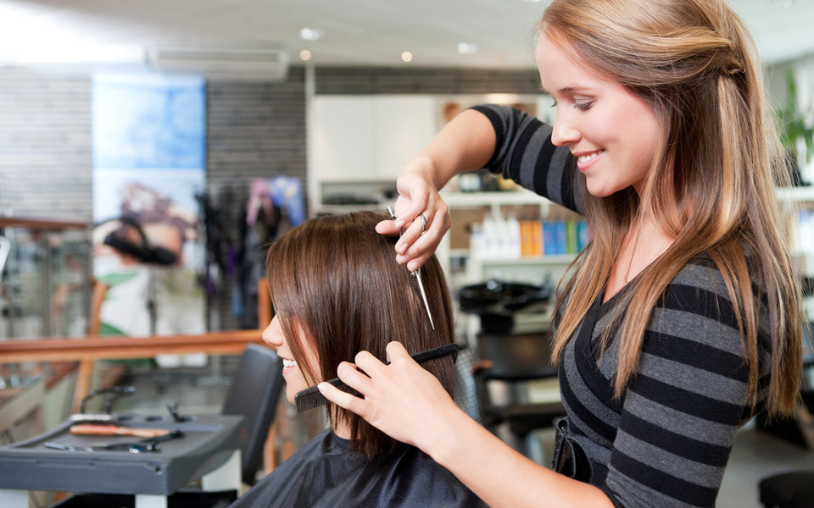
Who is she?
See Answer

Slide 18
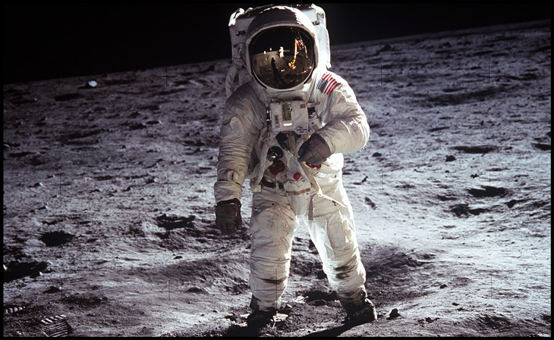
Who is he?
See Answer

Slide 19
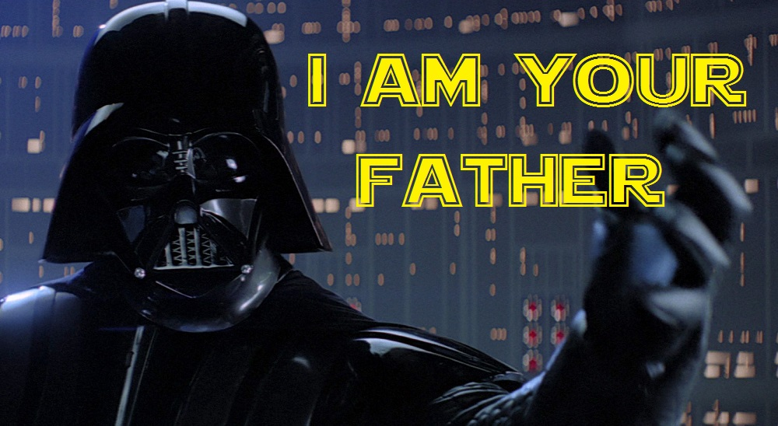
Who is he?
See Answer

