Slide 1
What is he doing?
Guessing Game

Slide 2
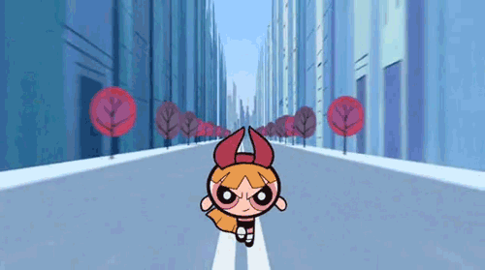
What is she doing?
Hint
Answer
She’s running.

Slide 3
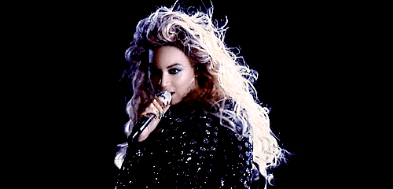
What is she doing?
Hint
Answer
She’s singing.

Slide 4
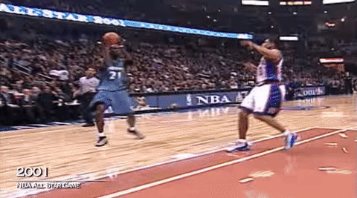
What is he doing?
Hint
Answer
He’s playing basketball.

Slide 5
What is he doing?
Hint
Answer
He’s sleeping.

Slide 6
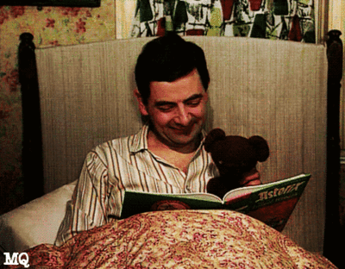
What is he doing?
Hint
Answer
He’s reading a book.

Slide 7
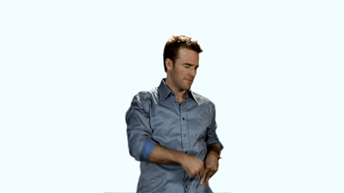
What is he doing?
Hint
Answer
He’s dancing.

Slide 8
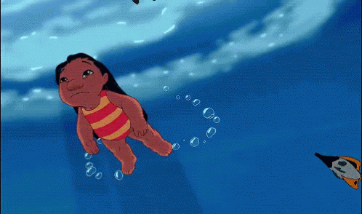
What is she doing?
Hint
Answer
She’s swimming.

Slide 9
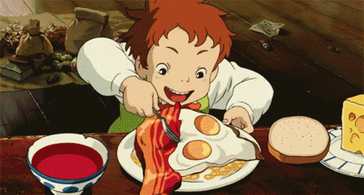
What is he doing?
Hint
Answer
He’s eating.

Slide 10
What is he doing?
Hint
Answer
He’s listening to music.

Slide 11
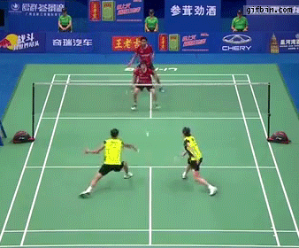
What are they doing?
Hint
Answer
They’re playing badminton.

Slide 12
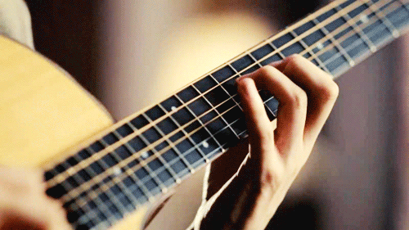
What is she doing?
Hint
Answer
She’s playing guitar.

Slide 13
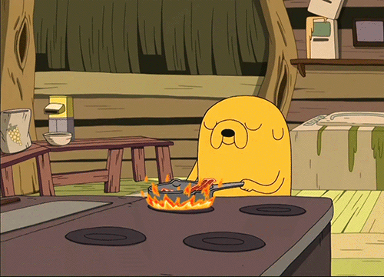
What is he doing?
Hint
Answer
He’s cooking.

Slide 14
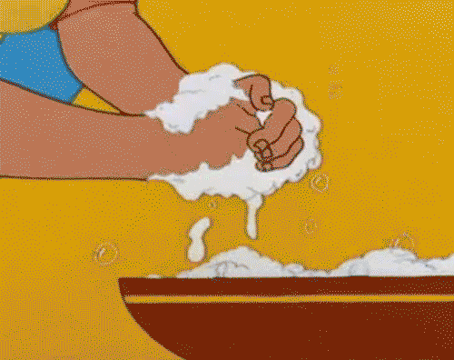
What is she doing?
Hint
Answer
She’s washing her hands.

Slide 15
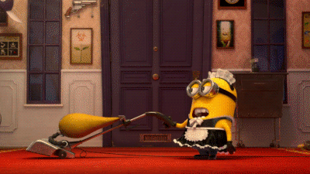
What is he doing?
Hint
Answer
He’s cleaning.

Slide 16
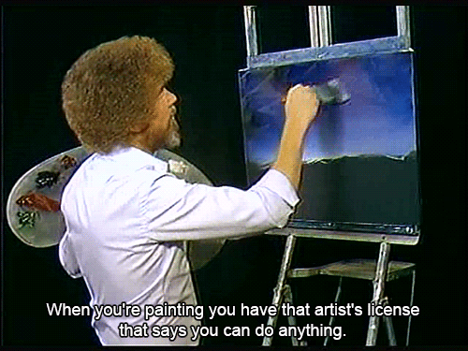
What is he doing?
Hint
Answer
He’s painting.

Slide 17
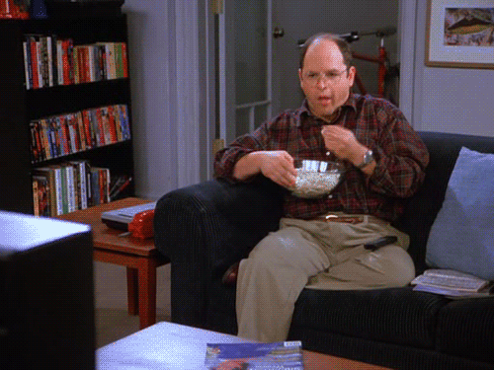
What is he doing?
Hint
Answer
He’s watching tv.

Slide 18
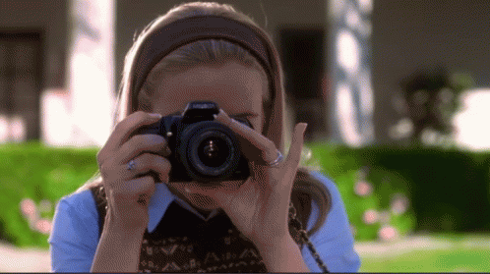
What is she doing?
Hint
Answer
She’s taking pictures.

Slide 19
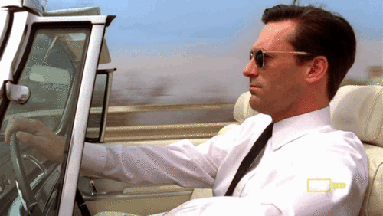
What is he doing?
Hint
Answer
He’s driving.

Slide 20
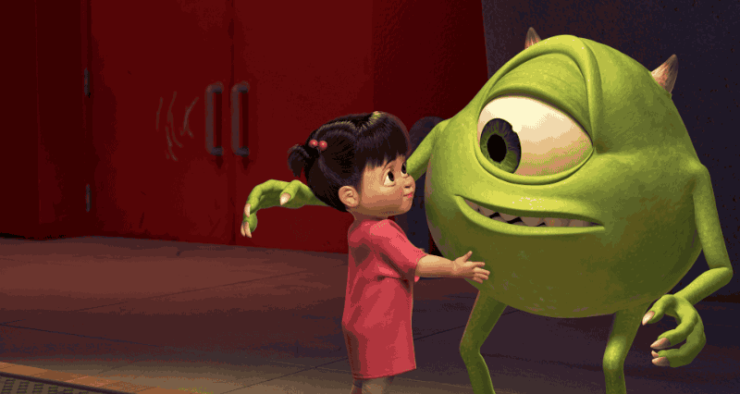
What are they doing?
Hint
Answer
They’re hugging.

